Slide 1
403IT Problem Solving and Programming Personal Development Powerpoint
This PowerPoint will display evidence of understanding and knowledge of a range of python fundamentals and functions.
This will be referred to throughout the Portfolio.

Slide 2
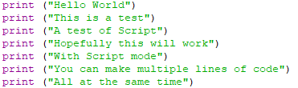
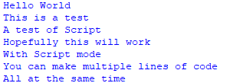
Print Function
Script
Output
The print function is one of the most simple elements to use.
print(“”) produces whatever is within the brackets & speech marks, as an output.

Slide 3
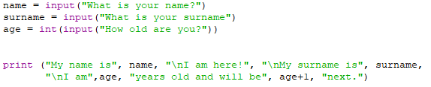
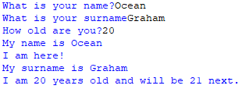
Input Function and Variable
Script
Output
The Input function is another important fundamental for most Python scripts.
input(“”) prints what was typed out in the input function.
In this example, as well as inputs, there is variables.
Variables are containers that store and hold data, in this case,
the value of the data is given through the input into the variables “name”, “surname”, “age”.
This is then output in the 4th line onwards.

Slide 4
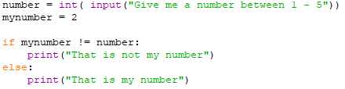

If – Else Statement
Script
Outputs
If-Else Statements are conditional statements based on the input, they are a an example of ‘Selection’ (A program that chooses which block of code to execute based on certain conditions).
This example shows how the output varies based on which number the input is.
If 2, it prints “That is my number”
Else, if anything else it prints “That is not my number”

Slide 5


While Loop
Script
Output
While Loops are a way to create a repeating cycle, these continue endlessly

