Slide 1
screenshotting
For palindrome
6/2/25 – 10/2/25
Flowchart done 5/2/25

Slide 2
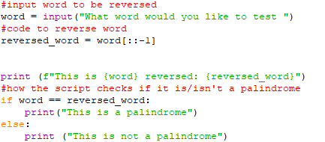


1st functioning version very simple
Need to remove spaces, and capitals, punctuation and numbers
Make a loop to repeat process

Slide 3
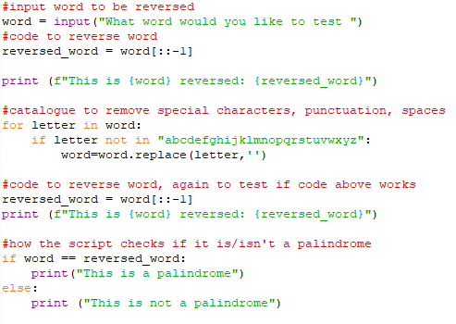

2nd solving stage, not for use
Added the script to remove special characters space and punctuation, need to make a loop to repeat rather than immediately executing upon ending

Slide 4
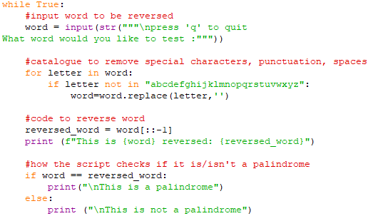
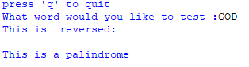

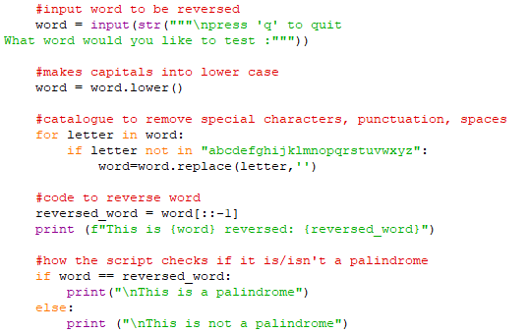
3rd solving stage, capitalisation was removed
With capitals, text would disappear
Added .lower to solve

Slide 5
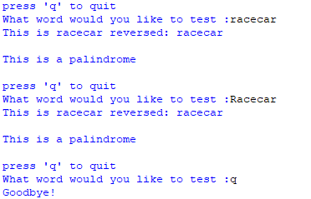
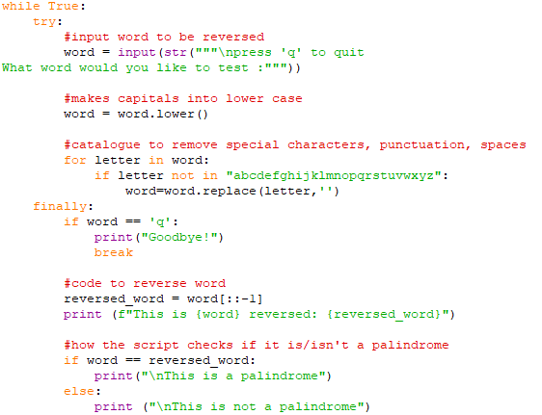

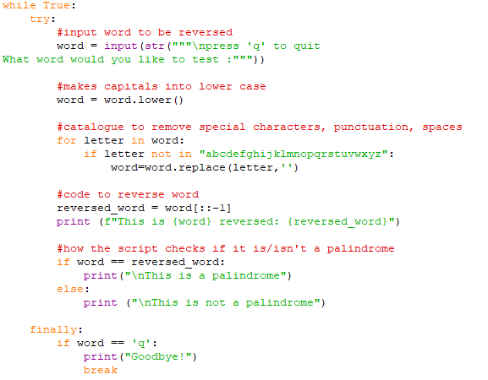
4th stage while loop
Added a loop, to repeatedly ask rather and choose to end process when you desire to
Have to put finally before response so that it doesn’t repeat still

Slide 6
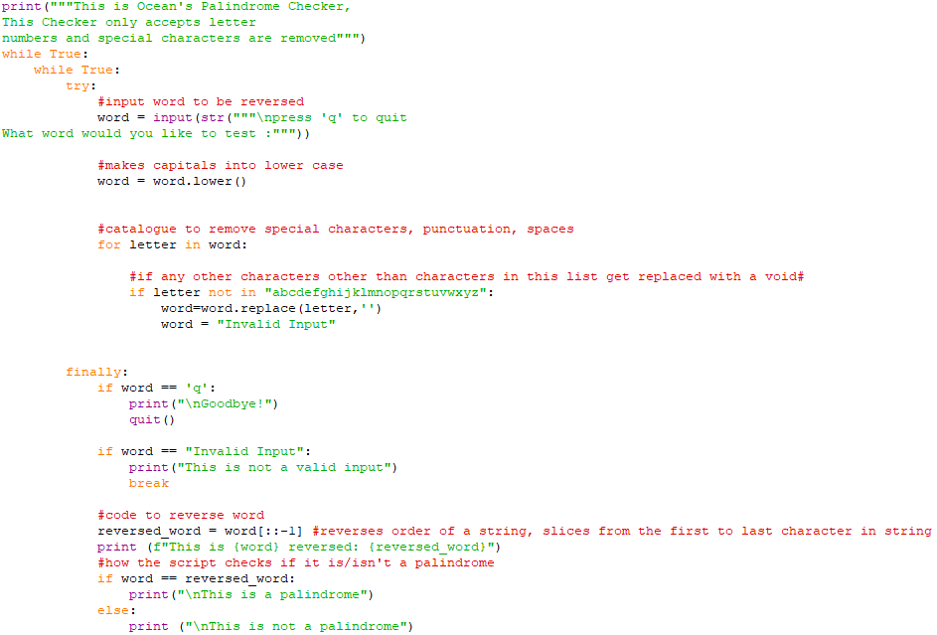
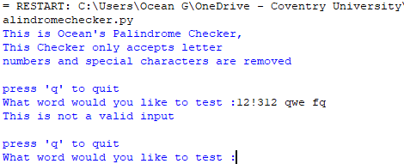
12/2/25

Slide 7
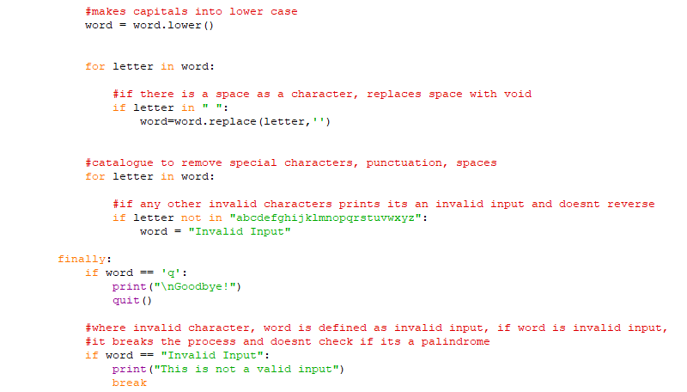
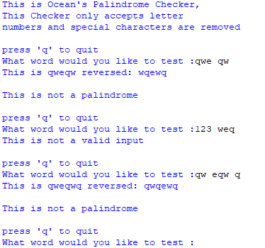
12/2/25

