Slide 1
screenshotting
For palindrome
6/2/25 – 10/2/25
Flowchart done 5/2/25

Slide 2
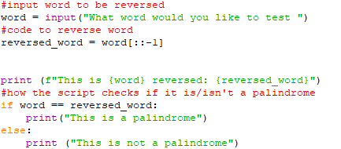


1st functioning version very simple
Need to remove spaces, and capitals, punctuation and numbers
Make a loop to repeat process

Slide 3
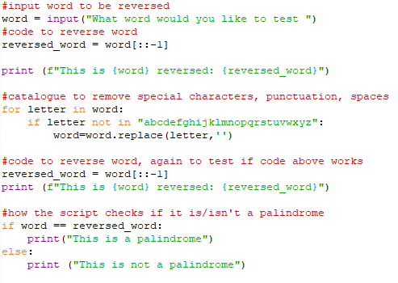

2nd solving stage, not for use
For letter in word, checks the characters in word for alphabet letters, if not then it removes them
Added the script to remove special characters space and punctuation, need to make a loop to repeat rather than immediately executing upon ending

Slide 4
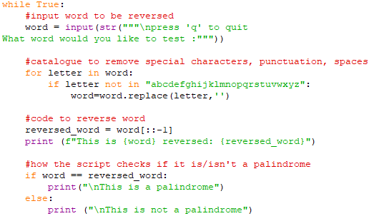
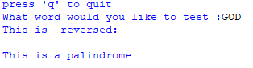
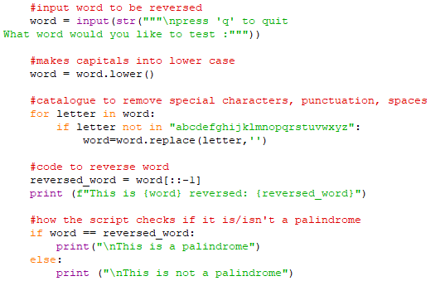

3rd solving stage, capitalisation was removed
--------------------------------------------------------------------------------------------------------------------------------------------
resolution
With capitals, text would disappear
Added .lower to solve

Slide 5
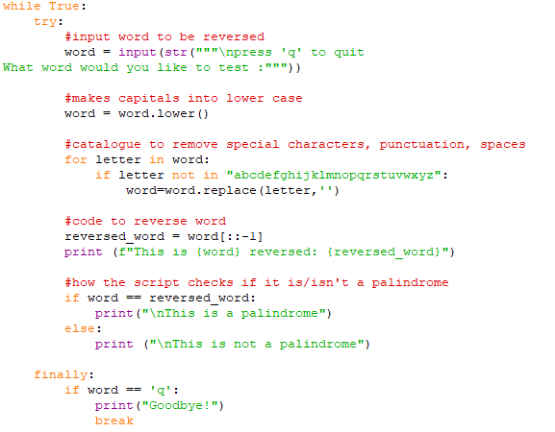

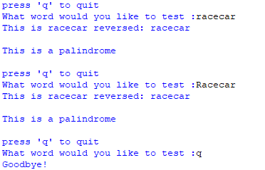
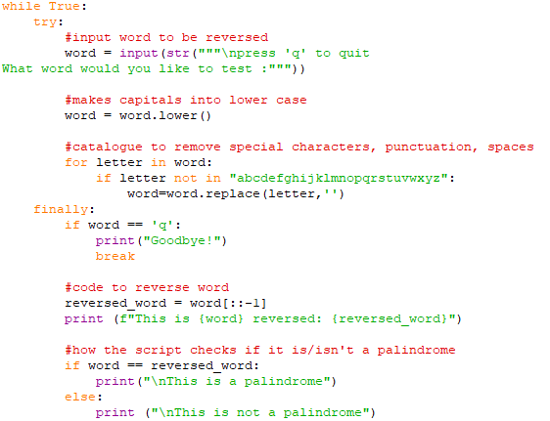
4th stage while loop
Issues with q for quit not working resolved, moved the q for quit block up
------------------------------------------------------------------
Added a loop, to repeatedly ask rather and choose to end process when you desire to
Have to put finally before response so that it doesn’t repeat still

Slide 6
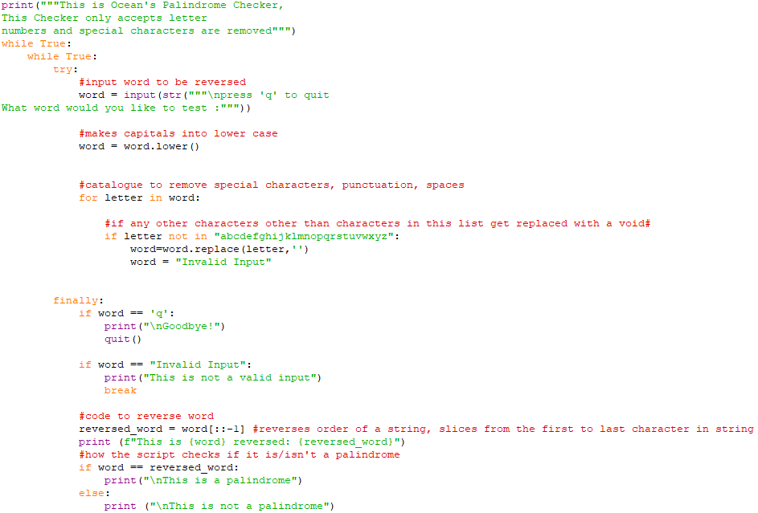
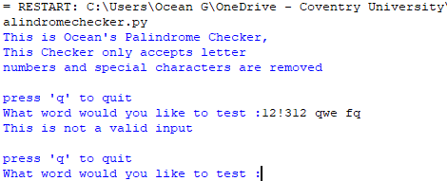
12/2/25
Added Invalid input prompt if numbers and specials added, rather than allowing the input to continue with special characters and numbers removed

Slide 7
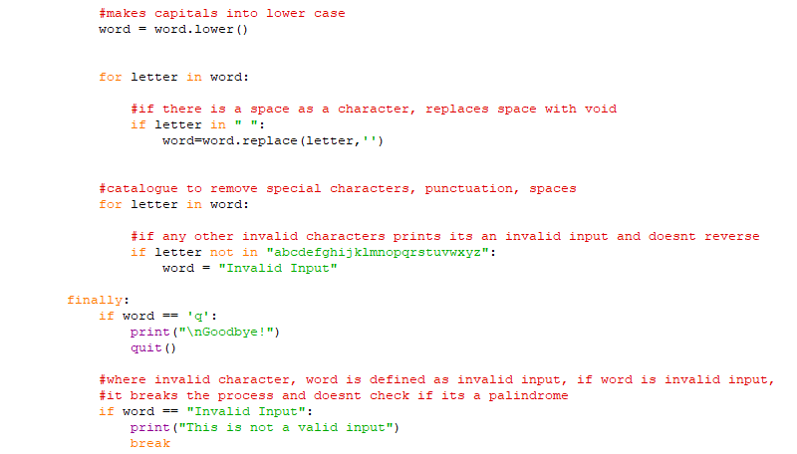
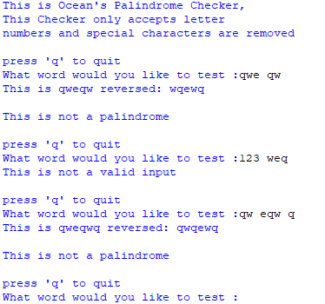
12/2/25
Altered invalid input prompt to accept spaces, then remove them. (as long as theres no special characters or numbers)

