Slide 1
screenshotting
For tip calculator
10/2/25-12/2/25
Flowchart done 10/2/25

Slide 2
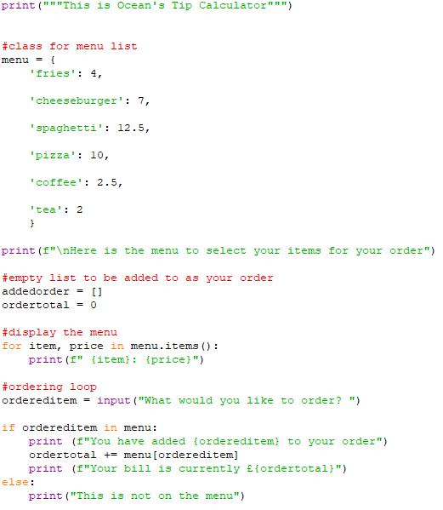
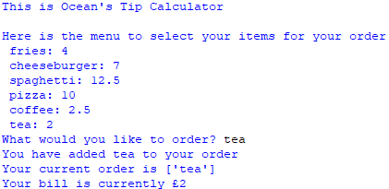
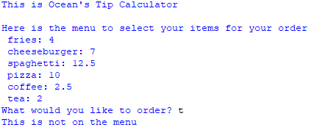
1st forming the menu and order functions

Slide 3
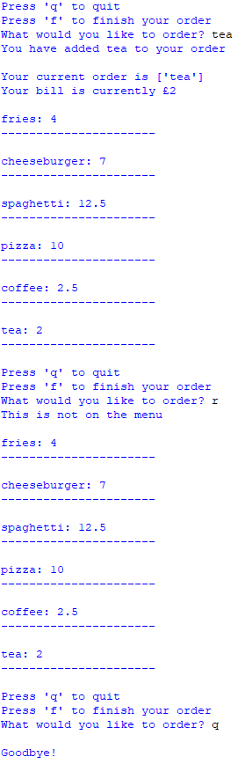
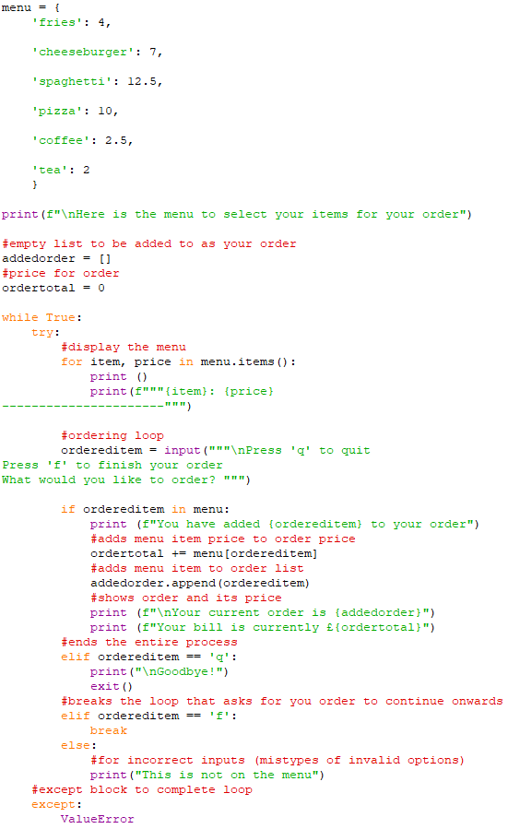
2nd added loop to continue asking for items q to break

Slide 4
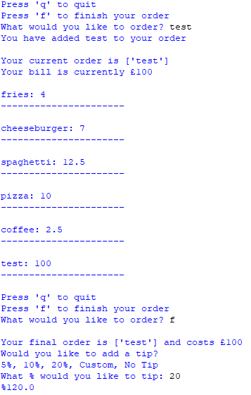
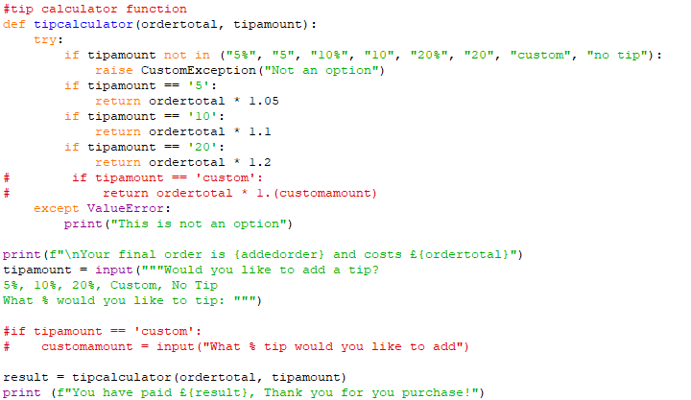
3rd tip calculator
Tip calculator function started, figure options work.
no tip and custom not functional

Slide 5
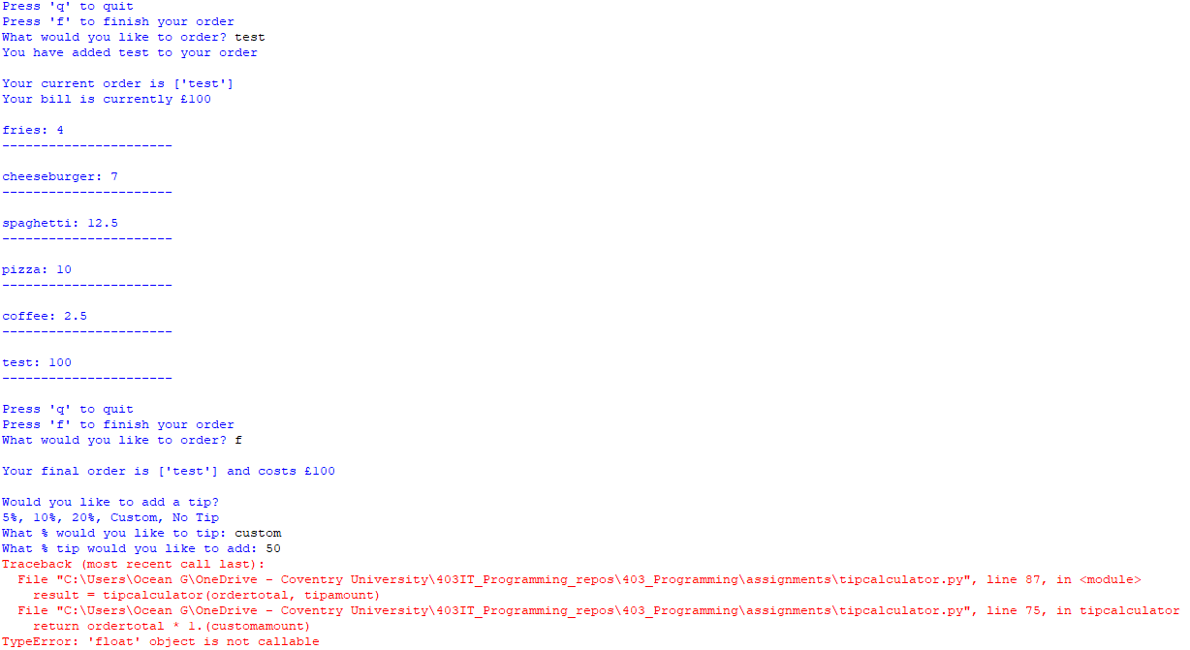
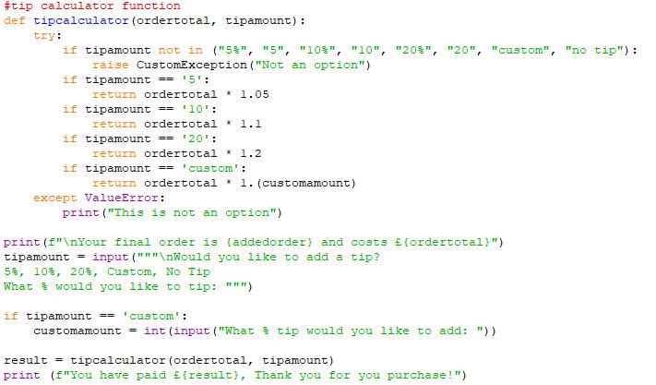
4th custom option float error
The way custom was calculated was not working, the way is later changed from order * 1.(customamount).
This caused the float error

Slide 6
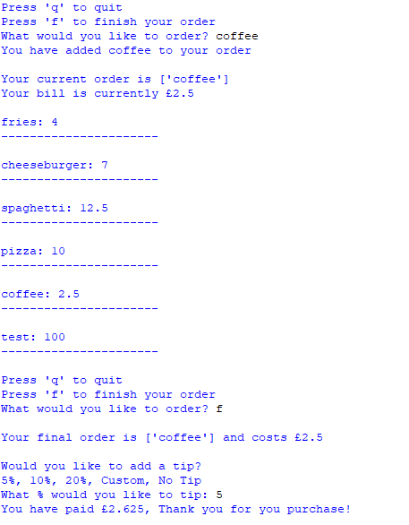
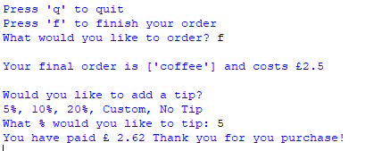
Format issue with decimals
Round function rounds decimal and formats it to 2 decimal places due to (result, 2), the 2 meaning 2 decimal places

Slide 7
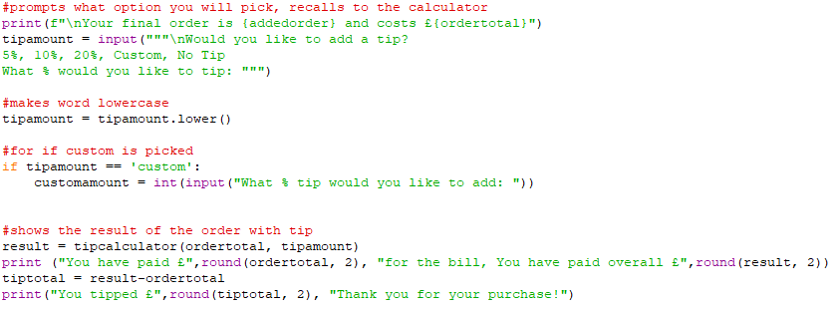
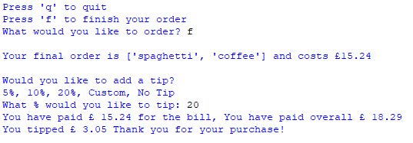
Result that states tip amount, bill, overall

Slide 8
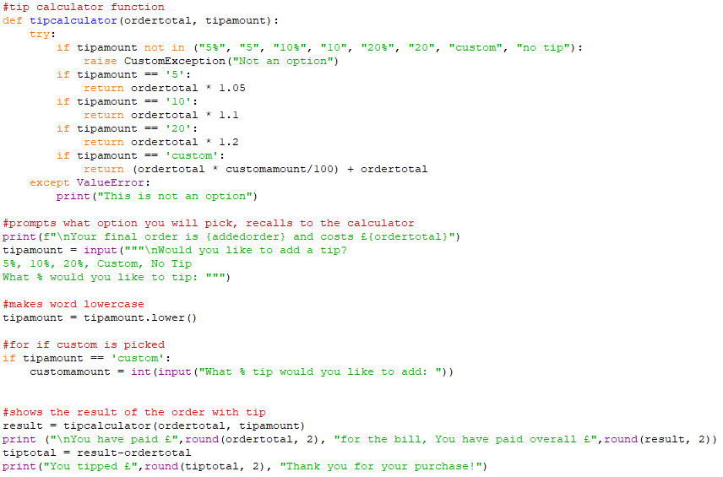
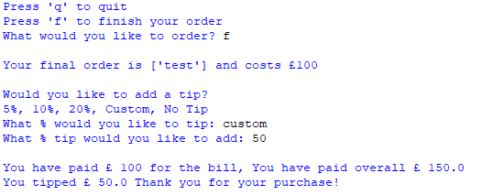
Response to 4th page attempted alternate way, works
Using new calculation method clears float error, (ordertotal * customamount/100) + ordertotal

Slide 9
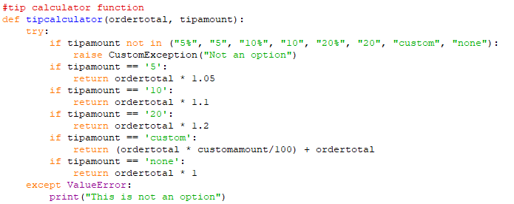
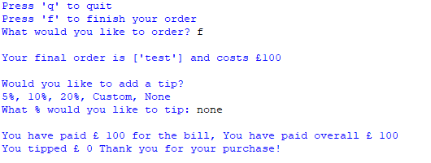
None option

Slide 10
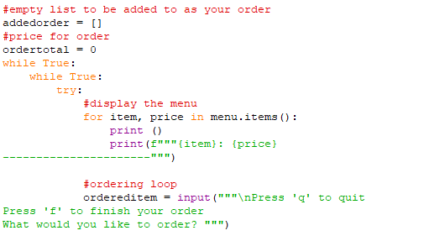
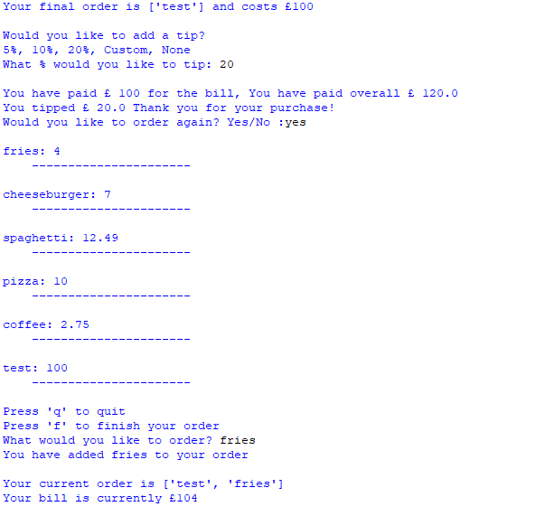
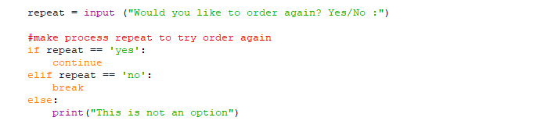
Added a loop to repeat the entire process issue, bill doesn’t reset. Everything gets tabbed out to make second loop function, 2 while true

Slide 11
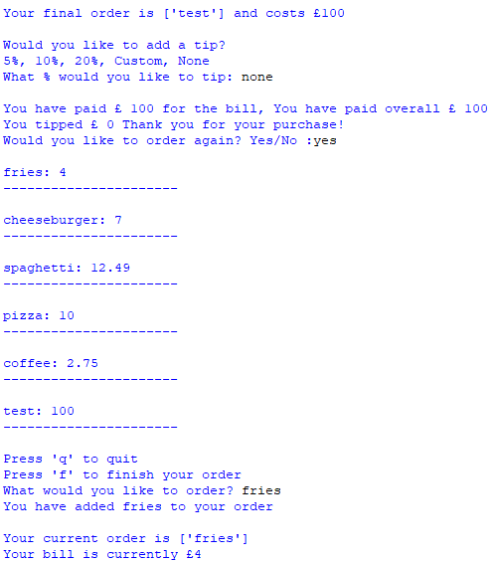
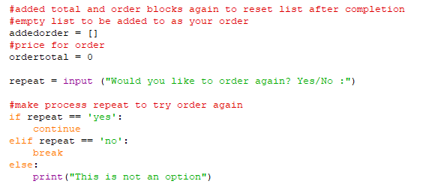
Order again option
Resets the order and ordertotal by putting the lines after paying for your order.

Slide 12
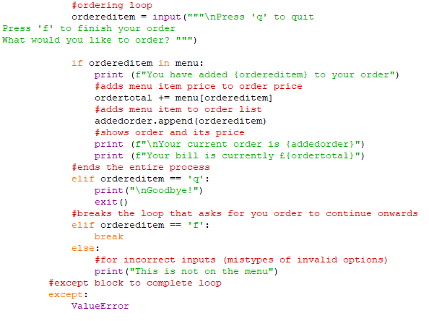
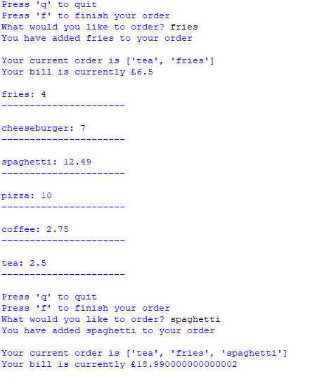

Not a clue, no changes to code, format issue

Slide 13
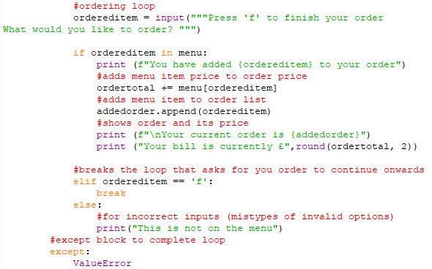
Resolution to format problem, change from f strings to round

Slide 14
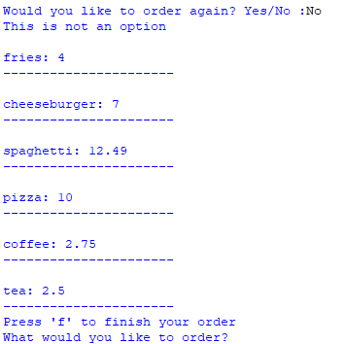
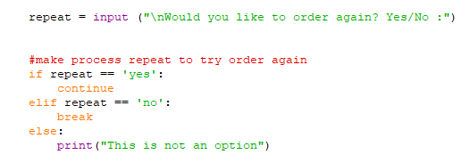
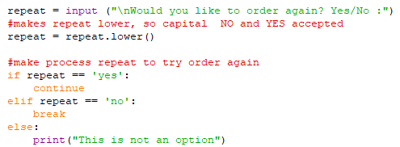
Capitalisation didn’t allow, need a lower block

Slide 15
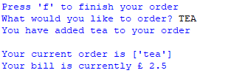

Continuation of page 14

Slide 16
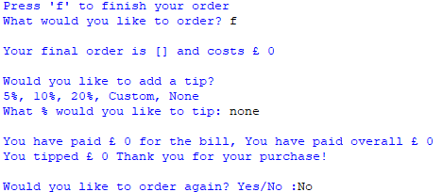
Continues even if you haven’t ordered anything with f

Slide 17
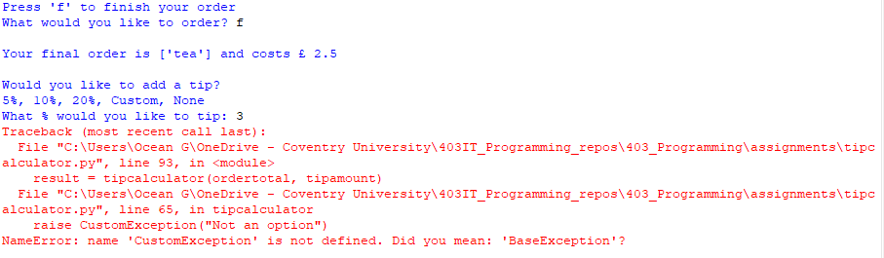
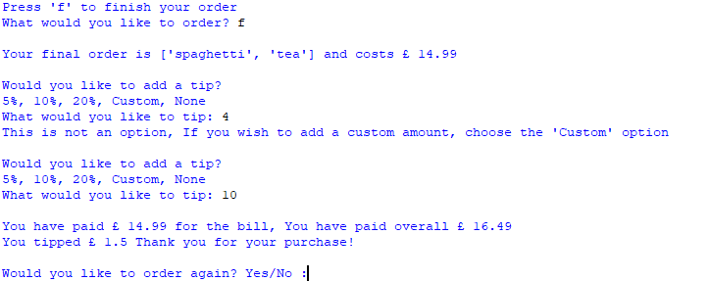
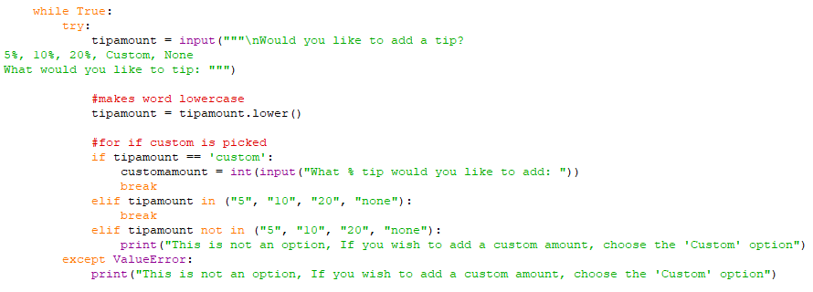
Errors if you put a tip that isn’t part of the list

Slide 18
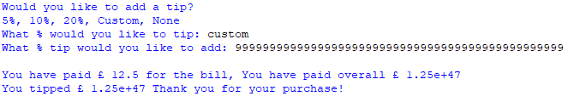
No resolution possible, this is simply how a number of that size is presented.

Slide 19
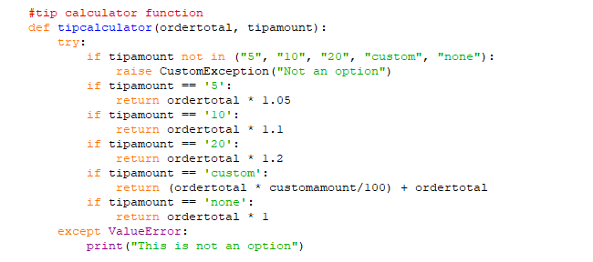
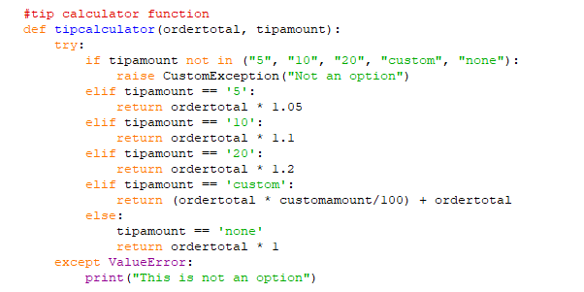
Tipcalculator section needs all to be elif rather than if

