Slide 1
403IT Problem Solving and Programming Personal Development Powerpoint
This PowerPoint will display evidence of understanding and knowledge of a range of python fundamentals and functions.
This will be referred to throughout the Portfolio.

Slide 2
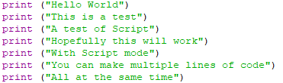
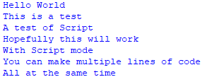
Print Function
Script
Output
The print function is one of the most simple elements to use.
print(“”) produces whatever is within the brackets & speech marks, as an output.

Slide 3
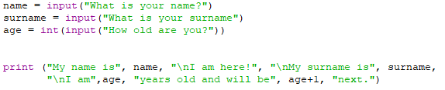
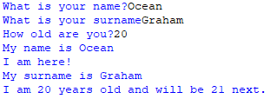
Input Function and Variable
Script
Output
The Input function is another important fundamental for most Python scripts.
input(“”) prints what was typed out in the input function.
In this example, as well as inputs, there is variables.
Variables are containers that store and hold data, in this case,
the value of the data is given through the input into the variables “name”, “surname”, “age”.
This is then output in the 4th line onwards.

Slide 4
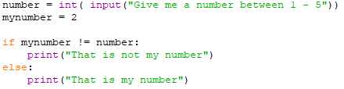

If – Else Statement
Script
Outputs
If-Else Statements are conditional statements based on the input, they are a an example of ‘Selection’ (A program that chooses which block of code to execute based on certain conditions).
This example shows how the output varies based on which number the input is.
If 2, it prints “That is my number”
Else, if anything else it prints “That is not my number”

Slide 5


While Loop
Script
Output
While Loops are a way to create a repeating cycle, these execute a block of code until a certain condition is met. They are favoured when you are uncertain with the length of repetition.
In this example, it repeats until ‘i’ reaches 10 then stops. However, if done incorrectly it may endlessly repeat, and the program must be closed to end it.

Slide 6


For Loop
Script
Output
For Loops are a 2nd way to create a loop, this loop is used for iterating a sequence, for items in range (start, end);
In this case a list (of names).
This works by the variable (name), taking each item in the list (each name in ‘names’) and outputting it.

Slide 7


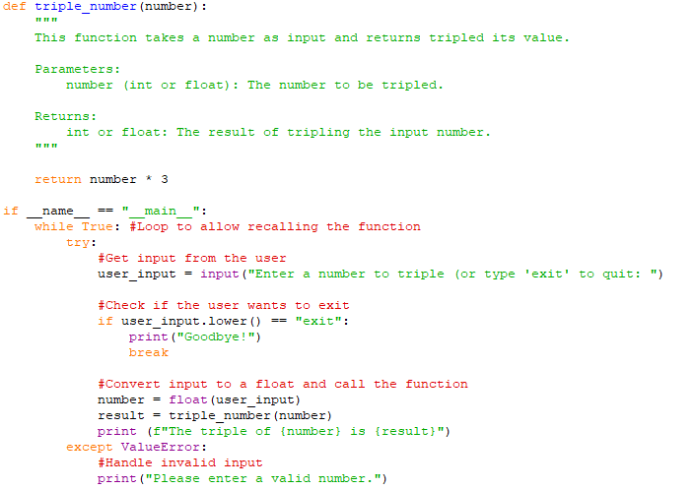
Functions (def)
Scripts
Outputs
Functions are a reuseable code block that perform a task. The first example shows this simply.
The second example shows the further capabilities of the function element.
There is an ‘if’ statement (selection) in here followed by __name__ == “__main”__: checking if the script is not imported but directly in the script.
While True: Is an endless loop which runs until directly stopped.
Try: tries to run the command indented.
If user_input.lower == “exit”: ends the process, breaking the ‘while’ ‘s infinite loop.

Slide 8
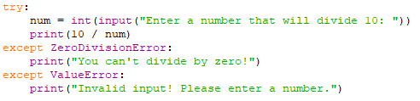

Try-Except Block
Script
Output
As explained slightly in the prior slide. Try-Except block tries to execute a command and if it cannot execute as intended, the except block activates. The except block only functions if the try block doesn’t work. This example Tries, to prompt the user to input a number, If a number is input, then the except protocols aren’t required thus don’t execute. However if a word, or 0 is input, one of the two except blocks pickup and print a line to present the error more graciously and cleanly.

Slide 9
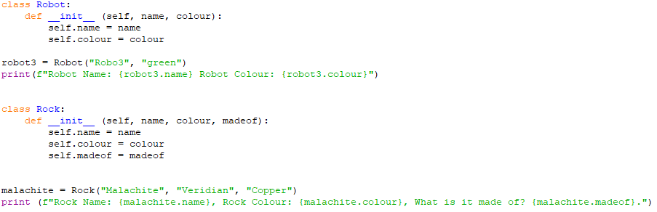
Classes
Script
Output
- Classes are a schematic for creating grouping objects.
- __init__ is a constructor that intialises the attributes of the object.
- Objects are the things created from the blueprint of the class, eg Robo3 is a Robot. Robo3 is the object of the Robot Class
Attributes are things the object has eg:- (self, name, colour, etc)

Slide 10
Set
Script
Output
Sets are one of the 4 types of data storage.
They are unordered, unindexed (meaning they are randomised, and each key has no assignment)
do not allow duplicate elements
Sets are written with { }
This would be better suited for storing a load that doesn’t require an order.

Slide 11
Tuples
Script
Output
Tuples are one of the 4 data stores
They are unchanging, ordered and indexed
They allow duplicates
The are written with ( )
Tuple are suited for efficiency as they are faster than other stores due to being immutable

Slide 12
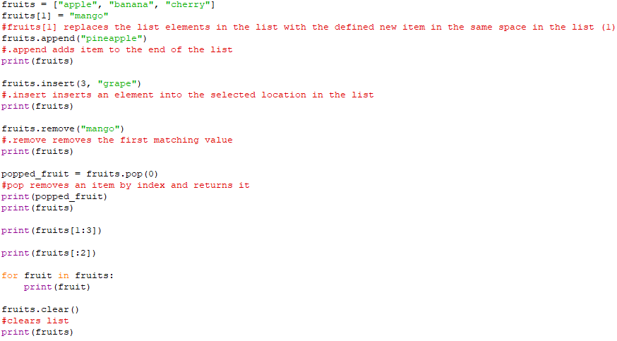
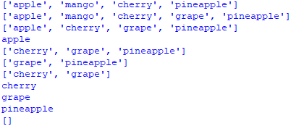
Lists
Script
Output
Lists are one of the 4 ways to store data.
They are used as opposed to others as they are changeable and indexed.
They allow duplicated elements.
Lists use square brackets [ ]
Suited for ordered collections

Slide 13

Dictionary
Script
Output
Dictionarys are the final of the 4 data stores
They are ordered, changeable but don’t allow duplicates
Dictionarys are suited for Key Value storing and Cataloguing data.

