Slide 1
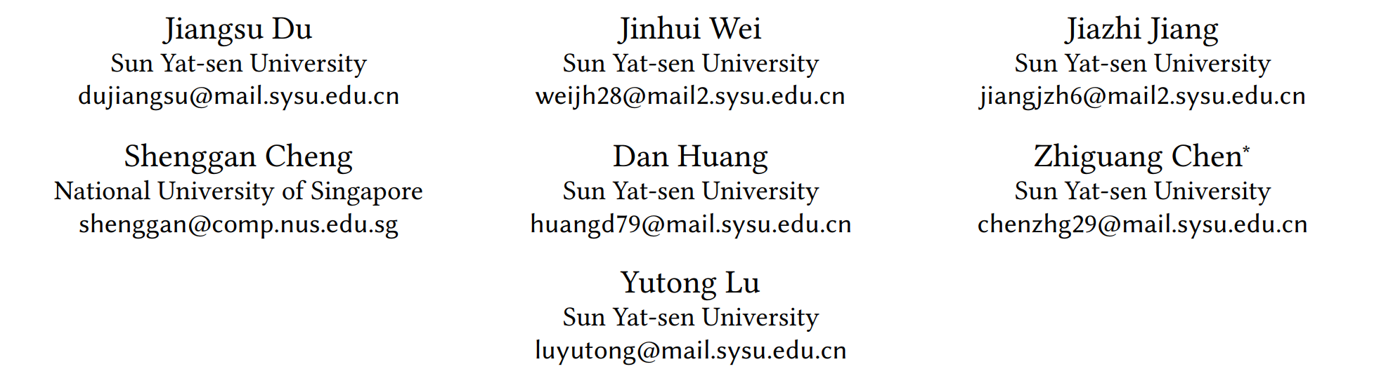


﻿ ﻿Liger: Interleaving Intra- and Inter-Operator Parallelism for Distributed Large Model Inference (PPoPP24)
汇报人：李鹏图
2024-11-2

Slide 2
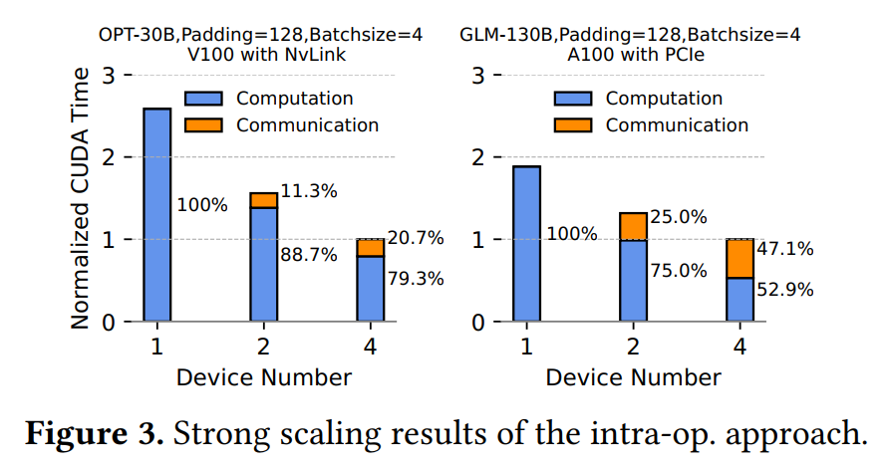
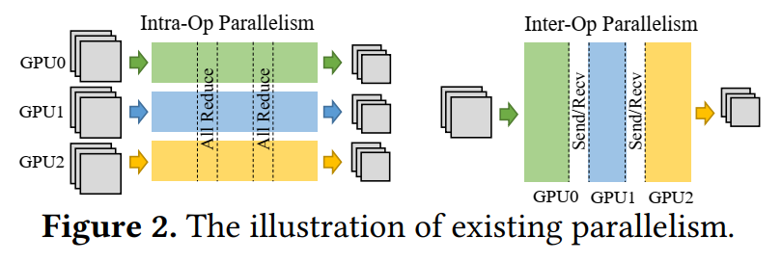
intro
Traditional parallel strategies not good：intra and inter-operator parallelism
Intra：model parallel（Megatron-lm） latency reduced, heavy communication overhead
Inter：pipeline parallel（Gpipe） ﻿improve ﻿throughput, doesn’t improve latency
Notes:
- 论文提出的背景，传统的并行策略不够好，介绍常用并行算法
- intra parallel: Device number 4, 50% overhead, Even with NV link, still count 20% overhead

Slide 3
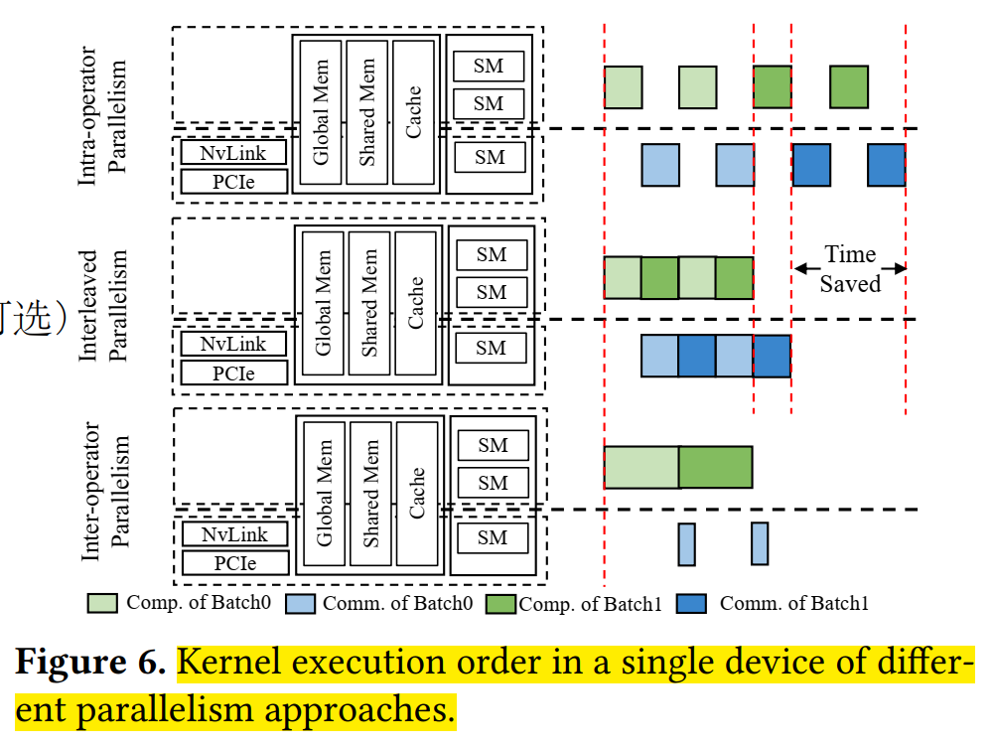
﻿intro
﻿Liger, an inference runtime system
Scenario：single node with multi-GPU
Key idea：interleaved parallelism through GPU schedule，max overlap of comm,comp
Adapt to dynamic loads
Low request rates degrade to intra-oper
high request rates start to overlap
Sigle gpu
Notes:
- ﻿first work that schedules inter-device kernels in a latency-critical scenario.
- idea
Model parallel+pipeline通信重叠的思想，实际没有用Pipeline parallel
计算kernel插入通信kernel的间隙

Slide 4
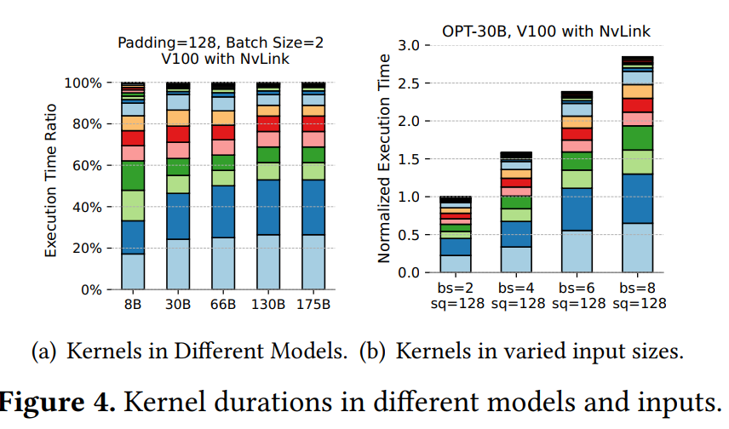
intro
Challenge（GPU schedule）
﻿Communication Kernel Execution Lag（delay）
﻿scheduling logic in GPUs prioritize computation kernels.
﻿keep strict execution order of computation and communication kernels across multiple streams
﻿Hardware Resource Contention
﻿Memory Bandwidth contention ， all read and write memory
﻿Compute contention ,comm kernel need comp resources
﻿Widely-varied Kernel Duration
Beacause Kernel type varies；varying input size
太长导致难以重叠； 且难以区分计算和通信kernel
Notes:
﻿C1:同时启动计算和通信kernel，会优先启动计算kernel；难以确保按设想顺序执行
C2:对于计算来说，通信核也会占用计算资源，例如all reduce操作，network driving
C3：导致两个问题

Slide 5
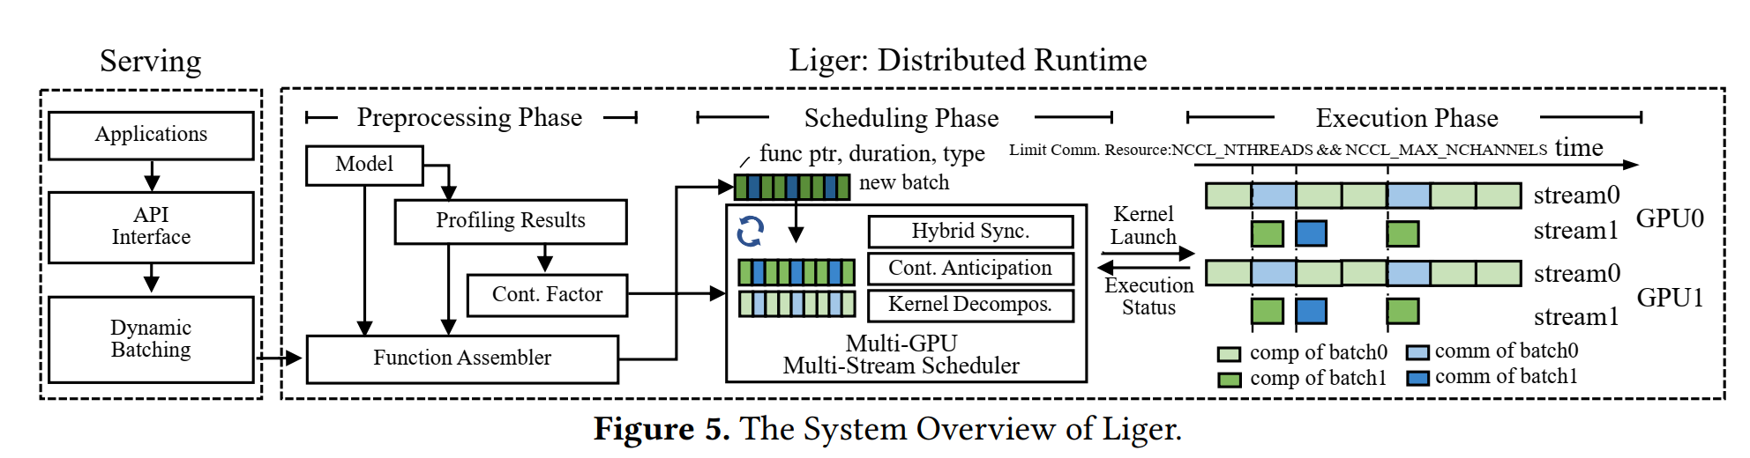
Method-overview
offline
online
﻿requests → batch → Liger
three primary phases:
preprocessing phase
The offline procedure runs once → generate contention factors
The online procedure assembles kernel launch functions of an inference → a function list(for each batch).
scheduling phase
﻿periodically finds kernel subsets
Kernel Launch
execution phase
Notes:
简单介绍流程
预处理，包括离线在线，简要介绍，在线产生batch对应的模型的kernel
调度，periodically将kernel调度执行
执行，Kernel Launch with hybrid synchronization + ﻿contention aticipateion + ﻿kernel decomposition，用了三种方法

Slide 6
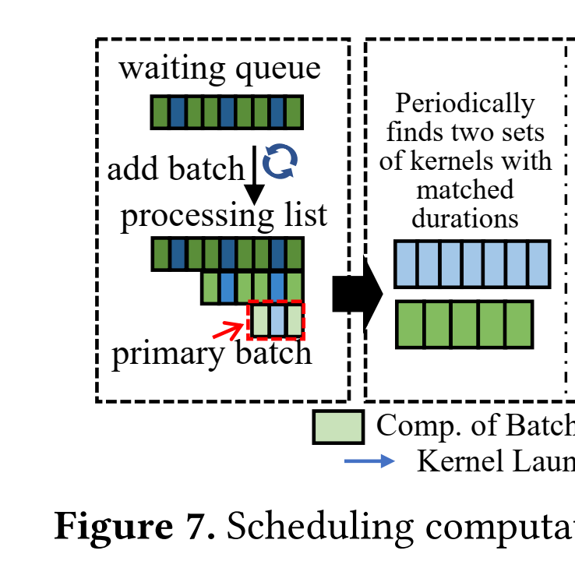
﻿Method-easy Scheduler
Waiting queue: contain pending tasks
Processing list: contain fixed number of tasks
Steps:
collects kernels from the primary batch（ Prioritize executing batches that come first to ensure latency ）until kernel type switch point and accumulates durations.
﻿goto subsequent batches to get kernels in another type with matched durations.
use two cuda stream run two sets（comp and comm）
A function list of a batch
Notes:
队列处理kernel list
Steps:
﻿collects kernels from the primary batch until meeting the kernel type switch point and accumulates their durations. 举个例子，例如计算核遇到通信核
﻿Then it goto subsequent batches to identify kernels in another type with matched durations.注意是subsequent，要满足依赖关系，不能还没通信就计算同一个batch
Then use two cuda stream run the two sets（comp and comm）

Slide 7
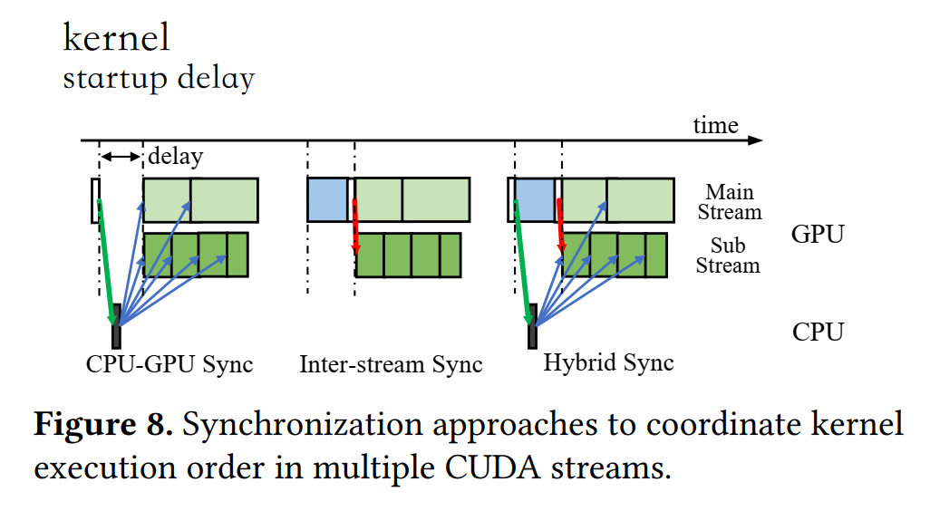
Method-complete scheduler
﻿Hybrid Synchronization﻿（challenge1）
Cuda api provide
CPU-GPU synchronization
interstream synchronization
purpose
hide ﻿kernel startup delay（CPU-GPU sync）
ensure strict overlap（interstream sync）
Only use inter-stream sync incurs comm kernels lag
Key：inserts two CUDA events before and after the switch kernel.
﻿very limited overhead,
Cuda event
﻿CUDA API offers
Notes:
混合同步
介绍两种官方同步方法
1. ﻿CPU-GPU synchronization allows for coordination between
the CPU and GPU. Once the CPU is informed that all kernels
have terminated, it can launch the communication subset
first and then the computation subset for achieving the precise control.
巨大启动延时
2. the interstream synchronization controls the execution order of different
streams by utilizing the inter-stream communication
capability. Liger can theoretically use it to control the kernel
execution order across streams throughout the entire working process.
不能只用这种同步，带来communication延时
3. ﻿When the first CUDA
event is triggered, it notifies the CPU to launch these two
subsets of kernels, with the communication subset ranking
first. During the kernel launching process, there is still one
kernel running in the GPU, being able to hide the kernel
launch overhead. These newly-launched kernels will not
be executed immediately. Instead, their execution begins
until the second CUDA event is triggered. This event takes
the inter-stream synchronization, directly communicating
between streams without involving the CPU.

Slide 8
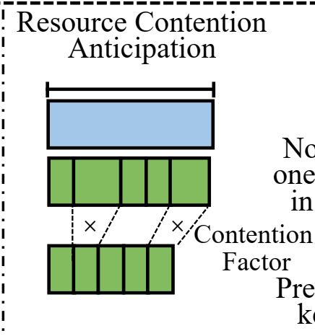
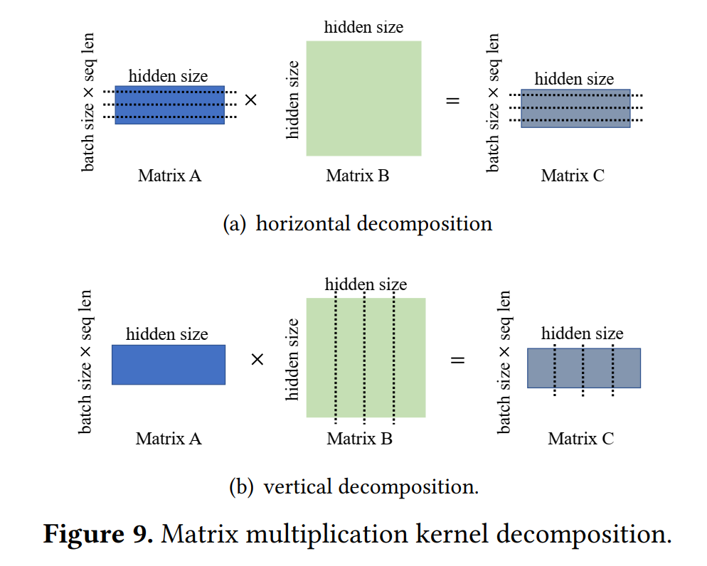
Method-complete scheduler
Contention Mitigation and Anticipation（challenge2）
Content lead to inaccurate ﻿kernel duration
Key
reducing resource allocation of comm kernels
scales kernel durations of subsequent batches with content factor
Runtime Kernel Decomposition（challenge3）
why：﻿lengthy kernels struggle to find matched kernel
how：break down to small unit
- Better ﻿data locality
- Less io overhead
Notes:
Content lead to inaccurate ﻿kernel duration,导致重叠程度不够，并导致更大的争用
NCCL generally allocates redundant CUDA blocks to communication kernels by default，所以减少用于通信的 CUDA 块和 CUDA 线程的数量
scales kernel durations of subsequent batches with contention factors when scheduling. 并且在调度时只使用争用因子缩放后续批次的内核 du-ratio。这样，以重叠程度为代价， 其累积持续时间永远不会超过主要子集的持续时间

Slide 9
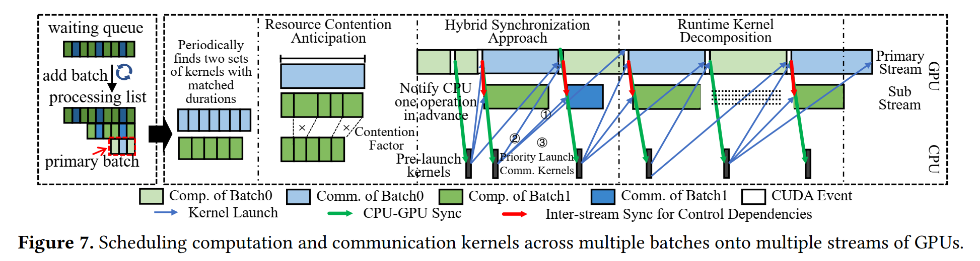
﻿Method-complete Scheduler

Slide 10
exp
environment
﻿3k lines of code in C++
Reuse ﻿CUDA kernels mainly from FasterTransformer
﻿4 NVIDIA Tesla V100 GPUs (16GB) with NVLink
﻿4 NVIDIA Ampere A100 GPUs (80GB) with PCIE
Baseline
﻿Intra-Op(magatron-lm)
Inter-Op(gpipe)
﻿Theoretical Inter-operator Parallelism(stage more average)

Slide 11
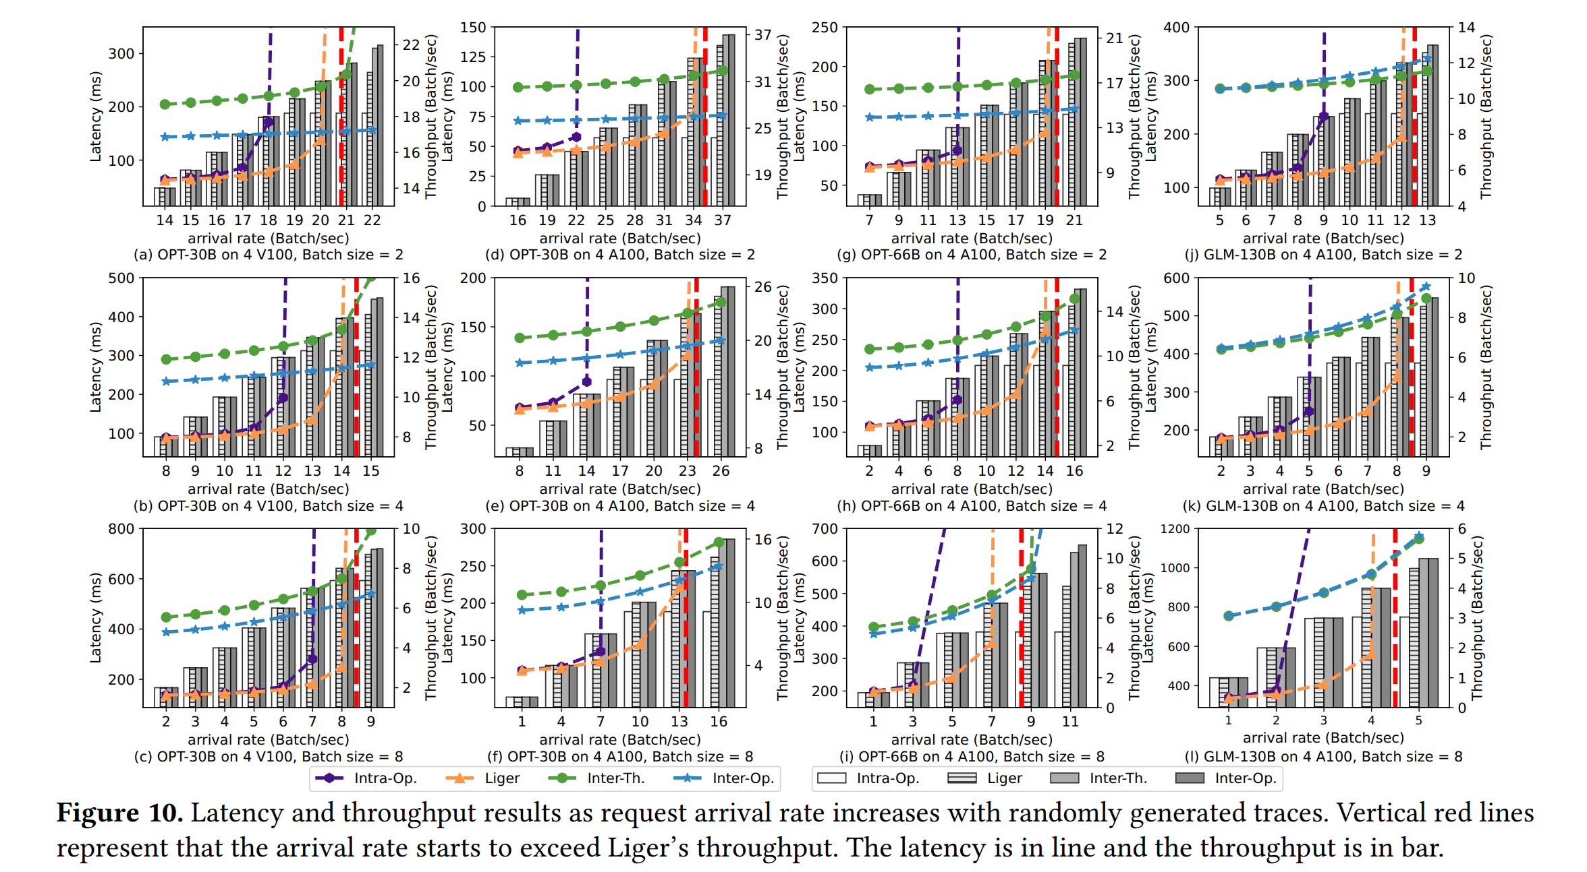
exp
Notes:
延迟接近或小于model parallel;吞吐量接近pipeline parallel
更能利用有限的带宽，无nvlink时
﻿As batch size increases, Liger achieves the better throughput improvement. 因为更大batch size导致更多的通信kernel
﻿a larger model size benefits less from applying Liger.因为计算量与其大小呈二次关系，而通信量则呈线性关系。通信量相对减少

Slide 12
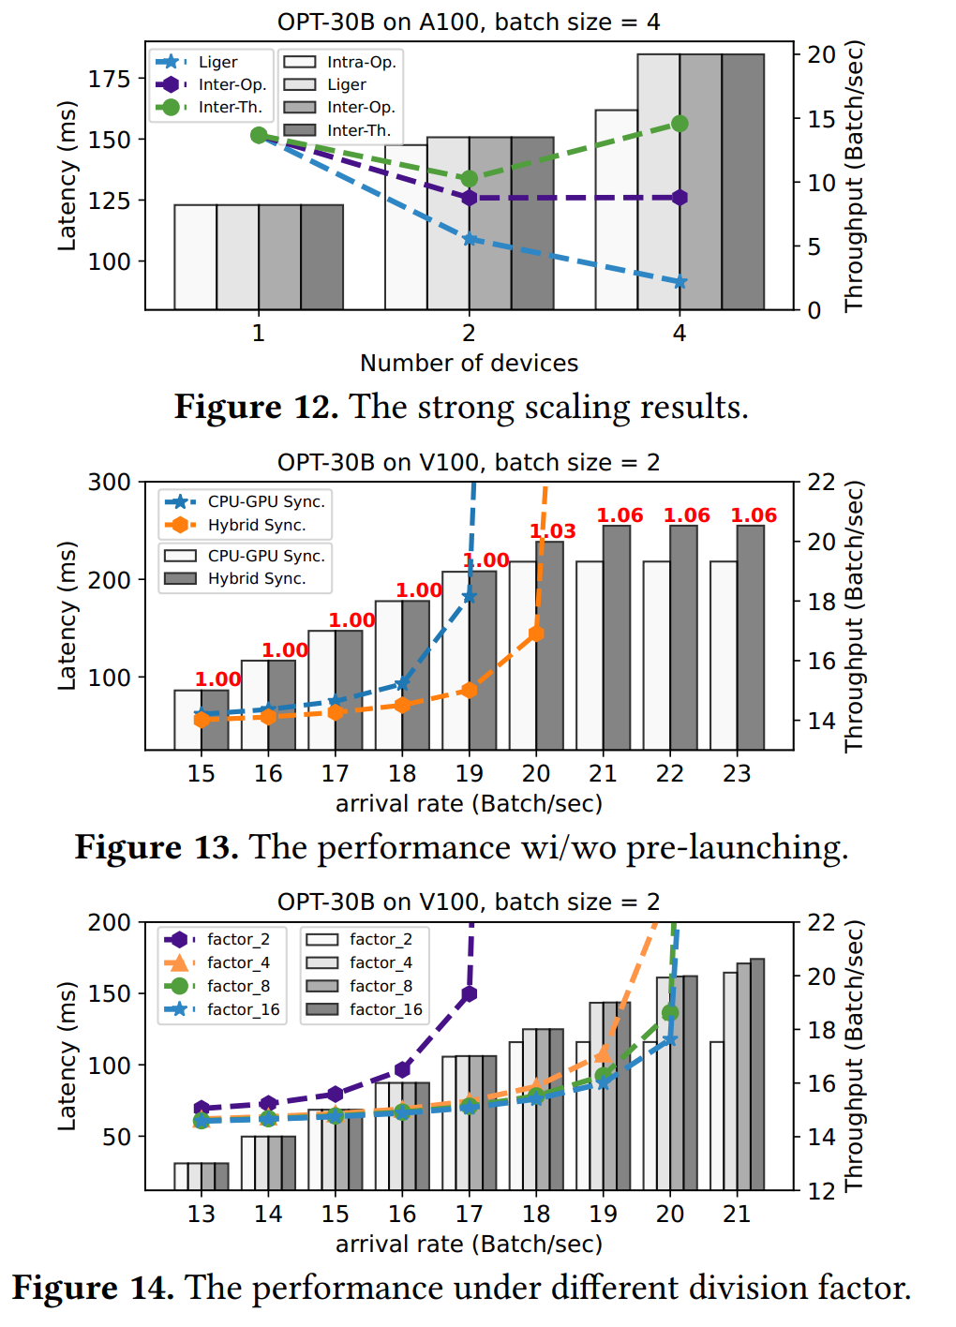
exp

