Slide 1
Verbs for
action ‘move’
Noun prepositions for action ‘move’
Nouns with
known locations
Robot nouns
Move
Go
Run
steer
Robot
TCP
Tool point
System
Towards
In
Through
Into
Frame 0
Point 1
Point 2
Frame 1
Box
Apple
cup
database
“Steer the robot towards point 1”

Slide 2
“Steer the robot towards point 1”
Transformation into verb sentence
[[steer, verb], [robot, noun], [[point 1, noun], [towards, preposition]]
Better Visual representation of verb sentences
Steer ‘VB’
Robot ‘NN’ point 1 ‘NN’
Towards ‘IN’

Slide 3
Move action: Moving to destination
(action: MOVE, Subject: destination: )
Example
(action: MOVE, Subject: robot, destination: point 0)
Move action: Move relative
(action: MOVE, axis: units: )
Example
(action: MOVE, axis: y-axis, units: 0.5 m )

Slide 4
Grab/Put down action
(action: Grab/Put subject: destination: )
Example
(action: Grab /Put subject: Object destination: Point 0)

Slide 5
Pick up object:
[‘PICK’, ‘SUBJECT’]
Example
[‘PICK’, ‘apple’]
Put down object:
[‘PUT’, ‘SUBJECT’]
Example
[‘PUT’, ‘apple’]

Slide 6
Action rotate:
(action: Rotate, subject: units: )
Example
(action: Rotate, subject: Wrist 3, units: 30 degrees)

Slide 7
Repeat action
(action: Repeat, units: subject: )
Example
(action: Repeat, units: 3 subject: All )

Slide 8
Set action:
(action: Set, subject: set as: )
Example
(action: Set, subject: Point 0 set as: TCP)

Slide 9
Input
set frame 1, then go to point 0, then turn the base 180 degrees
NLP pipeline output
Parser pipeline output
(action: Set, subject: frame 1 set as: TCP)
(action: Move, subject: robot, destination: point 0)
(action: Rotate, subject: ‘robot’, units: 180 degrees)
Set [verb]
Frame 1 [noun]
Go [Verb]
Point 0 [noun]
To [preposition]
Turn [verb]
Base [noun] Degrees [noun]
180 [cardinal number]

Slide 10
Full system
Text input
Kinematics pipeline
Robot motion
NLP pipeline
Parser pipeline
NLP output
List of actions
Chapter 4
Chapter 5
Chapter 6

Slide 11
y
y
Point 2
y
Frame 1
Point 1
x
x
Point 0
y
Point 0
Point 1
Point 2
Frame 2
x
x
Frame 0
Frame 0

Slide 12
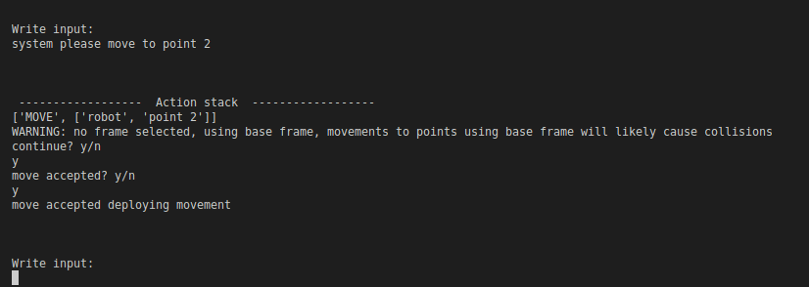

Slide 13
}
}
a3
a2
}
d1

Slide 14
y5
α4
d4
x5
y4
y3
y2
yTCP
z5
z4
z3
a2
z2
α1
a3
zTCP
xTCP
x4
x3
x2
y6
d5
d1
z1
d6
z6
α5
x6
y1
x1

Slide 15
y5
θ5
x5
y4
y3
y2
yTCP
z5
θ4
θ3
θ2
z4
z3
z2
zTCP
xTCP
x4
x3
x2
y6
z6
z1
θ6
x6
θ1
y1
x1

Slide 16
Kinematics | θ [radians] | a [m] | d [m] | α [radians]
Base (Joint 1) | θ1 | 0 | 0.1625 (d1) | π/2 (α1)
Shoulder (Joint 2) | θ2 | -0.425 (a2) | 0 | 0
Elbow (Joint 3) | θ3 | -0.3922 (a3) | 0 | 0
Wrist1 (Joint 4) | θ4 | 0 | 1.333 (d4) | π/2 (α4)
Wrist2 (Joint 5) | θ5 | 0 | 0.0997 (d5) | -π/2 (α5)
Wrist3 (Joint 6) | θ6 | 0 | 0.0996 (d6) | 0

Slide 17
Kinematics pipeline
Pass to RTDE if simulation is accepted
List of actions
Robotics system toolbox (RST)
RST simulation
RTDE
Environment manipulation
List of joint configurations

Slide 18
RST kinematic process
System Action info
System manipulation handler
(1)
coordinate goal
List of actions
(one action at a time)
(2)
Inverse kinematics
Add joint configuration to list
List of joint configurations
(3)
Joint configuration
(1)
If action is for system manipulation
(2)
If move to point/frame in space or move in reference to robot position
(3)
If rotate joint

Slide 19
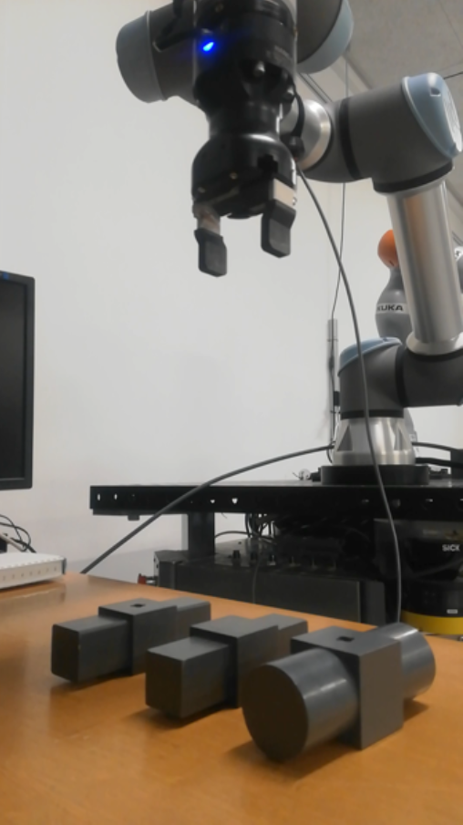
Point 8
Point 12
Point 13
Point 11
Point 10
Point 9

Slide 20
z
Frame 1
z
x
x
Frame 0

Slide 21
Point | the | gripper | towards | point | 1
Verb | Determinant | Noun | Preposition | Noun | Cardinal number
Point | close | gripper
noun | noun | noun
Computer | grip
noun | noun

Slide 22
Longest distance = 9 -> O(N)
Move the robot to the other place specified as point 0
1 2 3 4 5 6 7 8 9 10
Neural network types | Recurrent | Convolutional | attention
Maximum path length complexity | O(n) | O(log(n)) | O(1)
length given n = 9 | 9 | 3 | 1

Slide 23
norm
Feed forward
norm
norm
Multi-headed Attention
Feed forward
norm
norm
0
Masked Multi-headed Attention
Multi-headed Attention
Positional encoding
Positional encoding
Input embedding
output embedding

Slide 24
Output
Softmax
Linear
Normalize
Feed forward
Normalize
Normalize
Multi-headed Attention
Encoder layer
Feed forward
Decoder layer
Normalize
Normalize
Masked Multi-headed Attention
Multi-headed Attention
Positional encoding
Positional encoding
Input embedding
Output embedding
Input
Output

Slide 25
Multiheaded attention
Linear
concatenation
Scaled Dot-Product Attention
Scaled Dot-Product Attention
Scaled Dot-Product Attention
Linear
Linear
Linear
Linear
Linear
Linear
Linear
Linear
Linear
Q
Q
K
V
V
Q
K
V
K
Q
K
V

Slide 26
Word-by-word training examples:
Robot [MASK] to point 0 and grab the object
move
Move to point 0 [MASK] put down the object
move

Slide 27
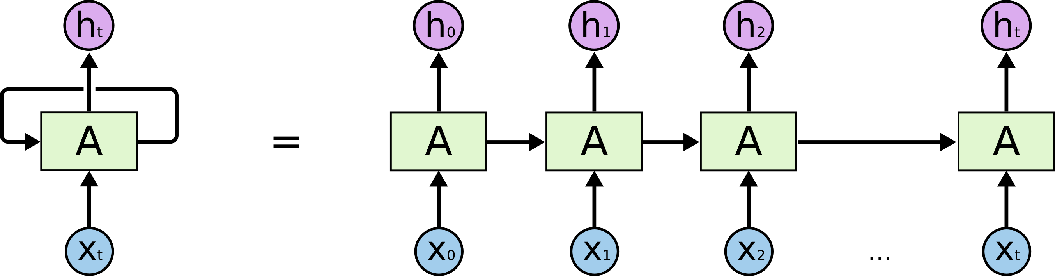
Output vector representation
Output word 1
Output word 2
Recurrent neural network layer
=
. . .
Recurrent neural network layer
Recurrent neural network layer
Recurrent neural network layer
Output vector representation
Input
Input word 1
Input word 2
Input word last

Slide 28
Neural network types | Calculations per layer | Maximum path length
Transformer | O(n² d) | O(1)
Recurrent | O(n d²) | O(n)
Convolutional | P(k n d²) | O(log(n))

Slide 29
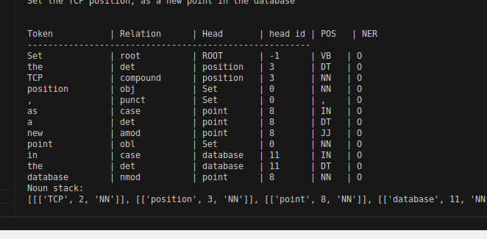
Words: | Set | the | TCP | as | a | new | point
POS tags: | Verb | Determinant | Noun | preposition | determinant | Adjective | noun

Slide 30
Move the robot towards point 0, then grab the object
NLP pipeline
Relation: parataxis
Move [verb]
robot [noun] point [noun]
the [determinant] towards [preposition] 0 [cardinal number]
Grab [verb]
then [adverb] object [noun]
the [determinant]

Slide 31
Let go of the object
Relation: xcomp
Let [verb]
go [verb] object [noun]
of [preposition] the [determinant]

Slide 32
(input)
“Robot proceed to point 0”
Verbs for
action ‘move’
move - Similarity score: 0.59
run - Similarity score: 0.44
go - Similarity score: 0.43
steer - Similarity score: 0.43
(1)
(2)
(3)
(4)
(5)
With the verb ‘proceed’ did you mean ‘move?
With the verb ‘proceed’ did you mean ‘run?
With the verb ‘proceed’ did you mean ‘go?
With the verb ‘proceed’ did you mean ‘steer?
Could not interpret the verb ‘proceed’
database

Slide 33
Move the robot towards point 0, then grab the object
NLP pipeline
Parser pipeline
Actions
(action: MOVE, Subject: robot, destination: point 0)
(action: GRAB, Subject: object, destination: TCP)

Slide 34
Instructions
Instruction 1
Action: move to point 0
Action: grab
Instruction 2
Action: move to point 1
Grab the object at point 0, then move to point 1
Input sentence

Slide 35
Task 1: Put the object on top of the other object:
- Start in origin of frame 1.
- Grab object at point 0.
- Lift the arm to point 2.
- Move the arm to point 1.
- Let go of object.
Task 2: Put pushed object on top of another object
- Start in point 7.
- Move robot to point 3.
- Push the objects by moving to point 4.
- Move out of the way, by going to point 5.
- Grab object at position 6.
- Lift object 10 centimetres up the z-axis.

Slide 36
Task 3: Stack three objects on top of each other
- Start in point 8.
- Pickup object at point 9.
- Go back to point 8.
- Move to point 10.
- Rotate wrist 3 90 degrees.
- Let go of object.
- Move 20 centimetres up the z-axis.
- Move to point 8
- Move to point 13
- Then grab at point 11.
- Move back to point 8.
- Move to point 12.
- Rotate wrist 3 45 degrees.
- Put down object.
- move 5 centimetres up the z-axis.
- go back to point 8

Slide 37
Actions
44
12
2
3

Slide 38
Output
Softmax
Linear
Normalize
Feed forward
Normalize
Normalize
Multi-headed Attention
Ct-1
Forget gate
Output gate
Ct
Encoder layer
Feed forward
Decoder layer
Normalize
Normalize
Tanh
Input gate
Masked Multi-headed Attention
Multi-headed Attention
σ
σ
Tanh
Tanh
ht-1
ht
Positional encoding
Positional encoding
xt
Trainable layers
Input embedding
Output embedding
Input
Output

Slide 39
