Slide 1


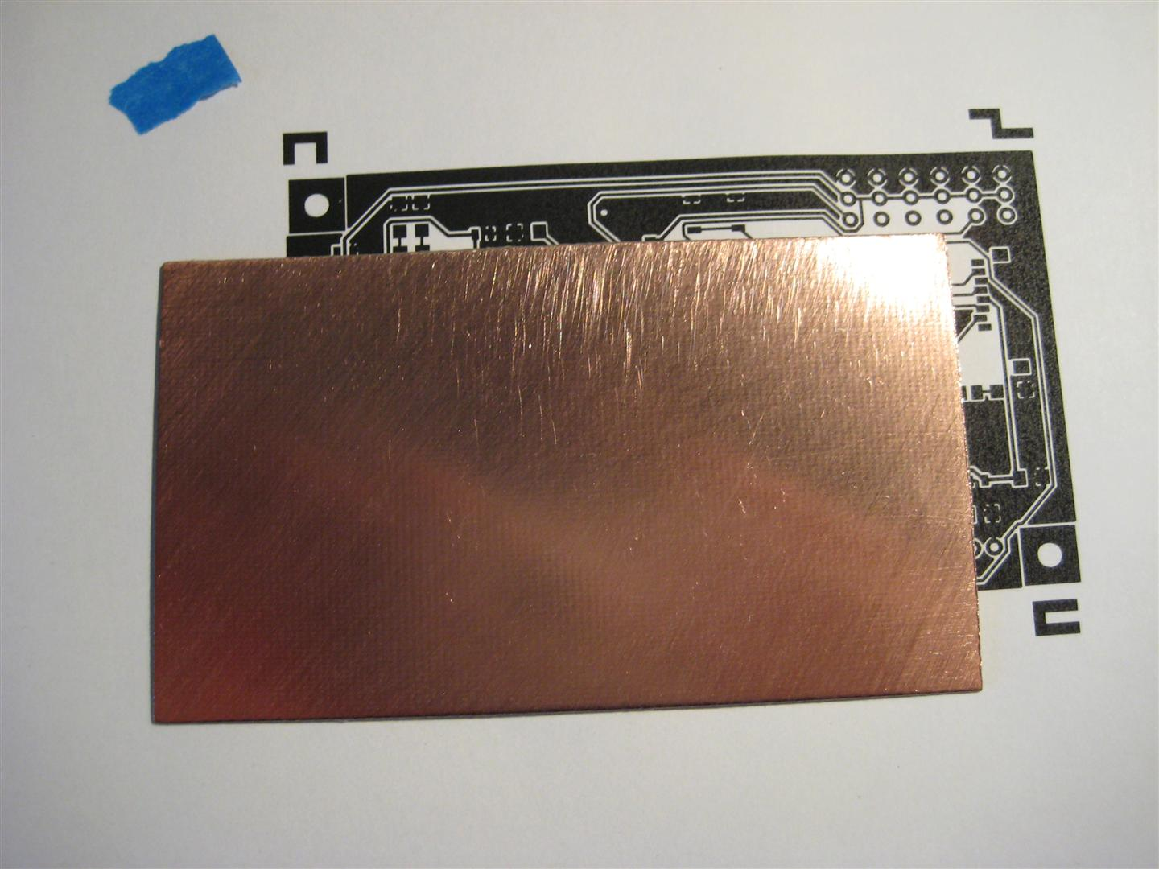
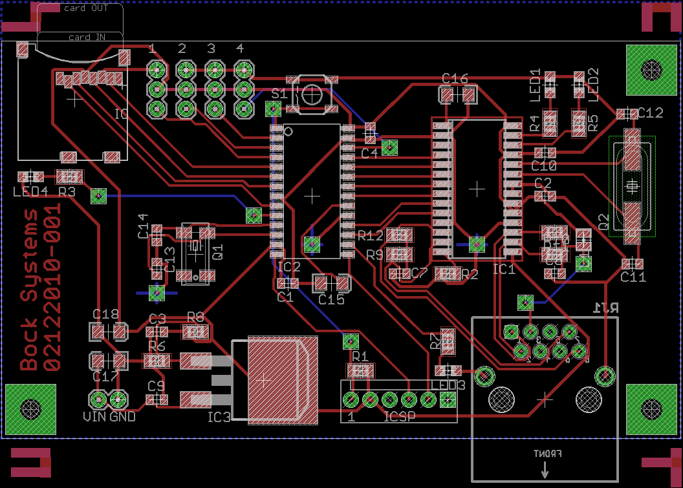
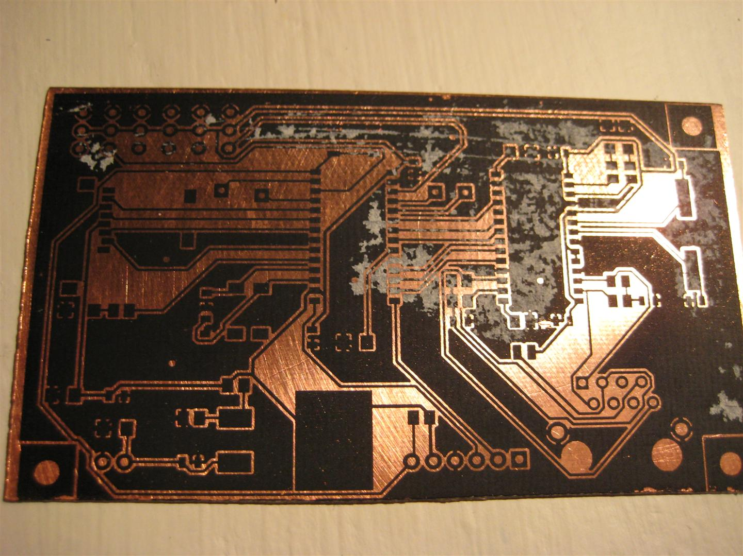
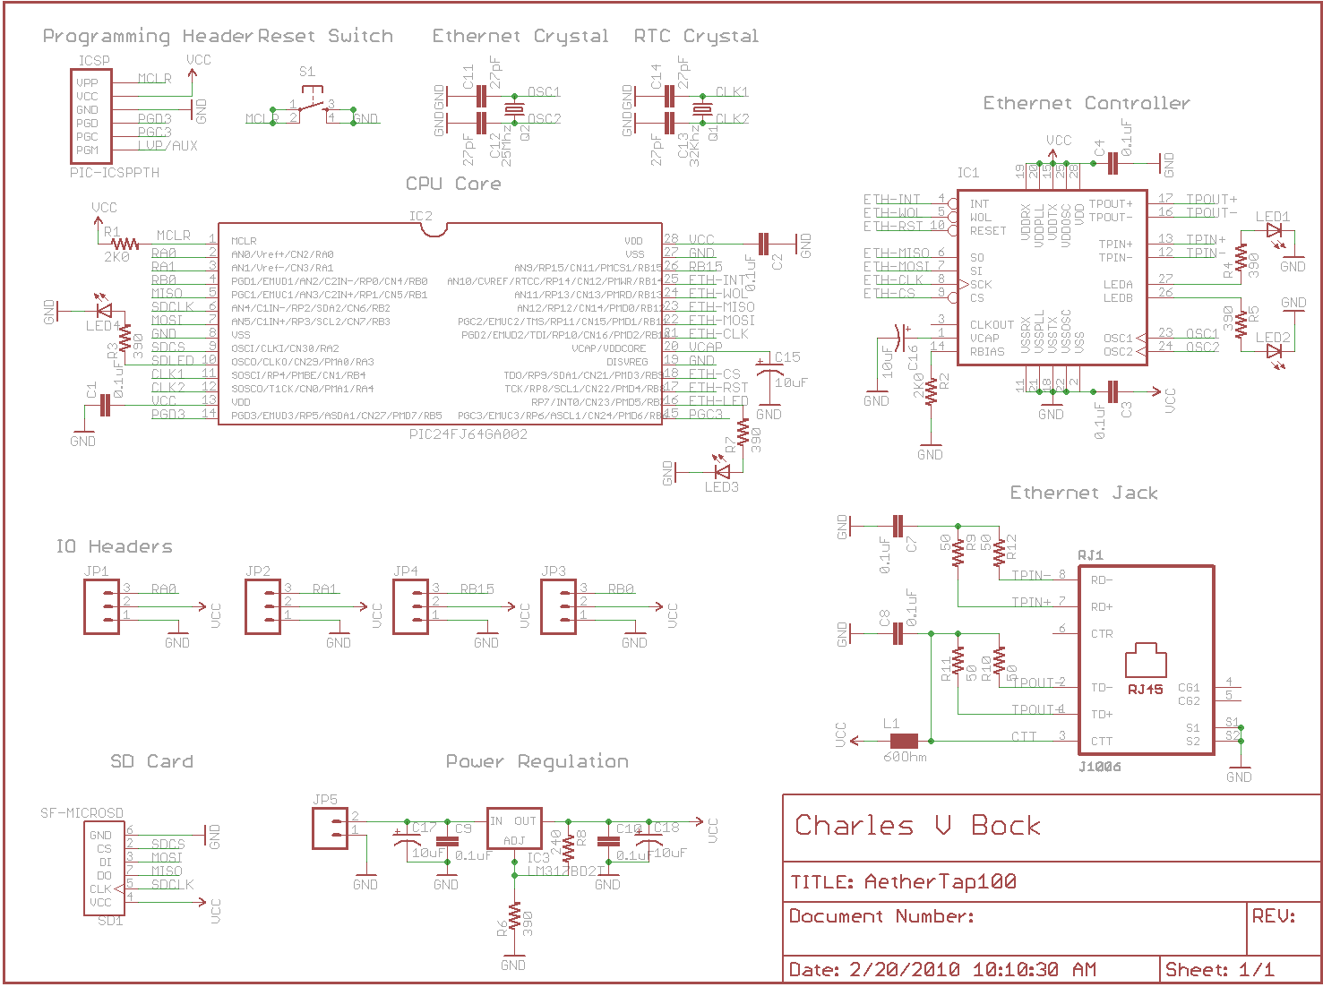
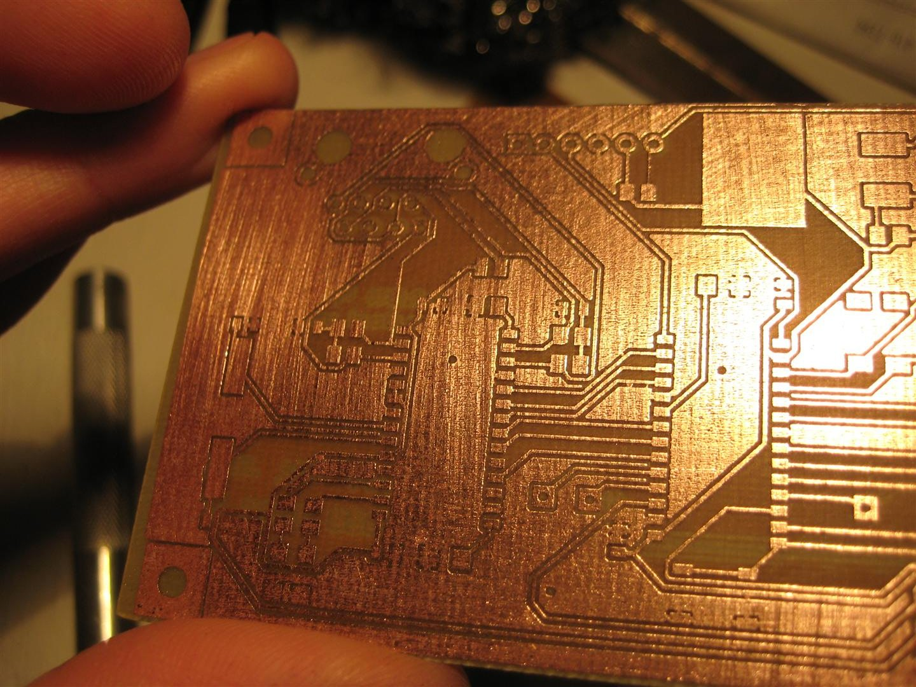
AetherTap Network Enabled uC Platform
Charles V Bock - Richard O Whitehouse Arizona State University 7001 E. Williams Field Road, Mesa, AZ 85212
Design Goals
PCB Routing and Layout
PCB Production
Block Diagram
The primary objective of this project is to produce an inexpensive Ethernet enabled controller which can be interacted with via the Internet. The device will be a product of its programming, meaning that depending on what the current task at hand is the device should be able to perform all of the following functions.
Host web content and display real time data via the web.
Send emails or alerts when necessary.
Monitor and interact with external devices, sensors, and appliances.
Allow control of the above mentioned devices via email, web based interface, or internet connected smart phone (Android, IPhone, etc.)
Log and respond to network traffic.
Inject arbitrary packets into the network (security research).
After all logical connections are established, the next design step is to place and route the individual components. In modern PCB fabrication facilities this is sometimes done completely by computer algorithms. For this project a significant portion of the placement and routing of components was done by hand to reduce the complexity of the layout and make the resulting board easier to produce. Components are commonly laid out as close to other connected components as possible. This reduces latency introduced by electrons traversing the relatively vast distances between components. After placement, interconnects must be routed between pins and all passive components. This process is not trivial and would require days or weeks of work to complete if done completely by hand. Luckily there are algorithms which are fairly good at this kind of NP problem. Using routing algorithms this kind of work can be reduced to minutes with after-refinements taking only a few hours. Its also interesting to notice alignment markers are placed at each corner which will help with the PCB creation process in the next several stages of design.
After finalizing the physical layout of the PCB it is time to etch the design into the copper clad. To begin this process the etch-resist mask is printed out using a laser printer. A laser printer is preferable to an ink based printer because of the use of pulverized plastic which resists being eaten away by the acidic etchant. After the mask is prepared it is applied to the bare copper using large amounts of heat and pressure. The heat and pressure cause the mask to bind to the copper, which then allows the paper backing to be removed without damaging or skewing the mask. Finally after the etch resist is applied the copper substrate is subjected to warm ferric chloride. This causes any unmasked copper to be removed, leaving behind only the initially desired traces.
Servos
Pololu Module
Pololu Serial Communication
Android Communication
Network Stack
Pic 24FJ64GA002
Device Schematics
ENC28J60 Driver Stack
ENC28J60
Bill Of Materials
PIC 24F Series Overview
ENC28J60 Overview
Part | Value | Package | Mouser Part #
C1-10 | 0.1uF | 805 | 80-C0805C104M5R
C11-14 | 27pF | 805 | 140-CC501N270J-RC
C15-18 | 10uF | 1206 | 74-293D106X96R3A2TE3
IC1 | ENC28J60 | SO28W | 579-ENC28J60-I/SO
IC2 | PIC24FJ64GA002 | SO28W | 579-PIC24FJ64GA002SO
IC3 | LM317D2TG | D2PACK | 863-LM317D2TG
ICSP | ICSP Header | 1X6 Pin Header | 538-22-28-8062
JP1-4 | IO Header | 1X3 Pin Header | 517-2314-6111TG
JP5 | Power Header | 1X2 Pin Header | 517-2314-6111TG
L1 | 60Ohm | 805 | 81-BLM21BB600SN1D
LED1-4 | Green | 805 | 645-598-8170-107F
Q1 | 32Khz | MM20SS | 695-CM200C-327KF-U
Q2 | 25Mhz | HC49UP | 815-ABLS-25-B2
R1-2 | 2K0 | 805 | 292-2.0K-RC
R3-7 | 390 | 805 | 71-CRCW0805-390
R8 | 240 | 805 | 71-CRCW0805-240
R9-12 | 49.9 | 805 | 71-CRCW0805-49.9
RJ1 | Ethernet Jack | RJ45 | 673-J1006F21
S1 | Push Button | SMD | On Hand
SD1 | SD Card Slot | MICROSD | 517-2908-05WB-MG
The PIC24F series has many advantages over its 10, 12, 16, and 18 series cousins; First and foremost the 16 bit architecture allows the chip to have a far expanded instruction set which makes it much more viable to program the chip in a higher level language such as C or even BASIC. This project will make use of Microchip’s student version of its C30 Compiler which comes fully loaded with individual header files for each chip in the 24 series and even libraries to help out with the on chip hardware peripherals like USART, I2C, SPI, Etc. The 24 series also has one advantage that most people tend to overlook, its hardware peripheral pins can be remapped to almost any pin on the device, meaning much less time working on routing a PCB. Its also interesting to notice the distinction between the 24F and 24H series controllers, while the 24H controllers can typically run at much higher speeds achieving in the range of 64mips, it typically lacks the expanded peripherals of the 24F series which on average has about double the hardware peripherals of the 24H series but performs at only around 16Mips The exact model used in this project is the PIC24Fj64GA002 with 64K of flash memory, 2 hardware SPI interfaces, and a max speed of 32 MHz (16Mips).
The ENC28J60 Ethernet controller handles everything below the network layer of the standard OSI Model. It handles the media access control layer and the physical reception and transmission of packets. The ENC28J60 interfaces to a main controller via SPI and receives and transmits information via an internal 8k buffer operating in a FIFO fashion. The ENC28J60 supports full and half duplex modes as well as unicast, multicast, and broadcast packets. It is also fully compatible with all 10/100/1000 Base-T networks making it a very “plug and play” device as far as embedded Ethernet solutions go. One drawback about this device is that it doesn’t support auto-negotiation which means it’s not safe to use full-duplex mode unless the switch port can be manually changed to full-duplex.
The Schematic design process is a combination of logical planning and reading a considerable number of product data sheets. During this phase of the project all main and passive components are accounted for and a logical mapping is established. Passive components are selected for by using requirements defined in the main component data sheets. For example the “CPU Core” (PIC24FJ64GA002) marked above requires a core voltage of 2.5 volts which means a filtered power supply “Power Regulation” must be established which provides 3.3 volts to the VCAP pin on the PIC, this is then down converted to 2.5 volts using an internal regulation process. This and other requirements are all outlined in the respective component data sheets. At this stage a number of 0.1uF (0.1 microfarad) capacitors are also added to help decouple the power bus and remove any voltage spikes or noise which may occur.

