Slide 1
PRINCETON UNIVERSITY / RESEARCH TALK
Linear Attention,
State Spaces, and RLT
Memory updates and computation across tokens
Yifan Zhang
Princeton ECE / October 2026
Based on
A Note on Linear Attention and State Space Models
and
Recurrent Looped Transformer
01 / 14
Notes:
The organizing question is what a sequence model carries forward and how it updates that state. The note explains linear attention, selective state spaces, and the delta rule using explicit recurrences. RLT adds a different choice: a complete Transformer decoder becomes the recurrent cell.
We will derive the attention–recurrence connection, identify the algebra behind parallel evaluation, and then write RLT's transition function explicitly. The final examples concern supervised algorithmic state tracking.
Sources
Zhang and Kung / Linear Attention and SSMs: https://github.com/yifanzhang-pro/A-Note-on-Linear-Attention-and-SSMs/blob/4f14583b2b6195bc884510e1b484954f28c4e7f8/main.tex
Zhang et al. / RLT: https://github.com/yifanzhang-pro/Recurrent-Looped-Transformer-Overleaf/blob/2367dfd6a6c211d2f3d8b9ac0b6133eb611c4b5f/main.tex
Equation source (LaTeX)

Slide 2
01 / A COMMON LANGUAGE
The state-space view
Object | Meaning | Question to ask
State hₜ | Information carried into the next update | What must persist?
Input uₜ | New data and conditioning features | What is available before the update?
Transition Fθ | The rule that transforms the state | Affine or nonlinear in the old state?
The recurrence index can represent token position or network depth.
Note:
Yifan Zhang and Sun-Yuan Kung
RLT:
Yifan Zhang, Jichen Feng, Shihan Qin, Sun-Yuan Kung, and Mengdi Wang
Note / State-space representations
/
RLT / Sequence and state
02 / 14
Notes:
A state-space representation is a mathematical description, broader than the structured SSM layers used in modern language models. An RNN is one instance, with a learned nonlinear transition. A layered network can also be expressed recursively over depth, but that alone does not create memory across tokens.
The state must include everything needed for the next transition, conditional on the supplied input. For RLT, the feedback vector alone is insufficient because the decoder also reads a local KV cache. Its global encoder memory will appear explicitly as a conditioning input.
Sources
Note / State-space representations: https://github.com/yifanzhang-pro/A-Note-on-Linear-Attention-and-SSMs/blob/4f14583b2b6195bc884510e1b484954f28c4e7f8/main.tex
RLT / Sequence and state: https://github.com/yifanzhang-pro/Recurrent-Looped-Transformer-Overleaf/blob/2367dfd6a6c211d2f3d8b9ac0b6133eb611c4b5f/main.tex
Equation source (LaTeX)
h_t=\mathcal F_\theta(h_{t-1};u_t),\qquad y_t=\mathcal G_\theta(h_t;u_t)

Slide 3
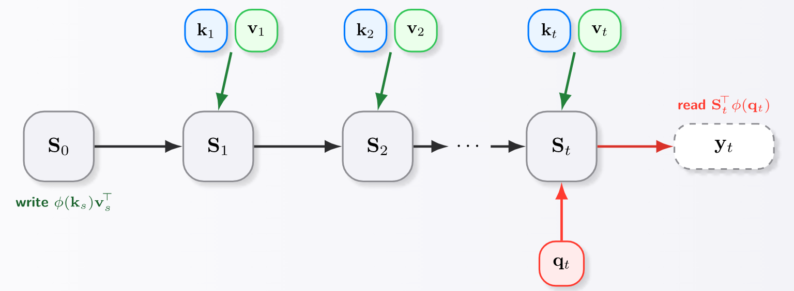


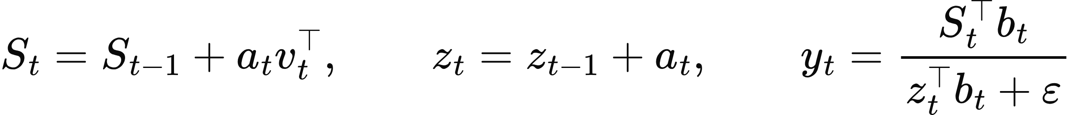


02 / LINEAR ATTENTION
Linear attention as recurrent memory
Key features
, query features
. Read after writing the current token.
State size
stays fixed as the sequence grows. The vector
supplies the normalizer.
Note / Linear attention and original figure
/
Katharopoulos et al., 2020
03 / 14
Notes:
Initialize both states to zero and use a read-after-write convention, so the query at position t includes the current key and value. The matrix state stores the sum of all outer products, while the vector state stores the sum of key features. Nonnegative kernel features and a positive epsilon give a positive normalizer.
“Linear” refers to the sequence-length cost of the recurrent evaluation at fixed feature and value dimensions. The feature map and the surrounding network can be nonlinear. The recurrent state update itself is additive and therefore affine in the old state.
Sources
Note / Linear attention and original figure: https://github.com/yifanzhang-pro/A-Note-on-Linear-Attention-and-SSMs/blob/4f14583b2b6195bc884510e1b484954f28c4e7f8/main.tex
Katharopoulos et al., 2020: https://proceedings.mlr.press/v119/katharopoulos20a.html
Equation source (LaTeX)
a_t=\phi(k_t)
b_t=\phi(q_t)
S_t=S_{t-1}+a_tv_t^\top,\qquad z_t=z_{t-1}+a_t,\qquad y_t=\frac{S_t^\top b_t}{z_t^\top b_t+\varepsilon}
O(md_v)
z_t

Slide 4
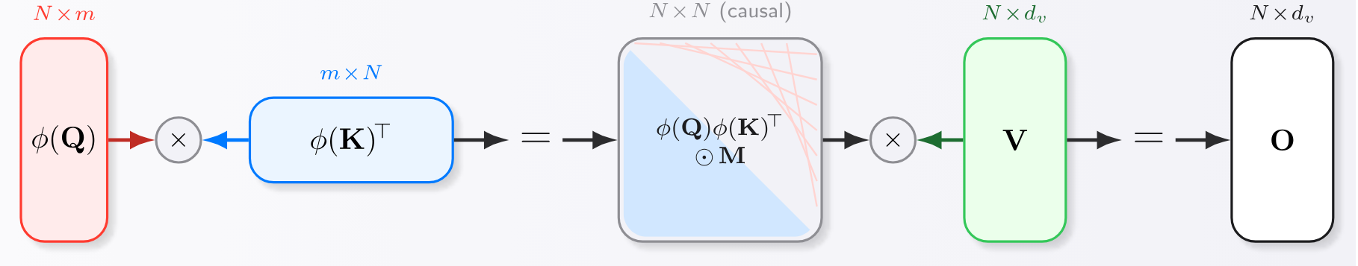
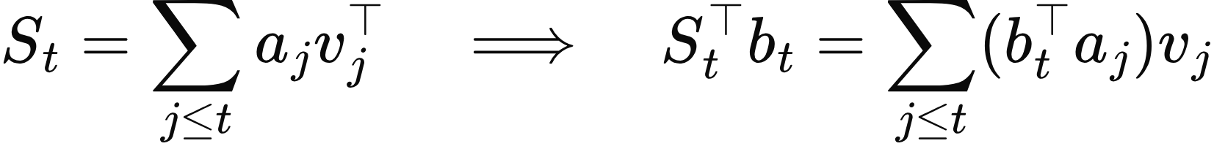

03 / EXACT DUAL VIEWS
The same computation in attention form
Same outputs, different evaluation: a running state or a causal
score matrix.
Unnormalized outputs shown. Normalized attention also divides each row by its kernel sum.
Note / Original recurrent and parallel views
/
Katharopoulos et al., 2020
04 / 14
Notes:
Stack the query and key features into rows of Phi-Q and Phi-K. The causal mask removes future positions. Reordering the sums gives the same output as the recurrence, with no approximation between these two forms.
This equivalence does not identify a finite feature kernel with ordinary softmax attention. Any approximation to the softmax kernel is a separate choice. The recurrent implementation takes O(T m d-v) work and O(m d-v) state. The explicit attention implementation materializes a quadratic score matrix. Specialized chunk algorithms offer further evaluation choices. For normalized attention, the same rearrangement applies to the denominator.
Sources
Note / Original recurrent and parallel views: https://github.com/yifanzhang-pro/A-Note-on-Linear-Attention-and-SSMs/blob/4f14583b2b6195bc884510e1b484954f28c4e7f8/main.tex
Katharopoulos et al., 2020: https://proceedings.mlr.press/v119/katharopoulos20a.html
Equation source (LaTeX)
S_t=\sum_{j\le t}a_jv_j^\top\quad\Longrightarrow\quad S_t^\top b_t=\sum_{j\le t}(b_t^\top a_j)v_j
Y=(M\odot\Phi_Q\Phi_K^\top)V,\qquad M_{tj}=\mathbf 1\{j\le t\}
T\times T

Slide 5
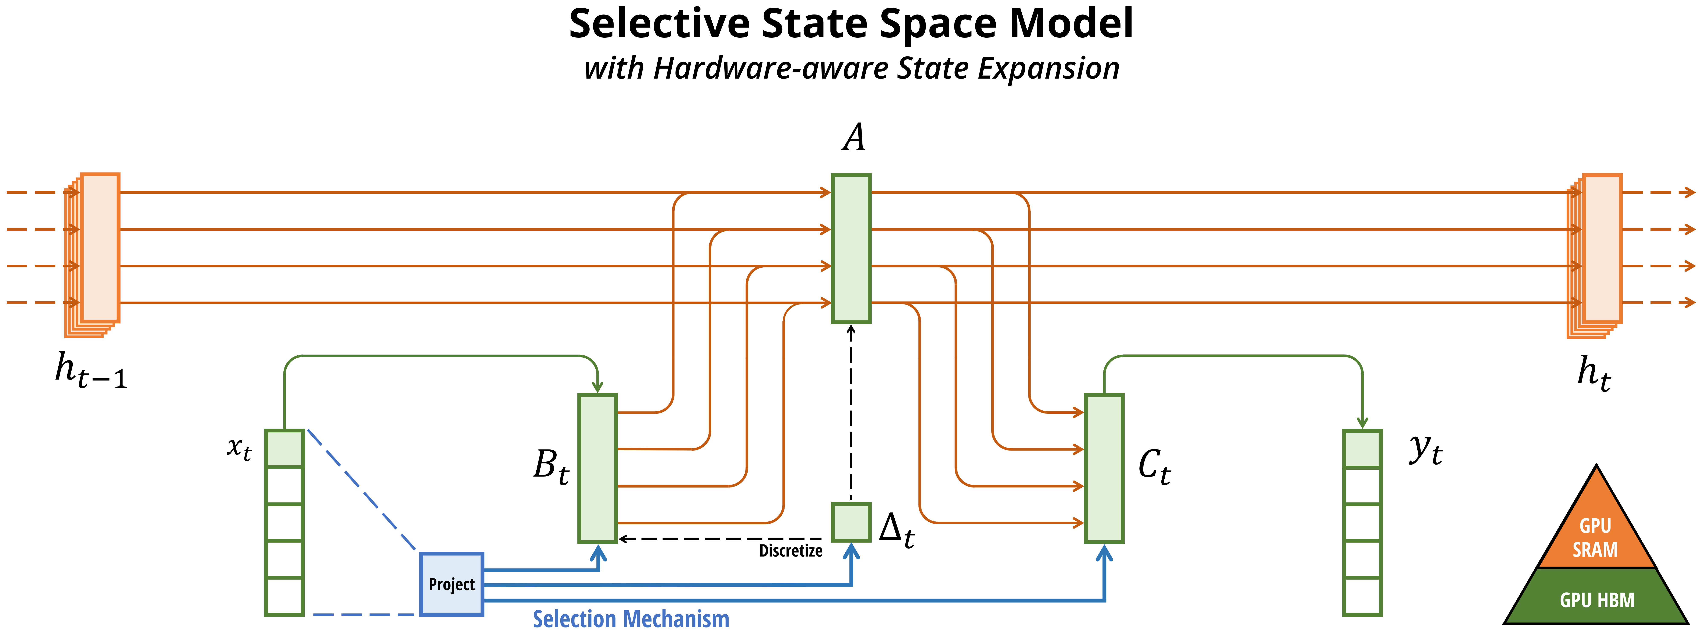
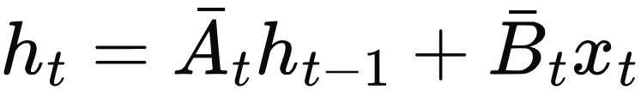
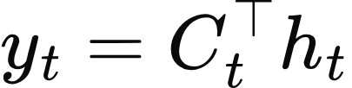


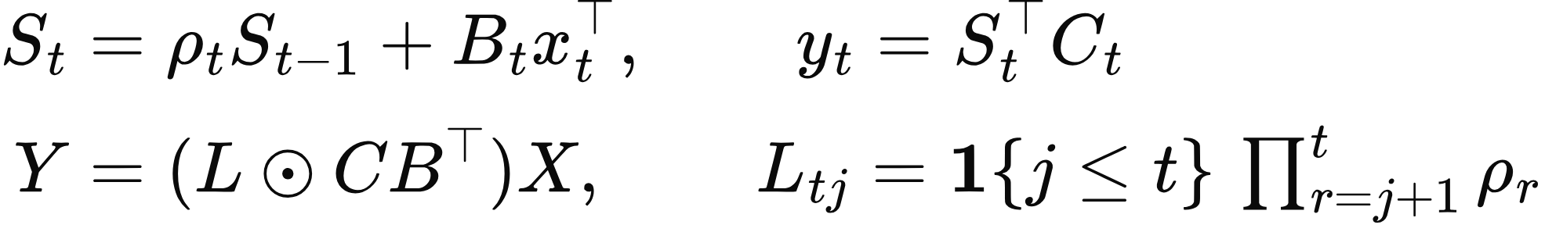




04 / DECAY AND SELECTIVITY
Selective SSMs and state-space duality
The SSM core
Mamba selects
from layer inputs.
.
Scalar-transition SSD, with zero initial state
: queries,
: keys,
: values. Setting
recovers causal linear attention.
Note / Selective SSMs and SSD
/
Gu and Dao / Mamba, Fig. 1
/
Dao and Gu / SSD
05 / 14
Notes:
The figure is reproduced from Mamba Figure 1, https://arxiv.org/html/2312.00752v2/selection.svg. It illustrates selection and the expanded recurrent state. The equations on the right give the discrete SSM core. Mamba selects coefficients from the current layer input, which allows them to be computed before the recurrent scan of that layer. Once those inputs are fixed, the update is affine in the previous recurrent state. This is more specific than a general model whose coefficients depend on that same previous state.
For the scalar-transition SSD case, S is an m by d-v matrix, B and C are m-dimensional vectors, and x is d-v dimensional. The scalar rho is the decay at a position. Unrolling the recurrence weights each key–query interaction by the product of intervening decays. The empty product for j=t equals one.
The duality is the core connection used by Mamba-2. It concerns this structured mixer and does not equate every Transformer block with every SSM architecture.
Sources
Note / Selective SSMs and SSD: https://github.com/yifanzhang-pro/A-Note-on-Linear-Attention-and-SSMs/blob/4f14583b2b6195bc884510e1b484954f28c4e7f8/main.tex
Gu and Dao / Mamba, Fig. 1: https://arxiv.org/abs/2312.00752
Dao and Gu / SSD: https://arxiv.org/abs/2405.21060
Equation source (LaTeX)
h_t=\bar A_t h_{t-1}+\bar B_t x_t
y_t=C_t^\top h_t
\Delta_t,B_t,C_t
\bar A_t=\exp(\Delta_t A)
\begin{aligned}
S_t&=\rho_t S_{t-1}+B_t x_t^\top,\qquad y_t=S_t^\top C_t\\[3pt]
Y&=(L\odot CB^\top)X,\qquad L_{tj}=\mathbf 1\{j\le t\}\,\textstyle\prod_{r=j+1}^{t}\rho_r
\end{aligned}
C
B
X
\rho_t=1

Slide 6
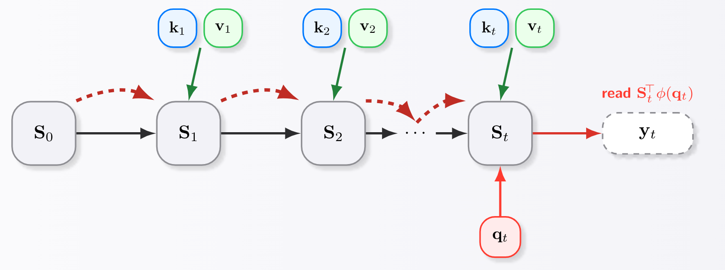
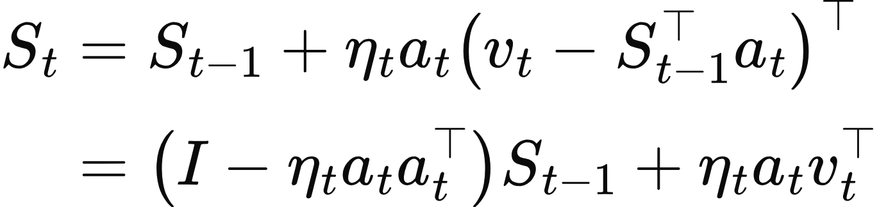
05 / CORRECTIVE MEMORY
DeltaNet writes the retrieval error
Write the retrieval error. The update is affine in the old state when the inputs are fixed.
Green arrows: writes. Dashed red arrows: key-dependent edits to the old memory.
Note / Delta Networks and original figure
/
Yang et al., 2024
06 / 14
Notes:
The squared loss asks the memory matrix to retrieve v from key a. Taking one gradient step yields an error-correcting write. Expanding the error exposes an affine state transition with a rank-one edit.
The scalar example uses zero initial state and epsilon zero for normalized attention. After the first value, each memory holds or reads 1. The second additive write produces a sum of 4, and its normalized read divides by two. DeltaNet instead adds the error 3 minus 1, giving 3.
The edit matrix is an orthogonal projector only when eta equals the inverse squared key norm. The general update is a rank-one edit. The note also derives a triangular solve for the residual writes, followed by a masked read. That structure supports the chunkwise parallel algorithms studied by Yang and colleagues.
Sources
Note / Delta Networks and original figure: https://github.com/yifanzhang-pro/A-Note-on-Linear-Attention-and-SSMs/blob/4f14583b2b6195bc884510e1b484954f28c4e7f8/main.tex
Yang et al., 2024: https://arxiv.org/abs/2406.06484
Equation source (LaTeX)
\begin{aligned}
S_t&=S_{t-1}+\eta_ta_t\bigl(v_t-S_{t-1}^\top a_t\bigr)^\top\\[3pt]
&=\bigl(I-\eta_ta_ta_t^\top\bigr)S_{t-1}+\eta_ta_tv_t^\top
\end{aligned}

Slide 7

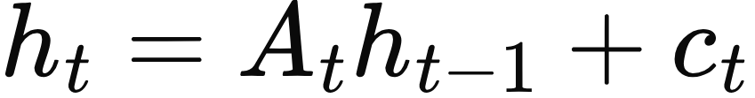
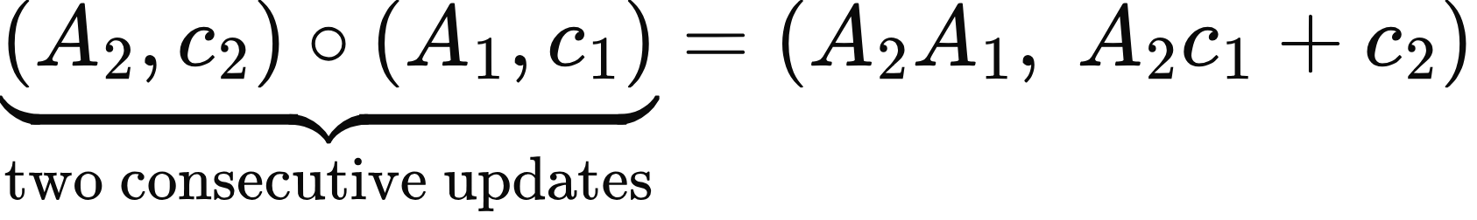
06 / THE ALGEBRA OF PARALLEL EVALUATION
Why affine updates admit a scan
Fix a layer’s input sequence. Represent one transition by
:
Closed under composition
Structure controls cost
A segment of updates is still one affine map.
Additive, diagonal, scalar, and low-rank forms
Prefix composition is associative.
support efficient implementations.
A general nonlinear recurrence has no comparable fixed-size affine summary.
Note / Structured transitions
/
Mamba / Parallel scan
/
DeltaNet / Parallelization
07 / 14
Notes:
Substitute the first update into the second to derive the pair-composition rule. Its associativity enables prefix scans. This is an algebraic statement about the affine core after its inputs and coefficients are fixed.
Associativity alone does not guarantee speed: dense matrix products can be expensive, and products of rank-one edits need not remain rank one. SSMs exploit structured transitions, while DeltaNet uses specialized factorizations and triangular solves.
Function composition is associative even for nonlinear functions. The issue for a general nonlinear cell is that composing many cells does not leave a compact affine pair with cheap composition. RLT therefore cannot directly use this affine-scan algorithm.
Sources
Note / Structured transitions: https://github.com/yifanzhang-pro/A-Note-on-Linear-Attention-and-SSMs/blob/4f14583b2b6195bc884510e1b484954f28c4e7f8/main.tex
Mamba / Parallel scan: https://arxiv.org/abs/2312.00752
DeltaNet / Parallelization: https://arxiv.org/abs/2406.06484
Equation source (LaTeX)
(A_t,c_t)
h_t=A_t h_{t-1}+c_t
\underbrace{(A_2,c_2)\circ(A_1,c_1)}_{\text{two consecutive updates}}=(A_2A_1,\ A_2c_1+c_2)

Slide 8
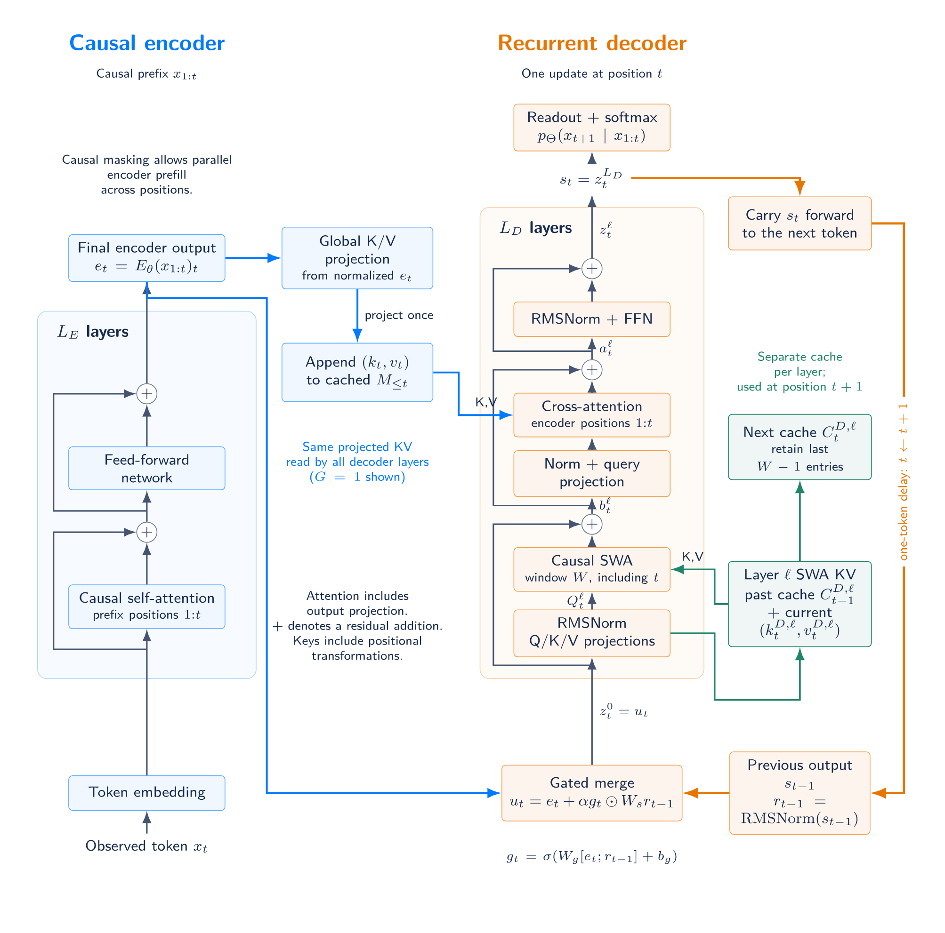



07 / RECURRENT LOOPED TRANSFORMER
RLT: a Transformer decoder as the recurrent cell
Causal encoder
Known tokens produce
and prefix memory
.
Gated feedback
Merge
with the previous final decoder
output
.
Full decoder update
SWA, cross-attention, and an FFN transform
the merged input.
SWA = sliding-window attention.
Every output predicts the next token.
RLT / Encoder, gated merge, and decoder blocks
08 / 14
Notes:
Read the figure from bottom to top. The causal encoder produces a representation at each position and projected key–value memory. For known tokens, each encoder layer can process positions in parallel with a causal mask.
The decoder receives the current encoder representation and the previous token's final decoder output through the gated merge. Each decoder layer has local sliding-window self-attention, cross-attention to the causal prefix of encoder memory, and a feed-forward network. The orange feedback path returns the final decoder output to the next token's merge.
The paper authors are Yifan Zhang, Jichen Feng, Shihan Qin, Sun-Yuan Kung, and Mengdi Wang. The architecture figure is reused from the supplied general-exam slides, whose source is the RLT manuscript.
Sources
RLT / Encoder, gated merge, and decoder blocks: https://github.com/yifanzhang-pro/Recurrent-Looped-Transformer-Overleaf/blob/2367dfd6a6c211d2f3d8b9ac0b6133eb611c4b5f/main.tex
Equation source (LaTeX)
e_t
M_{\le t}
e_t
s_{t-1}

Slide 9

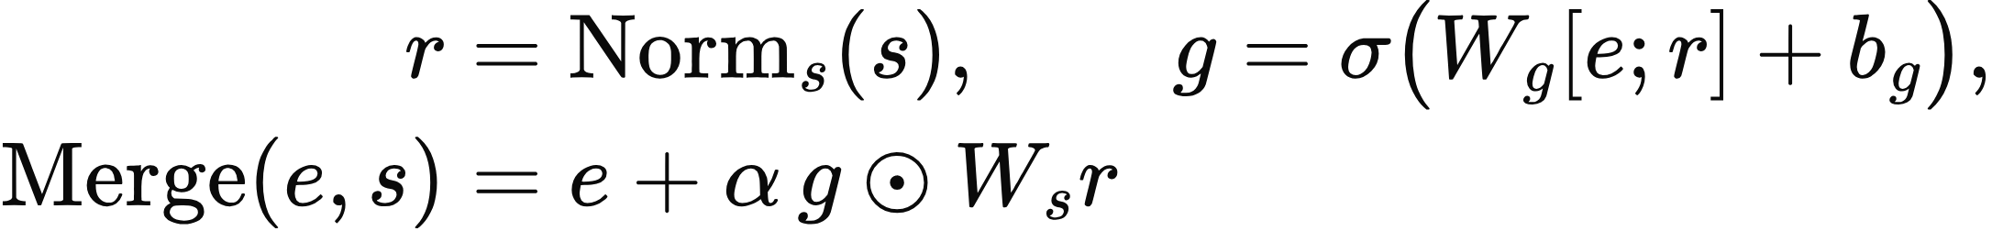


08 / A NONLINEAR STATE-SPACE SYSTEM
RLT’s explicit state-transition function
Complete decoder state:
, including the feedback vector and local KV cache.
One transition updates both
and
, conditioned on encoder features and memory.
RLT / Method, with the current manuscript’s explicit state-space notation
09 / 14
Notes:
The function definition specifies the state transformation rather than merely calling RLT an SSM. Given the old state H, extract s for the merge and C-D for decoder self-attention. The full decoder returns the new feedback vector and the updated cache.
The conditioning inputs e, M, and the absolute token position t remain explicit. The output function uses the feedback vector component of the new state to predict the next token. The initial feedback vector is learned, and the initial decoder cache is empty.
The norm, gate, attention, and feed-forward operations make this transition nonlinear in the previous decoder state, even after the encoder inputs are fixed. The same cell parameters are reused across tokens, while different decoder layers may have different parameters.
Sources
RLT / Method, with the current manuscript’s explicit state-space notation: https://github.com/yifanzhang-pro/Recurrent-Looped-Transformer-Overleaf/blob/2367dfd6a6c211d2f3d8b9ac0b6133eb611c4b5f/main.tex
Equation source (LaTeX)
H=(s,C^D)
\boxed{\mathcal F_\Theta(H;e,M,t):=D_\phi\bigl(\operatorname{Merge}(e,s);M,C^D,t\bigr)}
\begin{aligned}
r&=\operatorname{Norm}_s(s),\qquad g=\sigma\bigl(W_g[e;r]+b_g\bigr),\\
\operatorname{Merge}(e,s)&=e+\alpha\,g\odot W_s r
\end{aligned}
H_t=\mathcal F_\Theta(H_{t-1};e_t,M_{\le t},t),\qquad H_0=(s_\star,\varnothing)
\mathcal G_\Theta(H)=\operatorname{softmax}\bigl(W_o\operatorname{Norm}_o(s)\bigr),\qquad p_\Theta(\cdot\mid x_{1:t})=\mathcal G_\Theta(H_t)
s_t
C_t^D

Slide 10
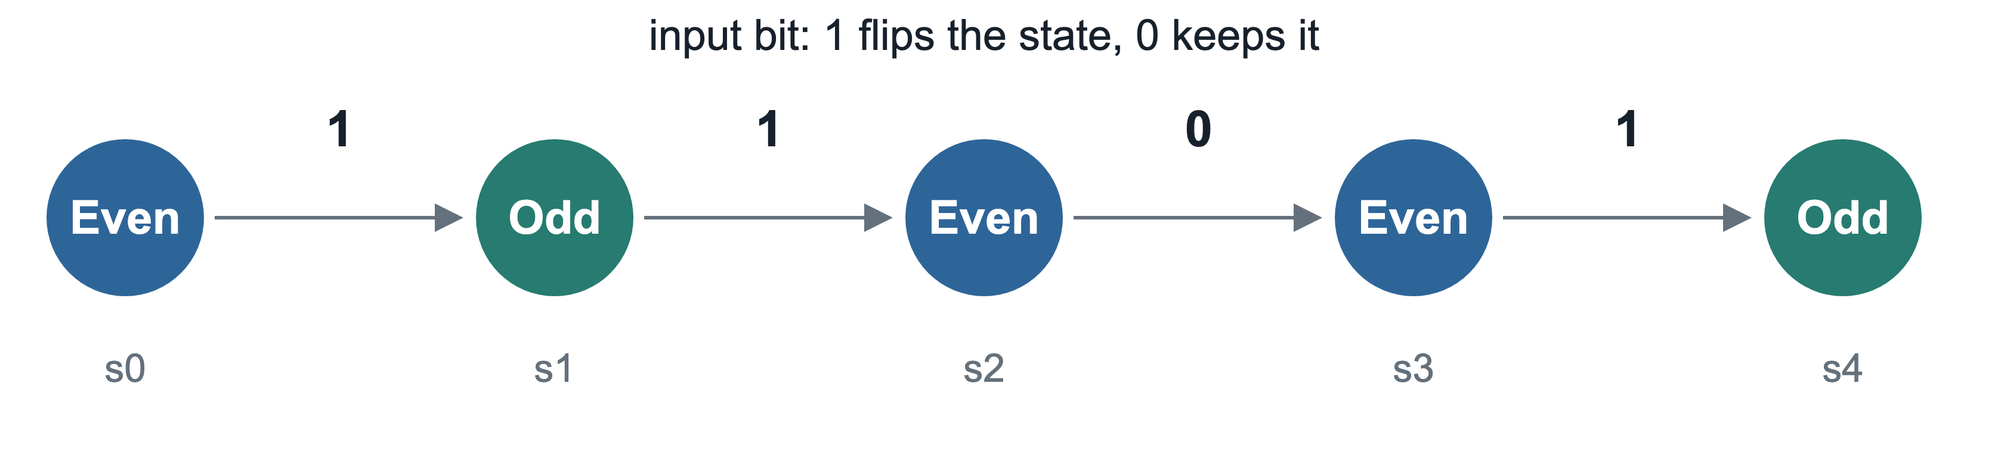



09 / RNN INTERPRETATION
Feedback extends the computation across tokens
Per token
Across
tokens
Transformer blocks.
The feedback path traverses
decoder
The merge connects successive updates.
blocks with parameters reused.
Known-token encoding is parallel. RLT-1 decoder updates follow token order.
RLT / Prompt-state composition and depth accounting
10 / 14
Notes:
A running parity computation is a simple example of a repeated state update: a one toggles parity and a zero preserves it. The picture illustrates the task, not a decoded internal neuron or a proof of the learned representation.
RLT is an RNN whose cell is a gated merge followed by a full Transformer decoder. It gains a computation path through multiple decoder stacks as more tokens arrive. Each token still runs the stated number of blocks. The T times L-D count refers to this feedback path, not to a claim of lower total attention cost.
For L-D equal to zero, there are no decoder blocks but the gated merge still recurs. The experiments use several encoder–decoder allocations, so decoder depth and recurrence remain distinct design choices.
Sources
RLT / Prompt-state composition and depth accounting: https://github.com/yifanzhang-pro/Recurrent-Looped-Transformer-Overleaf/blob/2367dfd6a6c211d2f3d8b9ac0b6133eb611c4b5f/main.tex
Equation source (LaTeX)
H_T=F_T\circ\cdots\circ F_1(H_0),\qquad F_t(H)=\mathcal F_\Theta(H;e_t,M_{\le t},t)
L_E+L_D
T
T L_D

Slide 11
10 / RLT EVIDENCE
Length generalization depends on the depth split
Eight-layer models. Test accuracy at length 256, mean ± sample SD over three seeds.
Task | RLT-1 allocation | GPT Layer 8 | RLT-1
Parity Train: 3–40 bits | Layer 5 + 3 or Layer 7 + 1 | 50.07 ± 1.63% | 100.00 ± 0.00%
Swaps-S₅ Train: 32 operations | Layer 4 + 4 | 0.85 ± 0.30% | 97.30 ± 2.76%
Parity favors a shallow decoder. Swap tracking benefits from more decoder layers.
2,000 training steps, seeds 42–44, 1,024 shared test examples per length.
Each run selects its checkpoint using minimum in-distribution validation loss.
Layer counts match. Parameters and compute differ: RLT-1 has 26.10–28.73M parameters, versus GPT’s 25.31M.
RLT / Algorithmic experiments and length extrapolation
11 / 14
Notes:
These are selected length-generalization results from the manuscript's six-task study. Parity scores the final answer, while swaps-S5 scores the final permutation state. The swaps task uses the identity and the ten single transpositions of five elements. Its uniform final-state reference is 1/120, about 0.83 percent.
The best encoder–decoder allocation depends on the task. Both parity allocations listed achieve 100 percent in each of the three seeds. For swaps, increasing decoder depth up to four layers improves the reported 256-operation result. The seeds vary initialization on a shared training stream and held-out examples.
All comparisons use width 512 and four attention heads. Equal logical depth is not a parameter- or compute-matched comparison. Addition extrapolation and standard S5 remain difficult in this study. These experiments compare RLT with a Transformer baseline and do not measure an SSM or DeltaNet baseline.
Sources
RLT / Algorithmic experiments and length extrapolation: https://github.com/yifanzhang-pro/Recurrent-Looped-Transformer-Overleaf/blob/2367dfd6a6c211d2f3d8b9ac0b6133eb611c4b5f/contents/experiments.tex
Equation source (LaTeX)

Slide 12
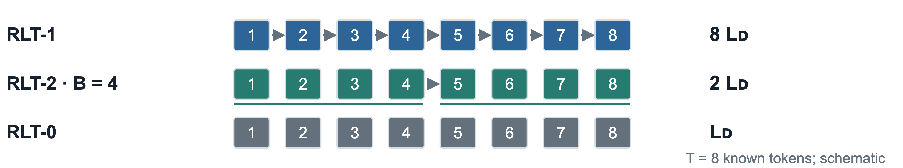
11 / RLT-1 AND RLT-2
Feedback frequency and parallelism
At Layer 4 + 4 | Feedback interval | Parity / 64 bits | Swaps-S₅ / 64 ops
RLT-1 | 1 token | 100.00 ± 0.00% | 100.00 ± 0.00%
RLT-2 | 4 tokens | 98.99 ± 1.66% | 19.60 ± 6.54%
RLT-2 shares the previous boundary state within each chunk.
Known positions in a chunk run in parallel, then its last output updates feedback.
Final-answer/state accuracy, mean ± sample SD, seeds 42–44. Same checkpoint protocol as the previous slide.
RLT / Feedback frequency
/
RLT-2 / Chunk semantics
12 / 14
Notes:
Both models have the same encoder–decoder allocation and parameters. RLT-2 changes how often feedback updates. Within a chunk, each position receives the same previous boundary feedback vector, while causal attention and KV updates remain part of the model.
Chunk size four preserves nearly all 64-bit parity accuracy at this split but sharply reduces 64-operation swap tracking. Removing feedback entirely gives 50.23 plus or minus 3.80 percent parity accuracy and near-uniform swap tracking at this length. The RLT-0 control also removes the merge parameters, making it 787,968 parameters smaller.
RLT chunking changes the recurrence and therefore the model. This differs from an SSD chunk algorithm that reorganizes evaluation of the same affine recurrence. Known-token chunks can run in parallel, while autoregressive generation still waits for newly sampled tokens. The schedule diagram describes dependencies, not measured speedups.
Sources
RLT / Feedback frequency: https://github.com/yifanzhang-pro/Recurrent-Looped-Transformer-Overleaf/blob/2367dfd6a6c211d2f3d8b9ac0b6133eb611c4b5f/contents/experiments.tex
RLT-2 / Chunk semantics: https://github.com/yifanzhang-pro/Recurrent-Looped-Transformer-Overleaf/blob/2367dfd6a6c211d2f3d8b9ac0b6133eb611c4b5f/contents/rlt2.tex
Equation source (LaTeX)

Slide 13
12 / COMPARING THE MECHANISMS
State size and parallel evaluation
Model core | Update in the previous state | Persistent memory* | Known-token evaluation
Linear attention | Additive / affine | Fixed matrix and normalizer | Prefix sums or chunked contraction
Selective SSM | Input-conditioned affine | Fixed state | Structured scan or SSD
DeltaNet | Affine rank-one edit | Fixed matrix | Structured chunk algorithm
RLT-1 | Nonlinear decoder cell | Bounded decoder state, growing encoder memory | Parallel encoder, sequential decoder
*At fixed width, depth, and local window. State sizes refer to inference, excluding training activations.
Note / Linear attention, SSD, and Delta Networks
/
RLT / State and execution
13 / 14
Notes:
This table compares the recurrent cores, with each layer's inputs held fixed when classifying affine transitions. Nonlinear feature projections, gates outside the core, and stacked layers can make the overall models nonlinear.
The fixed-state claims for linear attention, SSMs, and DeltaNet hold at fixed architectural dimensions. Their training activations can still grow with sequence length. RLT's decoder state contains a fixed-width vector and at most W minus one cached positions per SWA layer.
RLT also stores encoder memory over the entire prefix, as well as the encoder caches needed during incremental generation. It therefore does not have constant total inference memory. The full-prefix attention operations also prevent inferring linear total sequence cost from the bounded decoder state.
Sources
Note / Linear attention, SSD, and Delta Networks: https://github.com/yifanzhang-pro/A-Note-on-Linear-Attention-and-SSMs/blob/4f14583b2b6195bc884510e1b484954f28c4e7f8/main.tex
RLT / State and execution: https://github.com/yifanzhang-pro/Recurrent-Looped-Transformer-Overleaf/blob/2367dfd6a6c211d2f3d8b9ac0b6133eb611c4b5f/main.tex
Equation source (LaTeX)

Slide 14

13 / CONNECTION TO RLT
The transition determines the computation
Structured recurrent memory
Nonlinear recurrent computation
Linear attention, SSMs, and DeltaNet compress
RLT reuses a complete decoder cell across
history through structured affine updates.
tokens and retains explicit context memory.
The state-space view connects the models.
The transition’s structure determines what can be composed efficiently.
Open question: can a structured transition retain RLT’s state-tracking gains?
Zhang and Kung / Linear Attention and SSMs
/
Zhang et al. / RLT
14 / 14
Notes:
The note and RLT meet at the state-transition viewpoint. The note explains how structured updates combine compressed memory with efficient parallel evaluation. RLT makes the state transition a deep nonlinear computation conditioned on encoder memory.
The RLT experiments show that both decoder allocation and feedback frequency matter for the tested algorithmic tasks. An empirical comparison against structured SSM and DeltaNet cores would test whether those gains require the current nonlinear decoder cell. That comparison is a research question, not a result established by the reported experiments.
Sources
Zhang and Kung / Linear Attention and SSMs: https://github.com/yifanzhang-pro/A-Note-on-Linear-Attention-and-SSMs/blob/4f14583b2b6195bc884510e1b484954f28c4e7f8/main.tex
Zhang et al. / RLT: https://github.com/yifanzhang-pro/Recurrent-Looped-Transformer-Overleaf/blob/2367dfd6a6c211d2f3d8b9ac0b6133eb611c4b5f/main.tex
Equation source (LaTeX)
h_t=A_t h_{t-1}+c_t
H_t=\mathcal F_\Theta(H_{t-1};e_t,M_{\le t},t)

