Slide 1
M2
Zeduo Yu Pengyang Zhou Xiwei Wang
zeduoyu2 pz6 xiwei2
ECE411 MP4 Demonstration

Slide 2
Overview
Out-of-order CPU with Reorder Buffer.
A branch predictor utilizing local branch history table and return address stack.

Slide 3
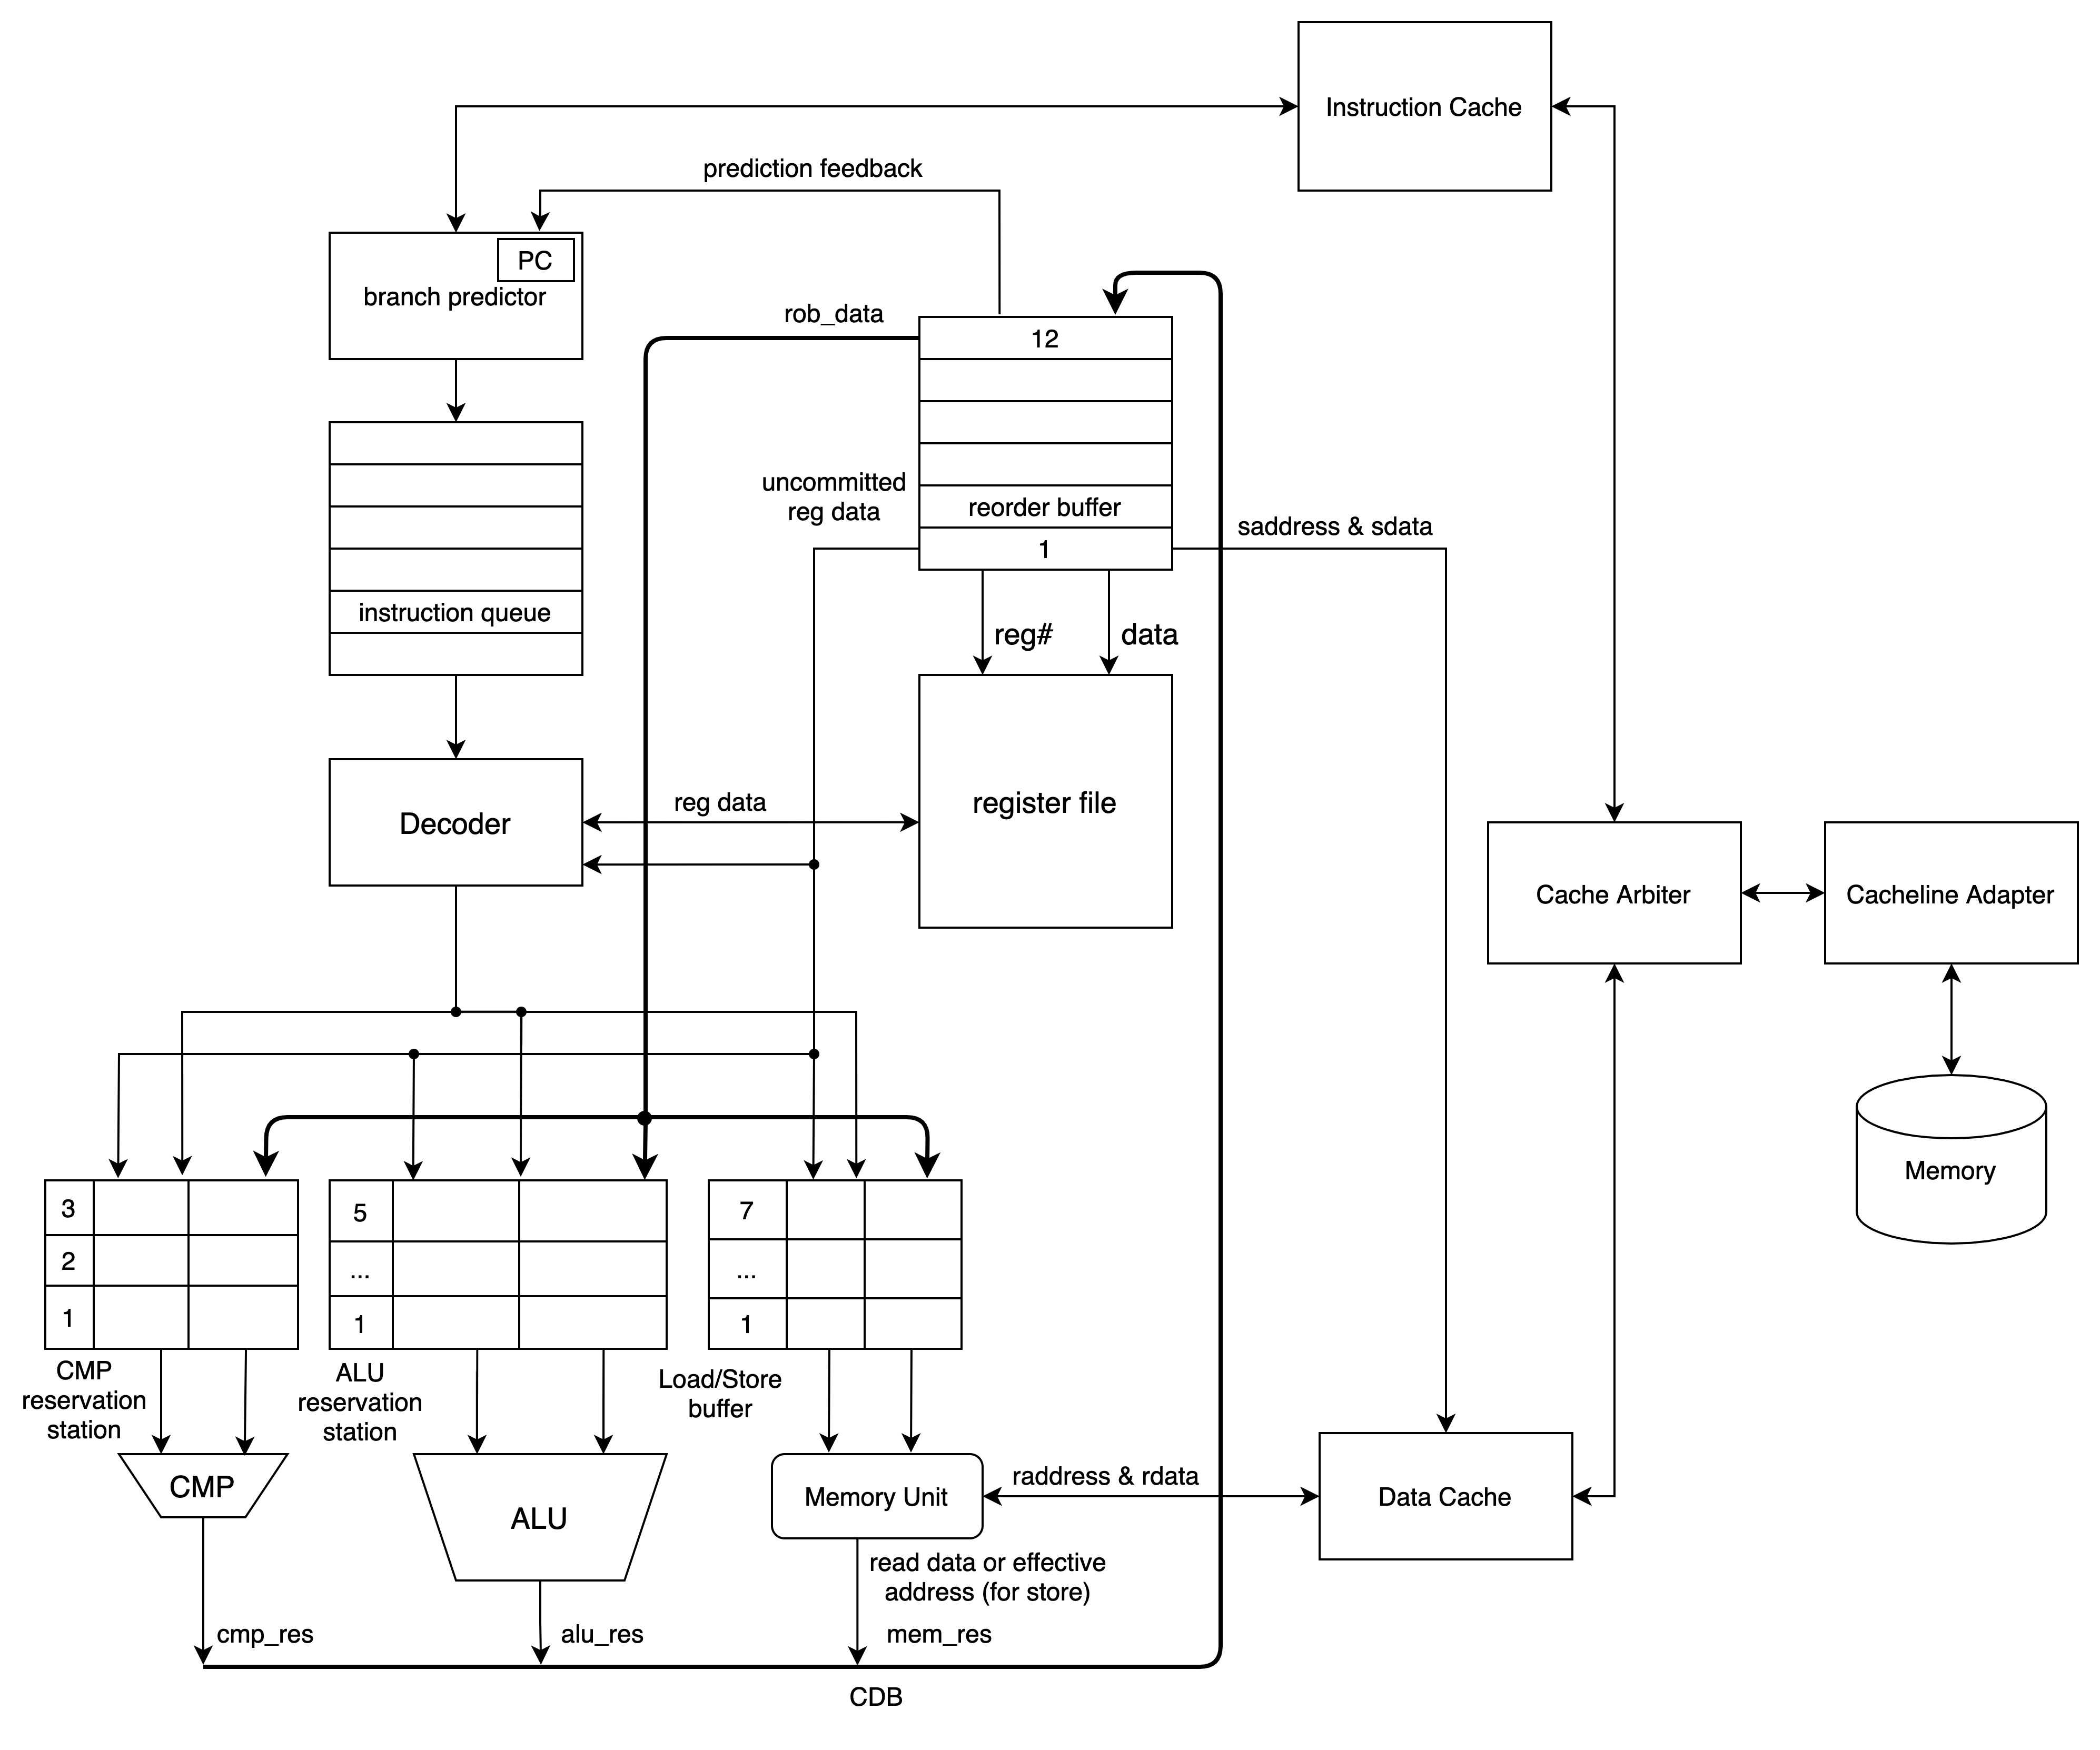
Feature 1, Out-of-order Execution.
Diagram >

Slide 4
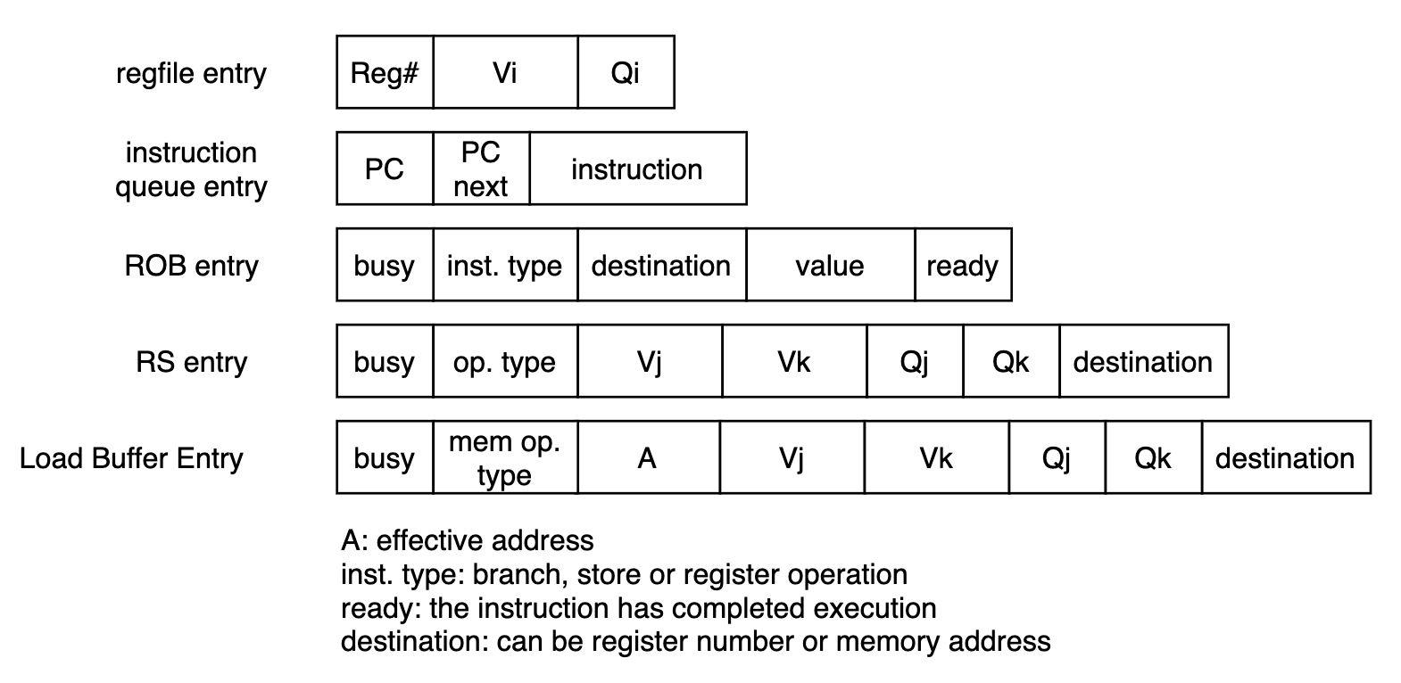
Feature 1, Out-of-order Execution.
Reservation Station Definition >

Slide 5
Feature 1, Out-of-order Execution.
Challenges >
1. CDB complexity.
2. Fitting the design.
3. Edge case timing.
4. Debug difficulty.
😭
Notes:
flush timing. register read and write.

Slide 6
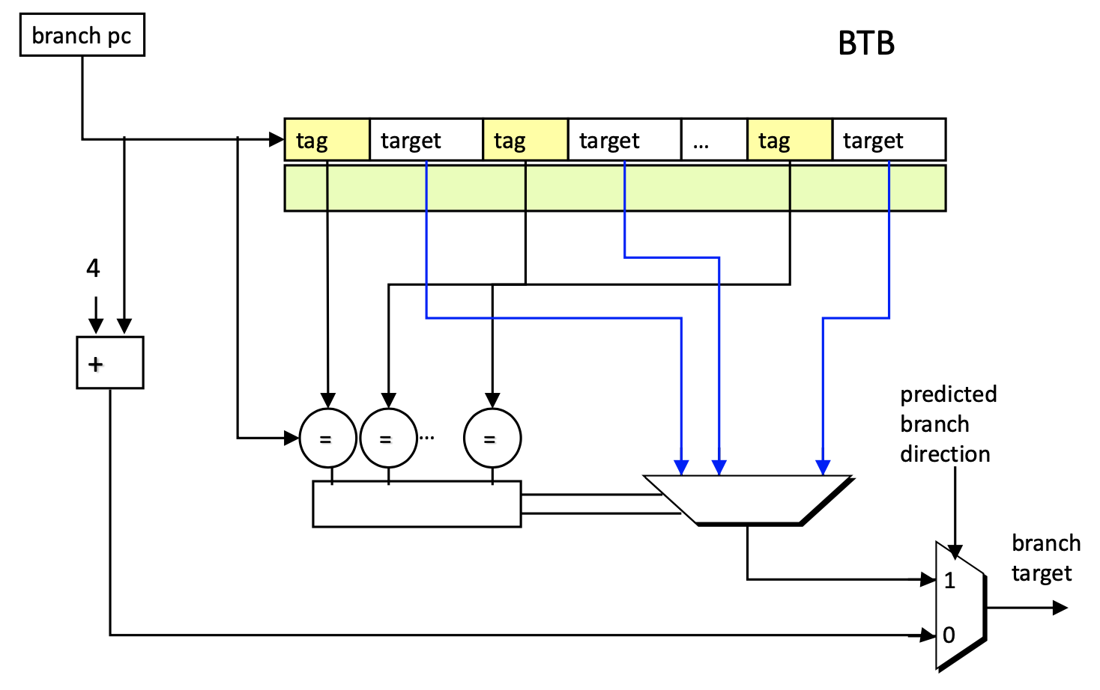
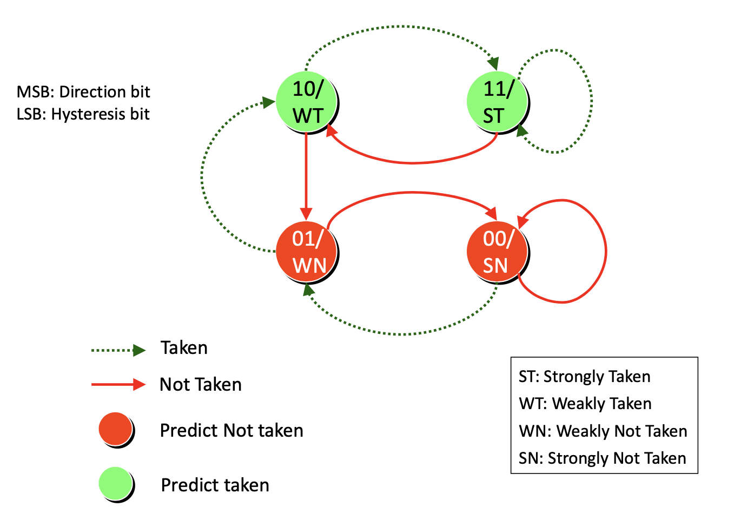
Feature 2, Branch Predictor.
Diagram >
BR type

Slide 7
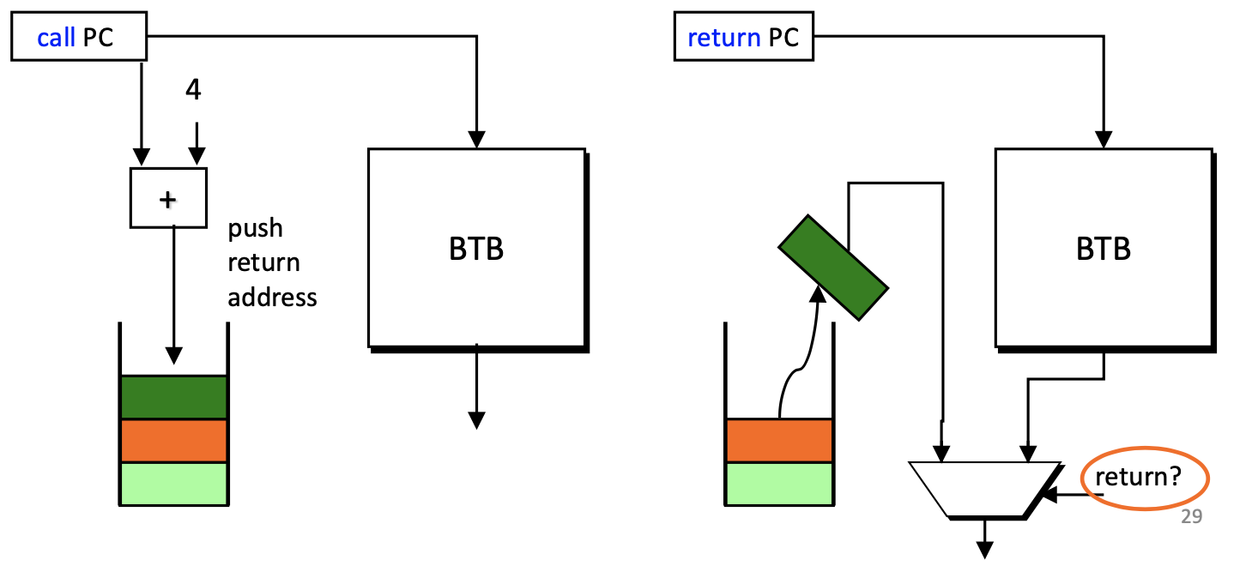
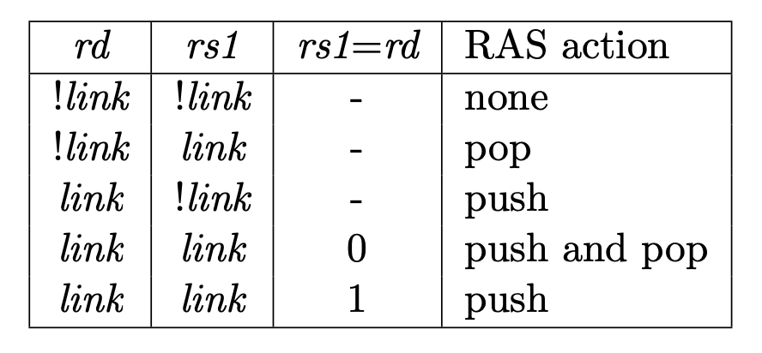
Feature 2, Branch Predictor.
Diagram >
JALR type

Slide 8
Feature 2, Branch Predictor.
Performance >
Accuracy¹ | Comp1 | Comp2_i | Comp3
Our design | 89.52% | 84.39% | 89.12%
1. Include JAL/JALR operations.

Slide 9
Feature 2, Branch Predictor.
Challenges >
1. Critical path.
2. JALR handling.

Slide 10
Overall Performance
Time/ns | Comp1 | Comp2_i | Comp3
Our design | 702,920 | 3,040,950 | 894,860
Baseline | 720,755 | 4,521,285 | 3,639,265
MP2 | 14,563,465 | 28,469,605 | 17,763,205
4.1x
faster execution speed¹
Up to
1. Compared to baseline implementation

Slide 11
Overall Performance
Power/mw | Comp1 | Comp2_i | Comp3
Our design | 979.21 | 949.26 | 960.27
Baseline | 448.44 | 430.48 | 425.27
2x
More power consumption
But about

Slide 12
Overall Performance
Score¹ | Comp1 | Comp2_i | Comp3
Our design | 3.10E-10 | 2.44E-8 | 6.28E-10
Baseline | 1.68E-10 | 3.98E-8 | 2.05E-8
32x
faster execution speed²
Up to
Use Fmax = 103.11MHz of model “Slow 900mV 100C”
Compared to baseline.

Slide 13
Competition Score
Gem Mean = (3.10E-10 x 2.44E-8 x 6.28E-10)^(1/3)
1.681E-9
3.1x
That is better than the baseline score (5.15E-09).

Slide 14
What if…
Superscalar? Put more demand on instruction cache and resources. But a chance to achieve higher performance.
L2 cache? May provide higher hit rate. But our caches are good enough.
Non-blocking cache? Requires tremendous effort and resources. Would try it if more time was given.
Simultaneous commit? Commit multiple instructions at the same time. Too much complexity.

Slide 15
Q&A
Thank you for listening.

