Slide 1
Preparatory work of MFT QC Operation
Pengyao Cui

Slide 2

What I had done
Generate 10 000 events
Got root files: mfttracks.root, mftclusters.root et. al.
Got root file:RCut_0.0100/MFTEffCheck.root
Got eps files

Slide 3
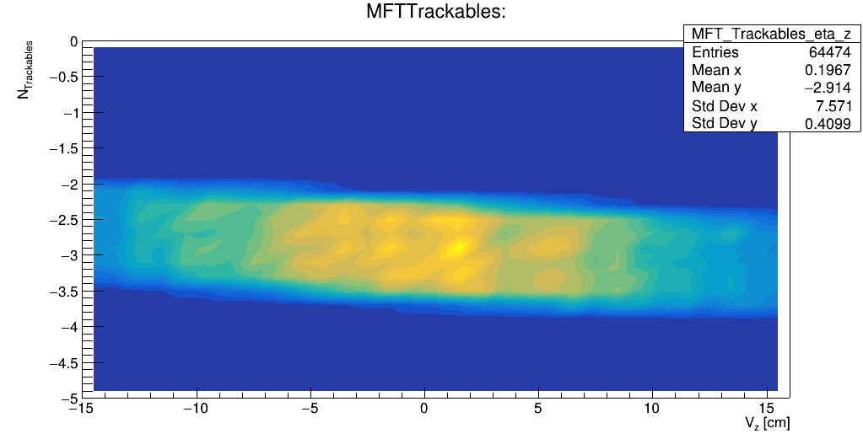
Some of plots in MFTEffCheck.root

Slide 4
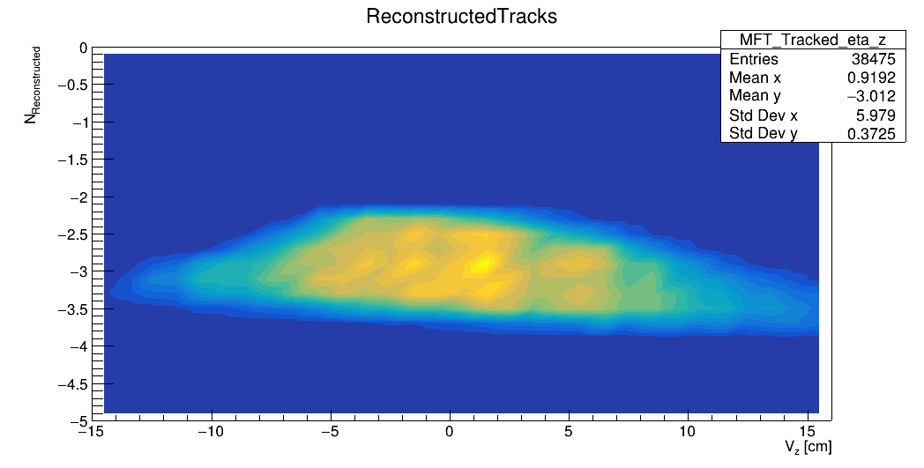
Some of plots in MFTEffCheck.root

Slide 5
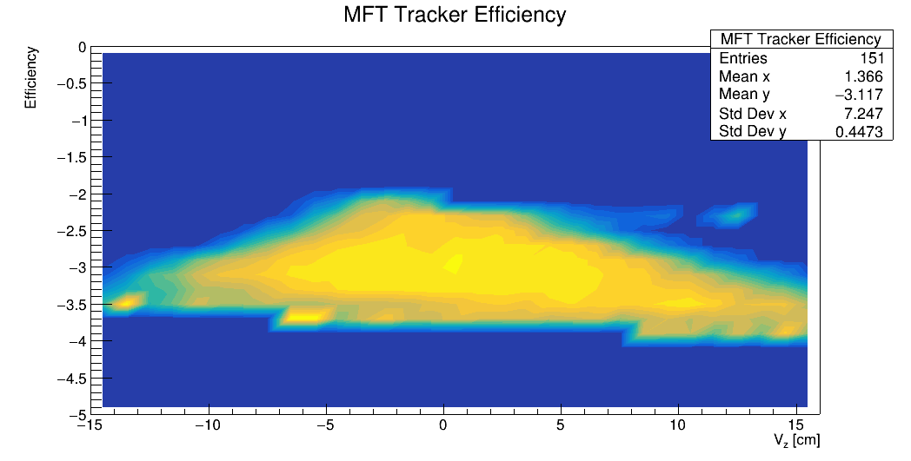
Some of plots in MFTEffCheck.root

Slide 6
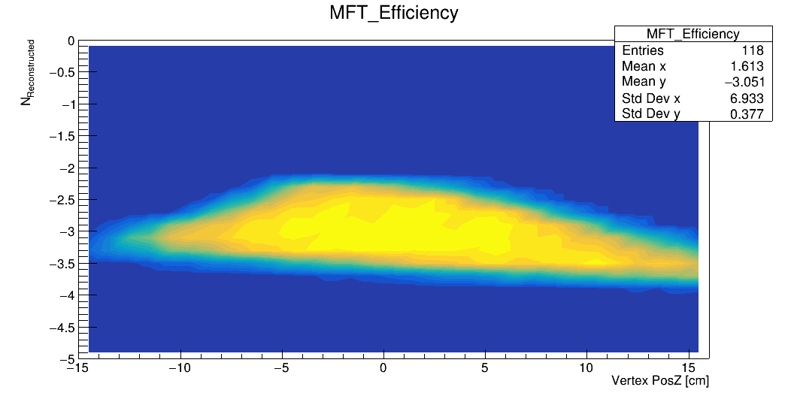
Some of plots in MFTEffCheck.root

Slide 7
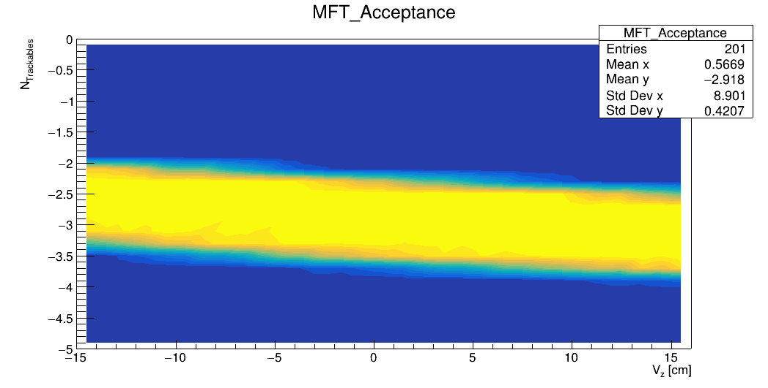
Some of plots in MFTEffCheck.root

Slide 8
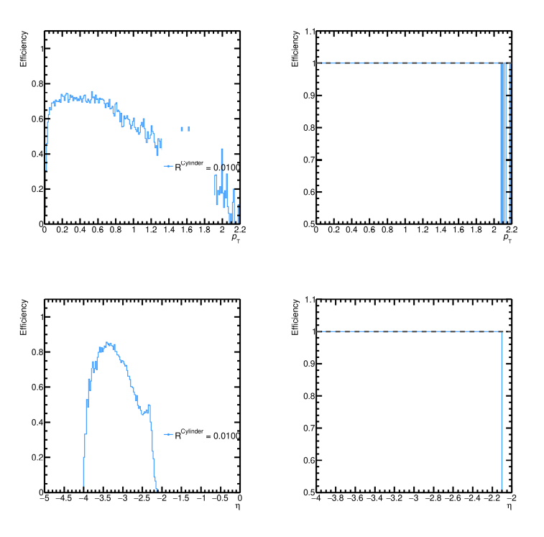
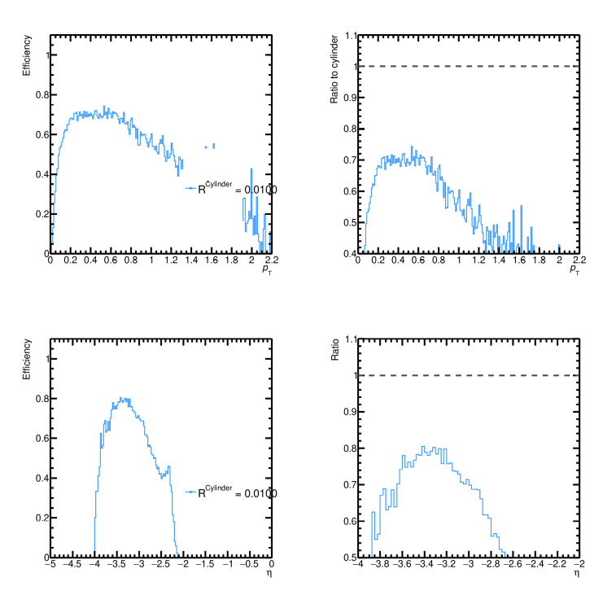
Got plots run CompToAE.C

Slide 9
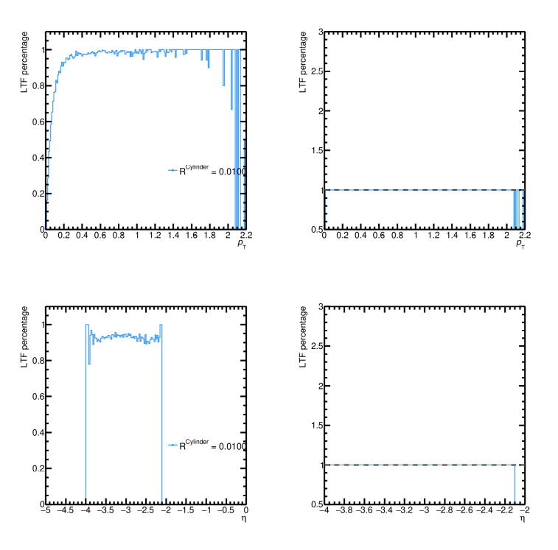
Got plots run CompToAE.C

