Slide 1
Preparatory work of MFT QC Operation
Pengyao Cui

Slide 2
Generate events
Generate 50 000 event with pythia 8 generator
Convert generated level to reconstructed level
Run reconstruction workflow — Get reconstructed track
Got root files: mfttracks.root, mftclusters.root et. al.

Slide 3
Analysis generated events
Run MFTFitterTrackerChecker.C analyze the generated event through loop each events and MFT tracks to get need plots

Slide 4
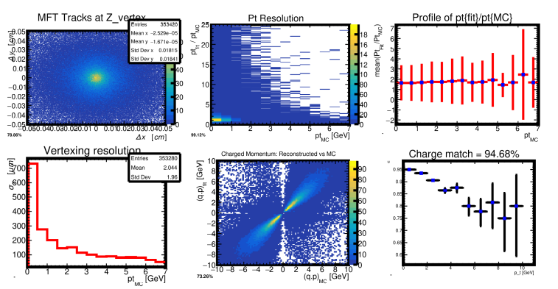
Some of plots I got
Parameters summary

Slide 5
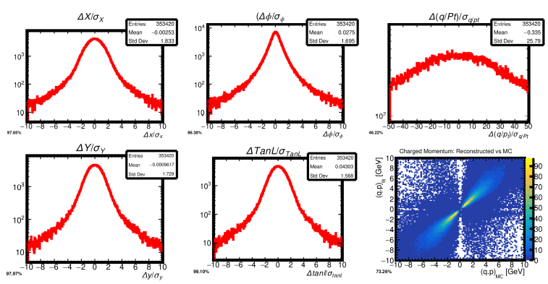
Some of plots I got
Covariance summary

Slide 6
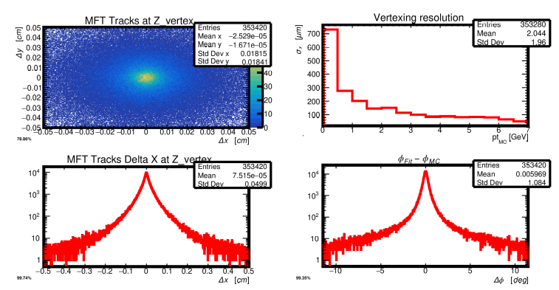
Some of plots I got
Vertex information

