Slide 1
Study strange particle in jet
Changed to TTree
50 M events pp 7 TeV

Slide 2
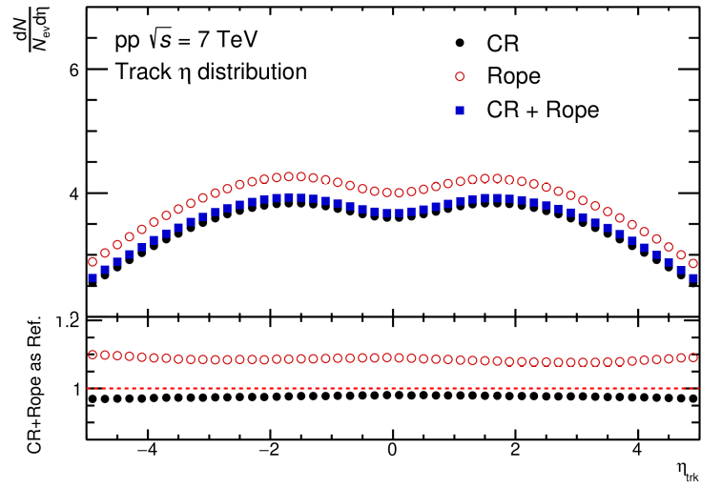
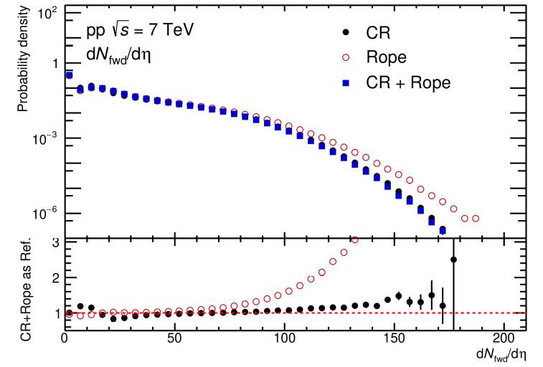
Tracks
Track eta distribution in MB events
Forward tracks dNdeta distribution

Slide 3
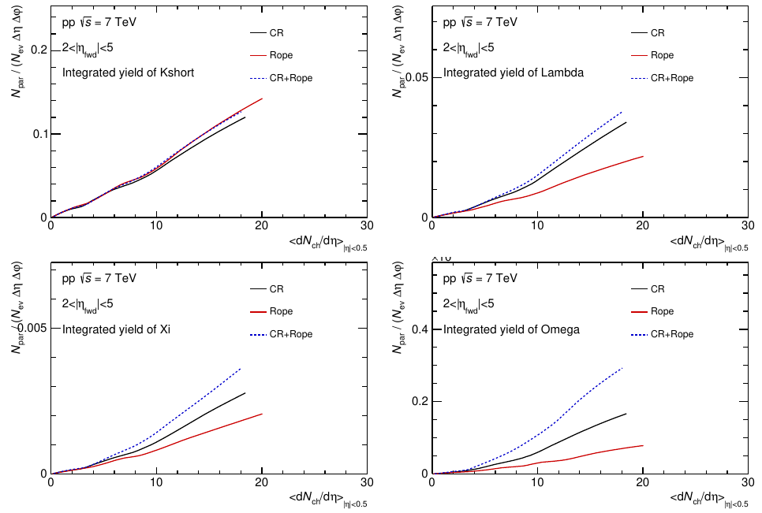
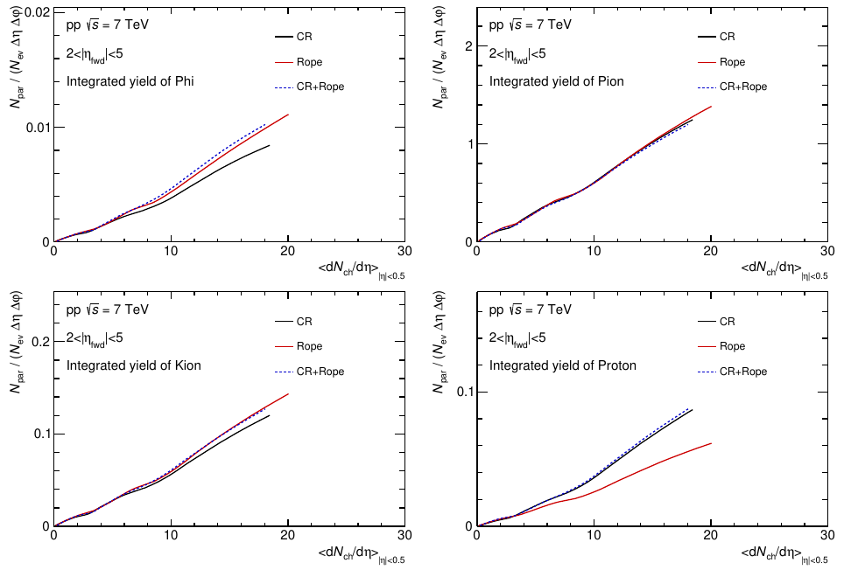
Integrated yield vs <dNdeta>
Integrated yield of some interest particles

Slide 4
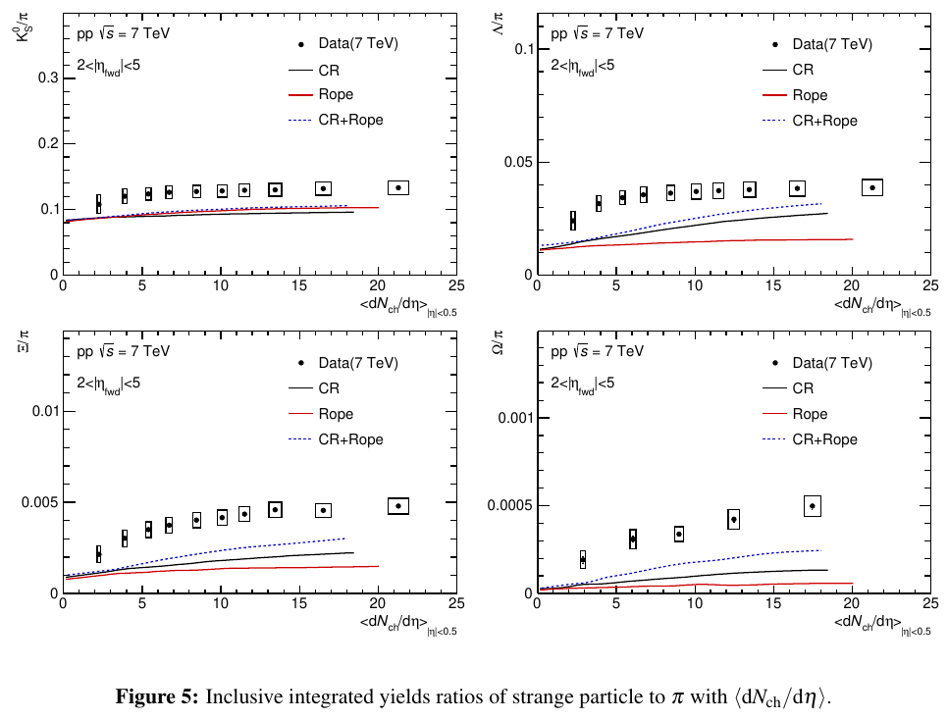
Particle-to-pion ratios with <dNdeta>
Data taken from 1606.07424v2

Slide 5
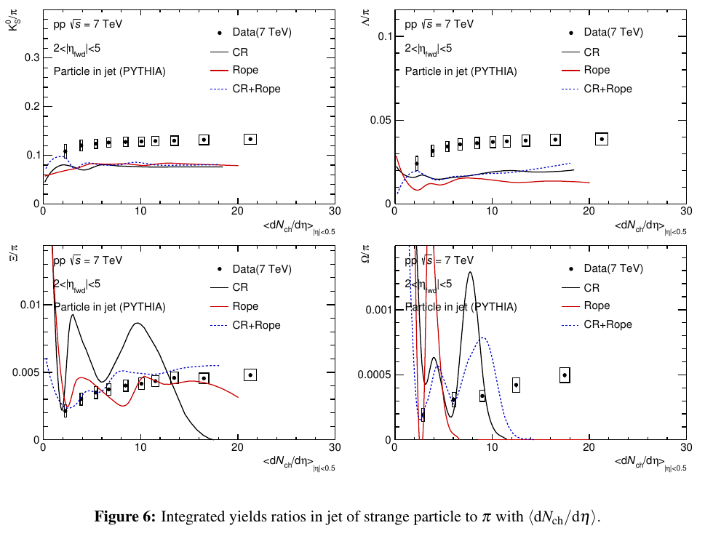
Particle-to-pion ratios in jet with <dNdeta>
Data for inclusive results
Kshort and Lambda to pion ratio almost independent with <dN/deta>
Xi and Omega to pion ratio is unreasonable

Slide 6
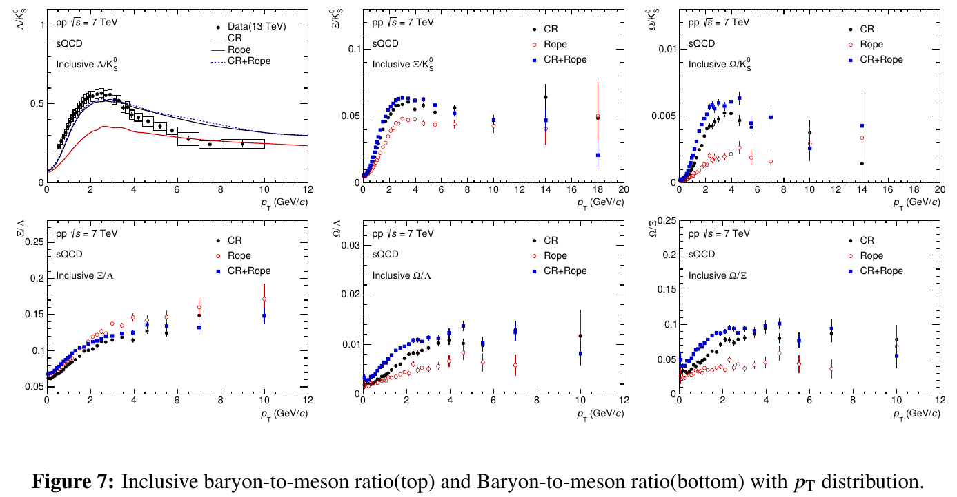
Inclusive particle ratio with pT distribution
Only find data point of Lambda/Kshort in 13 TeV from 2005.11120

Slide 7
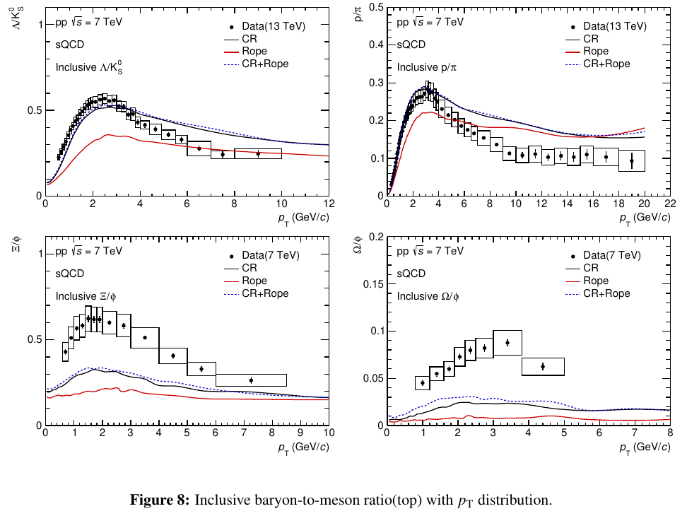
Inclusive particle ratio with pT distribution
Baryon to meson ratios with different setting
Data point taken from 2005.11120

Slide 8
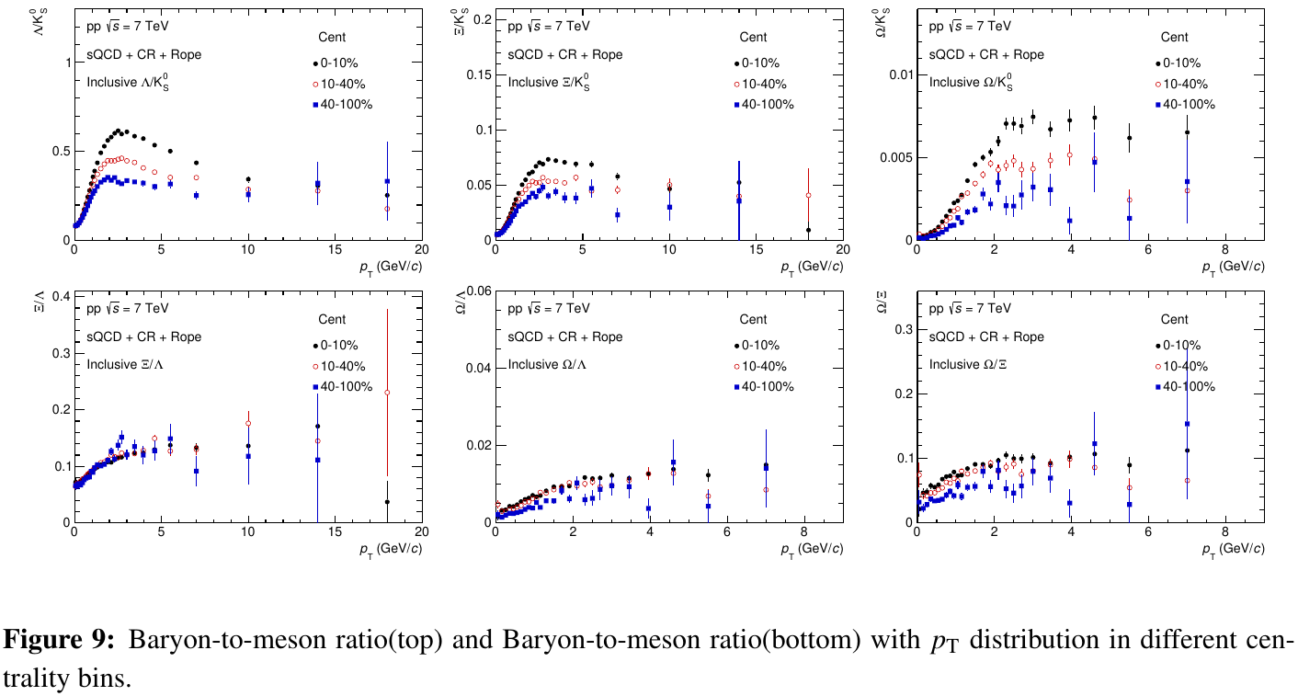
Particle ratio in different centrality bin

Slide 9
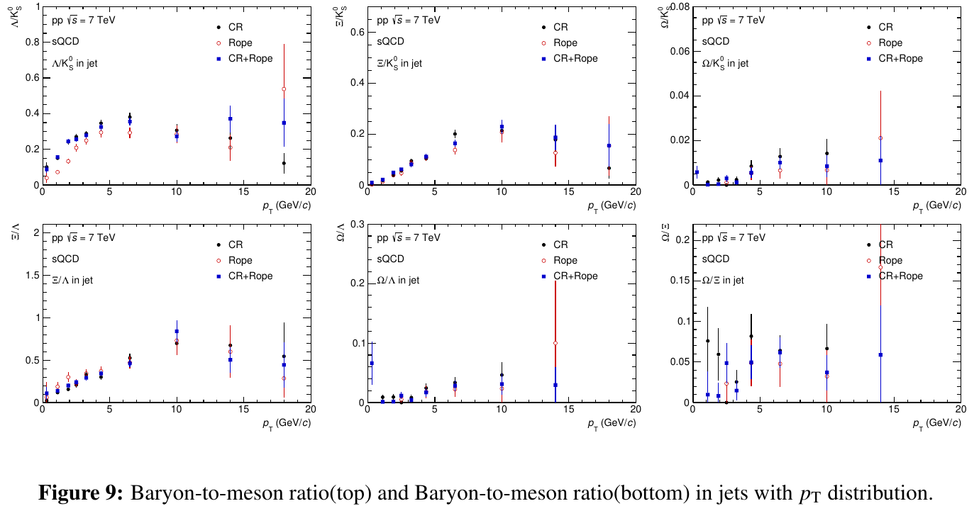
Particle ratio in jet with pT distribution

Slide 10
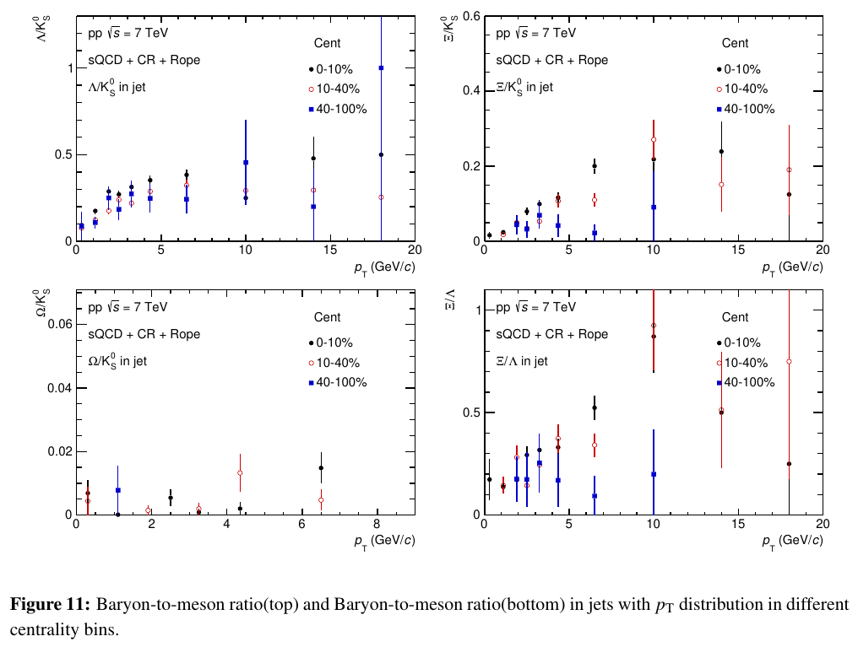
Particle ratio in jet with different centrality bin
For Omega didn’t have enough statistics

