Slide 1
Study strange particle in jet
150 M events pp 7 TeV
New updated
To be updated

Slide 2
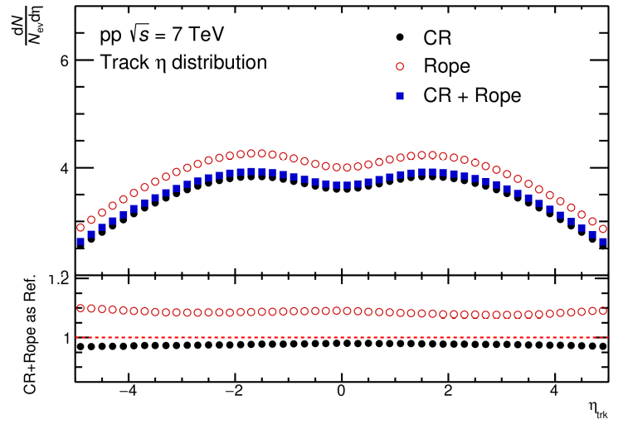
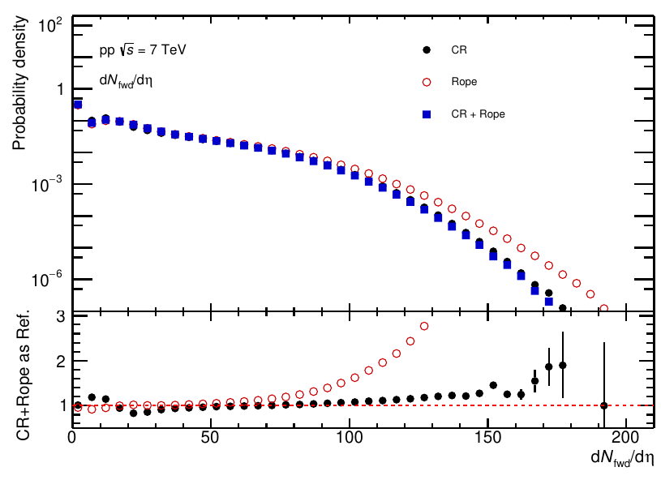
Tracks
Track eta distribution in MB events
Forward tracks dNdeta distribution

Slide 3
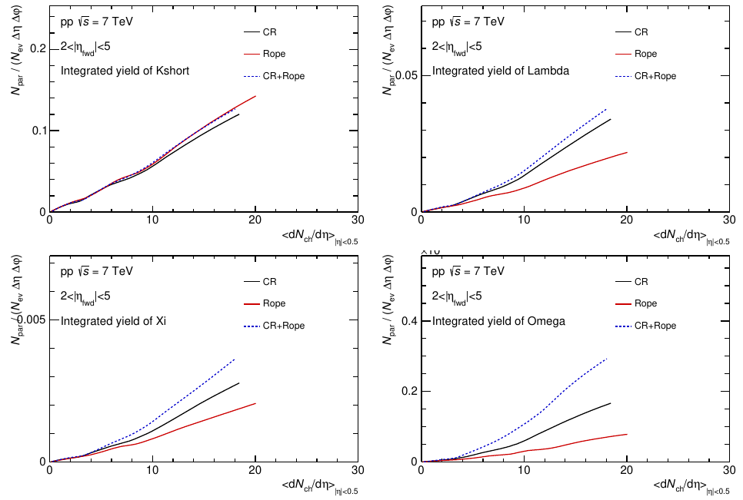
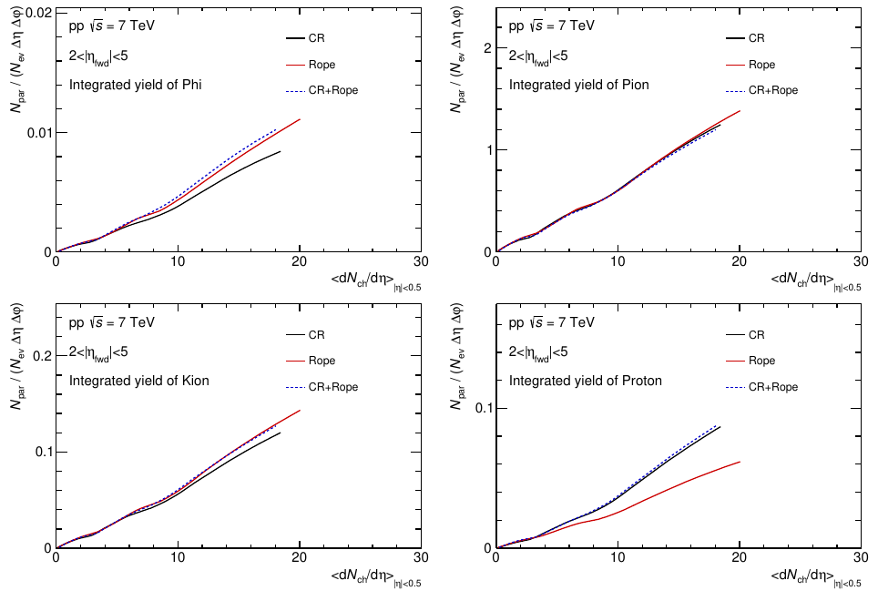
Integrated yield vs <dNdeta>
Integrated yield of some interest particles (compare to Data)

Slide 4
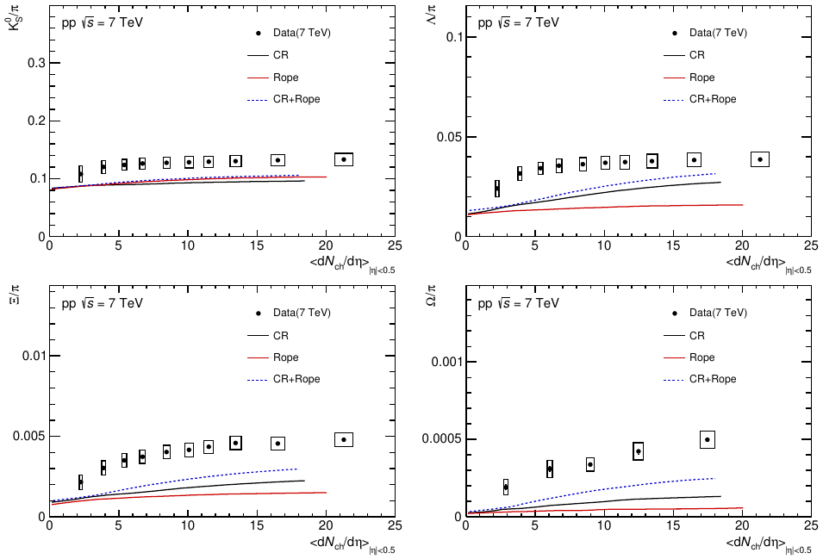
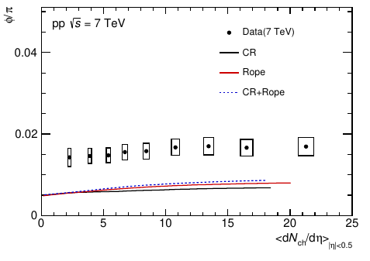
Particle-to-pion ratios with <dNdeta>

Slide 5
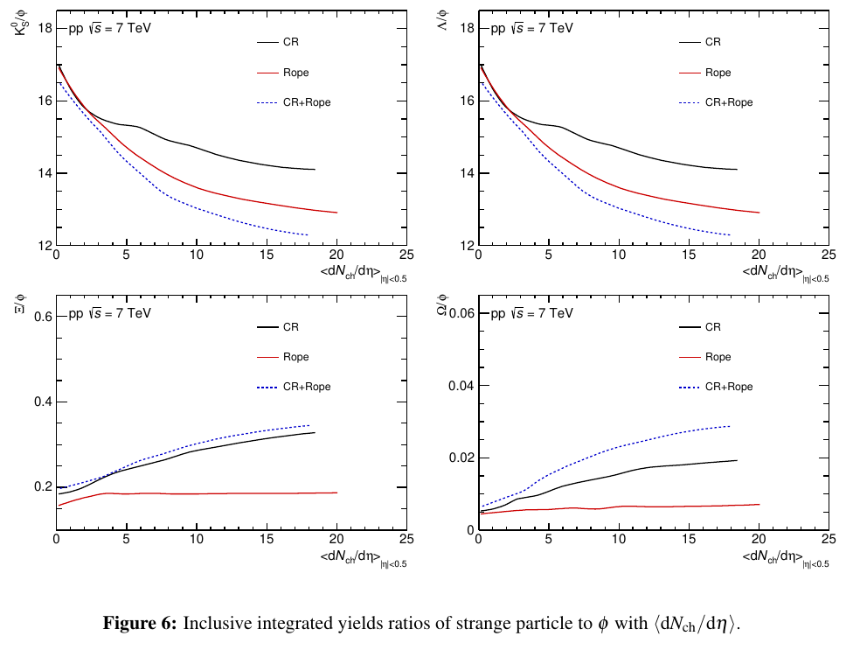
Strange particle to phi ratio with <dNdeta>

Slide 6
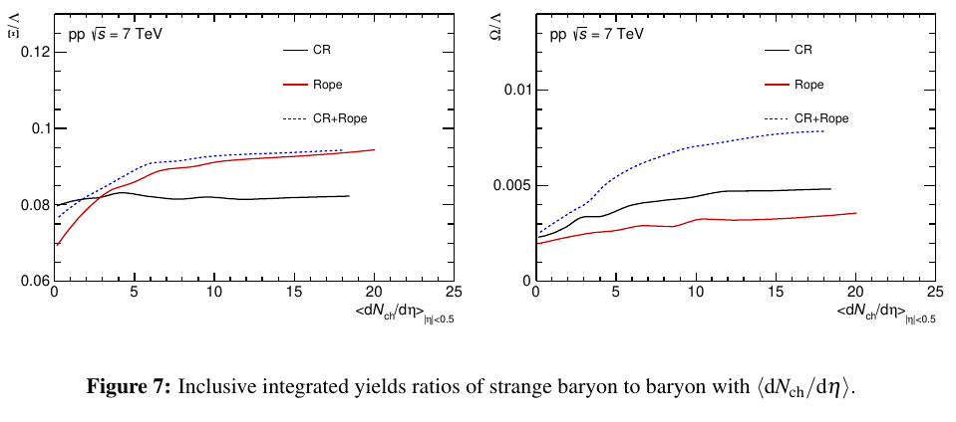
Strange baryon to baryon ratio with <dNdeta>

Slide 7
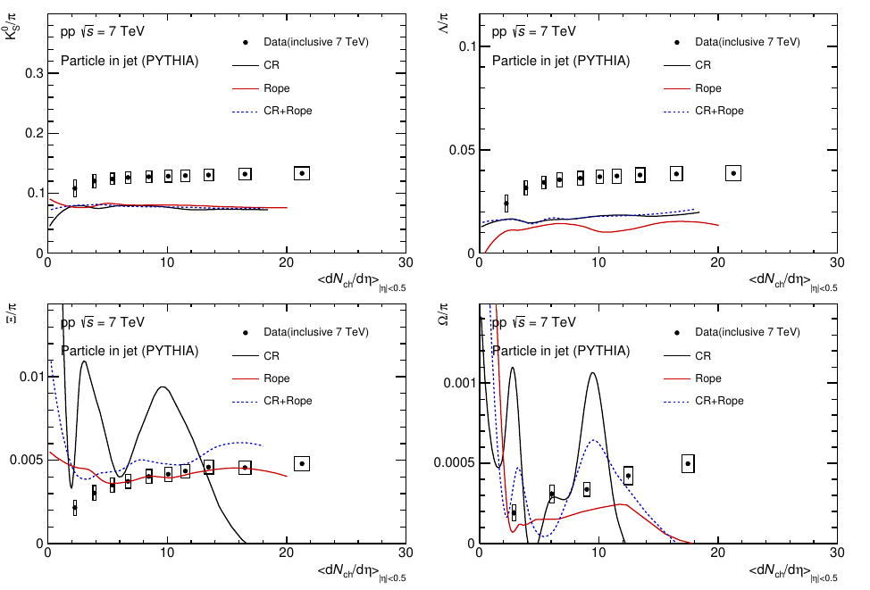
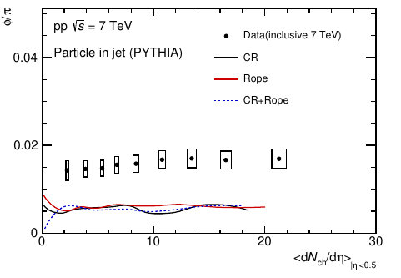
Particle-to-pion ratios in jet with <dNdeta>
Kshort, Lambda and phi to pion ratio almost independent with <dN/deta>
Xi and Omega still lack of statistics

Slide 8
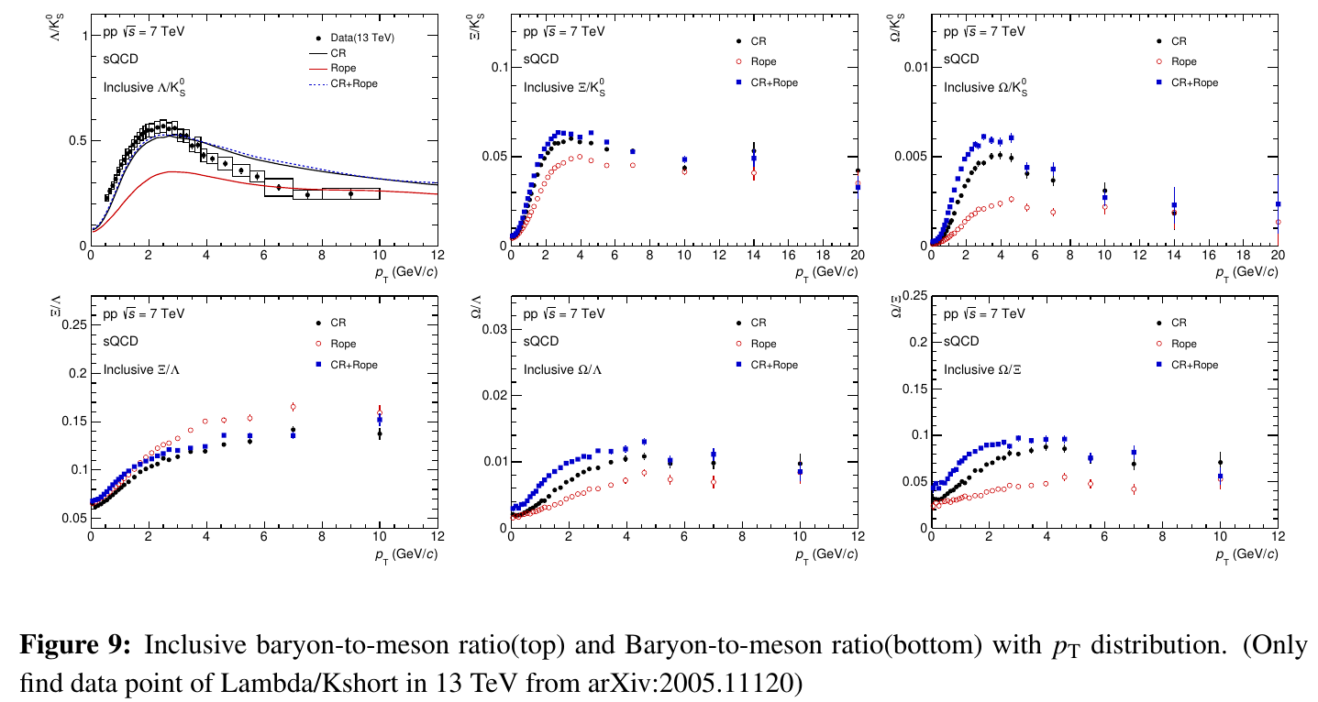
Inclusive particle ratio with pT distribution

Slide 9
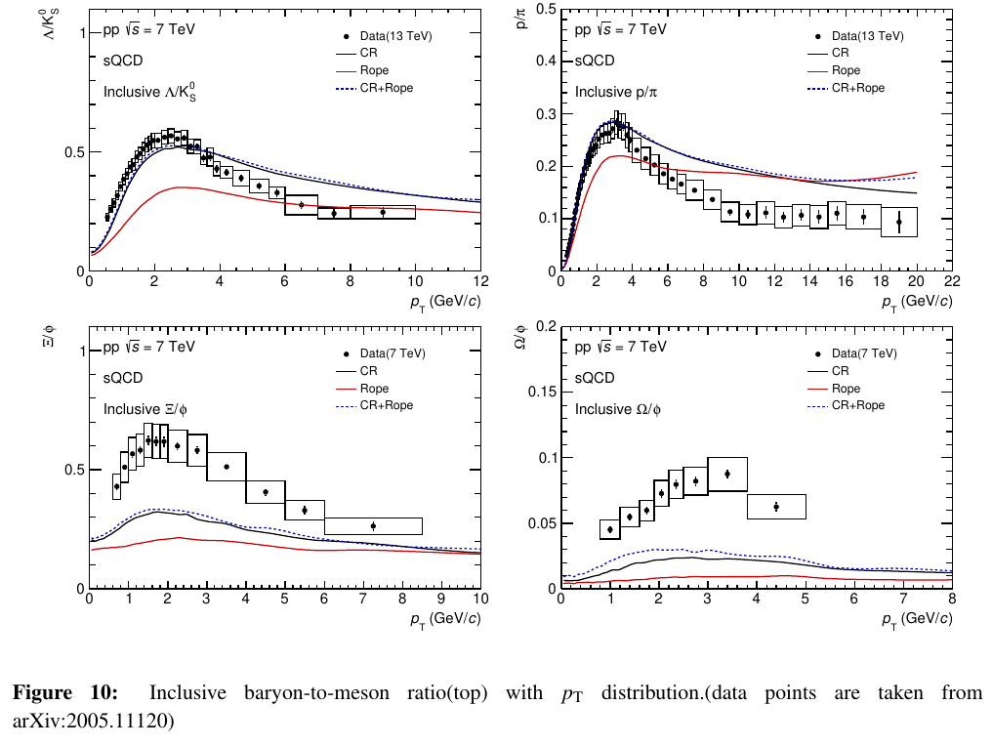
Inclusive particle ratio with pT distribution

Slide 10
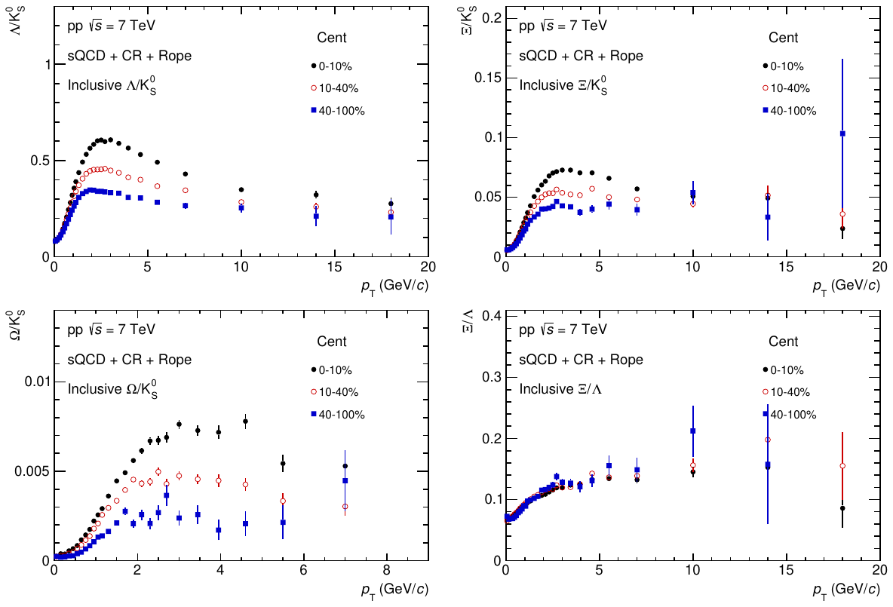
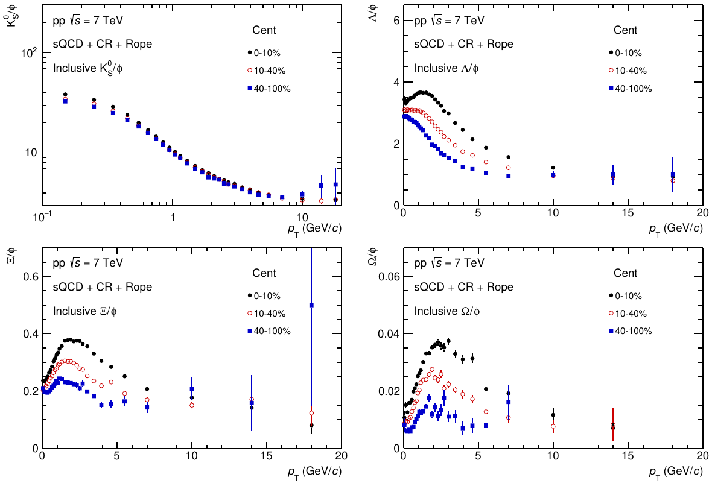
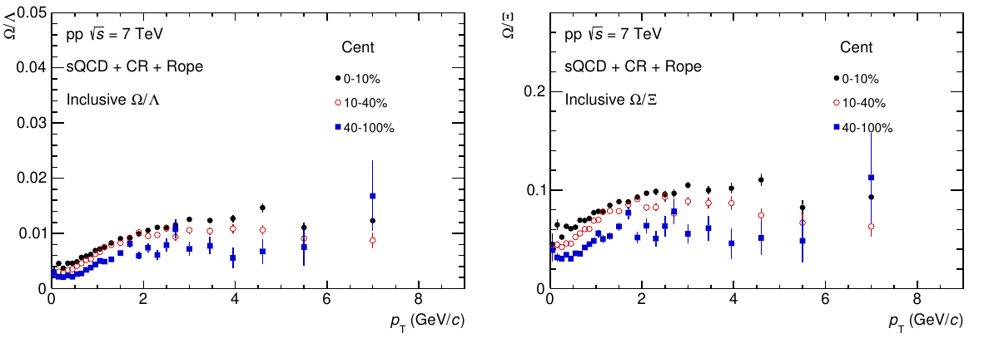
Particle ratio in different centrality bin
CR+Rope
BB and BM with pT distribution

Slide 11
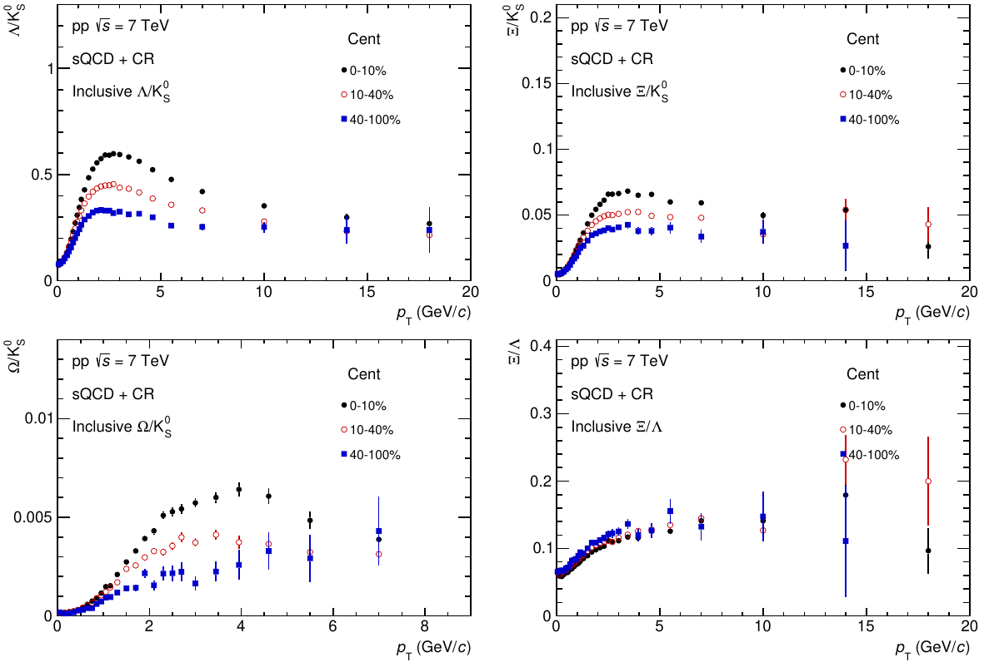
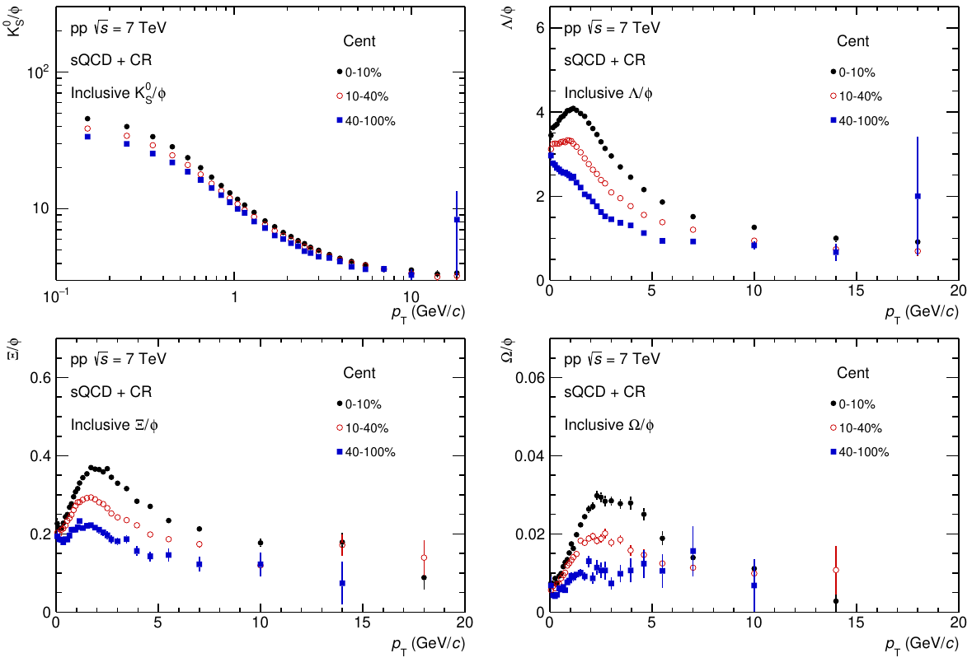
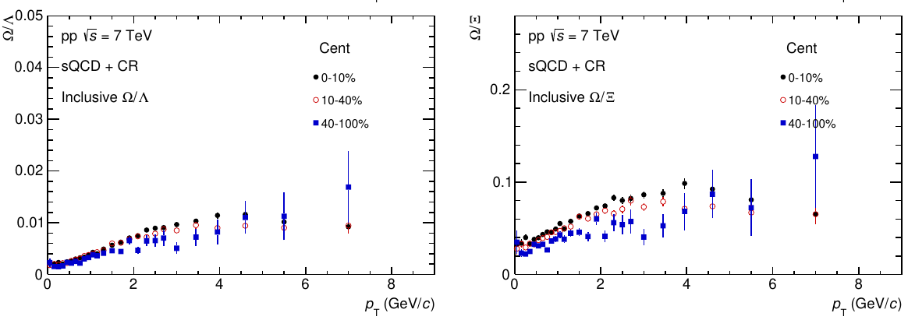
Particle ratio in different centrality bin
CR
BB and BM with pT distribution

Slide 12
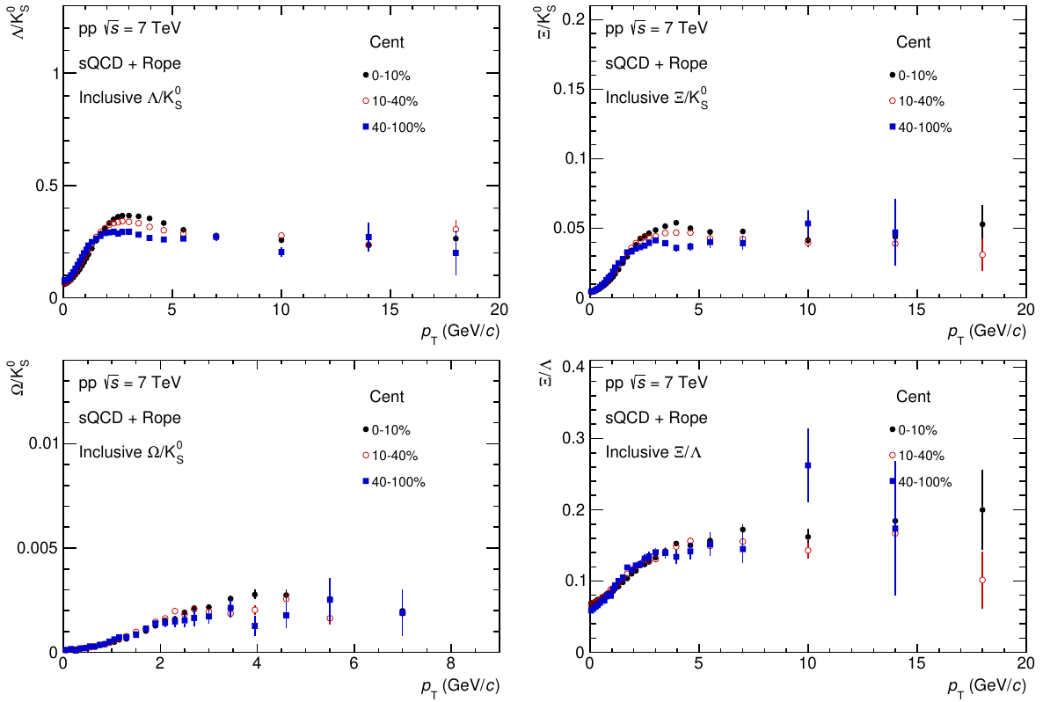
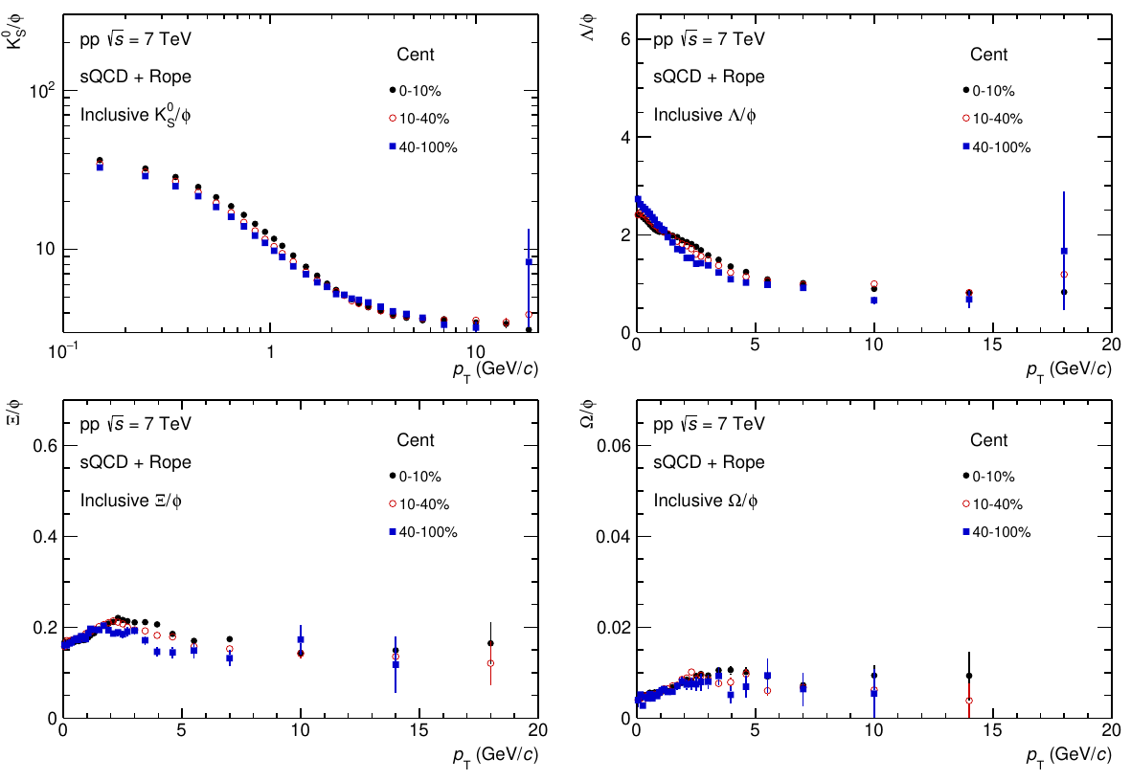
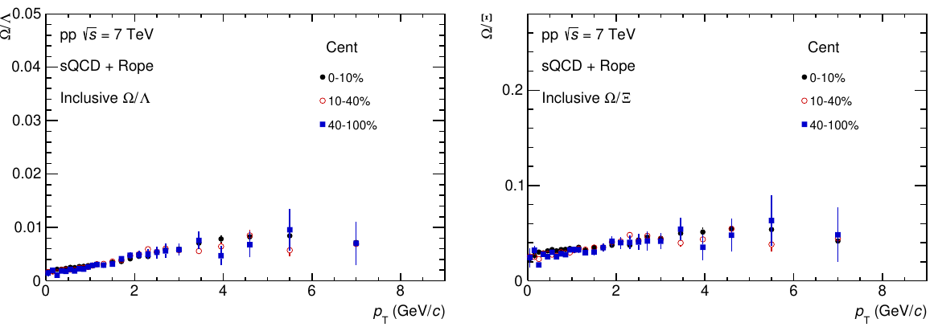
Particle ratio in different centrality bin
Rope
BB and BM with pT distribution

Slide 13
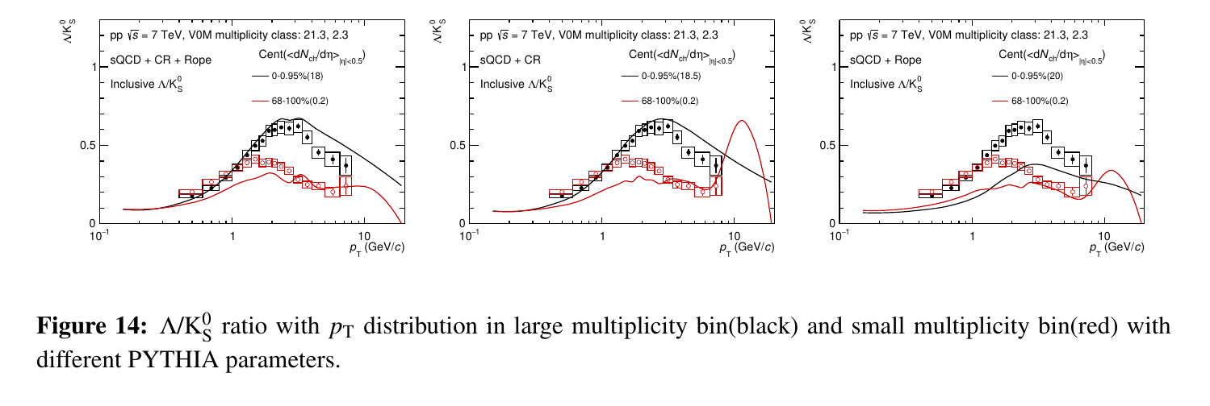
Lambda/Kshort with multiplicity bin

Slide 14
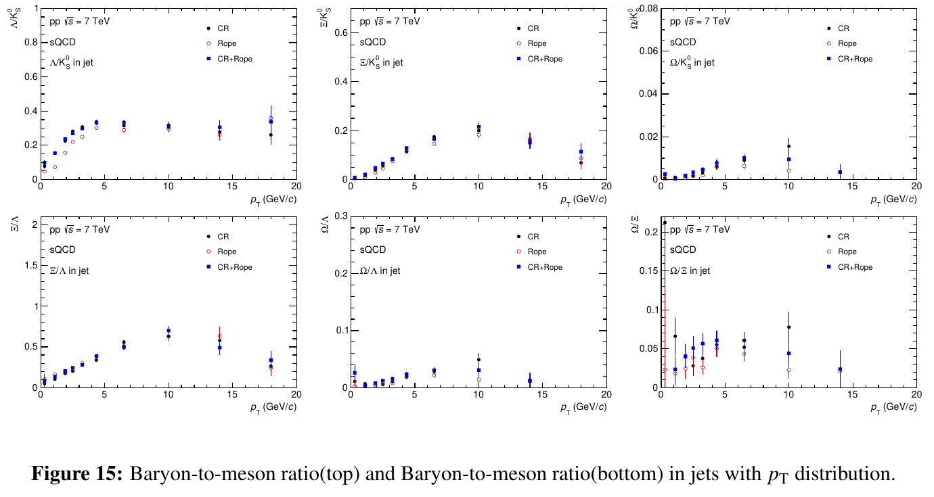
Particle ratio in jet with pT distribution

Slide 15
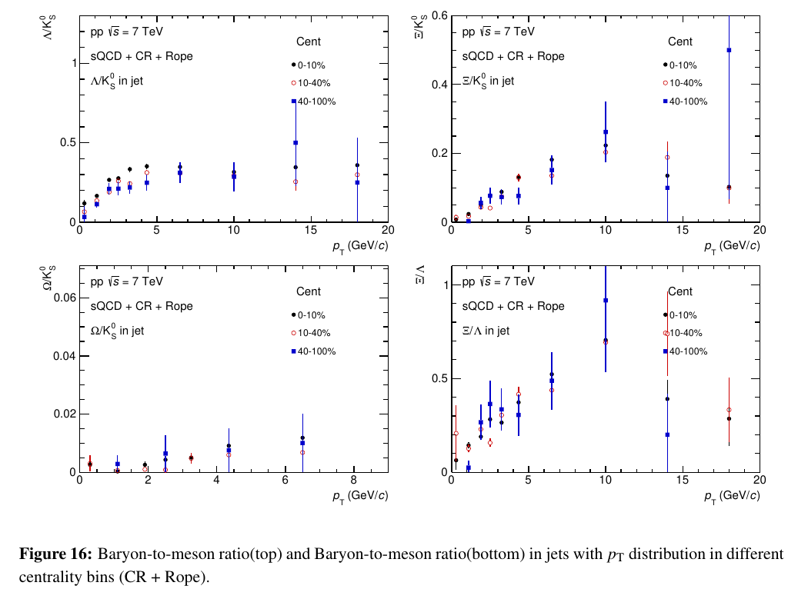
Particle ratio in jet with different centrality bin
CR+Rope

Slide 16
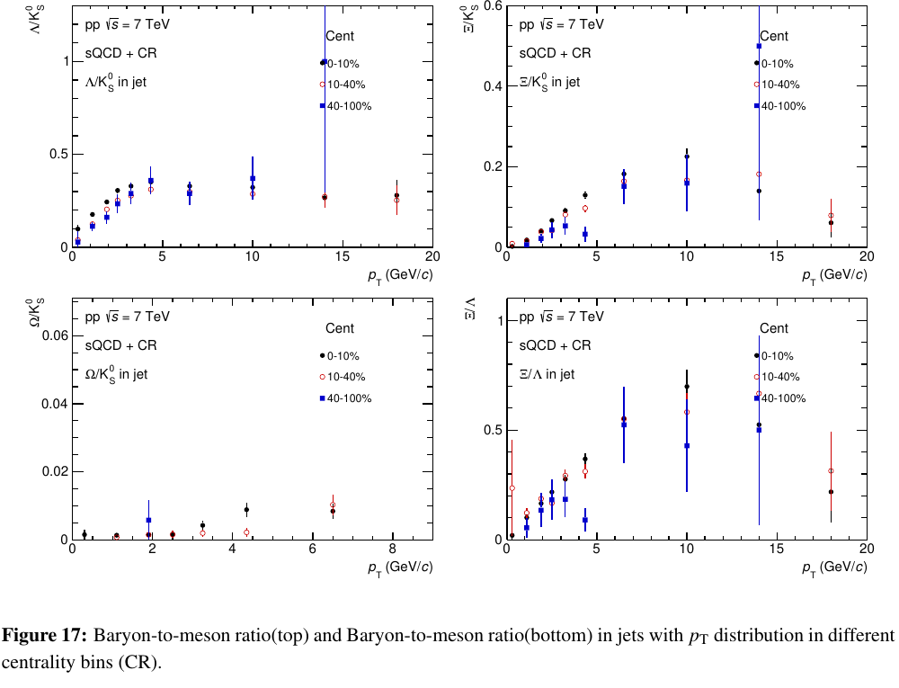
Particle ratio in jet with different centrality bin
CR

Slide 17
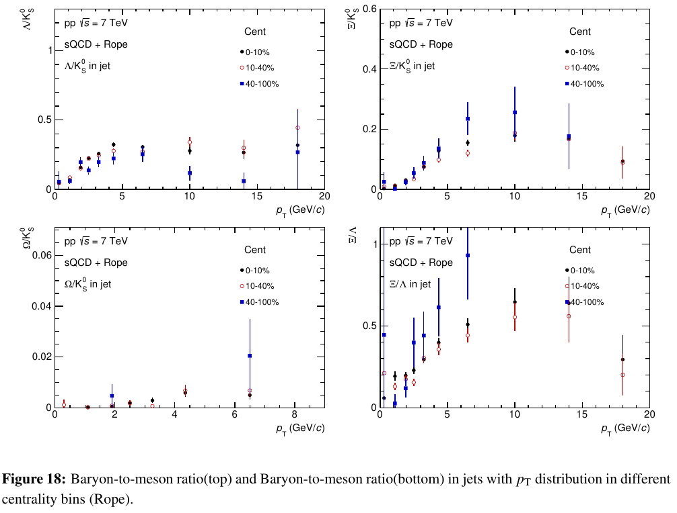
Particle ratio in jet with different centrality bin
Rope

