Slide 1
Study strange particle in jet
Changed to TTree
50 M events pp 7 TeV

Slide 2
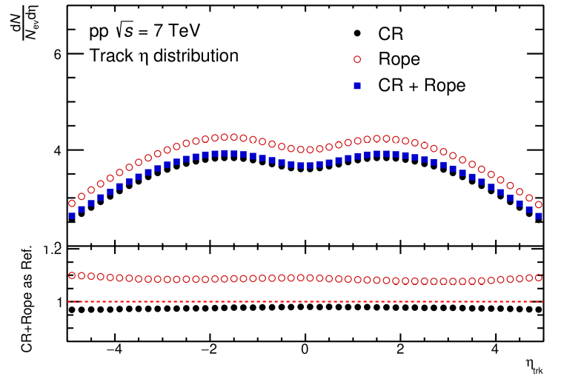
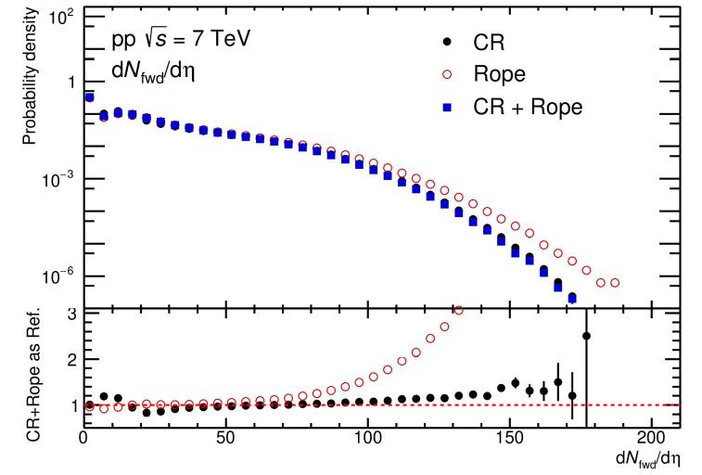
Tracks
Track eta distribution in MB events
Normalized to probability density
No significant different between different settings

Slide 3
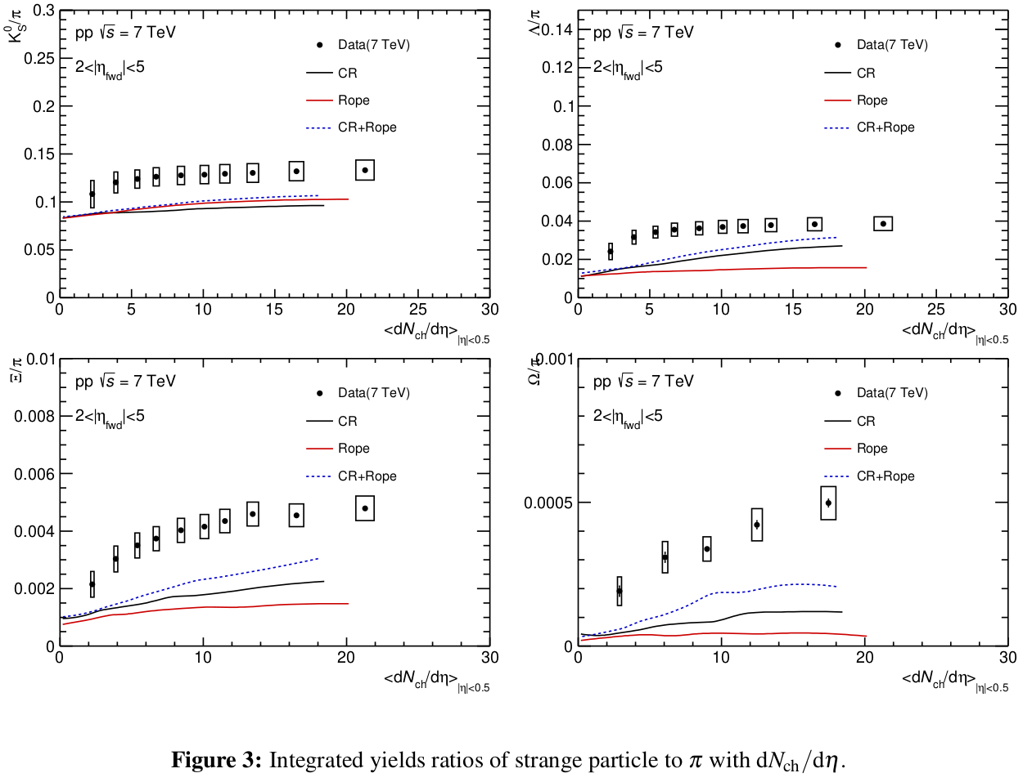
Inclusive integrated yield
Particle-to-pion ratios with dNdEta distribuiton

Slide 4
Integrated yield to pion ratio
Particle-to-pion ratios with dNdEta distribuiton

Slide 5
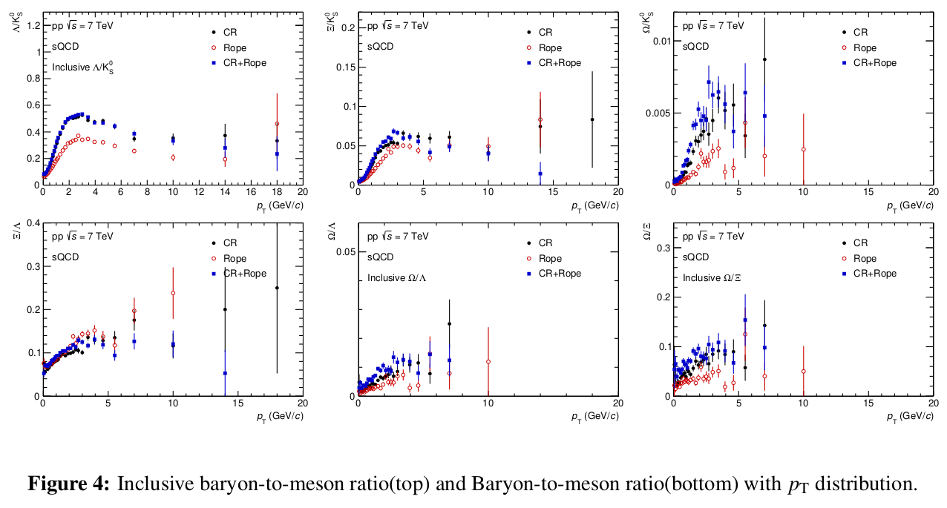
Inclusive particle ratio with pT distribution

Slide 6
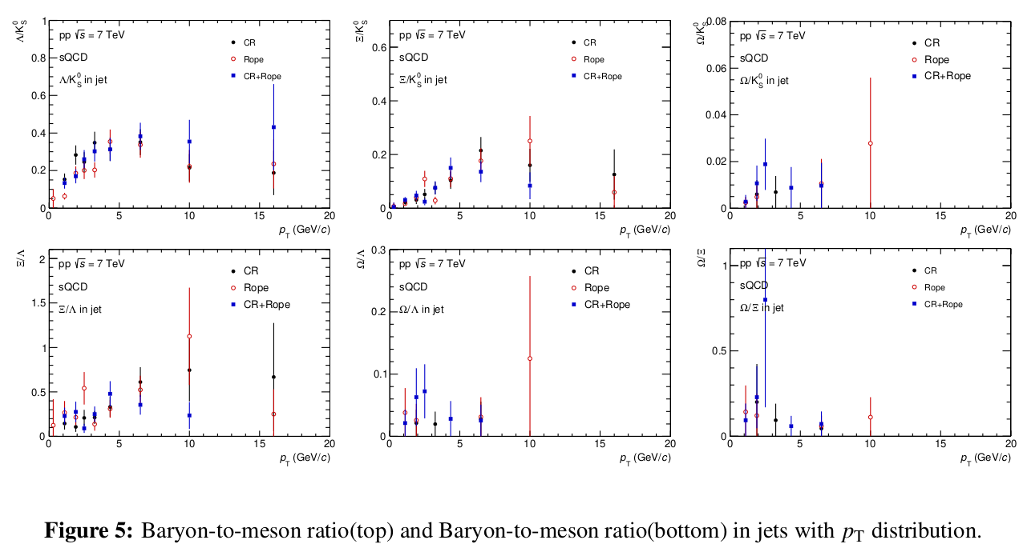
Particle ratio in jet with pT distribution

