Slide 1
Study strange particle in jet
THnSparse need large computer memory
5 M events pp 7 TeV

Slide 2
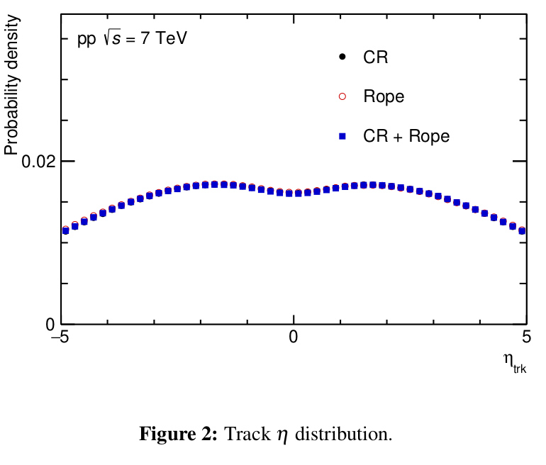
Track eta distribution
Track eta distribution in MB events
Normalized to probability density
No significant different between different settings

Slide 3
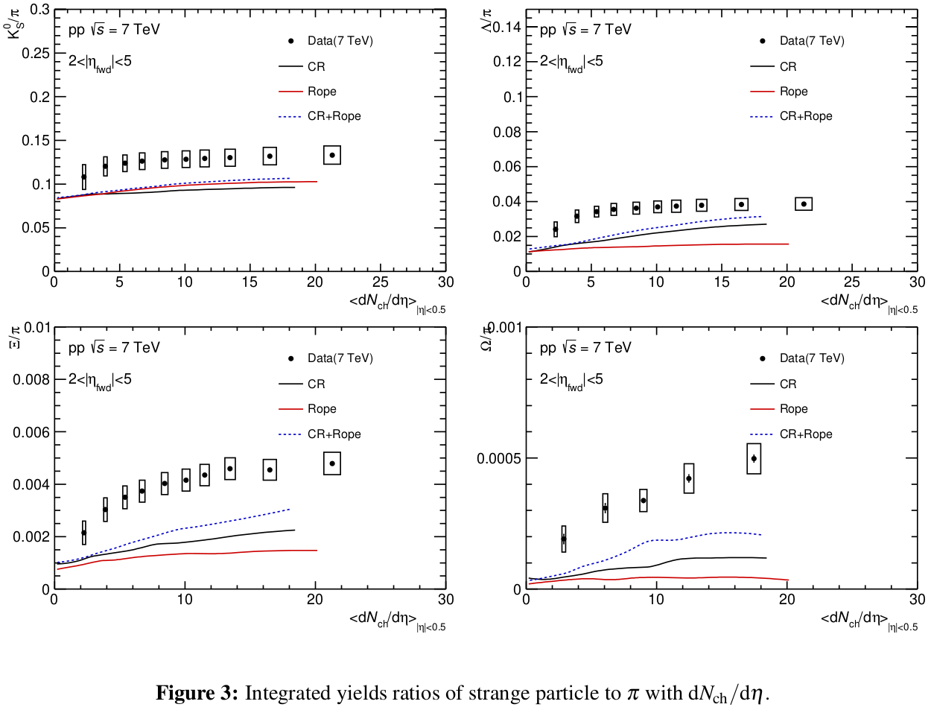
Integrated yield to pion ratio
Particle-to-pion ratios with dNdEta distribuiton

Slide 4
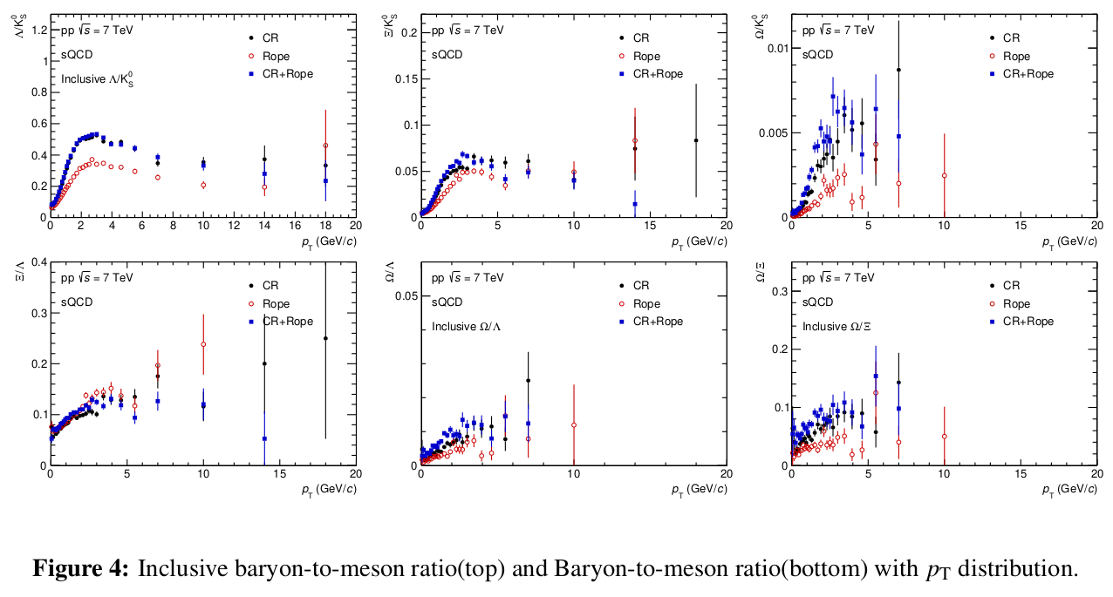
Inclusive particle ratio with pT distribution

Slide 5
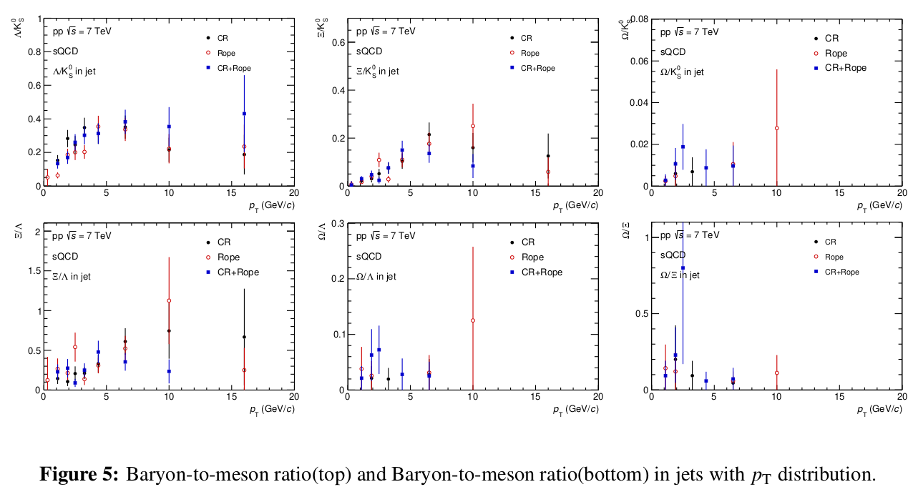
Particle ratio in jet with pT distribution

