Slide 1

Natural Language Processing with Deep Learning
CS224N/Ling284
Christopher Manning
Lecture 6: LSTM RNNs and Neural Machine Translation

Slide 2
Lecture Plan
Exploding and vanishing gradients (15 mins)
Long Short-Term Memory RNNs (LSTMs) (25 mins)
Other uses of RNNs (5 mins)
Bidirectional and multi-layer RNNs (15 mins)
Machine translation (10 mins)
Neural machine translation introduction (10 mins)
Final Projects: Next Tuesday, part of the lecture is about choosing final projects
It’s fine to just work on Ass3 and to delay thinking about projects until next week!
But if you’re already thinking about projects, you can view some info/inspiration on the website. It’s still last year’s information at present! DFP will be different!
It’s great if you can line up your own mentor; we are also lining up some mentors

Slide 3
Recap
Language Model: A system that predicts the next word
Recurrent Neural Network: A family of neural networks that:
Take sequential input of any length; apply the same weights on each step
Can optionally produce output on each step
Recurrent Neural Network ≠ Language Model
RNNs can be used for many other things (see later)
Language Modeling is a traditional subcomponent of many NLP tasks, all those involving generating text or estimating the probability of text:
Now everything in NLP is being rebuilt upon Language Modeling: GPT-3 is an LM!

Slide 4
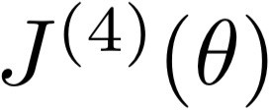
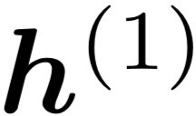
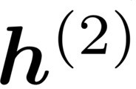
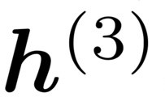
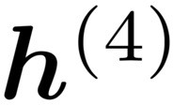





1. Problems with RNNs: Vanishing and Exploding Gradients

Slide 5
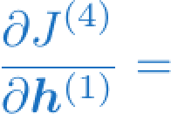
Vanishing gradient intuition
?

Slide 6
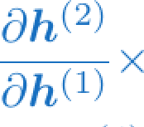
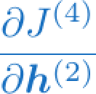
Vanishing gradient intuition
chain rule!

Slide 7
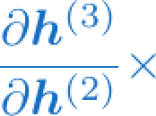
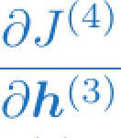
Vanishing gradient intuition
chain rule!

Slide 8
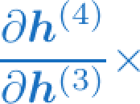
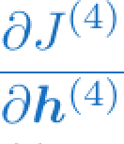
Vanishing gradient intuition
chain rule!

Slide 9
Vanishing gradient intuition
Vanishing gradient problem: When these are small, the gradient signal gets smaller and smaller as it backpropagates further
What happens if these are small?

Slide 10
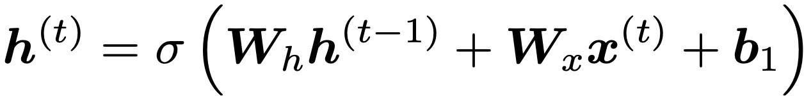


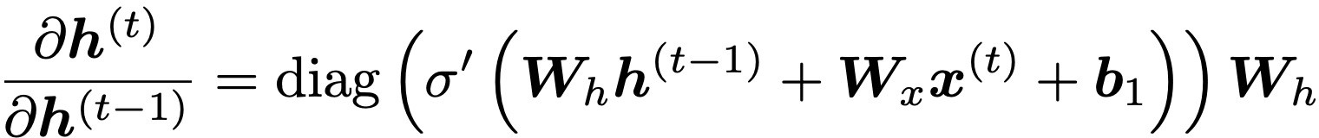

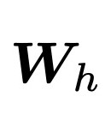






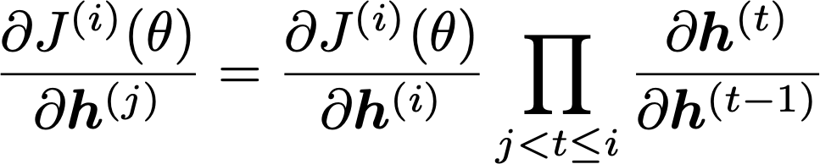
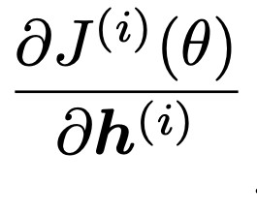
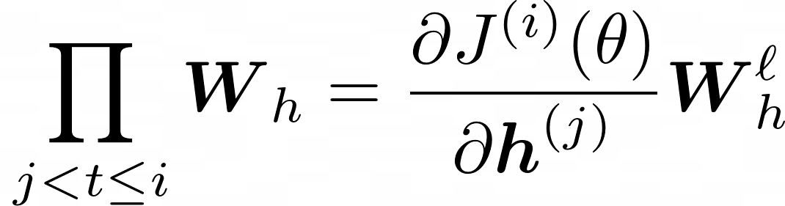
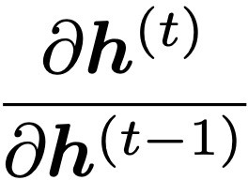


Vanishing gradient proof sketch (linear case)
Recall:
What if were the identity function, ?
(chain rule)
Consider the gradient of the loss on step , with respect to the hidden state on some previous step . Let
(chain rule)
(value of )
If W_{h} is “small”, then this term gets exponentially problematic as becomes large
Source: “On the difficulty of training recurrent neural networks”, Pascanu et al, 2013. http://proceedings.mlr.press/v28/pascanu13.pdf
(and supplemental materials), at http://proceedings.mlr.press/v28/pascanu13-supp.pdf
10

Slide 11
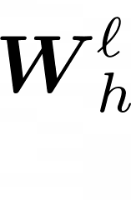



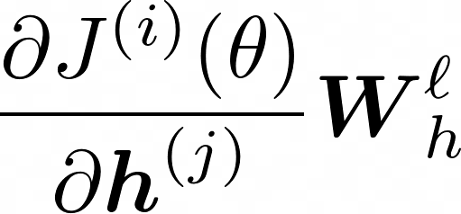
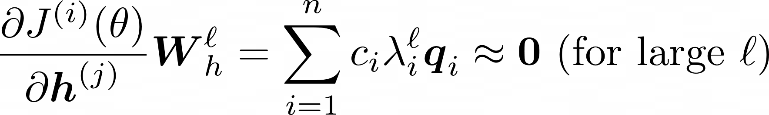



Vanishing gradient proof sketch (linear case)
sufficient but
What’s wrong with ?
not necessary
Consider if the eigenvalues of are all less than 1:
(eigenvectors) using the eigenvectors of
We can write
as a basis:
Approaches 0 as
grows, so gradient vanishes
What about nonlinear activations (i.e., what we use?)
Pretty much the same thing, except the proof requires
for some
dependent on dimensionality and
Source: “On the difficulty of training recurrent neural networks”, Pascanu et al, 2013. http://proceedings.mlr.press/v28/pascanu13.pdf
(and supplemental materials), at http://proceedings.mlr.press/v28/pascanu13-supp.pdf
11

Slide 12
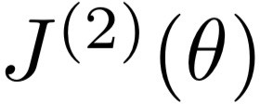
Why is vanishing gradient a problem?
Gradient signal from far away is lost because it’s much smaller than gradient signal from close-by.
So, model weights are basically updated only with respect to near effects, not long-term effects.

Slide 13
Effect of vanishing gradient on RNN-LM
LM task: When she tried to print her tickets, she found that the printer was out of toner. She went to the stationery store to buy more toner. It was very overpriced. After installing the toner into the printer, she finally printed her
To learn from this training example, the RNN-LM needs to model the dependency between “tickets” on the 7th step and the target word “tickets” at the end.
But if the gradient is small, the model can’t learn this dependency
So, the model is unable to predict similar long-distance dependencies at test time
In practice a simple RNN will only condition ~7 tokens back [vague rule-of-thumb]

Slide 14
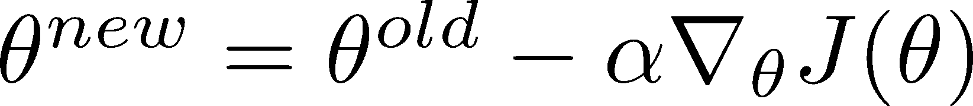
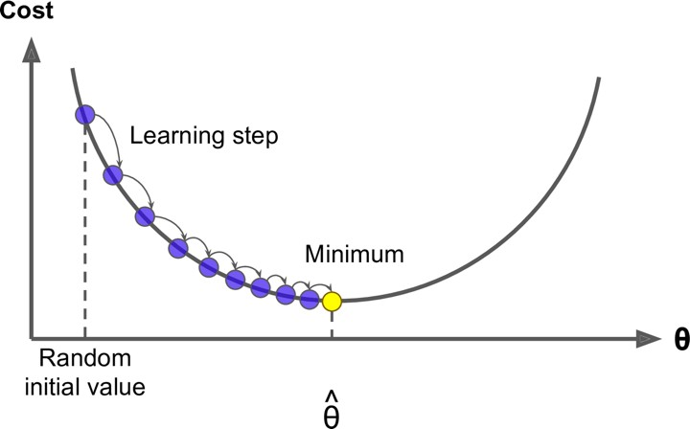
Why is exploding gradient a problem?
If the gradient becomes too big, then the SGD update step becomes too big:
learning rate
gradient
This can cause bad updates: we take too large a step and reach a weird and bad parameter configuration (with large loss)
You think you’ve found a hill to climb, but suddenly you’re in Iowa
In the worst case, this will result in Inf or NaN in your network (then you have to restart training from an earlier checkpoint)

Slide 15
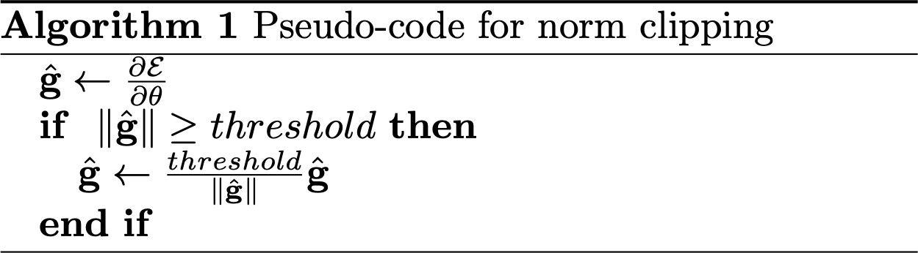
Gradient clipping: solution for exploding gradient
Gradient clipping: if the norm of the gradient is greater than some threshold, scale it down before applying SGD update
Intuition: take a step in the same direction, but a smaller step
In practice, remembering to clip gradients is important, but exploding gradients are an easy problem to solve
15
Source: “On the difficulty of training recurrent neural networks”, Pascanu et al, 2013. http://proceedings.mlr.press/v28/pascanu13.pdf

Slide 16
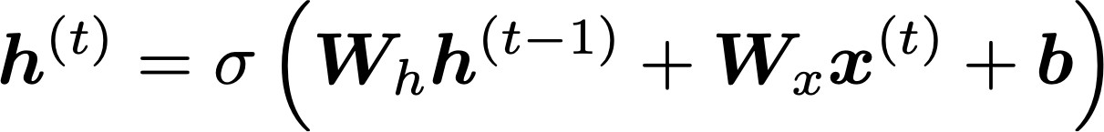
How to fix the vanishing gradient problem?
The main problem is that it’s too difficult for the RNN to learn to preserve information over many timesteps.
In a vanilla RNN, the hidden state is constantly being rewritten
Could we design an RNN with separate memory which is added to?
16

Slide 17
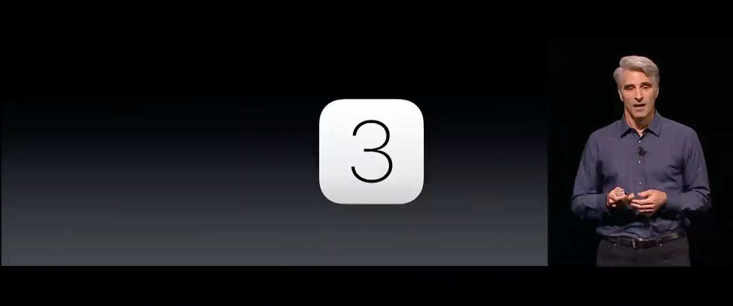
2. LSTMs: Apple WWDC Keynote 2016

Slide 18

Long Short-Term Memory RNNs (LSTMs)
A type of RNN proposed by Hochreiter and Schmidhuber in 1997 as a solution to the problem of vanishing gradients
Everyone cites that paper but really a crucial part of the modern LSTM is from Gers et al. (2000)
Only started to be recognized as promising through the work of S’s student Alex Graves c. 2006
Work in which he also invented CTC (connectionist temporal classification) for speech recognition
But only really became well-known after Hinton brought it to Google in 2013
Following Graves having been a postdoc with Hinton
Hochreiter and Schmidhuber, 1997. Long short-term memory. https://www.bioinf.jku.at/publications/older/2604.pdf Gers, Schmidhuber, and Cummins, 2000. Learning to Forget: Continual Prediction with LSTM. https://dl.acm.org/doi/10.1162/089976600300015015
Graves, Fernandez, Gomez, and Schmidhuber, 2006. Connectionist temporal classification: Labelling unsegmented sequence data with recurrent neural nets.
https://www.cs.toronto.edu/~graves/icml_2006.pdf

Slide 19
Long Short-Term Memory RNNs (LSTMs)
On step t, there is a hidden state 𝒉^{(")} and a cell state 𝒄^{(")}
Both are vectors length n
The cell stores long-term information
The LSTM can read, erase, and write information from the cell
The cell becomes conceptually rather like RAM in a computer
The selection of which information is erased/written/read is controlled by three corresponding gates
The gates are also vectors of length n
On each timestep, each element of the gates can be open (1), closed (0), or somewhere in-between
The gates are dynamic: their value is computed based on the current context

Slide 20
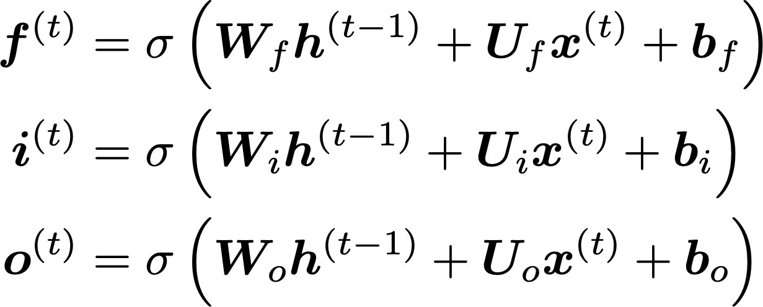
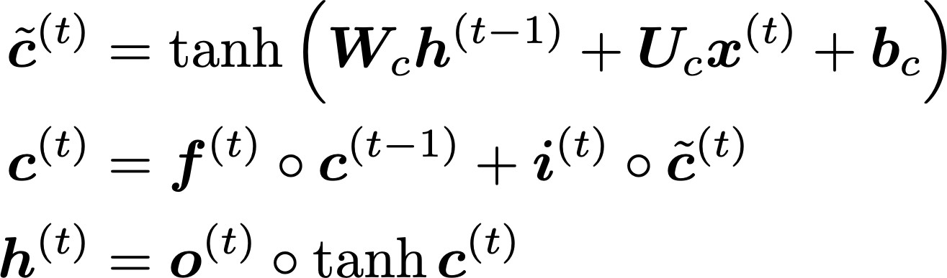
Long Short-Term Memory (LSTM)
We have a sequence of inputs 𝑥^{(")}, and we will compute a sequence of hidden states ℎ^{(")} and cell states
𝑐^{(")}. On timestep t:
Sigmoid function: all gate values are between 0 and 1
Forget gate: controls what is kept vs forgotten, from previous cell state
Input gate: controls what parts of the new cell content are written to cell
All these are vectors of same length n
Output gate: controls what parts of cell are output to hidden state
New cell content: this is the new content to be written to the cell
Cell state: erase (“forget”) some content from last cell state, and write (“input”) some new cell content
Hidden state: read (“output”) some content from the cell
Gates are applied using element-wise (or Hadamard) product: ⊙
20

Slide 21
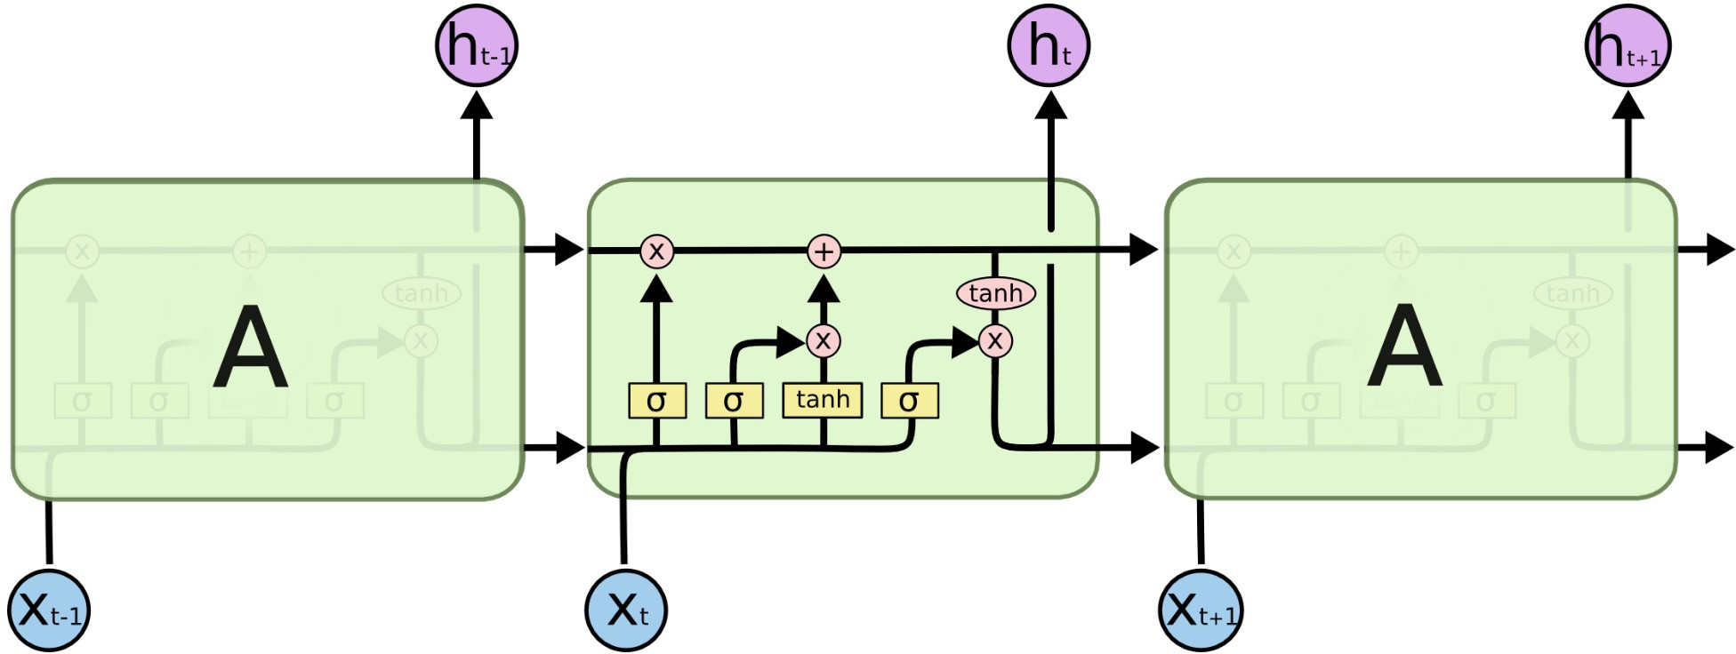
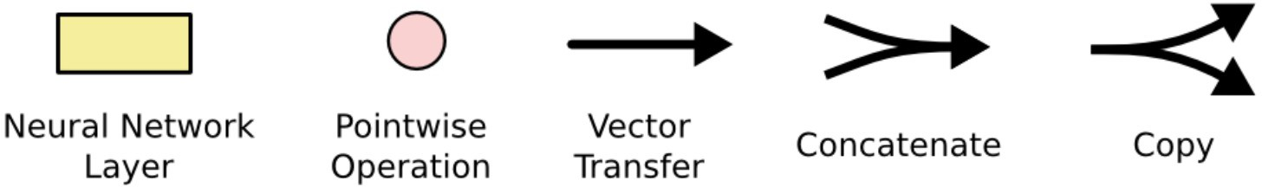
Long Short-Term Memory (LSTM)
You can think of the LSTM equations visually like this:
Source: http://colah.github.io/posts/2015-08-Understanding-LSTMs/

Slide 22
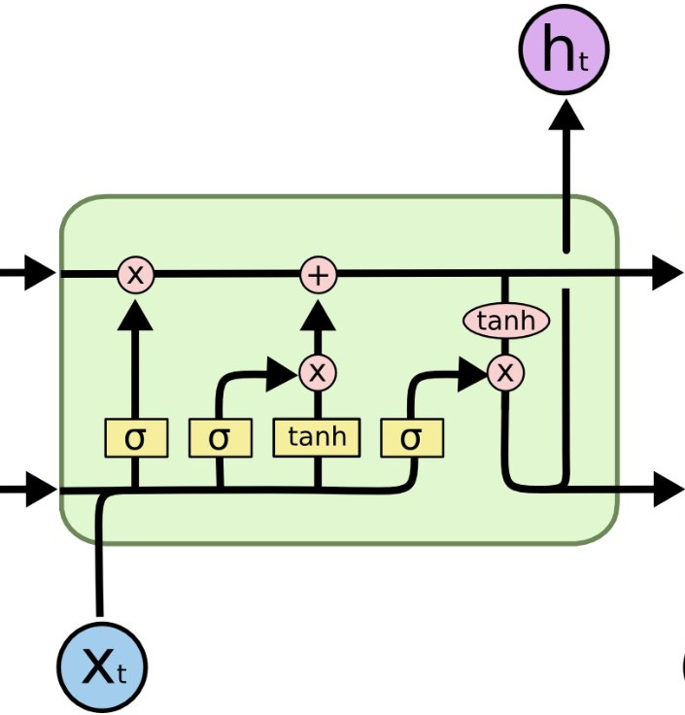
Long Short-Term Memory (LSTM)
You can think of the LSTM equations visually like this:
Write some new cell content
The + sign is the secret!
Forget some cell content
c_{t}
c
ct-1
t
f
i_{t}
o_{t}
Output some cell content to the hidden state
Compute the forget gate
t
_{c}~
t
ht-1
h_{t}
Compute the input gate
Compute the new cell content
Compute the output gate
Source: http://colah.github.io/posts/2015-08-Understanding-LSTMs/

Slide 23
How does LSTM solve vanishing gradients?
The LSTM architecture makes it much easier for an RNN to preserve information over many timesteps
e.g., if the forget gate is set to 1 for a cell dimension and the input gate set to 0, then the information of that cell is preserved indefinitely.
In contrast, it’s harder for a vanilla RNN to learn a recurrent weight matrix W_{h} that preserves info in the hidden state
In practice, you get about 100 timesteps rather than about 7
However, there are alternative ways of creating more direct and linear pass-through connections in models for long distance dependencies

Slide 24
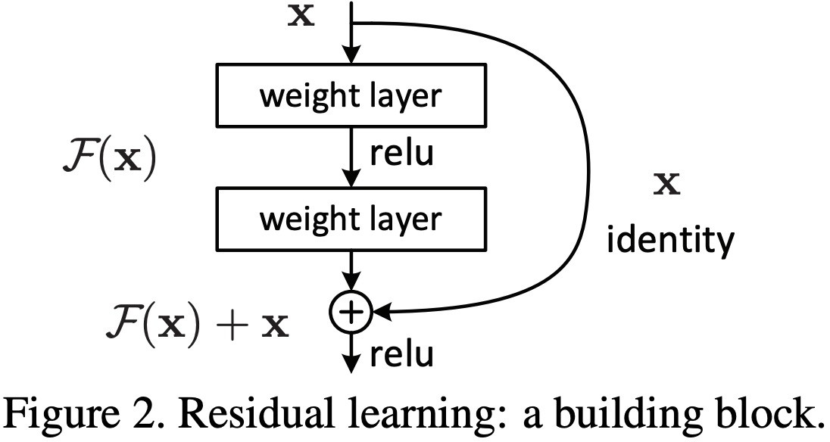
Is vanishing/exploding gradient just an RNN problem?
No! It can be a problem for all neural architectures (including feed-forward and convolutional), especially very deep ones.
Due to chain rule / choice of nonlinearity function, gradient can become vanishingly small as it backpropagates
Thus, lower layers are learned very slowly (i.e., are hard to train)
Another solution: lots of new deep feedforward/convolutional architectures add more direct connections (thus allowing the gradient to flow)
For example:
Residual connections aka “ResNet”
Also known as skip-connections
The identity connection preserves information by default
This makes deep networks much easier to train
24
"Deep Residual Learning for Image Recognition", He et al, 2015. https://arxiv.org/pdf/1512.03385.pdf

Slide 25
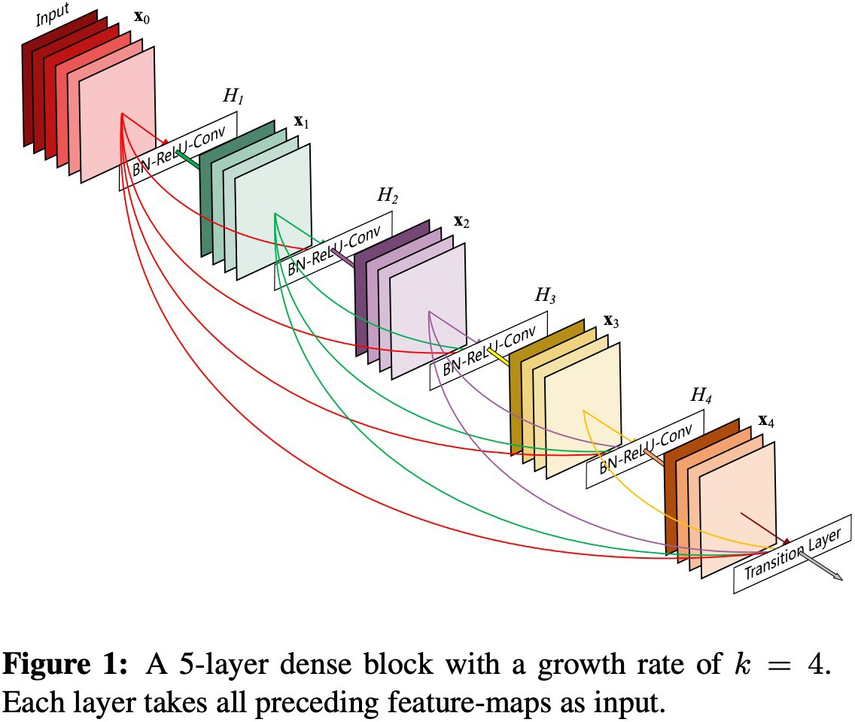
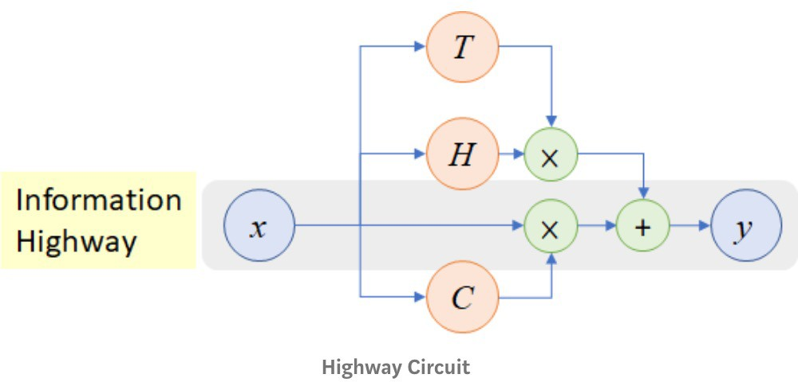
Is vanishing/exploding gradient just a RNN problem?
Other methods:
Dense connections aka “DenseNet”
Directly connect each layer to all future layers!
Highway connections aka “HighwayNet”
Similar to residual connections, but the identity connection vs the transformation layer is controlled by a dynamic gate
Inspired by LSTMs, but applied to deep feedforward/convolutional networks
Conclusion: Though vanishing/exploding gradients are a general problem, RNNs are particularly unstable due to the repeated multiplication by the same weight matrix [Bengio et al, 1994]
”Densely Connected Convolutional Networks", Huang et al, 2017. https://arxiv.org/pdf/1608.06993.pdf ”Highway Networks", Srivastava et al, 2015. https://arxiv.org/pdf/1505.00387.pdf
”Learning Long-Term Dependencies with Gradient Descent is Difficult", Bengio et al. 1994, http://ai.dinfo.unifi.it/paolo//ps/tnn-94-gradient.pdf
25

Slide 26
LSTMs: real-world success
In 2013–2015, LSTMs started achieving state-of-the-art results
Successful tasks include handwriting recognition, speech recognition, machine translation, parsing, and image captioning, as well as language models
LSTMs became the dominant approach for most NLP tasks
Now (2019–2023), Transformers have become dominant for all tasks
For example, in WMT (a Machine Translation conference + competition):
In WMT 2014, there were 0 neural machine translation systems (!)
In WMT 2016, the summary report contains “RNN” 44 times (and these systems won)
In WMT 2019: “RNN” 7 times, ”Transformer” 105 times
Source: "Findings of the 2016 Conference on Machine Translation (WMT16)", Bojar et al. 2016, http://www.statmt.org/wmt16/pdf/W16-2301.pdf Source: "Findings of the 2018 Conference on Machine Translation (WMT18)", Bojar et al. 2018, http://www.statmt.org/wmt18/pdf/WMT028.pdf Source: "Findings of the 2019 Conference on Machine Translation (WMT19)", Barrault et al. 2019, http://www.statmt.org/wmt18/pdf/WMT028.pdf

Slide 27
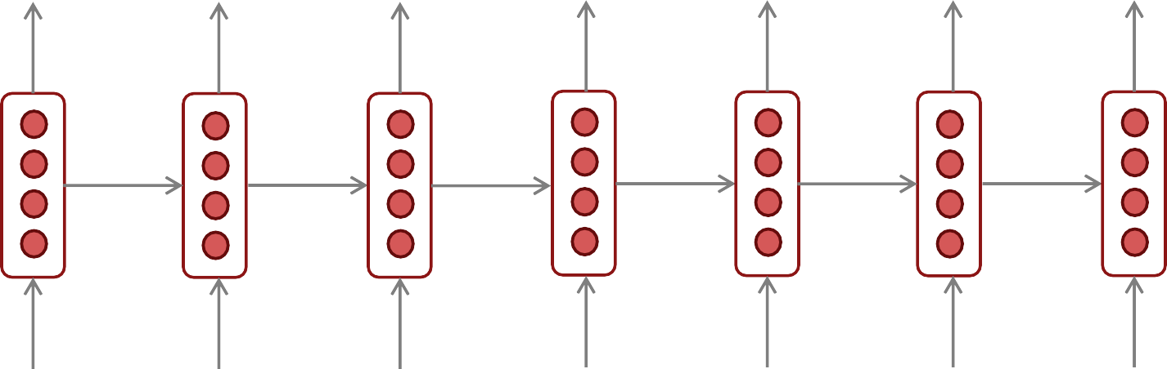
3. Other RNN uses: RNNs can be used for sequence tagging
e.g., part-of-speech tagging, named entity recognition
DT
JJ
NN
VBN
IN
DT
NN
the startled cat
knocked
over
the
vase

Slide 28


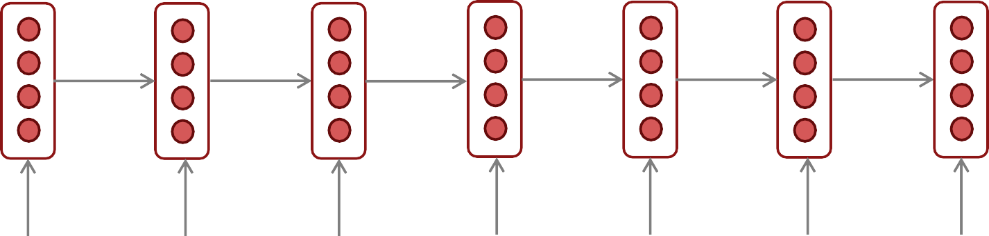
RNNs can be used as a sentence encoder model
e.g., for sentiment classification
positive
How to compute
sentence encoding?
Sentence encoding
overall
I
enjoyed
the
movie
a
lot

Slide 29
RNNs can be used as a sentence encoder model
e.g., for sentiment classification
positive
How to compute
sentence encoding?
Sentence encoding
Basic way:
Use final hidden state
equals
overall
I
enjoyed
the
movie
a
lot

Slide 30
RNNs can be used as a sentence encoder model
e.g., for sentiment classification
positive
How to compute sentence encoding?
Sentence encoding
Usually better: Take element-wise max or mean of all hidden states
overall
I
enjoyed
the
movie
a
lot

Slide 31
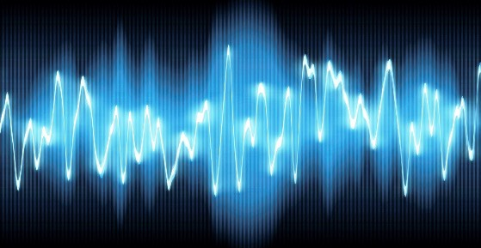

RNN-LMs can be used to generate text based on other information
e.g., speech recognition, machine translation, summarization
RNN-LM
Input (audio)
what’s
the weather
conditioning
<START>
what’s the
This is an example of a conditional language model.
We’ll see Machine Translation as an example in much more detail

Slide 32
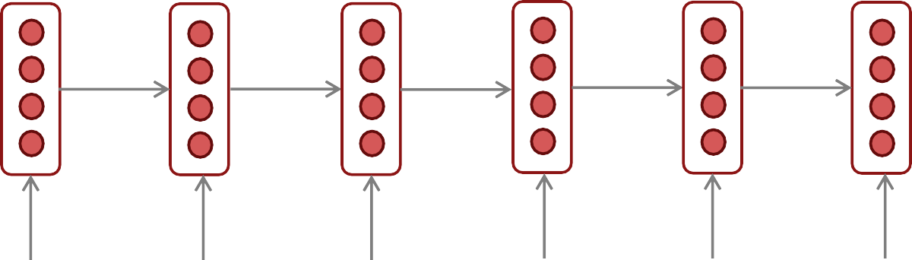
4. Bidirectional and Multi-layer RNNs: motivation
Task: Sentiment Classification
We can regard this hidden state as a representation of the word “terribly” in the context of this sentence. We call this a contextual representation.
positive
Sentence encoding
These contextual representations only contain information about the left context (e.g. “the movie was”).
What about right
context?
In this example, “exciting” is in the right context and this modifies the meaning of “terribly” (from negative to positive)
element-wise mean/max
element-wise mean/max
the
movie was
terribly
exciting
!

Slide 33
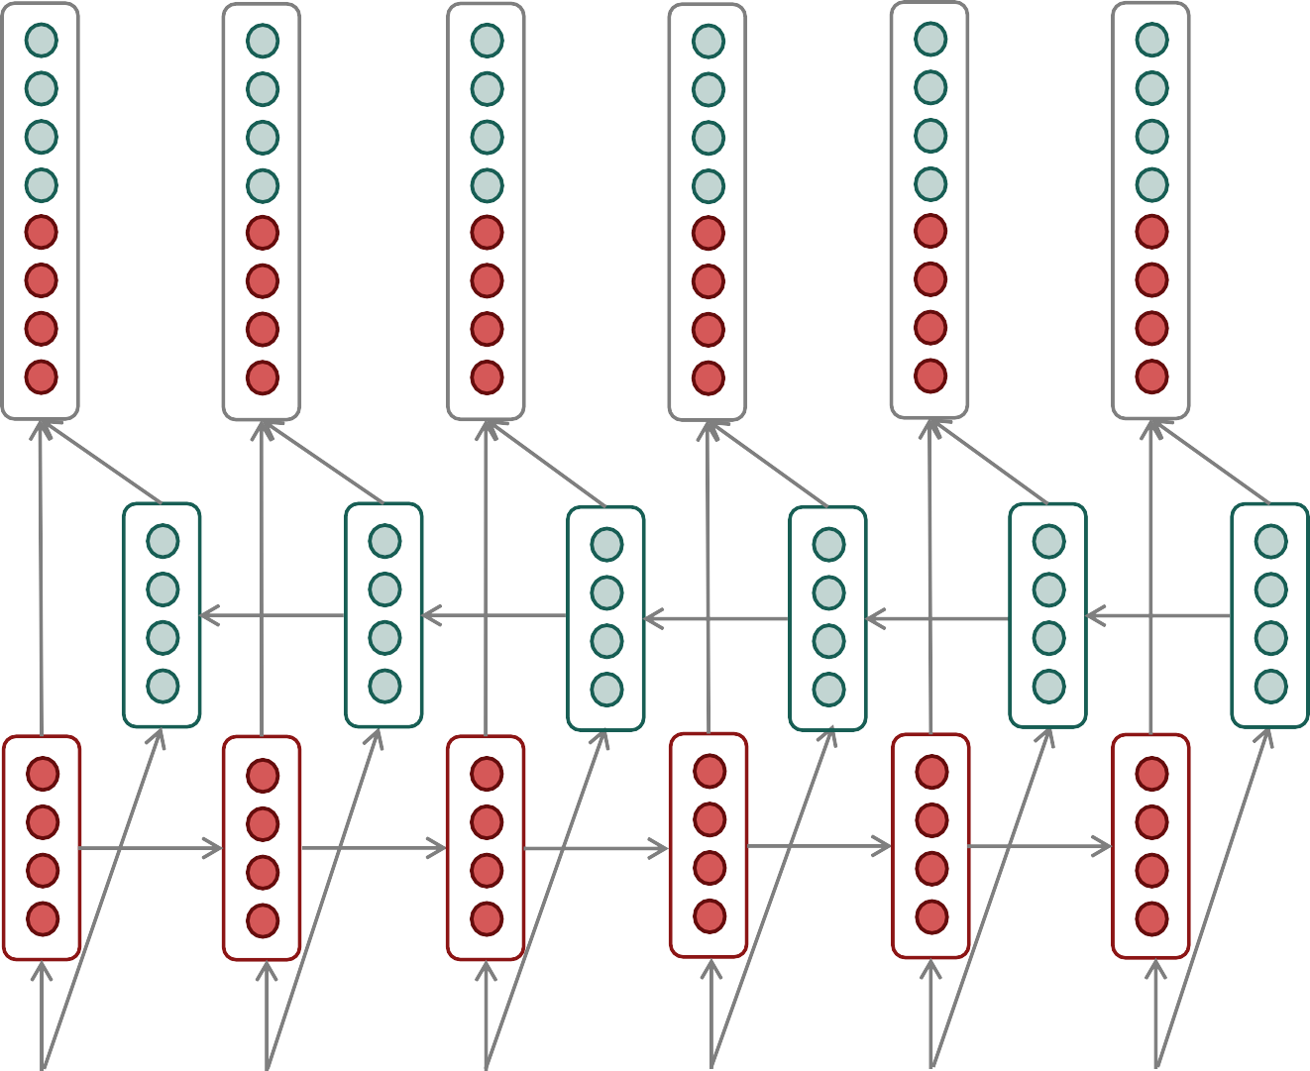
Bidirectional RNNs
This contextual representation of “terribly” has both left and right context!
Concatenated hidden states
Backward RNN
Forward RNN
the
movie
was terribly
exciting
!

Slide 34
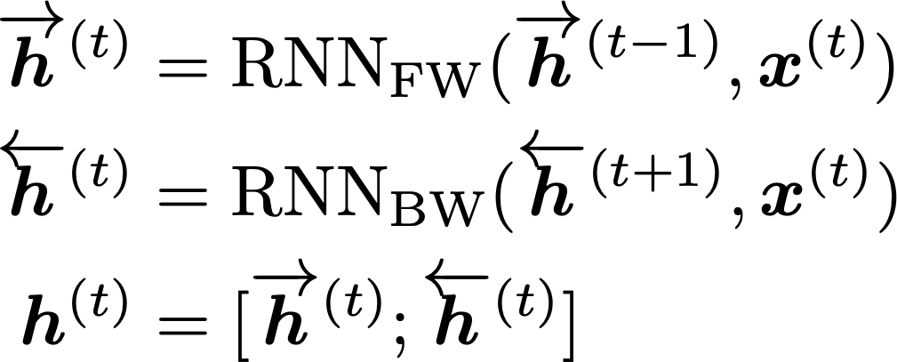
Bidirectional RNNs
This is a general notation to mean “compute one forward step of the RNN” – it could be a simple RNN or LSTM computation.
On timestep t:
Forward RNN
Backward RNN Concatenated hidden states
Generally, these two RNNs have separate weights
We regard this as “the hidden state” of a bidirectional RNN. This is what we pass on to the next parts of the network.
34

Slide 35
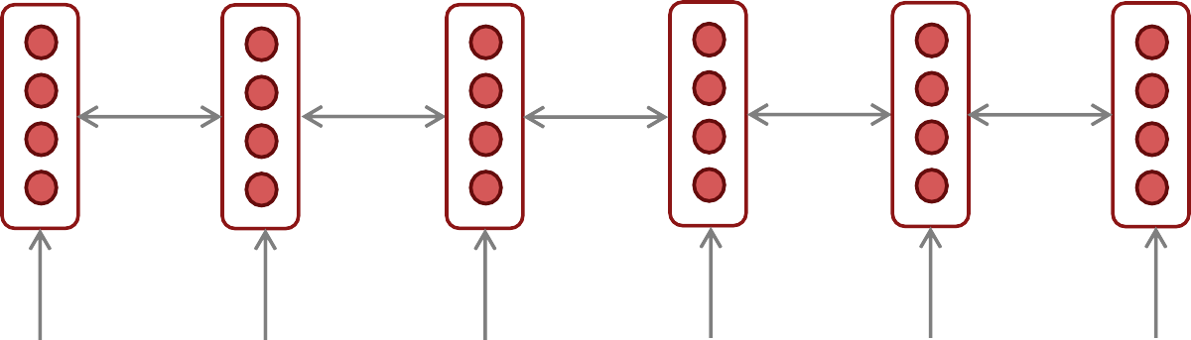
Bidirectional RNNs: simplified diagram
the
movie was
terribly
exciting
!
The two-way arrows indicate bidirectionality and the depicted hidden states are assumed to be the concatenated forwards+backwards states

Slide 36
Bidirectional RNNs
Note: bidirectional RNNs are only applicable if you have access to the entire input sequence
They are not applicable to Language Modeling, because in LM you only have left context available.
If you do have entire input sequence (e.g., any kind of encoding), bidirectionality is powerful (you should use it by default).
For example, BERT (Bidirectional Encoder Representations from Transformers) is a powerful pretrained contextual representation system built on bidirectionality.
You will learn more about transformers, including BERT, in a couple of weeks!

Slide 37
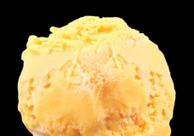
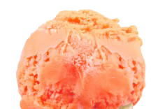
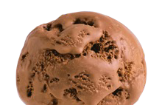
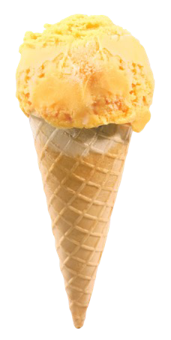
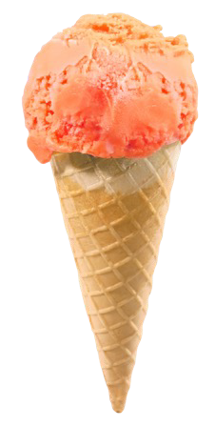
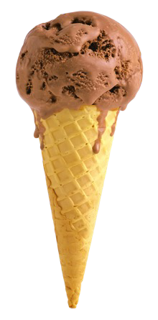
Multi-layer RNNs
RNNs are already “deep” on one dimension (they unroll over many timesteps)
We can also make them “deep” in another dimension by applying multiple RNNs – this is a multi-layer RNN.
This allows the network to compute more complex representations
The lower RNNs should compute lower-level features and the higher RNNs should compute higher-level features.
Multi-layer RNNs are also called stacked RNNs.

Slide 38
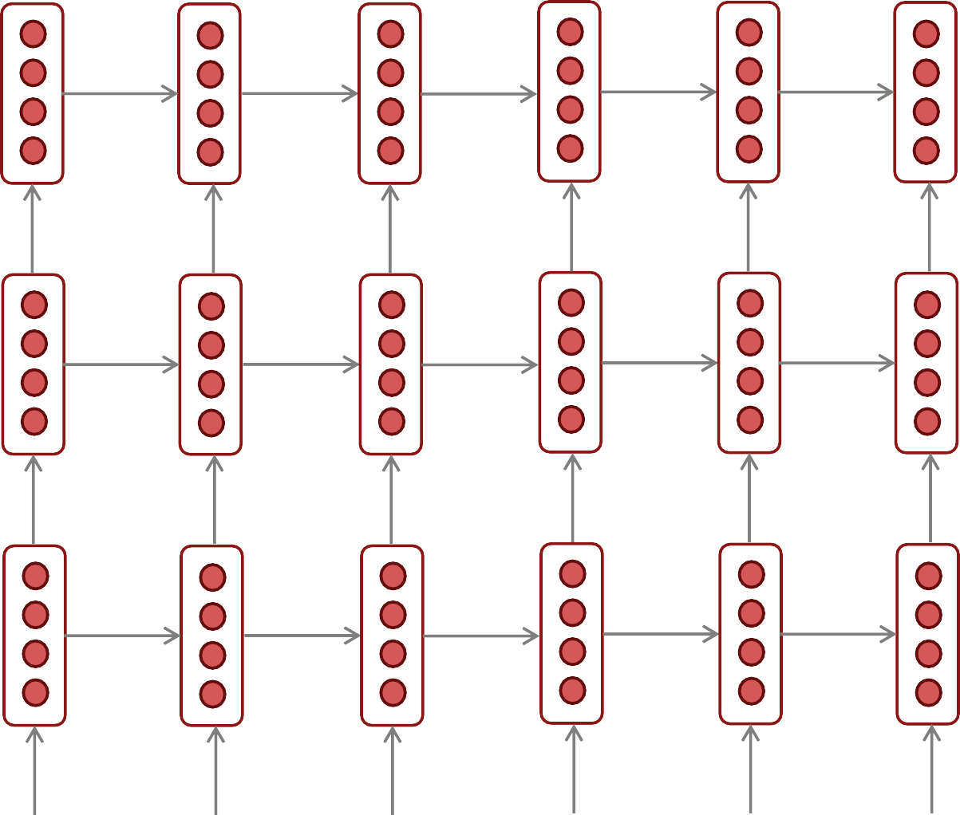
Multi-layer RNNs
The hidden states from RNN layer i
are the inputs to RNN layer i+1
RNN layer 3
RNN layer 2
RNN layer 1
the
movie
was terribly
exciting
!

Slide 39
Multi-layer RNNs in practice
Multi-layer or stacked RNNs allow a network to compute more complex representations – they work better than just have one layer of high-dimensional encodings!
The lower RNNs should compute lower-level features and the higher RNNs should compute higher-level features.
High-performing RNNs are usually multi-layer (but aren’t as deep as convolutional or feed-forward networks)
For example: In a 2017 paper, Britz et al. find that for Neural Machine Translation, 2 to 4 layers is best for the encoder RNN, and 4 layers is best for the decoder RNN
Often 2 layers is a lot better than 1, and 3 might be a little better than 2
Usually, skip-connections/dense-connections are needed to train deeper RNNs (e.g., 8 layers)
Transformer-based networks (e.g., BERT) are usually deeper, like 12 or 24 layers.
You will learn about Transformers later; they have a lot of skipping-like connections
“Massive Exploration of Neural Machine Translation Architecutres”, Britz et al, 2017. https://arxiv.org/pdf/1703.03906.pdf
39

Slide 40
Machine Translation
Machine Translation (MT) is the task of translating a sentence x from one language (the source language) to a sentence y in another language (the target language).
x:
L'homme est né libre, et partout il est dans les fers
y:
Man is born free, but everywhere he is in chains
– Rousseau
40

Slide 41
The early history of MT: 1950s
Machine translation research began in the early 1950s on machines less powerful than high school calculators (before term “A.I.” coined!)
Concurrent with foundational work on automata, formal languages, probabilities, and information theory
MT heavily funded by military, but basically just simple rule-based systems doing word substitution
Human language is more complicated than that, and varies more across languages!
Little understanding of natural language syntax, semantics, pragmatics
Problem soon appeared intractable
1 minute video showing 1954 MT: https://youtu.be/K-HfpsHPmvw

Slide 42

The early history of MT: 1950s

Slide 43


1990s-2010s: Statistical Machine Translation
Core idea: Learn a probabilistic model from data
Suppose we’re translating French → English.
We want to find best English sentence y, given French sentence x
Use Bayes Rule to break this down into two components to be learned separately:
Translation Model
Models how words and phrases should be translated (fidelity).
Learned from parallel data.
Language Model
Models how to write good English (fluency).
Learned from monolingual data.
43

Slide 44

What happens in translation isn’t trivial to model!
1519年600名西班牙人在墨西哥登陆，去征服几百万人口的阿兹特克帝国，初次交锋他们损兵三分之二。
In 1519, six hundred Spaniards landed in Mexico to conquer the Aztec Empire with a population of a few million. They lost two thirds of their soldiers in the first clash.
translate.google.com (2009): 1519 600 Spaniards landed in Mexico, millions of people to conquer the Aztec empire, the first two-thirds of soldiers against their loss. translate.google.com (2013): 1519 600 Spaniards landed in Mexico to conquer the Aztec
empire, hundreds of millions of people, the initial confrontation loss of soldiers two-thirds.
translate.google.com (2015): 1519 600 Spaniards landed in Mexico, millions of people to conquer the Aztec empire, the first two-thirds of the loss of soldiers they clash.

Slide 45
1990s–2010s: Statistical Machine Translation
SMT was a huge research field
The best systems were extremely complex
Hundreds of important details
Systems had many separately-designed subcomponents
Lots of feature engineering
Need to design features to capture particular language phenomena
Required compiling and maintaining extra resources
Like tables of equivalent phrases
Lots of human effort to maintain
Repeated effort for each language pair!
45

Slide 46
What is Neural Machine Translation?
Neural Machine Translation (NMT) is a way to do Machine Translation with a single end-to-end neural network
The neural network architecture is called a sequence-to-sequence model (aka seq2seq) and it involves two RNNs
46

Slide 47


Neural Machine Translation (NMT)
The sequence-to-sequence model
Target sentence (output)
Encoding of the source sentence.
Provides initial hidden state
for Decoder RNN.
he hit me with a pie <END>
argmax
argmax
argmax
argmax
argmax
argmax
argmax
Encoder RNN
Decoder RNN
il
a
m’ entarté
<START> he hit me with a pie
Source sentence (input)
Decoder RNN is a Language Model that generates target sentence, conditioned on encoding.
Encoder RNN produces an encoding of the source sentence.
Note: This diagram shows test time behavior: decoder output is fed in as next step’s input
47

Slide 48
Sequence-to-sequence is versatile!
The general notion here is an encoder-decoder model
One neural network takes input and produces a neural representation
Another network produces output based on that neural representation
If the input and output are sequences, we call it a seq2seq model
Sequence-to-sequence is useful for more than just MT
Many NLP tasks can be phrased as sequence-to-sequence:
Summarization (long text → short text)
Dialogue (previous utterances → next utterance)
Parsing (input text → output parse as sequence)
Code generation (natural language → Python code)

Slide 49

Neural Machine Translation (NMT)
The sequence-to-sequence model is an example of a Conditional Language Model
Language Model because the decoder is predicting the next word of the target sentence y
Conditional because its predictions are also conditioned on the source sentence x
NMT directly calculates
:
Probability of next target word, given target words so far and source sentence x
Question: How to train an NMT system?
(Easy) Answer: Get a big parallel corpus…
But there is now exciting work on “unsupervised NMT”, data augmentation, etc.

Slide 50


Training a Neural Machine Translation system
= negative log prob of “he”
= negative log prob of “with”
= negative log prob of <END>
1
*
𝐽 = _{𝑇} ( 𝐽₍
=
𝐽!
+
𝐽"
𝐽#
𝐽$
𝐽%
𝐽&
𝐽'
+ +
+
+ +
()!
𝑦"!
𝑦""
𝑦"#
𝑦"$
𝑦"%
𝑦"&
𝑦"'
Encoder RNN
Decoder RNN
il a m’ entarté
Source sentence (from corpus)
<START> he hit me with
Target sentence (from corpus)
a pie
Seq2seq is optimized as a single system. Backpropagation operates “end-to-end”.
50

Slide 51



Multi-layer deep encoder-decoder machine translation net
[Sutskever et al. 2014; Luong et al. 2015]
The hidden states from RNN layer i
are the inputs to RNN layer i+1
Translation generated
The protests escalated
over
the weekend <EOS>
 | 0.1 | 0.2 | 0.4 | 0.5 | 0.2 | -0.1 | 0.2 | 0.2 | 0.3 | 0.4 | -0.2 | -0.4 | -0.3
 | 0.3 | 0.6 | 0.4 | 0.5 | 0.6 | 0.6 | 0.6 | 0.6 | 0.6 | 0.4 | 0.6 | 0.6 | 0.5
 | 0.1 | -0.1 | 0.3 | 0.9 | -0.1 | -0.1 | -0.1 | -0.1 | -0.1 | -0.1 | -0.1 | -0.1 | -0.1
 | -0.4 | -0.7 | -0.2 | -0.3 | -0.5 | -0.7 | -0.7 | -0.7 | -0.7 | -0.7 | -0.7 | -0.7 | -0.7
 | 0.2 | 0.1 | -0.3 | -0.2 | 0.1 | 0.1 | 0.1 | 0.1 | 0.1 | 0.1 | 0.1 | 0.1 | 0.1
Encoder:
0.2 |  | 0.2 | 0.1 | 0.2 | 0.2 | 0.2 | 0.2 | -0.4 | 0.2 | -0.1 | 0.2 | 0.3 | 0.2
 |  | 0.6 | 0.3 | 0.6 | -0.8 | 0.6 | -0.1 | 0.6 | 0.6 | 0.6 | 0.4 | 0.6 | 0.6
-0.1 |  | -0.1 | -0.1 | -0.1 | -0.1 | -0.1 | -0.1 | -0.1 | -0.1 | -0.1 | -0.1 | -0.1
0.1 |  | -0.7 | -0.7 | -0.4 | -0.5 | -0.7 | -0.7 | -0.7 | 0.3 | 0.3 | 0.2 | -0.5 | -0.7
meaning |  | 0.1 | 0.1 | 0.1 | 0.1 | 0.1 | 0.1 | 0.1 | 0.1 | 0.1 | 0.1 | 0.1 | 0.1
0.2 |  | 0.4 | 0.2 | 0.2 | 0.4 | 0.2 | 0.2 | 0.2 | 0.2 | -0.1 | -0.2 | -0.4 | 0.2
0.6 |  | -0.6 | -0.3 | 0.4 | -0.2 | 0.6 | 0.6 | 0.6 | 0.6 | 0.3 | 0.6 | 0.5 | 0.6
-0.1 |  | 0.2 | -0.1 | 0.1 | -0.3 | -0.1 | -0.1 | -0.1 | -0.1 | -0.1 | 0.1 | -0.5 | -0.1
-0.7 |  | -0.3 | -0.4 | -0.5 | -0.4 | -0.7 | -0.7 | -0.7 | -0.7 | -0.7 | 0.3 | 0.4 | -0.7
0.1 |  | 0.4 | 0.2 | -0.2 | -0.2 | 0.1 | 0.1 | 0.1 | 0.1 | 0.1 | 0.1 | 0.1 | 0.1
^{Source} Die Proteste waren am Wochenende eskaliert <EOS> The protests escalated over the weekend ^{Feeding in}
Builds up sentence
Decoder
-0.2
-0.1
0.1
sentence
last word
Conditioning = Bottleneck
51

Slide 52
How do we evaluate Machine Translation?
BLEU (Bilingual Evaluation Understudy)
You’ll see BLEU in detail in Assignment 4!
BLEU compares the machine-written translation to one or several human-written translation(s), and computes a similarity score based on:
n-gram precision (usually for 1, 2, 3 and 4-grams)
Plus a penalty for too-short system translations
BLEU is useful but imperfect
There are many valid ways to translate a sentence
So a good translation can get a poor BLEU score because it has low n-gram overlap with the human translation ®
52
Source: ”BLEU: a Method for Automatic Evaluation of Machine Translation", Papineni et al, 2002. http://aclweb.org/anthology/P02-1040

Slide 53



BLEU score against 4 reference translations
Reference translation 1:
The U.S. island of Guam is maintaining a high state of alert after the Guam airport and its offices both received an e-mail from someone calling himself the Saudi Arabian Osama bin Laden and threatening a biological/chemical attack against public places such as the airport .
Reference translation 2:
Guam International Airport and its offices are maintaining a high state of alert after receiving an e-mail that was from a person claiming to be the wealthy Saudi Arabian businessman Bin Laden and that threatened to launch a biological and chemical attack on the airport and other public places .
Reference translation 1:
The U.S. island of Guam is maintaining a high state of alert after the Guam airport and its offices both received an e-mail from someone calling himself the Saudi Arabian Osama bin Laden and threatening a biological/chemical attack against public places such as the airport .
Reference translation 2:
Guam International Airport and its offices are maintaining a high state of alert after receiving an e-mail that was from a person claiming to be the wealthy Saudi Arabian businessman Bin Laden and that threatened to launch a biological and chemical attack on the airport and other public places .
Machine translation:
The American [?] international airport and its the office all receives one calls self the sand Arab rich business [?] and so on electronic mail , which sends out ; The threat will be able after public place and so on the airport to start the biochemistry attack
, [?] highly alerts after the maintenance.
Machine translation:
The American [?] international airport and its the office all receives one calls self the sand Arab rich business [?] and so on electronic mail , which sends out ; The threat will be able after public place and so on the airport to start the biochemistry attack
, [?] highly alerts after the maintenance.
Reference translation 3:
The US International Airport of Guam and its office has received an email from a self-claimed Arabian millionaire named Laden , which threatens to launch a biochemical attack on such public places as airport . Guam authority has been on alert .
Reference translation 4:
US Guam International Airport and its office received an email from Mr. Bin Laden and other rich businessman from Saudi Arabia . They said there would be biochemistry air raid to Guam Airport and other public places . Guam needs to be in high precaution about this matter .
Reference translation 3:
The US International Airport of Guam and its office has received an email from a self-claimed Arabian millionaire named Laden , which threatens to launch a biochemical attack on such public places as airport . Guam authority has been on alert .
Reference translation 4:
US Guam International Airport and its office received an email from Mr. Bin Laden and other rich businessman from Saudi Arabia . They said there would be biochemistry air raid to Guam Airport and other public places . Guam needs to be in high precaution about this matter .
[Papineni et al. 2002]

Slide 54
MT progress over time
[Edinburgh En-De WMT newstest2013 Cased BLEU; NMT 2015 from U. Montréal; NMT 2019 FAIR on newstest2019]
45
40
35
30
25
20
15
10
5
0
Phrase-based SMT
Syntax-based SMT
Neural MT
2013 2014 2015 2016 2017 2018 2019
Sources: http://www.meta-net.eu/events/meta-forum-2016/slides/09_sennrich.pdf & http://matrix.statmt.org/

Slide 55
Advantages of NMT
Compared to SMT, NMT has many advantages:
Better performance
More fluent
Better use of context
Better use of phrase similarities
A single neural network to be optimized end-to-end
No subcomponents to be individually optimized
Requires much less human engineering effort
No feature engineering
Same method for all language pairs

Slide 56
Disadvantages of NMT?
Compared to SMT:
NMT is less interpretable
Hard to debug
NMT is difficult to control
For example, can’t easily specify rules or guidelines for translation
Safety concerns!

Slide 57








NMT: the first big success story of NLP Deep Learning
Neural Machine Translation went from a fringe research attempt in 2014 to the leading standard method in 2016
2014: First seq2seq paper published
2016: Google Translate switches from SMT to NMT – and by 2018 everyone has
This is amazing!
SMT systems, built by hundreds of engineers over many years, outperformed by NMT systems trained by a small group of engineers in a few months

Slide 58



In summary
Lots of new information today! What are some of the practical takeaways?
1. LSTMs are powerful
2. Clip your gradients
The protests escalated over the weekend <EOS>
Translation generated
0
. 1
0
. 3
0
.
1
0
0 ⁰ ⁰ ⁰
0
0
0
. . . . . . . . .
. . .
2
0
. 6
4 5 2
2 2
3
0
4
0
. 4
1
0 0 0 0 ⁰
0
2 4 3
0 0 0
. . .
6 6 5
- - -
0 0 0
. . .
1 1 1
- - -
0 0 0
. . . . . . .
-
4 5 6
0 0 -
6
6
-
6
- 0
6
- 0
-
0
. 1
. .
0
-
0
. 1
0
. 1
3 9
- -
0
0
. .
. .
-
0
. .
1
-
1
1 1
0
. 4
0
. 2
-
0
.
5
-
- - - -
0 0 0
0
.
7
0
. 1
2
3
0
.
0
. . . .
.
. .
- -
0 0 0 0
7 ⁷ ⁷
0 0
7
7
0
. 1
7 7 7
0 0 0
. . .
0
. . . . . . .
Encoder: Builds up sentence meaning
3 2 ¹ 1 ¹ ¹
1
1 1 1
0 0
. .
. 2
0
. 2
0
. 6
. 2
0
0
-
0
. 2
0
.
4
0 0
. .
. .
1 2
0 0
3 6
- -
. .
0
.
1
. 6
3 2
0 0
6 6
- -
0 0
. .
- -
2
2
0
. 6
-
- 4
2
0
-
. .
0
. 8
0
0
0
. .
0
. 2
. . .
-
-
- ¹
6
6
Decoder
-
0
. 1
0 0
0
- - -
-
-
0
0
0
0
. 1
0
. 3
0
.
1
0
. 1
0
. 1
. . . . . .
1 1
-
0
. 1
1
1
1
1 1
-
0 0
. .
- ¹ -
- -
0 0
0 0 ⁻
0
.
7
0
. 1
0
0
0 0
. .
0
. 5
0
. 1
. . . .
1 7
7 4
0 0
. .
1 1
. .
7 7
3
. 1
2
0
.
1
5 7
0 0
. .
1 1
0 0
. .
1
0 0
. .
1
0
1
. 4
1
0
0
. 2
0
0 0 0
0
.
1
0
. 3
. .
. 2
0
.
4
0
.
1
. . . .
⁻ 0
⁰ .
.
. 2
0
.
6
2
0
.
6
4
-
- ² ²
2
2
0
-
0
. 3
0
0 0 0
4
0
. 5
0
. 6
0
. . . . .
2
. 6
2
-
6 6 6
- - -
0 0 0
6
0
- 0
-
- 0
-
-
-
. .
0
. 1
0
.
3
0
. 4
. . . .
0
0
0
.
5
0
. 1
1
2
-
1 1 1
- - -
0 0 0
1
-
0
. .
- -
-
0
. 5
-
1
1
0
. 3
0
1
-
0 0
0
0
0
.
-
. .
. . . .
0
. 7
0
.
. .
7 3 4 ⁻
0 0 0 ⁰
- 0
.
7
0
. 1
7 7 7
0
. . .
4 7
0 0
. .
. . . .
1 4
0 0
.
Source sentence
Die Proteste waren am Wochenende eskaliert <EOS> The protests escalated over the weekend
1 1 1
Feeding in last word
Conditioning =
Bottleneck
4. Encoder-Decoder Neural Machine Translation Systems work very well
3. Use bidirectionality when possible

