Slide 1
自我介紹
(niziima Live)
Notes:
嗨大家好！我是糖豆人！大家可以叫我“甜豆”！我的目標呢，就是要成為糖豆人競技場中的冠軍！
不過啊，要成為冠軍可不容易呢！每次比賽總是充滿各種阻礙——有時候會被巨大的旋轉槌子打飛，有時候踩到滾動的球球，甚至有時候，還會被擠成一團豆泥！
但是！我不會放棄！每次摔倒，我都會立刻站起來，繼續向終點衝刺！
結果呢，有時候我真的成功了！我站上了勝利的皇冠台！那一刻，真的是超級爽快！不過，也不是每次都這麼順利...像有一次，我快到終點了，結果被別的糖豆人絆了一下！哇～直接跌出了場地！
但你知道嗎？這些意外讓我學會了不放棄，也學會了隨時轉換策略！ 像是遇到難纏的障礙物，我學會先觀察，再巧妙地避開；遇到擠來擠去的其他糖豆人，我選擇跳得更高，走自己的路！
最後呢，即使我不一定每次都能拿到冠軍，但這些經歷讓我明白，最重要的不是冠軍，而是每次挑戰中那些滑稽、有趣的時刻！
所以，無論是跌倒還是勝利，我都會笑著繼續向前！我是糖豆人，永不放棄的競技場勇士！

Slide 2
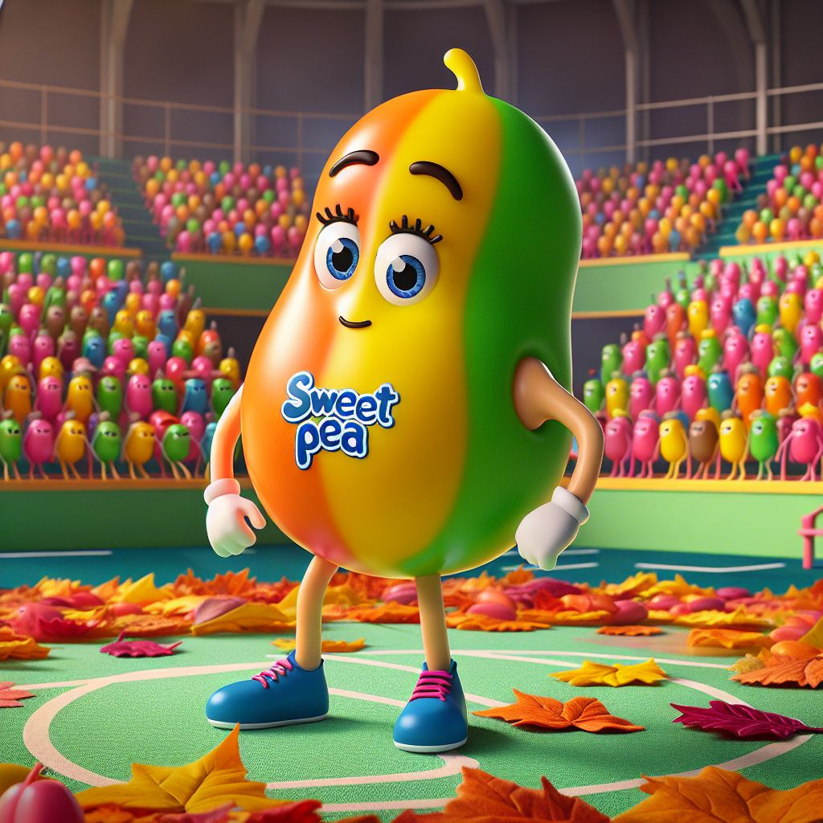
1. 目標
Notes:
Hi guys! I'm a jellybean! You can all call me "Sweet Pea"! My goal is to become the champion in the Fall Bean Arena!

Slide 3
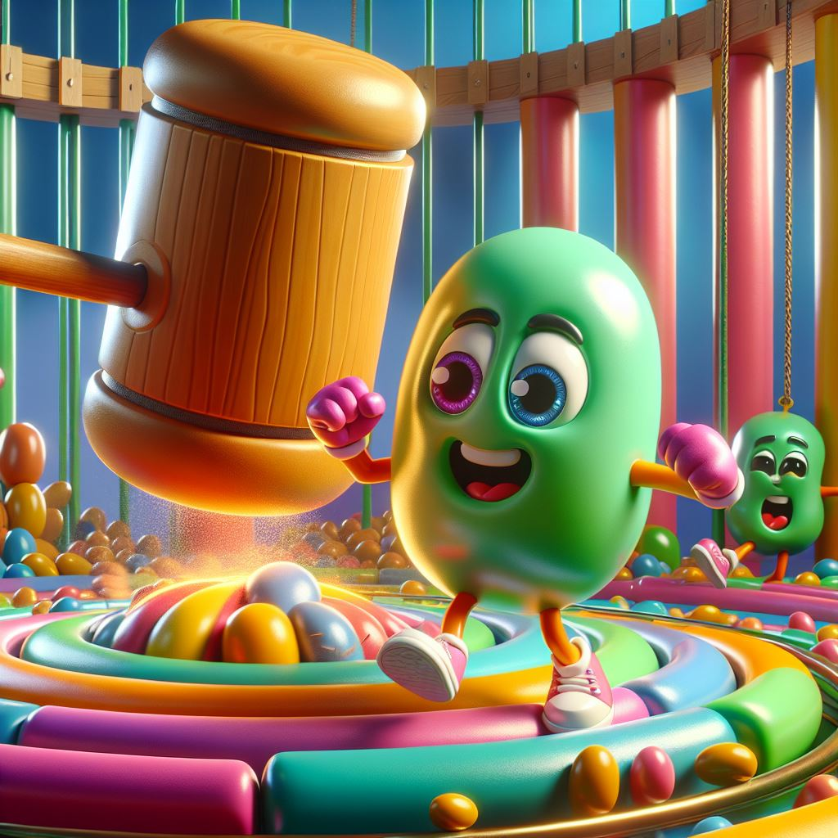
2. 阻礙
Notes:
Every game is always full of various obstacles - sometimes you will be knocked away by a huge rotating mallet, sometimes you will step on a rolling ball, and sometimes you will even be squeezed into a ball of mashed beans!

Slide 4
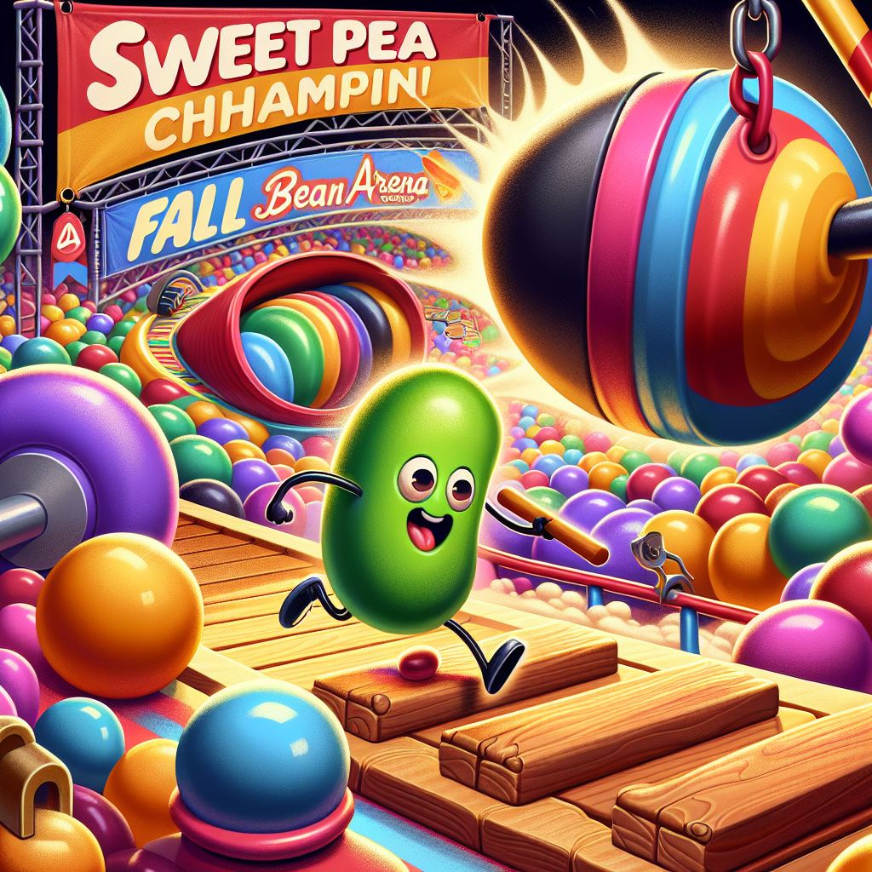
3. 努力
Notes:
I won't give up! Every time I fall, I will stand up immediately and continue sprinting towards the finish line!

Slide 5
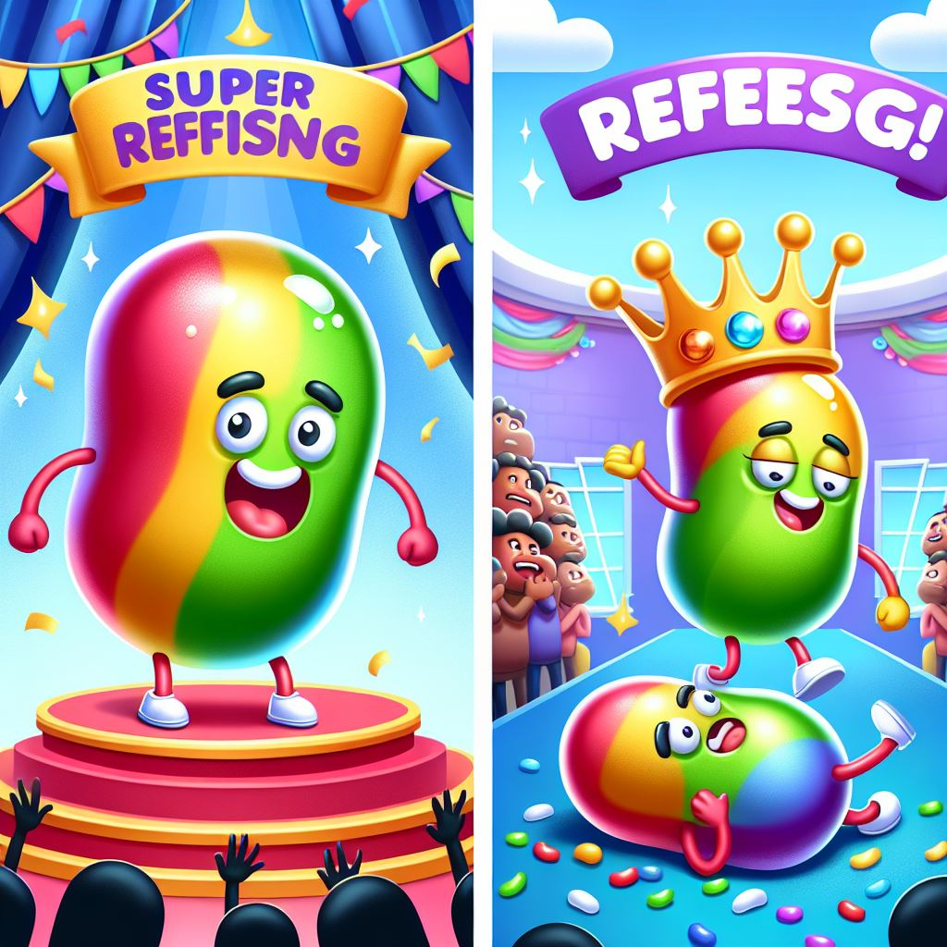
4. 結果
Notes:
I stood on the crown of victory! At that moment, it was really super refreshing! However, it doesn’t always go so smoothly... Like once, when I was almost at the finish line, I tripped over another jellybean! Wow ~ I fell out of the venue!

Slide 6
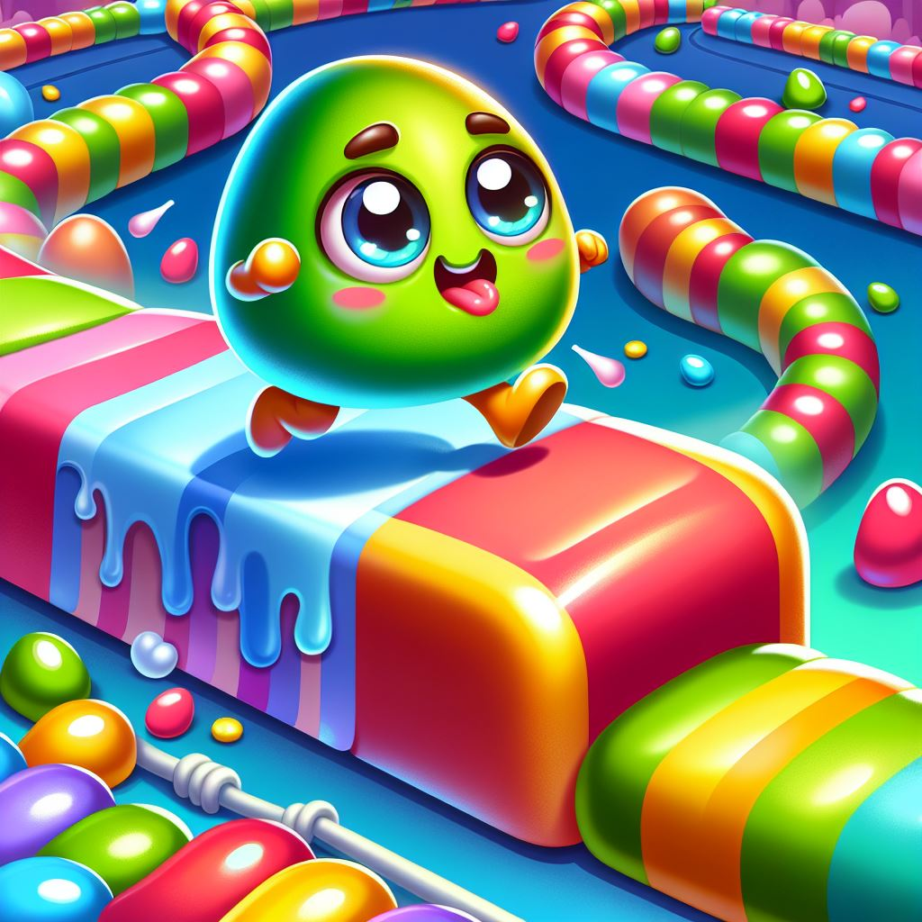
5. 意外
Notes:
For example, when encountering a difficult obstacle, I learn to observe first and then avoid it skillfully; when encountering other jelly beans crowded around, I choose to jump higher and go my own way!

Slide 7

6. 轉彎
Notes:
In the end, even though I may not win the championship every time, these experiences made me understand that the most important thing is not the championship, but the funny and interesting moments in each challenge!

Slide 8
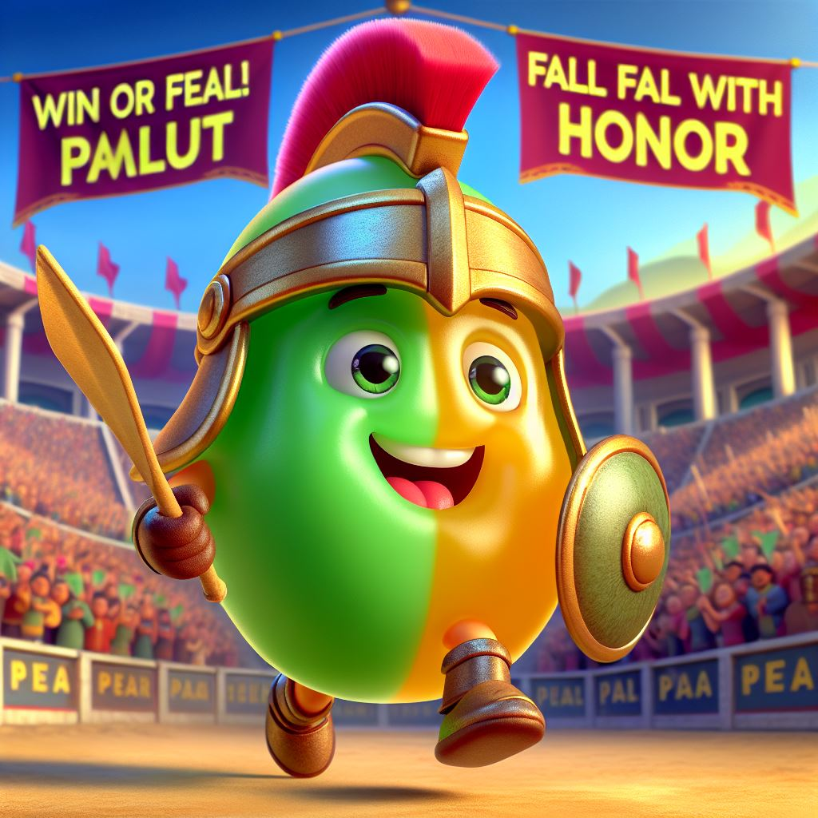
7. 結局
Notes:
So, whether I fall or win, I will smile and keep moving forward! I am a jelly bean, an arena warrior who never gives up!

