Slide 1
冒險故事
(VTube Studio)
Notes:
大家好！我是甜豆，今天要跟你們分享我一次驚心動魄的競技場冒險！
那天，我的目標很簡單——我要奪得那頂閃閃發亮的皇冠！競技場裡的挑戰非常多，但我充滿自信，因為這一次我已經準備好了。我站在起跑線上，心裡默默地告訴自己：“無論如何，我都要拿下冠軍！”
比賽一開始，阻礙就馬上出現了。第一關是那個我最不擅長的“翻滾球場”，巨大圓球從四面八方滾過來，擋住了我前進的道路。我知道這是對我的耐力和反應的挑戰！我心裡不斷告訴自己：“別慌，冷靜點，跟著球的節奏走！”於是我一邊小心躲避，一邊用最快的速度往前衝！
但是事情並沒有那麼簡單！眼看快到終點了，突然，我被一個巨大槌子擊飛了好幾米遠，直接掉進了最後一名！我告訴自己不能放棄，這才剛開始呢，我還有機會！於是我更加努力，堅持站起來，快速地追趕著前面的其他糖豆人，心裡不停地想：“加油，甜豆，這只是第一關，還有希望！”
然後發生了一件意外——我突然發現前面的道路被擠得水洩不通，其他糖豆人都擠在一個狹窄的角落裡，互相推搡著，根本無法前進！這時，我靈機一動，想到了一個轉彎的策略。我決定不跟大家擠在一起，而是繞到旁邊一條看起來沒什麼人注意的小路，雖然多繞了一點路，但我成功避開了擁擠區域，迅速通過了障礙。
接下來的關卡是“搖擺橋”，每一步都是驚險萬分。橋隨時可能翻轉把我甩下去，但這次我更加集中注意力，穩穩地一步步向前邁進。就在我快要到達終點時，突然一個糖豆人從我後面衝了過來，試圖超過我！我心跳加速，眼看他距離皇冠只有一步之遙了。
這時，我深吸一口氣，努力集中所有力量，在最後一秒跳起來——我終於抓住了那頂皇冠！結果是什麼？沒錯，我成功贏得了比賽！這一刻，所有的努力都值得了。
但你知道嗎？這場冒險教會我的不只是勝利，更重要的是——每次跌倒，重新站起來的那種決心和智慧。每一個轉彎，每一次困難，都是讓我變得更強大的機會。
我是甜豆，我的冒險永遠不會停止，下一次，我還會再向冠軍挑戰！

Slide 2
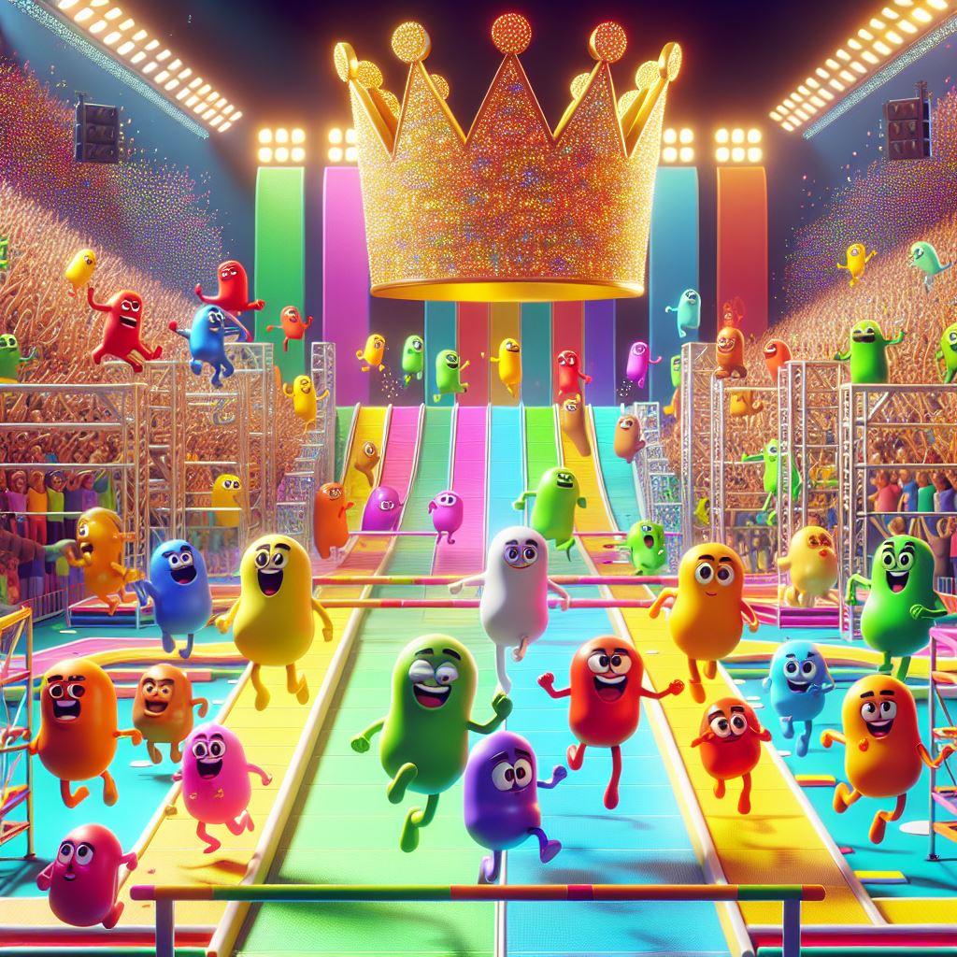
1. 目標
Notes:
Hello everyone! I'm Sweet Pea, and today I'm going to share with you one of my thrilling arena adventures!
That day, my goal was simple - I wanted to win that shining crown! There are many challenges in the arena, but I am confident because this time I am ready. I stood on the starting line and silently told myself: "No matter what, I will win the championship!"

Slide 3
1. 目標
Notes:
Hello everyone! I'm Sweet Pea, and today I'm going to share with you one of my thrilling arena adventures!
That day, my goal was simple - I wanted to win that shining crown! There are many challenges in the arena, but I am confident because this time I am ready. I stood on the starting line and silently told myself: "No matter what, I will win the championship!"

Slide 4
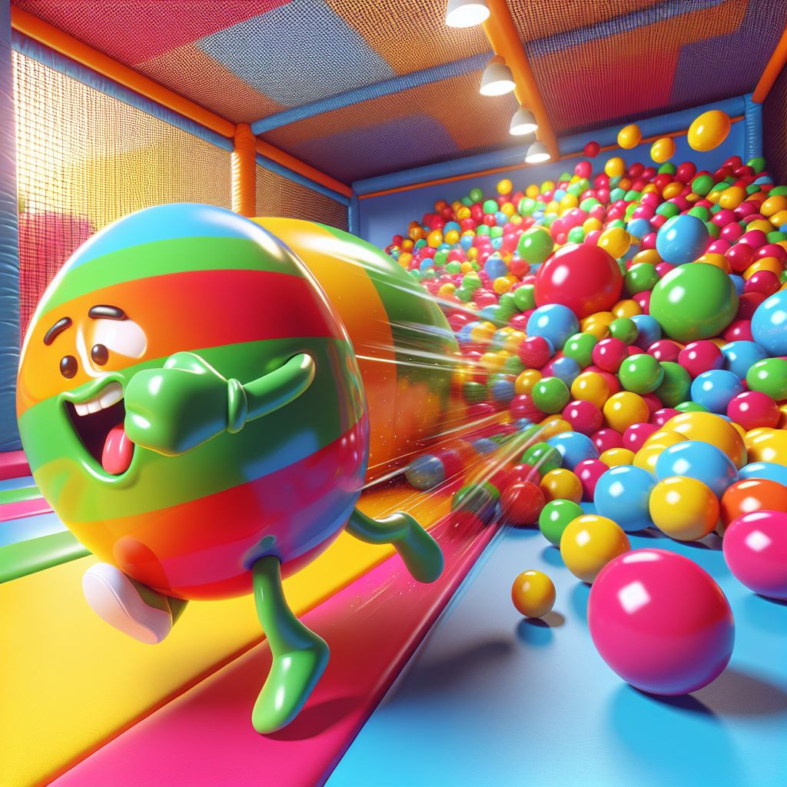
2. 阻礙
Notes:
As soon as the game started, obstacles appeared immediately. The first level was the "tumbling court" which I was least good at. Huge balls rolled over from all directions, blocking my way forward. I knew it was a challenge to my endurance and reflexes! I kept telling myself: "Don't panic, calm down and follow the rhythm of the ball!" So I avoided it carefully while rushing forward as fast as I could!

Slide 5
2. 阻礙
Notes:
As soon as the game started, obstacles appeared immediately. The first level was the "tumbling court" which I was least good at. Huge balls rolled over from all directions, blocking my way forward. I knew it was a challenge to my endurance and reflexes! I kept telling myself: "Don't panic, calm down and follow the rhythm of the ball!" So I avoided it carefully while rushing forward as fast as I could!

Slide 6
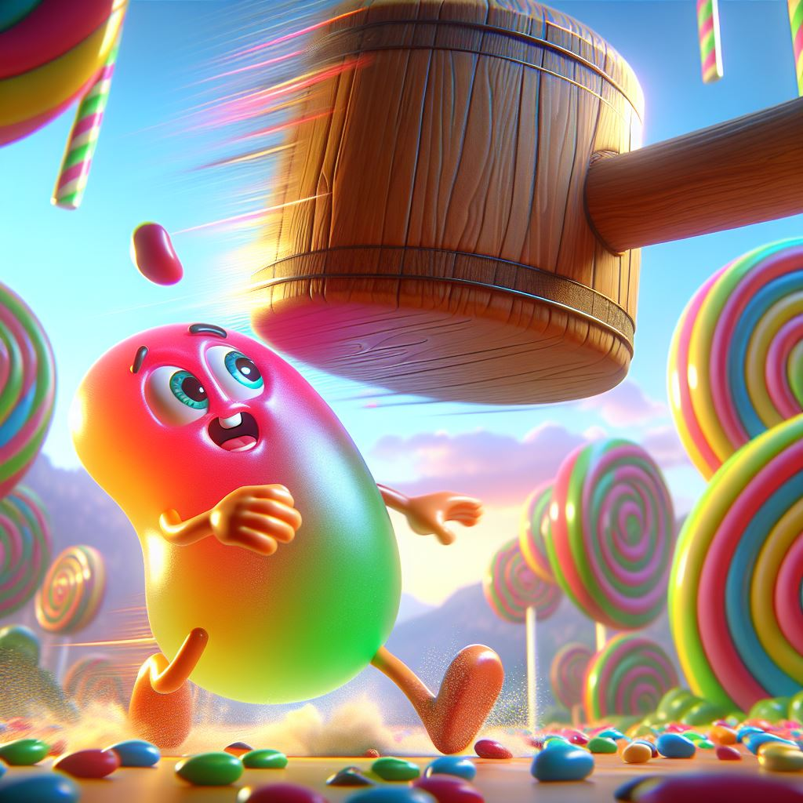
3. 努力
Notes:
But things are not that simple! Seeing that I was almost reaching the finish line, suddenly, I was hit several meters away by a huge hammer and fell directly into the last place! I told myself I couldn't give up, this was just the beginning, I still had a chance! So I worked harder, insisted on standing up, and quickly chased the other jelly beans in front of me. I kept thinking: "Come on, jelly beans, this is just the first level, there is still hope!"

Slide 7
3. 努力
Notes:
But things are not that simple! Seeing that I was almost reaching the finish line, suddenly, I was hit several meters away by a huge hammer and fell directly into the last place! I told myself I couldn't give up, this was just the beginning, I still had a chance! So I worked harder, insisted on standing up, and quickly chased the other jelly beans in front of me. I kept thinking: "Come on, jelly beans, this is just the first level, there is still hope!"

Slide 8
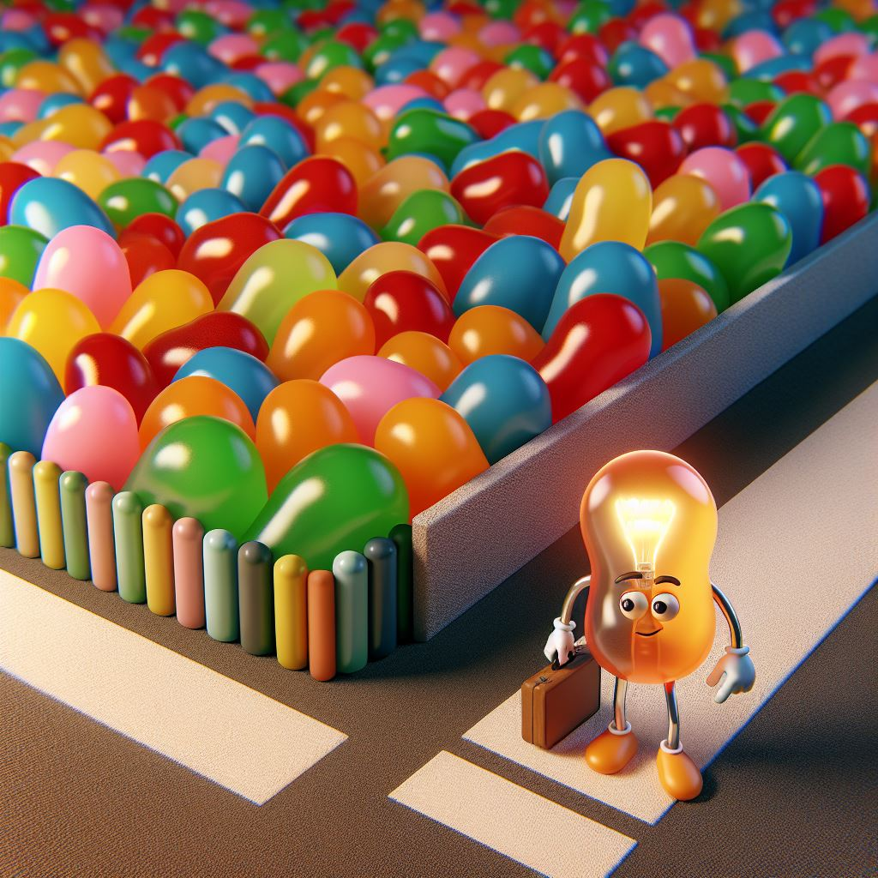
4. 結果
Notes:
Then something unexpected happened - I suddenly found that the road ahead was packed, and other jellybeans were crowded into a narrow corner, pushing each other, unable to move forward at all! At this time, I had an idea and thought of a turning strategy. I decided not to squeeze in with everyone, but went around to a side road that no one seemed to be paying attention to. Although it took a little more detour, I successfully avoided the crowded area and passed the obstacle quickly.

Slide 9
4. 結果
Notes:
Then something unexpected happened - I suddenly found that the road ahead was packed, and other jellybeans were crowded into a narrow corner, pushing each other, unable to move forward at all! At this time, I had an idea and thought of a turning strategy. I decided not to squeeze in with everyone, but went around to a side road that no one seemed to be paying attention to. Although it took a little more detour, I successfully avoided the crowded area and passed the obstacle quickly.

Slide 10
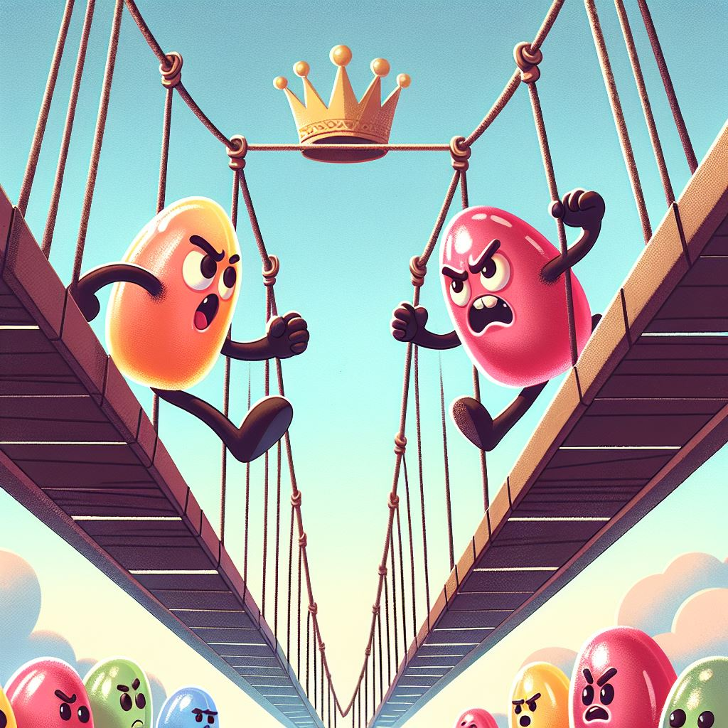
5. 意外
Notes:
The next level is the "Swinging Bridge", and every step is thrilling. The bridge could flip over and throw me off at any time, but this time I focused more on it and moved forward steadily step by step. Just when I was about to reach the finish line, suddenly a jelly bean man rushed over from behind me and tried to pass me! My heart beat faster, seeing that he was only one step away from the crown. crown in the sky

Slide 11
5. 意外
Notes:
The next level is the "Swinging Bridge", and every step is thrilling. The bridge could flip over and throw me off at any time, but this time I focused more on it and moved forward steadily step by step. Just when I was about to reach the finish line, suddenly a jelly bean man rushed over from behind me and tried to pass me! My heart beat faster, seeing that he was only one step away from the crown. crown in the sky

Slide 12
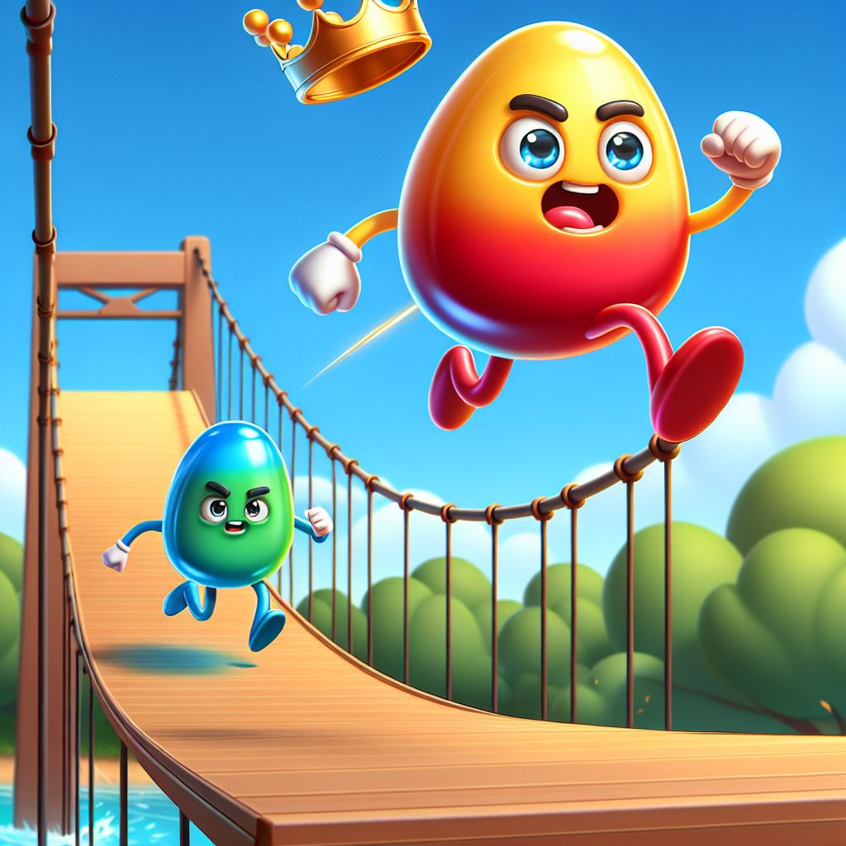
6. 轉彎
Notes:
At this time, I took a deep breath, tried to concentrate all my strength, and jumped up at the last second - I finally caught the crown! What's the result? Yes, I managed to win the contest! At this moment, all the efforts were worth it.

Slide 13
6. 轉彎
Notes:
At this time, I took a deep breath, tried to concentrate all my strength, and jumped up at the last second - I finally caught the crown! What's the result? Yes, I managed to win the contest! At this moment, all the efforts were worth it.

Slide 14
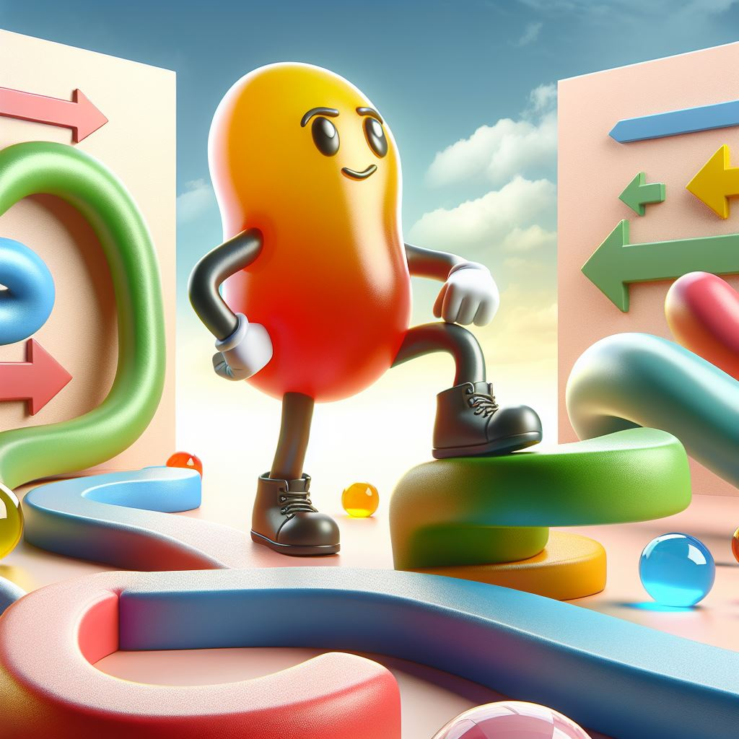
7. 結局
Notes:
But you know what? This adventure taught me not only victory, but more importantly - the determination and wisdom to stand up again every time I fall. Every turn, every difficulty, is an opportunity to become stronger.
I am Sweet Pea, and my adventures will never stop. Next time, I will challenge the champion again!

