Slide 1

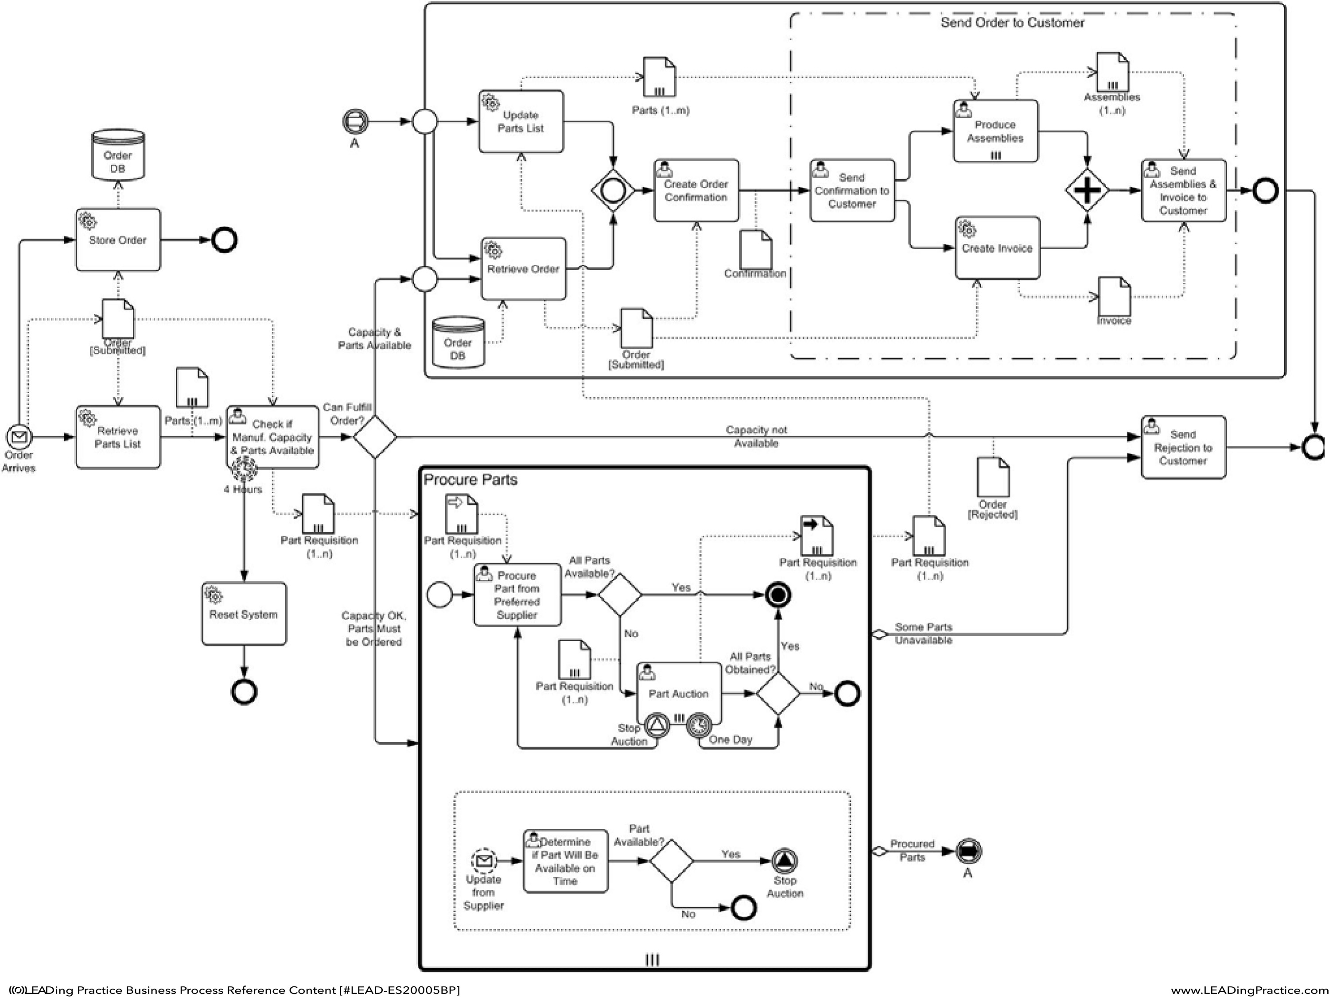







RP 14: Clinical pathway discovery based on electronic health record data
Praveen Jagan Nath², Britta Böckmann², Christoph M. Friedrich², Elizabeth Livingstone¹
¹ UHE; ² FHDO
Motivation Figure
Clinical guidelines and standard operating procedures (SOPs) provide essential, evidence- based knowledge for melanoma treatment
Thier unstructured format and lack of overiview in electronic health records hinder personalized and focused treatment decisions
This created an opportunity to develop data- driven models that link SOPs and clinical pathways with individual patient context
Extraction and representation of logs from FHIR patient resources (SHIP) based on Encounter data (2019).
Materials and Methods
Data Accessibillity
Log extraction
Melanoma SOP
Compare
Decision Support
Export
Discovery
Compare
FHIR-PYRATE
FHIR-METRICS
HMMs/
BPMN individual pathways
VPAEs
Consensus Pathway
Process mining approach to extract event logs from SHIP (database) health records, visualizing them as BPMN models. Techniques such as Hidden Markov Models and Variational Predictive Autoencoders will reveal patient pathways, enabling real-time comparison of clinical journeys with SOPs to guide optimal treatment decisions.
Connections Next Steps
RP01
RP08
Jessica Swoboda
Catharina Beckmann
Develop decision support at the point of care
Discover clinical pathway using over 3000 melanoma patient datasets.
BPMN/Continuation of project
FHIR resource analysis
Evaluate pathways against manually modelled SOP which will be used as gold standard.
RP14 PJN
Connect pathways with EHR data to provide personalized treatment recommendations
AI /Clinical Pathway
Workflow, Process mining
Support physicians with personalized guidance for melanoma treatment.
Enhance treatment quality and efficiency by aligning data with clinical guidelines
Johannes Wutzkowsky
RP17
Mikel Bahn

