Slide 1
Microbiome Center Bootcamp: Sequencing Technology
Dr. Darrell Cockburn Associate Professor of Food Science

Slide 2
Why does sequencing technology matter?
The various sequencing technologies out there generally all have the same goal of finding the sequence of the DNA (or RNA) in your sample, so why does the technology used matter?
It comes down to a series of tradeoffs that the various sequencing platforms/kits offer. There are some differences in technical capabilities, but it mostly comes down to three factors:
Cost/Number of Reads/total output
Error Rate
Read Length

Slide 3
Long vs. short read technologies
Why does read length matter?
Shorter reads mean more depth – more likely to find rarer things
Shorter reads can be (but are not always) associated with greater total throughput, so can give better total coverage
Longer reads make it easier to join things together into even bigger pieces such as for full genes, operons, chromosomes or genomes
Longer reads are much better for detecting structural variants, i.e. insertions, deletions, duplications, rearrangements

Slide 4
Illumina Technology
Illumina technology is the most popular in use today
It is a short-read technology, technically limited to about 500 bp§, but often less depending on how the sequencing is performed
Known for excellent error rates
Notes:
The dye linked bases have a reversible terminator that only allows one to be added at a time. So a base is added, the fluorescent signal is recorded so that what base was incorporated at each cluster can be determined, then the terminator is removed and the next cycle begins. § Long read Illumina kits are starting to become available where you can do long read sequencing on an illumina instrument

Slide 5
Question 1: Why use clusters?
In Illumina technology each bound DNA molecule is replicated about 1000x to make clonal clusters of each molecule before sequencing takes place. Why is this necessary?
Improves sensitivity and allows for that really good error rate as you are getting the consensus for the same molecule being sequenced many times in the cluster.

Slide 6
Question 2: Why are the reads short?
The Illumina technology is limited to about 150 or 250 bp read lengths and while you could make the instrument run longer, quality of reads would drop off dramatically? Why is this? Over time the DNA polymerases on the various molecules in the cluster get out of sync and error rate will shoot up.

Slide 7
What’s with all the Seqs?
iSeq100 – 4 million max reads per run (2x150bp)
MiniSeq – 25 million max reads per run (2x150bp)
*MiSeq – 25 million max reads per run (up to 2x300bp)
*NextSeq – 1.2 billion max reads per run (up to 2x300bp)
**NovaSeq – 20 billion max reads per run (up to 2x250bp)
NovaSeqX – 52 billion max reads per run (2x150bp)
* Present at Huck Genomics Core
** Available at Hershey Sequencing Core

Slide 8
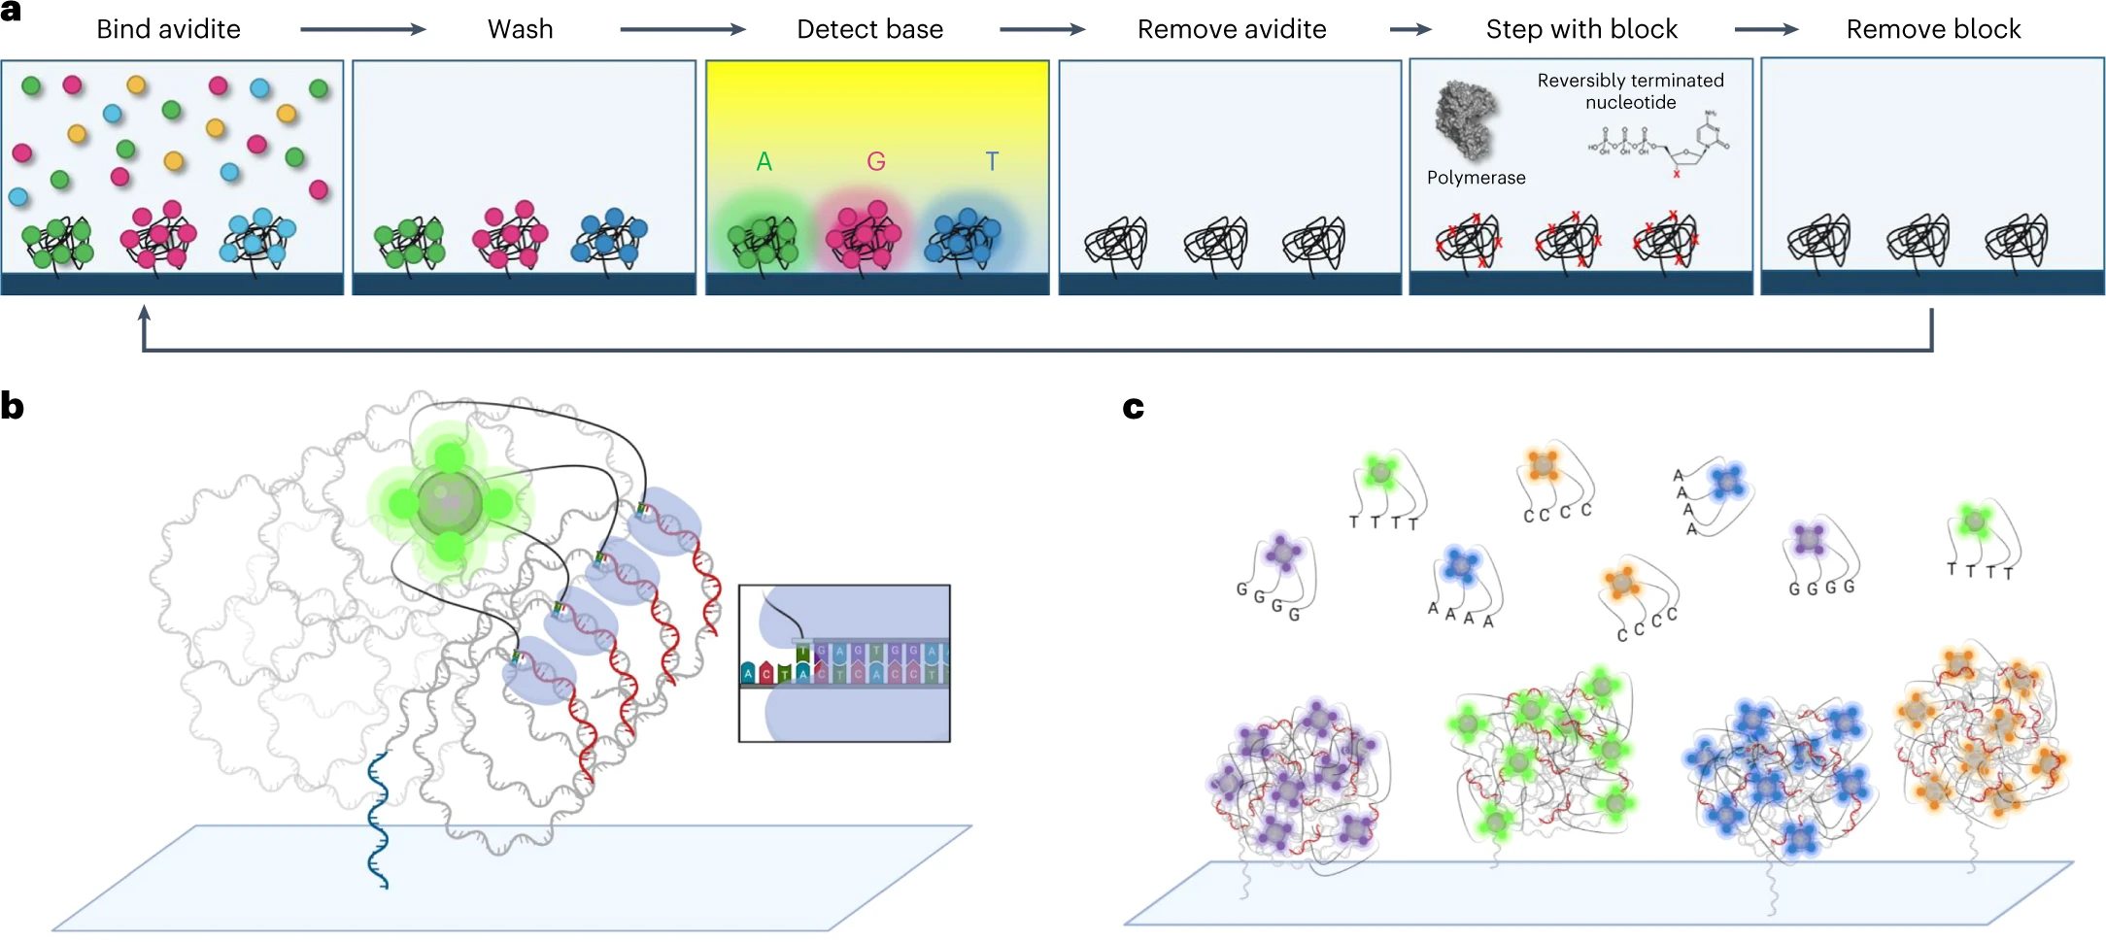
Element Biosciences Aviti
An emerging variation on the sequencing by synthesis paradigm, this process separates base detection and synthesis steps.
Also adds multiple interactions between flurophore and polymerase for avidity effects
Notes:
Instrument has capabilities approximately on par with Illumina NextSeq. Longer read kits available. Main advantage seems to be even lower error rates than achieved with Illumina

Slide 9
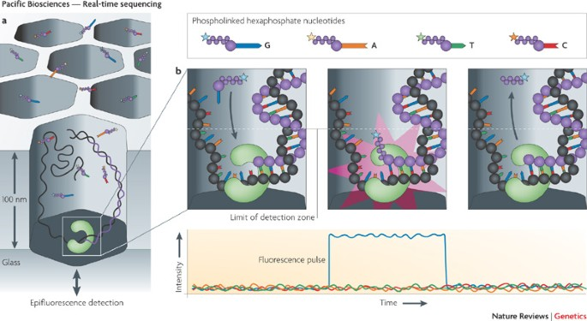
PacBio Technology
A long-read technology, PacBio utilizes a single molecule approach to generating reads – no clustering induced limitations.
Also utilizes real-time sequencing – there is no pause between nucleotide additions. This means that kinetics of base addition can be used to detect modified bases
Doi:10.1038/nrg2626
Notes:
A number of wells called zero-mode waveguides, where each sequencing by synthesis reaction takes place

Slide 10
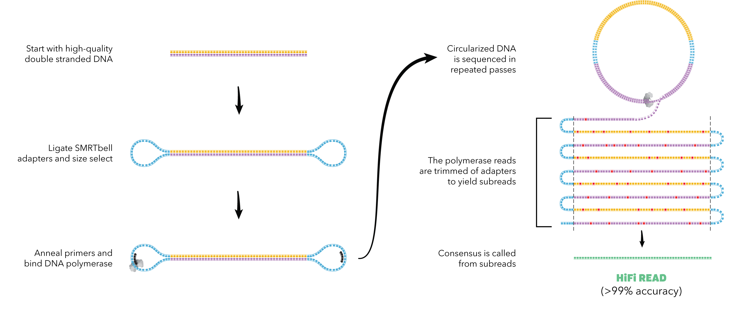
PacBio Mode 1: Circular Consensus Sequencing
In CCS mode, inserts less than about 15-20 Kb get sequenced multiple times (About 10x). A consensus read can then be generated from these sub-reads to get a very high accuracy

Slide 11
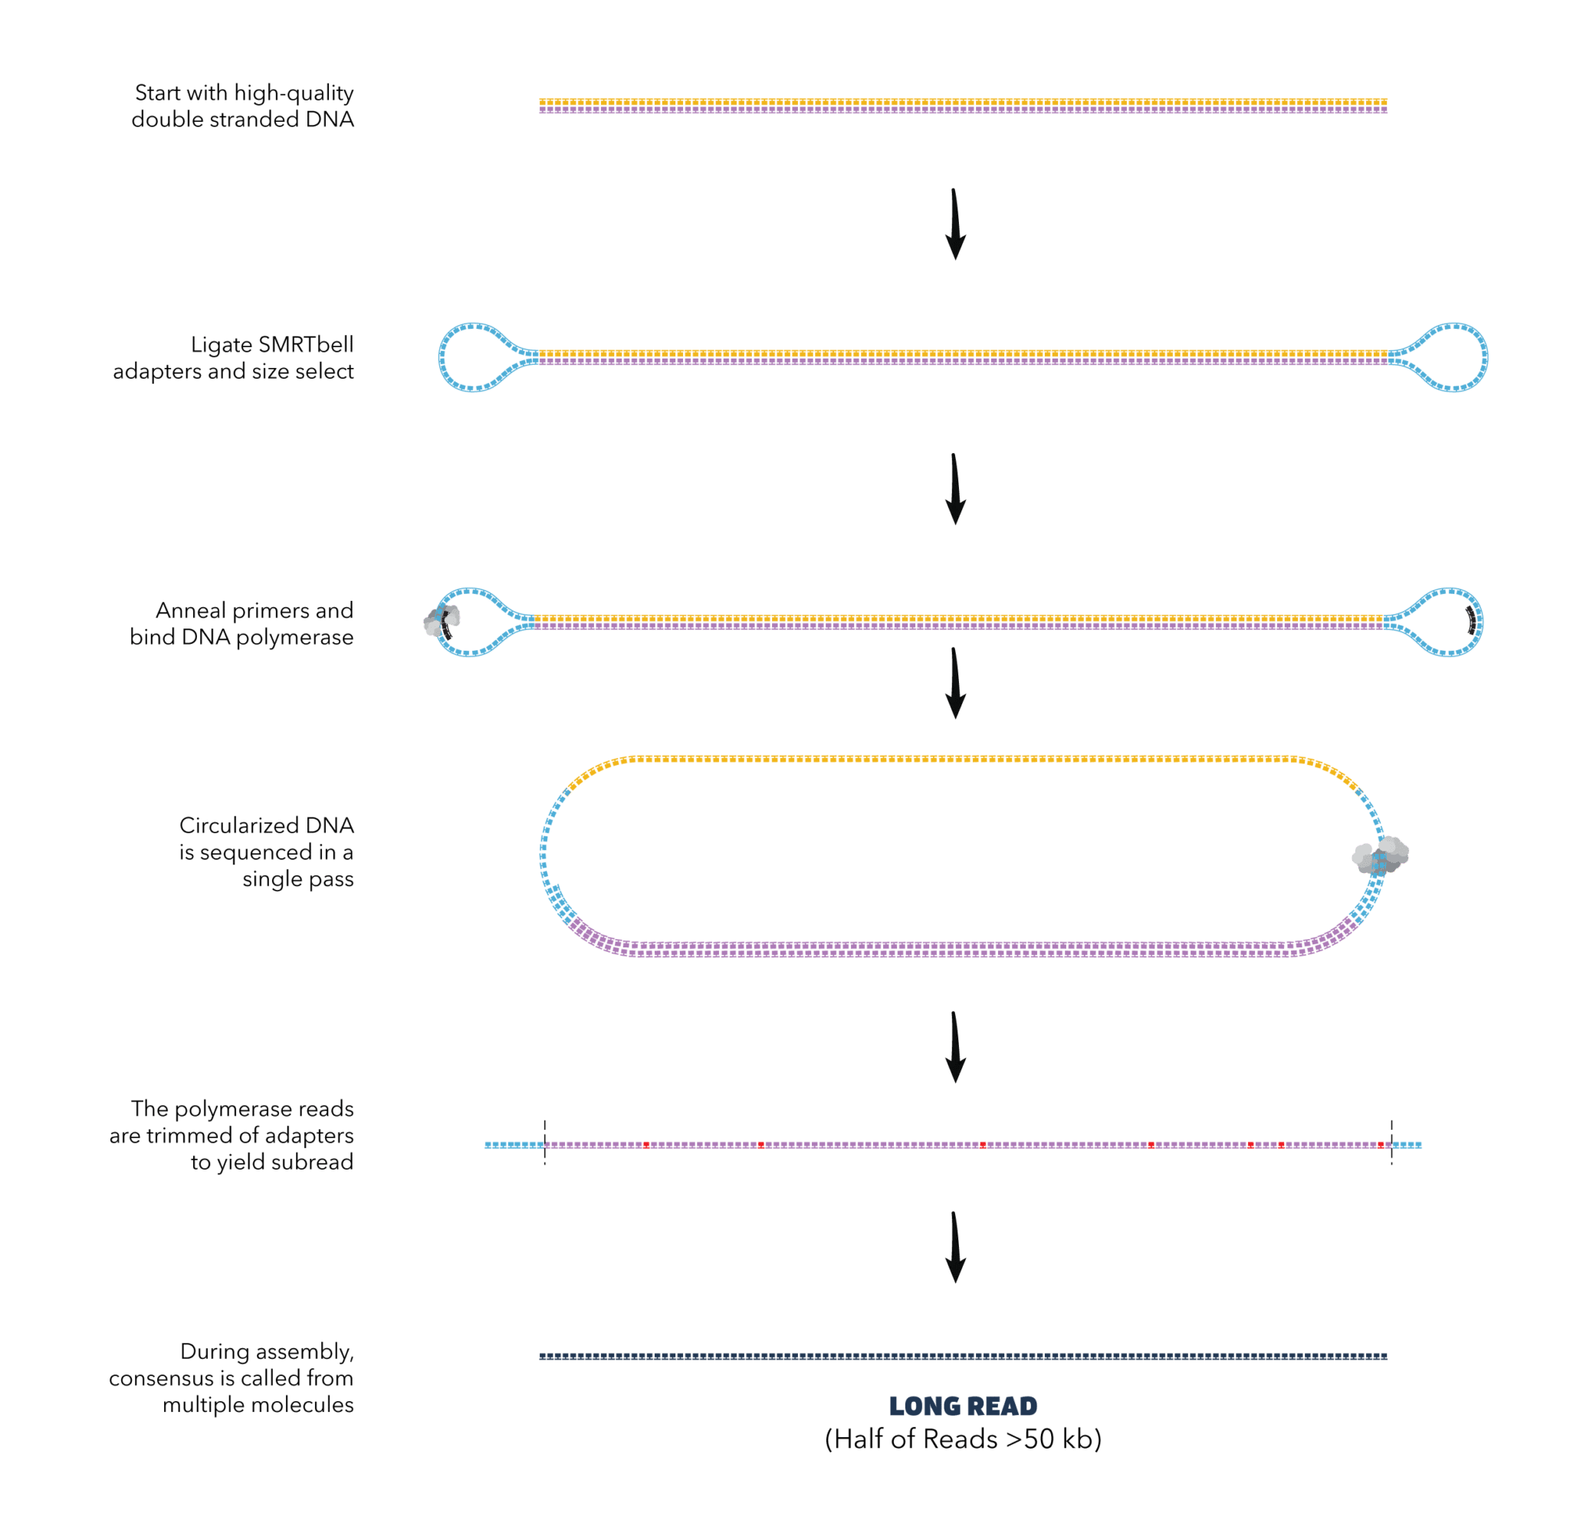
PacBio Mode 2: Continuous Long Read
In this mode the system is optimized to produce as long of reads as possible, but not repeatedly
Limited in length of read by the quality of the DNA (are there intact fragments long enough) and by the maximum single run synthesis by the polymerase
Variable lengths, but many above 50 Kb and up to 175 Kb

Slide 12
PacBio Instruments
*Sequel II has 8 million ZMWs and can generate 2.5 million-4 million reads per run
Revio has 25 million ZMWs per cell, 4 cells so up to 100 million ZMWs up to about 50 million reads
Onso – a short read system with capabilities similar to Aviti
Why do they only generate between 1/3 and ½ the number of reads relative to the number of ZMWs? Poisson distribution to get no more than one DNA molecule per ZMW
* Available in Huck Genomics Core

Slide 13
Oxford Nanopore technology
Another long-read (up to 2 Mb!) technology that uses single molecules
This differs from the others we have discussed in that it is not sequencing by synthesis, rather individual bases are detected in turn as they pass through a nanopore and disrupt an ionic current
Potentially significantly cheaper than the other technologies (depending on instrument and experiment)
Big drawback is error rate – initially as high as 30%!, now latest flow cells and chemistries seem to be down to <2%
Notes:
Though the company claims <0.2% error rates, real world experience doesn’t seem to quite reach these levels. Other techs are ranging from 0.1-0.01% error rates

Slide 14
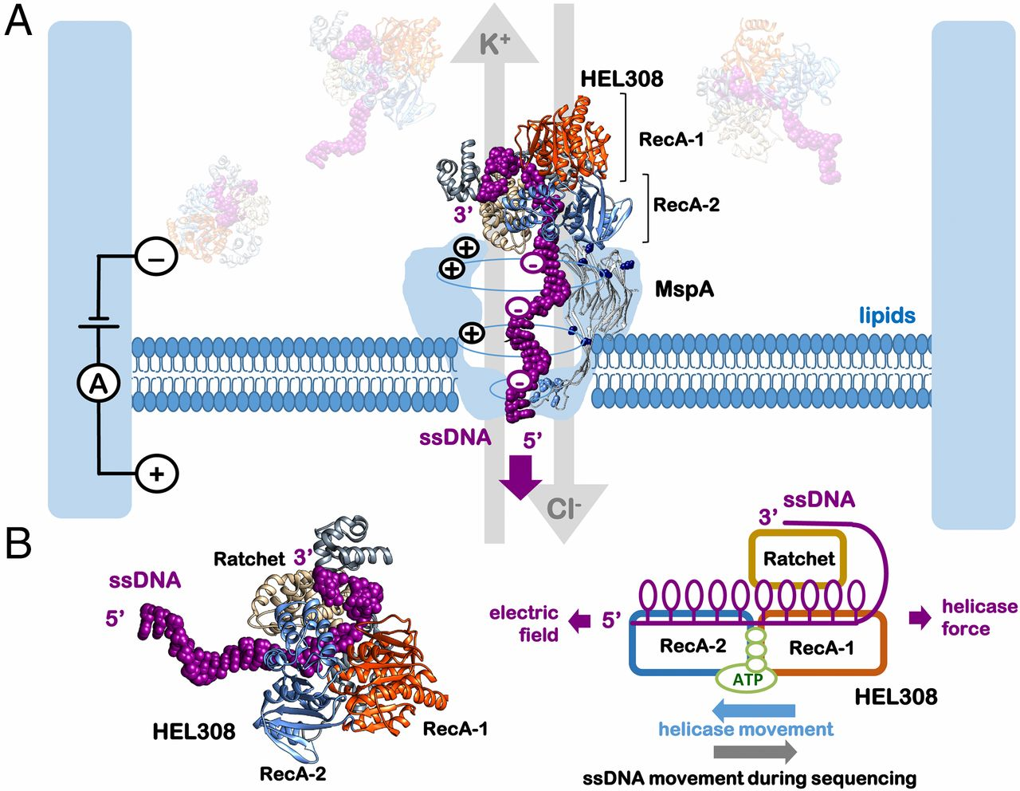
Nanopore Technology
Each nanopore is created by a pore forming protein that DNA can be fed through
A motor protein, DNA helicase unwinds a single strand of DNA and pushes it through the pore
Changes in ion flow between the compartments is analyzed to determine the base sequence of the DNA
Notes:
Updates to the ‘chemistry’ are changes in sample prep, updates to flow cells are primarily alterations to these pore/helicase proteins. Software improvements are also possible.

Slide 15
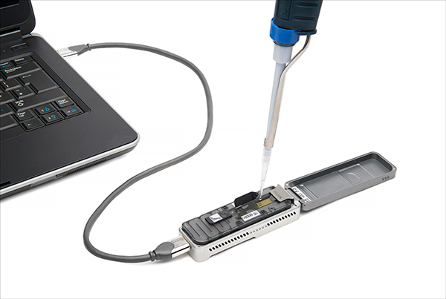
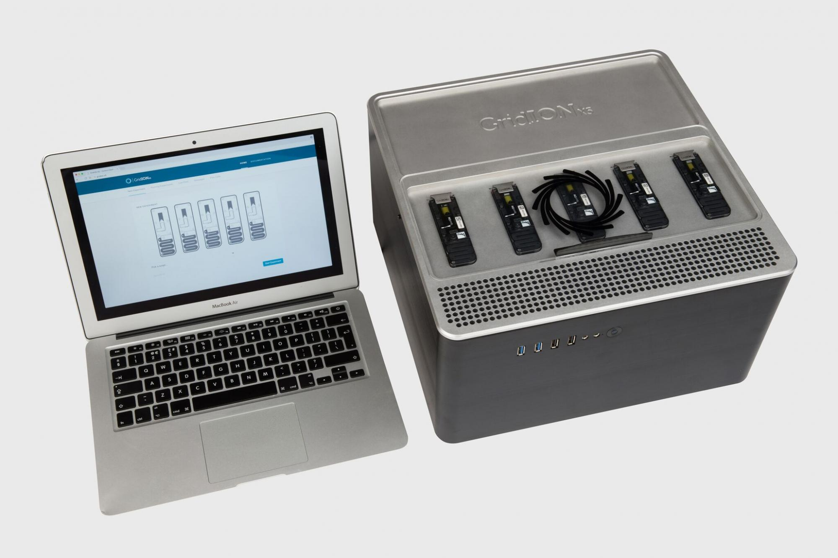
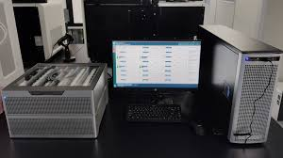
The Instruments
*MinIon – Processes one flow cell with 512 nanopores, capable of up to 30 Gb of sequencing
GridIon – Process up to 5 flow cells at a time (+ built in computing power for analysis)
PromethIon – Process up to 48 flow cells at a time each with 3000 nanopores for up to 8 Tb of data per run!
Notes:
Available in Huck Genomics Sequencing Core. Coming soon SmidgION that connects directly to your smart phone!

Slide 16
Applications
Real time sequencing results – can be out in the field with these instruments (especially MinIon) and be getting results within minutes for rapid diagnostic purposes
Read Until… - possible to have the instrument selectively sequence certain sequence signatures – if it doesn’t match a certain pattern within the first few bases, DNA molecule can be expelled from pore and a new one bound
Direct analysis of molecule without sequencing by synthesis allows direct detection of DNA/RNA modifications (including direct reading of RNA

Slide 17
Combining short and long read technology
Would there be any advantage to combining these various technologies?
For long assemblies such as genomes, long reads can be used to provide the majority of the assembly and short reads can be used to error correct.
Alternatively, the short reads can be used to provide the majority of the sequence and long reads can be used to help assemble them
With metagenomes long reads can provide enhanced assemblies, while short reads can provide depth to detect rare taxa

Slide 18
Questions:
1. What aspects of your mars sampling project would you need to consider when choosing your sequencing technology/approach
2. Which technology/approach would you choose?
3. If you had to consider costs would your answer change?

