Slide 1

sourmash
a tutorial on the FracMinHash sketch approach
for metagenomic data
Judith Rodriguez^{1,2,3} and David Koslicki^{1,2,3,4}
Bioinformatics and Genomics Program, Penn State
Life Sciences Huck Institute, Penn State
Department of Electrical Engineering and Computer Science, Penn State
Department of Biology, Penn State

Slide 2

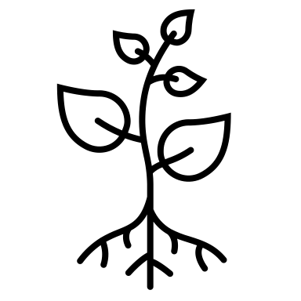


Genomics and metagenomics research can be computationally overwhelming
Metagenome
Sampling
Whole Shotgun Sequencing
400k genomes
80k species
3TB genetic data
More accessible sequencing
Leading to time consuming analyses

Slide 3

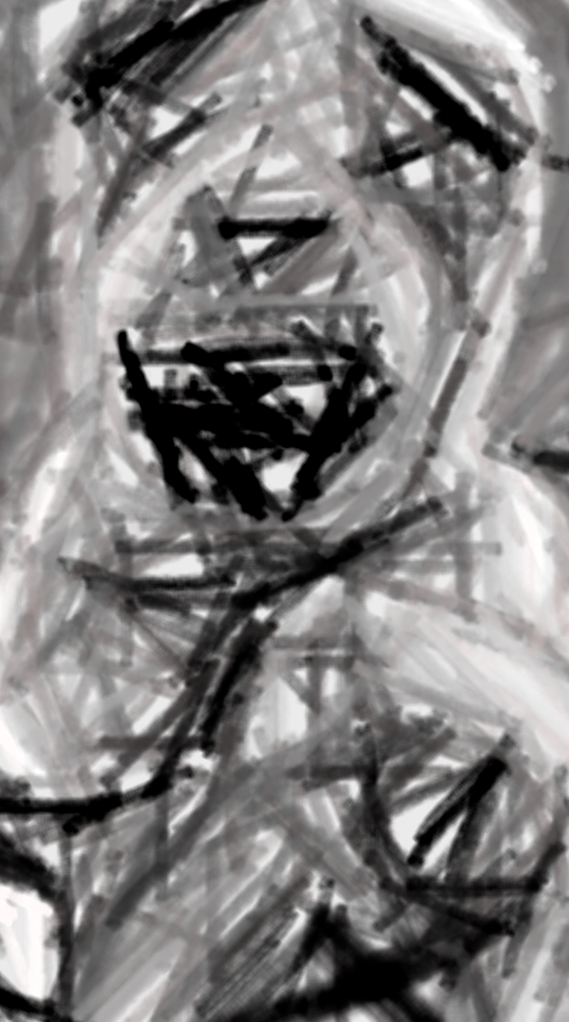

sketching approaches can help with big data
Do we recognize who this is?
Condense data to a simpler representation

Slide 4
sourmash facilitates sketching and analyses of large sequencing data
sequence
k-mers
k-mer set
k-mer sketch
Let’s take a closer look into utilizing sourmash…
https://sourmash.readthedocs.io/
Brown, C. T., & Irber, L. (2016). sourmash: a library for MinHash sketching of DNA. Journal of open source software, 1(5), 27.

Slide 5
sourmash sketch
first step in
sourmash analyses

Slide 6



The FracMinHash sketch
Genome A
k-mer Set A
FRAC_{s}(A)
Scale Factor
$${FRAC}_{s}\left(A\right)=\{h(a)|a ∈A and h\left(a\right)≤Hs\}$$
$$s.H$$
0
$$H$$
$${FRAC}_{s}(A)$$
Hera, M. R., Pierce-Ward, N. T., & Koslicki, D. (2023). Deriving confidence intervals for mutation rates across a wide range of evolutionary distances using FracMinHash. Genome research, 33(7), 1061-1068.

Slide 7
sourmash sketch producing a FracMinHash sketch
Genome A
k-mer Set A
FRAC_{s}(A)
Scale Factor
sourmash sketch <dna, protein, translate> <FASTA/Q> -p k=<ksize>,scaled=<int>
sourmash command

Slide 8
sourmash sketch producing a FracMinHash sketch
Genome A
k-mer Set A
FRAC_{s}(A)
Scale Factor
sourmash sketch <dna, protein, translate> <FASTA/Q> -p k=<ksize>,scaled=<int>
identify the type of input sequences

Slide 9
sourmash sketch producing a FracMinHash sketch
Genome A
k-mer Set A
FRAC_{s}(A)
Scale Factor
sourmash sketch <dna, protein, translate> <FASTA/Q> -p k=<ksize>,scaled=<int>
Identify the filename with sequences

Slide 10
sourmash sketch producing a FracMinHash sketch
Genome A
k-mer Set A
FRAC_{s}(A)
Scale Factor
sourmash sketch <dna, protein, translate> <FASTA/Q> -p k=<ksize>,scaled=<int>
Flag required to tune parameters

Slide 11
sourmash sketch producing a FracMinHash sketch
Genome A
k-mer Set A
FRAC_{s}(A)
Scale Factor
sourmash sketch <dna, protein, translate> <FASTA/Q> -p k=<ksize>,scaled=<int>
Identify the filename with sequences

Slide 12
sourmash sketch producing a FracMinHash sketch
Genome A
k-mer Set A
FRAC_{s}(A)
Scale Factor
sourmash sketch <dna, protein, translate> <FASTA/Q> -p k=<ksize>,scaled=<int>
scales down sketch

Slide 13
sourmash sketch producing a FracMinHash sketch
Genome A
k-mer Set A
FRAC_{s}(A)
Scale Factor
sourmash sketch <dna, protein, translate> <FASTA/Q> -p k=<ksize>,scaled=<int>
Example: scaled=10
will keep 1 of 10 k-mers

Slide 14
sourmash compare
perform pairwise similarity estimations between metagenomic samples

Slide 15
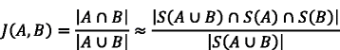
Estimating similarity indexes: jaccard
set A
set B
Indexes close to 1 are interpreted as more similar

Slide 16
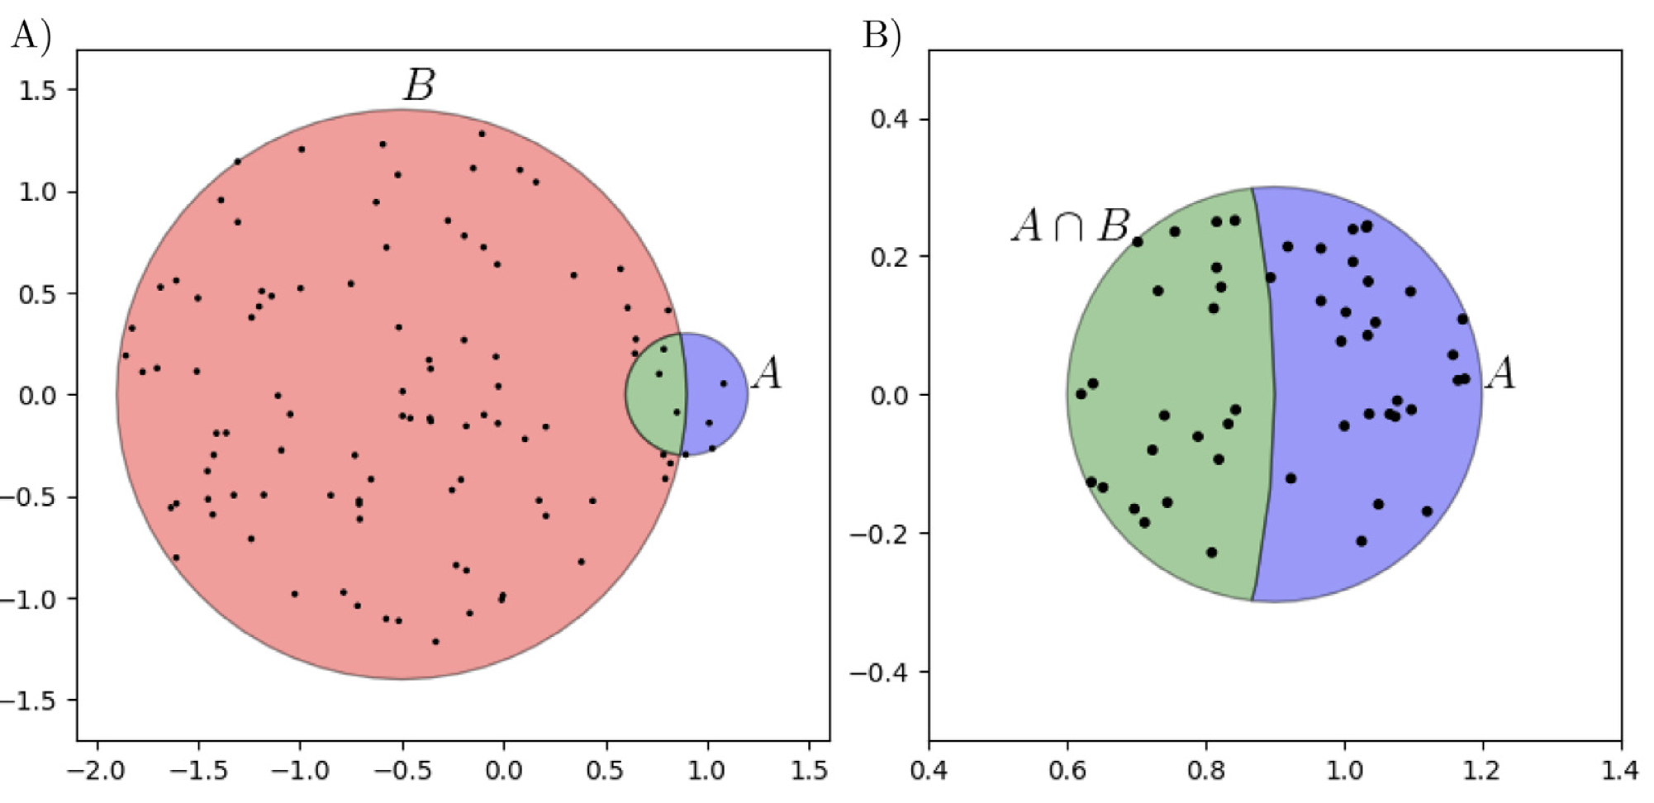
However, the jaccard estimate becomes worse with differing set sizes

Slide 17
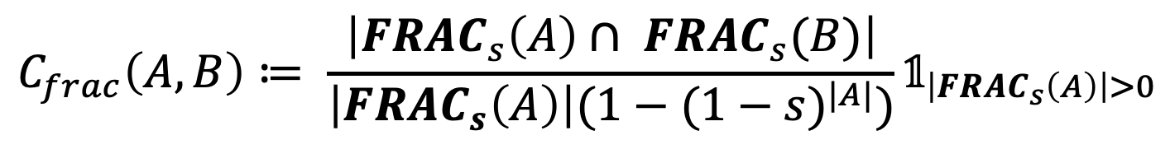
Estimating similarity indexes: containment
…addresses issues using in jaccard
Genome A
k-mer Set A
k-mer Set B
Genome B
FRAC_{s}(A)
FRAC_{s}(B)
Scale Factor
Scale Factor
$$C_{frac}\left(A,B\right)≔ \frac{\left|{FRAC}_{s}\left(A\right)∩ {FRAC}_{s}(B)\right|}{\left|{FRAC}_{s}\left(A\right)\right|({1−(1−s)}^{|A|})}𝟙_{\left|{FRAC}_{s}\left(A\right)\right|>0}$$
Hera and colleagues 2023

Slide 18
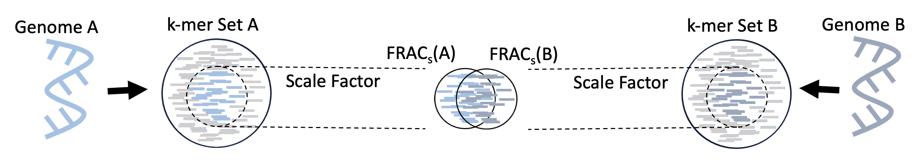
sourmash compare
Estimate the containment between two genomes
sourmash compare <ref signature> <query signature> --containment --ksize <ksize>
sourmash command

Slide 19
sourmash compare
Estimate the containment between two genomes
sourmash compare <query signature> <ref signature> --containment --ksize <ksize>
sample of interest

Slide 20
sourmash compare
Estimate the containment between two genomes
sourmash compare <query signature> <ref signature> --containment --ksize <ksize>
compared to another sample

Slide 21
sourmash compare
Estimate the containment between two genomes
sourmash compare <query signature> <ref signature> --containment --ksize <ksize>
indicate the
similarity index

Slide 22
sourmash compare
Estimate the containment between two genomes
sourmash compare <query signature> <ref signature> --containment --ksize <ksize>

Slide 23
sourmash search
report highly similar sequences data between samples

Slide 24
sourmash search
First, produce a MANIFEST.csv to search using an md5 identifier as the query
sourmash sig manifest <signature file> -o MANIFEST.csv
command for further options to information from signatures

Slide 25
sourmash search
First, produce a MANIFEST.csv to search using an md5 identifier as the query
sourmash sig manifest <signature file> -o MANIFEST.csv
option to create MANIFEST

Slide 26
sourmash search
First, produce a MANIFEST.csv to search using an md5 identifier as the query
sourmash sig manifest <signature file> -o MANIFEST.csv
input signature query of interest

Slide 27
sourmash search
First, produce a MANIFEST.csv to search using an md5 identifier as the query
sourmash sig manifest <signature file> -o MANIFEST.csv
output name flag

Slide 28
sourmash search
First, produce a MANIFEST.csv to search using an md5 identifier as the query
sourmash sig manifest <signature file> -o sample_001.manifest.csv
# SOURMASH-MANIFEST-VERSION: 1.0
internal_location,md5,md5short,ksize,moltype,num,scaled,n_hashes,with_abundance,name,filename
sample_001.fna.singleton.sig,d3513280b35b2a918a7181875c0683c8,d3513280,31,DNA,0,500,22,0,genome_A,sample_001.fna
sample_001.fna.singleton.sig,2d96ee330b6b295a06b70fdbfb75af34,2d96ee33,31,DNA,0,500,21,0,genome_B,sample_001.fna
sample_001.fna.singleton.sig,364c20a1ca43d3ae3e9ae7d9e9a6c837,364c20a1,31,DNA,0,500,19,0,genome_C,sample_001.fna
Column Name | Description
internal_location | Name of signature file
md5 | Name for sketch
ksize | Size used to produce k-mers
moltype | Type of sequence: DNA, Protein
scaled | Parameter used for sourmash sketch to reduce k-mer set
n_hashes | Total k-mers in final sketch
name | Sequence name in FASTA/Q
filename | Input FASTA/Q name

Slide 29
sourmash search
First, produce a MANIFEST.csv to search using an md5 identifier as the query
sourmash sig manifest <signature file> -o sample_001.manifest.csv
# SOURMASH-MANIFEST-VERSION: 1.0
internal_location,md5,md5short,ksize,moltype,num,scaled,n_hashes,with_abundance,name,filename
sample_001.fna.singleton.sig,d3513280b35b2a918a7181875c0683c8,d3513280,31,DNA,0,500,22,0,genome_A,sample_001.fna
sample_001.fna.singleton.sig,2d96ee330b6b295a06b70fdbfb75af34,2d96ee33,31,DNA,0,500,21,0,genome_B,sample_001.fna
sample_001.fna.singleton.sig,364c20a1ca43d3ae3e9ae7d9e9a6c837,364c20a1,31,DNA,0,500,19,0,genome_C,sample_001.fna
sourmash search <signature query> <signature ref> --md5 d3513280b35b2a918a7181875c0683c8 --containment
command to searching signatures

Slide 30
sourmash search
First, produce a MANIFEST.csv to search using an md5 identifier as the query
sourmash sig manifest <signature file> -o sample_001.manifest.csv
# SOURMASH-MANIFEST-VERSION: 1.0
internal_location,md5,md5short,ksize,moltype,num,scaled,n_hashes,with_abundance,name,filename
sample_001.fna.singleton.sig,d3513280b35b2a918a7181875c0683c8,d3513280,31,DNA,0,500,22,0,genome_A,sample_001.fna
sample_001.fna.singleton.sig,2d96ee330b6b295a06b70fdbfb75af34,2d96ee33,31,DNA,0,500,21,0,genome_B,sample_001.fna
sample_001.fna.singleton.sig,364c20a1ca43d3ae3e9ae7d9e9a6c837,364c20a1,31,DNA,0,500,19,0,genome_C,sample_001.fna
sourmash search <signature query> <signature ref> --md5 d3513280b35b2a918a7181875c0683c8 --containment
signature file where md5 of interest is found

Slide 31
sourmash search
First, produce a MANIFEST.csv to search using an md5 identifier as the query
sourmash sig manifest <signature file> -o sample_001.manifest.csv
# SOURMASH-MANIFEST-VERSION: 1.0
internal_location,md5,md5short,ksize,moltype,num,scaled,n_hashes,with_abundance,name,filename
sample_001.fna.singleton.sig,d3513280b35b2a918a7181875c0683c8,d3513280,31,DNA,0,500,22,0,genome_A,sample_001.fna
sample_001.fna.singleton.sig,2d96ee330b6b295a06b70fdbfb75af34,2d96ee33,31,DNA,0,500,21,0,genome_B,sample_001.fna
sample_001.fna.singleton.sig,364c20a1ca43d3ae3e9ae7d9e9a6c837,364c20a1,31,DNA,0,500,19,0,genome_C,sample_001.fna
sourmash search <signature query> <signature ref> --md5 d3513280b35b2a918a7181875c0683c8 --containment
signature file that will be searched against

Slide 32
sourmash search
First, produce a MANIFEST.csv to search using an md5 identifier as the query
sourmash sig manifest <signature file> -o sample_001.manifest.csv
# SOURMASH-MANIFEST-VERSION: 1.0
internal_location,md5,md5short,ksize,moltype,num,scaled,n_hashes,with_abundance,name,filename
sample_001.fna.singleton.sig,d3513280b35b2a918a7181875c0683c8,d3513280,31,DNA,0,500,22,0,genome_A,sample_001.fna
sample_001.fna.singleton.sig,2d96ee330b6b295a06b70fdbfb75af34,2d96ee33,31,DNA,0,500,21,0,genome_B,sample_001.fna
sample_001.fna.singleton.sig,364c20a1ca43d3ae3e9ae7d9e9a6c837,364c20a1,31,DNA,0,500,19,0,genome_C,sample_001.fna
sourmash search <signature query> <signature ref> --md5 d3513280b35b2a918a7181875c0683c8 --containment
md5 identifier of interest indicated

Slide 33
sourmash search
First, produce a MANIFEST.csv to search using an md5 identifier as the query
sourmash sig manifest <signature file> -o sample_001.manifest.csv
# SOURMASH-MANIFEST-VERSION: 1.0
internal_location,md5,md5short,ksize,moltype,num,scaled,n_hashes,with_abundance,name,filename
sample_001.fna.singleton.sig,d3513280b35b2a918a7181875c0683c8,d3513280,31,DNA,0,500,22,0,genome_A,sample_001.fna
sample_001.fna.singleton.sig,2d96ee330b6b295a06b70fdbfb75af34,2d96ee33,31,DNA,0,500,21,0,genome_B,sample_001.fna
sample_001.fna.singleton.sig,364c20a1ca43d3ae3e9ae7d9e9a6c837,364c20a1,31,DNA,0,500,19,0,genome_C,sample_001.fna
sourmash search <signature query> <signature ref> --md5 d3513280b35b2a918a7181875c0683c8 --containment
indicate the
similarity index

Slide 34
sourmash search
First, produce a MANIFEST.csv to search using an md5 identifier as the query
sourmash sig manifest <signature file> -o sample_001.manifest.csv
# SOURMASH-MANIFEST-VERSION: 1.0
internal_location,md5,md5short,ksize,moltype,num,scaled,n_hashes,with_abundance,name,filename
sample_001.fna.singleton.sig,d3513280b35b2a918a7181875c0683c8,d3513280,31,DNA,0,500,22,0,genome_A,sample_001.fna
sample_001.fna.singleton.sig,2d96ee330b6b295a06b70fdbfb75af34,2d96ee33,31,DNA,0,500,21,0,genome_B,sample_001.fna
sample_001.fna.singleton.sig,364c20a1ca43d3ae3e9ae7d9e9a6c837,364c20a1,31,DNA,0,500,19,0,genome_C,sample_001.fna
sourmash search <signature query> <signature ref> --md5 d3513280b35b2a918a7181875c0683c8 --containment
select query k=31 automatically.
loaded query: genome_A (k=31, DNA)
–
loaded 10 total signatures from 1 locations. after selecting signatures compatible with search, 10 remain.
9 matches above threshold 0.080; showing first 3:
similarity match
---------- -----
100.0% ref_gene
90.9% genome_A_2
86.4% genome_A_1

Slide 35
sourmash overview

Slide 36
Task
sketch a signature file
sourmash
overview
Produce a scaled down representation of your sequencing data
Commands
sourmash sketch
Task
Task
Output
report similarity highly similar sketches
similarity index matrix
sketch.sig
Report similarity between sequencing data
Commands
sourmash compare
Commands
sourmash search
Output
Output
similarity_matrix.csv
similarity match
---------- -----
100.0% ref_gene
90.9% genome_A_2
86.4% genome_A_1
Match highly similar sequences data

Slide 37
sourmash tutorial
https://github.com/KoslickiLab/sourmash_tutorial

Slide 38
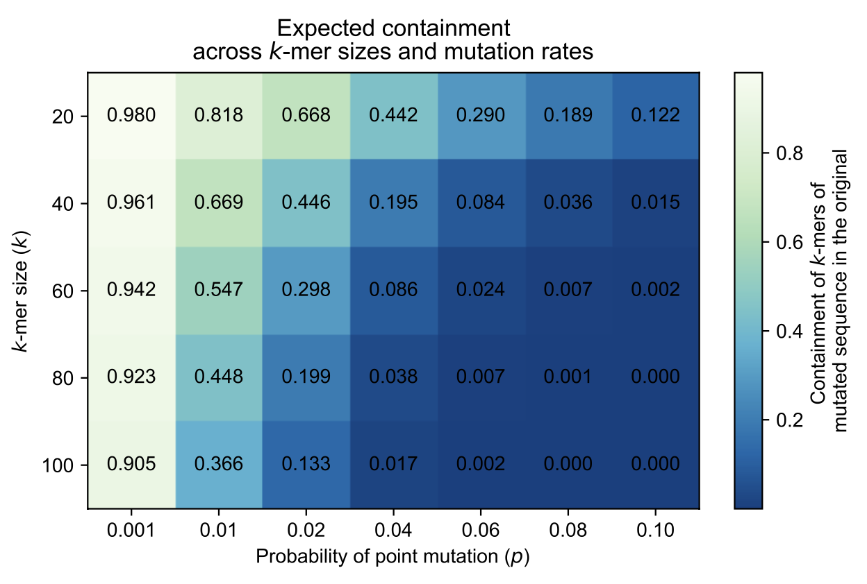
Hera and colleagues, Genome Res, 2023

