Slide 1
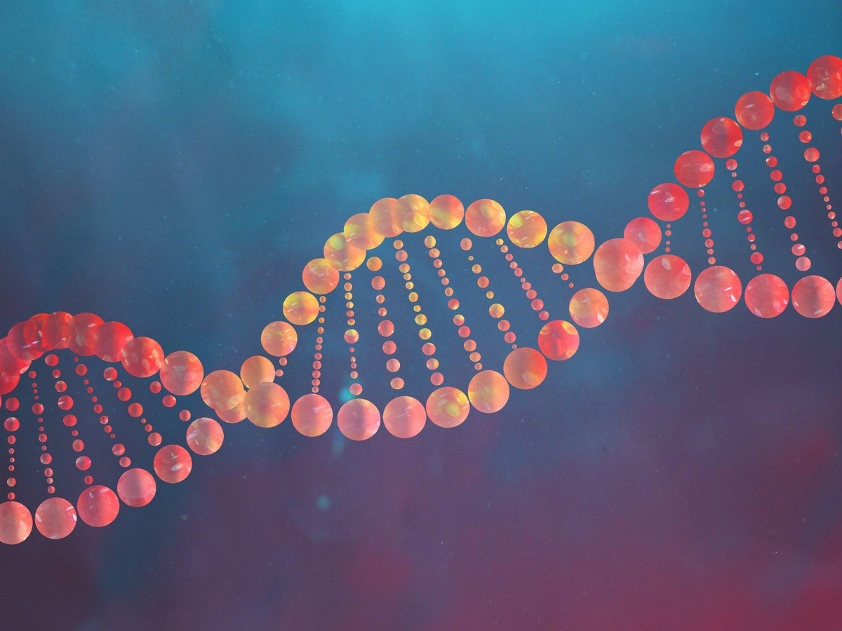
DNA Extraction & Library Preparation
Microbiome Kickstart Workshop August 5th 2026 Molly Bletz, Dept of Ecosystem Science & Management
Image: howstuffworks

Slide 2
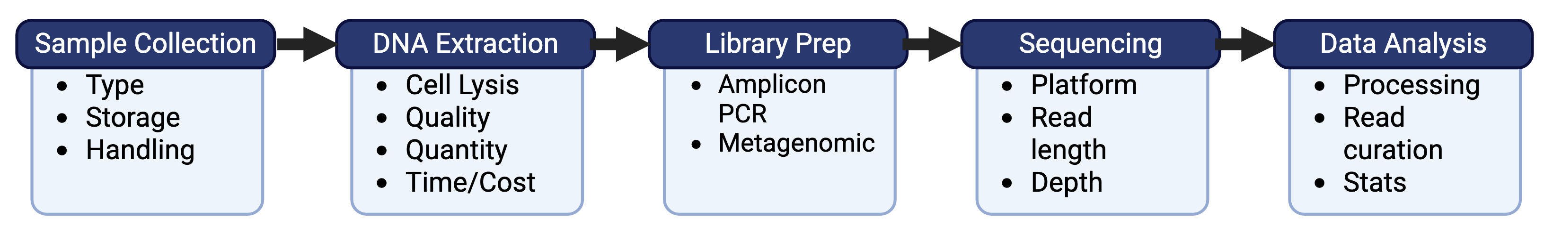
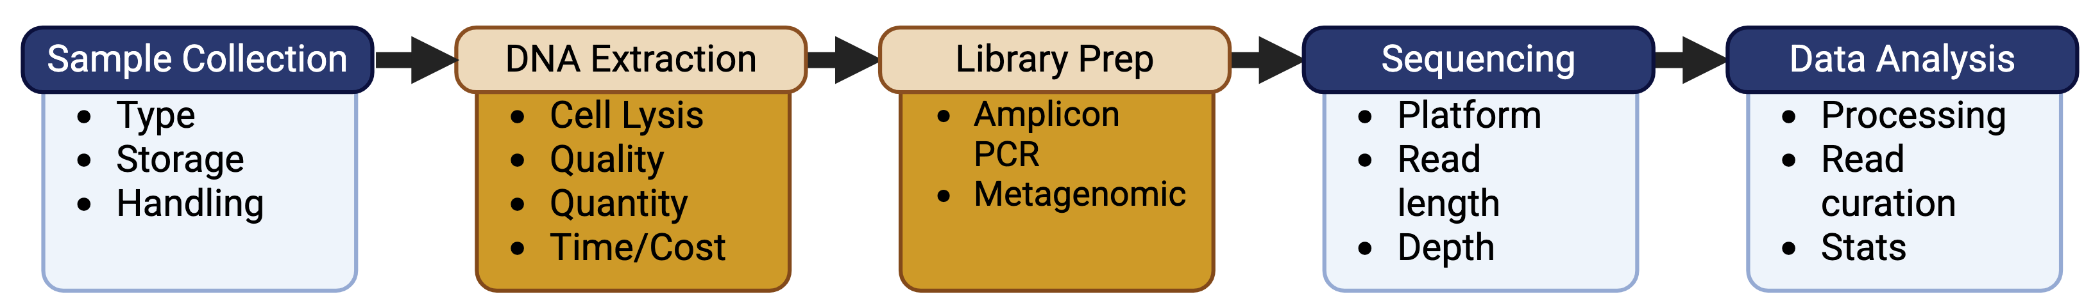
Roadmap
Why it matters: DNA quality & prep impacts microbiome insights
Image: Biorender
Notes:
Recap: Briefly acknowledge previous sessions (Sampling, Controls/Contamination).
You've learned how to carefully collect samples and manage potential contamination – vital first steps!
Today's Focus: Bridge the gap from collected sample to data analysis.
Now, we'll dive into how we get the actual genetic material from your samples and prepare it for the sequencing machines.
Why it matters: Emphasize that these steps are crucial for accurate and unbiased downstream analysis.
The quality of your DNA and how you prepare it directly impacts the reliability of your microbiome insights.

Slide 3
The DNA Extraction Challenge
Diverse microbial cell structures: bacteria, fungi, archaea, viruses
Low biomass samples and host contamination
Inhibitors: e.g., humic acids, bile salts, polysaccharides
Goal: Obtain high-quality, representative DNA from all microbes in your sample.
Notes:
Diverse microbial cell structures require varied lysis strategies
Low biomass samples pose yield challenges
Host contamination can overwhelm microbial signals
Inhibitors interfere with downstream reactions
Why it's challenging:
Diverse Microbial Cell Structures: Different microorganisms have unique cell wall/membrane compositions that require varied lysis strategies.
Bacteria: Gram-positive (thick peptidoglycan) vs. Gram-negative (outer membrane).
Fungi: Chitin-rich cell walls, often requiring specific enzymatic or more vigorous mechanical lysis.
Archaea: Pseudopeptidoglycan or S-layer proteins, can be tough to lyse.
Viruses: No cell wall, but often require specific methods to release genetic material from capsids.
Low Biomass Samples: Skin swabs, air samples, environmental filters, where microbial DNA is scarce.
Host Contamination: Human/animal DNA in clinical samples (gut, skin, oral cavity) can overwhelm microbial signals.
Inhibitors: Substances inherent to samples (e.g., humic acids in soil, heme in blood, bile salts in gut, polysaccharides in plants) that can interfere with downstream enzymatic reactions (PCR, sequencing).

Slide 4
Key Considerations for DNA Extraction
Sample Type
Cell Lysis
DNA Purification/Elution
Host DNA Removal (sometimes important)
Controls
Notes:
1. Sample Type: Dictates the method.
Feces, soil, water, tissue, swabs – each has unique challenges.
Sample Volume and Amount

Slide 5
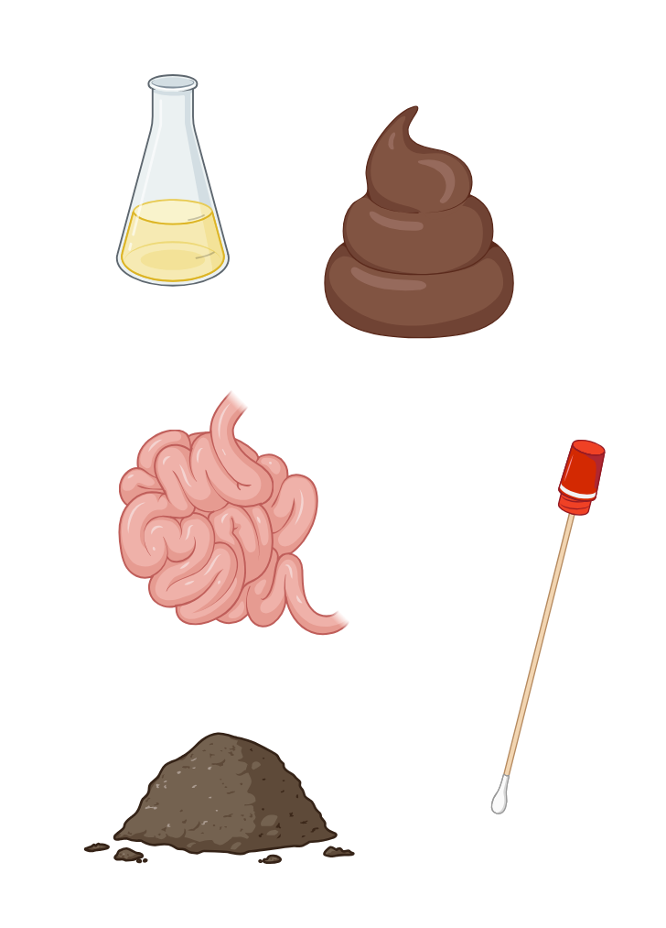
Key Considerations for DNA Extraction
Sample Type: Feces, soil, tissue, swabs
Cell Lysis: Mechanical (bead-beating), enzymatic, chemical
DNA Purification: Silica columns, magnetic beads, phenol-chloroform
Host DNA Removal: Differential lysis, NEBNext kits
Image: Biorender
Notes:
1. Sample Type: Dictates the method.
Feces, soil, water, tissue, swabs – each has unique challenges.
Sample Volume and Amount

Slide 6
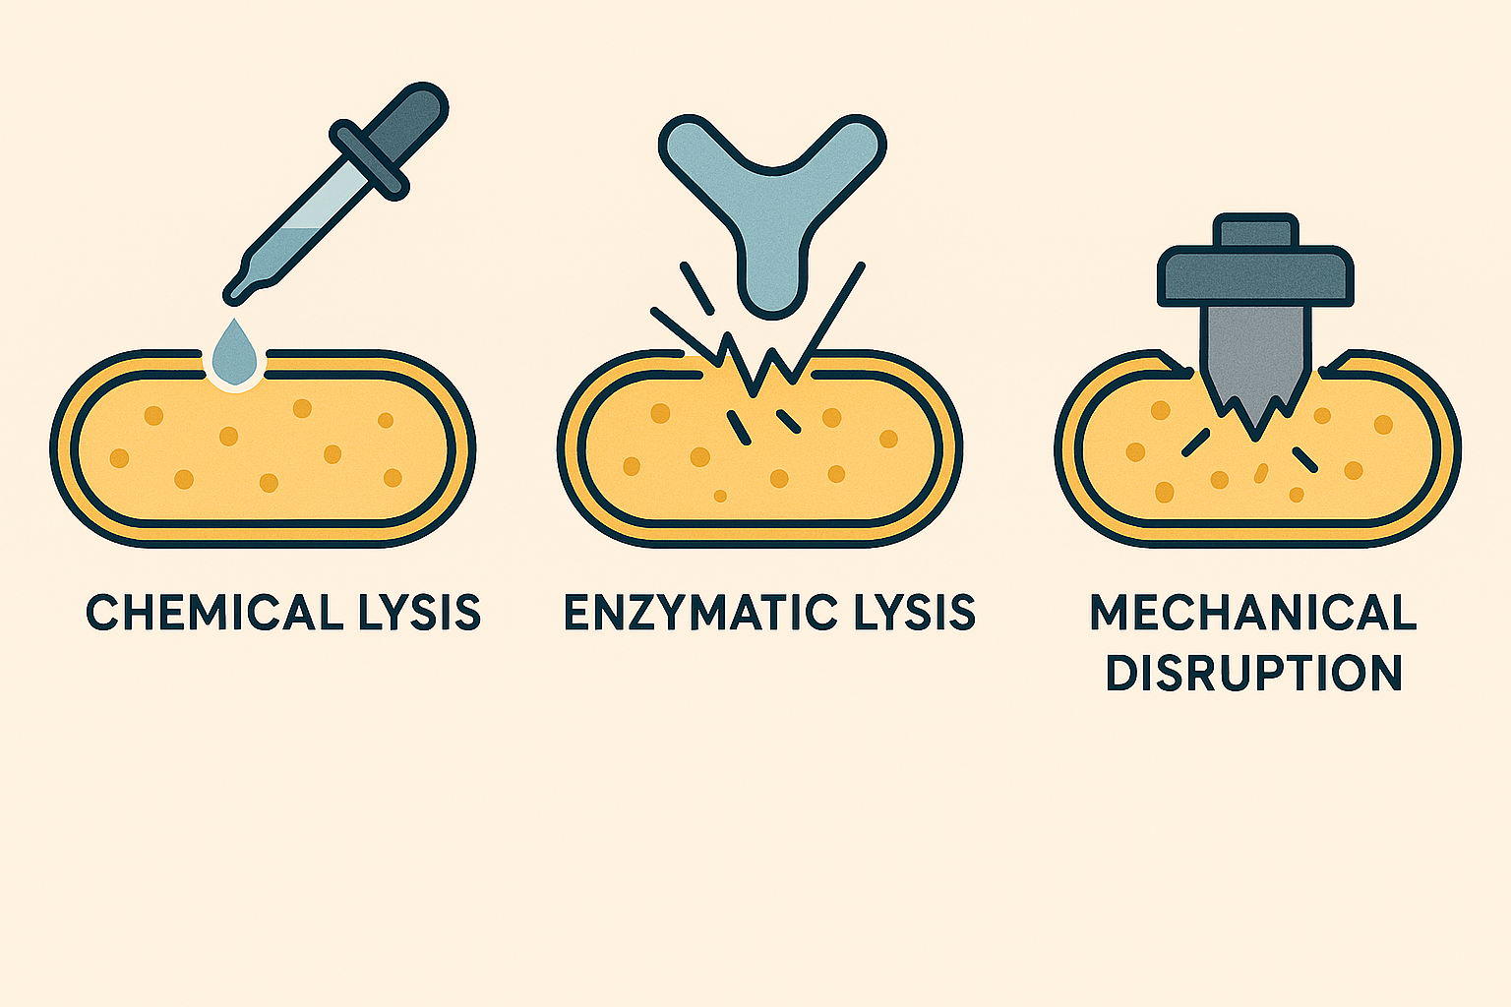
Key Considerations for DNA Extraction
Sample Type: Feces, soil, tissue, swabs
Cell Lysis: Mechanical (bead-beating), enzymatic, chemical
DNA Purification: Silica columns, magnetic beads, phenol-chloroform
Host DNA Removal: Differential lysis, NEBNext
Negativ
Things to ponder:
Aggressiveness
Duration
Amount of sample
Notes:
Cell Lysis Method: How do you break open the cells?
Mechanical Lysis: Bead-beating (most common, robust for tough cells like Gram-positives, fungi, archaea).
Considerations: Bead size, beating time/speed (can shear DNA).
Enzymatic Lysis: Lysozyme, mutanolysin (target bacterial cell walls); chitinases, glucanases (target fungal cell walls).
Chemical Lysis: Detergents (SDS), chaotropic salts.
Often a combination is used for broad-spectrum lysis to ensure all microbial types are represented.

Slide 7
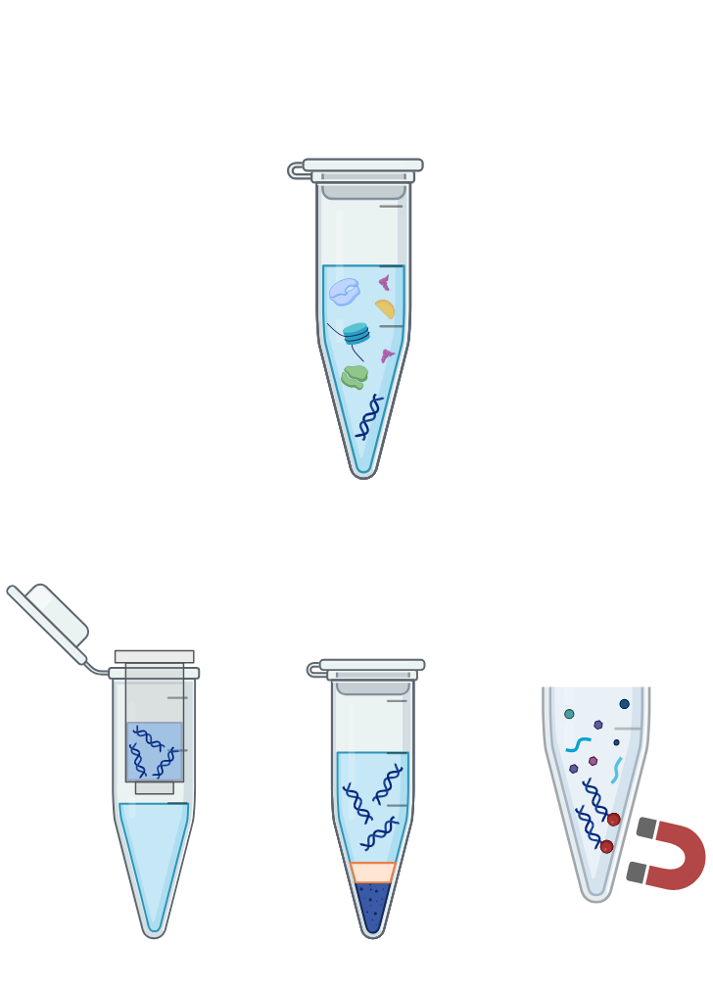
Key Considerations for DNA Extraction
Sample Type: Feces, soil, tissue, swabs
Cell Lysis: Mechanical (bead-beating), enzymatic, chemical
DNA Purification/Elution: Silica columns, magnetic beads, phenol-chloroform
Host DNA Removal: Differential lysis, NEBNext k
Lysed sample
Spin-column
Magnetic beads
Phase
Separation
Image: Biorender
Notes:
3. DNA Purification: Separating DNA from cellular debris and inhibitors. (proteins, contaminants
Column-based methods: Silica columns (bind DNA, wash away impurities).
Magnetic bead-based methods: (e.g., AMPure beads) for purification and size selection.
Phenol-chloroform extraction: Traditional, but hazardous and less common now.

Slide 8
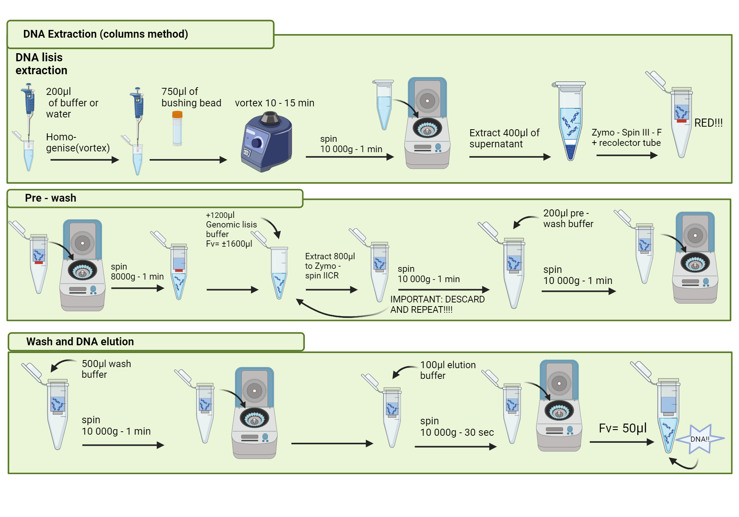
Key Considerations for DNA Extraction
Sample Type: Feces, soil, tissue, swabs
Cell Lysis: Mechanical (bead-beating), enzymatic, chemical
DNA Purification: Silica columns, magnetic beads, phenol-chloroform
Host DNA Removal: Differential lysis, NEBNext kits
Lysed sample
Spin-column
Magnetic beads
Phase
Separation
Notes:
3. DNA Purification: Separating DNA from cellular debris and inhibitors.
Column-based methods: Silica columns (bind DNA, wash away impurities).
Magnetic bead-based methods: (e.g., AMPure beads) for purification and size selection.
Phenol-chloroform extraction: Traditional, but hazardous and less common now.

Slide 9
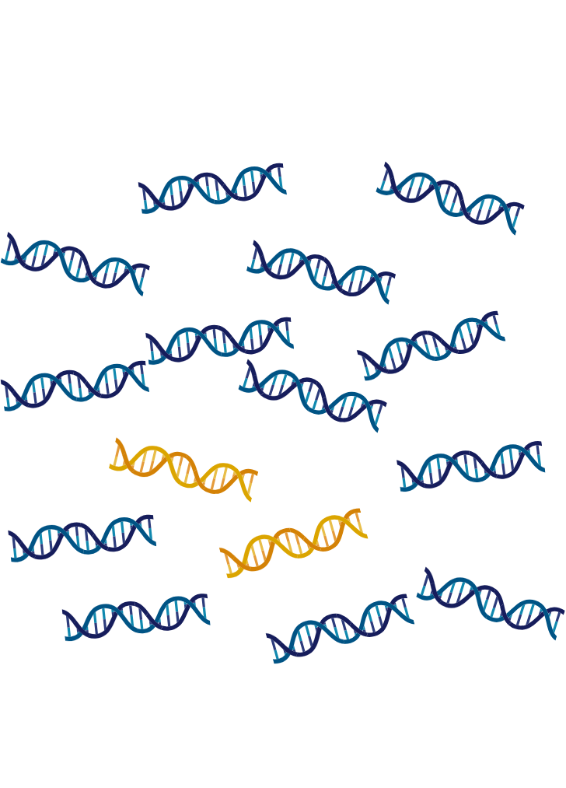
Key Considerations for DNA Extraction
Sample Type: Feces, soil, tissue, swabs
Cell Lysis: Mechanical (bead-beating), enzymatic, chemical
DNA Purification/Elution: Silica columns, magnetic beads, phenol-chloroform
Host DNA Removal: Differential lysis, special kits
Controls
Host
microbe
Notes:
4. Host DNA Removal (if applicable):
Differential lysis, selective binding (e.g., NEBNext Microbiome DNA Enrichment Kit for methylated host DNA).
Host Contamination: Can overwhelm microbial reads in shotgun metagenomics.
Mitigation: Host DNA depletion methods.

Slide 10
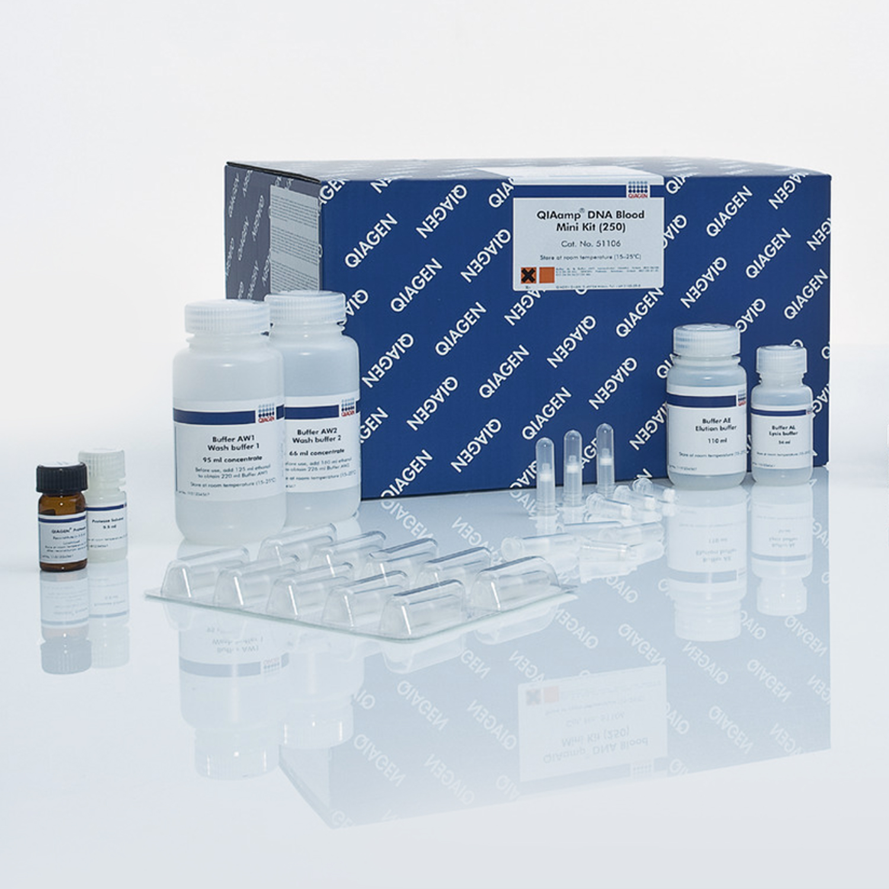
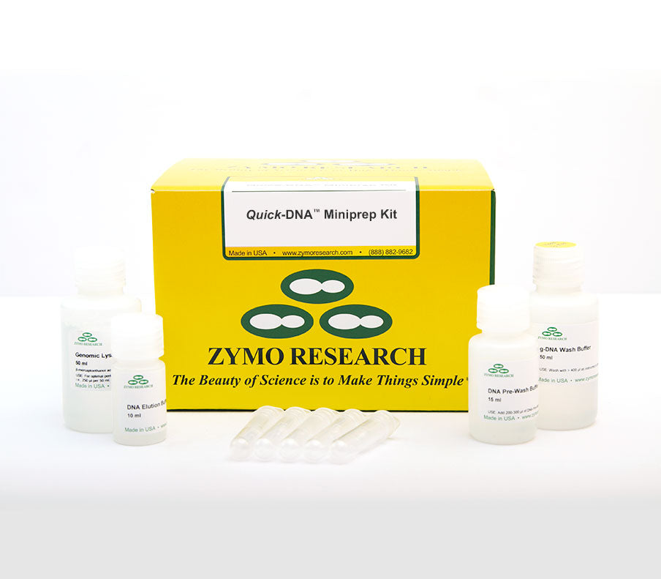
Common DNA Extraction Methods/Kits
Why Kits? Standardized, validated
In-house protocols: customizable, need validation
Best Practice: Match method to sample type and question
Image: Qiagen/Zymo
Notes:
Commercial Kits: Most common approach for reproducibility and ease of use.
Examples: Qiagen DNeasy PowerSoil/PowerLyzer, ZymoBIOMICS DNA Mini Kit.
Why kits? Standardized protocols, optimized reagents, often include bead-beating.
In-house protocols: Can be customized but require rigorous validation.
Best Practice: Choose a method validated for your specific sample type and microbial community.
"No single 'best' method – it's about what works for your samples and your research question."
Low DNA Yield: Inefficient lysis, poor purification, low biomass.
Low DNA Purity: Contaminants inhibiting PCR/sequencing.
Degraded DNA: Improper storage, harsh extraction.

Slide 11
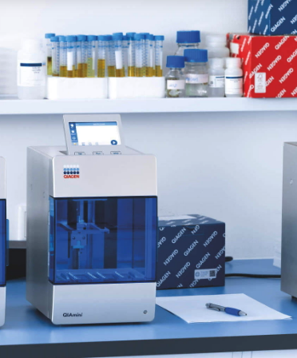
Automated extractions
Tiny application to win a QIAmini

Slide 12
Garbage in, Garbage out
Goal: Clean, high molecular weight DNA
QC of DNA is key
How much DNA is there?
Is the DNA pure?
Is the DNA intact or degraded?
Notes:
Why QC? Ensure DNA is suitable for library prep and sequencing. "Garbage in, garbage out!"
Key Metrics:
Quantity: How much DNA do you have? (e.g., Qubit fluorometer, NanoDrop spectrophotometer).
Note on NanoDrop: Can be affected by contaminants.
Purity: Is the DNA free from proteins, RNA, and other contaminants? (e.g., NanoDrop A260/280 and A260/230 ratios).
Ideal ratios: A260/280 ≈1.8−2.0, A260/230 ≈2.0−2.2.
Integrity/Size: Is the DNA intact or degraded? (e.g., Agarose gel electrophoresis, Bioanalyzer/TapeStation).
Goal: High molecular weight DNA for shotgun, specific size for amplicon.

Slide 13
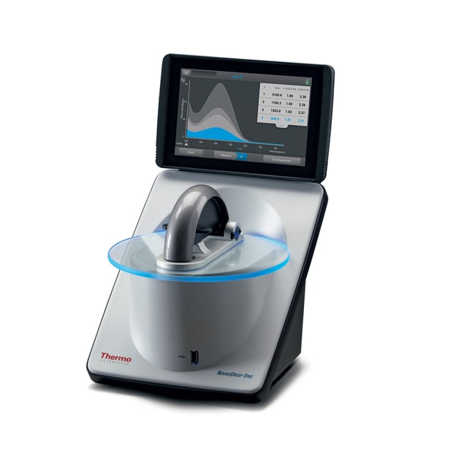
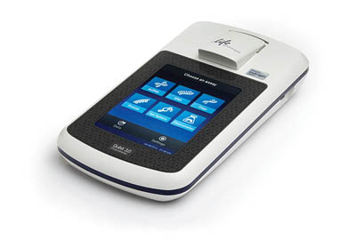
Garbage in, Garbage out
Goal: Clean, high molecular weight DNA
Quality & Quantity of DNA is key
How much DNA is there?
NanoDrop
Qubit
Image: ThermoFisher
Notes:
Why QC? Ensure DNA is suitable for library prep and sequencing. "Garbage in, garbage out!"
Key Metrics:
Quantity: How much DNA do you have? (e.g., Qubit fluorometer, NanoDrop spectrophotometer). Or qPCR
Note on NanoDrop: Can be affected by contaminants.

Slide 14
Garbage in, Garbage out
Goal: Clean, high molecular weight DNA
Quality & Quantity of DNA is key
How much DNA is there?
Is the DNA pure?
A260/280 ≈1.8–2.1, A260/230 >1.8
Notes:
Why QC? Ensure DNA is suitable for library prep and sequencing. "Garbage in, garbage out!"
Key Metrics:
Quantity: How much DNA do you have? (e.g., Qubit fluorometer, NanoDrop spectrophotometer).
Note on NanoDrop: Can be affected by contaminants.
Purity: Is the DNA free from proteins, RNA, and other contaminants? (e.g., NanoDrop A260/280 and A260/230 ratios).
Ideal ratios: A260/280 ≈1.8−2.0, A260/230 ≈2.0−2.2.
Integrity/Size: Is the DNA intact or degraded? (e.g., Agarose gel electrophoresis, Bioanalyzer/TapeStation).
Goal: High molecular weight DNA for shotgun, specific size for amplicon.

Slide 15
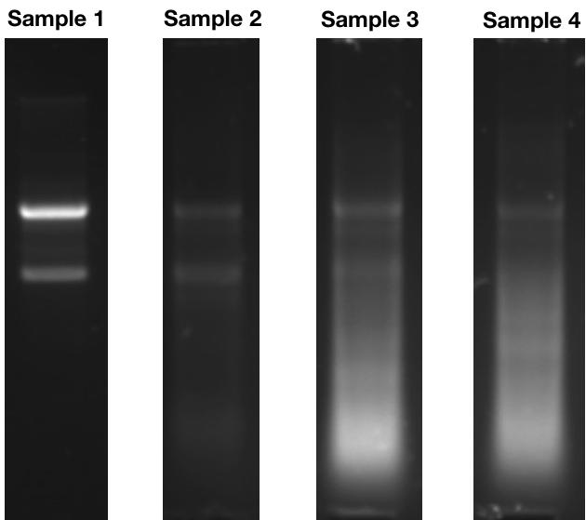
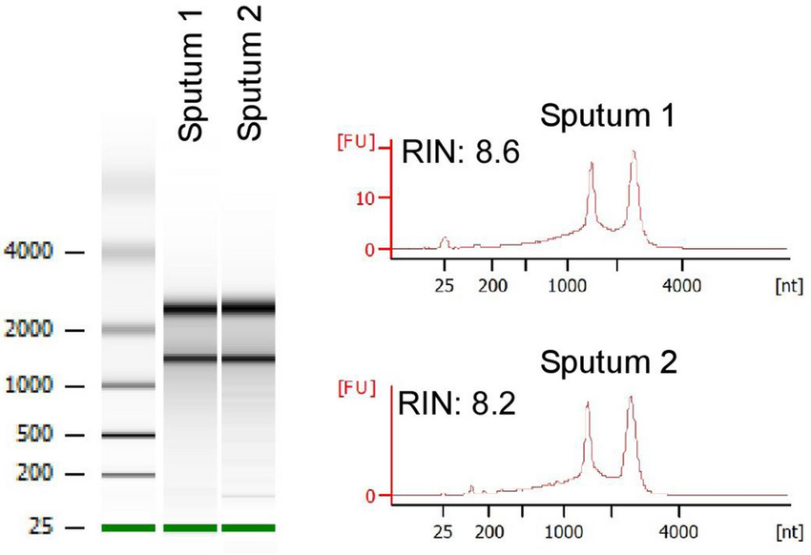
Garbage in, Garbage out
Goal: Clean, high molecular weight DNA
Quality & Quantity of DNA is key
How much DNA is there?
Is the DNA pure?
Is the DNA intact or degraded?
Image: Abterra Biosciences
Notes:
Why QC? Ensure DNA is suitable for library prep and sequencing. "Garbage in, garbage out!"
Key Metrics:
Quantity: How much DNA do you have? (e.g., Qubit fluorometer, NanoDrop spectrophotometer).
Note on NanoDrop: Can be affected by contaminants.
Purity: Is the DNA free from proteins, RNA, and other contaminants? (e.g., NanoDrop A260/280 and A260/230 ratios).
Ideal ratios: A260/280 ≈1.8−2.0, A260/230 ≈2.0−2.2.
Integrity/Size: Is the DNA intact or degraded? (e.g., Agarose gel electrophoresis, Bioanalyzer/TapeStation).
Goal: High molecular weight DNA for shotgun, specific size for amplicon.
In my experience for amplicon data – look at gels post PCR and might run a few samples on nano drop to confirm Quantity and quality….

Slide 16
Roadmap
What are the key things to think about for DNA extraction?
Notes:
Why type of microbe are you extracting (bacteria? archaea? fungi?)
How harsh/gentile should you be considering your sample type?
How much bacterial biomass are you expecting?
Do you anticipate PCR inhibitors from your sample type?
How high throughput do you need to be?
What will your storage conditions be after extraction?
What controls should you consider, both positive and negative?
Are you cost-limited (*we all are!)?

Slide 17
Library Preparation
What
Process of preparing DNA for NGS
Why
Required for sequence platforms
How
Two Approaches: PCR-based and Shotgun
Barcode: unique short DNA sequence to allow the differentiation of multiple samples
Adaptor: short DNA sequence that enables DNA fragment to attach
to sequencing platform
Notes:
Adapters enable flow cell binding and primer annealing
What is a "Library"? A collection of DNA fragments with specific adapters ligated to their ends.
Why do we need it? Sequencing platforms require DNA in a very specific format.
Adapters are crucial for binding to the flow cell, primer annealing, and sequencing.
Two Main Approaches for Microbiome Sequencing:
1. Targeted Amplicon Sequencing (e.g., 16S rRNA gene, ITS): Focuses on specific marker genes for taxonomic profiling.
2. Shotgun Metagenomic Sequencing: Sequences all DNA in the sample for comprehensive taxonomic and functional insights.

Slide 18
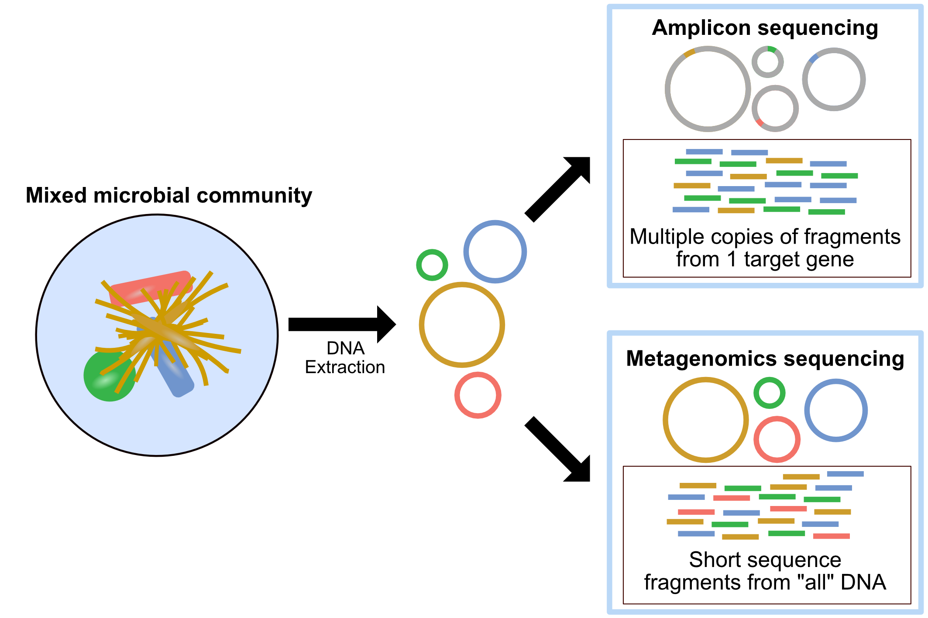
Library Types
Image: Happy Bell Bioinformatics

Slide 19

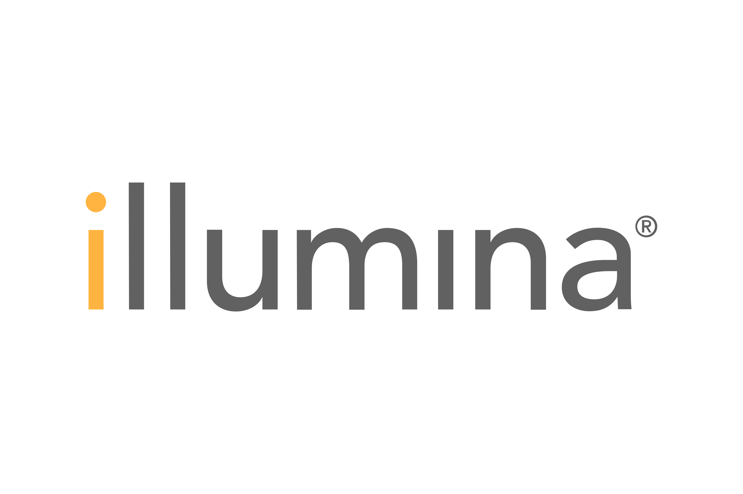
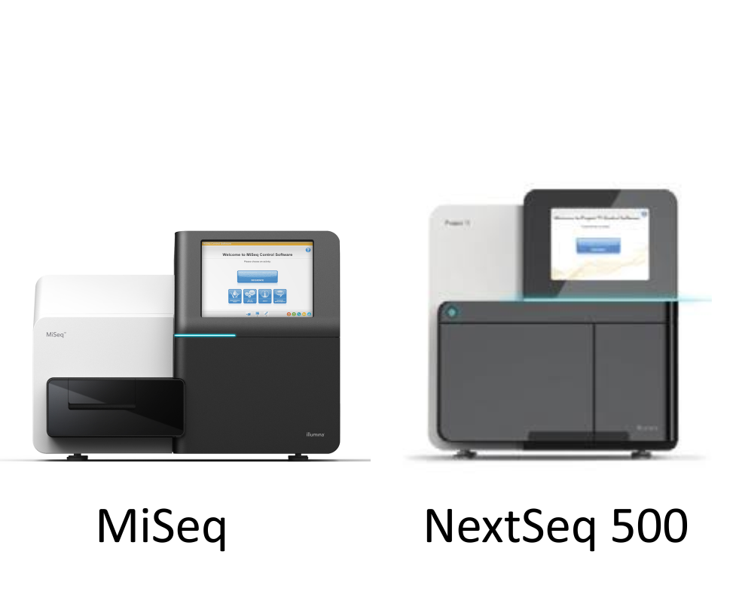

Library Preparation
Fragment /Amplify DNA
Ligate Adaptors
Add barcodes
Pool samples
Clean up
Notes:
5 key elements or steps of Library prep and the order and nature depend on the type of sequencing and researcher preference.

Slide 20
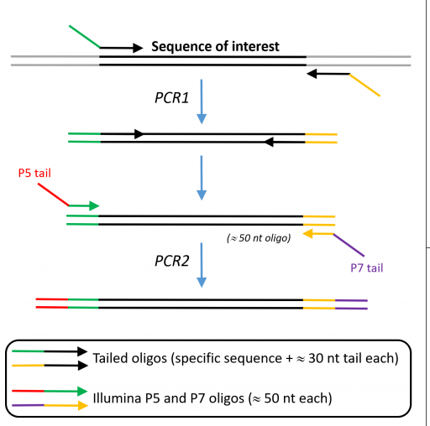
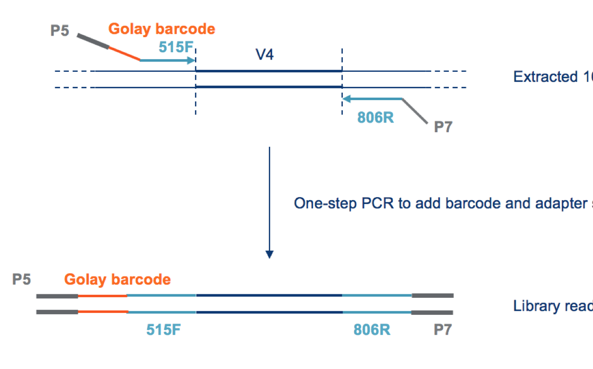
Library Prep: Amplicon Sequencing
1 Step
2 Step
Image: GTF/IDT
Notes:
Goal: Amplify a specific hypervariable region of a marker gene (e.g., V3-V4 region of 16S rRNA gene).
Steps:
1. PCR Amplification: Using universal primers that flank the target region.
Primer Choice: V1-V2, V3-V4, V4, V4-V5, etc. (impacts taxonomic resolution).
PCR Cycles: Optimize to avoid chimeras (artifacts) and ensure sufficient product.
2. Adding Adapters & Barcodes/Indexes:
Two-step PCR:
1st PCR: Amplifies target region with partial adapters.
2nd PCR: Adds full sequencing adapters and unique barcodes/indexes (short DNA sequences) to each sample.
Multiplexing: Allows pooling many samples into one sequencing run.
PCR Amplification: Target hypervariable region (e.g., 16S V3-V4)
Primer Choice affects taxonomic resolution
Two-step PCR: 1st = target; 2nd = adapters & indexes
Multiplexing: Unique barcodes for pooling samples
QC: Qubit, Bioanalyzer/TapeStation (no primer dimers)
PCR Bias (Amplicon): Preferential amplification of certain templates, leading to skewed community profiles.
Mitigation: Optimize PCR conditions, use high-fidelity polymerases, limit cycles.

Slide 21
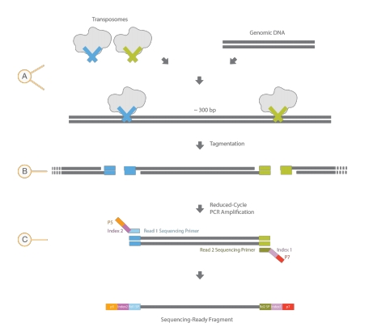
Library Prep: Shotgun Metagenomics
Image: Illumina
Notes:
Goal: Prepare all DNA in the sample for sequencing.
Steps:
1. DNA Fragmentation: Break DNA into desired size range (e.g., 300-600 bp for Illumina).
Methods:
Mechanical Shearing: Sonication (Covaris focused-ultrasonicator) – less bias.
Enzymatic Fragmentation: Transposase-based (e.g., Illumina Nextera) – faster, lower input. Tagmentation
3. Adapter Ligation: Ligate adapters (containing sequencing primer sites, binding sites for flow cell,) to both ends of the fragmented DNA.
4. Low cycle PCR to add indexes/barcodes Minimize cycles to reduce bias.
Fragmentation: Mechanical (sonication) or enzymatic
End Repair & A-tailing, Adapter Ligation
Optional PCR for low input
Purification & Size Selection: Remove dimers, optimize size
QC: Qubit, Bioanalyzer (no adapter dimers)

Slide 22
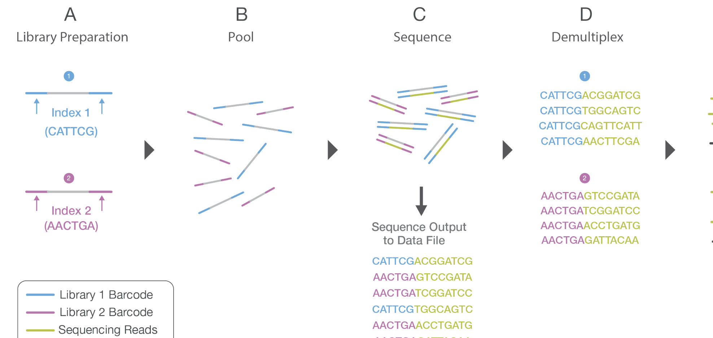
Library Preparation: Clean up & Pooling
Purification, Normalization, Final QC
Image: Illumina
Notes:
3. Purification & Size Selection: Remove excess primers, short fragments (primer dimers), and large fragments. (e.g., AMPure beads).
4. Final Library QC:
Quantity: Qubit.
Size Distribution: Bioanalyzer/TapeStation (expected peak size for amplicon).
No Primer Dimers: Crucial for clean data.
5. Purification & Size Selection: Remove unligated adapters and select desired fragment sizes (e.g., AMPure beads).
6. Final Library QC:
Quantity: Qubit.
Size Distribution: Bioanalyzer/TapeStation (broad peak around target size).
No Adapter Dimers: Critical for efficient sequencing. - Unligated adapters ligating to each other, consuming sequencing reads.
Mitigation: Efficient purification/size selection.
You've now got your sequence-ready libraries!" What happens next? Sequencing on platforms like Illumina, then bioinformatics analysis."

Slide 23
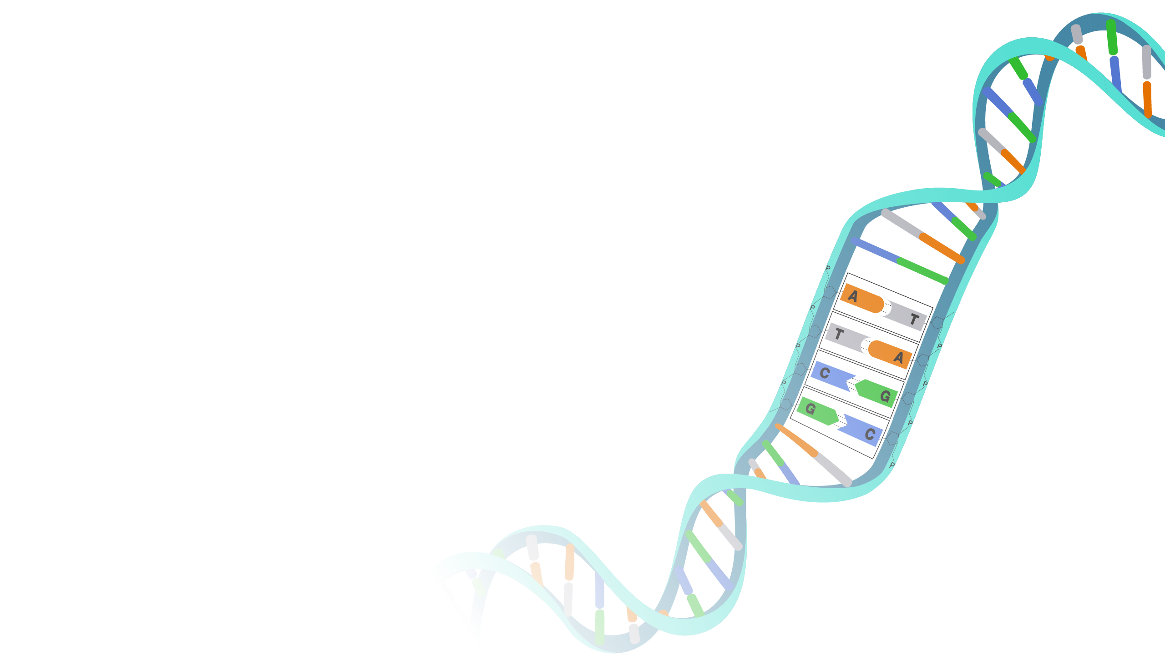
Recap & Key Considerations
Sample-specific strategies for DNA extraction
Appropriate lysis is key
Library prep allows for NGS sequencing & multiplexing
QC is critical for success
Know your biases
Image: NHGRI
Notes:
DNA Extraction: Critical first step. Method choice depends on sample type and desired output. Aim for high yield, purity, and integrity.
Library Preparation: Converts DNA into a sequence-ready format. Different strategies for amplicon vs. shotgun.
Quality Control: Essential at every step to ensure reliable and unbiased sequencing data.
Bias Awareness: Be aware that both steps can introduce biases; understanding these is key to interpreting your results.
Sample-specific strategies for DNA extraction
Appropriate lysis is key
Library prep allows for sequencing & multiplexing
QC is critical for success
Know your biases because affects interpretation

Slide 24
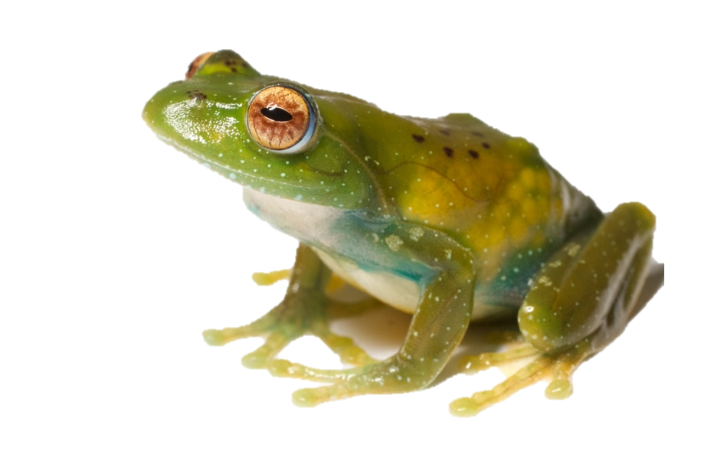
Mini-Activity: Design your methods!
Image: M. Vences

Slide 25
Mini-Activity: Design your methods!
DNA Extraction:
what are the primary challenges you might anticipate for DNA extraction from your samples?
Which lysis methods would you prioritize to ensure you capture DNA from all these diverse microbial groups, while also overcoming the challenge of inhibitors?
Library Preparation:
Would you choose targeted amplicon sequencing or shotgun metagenomic sequencing for this project? Why?
What specific QC steps would you perform to ensure good data is generated?
Image: M. Vences
Notes:
Wrap-up: Briefly discuss group answers, highlighting the decision-making process.

