Slide 1
An Introduction to R
Dan Navarro (daniel.navarro@adelaide.edu.au) School of Psychology, University of Adelaide
ua.edu.au/ccs/people/dan CSIRO R Workshop, 28-Nov-2013
Adapted from

Slide 2
What is R?
R is a statistical programming language
an effective data handling and storage facility,
a suite of operators for calculations on arrays, in particular matrices
a large, coherent, integrated collection of intermediate tools for data analysis
graphical facilities for data analysis and display either on-screen or on hardcopy
a well-developed, simple and effective programming language which includes conditionals, loops, user-defined recursive functions and input and output facilities.
https://www.r-project.org/about.html

Slide 3
What is R?
R is a statistical programming language
an effective data handling and storage facility,
a suite of operators for calculations on arrays, in particular matrices
a large, coherent, integrated collection of intermediate tools for data analysis
graphical facilities for data analysis and display either on-screen or on hardcopy
a well-developed, simple and effective programming language which includes conditionals, loops, user-defined recursive functions and input and output facilities.

Slide 4

Getting R
R website:
http://cran.r-project.org/
Windows installer file:
http://cran.mirrors.hoobly.com/bin/windows/base/R-3.6.1-win.exe
Mac installer file:
http://cran.mirrors.hoobly.com/bin/macosx/R-3.6.1.pkg

Slide 5
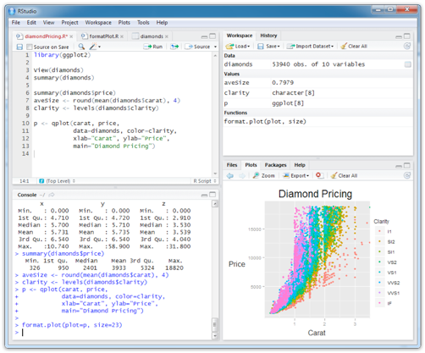
Rstudio is a front end to R.
It’s intended to provide the same user experience regardless of what kind of computer you’re using
Rstudio webpage: www.rstudio.org
Rstudio download link: https://www.rstudio.com/products/rstudio/download/

Slide 6
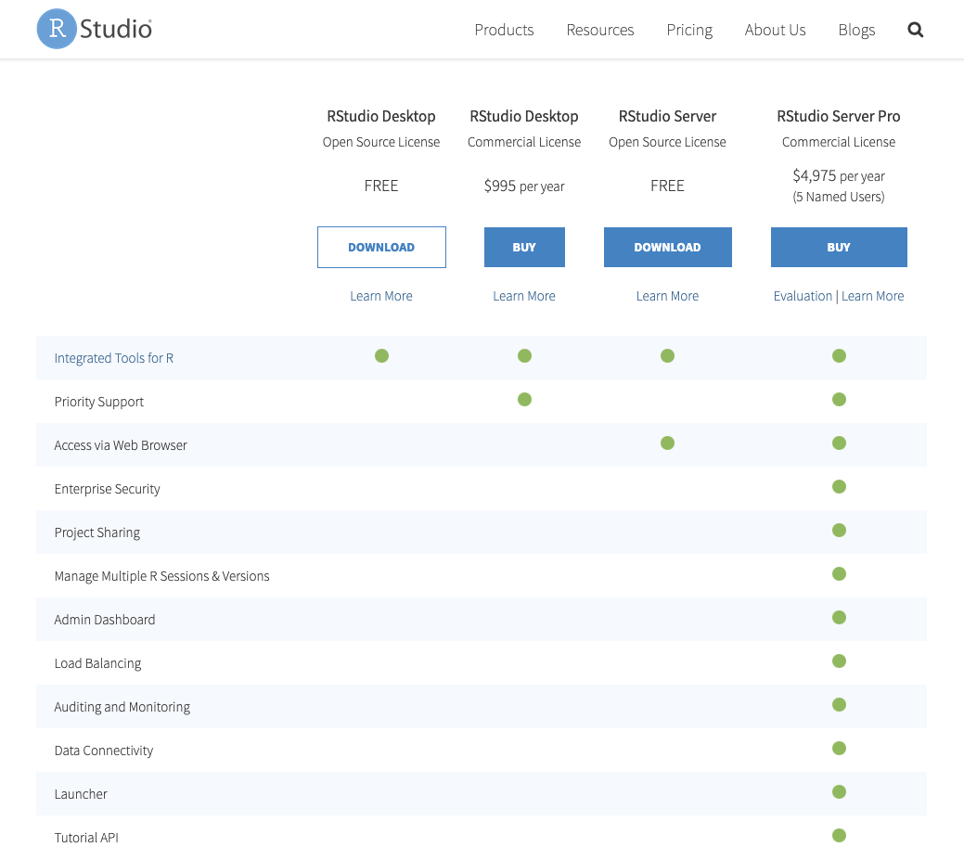
There are multiple version of Rstudios
Choose the free desktop version

Slide 7
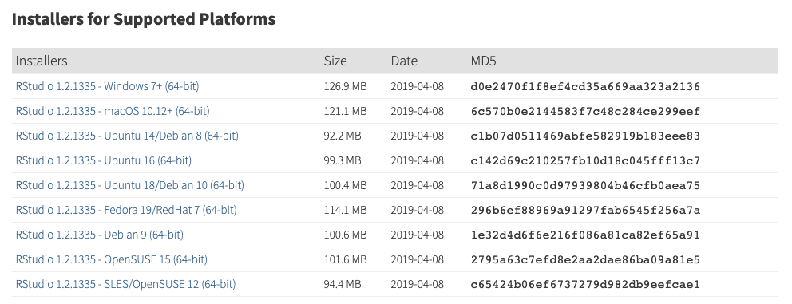
Clicking on the ”download” should prompt you to this session of the website
Choose the one of your operating system

Slide 8
Please contact TAs or shoot us emails if you have problem installing R or Rstudio before the workshop

Slide 9
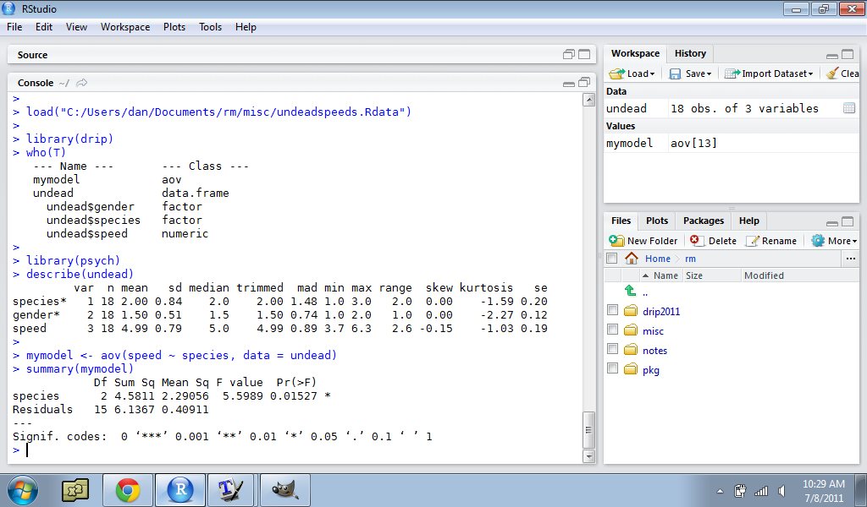
Rstudio is divided into several panels

Slide 10
Minimising and maximising panels:

Slide 11
Switching between panels:

Slide 12
Menu system

Slide 13
Our real interest is the “console”... that’s R running in there

Slide 14
Loading data
Descriptive statistics
ANOVA

Slide 15
We will be using R markdown files through out the workshop
Markdown is a simple formatting syntax for authoring HTML, PDF, and MS Word documents. For more details on using R Markdown see http://rmarkdown.rstudio.com.

Slide 16
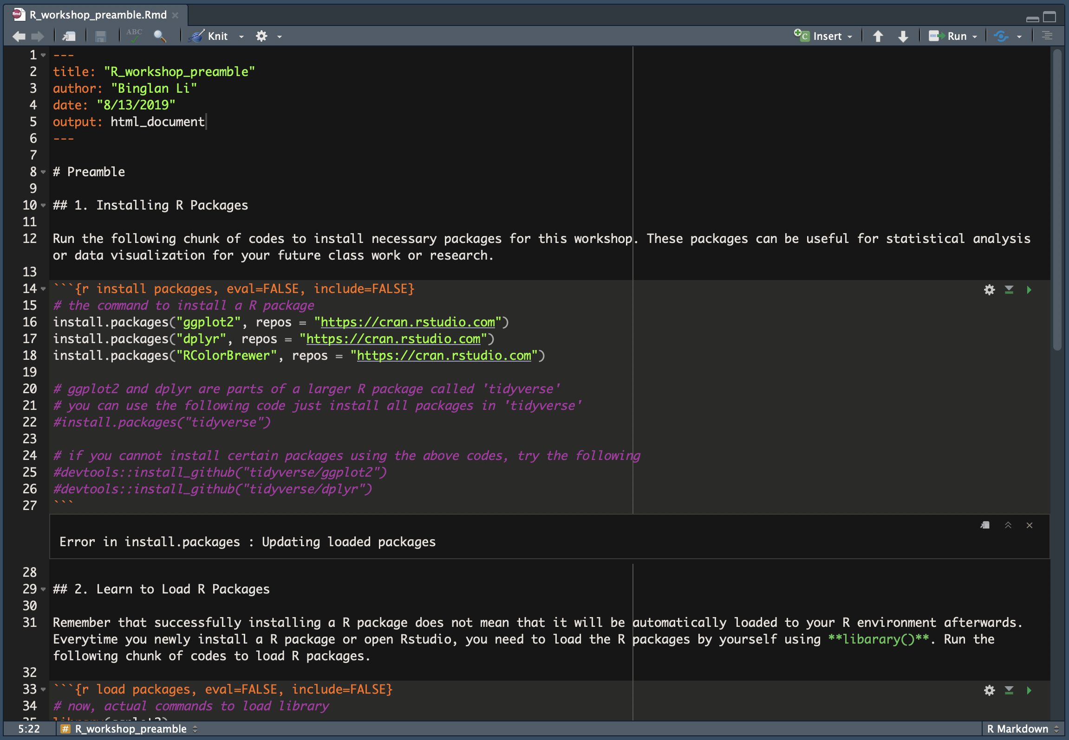
Source console of R markdown
Basic information
Notes
R code chunk

