Slide 1
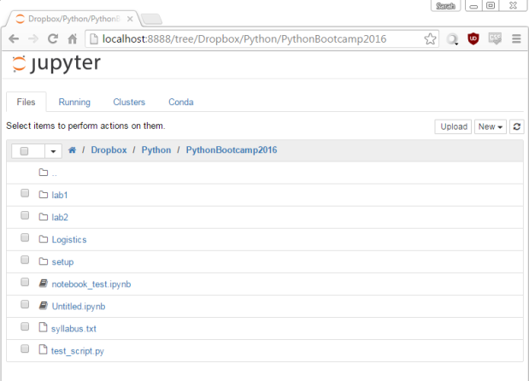
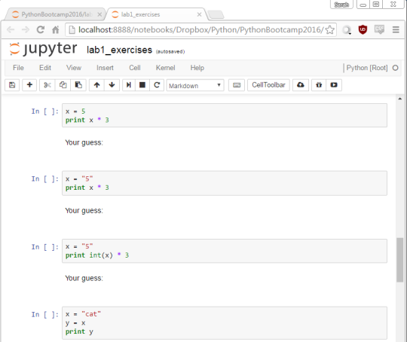
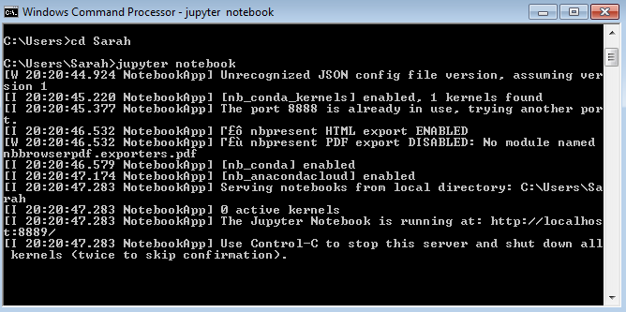
Launches
Opens
Jupyter Server
Do not close this window until you are completely done!
You can't use this terminal window while the server is running
To end the server: Ctrl+C twice
This server is not accessible from the internet (there are ways you could make it accessible, but it's not by default).
Jupyter File Browser
Do not close this tab until you are completely done!
The files shown are all on your computer.
Although it uses your web browser, it does not use the internet.
Think of it as just a viewer/naviagtor for files on your computer.
Click a notebook (.ipynb file) to open it.
Jupyter Notebook
You can have many notebooks open at once.
Closing this tab does not actually terminate the notebook (it'll keep running in the background).
To terminate the notebook, go to File > Close and Halt
When you edit this notebook here, you are editing the notebook on your computer.
When you save this notebook here, you are saving it on your computer.
Make sure to save before closing.

