Slide 1
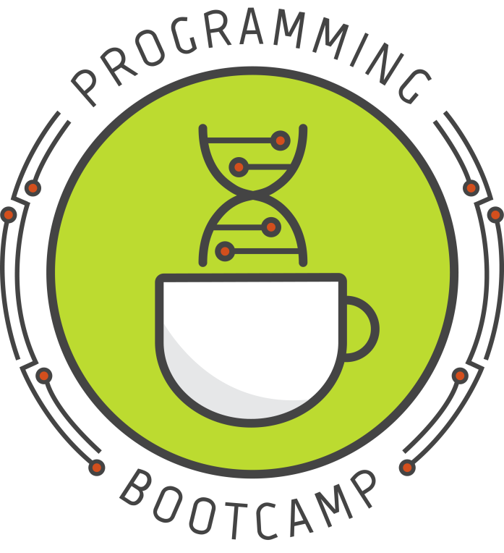




Welcome to Programming Bootcamp!
(Please sign-in on the counter near the back door)
Sponsored by:
Notes:
Thanks so much to BGS,IBI, and GCB for sponsoring this year's bootcamp! Thank you to Sarah Middleton for creating and making this workshop possible. This workshop is is run by students who are juggling research and volunteering so I apologize in advanced and thank everyone for their patience. There will be two lecturers: Apexa and Scott and handful of TA that will be providing help through out the course.
http://upibi.org/

Slide 2








Today’s TAs
Apexa
Sammy
Ben
Alex
Chris
Dr.
Shweta Ramdas
Louis
Kathy

Slide 3
Lab1: Review
Object types: strings vs ints vs floats
Different object types have different functions, but sometimes the functions have the same format.

Slide 4
Same Function Name,
Different Function
Code:
a=1
b=1
sum_ab=a+b
print(sum_ab)
Result:
Notes:
For those at home, reading these slides, please try these in your jupyter notebook so see the results.

Slide 5
Same Function Name,
Different Function
Code:
a=”1”
b=”1”
sum_ab=a+b
print(sum_ab)
Result:
Notes:
For those at home, reading these slides, please try these in your jupyter notebook so see the results.

Slide 6
Same Function Name,
Different Function
Code:
a=1.0
b=1.0
sum_ab=a+b
print(sum_ab)
Result:
Notes:
For those at home, reading these slides, please try these in your jupyter notebook so see the results.

Slide 7
Lab1: Review
Object types: strings vs ints vs floats
Different object types have different functions, but sometimes the functions have the same format.
Printing Numbers
There are so many ways to print numbers!
Notes:
:.2f specifies two decimal points. https://docs.python.org/2/library/string.html talks about syntax with str.format(). When we spoke in class I was mentioning an old format I was used to which used '%' instead of ':’.

Slide 8
Printing rounded numbers with strings
pi = 3.14159265359
THE ROUND FUNCTION*
the comma `,` operator inside print statements automatically convert int and float ## objects to strings
print ("pi:", round(pi, 2))
the plus `+` operator inside print statements does not automatically convert objects to specific types
print ("pi: "+ str(round(pi, 2)))
Notes:
For those at home, reading these slides, please try these in your jupyter notebook so see the results. Note that we will discuss the round function in more detail in this lecture.

Slide 9
Printing rounded numbers with strings
pi = 3.14159265359
THE ROUND FUNCTION*
the comma `,` operator inside print statements automatically convert int and float ## objects to strings
print ("pi:", round(pi, 2))
the plus `+` operator inside print statements does not automatically convert objects to specific types
print ("pi: "+ str(round(pi, 2)))
STRING FORMATTING OPERATOR `%`
“the old way” of formatting strings in python. The syntax is: ((str_format) % (values))
print (("pi: %.2f") % (pi))
Notes:
For those at home, reading these slides, please try these in your jupyter notebook so see the results. Note that we will discuss the round function in more detail in this lecture.

Slide 10
Printing rounded numbers with strings
pi = 3.14159265359
THE ROUND FUNCTION*
the comma `,` operator inside print statements automatically convert int and float ## objects to strings
print ("pi:", round(pi, 2))
the plus `+` operator inside print statements does not automatically convert objects to specific types
print ("pi: "+ str(round(pi, 2)))
STRING FORMATTING OPERATOR `%`
“the old way” of formatting strings in python. The syntax is: ((str_format) % (values))
print (("pi: %.2f") % (pi))
THE FORMAT FUNCTION
the formatting function is “the new way” of formatting strings in python it allows the user to concatenate elements within a string through position formatting.
See: https://www.geeksforgeeks.org/python-format-function/
print(("pi: {0:.2f}").format(pi))
Notes:
For those at home, reading these slides, please try these in your jupyter notebook so see the results. Note that we will discuss the round function in more detail in this lecture.

Slide 11
Printing rounded numbers with strings
pi = 3.14159265359
THE ROUND FUNCTION*
the comma `,` operator inside print statements automatically convert int and float ## objects to strings
print ("pi:", round(pi, 2))
the plus `+` operator inside print statements does not automatically convert objects to specific types
print ("pi: "+ str(round(pi, 2)))
STRING FORMATTING OPERATOR `%`
“the old way” of formatting strings in python. The syntax is: ((str_format) % (values))
print (("pi: %.2f") % (pi))
THE FORMAT FUNCTION
the formatting function is “the new way” of formatting strings in python it allows the user to concatenate elements within a string through position formatting.
See: https://www.geeksforgeeks.org/python-format-function/
print(("pi: {0:.2f}").format(pi))
Note that if a position is not specified in the format function, its implied.
print(("pi: {:.2f}").format(pi))
Notes:
For those at home, reading these slides, please try these in your jupyter notebook so see the results. Note that we will discuss the round function in more detail in this lecture.

Slide 12
Lab1: Review
Object types: strings vs ints vs floats
Different object types have different functions, but sometimes the functions have the same format.
Printing Numbers
There are so many ways to print numbers!
Python mostly follows the Order of Operations
The exponential operator goes before the negation operator
Notes:
:.2f specifies two decimal points. https://docs.python.org/2/library/string.html talks about syntax with str.format(). When we spoke in class I was mentioning an old format I was used to which used '%' instead of ':’.

Slide 13
Same Function Name,
Different Function
Code:
a = -2
b = 2
equation = a ** b
print (equation)
Result:
Notes:
For those at home, reading these slides, please try these in your jupyter notebook so see the results.

Slide 14
Same Function Name,
Different Function
Code:
a = -2
b = 2
equation = -2 ** 2
print (equation)
Result:
Notes:
For those at home, reading these slides, please try these in your jupyter notebook so see the results.

Slide 15
Lab1: Review
Any specific questions about the homework?
Object types: strings vs ints vs floats
Different object types have different functions, but sometimes the functions have the same format.
Printing Numbers
There are so many ways to print numbers!
Python mostly follows the Order of Operations
The exponential operator goes before the negation operator
Notes:
:.2f specifies two decimal points. https://docs.python.org/2/library/string.html talks about syntax with str.format(). When we spoke in class I was mentioning an old format I was used to which used '%' instead of ':’.

Slide 16
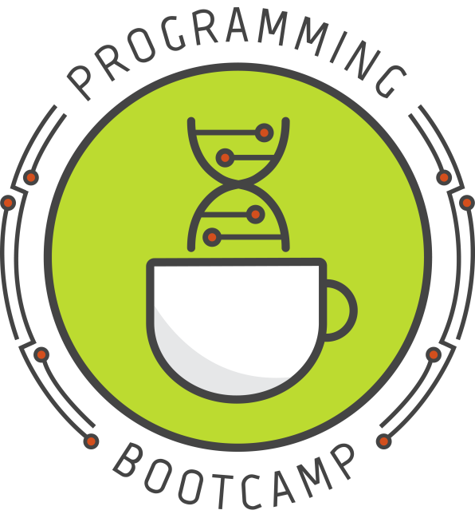
Writing code that makes decisions: if/else statements
Lesson 2 – 7/25/18
Slides created by: Dr. Sarah Middleton
Notes:
With notes!

Slide 17
Today's topics
if/else statements
Built-in functions
input(), len(), abs(), round()
Non-built-in functions
a brief intro to modules
How to read the PyDocs
Commenting your code
Notes:
Most of the class will focus on if/else statements and the logical statements ("conditionals") that are used to build them.
Then I'll go over a few useful functions (some built into standard Python; some requiring you to import a "module" first)
Finally, I'll talk about commenting your code - a very simple but important topic

Slide 18
1. if/else statements

Slide 19
Control statements – what are they?
Programming is a lot like giving someone instructions or directions. For example, if I wanted to give you directions to my house, I might say...
Turn right onto Main Street
Turn left onto Maple Ave
If there is construction, continue straight on Maple Ave, turn right on Cat Lane, and left on Fake Street; otherwise cut through the empty lot to Fake Street
Go straight on Fake Street until house 123

Slide 20
Control statements – what are they?
The same directions, but in code:
construction = False
print("Turn right onto Main Street”)
print("Turn left onto Maple Ave”)
if construction:
print("Continue straight on Maple Ave”)
print("Turn right onto Cat Lane”)
print("Turn left onto Fake Street”)
else:
print("Cut through the empty lot to Fake Street”)
print ("Go straight on Fake Street until house 123”)
Output:
Turn right onto Main Street
Turn left onto Maple Ave
Cut through the empty lot to Fake Street
Go straight on Fake Street until house 123

Slide 21
Control statements – what are they?
The same directions, but in code:
construction = False
print("Turn right onto Main Street”)
print("Turn left onto Maple Ave”)
if construction:
print("Continue straight on Maple Ave”)
print("Turn right onto Cat Lane”)
print("Turn left onto Fake Street”)
else:
print("Cut through the empty lot to Fake Street”)
print("Go straight on Fake Street until house 123”)
Output:
Turn right onto Main Street
Turn left onto Maple Ave
Cut through the empty lot to Fake Street
Go straight on Fake Street until house 123
True and False are special words in Python called Booleans
This is called an "if statement". It works pretty much how you'd expect it to: if the statement is true, it executes the first block of code; if the statement is false, it executes the second block of code (under the else)
Since construction holds the value False, the if statement skips the first block of print statements and only executes what is in the else: block.
Notes:
Control statements are things like the if statement here, which control the flow of your program. Each control statement has some sort of condition which it checks for True-ness or False-ness. For example, here the condition is simply the variable "construction". Since the value of this condition is False, we do not execute the "if" block, and instead execute the "else" block. Thus, we have changed the flow of the program based on the value of the variable "construction".
Control statements also include loops, which we'll talk about today.

Slide 22
Booleans - the logical datatype
A Boolean ("bool") is actually a type of variable, like a string, int, or float. However, a Boolean is only allowed to take the values True or False.
True and False are always capitalized and never in quotes.
Don't think of True and False as words. You can't treat them like you would strings. To the computer, they're actually interpreted as the numbers 1 and 0, respectively.

Slide 23
if/else statement
Purpose: creates a "fork" in the flow of the program.
Based on the Boolean value of a conditional statement, either executes the if-block or the else-block
The "blocks" are indicated by indentation.
The else-block is optional.

Slide 24
if/else statement
Syntax:
if conditional:
this code is executed
else:
this code is executed
Example:
x = 5
if (x > 0):
print("x is positive”)
else:
print("x is negative”)
Important to note:
Colons are required after the if condition and after the else
All code that is part of the if/else statement must be indented.
Notes:
The conditional can be pretty much anything that can be evaluated as either True or False. See next slide.

Slide 25
What kinds of "conditionals" are allowed?
Anything that can be evaluated as true or false!
is a True?
is a less than b?
is a equal to b?
is a equal to "ATGCTG"?
is (a greater than b) and (b greater than c)?

Slide 26
Forming conditionals
We use a special set of symbols/words to test whether statements are true or false:
Symbol | Meaning | Example
== | is equal to | if (a == 4):
!= | is not equal to | if (a != "applesauce"):
< | is less than | if (a < 10.5):
<= | is less than or equal to | if (a <= b):
> | is greater than | if (a > (b * 2)):
>= | is greater than or equal to | if (a >= -1):
and | and | if (a > 0) and (a != 3):
or | or | if (a > 5) or (a < -5):
not | not | if not (a == 1):
Notes:
Most of these are pretty intuitive. The big one people tend to mess up on in the beginning is ==. Remember, a single equals sign means assignment. A double equals means is the same as/is equal to. You will NEVER use a single equals sign in a conditional statement.

Slide 27
Question 1
What will this code print?
a = True
if a:
print ("Hooray, a was true!”)
Optional: enter your answers online!
https://goo.gl/forms/x1G57MV2QXJ8tXQG2
Notes:
https://goo.gl/forms/x1G57MV2QXJ8tXQG2

Slide 28
Question 1
What will this code print?
a = True
if a:
print ("Hooray, a was true!”)
Result
Hooray, a was true!

Slide 29
Question 2
What will this code print?
a = True
if a:
print ("Hooray, a was true!”)
print ("Goodbye now!”)

Slide 30
Question 2
What will this code print?
a = True
if a:
print ("Hooray, a was true!”)
print ("Goodbye now!”)
Result
Hooray, a was true!
Goodbye now!

Slide 31
Question 3
What will this code print?
a = False
if a:
print ("Hooray, a was true!”)
print ("Goodbye now!”)

Slide 32
Question 3
What will this code print?
a = False
if a:
print ("Hooray, a was true!”)
print ("Goodbye now!”)
Result
Goodbye now!
Notes:
Since the line 'print "Goodbye now!" ' is not indented, it is NOT considered part of the if statement.
Therefore, it is printed no matter how the if-statement is evaluated.

Slide 33
Question 4
What will this code print?
morning = True
if morning:
print ("Good morning!”)
else:
print ("Hello!”)
print ("How are you?”)

Slide 34
Question 4
What will this code print?
morning = True
if morning:
print ("Good morning!”)
else:
print ("Hello!”)
print ("How are you?”)
Result
Good morning!
How are you?

Slide 35
Question 5
What will this code print?
a = True
b = False
if a and b:
print("Apple”)
else:
print("Banana”)

Slide 36
Question 5
What will this code print?
a = True
b = False
if a and b:
print("Apple”)
else:
print("Banana”)
Result
Banana
Notes:
Since a and b are not both True, we go to the else statement.

Slide 37
Question 6
What will this code print?
a = True
b = False
if a and not b:
print("Apple”)
else:
print("Banana”)

Slide 38
Question 6
What will this code print?
a = True
b = False
if a and not b:
print("Apple”)
else:
print("Banana”)
Result
Apple
Notes:
By using "not" before b, we negate its current value (False), making b True. Thus the entire conditional as a whole becomes True, and we execute the if-block.

Slide 39
Question 7
What will this code print?
a = True
b = False
if not a and b:
print("Apple”)
else:
print(”Banana”)

Slide 40
Question 7
What will this code print?
a = True
b = False
if not a and b:
print("Apple”)
else:
print("Banana”)
Result
Banana
Notes:
"not" only applies to what's directly in front of it. So a more clear way to show this statement might be like this:
(not a) and b
This turns into
(False) and False
and thus the overall conditional is not true. We therefore go to the else statement.

Slide 41
Question 8
What will this code print?
a = True
b = False
if not (a and b):
print("Apple”)
else:
print("Banana”)

Slide 42
Question 8
What will this code print?
a = True
b = False
if not (a and b):
print ("Apple”)
else:
print ("Banana”)
Result
Apple
Notes:
Using parentheses works like you'd expect in conditionals: grouped statements are evaluated first.
So Python first decides: (a and b)? ("are a and b both true?") -> False
Then it applies the not, which flips the False into a True. So then the final answer is True.
Here's another way of breaking down what's happening, in order:
not (a and b)
not (True and False)
not (False)
True

Slide 43
Question 9
What will this code print?
a = True
b = False
if a or b:
print("Apple”)
else:
print("Banana”)

Slide 44
Question 9
What will this code print?
a = True
b = False
if a or b:
print("Apple”)
else:
print("Banana”)
Result
Apple
Notes:
"is a or b True?"
As you'd expect, with "or" only one of them has to be True

Slide 45
Question 10
What will this code print?
a = True
b = False
if not (a or b):
print("Apple”)
else:
print("Banana”)

Slide 46
Question 10
What will this code print?
a = True
b = False
if not (a or b):
print("Apple”)
else:
print("Banana”)
Result
Banana

Slide 47
Question 11
What will this code print?
a = 5
b = 10
if (a == 5) and (b > 0):
print ("Apple”)
else:
print ("Banana”)

Slide 48
Question 11
What will this code print?
a = 5
b = 10
if (a == 5) and (b > 0):
print ("Apple”)
else:
print ("Banana”)
Result
Apple

Slide 49
Question 12
What will this code print?
a = 5
b = 10
if ((a == 1) and (b > 0)) or (b == (2 * a)):
print ("Apple")
else:
print ("Banana”)

Slide 50
Question 12
What will this code print?
a = 5
b = 10
if ((a == 1) and (b > 0)) or (b == (2 * a)):
print ("Apple”)
else:
print ("Banana")
Result
Apple
Notes:
How to solve these? Sometimes it's best to just write it down, and write down True or False as you solve each part.
((a == 1) and (b > 0)) or (b == (2 * a))
((5 == 1) and (10 > 0)) or (10 == (2 * 5))
((False) and (True)) or (True)
(False) or (True)
True
Hopefully you won't ever have to write or understand such a convoluted conditional. But, if you do, make sure to logic-check it very thoroughly, because it's very easy to make mistakes.

Slide 51
Note on indentation
Indentation is very important in Python; it's how Python tells what code belongs to which control statements
Consecutive lines of code with the same indenting are sometimes called "blocks"
Indenting should only be done in specific circumstances (if statements are one example, and we'll see a few more soon). Indent anywhere else and you'll get an error.
You can indent by however much you want, but you must be consistent. Pick one indentation scheme (e.g. 1 tab per indent level, or 4 spaces) and stick to it.
NOTE: Indentation via tab key is different between Macs and Windows, so if you try to run the same file it may not work and you will have to re-indent all your lines.
Notes:
Some people recommend using 4 spaces instead of a tab. I believe this is the official Python recommendation as well. Personally, I prefer tabs. People argue about this a lot, and there's no real consensus, unfortunately. You can pretty much use whatever you want when you code on your own, but if you ever start collaborating with someone else on the same code, just make sure you agree on one convention, or you're in for a real headache.

Slide 52
Other forms of the if statement
Multi-if/else:
choice = input("Choose option 1, 2, or 3: ")
if (choice == "1"):
print("You have chosen option 1: cake”)
elif (choice == "2"):
print("You have chosen option 2: ice cream”)
elif (choice == "3"):
print("You have chosen option 3: broccoli”)
else:
print("Invalid input.”)
Only one of these code blocks will be executed.
Notes:
Use "if" for the first block, "elif" for the middle blocks, and "else" for the final block (again, else is optional--it's like a catch-all for anything that didn't match an earlier statement)

Slide 53
Other forms of the if statement
"Nested" if/else:
test = input("What is 1+1? ")
if (test == "2"):
print("Correct!”)
test2 = input("What is 2314*32626? ")
if (test2 == "75496564"):
print("Correct! You passed all my tests!”)
else:
print("Sorry, that's wrong.”)
else:
print("Sorry, that's wrong.”)

Slide 54
2. Built-in functions

Slide 55
What's a built-in function?
Python provides some useful built-in functions that perform specific tasks
What makes them "built-in"?
Simply that you don't have to "import" anything in order to use them -- they're always available
We've already seen some examples:
print, int(), float(), str()
Now we'll look at a few more
Notes:
"Built-in" is in contrast the the non-built-in functions, which are packaged into modules of similar functions (e.g. "math") that you must import before using. More on this in a minute!
You can also create your own functions, which is super useful...more on that in a future class!
We'll talk more about what a function actually IS when we get to that class. For now, it's fine to think of them like commands.

Slide 56
input()
Description: A built-in function that allows user input to be read from the terminal.
formely raw_input() in python 2.7
As seen in the lab1 problem set.
The execution of the code will pause when it reaches the input() function and wait for the user to input something.
The input ends when the user hits "enter".
The data that is read by input() can then be stored in a variable and used in the code.
This function always returns a string, even if the user entered a number.
This allows us to change what our program does without actually changing the code itself!

Slide 57

input()
Syntax:
input("Optional prompt: ")
Examples:
name = input("Your name: ")
age = int(input("Your age: "))
Important to note:
We can nest commands inside of each other, as in the second example here. This works a lot like the order of operations in math—whatever is the most nested is executed first, and then execution proceeds outward.
Notes:
What happens if you don't assign the result of raw_input() to some variable?
> Well, nothing. You lose whatever was read. When you use a function, you only have one chance to "capture" their output. However, sometimes we don't care about the output, and in those cases we can just ignore it.

Slide 58
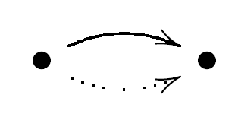
input()
Syntax:
input("Optional prompt: ")
Examples:
name = input("Your name: ")
age = int(input("Your age: "))
returned value
returned value
returned value
We say that input() "returns" a value
(in this case, a string version of whatever was entered in the terminal)
This value can then be used by another function (e.g. int()) or saved in a variable.
Notes:
Side note: you actually won't use raw_input() very much, if ever, after this lesson. There are much better ways of obtaining dynamic input– e.g. command line arguments and reading from files. We're only going over it because it's the only way of getting outside input that doesn't require explaining a whole lot of other concepts. ☺

Slide 59
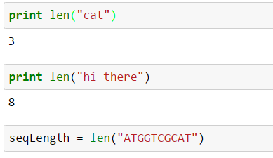
len()
Description: Returns the length of a string (also works on certain data structures). Doesn't work on numerical types.
Examples:
returned value
saved in variable

Slide 60
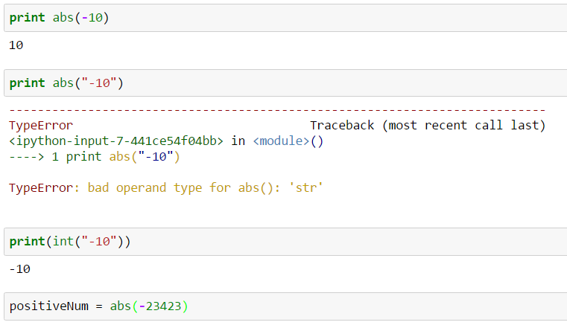
abs()
Description: Returns the absolute value of a numerical value. Doesn't accept strings.
Examples:

Slide 61
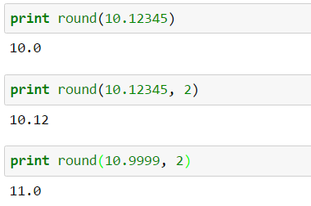
round()
Description: Rounds a float to the indicated number of decimal places. If no number of decimal places is indicated, rounds to zero decimal places.
Synatx:
round(someNumber, numDecimalPlaces)
Examples:

Slide 62
There are many more!
Most of the other built-in functions are too advanced right now, but we'll see some more in the future
If you're curious, there's a full list here:
https://docs.python.org/2/library/functions.html

Slide 63
3. Non-built-in functions

Slide 64
What is a non-built-in function?
The only difference is that these functions aren't accessible until you import them
Why aren't they all just built-in? It improves speed and memory usage to only import what is needed.
Related functions are grouped into modules. Importing a module imports all the module's functions.
We'll go over two modules today: math and random

Slide 65
How to use a module
First you must import the module. Add this to the top of your script:
import <moduleName>
To use a function of the module, you must prefix the function with the name of the module (using a period between them):
<moduleName>.<functionName>
Notes:
Replace <moduleName> with the name of the module you want, and <functionName> with the name of a function in the module.
The <moduleName>.<functionName> synatx is needed so that Python knows where the function comes from. There can potentially be other functions with the same name (e.g.

Slide 66
The math module
Description: Contains many advanced math-related functions.
Usage example:
import math
math.sqrt(4)
math.log10(1000)
math.sin(1)
math.cos(0)
Important to note:
These functions all return values! (As do most functions)
You must save the returned value in a variable to use it elsewhere in the code.

Slide 67
The random module
Description: contains functions for generating random numbers.
Usage example:
import random
random.random()
random.randint(0,10)
random.gauss(5, 2)
Important to note:
These functions all return values! (As do most functions)
You must save the returned value in a variable to use it elsewhere in the code.
Notes:
random.random() - Return the next random floating point number in the range [0.0, 1.0).
random.randint(a, b) - Return a random integer N such that a <= N <= b.
random.gauss(mu, sigma) - draw from the Normal distribution. mu is the mean, and sigma is the standard deviation.

Slide 68
Variations of importing
You can import more than one module at a time:
import math, random
You can give a module an alias and use that in your code (good when module name is long):
import random as rnd
You can import individual functions from a module (note that if you do this, you must call the function WITHOUT prefixing it):
from math import log10
log10(100)
You can import all functions as above if you use * (so then you can use all functions without prefixing with the module name):
from math import *
sqrt(64)
Important to note:
This last one is generally a bad idea, actually. It can lead to a lot of confusion in large scripts with many modules in use. Use it sparingly, if at all.

Slide 69
There are many more!
If you are curious, there's a list of modules here:
https://docs.python.org/2.7/py-modindex.html

Slide 70
4. Understanding the PyDocs

Slide 71
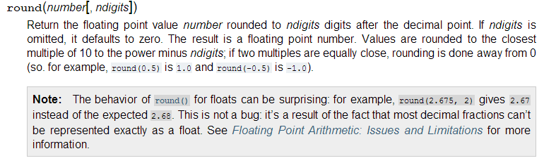
A quick primer on reading the PyDocs
Example PyDoc entry:
Notes:
PyDocs: the documentation of all Python, found here: https://docs.python.org/2/index.html
This will often pop up as the first google search hit, so it's important to be able to understand the various conventions used

Slide 72
A quick primer on reading the PyDocs
Example PyDoc entry:
function name
required parameters; there may be none or many; must be in the specified order
optional parameters are shown in brackets; must also be in the specified order
Useful
info

Slide 73
A quick primer on reading the PyDocs
Another example:

Slide 74
A quick primer on reading the PyDocs
Another example:
When brackets are nested like this, it means that to use the more nested parameters, you must also specify the previous parameters (i.e. the ones "less" nested)
Examples:
Allowed:
sorted(iterable)
sorted(iterable, cmp)
sorted(iterable, cmp, key)
sorted(iterable, cmp, key, reverse)
Not allowed:
sorted(cmp)
sorted(iterable, key)
sorted(iterable, reverse, cmp, key)
However, you can specify in any order if you refer to parameters by name:
sorted(iterable = someIterableThing, reverse = True)

Slide 75
5. Commenting your code

Slide 76
Commenting your code
Comments are text you add to your code that is ignored by Python. Comments are meant to help others (and yourself) better understand what your code is doing.
# this is a comment
# comments are ignored by Python
print("Hello!”) # you can put them almost anywhere
print("How are you?”) # use them often!
What this code prints:
Hello!
How are you?
Important to note:
If you add a comment in an indented block, the comment must be indented as well (otherwise you will get an error).
Notes:
Everything after the # sign on the same line will be ignored.

Slide 77
Multi-line comments
Single line comments are made using the # sign.
For a multi-line comment, use """ or ''' like so:
Example:
"""
This here is a multi-line comment.
Make sure to end it with matching quotes!
"""
print("hello”)
'''
This is another mutli-line comment!
What fun!
'''
Notes:
Everything between the pairs of """ or ''' will be ignored
Same thing about indenting goes for these -- they must have the same indent as the code that surrounds them

Slide 78
When should I comment?
Comments are meant to improve the understandability of your code to another person (and possibly yourself in the future).
Use them whenever you think a piece of code might be particularly confusing to a reader.
You can also use them to "section" your code. Sometimes I write comments first, before the code, and use it as an outline for the overall code structure.
Most importantly, though: always keep your comments up to date! Inaccurate comments are worse than no comments at all, because they mislead the reader and can cause false assumptions.
Notes:
In general, you should strive to write code that is so clear that it doesn't need comments. This isn't always practical, though...

Slide 79
Appendix: More if/else examples & practice

Slide 80
More practice
What will this code print?
yourAge = 50
catsYouOwn = 5
if (catsYouOwn > (yourAge / 10)):
print("You are officially a cat lady!”)
elif (catsYouOwn == (yourAge / 10)):
print("Careful! You are close to becoming a cat lady”)
else:
print("Congrats, you are not a cat lady”)

Slide 81
More practice
What will this code print?
yourAge = 50
catsYouOwn = 5
if (catsYouOwn > (yourAge / 10)):
print("You are officially a cat lady!”)
elif (catsYouOwn == (yourAge / 10)):
print("Careful! You are close to becoming a cat lady”)
else:
print("Congrats, you are not a cat lady”)
Result
Careful! You are close to becoming a cat lady

Slide 82
More practice
What will this code print?
alive = True
breathing = False
if alive and breathing:
print("Everything is ok!”)
elif alive and not breathing:
print("You! Go get help!”)
elif not alive and breathing:
print("Zombie attack?”)
elif not alive and not breathing:
print (":(”)

Slide 83
More practice
What will this code print?
alive = True
breathing = False
if alive and breathing:
print("Everything is ok!”)
elif alive and not breathing:
print("You! Go get help!”)
elif not alive and breathing:
print("Zombie attack?”)
elif not alive and not breathing:
print (":(”)
Result
You! Go get help!

Slide 84
More practice
What will this code print?
alive = True
breathing = False
if alive and breathing:
print ("Everything is ok!”)
if alive and not breathing:
print ("You! Go get help!”)
if not alive and breathing:
print ("Zombie attack?”)
if not alive and not breathing:
print (":(")

Slide 85
More practice
What will this code print?
alive = True
breathing = False
if alive and breathing:
print ("Everything is ok!”)
if alive and not breathing:
print ("You! Go get help!")
if not alive and breathing:
print ("Zombie attack?")
if not alive and not breathing:
print (":(”)
Result
You! Go get help!

Slide 86
More practice
What will this code print?
alive = True
breathing = False
if alive and breathing:
print ("Everything is ok!”)
if alive and not breathing:
print ("You! Go get help!”)
if not alive and breathing:
print ("Zombie attack?”)
if not alive and not breathing:
print (":(”)
Result
You! Go get help!
What's the difference?
Here we used only if statements instead of elif.
This example gives the same result as the previous example, but notice how that might not always be the case!
The setup shown here allows for the possibility that more than one of these statements can be executed, while the previous setup does not.
This could be good, or not, depending on what you want to do. Always think carefully about which approach makes more sense for what you want to accomplish.

Slide 87
More practice
What will this code print?
codon = "ATG"
if (len(codon) != 3):
print ("Error, codons must be 3 characters”)
else:
if (codon == "ATG"):
print ("This is a start codon”)
elif (codon == "TAG") or (codon == "TGA") or (codon == "TAA"):
print ("This is a stop codon”)
else:
print ("This is not a start or stop codon”)
print ("Goodbye!”)

Slide 88
More practice
What will this code print?
codon = "ATG"
if (len(codon) != 3):
print "Error, codons must be 3 characters"
else:
if (codon == "ATG"):
print ("This is a start codon”)
elif (codon == "TAG") or (codon == "TGA") or (codon == "TAA"):
print ("This is a stop codon”)
else:
print ("This is not a start or stop codon”)
print ("Goodbye!”)
Result
This is a start codon
Goodbye!

Slide 89
Tips about Programming
Practice a problem everyday.
Think of a data task in your lab that you can speed up by using code and program it.
Rosalind:
Practice programming specifically for bioinformatics
Unlock new levels and earn badges (gaming!)
http://rosalind.info/problems/locations/

Slide 90
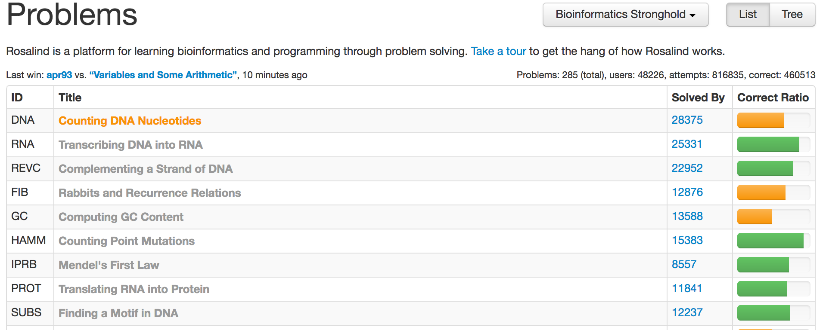
Rosalind Example
http://rosalind.info/problems/list-view/

