Slide 1
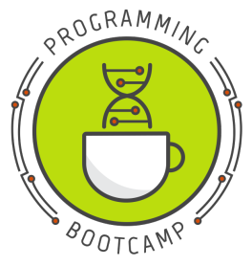
Programming Bootcamp
2019

Slide 2
What is Programming Bootcamp?
Programming bootcamp is an introductory python-based course taught by graduate students for (~35) graduate students
Topics include:
Introduction to programming, python, jupyter
Conditionals (if/then)
Loops & Custom Functions
Data structure: Lists
File writing & dictionaries
Modules & Introduction to Pandas DataFrames
Join & GroupBy in Pandas DataFrames
Visualizations

Slide 3
Why fund programming bootcamp?
A GCB member has organized python bootcamp for the last 5 years and students have found it helpful.
Last year students on average gave the bootcamp 4.35 stars.
Programming Bootcamp is volunteer-based and are the core to a successful bootcamp experience
Since programming bootcamp is volunteer-based we like to provide gratitude for our volunteers in the form of snacks during sessions

Slide 4
Snack Budget ($500)
Lab | Price of Snacks
1 | 62.5
2 | 62.5
3 | 62.5
4 | 62.5
5 | 62.5
6 | 62.5
7 | 62.5
8 | 62.5
Total | 500
Snacks Each Week | Amount | Serves | Price
ABP Sweet Bites | 2 | 10 | 15.49
Mini Croissants | 8 | 2 | 3.35
Total |  |  | 58
Total + Tax |  | 36 | 62.4024

Slide 5
Snack Budget ($500)
Lab | Price of Snacks
1 | 62.5
2 | 62.5
3 | 62.5
4 | 62.5
5 | 62.5
6 | 62.5
7 | 62.5
8 | 62.5
Total | 500
Snacks Each Week | Amount | Serves | Price
ABP Sweet Bites | 2 | 10 | 15.49
Mini Croissants | 8 | 2 | 3.35
Total |  |  | 58
Total + Tax |  | 36 | 62.4024

