Slide 1
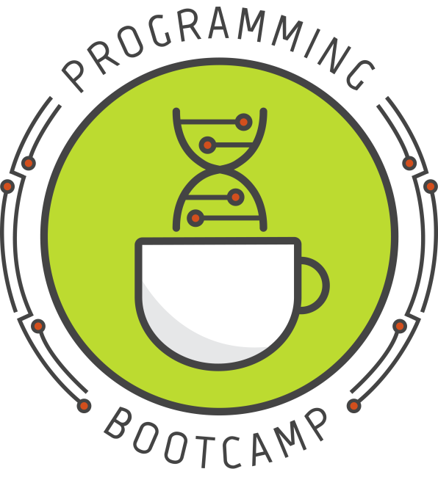
Writing your own functions
Lesson 6 – 9/23/16
Notes:
With notes!

Slide 2
Today's schedule
Defining your own functions
basics
importing from a separate file
variable "scope"

Slide 3
Defining your own functions
Why do it?
Allows you to re-use a certain piece of code without re-writing it
Organizes your code into functional pieces
Makes your code easier to read and understand

Slide 4
Defining a function
Syntax:
def function_name(parameters):
statements
var = something
return var
Example:
def strAdd(num1, num2):
result = int(num1) + int(num2)
return result
Notes:
Example: this is a silly example of a function that can add two numbers together when they are in string form.
Function names follow the same rules as variable names, pretty much.

Slide 5
Defining a function
Syntax:
def function_name(parameters):
statements
var = something
return var
Example:
def strAdd(num1, num2):
result = int(num1) + int(num2)
return result
This is the value that the function returns when we use it. To give a familiar example, the int() function's return value is the string converted to an integer.
Which value we return must be considered carefully, since no other information inside the function will be accessible when we call it. All we can do is capture the return value.
Notes:
Example: this is a silly example of a function that can add two numbers together when they are in string form.

Slide 6
Using a custom function
def strAdd(num1, num2):
result = int(num1) + int(num2)
return result

Slide 7
Using a custom function
def strAdd(num1, num2):
result = int(num1) + int(num2)
return result
first = raw_input("First number? ")
second = raw_input("Second number? ")
added = strAdd(first, second)
print added

Slide 8
Using a custom function
def strAdd(num1, num2):
result = int(num1) + int(num2)
return result
first = raw_input("First number? ")
second = raw_input("Second number? ")
added = strAdd(first, second)
print added
Function must be defined before it can be used (usually we define all our definitions at the very top of the script or in a separate script)
Here is where execution actually starts (the first un-indented line)
Here is where we "call" our function

Slide 9
Using a custom function
4
5
6
def strAdd(num1, num2):
result = int(num1) + int(num2)
return result
first = raw_input("First number? ")
second = raw_input("Second number? ")
added = strAdd(first, second)
print added
1
2
3/7
8

Slide 10
Using a custom function
START
4
5
6
def strAdd(num1, num2):
result = int(num1) + int(num2)
return result
first = raw_input("First number? ")
second = raw_input("Second number? ")
added = strAdd(first, second)
print added
1
2
3/7
8
Notes:
When python starts a script that has function definitions at the top, it skips those definitions entirely. It will only use them if they are called from somewhere in the main script body. Python looks for the first un-indented line to determine where it should start executing.

Slide 11
Using a custom function
START
4
5
6
def strAdd(num1, num2):
result = int(num1) + int(num2)
return result
first = raw_input("First number? ")
second = raw_input("Second number? ")
added = strAdd(first, second)
print added
1
2
3/7
8

Slide 12
Using a custom function
START
4
5
6
def strAdd(num1, num2):
result = int(num1) + int(num2)
return result
first = raw_input("First number? ")
second = raw_input("Second number? ")
added = strAdd(first, second)
print added
1
2
3/7
8

Slide 13
Using a custom function
START
4
5
6
def strAdd(num1, num2):
result = int(num1) + int(num2)
return result
first = raw_input("First number? ")
second = raw_input("Second number? ")
added = strAdd(first, second)
print added
1
2
3/7
8
End

Slide 14
What will this code print?
def strAdd(num1, num2):
result = int(num1) + int(num2)
return result
first = raw_input("First number? ")
second = raw_input("Second number? ")
added = strAdd(first, second)
print added
Result:
First number? <input> 5
Second number? <input> 4
Assuming we input these values for first and second

Slide 15
What will this code print?
def strAdd(num1, num2):
result = int(num1) + int(num2)
return result
first = raw_input("First number? ")
second = raw_input("Second number? ")
added = strAdd(first, second)
print added
Result:
First number? <input> 5
Second number? <input> 4
9
Notes:
So we used raw input to get numbers (in the form of strings) and then called a single function to both convert them to ints and to add them
If adding two int-strs together was something you had to do a lot, maybe this would be a function worth making (probably not though, since it doesn't save you much typing. A better function might be a wrapper for raw_input() that auto-converts integers when they're they're entered..)

Slide 16
A more useful example: counting
Result of using .count():
>>> seq = "CGCACGCACGCGC"
>>> seq.count("CGC")
3
Notice that there are actually 4 possible instances of "CGC" in this sequence – the "CGCGC" at the end can be counted as having two instances.
The .count() only counts non overlapping instances. What if that's not what we want?

Slide 17
A more useful example: counting
# Count (potentially overlapping) instances of a subsequence in a string
def count_occurrences(seq, subseq):
seq = seq.upper()
subseq = subseq.upper()
count = 0
index = 0
done = False
while not done:
index = seq.find(subseq, index)
if (index == -1):
done = True
else:
count += 1
index += 1 # add one so this pos won't be found again
return count
# main script
seq = raw_input("Full sequence: ")
subseq = raw_input("Subseq to search for: ")
result = count_occurrences(seq, subseq)
print "The subseq occurs", result, "times in the full seq"
Notes:
Since this is something that may occur often, we can put our code in a function so that we can use it multiple times in our code without having to copy and paste it.

Slide 18
A more useful example: counting
Result of using .count():
>>> seq = "CGCACGCACGCGC"
>>> seq.count("CGC")
3
Result:
Full sequence: CGCACGCACGCGC
Subseq to search for: CGC
The subseq occurs 4 times in the full seq

Slide 19
Keep your functions in a separate file
If you have a set of functions you want to use in various different scripts (e.g. a function to read in a fasta file), you can save these functions in a separate file and then import them into other scripts. Example:
useful_fns.py:
# Count (potentially overlapping) instances of a subsequence in a string
def count_occurrences(seq, subseq):
seq = seq.upper()
subseq = subseq.upper()
count = 0
index = 0
done = False
while not done:
index = seq.find(subseq, index)
if (index == -1):
done = True
else:
count += 1
index += 1
return count
test.py:
import useful_fns
seq = raw_input("Full sequence: ")
subseq = raw_input("Subseq to search for: ")
result = useful_fns.count_occurrences(seq, subseq)
print "The subseq occurs", result, "times"
Result:
> python test.py
Full sequence: CGCACGCACGCGC
Subseq to search for: CGC
The subseq occurs 4 times
Notes:
To make this function maximally useful, we can keep it in a separate file
That way if we ever need to change it (e.g. we find a bug), we only need to change it once, and all other scripts that use it will automatically be up to date
If, on the other hand, we just copied and pasted this code into each script, we'd have to go through and fix every instance. This can be very annoying, and can also cause more bugs.
Note, if we want to use one piece of code that works for many situations, we have to make it as generic as possible. That is, we want to write it in such a way that it will work for pretty much any situation we can imagine.

Slide 20
Keep your functions in a separate file
If you have a set of functions you want to use in various different scripts (e.g. a function to read in a fasta file), you can save these functions in a separate file and then import them into other scripts. Example:
useful_fns.py:
# Count (potentially overlapping) instances of a subsequence in a string
def count_occurrences(seq, subseq):
seq = seq.upper()
subseq = subseq.upper()
count = 0
index = 0
done = False
while not done:
index = seq.find(subseq, index)
if (index == -1):
done = True
else:
count += 1
index += 1
return count
test.py:
import useful_fns
seq = raw_input("Full sequence: ")
subseq = raw_input("Subseq to search for: ")
result = useful_fns.count_occurrences(seq, subseq)
print "The subseq occurs", result, "times"
we save the file of functions as useful_fns.py, but then import it using just the file name (no .py). Then we can access the functions in this file by saying useful_fns.functionName()
Result:
> python test.py
Full sequence: CGCACGCACGCGC
Subseq to search for: CGC
The subseq occurs 4 times
Notes:
To make this function maximally useful, we can keep it in a separate file
That way if we ever need to change it (e.g. we find a bug), we only need to change it once, and all other scripts that use it will automatically be up to date
If, on the other hand, we just copied and pasted this code into each script, we'd have to go through and fix every instance. This can be very annoying, and can also cause more bugs.
Note, if we want to use one piece of code that works for many situations, we have to make it as generic as possible. That is, we want to write it in such a way that it will work for pretty much any situation we can imagine.

Slide 21
A note on "scope"
Variables you create within a function are considered to be in a different "scope" than the rest of your code
This means that those variables are inaccessible outside of the function definition block
Reusing a variable name within a function definition block will not overwrite any variable defined outside the block.
Somewhat confusingly, functions can sometimes use variables defined within the main body (as long as it has been created before the function is called). However, doing this generally considered bad practice, since it makes the effects of a function harder to predict (especially if you plan to use it in many different scripts).
The best practice is to only allow functions to use the external variables that are supplied directly as parameters.

Slide 22
Example of scope
>>> def someFn(val):
... c = val * 10
... z = c * c
... return z
...
>>> x = 5
>>> z = 1
>>> result = someFn(x)

Slide 23
Example of scope
>>> def someFn(val):
... c = val * 10
... z = c * c
... return z
...
>>> x = 5
>>> z = 1
>>> result = someFn(x)
function scope
main scope

Slide 24
Example of scope
>>> def someFn(val):
... c = val * 10
... z = c * c
... return z
...
>>> x = 5
>>> z = 1
>>> result = someFn(x)
function scope
main scope
>>> print result

Slide 25
Example of scope
>>> def someFn(val):
... c = val * 10
... z = c * c
... return z
...
>>> x = 5
>>> z = 1
>>> result = someFn(x)
function scope
main scope
>>> print result
2500

Slide 26
Example of scope
>>> def someFn(val):
... c = val * 10
... z = c * c
... return z
...
>>> x = 5
>>> z = 1
>>> result = someFn(x)
function scope
main scope
>>> print result
2500
>>> print z

Slide 27
Example of scope
>>> def someFn(val):
... c = val * 10
... z = c * c
... return z
...
>>> x = 5
>>> z = 1
>>> result = someFn(x)
function scope
main scope
>>> print result
2500
>>> print z
1
The z defined in the main scope was not overwritten by the z defined in the function scope

Slide 28
Example of scope
>>> def someFn(val):
... c = val * 10
... z = c * c
... return z
...
>>> x = 5
>>> z = 1
>>> result = someFn(x)
function scope
main scope
>>> print result
2500
>>> print z
1
>>> print c

Slide 29
Example of scope
>>> def someFn(val):
... c = val * 10
... z = c * c
... return z
...
>>> x = 5
>>> z = 1
>>> result = someFn(x)
function scope
main scope
>>> print result
2500
>>> print z
1
>>> print c
Traceback (most recent call last):
File "<stdin>", line 1, in <module>
NameError: name 'c' is not defined
There is no c defined in the main scope, and we cannot access the c defined in the function scope, so this creates a NameError

