Slide 1
Data structures Part 1: Lists
Lesson 4: 9/14/2017
Speaker: Samantha Klasfeld

Slide 2
Today’s Schedule
Introduction to Data Structures
Lists
File parsing with .split()

Slide 3
1. Introduction to Data Structures

Slide 4
What is a Data Strucutre?
A data structure is an object for storing large amounts of data (numbers, strings, etc) in an organized manner, making storage and retrieval easier

Slide 5

It may be helpful to imagine
a data structure is a file cabinet…
Each object can be the contents of each folder within the cabinet
Notes:
different data structure organize these files differently

Slide 6
2. Lists

Slide 7

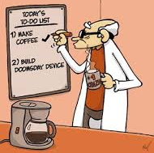
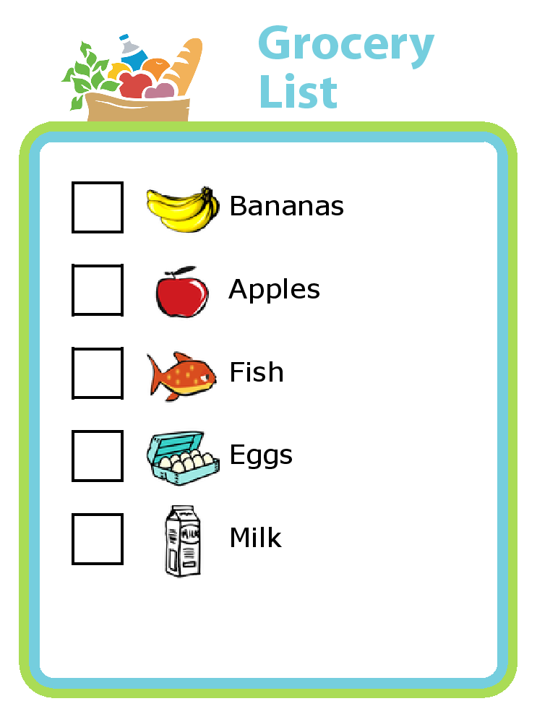
What is a list?
Grocery List
A list is a built-in data structure in Python (along with sets, tuples, and dictionaries) that is ordered by indexes
Notes:
Note for people who have used other programming languages:
Lists are similar to what other programming languages call "arrays". There are actually some subtle (but important) differences between lists and arrays (lists are closer to what is usually called a linked list), but for most purposes they perform the same role. The most obvious difference you might notice is that you don't need to specify ahead of time how large your list will be. This is because the size of the list grows dynamically as you add things to it (it also shrinks automatically as you take things out).

Slide 8
Python lists can look like this:
[“hello”, “world”, “i”, “am”, “sam”]
OR
Note that we only use one variable
name to refer to the whole list
[5, 4, 2, 1, 1]
OR
[5.001, 4.4, 2.0, .991, 42.6]
OR
[True, False, False]
OR
[]
OR
[3, “cat”, 56.9, 4, 10, True]
However, it may be more helpful to think of them like this
Indices (keys)
0 | 1 | 2 | 3 | 4 | 5
3 | “cat” | 56.9 | 4 | 10 | TRUE
Elements (values)
where each element is given an index, starting at 0.

Slide 9
If you think of lists as a type of file cabinet,
then the indices are the labels on each folder
56.9
3
2
1
the elements are the contents inside the folders

Slide 10
Accessing Elements in a List
Grocery List
Here is my grocery list.
What is the third item on my grocery list?
What are the first 2 items on my grocery list?
What are the last two items on my grocery list?

Slide 11
Accessing elements in a list
We use only one variable name to refer to the whole list. For example:
myList = [3, “cat”, 56.9, 4, 10, True]
To access a specific element in the list, we use the following syntax:
listName[index]
>>> myList[0]
3
0 | 1 | 2 | 3 | 4 | 5
3 | “cat” | 56.9 | 4 | 10 | TRUE
>>> myList[1]
cat
myList[0]
myList[1]

Slide 12
Practice with list indexing
0 | 1 | 2 | 3 | 4 | 5
3 | “cat” | 56.9 | 4 | 10 | TRUE
What will this code print?
myList = [3, "cat", 56.9, 4, 10, True]
print myList[1]

Slide 13
Practice with list indexing
0 | 1 | 2 | 3 | 4 | 5
3 | “cat” | 56.9 | 4 | 10 | TRUE
What will this code print?
myList = [3, "cat", 56.9, 4, 10, True]
print myList[1]
Result:
cat

Slide 14
Practice with list indexing
0 | 1 | 2 | 3 | 4 | 5
3 | “cat” | 56.9 | 4 | 10 | TRUE
What will this code print?
myList = [3, "cat", 56.9, 4, 10, True]
print myList[4]

Slide 15
Practice with list indexing
0 | 1 | 2 | 3 | 4 | 5
3 | “cat” | 56.9 | 4 | 10 | TRUE
What will this code print?
myList = [3, "cat", 56.9, 4, 10, True]
print myList[4]
Result:
10

Slide 16
Practice with list indexing
0 | 1 | 2 | 3 | 4 | 5
3 | “cat” | 56.9 | 4 | 10 | TRUE
What will this code print?
myList = [3, "cat", 56.9, 4, 10, True]
print myList[6]

Slide 17
Practice with list indexing
0 | 1 | 2 | 3 | 4 | 5
3 | “cat” | 56.9 | 4 | 10 | TRUE
What will this code print?
myList = [3, "cat", 56.9, 4, 10, True]
print myList[6]
Result:
This is an "index out of bounds" error. You cannot access an index that does not exist!
IndexError: list index out of range

Slide 18
Practice with list indexing
0 | 1 | 2 | 3 | 4 | 5
3 | “cat” | 56.9 | 4 | 10 | TRUE
What will this code print?
myList = [3, "cat", 56.9, 4, 10, True]
print myList[-1]

Slide 19
Practice with list indexing
0 | 1 | 2 | 3 | 4 | 5
3 | “cat” | 56.9 | 4 | 10 | TRUE
What will this code print?
myList = [3, "cat", 56.9, 4, 10, True]
print myList[-1]
Result:
Yep, this work! This comes in handy when you know you want the last element but you don’t know what the index of the last element is!
True

Slide 20
Practice with list indexing
0 | 1 | 2 | 3 | 4 | 5
3 | “cat” | 56.9 | 4 | 10 | TRUE
What will this code print?
myList = [3, "cat", 56.9, 4, 10, True]
print myList[-2]

Slide 21
Practice with list indexing
0 | 1 | 2 | 3 | 4 | 5
3 | “cat” | 56.9 | 4 | 10 | TRUE
What will this code print?
myList = [3, "cat", 56.9, 4, 10, True]
print myList[-2]
Result:
10

Slide 22
Practice with list indexing
0 | 1 | 2 | 3 | 4 | 5
3 | “cat” | 56.9 | 4 | 10 | TRUE
How would you get the third element?

Slide 23
Practice with list indexing
0 | 1 | 2 | 3 | 4 | 5
3 | “cat” | 56.9 | 4 | 10 | TRUE
How would you get the third element?
Answer:
myList[2]

Slide 24
Practice with list indexing
0 | 1 | 2 | 3 | 4 | 5
3 | “cat” | 56.9 | 4 | 10 | TRUE
What will this code print?
myList = [3, “cat”, 56.9, 4, 9, 10, True]
myList[0] = “dog”
print(myList)

Slide 25
Practice with list indexing
0 | 1 | 2 | 3 | 4 | 5
3 | “cat” | 56.9 | 4 | 10 | TRUE
What will this code print?
myList = [3, “cat”, 56.9, 4, 9, 10, True]
myList[0] = “dog”
print(myList)
Answer:
This is an easy way to overwrite list elements!
[“dog”, “cat”, 56.9, 4, 9, 10, True]

Slide 26
For-loops and Lists
Last time we used range() to create for loops.
In Python3 the type range is not the same as the type list (they are the same in Python2).
That being said, we can use both to create for loops!
for i in [1, 20, 3, 19, 6]:
print(i)
Output:
1
20
3
19
6

Slide 27
Practice with For-loops and Lists
What will the following code print?
for i in [“cat”, “dog”, “mouse”, “human”]:
print(“I am a”, i)

Slide 28
Practice with For-loops and Lists
What will the following code print?
for i in [“cat”, “dog”, “mouse”, “human”]:
print(“I am a”, i)
Answer:
I am a cat
I am a dog
I am a mouse
I am a human

Slide 29
Practice with For-loops and Lists
What will the following code print?
myStuff = [“cat”, 2, True, 99.5]
for i in myStuff:
print(i)

Slide 30
Practice with For-loops and Lists
What will the following code print?
myStuff = [“cat”, 2, True, 99.5]
for i in myStuff:
print(i)
Answer:
cat
2
True
99.5

Slide 31
Creating Lists
We now know how to:
create an empty list
myList = []
create a list of elements
myList = [2, 7, 8]
To create a list of numbers we can use the range function, but we must remember to specify it as a list or else will be caste as a range type.
myList = list(range(5, 50, 10))
recall that the format for range() is: range([start],stop[, step])

Slide 32
Adding to a List
After creating a list, you can add additional elements to the end by using the .append() function
Syntax:
list.append(newElement)
Important to note:
Most of the functions we've seen so far do not modify variables directly -- they simply "return" a value. (e.g. line.rstrip('\n') does nothing to the original string -- it just returns a modified version. You have to say line = line.rstrip('\n') to actually change line.)
.append() is different. When you say mylist.append(), you are directly modifying mylist. We'll see several examples of this type of function today.
Example:
>>>> myList = [2, 4, 6, 8]
>>>> myList.append(10)
print(myList)
[2, 4, 6, 8, 10]
Notes:
Notice that we don't have to say
myList = myList.append()
for this to work. Functions that work this way are said to be "in place" operations, because they modify the variable itself, instead of simply returning a value that must be captured. "In place" functions are not very common, but it's good to look up any new functions you use to check if they are, since you do not want to modify your variables without realizing it.

Slide 33
Removing from a list
After creating a list, you can remove elements from it using the .pop() function
Syntax:
list.pop(index)
This in-place function removes the element at the specified index, or if no index is given, removes the last item.
It also returns the removed item.
list.pop()
Example:
>>>> myList = [22, 44, 66, 88]
>>>> myList.pop(2)
print(myList)
[22, 44, 88]
Elements that come after will be moved up one index, so that there are no empty spaces in the list.
Notes:
.pop() is also an in-place function, but it returns something as well: the element that was "popped"

Slide 34
Practice with lists
0 | 1 | 2 | 3 | 4 | 5
‘a’ | ‘b’ | ‘c' | ‘d' | ‘e' | ‘f’
How do I add a ‘g’ to the end?

Slide 35
Practice with lists
0 | 1 | 2 | 3 | 4 | 5
‘a’ | ‘b’ | ‘c' | ‘d' | ‘e' | ‘f’
myList
How do I add a ‘g’ to the end?
Answer:
myList.append(‘g’)

Slide 36
Practice with lists
0 | 1 | 2 | 3 | 4 | 5
‘a’ | ‘b’ | ‘c' | ‘d' | ‘e' | ‘f’
myList
What will this code print?
myList.pop(4)
print(myList)

Slide 37
Practice with lists
0 | 1 | 2 | 3 | 4 | 5
‘a’ | ‘b’ | ‘c' | ‘d' | ‘e' | ‘f’
myList
What will this code print?
myList.pop(4)
print(myList)
Answer:
[‘a’,’b’,’c’,’d’,’f’]

Slide 38
Practice with lists
0 | 1 | 2 | 3 | 4 | 5
1 | 2 | 3 | 4 | 5 | 6
myList
What will this code print?
myList.pop()
print(myList)

Slide 39
Practice with lists
0 | 1 | 2 | 3 | 4 | 5
1 | 2 | 3 | 4 | 5 | 6
myList
What will this code print?
myList.pop()
print(myList)
Answer:
[1,2,3,4,5]

Slide 40
Practice with lists
0 | 1 | 2 | 3 | 4 | 5
“24” | 36 | 1 | 8 | “cat” | True
myList
What will this code print?
item = myList.pop()
print(item)

Slide 41
Practice with lists
0 | 1 | 2 | 3 | 4 | 5
“24” | 36 | 1 | 8 | “cat” | True
myList
What will this code print?
item = myList.pop()
print(item)
Answer:
True

Slide 42
Checking if something is in the list
To check if a particular element is in a list, you can just in, as we’ve seen before:
myList = [22, 44, 66, 88]
if (66 in myList):
print(“found it!”)
Output:
found it!

Slide 43
Iterating through a list
Again, we’ve actually already done this. It’s as simple as using a for loop:
myList = [“Joe”, “Sally”, “George”, “Mike”]
fir name in myList:
print(“Hello”,name)
Output:
Hello Joe
Hello Sally
Hello George
Hello Mike

Slide 44
List slicing
Sometimes you may want to extract a certain subset of a list.
0 | 1 | 2 | 3 | 4 | 5
‘a’ | ‘b’ | ‘c' | ‘d' | ‘f’ | ‘g’
myList
The syntax: list[begin:end] returns from index begin to end-1
>>> myList = [‘a’,’b’,’c’,’d’,’f’,’g’]
>>> myList[2:]
[’c’,’d’,’f’,’g’]
>>> myList[:4]
[‘a’,’b’,’c’,’d’]
>>> myList[2:4]
[‘c’,’d’]

Slide 45
List slicing
You can also slice from the end of the list using negative indices
0 | 1 | 2 | 3 | 4 | 5
‘a’ | ‘b’ | ‘c' | ‘d' | ‘f’ | ‘g’
myList
>>> myList = [‘a’,’b’,’c’,’d’,’f’,’g’]
>>> myList[-2:]
[’f’,’g’]
>>> myList[:-4]
[‘a’,’b’]
>>> myList[-4:-2]
[‘c’,’d’]

Slide 46
Side note: indexing strings like lists
Strings are NOT lists. But we can index into strings like we do lists:
>>> name = “Sammy”
>>> name[0]
’S’
>>> name[-1]
‘y’
>>> name[1:4]
‘amm’

Slide 47
Side note: indexing strings like lists
However, that being said, strings are not immutable (cannot be changed), so none of these operations are allowed:
>>> name = “Sammy”
>>> name[0]=“T”
TypeError: 'str' object does not support item assignment
>>> name.append(“s”)
AttributeError: 'str' object has no attribute 'append'
Notes:
Yes, strings really aren't allowed to be changed. Whenever we've "changed" strings in the past, what we really did was overwrite the variable holding the string with a new version of the string. This is a subtle but important distinction.

Slide 48
Useful list functions
Lists come with several other helpful functions:
.sort() - sorts in place (overwrites the list). Can sort both strings and numerical data.
.reverse() - reverses order of items, in place
.index(element) - returns index of the first occurrence of the specified element
.remove(element) - Removes the first occurrence of the specified element. Elements that come after will shift down one index.
.insert(value, index) - insert the value at the specified index. Elements that come after that index will shift up one index.
.count(element) - returns the number of times the specified element occurs in the list
Notes:
Experiment with these on your own to see how they work!

Slide 49
Functions that work on lists
There are also several built-in Python functions that work on lists:
len(list) - returns the total number of elements in the list
max(list) - returns the element in the list with the largest value
min(list) - returns the element in the list with the smallest value
sum(list) - returns the sum of the elements of the list

Slide 50
3. File parsing with .split()

Slide 51
The Situations
You have a file with multiple columns separated by either tabs, commas, etc
You want to extract certain columns of data to analyze
How can you do this in Python?

Slide 52
.split()
This functions splits a string into a list based on a delimiter.
The delimiter can be anything you want, but usually it'll be a tab, space, or comma.
This effectively lets you chop up a file into columns!

Slide 53
.split()
Purpose:
Splits a string every time it encounters the specified delimiter. If no delimiter is given, splits on whitespace (spaces, tabs, and newlines). The delimiter is not included in the output. If maxsplit is given, splits no more than maxsplit times. Returns a list.
Syntax:
result = string.split([delimiter[,maxsplit]])
Example:
>>> sentence = "Hello, how are you today?"
>>> sentence.split()
['Hello,', 'how', 'are', 'you', 'today?']
Notice that the spaces are removed!

Slide 54
More examples
>>> sentence = "Hello, how are you today?"
>>> sentence.split(',')
['Hello', ' how are you today?']
Notice that now the comma is removed, but spaces are not!
>>> sentence.split(None, 2)
['Hello,', 'how', 'are you today?']
maxsplit must always be the second parameter. So if we don't want to specify a delimiter, we can put None instead as a placeholder

Slide 55
Why is .split() important?
This is perhaps the single most useful tool for parsing a text file (for what I do, anyway)
Let’s take a look at a real-life example.

Slide 56
A more realistic example: parsing a data file
A data file organized in rows and columns (data "table") can be easily parsed using a combination of a for loop and .split().
Input Data File:
knownGene GeneName InitCodon DisttoCDS FramevsCDS InitContext CDSLength PeakStart PeakWidth #HReads PeakScore Codon Product
uc007zzs.1 Cbr3 36 -23 -1 GCCACGG 22 35 3 379 4.75 nearcog uorf
uc009akk.1 Rac1 196 0 0 CAGATGC 192 195 3 3371 4.70 aug canonical
uc009eyb.1 Saps1 204 -91 1 GCCACGG 23 203 3 560 4.68 nearcog uorf
uc008wzq.1 Ppp1cb 96 0 0 AAGATGG 327 94 4 3218 4.56 aug canonical
uc007hnl.1 Pa2g4 38 -23 0 AGCCTGT 14 37 4 6236 4.54 nearcog uorf
uc007hnl.1 Pa2g4 40 -22 -1 CCTGTGG 17 37 4 6236 4.54 nearcog uorf
uc008tvu.1 Leprot 27 0 0 GACATGG 131 26 3 830 4.53 aug canonical
uc008vlv.1 Capzb 95 0 0 ACCATGA 277 94 3 3024 4.51 aug canonical
uc007xgk.1 Ncaph2 63 -2 -1 GACATGG 38 62 3 983 4.48 aug uorf-overlap

Slide 57
A more realistic example: parsing a data file
Let's say I just want to extract the 6th column of each row (in this case, the initiation context for each start site).
Code:
inFile = "init_sites.txt"
input = open(inFile, 'r')
input.readline() #skip header
for line in input:
line = line.rstrip('\n')
data = line.split() #splits line on tabs
print(data[5]) #6th column = index 5
input.close()

Slide 58
A more realistic example: parsing a data file
Let's say I just want to extract the 6th column of each row (in this case, the initiation context for each start site).
Output:
Code:
inFile = "init_sites.txt"
input = open(inFile, 'r')
input.readline() #skip header
for line in input:
line = line.rstrip('\n')
data = line.split() #splits line on tabs
print(data[5]) #6th column = index 5
input.close()
GCCACGG
CAGATGC
GCCACGG
AAGATGG
AGCCTGT
CCTGTGG
GACATGG
ACCATGA
GACATGG

Slide 59
Appendix
Nested lists
List comprehensions
Examples of .insert() and .remove()

Slide 60
Nested lists
A list can hold pretty much anything, including other lists:
>>> geneList = [["uc007agk.1", "Rrs1"], ["uc007ahe.1", "Cops5"], ["uc007bgr.1", "Creb1"]]
0 |  |  |  | 1 |  |  |  | 2
1 | 2 |  |  | 1 | 2 |  |  | 1 | 2
"uc007agk.1" | "Rrs1" |  |  | "uc007ahe.1" | "Cops5" |  |  | "uc007bgr.1" | "Creb1"
>>> geneList[1]
['uc007ahe.1', 'Cops5']
>>> geneList[1][0]
'uc007ahe.1'
You can access individual items in a list of lists using double indexing:
list[index][subindex]

Slide 61
List comprehensions (advanced)
A list comprehension is just a quick, concise way of performing operations on the elements of a list. Returns a new list with the modified elements.
Syntax:
newList = [expression for item in list if condition]
Example:
>>> myList = [1, 2, 3, 4, 5]
>>> newList = [i * 2 for i in myList]
>>> newList
[2, 4, 6, 8, 10]
>>> newList = [i * 2 for i in myList if i > 3]
>>> newList
[8, 10]

Slide 62
List comprehensions (advanced)
Almost any function can be used as the expression part:
>>> myList = ["Joe", "Sally", "George", "Mike"]
>>> [len(i) for i in myList]
[3, 5, 6, 4]
>>>
>>> [i.upper() for i in myList]
['JOE', 'SALLY', 'GEORGE', 'MIKE']
>>>
>>> [(i == "George") for i in myList]
[False, False, True, False]
>>>
>>> [print(i) for i in myList]
File "<stdin>", line 1
[print(i) for i in myList]
^
SyntaxError: invalid syntax

Slide 63
Inserting into a list: .insert()
Purpose:
Insert new element at specified index. All elements after will be pushed back one index.
Syntax:
list.insert(index, newElement)
Example:
>>> myList = [2, 4, 6, 8]
>>> myList.insert(1, "hi!")
>>> print myList
[2, 'hi!', 4, 6, 8]

Slide 64
Practice with adding to lists
0 | 1 | 2 | 3 | 4 | 5
‘a’ | ‘b' | ‘c’ | ‘d’ | ‘f’ | ‘g'
How do I insert an ‘e' between the ‘d’ and ‘f’?

Slide 65
Practice with adding to lists
0 | 1 | 2 | 3 | 4 | 5
‘a’ | ‘b' | ‘c’ | ‘d’ | ‘f’ | ‘g'
How do I insert an ‘e' between the ‘d’ and ‘f’?
Answer:
myList.insert(4, “e”)

Slide 66
Remove element from a list: .remove()
Purpose:
Removes the first occurrence of the specified element. Elements that come after will be moved up one index.
Syntax:
list.remove(element)
Example:
>>> myList = [22, 44, 66, 88]
>>> myList.remove(44)
>>> print myList
[22,66,88]

Slide 67
Practice with removing from lists
0 | 1 | 2 | 3 | 4 | 5
1 | 2 | 3 | 4 | 5 | 6
What will this code print?
myList.remove(4)
print myList

Slide 68
Practice with removing from lists
0 | 1 | 2 | 3 | 4 | 5
1 | 2 | 3 | 4 | 5 | 6
What will this code print?
myList.remove(4)
print myList
Answer
[1,2,3,5,6]

