Slide 1

Python Bootcamp 2020
Session 1

Slide 2
General Course Logistics
Weekly homeworks
Optional but recommended
We provide a template
TA sessions continue
3 modules (2 lectures each)
Module 1: Getting up-and-running writing and executing scripts
Module 2: Data processing and visualization
Module 3: Data analyses

Slide 3
What is a script?
script.txt
script.txt
Computer interprets the instructions given the language it’s written in
First do this
Then do that
Do a few more things
Finally, write this stuff to a file
000101010010010010101001….
And executes said command

Slide 4
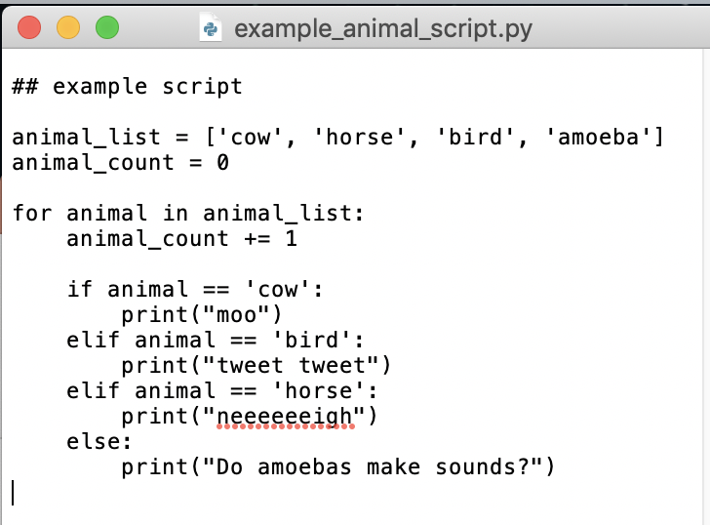
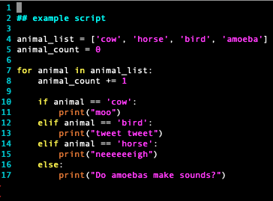
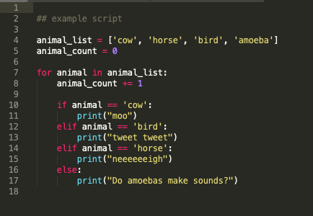
So how Do you write a script?
Open a text file and start writing!
TextEdit
Vim
Sublime
Notes:
Writing a script is as easy as opening text edit and writing
Many different text editors exist to make writing code more visually appealing, but ultimately, just coloring the syntax
Common examples include vim, emacs, sublime, pycharm, etc

Slide 5
How do you write a script Well?
When writing a script, you want it to be:
Readable
Easy to debug
Computationally efficient

Slide 6
Making a script Readable
Python Style Manual – highly recommend!
Future you will thank Past you

Slide 7
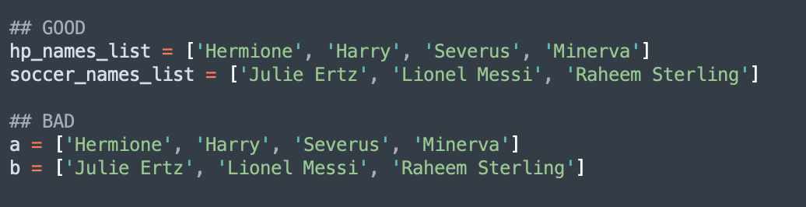
Making a script Readable
Use good, descriptive names. No single letter variables

Slide 8
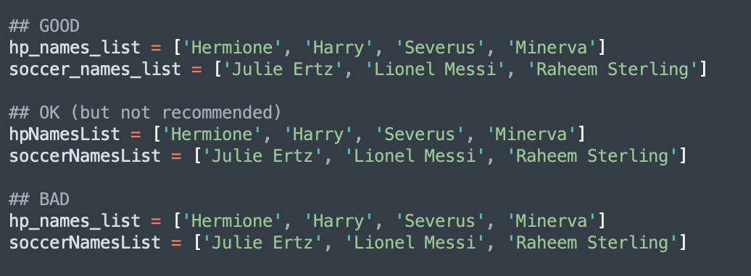
Making a script Readable
Consistency is key! Use the same format to name variables and functions. There are agreed upon formats, but most importantly you are internally consistent

Slide 9
Making a script Readable
Few more quick hits:
It’s ok to use more lines to make your code more readable
Let the code breathe
Maximize interpretability even at the expense of minor computational efficiency
The endless debate – spaces or tabs (use spaces!)
#comments comments comments. Your code acts as an electronic lab notebook!
Notes:
Ultimately want to ensure that whoever looks at your code in the future, can figure out what is going on!

Slide 10
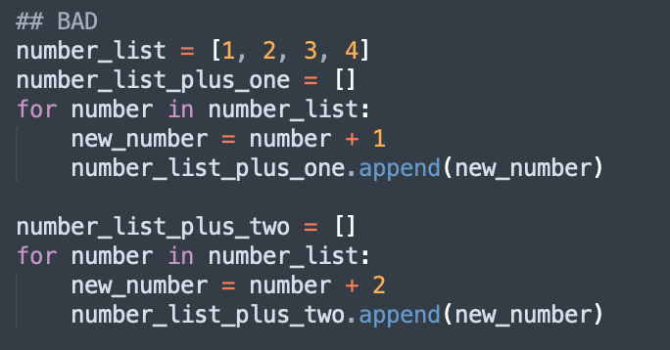
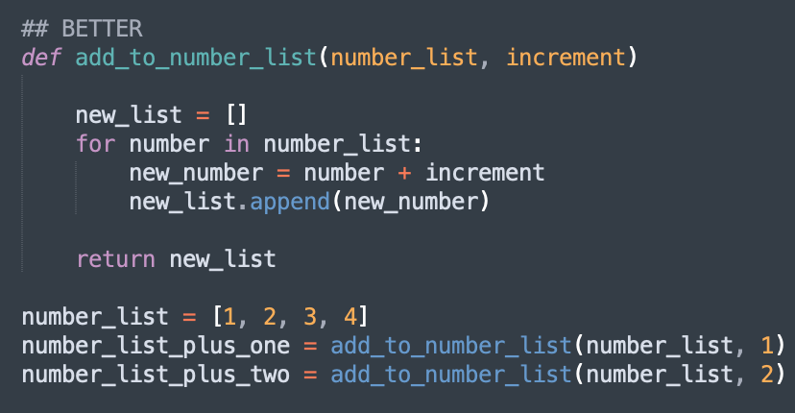
Making a script debuggable
Smart organization of code – reuse code by dividing units into functions

Slide 11
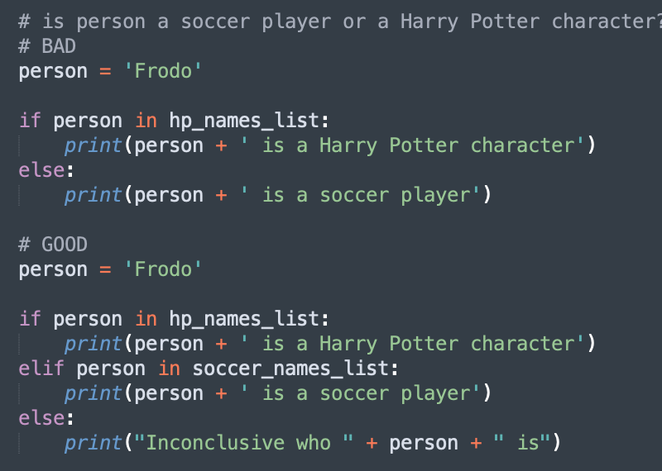
Making a script debuggable
Consider edge cases as you write your script and install checks to catch them – increase generalizability

Slide 12
Making a script debuggable
Readability
Debuggability

Slide 13
Computational Efficiency
For now, avoid using loops inappropriately:
No infinite loops!
Minimize nested loops
Try to only iterate once through each iterable if possible

Slide 14
Command Line
Worksheet + Demo

Slide 15

Github
As scientists, reproducibility is one of our major concerns
With reproducibility, comes version control

Slide 16
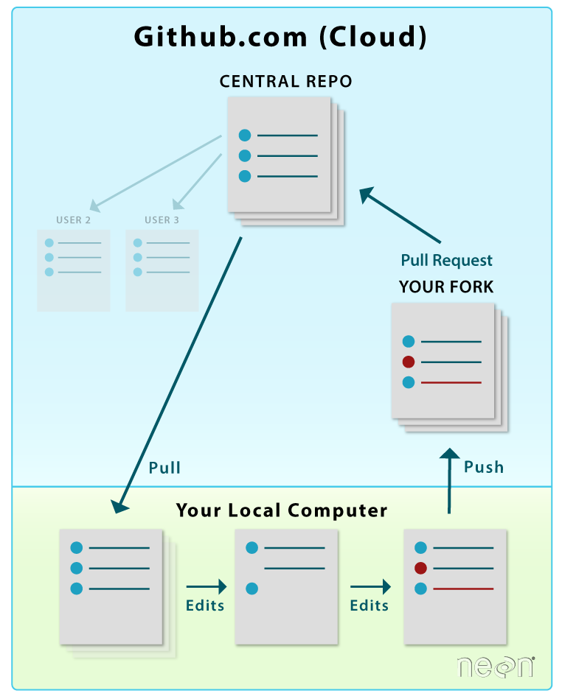
Github
Major uses:
Defacto lab notebook
Collaborative projects
https://www.neonscience.org/sites/default/files/images/pre-institute-content/pre-institute2-git/git-fork-loop.png

Slide 17
This week’s homework
Download Github Desktop
Download a text editor if you’d like
Get acquainted with your command line
Complete the scripting exercise and submit via piazza

