Slide 1

GRMPY: Resting State Functional Connectivity and Behavioral Inhibition
Diego G. Dávila

Slide 2
Overview
GRMPY Dataset
First Approach (ARI)
Second Approach (BIS)
Results & Visualizations
Ongoing Analysis

Slide 3

GRMPY
Irritability in Youth + Adolescence
N=200 (Participated in PNC) IRR=140 (Dx agnostic, screened IRR in PNC) TD=60
Age: 11-30
Multimodal Neuroimaging (sMRI, fMRI, DTI, CBF)
Clinical & Cognitive (CAPA, Self-Report, CNB, Neuroeconomic Tasks)

Slide 4
First Approach: ARI
Let’s evaluate the relationship between functional network connectivity and irritability via the ARI

Slide 5
First Approach: Initial Considerations
Paucity of literature re: neuroimaging and irritability
We must be data-driven

Slide 6
GRMPY – Functional Connectivity: Questions
Is resting-state functional connectivity related to irritability, measured by ARI?
If so, what features of connectivity are associated with increased irritability?

Slide 7
Analysis Sample
153 passed QA and had complete data
93 females
Age range 11-30
Mean age 19.5

Slide 8

Method
Voxel-level CWAS: A starting point
Advantage:
Whole Brain
Disadvantage:
Need further analysis to get drivers of any effect

Slide 9
Method
Voxel-level CWAS:
Calculate BOLD signal correlations between each pair of grey matter voxels in the brain
Test individual differences between subjects’ multivariate patterns of connectivity for every pair of subjects in the sample
Multivariate Distance Matrix Regression (MDMR) to examine whether individuals with similar connectivity patterns scored similarly on ARI Covariates: Age, Sex, Motion

Slide 10
Results

Slide 11
Results
Null, minimum p-value = 0.95

Slide 12
Then… we tried other stuff
Between-Within Module Connectivity Analysis
10-Fold Ridge Regression to see if we could predict out-of-sample irritability with rsfc data

Slide 13
Then… we tried other stuff
Between-Within Module Connectivity Analysis
10-Fold Ridge Regression to see if we could predict out-of-sample irritability with rsfc data
Results were also null

Slide 14

So, we looked beyond the ARI to related symptoms

Slide 15
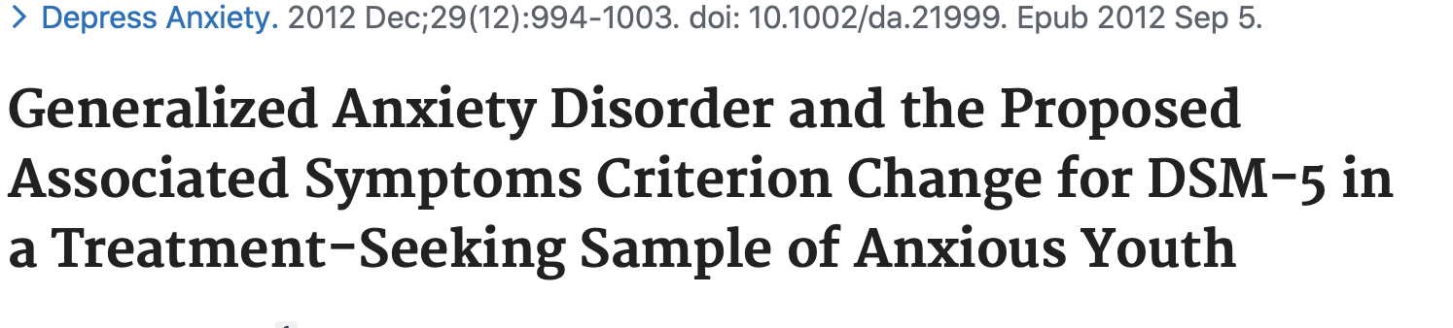
Anxiety and Irritability
Comer et al., 2012 (From BU’s CARD – I used to be an RA here!)
N = 650 anxious youth
Irritability most predictive associated Sx of a GAD Dx
Notes:
Comer JS, Pincus DB, Hofmann SG. Generalized anxiety disorder and the proposed associated symptoms criterion change for DSM-5 in a treatment-seeking sample of anxious youth. Depress Anxiety. 2012;29(12):994‐1003. doi:10.1002/da.21999

Slide 16
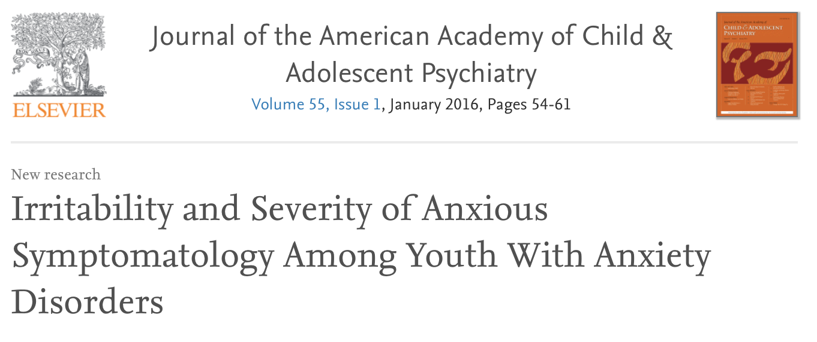
Anxiety and Irritability
Cornacchio et al., 2015 (From MINT and BU’s CARD)
N = 663 youths
Link between Irritability and Anxiety in youth across anxiety disorders
Notes:
Irritability and Severity of Anxious Symptomatology Among Youth With Anxiety Disorders - ScienceDirect. Accessed June 1, 2020. https://www.sciencedirect.com/science/article/pii/S0890856715006905

Slide 17
How can we get at this in our sample?

Slide 18
Second Approach: Behavioral Inhibition
Behavioral Inhibition is a strong indicator of anxiety that is agnostic of DSM diagnosis
In GRMPY, this is captured by the BIS component of the BIS-BAS scale
Lack of literature regarding imaging studies on BIS
Notes:
BIS is negatively correlated with being TD, r=-0.28, p=0.0005

Slide 19
Behavioral Inhibition: Questions
Is resting-state functional connectivity related to behavioral inhibition in our irritability sample?
If so, what features of connectivity are associated with BIS score in this context?
Notes:
BIS is negatively correlated with being TD, r=-0.28, p=0.0005

Slide 20
Method
Between-within network connectivity analysis
Schaefer 400 Parcellation -> 7 Networks
Visual
Somatomotor
Dorsal Attention
Ventral Attention
Limbic
Frontoparietal
Default Mode

Slide 21
Within-Network Analysis
For all subjects, get node-to-node connectivity, for all nodes in a module
Then, we see if it is related to BIS score

Slide 22
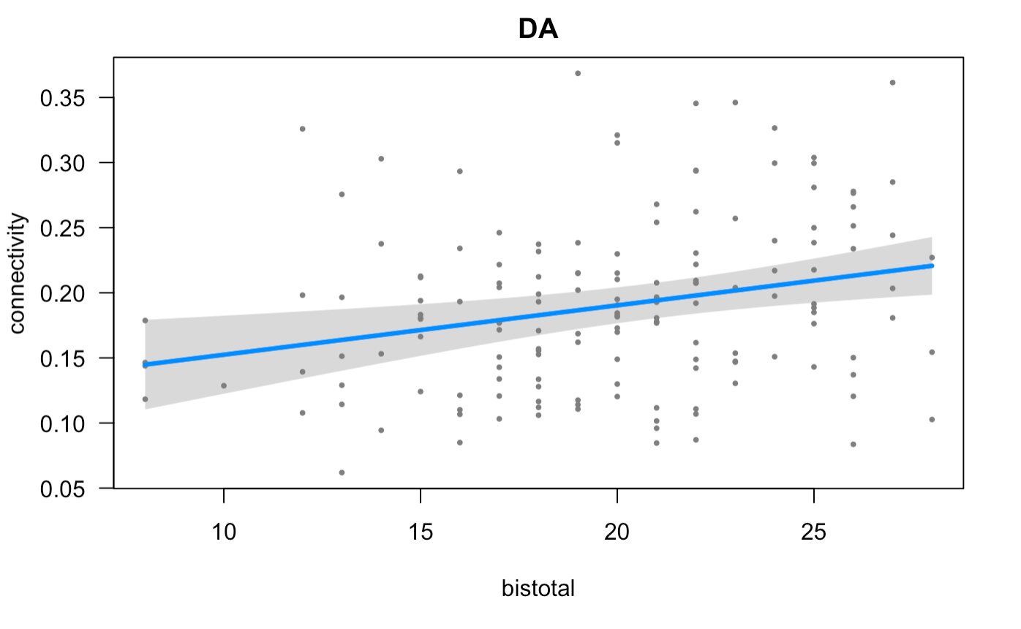
Within Network Results
Connectivity between nodes in the Dorsal Attention network is positively associated with BIS score
FDR-corrected p-value: 0.0187

Slide 23


Between-Network Analysis
For all subjects, for all pairs of modules:
Get node-to-node connectivity, between each node in one module and every node in the second module
Then, we see if it is related to BIS score

Slide 24
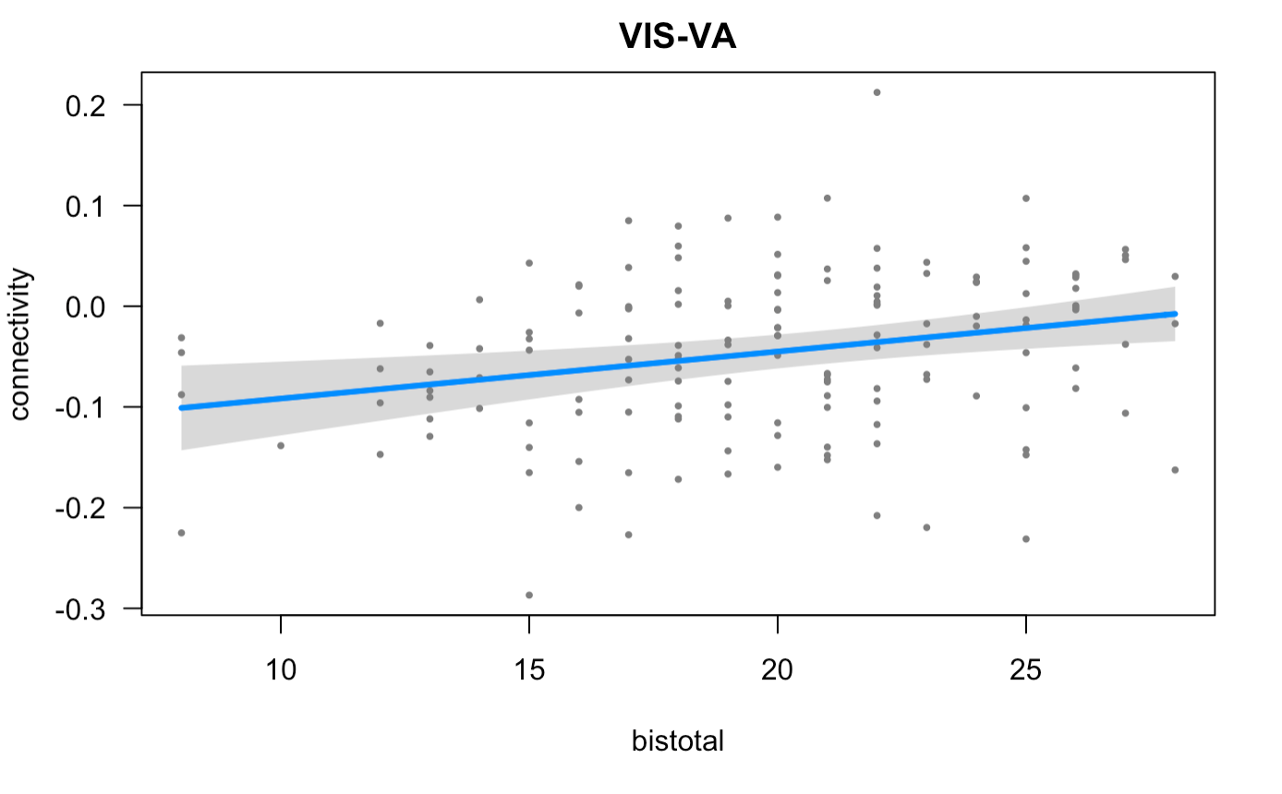
Between Network Results Pt. I
Connectivity between the Visual and Ventral Attention networks is positively associated with BIS score
FDR-corrected p-value: 0.0259

Slide 25
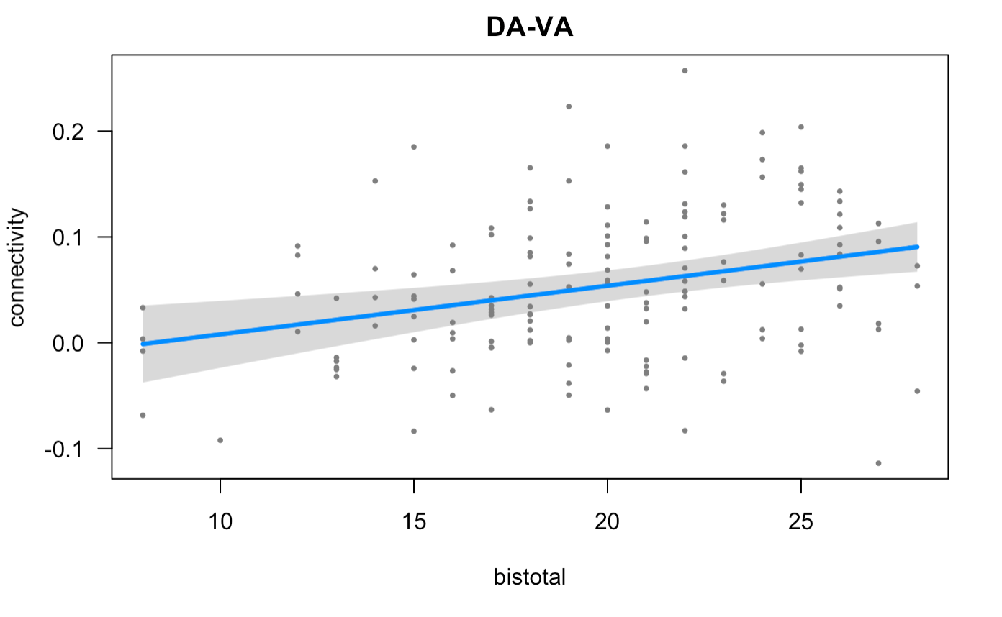
Between Network Results Pt. II
Connectivity between the Dorsal Attention and Ventral Attention networks is positively associated with BIS score
FDR-corrected p-value: 0.0129

Slide 26
Let’s get granular
The Between-Within Connectivity Analysis is operating at the community level
The next step was to dig deep and see which nodes are driving these results

Slide 27
Node-level analysis
Similar to the Between-Within analysis
Instead of summing up the connectivity strength for each community, run regressions at the node-to-node level

Slide 28

Results

Slide 29
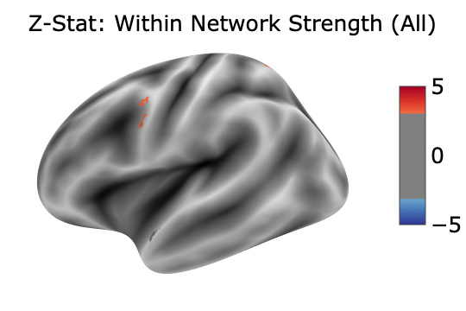
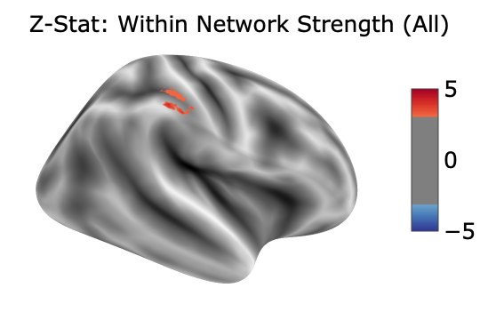
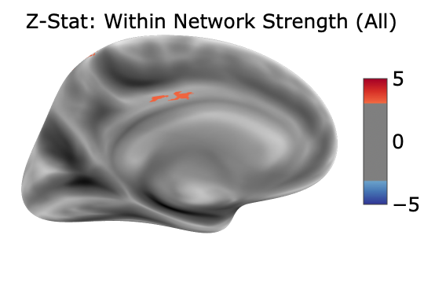
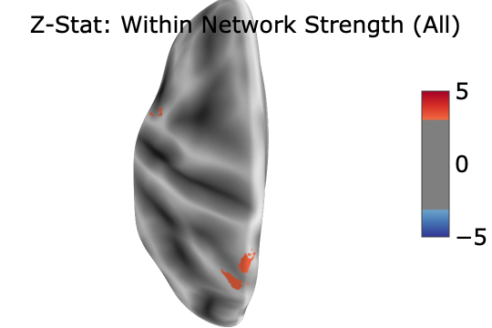
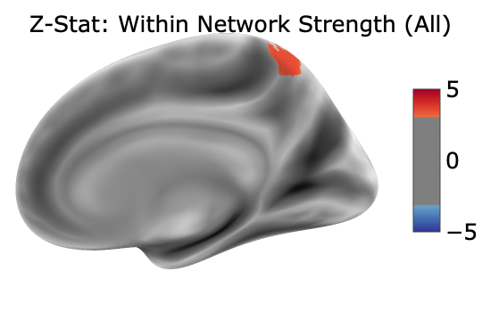
Within Network Strength (DA)

Slide 30
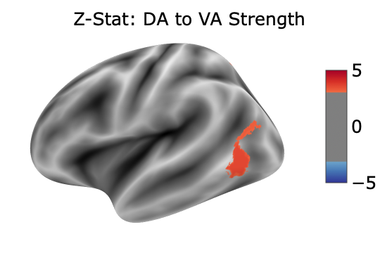
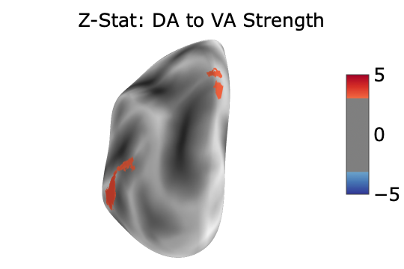
DA to VA Strength

Slide 31
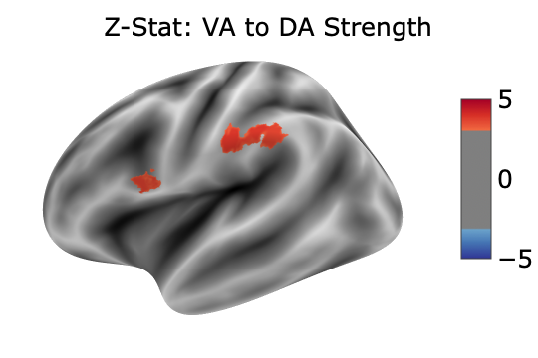
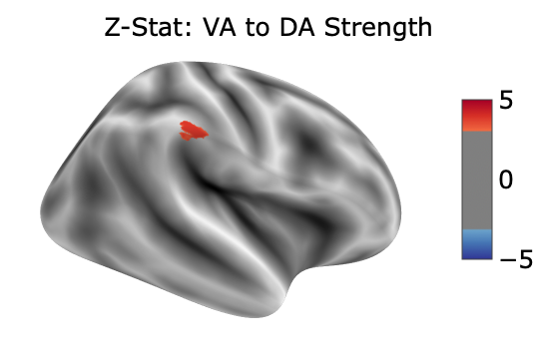
VA to DA Strength

Slide 32
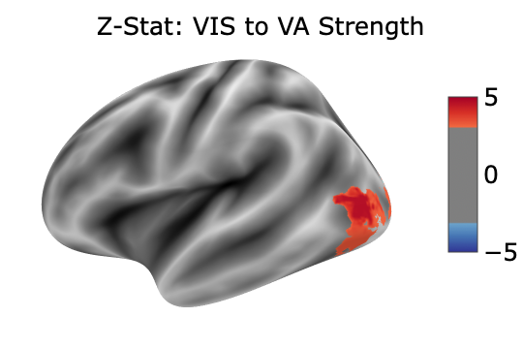
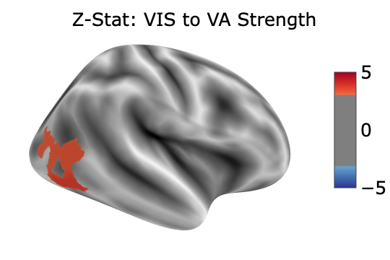
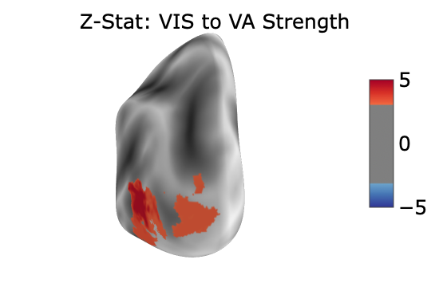
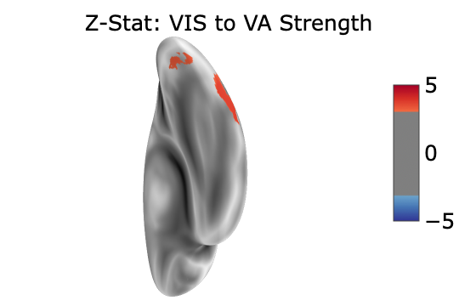
VIS to VA Strength

Slide 33
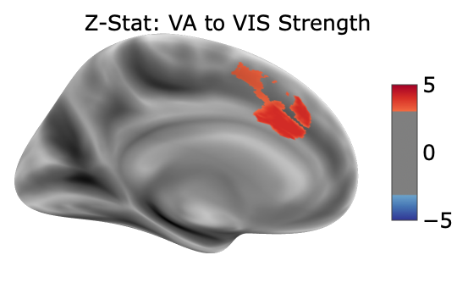
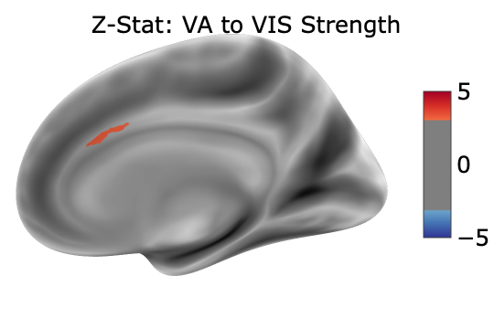
VA to VIS Strength

Slide 34
Ongoing Analysis
Let’s Get Longitudinal
GRMPY Subjects completed PNC
BIS was collected in PNC
After QA we have ~100 subjects who overlap and have complete data

Slide 35
Ongoing Analysis
Let’s Get Longitudinal
Annualized Rate of Change
Mixed-Model Analysis integrating both timepoints

Slide 36
Thanks!
Everyone in the lab

