Slide 1
SYPRES · MASTER DATABASE
The psychedelic RCT map:
what we're targeting
An open, searchable database of every randomized controlled trial that has administered
a psychedelic drug — the figures we're building toward, and the small template decisions
to lock in before extraction scales.
Team briefing
Pilot: 95 papers included · 16 verified extractions
Notes:
The database is built and the template basically works. This deck shows the figures we're building toward, then the four small extraction gaps to close before we extract hundreds of studies.

Slide 2
STATUS
Where the pilot stands
95
45
16
22
papers included
have an extraction
verified (consensus-
equivalent) so far
distinct trials
identified
What's built
Where that puts us
Reproducible build pipeline + interactive dashboard on sypres.io
PRISMA study-flow — upstream counts entered and reconcile exactly
Trials auto-enriched from ClinicalTrials.gov; papers linked into trials
Ten preview figures, regenerated on every rebuild
The pipeline and the template are settled enough to see the shape of the evidence base. Before extraction scales to hundreds of studies, four small template decisions are worth locking in — each cheap now and expensive as a retrospective pass later.
Notes:
Four stat callouts show pilot scale. Left: what already works. Right: the decision point — lock the template before bulk extraction.

Slide 3
WHAT WE'RE BUILDING TOWARD
Ten figures — the shape of the
finished evidence map
These are pilot previews.
Extraction-derived panels rest on the 16 verified studies — far too few to report as results. What matters is the shape each figure takes at full scale, and which ones the four extraction gaps complete.
Notes:
Frame these as targets, not results. Several figures are already at full scale (they need no extraction); the extraction-derived ones are 16-study previews of what's coming.

Slide 4
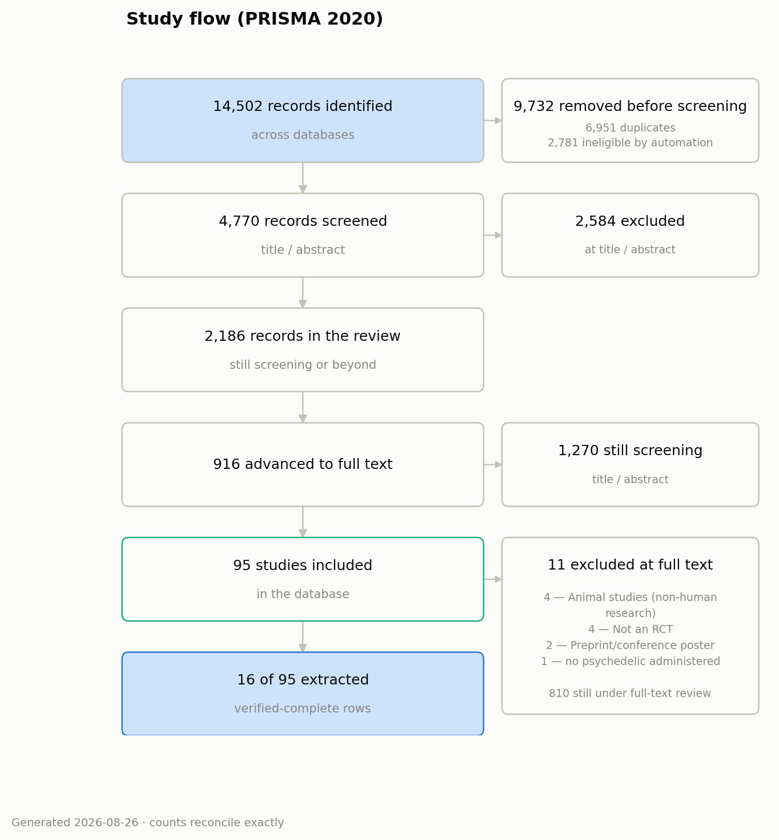
FIGURE 1 · STUDY FLOW (PRISMA 2020)
Complete
Every record accounted for — from 14,502 identified
down to the included set, and it reconciles exactly.
Why it matters
The transparency backbone of any systematic review — reviewers and journals expect it.
Upstream counts (identified, de-duplicated, auto-excluded) are now entered by hand and reconcile to the record.
Following PRISMA 2020, automation removals count as “removed before screening,” not screened.
Regenerates from the data on every rebuild, so it never drifts from the actual corpus.
Notes:
PRISMA is the process figure — how the corpus was assembled. The point for the team: the funnel is complete and reconciles.

Slide 5
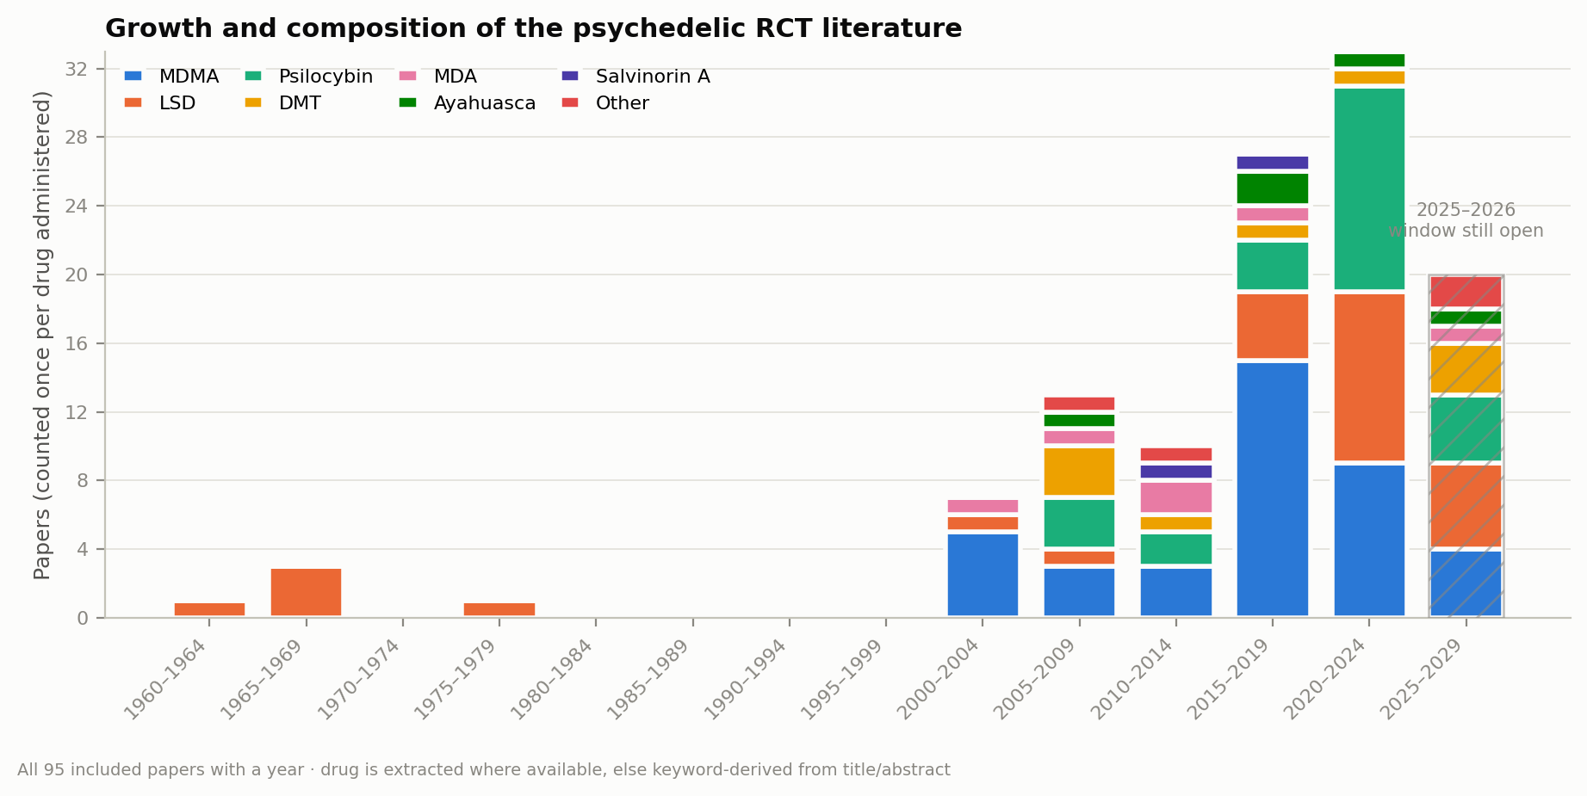
FIGURE 2 · GROWTH & COMPOSITION
All 95 papers
Two distinct eras, and a shift from LSD toward MDMA and psilocybin — already at full scale.
Notes:
Needs only year + drug, so it already covers every included paper — no extraction required.

Slide 6
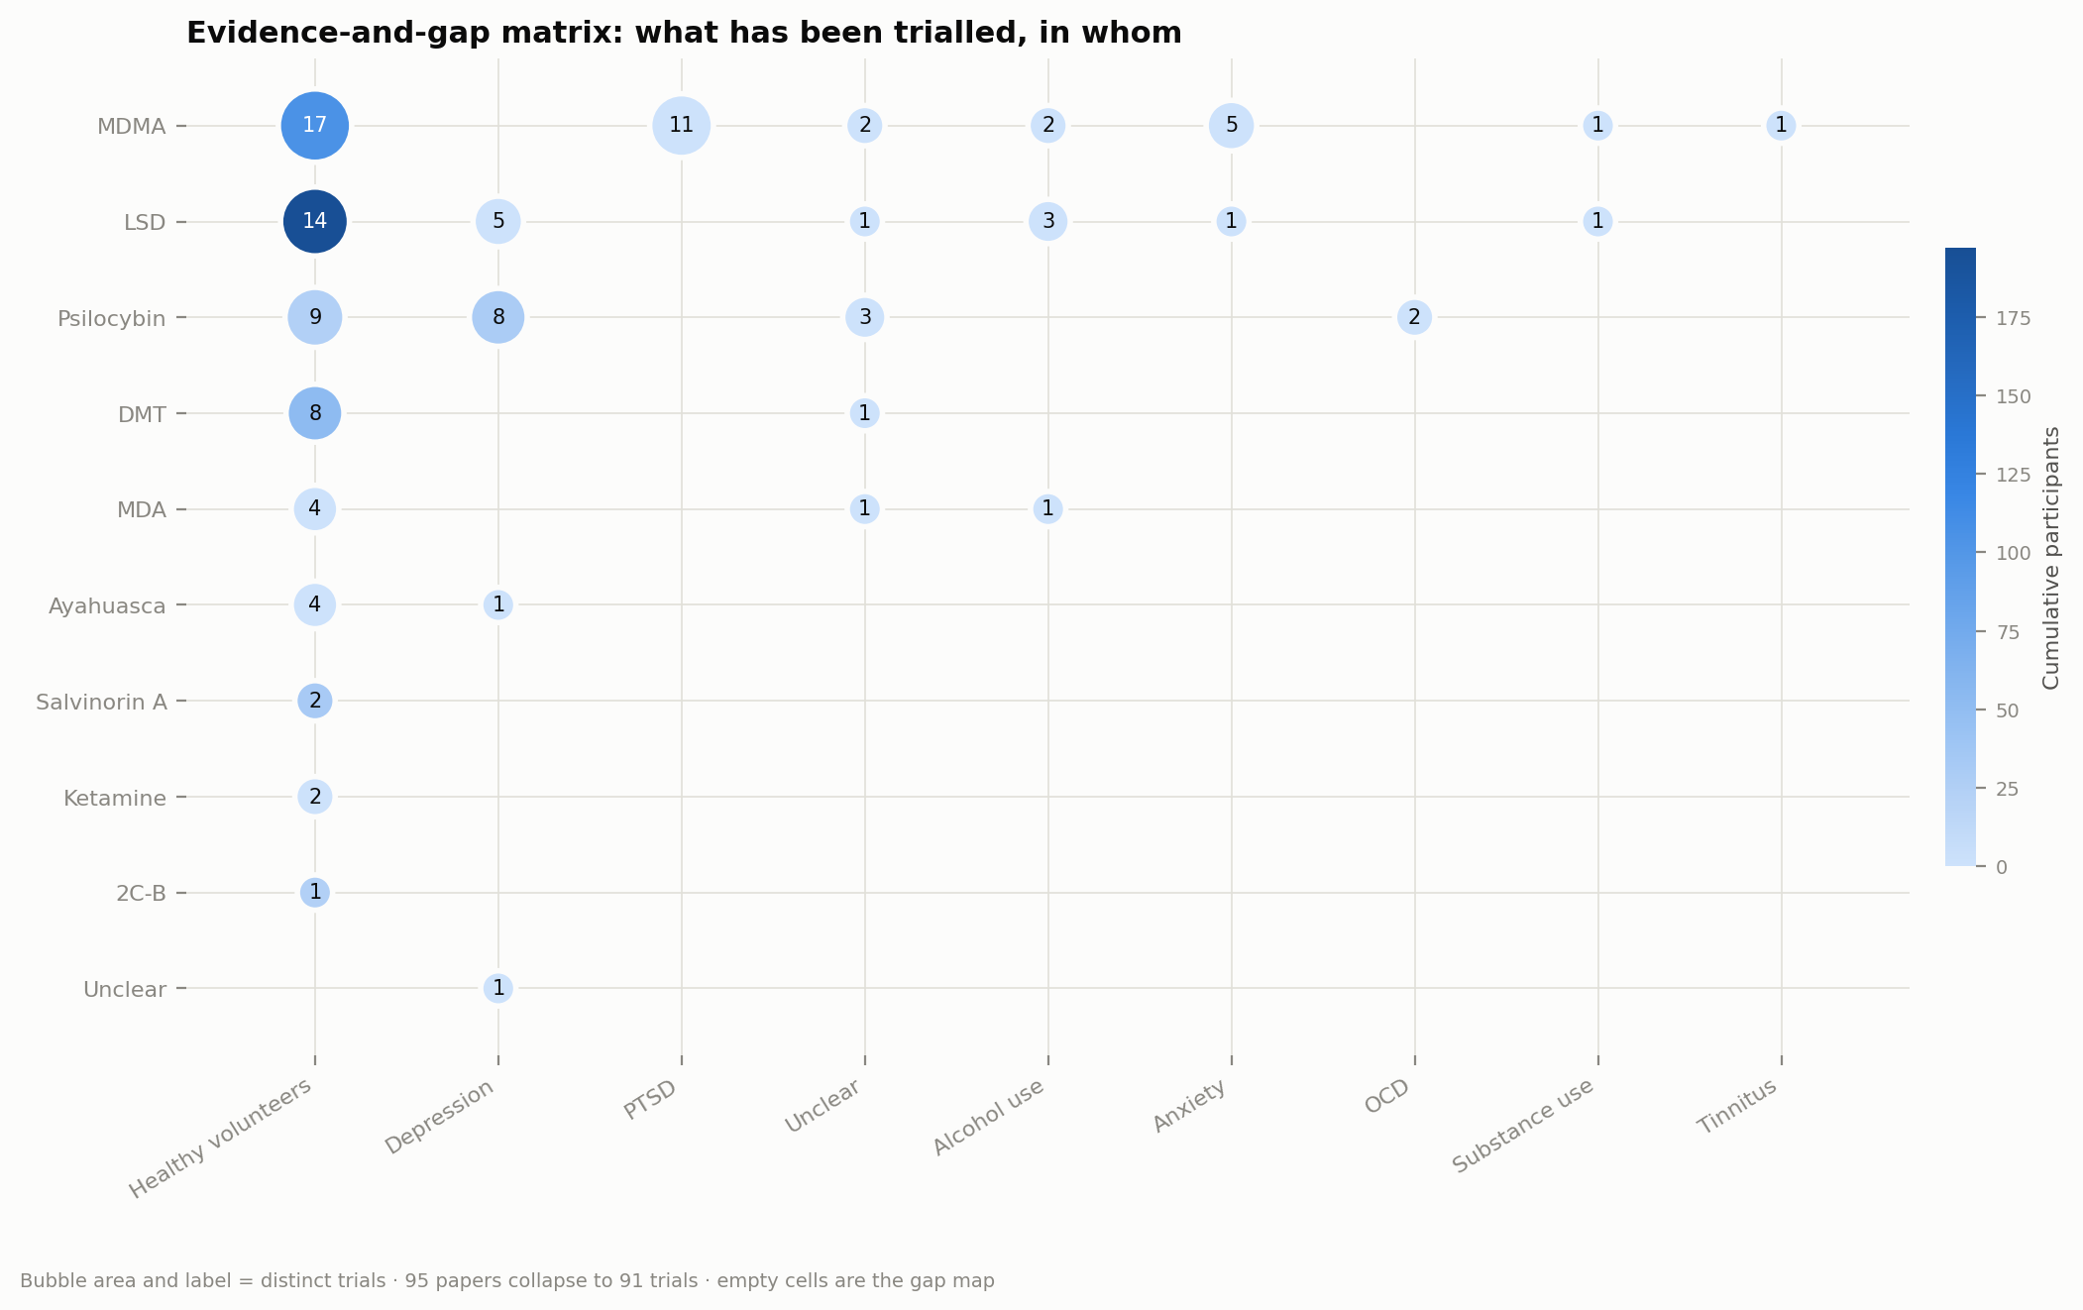
FIGURE 3 · EVIDENCE-AND-GAP MATRIX
Signature figure
What has been trialled, in whom — the empty cells are the research-gap map.
Notes:
The signature figure of a systematic map. Bubble = distinct trials, fill = participants. The gaps are the point.

Slide 7
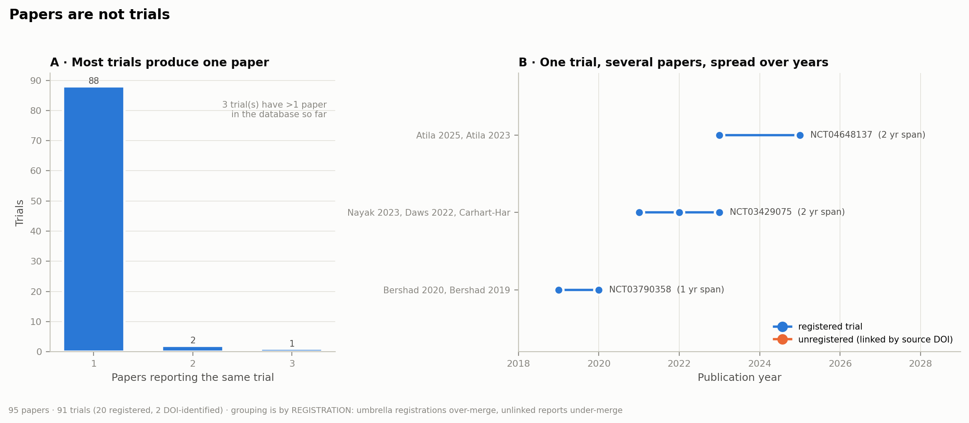
FIGURE 4 · PAPERS ARE NOT TRIALS
Novel
95 papers collapse to 22 identified trials — and single trials span several papers over years.
Notes:
Quantifies the papers-vs-trials gap, including for unregistered trials via source-paper DOIs. The most novel figure.

Slide 8
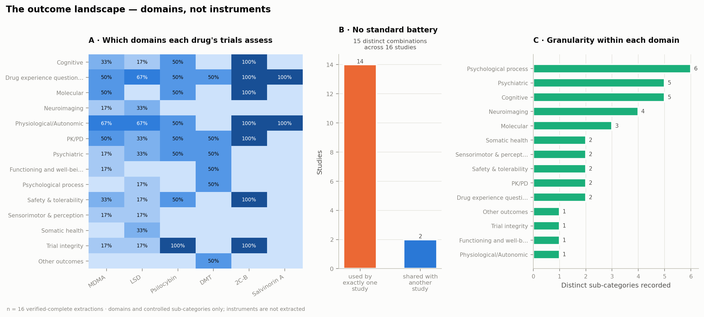
FIGURE 5 · THE OUTCOME LANDSCAPE
Verified n=16
No two trials measure the same set of domains — the empirical case for a core outcome set.
Notes:
Domains, not instruments. 15 distinct domain combinations across 16 verified studies, 14 unique to one study.

Slide 9
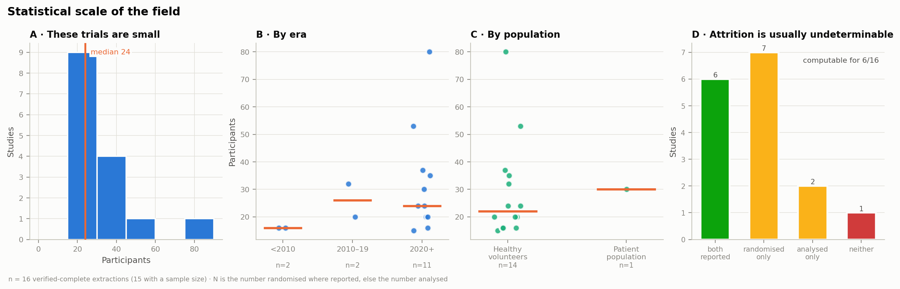
FIGURE 6 · STATISTICAL SCALE
Verified n=16
Small trials (median 24 participants), and attrition that is usually undeterminable — why Gap 2 matters.
Notes:
Panel D is the honest attrition panel: computable for only 6 of 16. Gap 2 (a “not reported” option) fixes the ambiguity.

Slide 10
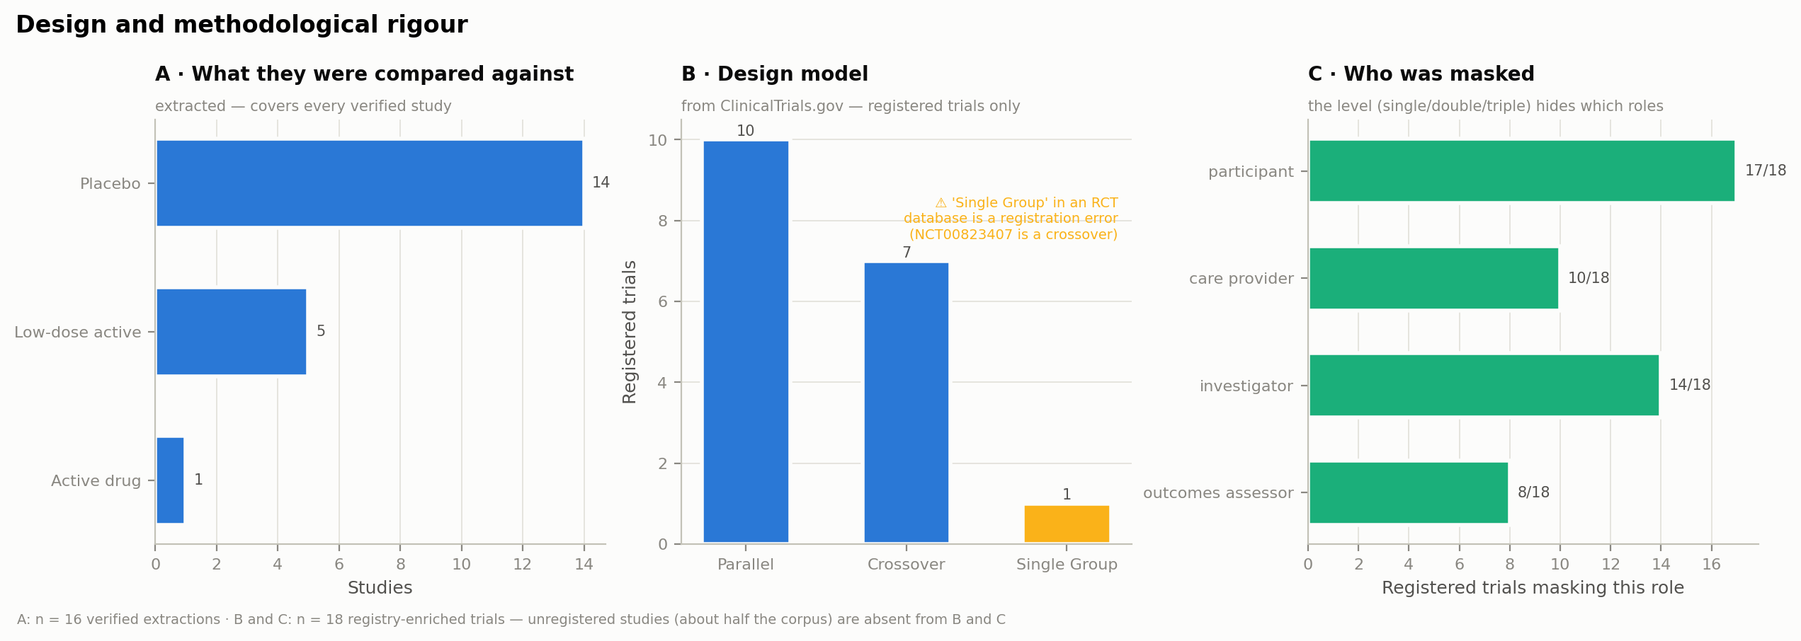
FIGURE 7 · DESIGN & RIGOUR
Registered only
Comparators are extracted; design and masking come free from the registry — for registered trials only.
Notes:
Panels B and C are registry-sourced and cover only registered trials — the half Gap 3 fills for the rest of the corpus.

Slide 11
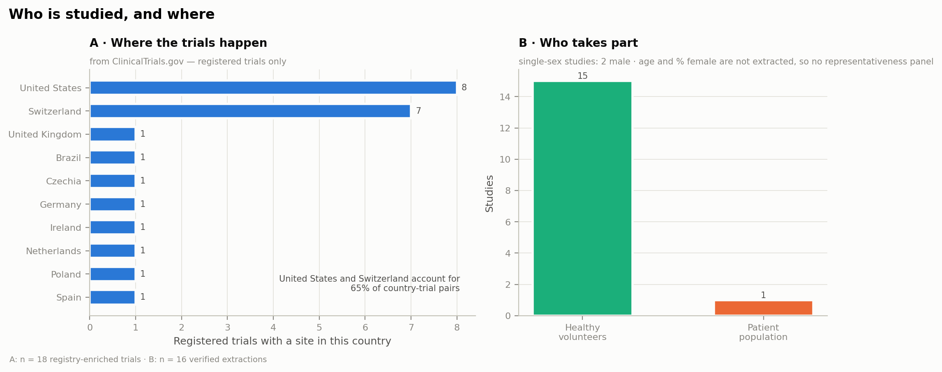
FIGURE 8 · WHO IS STUDIED, AND WHERE
Registry + n=16
Heavily US- and Switzerland-based. Demographics are the missing panel — Gap 4.
Notes:
Geography from the registry; population split from extraction. Age / % female (Gap 4) would add a representativeness panel.

Slide 12
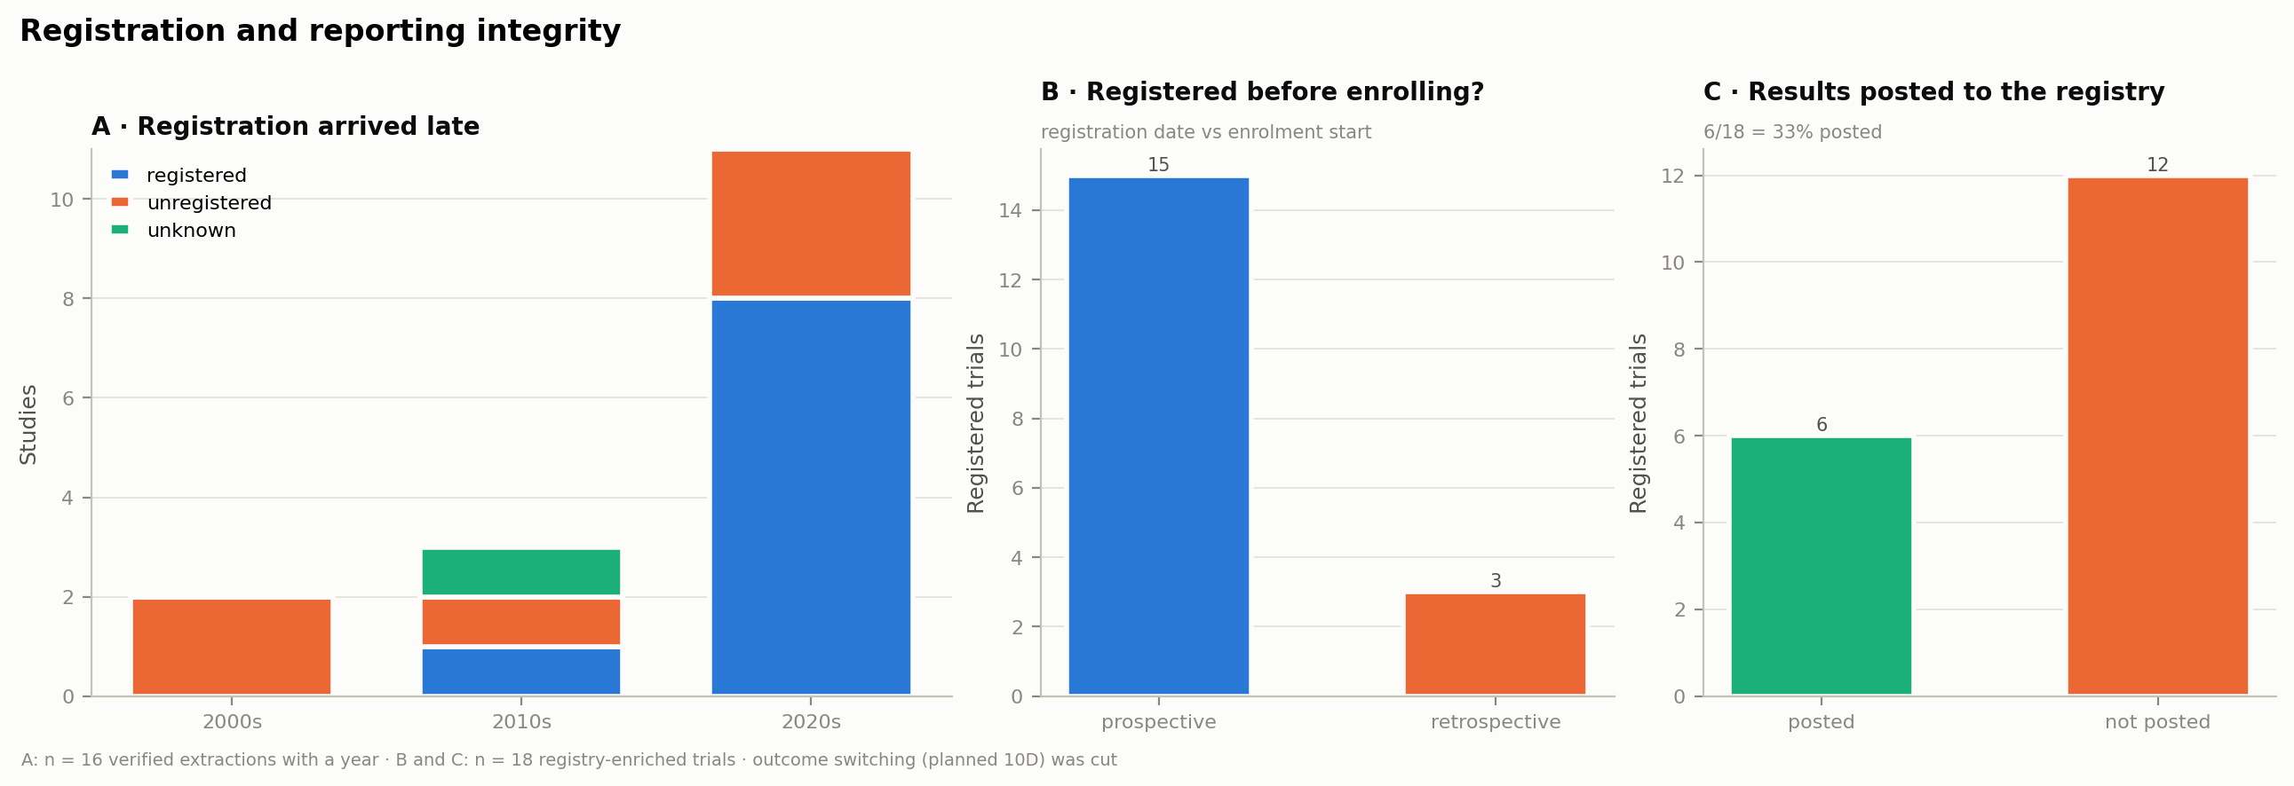
FIGURE 10 · REGISTRATION & REPORTING
Ready
Registration arrived late, and most trials still haven't posted results.
Notes:
Prospective-vs-retrospective and results-posted come free from the registry. Outcome switching was cut — not meaningful here.

Slide 13
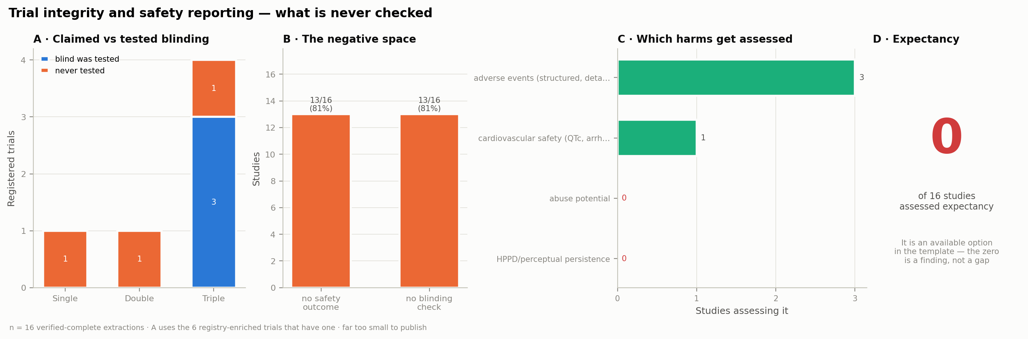
FIGURE 11 · TRIAL INTEGRITY & SAFETY
Verified n=16
What these trials never check: blinding integrity, and the psychedelic-specific harms.
Notes:
A negative-space figure — the finding is the absence. Expectancy is an available option recorded for zero studies.

Slide 14
ROADMAP
Three phases to a published database
1
NOW
2
DURING EXTRACTION
3
AT COMPLETION
Lock the template
Extract & sanity-check
Freeze & publish
PRISMA upstream counts entered — the funnel reconciles.
Decide the four extraction gaps (next slides) and add them to Covidence before extraction scales.
Doing it now avoids a retrospective pass over hundreds of studies.
Run consensus, then switch the build from single-reviewer rows to the consensus rows.
Rebuild the growth, gap-matrix, and outcome figures on the growing set as a running check that the schema holds.
Freeze a versioned, citable release with a Zenodo DOI.
Write the paper against the frozen version, so every number is reproducible from a citable artifact.
Notes:
Phase 1 is where the four gaps live. Phases 2 and 3 are the path after the template is locked.

Slide 15
THE FOUR GAPS
What completes the figures — and none of it is a new burden
A restored yes/no flag, two dropdown options, design questions asked only when there's no registry to pull from, and one optional demographic pair.
1
Microdosing flag
2
“Not reported” on sample size
Separates microdose from full-dose trials — cleans up Figures 3, 5 and 6.
Makes Figure 6's attrition panel real: a blank N stops meaning two different things.
COST
Very low
Reviewer open to it
COST
Very low
Proposed
3
Design & blinding
4
Age & % female
Fills Figure 7 for the ~half of the corpus with no registry — asked only for unregistered trials.
Adds the demographic panel to Figure 8. Race/ethnicity stays out of scope.
COST
Low
Vocabulary drafted
COST
Low
Optional
Notes:
Each gap now names the figure it completes. Gaps 1 and 2 are near-free; gap 3 is the substantive one; gap 4 is optional.

Slide 16
GAPS 1 & 2 · ADD NOW
Two near-free additions
1
Restore the microdosing flag
2
“Not reported” on both N fields
The template revision dropped the yes/no microdosing flag with no replacement — so a 15 µg and a 200 µg LSD study now sit in the same bucket.
Older unregistered trials often give a single N and never mention dropouts — so a blank means either “no dropouts” or “not recorded.” They can't be told apart.
Dose itself is out of scope: reported too many ways (mg vs mg/kg), route-dependent, heavy to extract. A binary flag is the only way left to separate microdose from full-dose trials.
An explicit “not reported” option on both N randomized and N analyzed makes the difference recordable. N randomized is already missing on 18% of rows.
COMPLETES
COMPLETES
The microdose / full-dose split in Figures 3, 5 and 6.
Figure 6's attrition panel — “undeterminable in X% of trials” becomes a finding.
Notes:
Both are essentially free and each recovers a real analysis. Recommend approving both for the template now.

Slide 17
GAP 3 · THE SUBSTANTIVE ONE
Design & blinding — for unregistered trials only
Why only when there's no registry
Design
ClinicalTrials.gov already gives us design, masking, allocation, sponsor and country for registered trials — at 100% coverage. We never re-collect those.
parallel · crossover · factorial · quasi-randomised · other · not reported
No “single-group”: in an RCT database it shouldn't exist — our one instance turned out to be a mislabelled crossover (the build now flags it).
But roughly half the corpus — and the older half — is unregistered, and the registry can't describe it. This is the one place extracting design isn't duplicated effort.
Blinding — record who was masked, not “single / double”
participant · care provider · investigator · outcomes assessor
+ open-label · not reported
Completes
Single / double / triple falls out by counting — the classic label with no information lost.
It's identical to the registry's own fields, so registered and unregistered trials stay comparable.
Captures the care provider — the session monitor, least likely to be truly blind in psychedelic-assisted therapy.
Figure 7 across the whole corpus, not just the registered, newer half.
Notes:
The one gap with real design content: record who was masked, not a single/double/open label — the level is recoverable by counting and matches how the registry stores it.

Slide 18
THE ASK
Three decisions for the team
Approve gaps 1 & 2 now
Why now
Restore the microdosing flag and add “not reported” to both N fields. Near-free, and each completes a figure.
Add these before bulk extraction.
Approve the design / blinding vocabulary
For unregistered trials only. Record who was masked; keep the design list as drafted.
Locked in now, they cost a dropdown edit. Added later, they need a retrospective pass over hundreds of studies.
Decide on gap 4 (optional)
Age and % female for Figure 8's demographic panel — worth it, or leave for later? Race/ethnicity stays out.
Notes:
Close on the three decisions. The right-hand block is the timing argument — cheap now, a retrospective pass later.

