Slide 1


Accessing and Visualizing Census Data
Girmaye Misgna
gmisgna@upenn.edu
Date: 09-16-2021

Slide 2
Outline
Census data can be accessed on the web at no cost through various sources.
I will focus only on the following three sources:
Accessing and downloading census data through Social Explorer.
Accessing and downloading “TIGER/Line with Selected Demographic and Economic Data” geodatabase from Census Bureau website.
Accessing and downloading through python based census API wrapper (Cenpy).
The next steps provide guidance to:
Access spatial (census geography) data
Access census data variables (attributes),
and how to relate these two types of data for visualization.
Notes:
This tutorial intends to provide basic guidance for anyone who might be interested in accessing census files and using them to visualize their communities based on census variables.

Slide 3
Main Census Products (survey and census data tables)
The American Community Survey (ACS)
Three key annual ACS releases
1 year estimates (Published for selected geographic areas with populations 65,000 or greater)
1 year supplemental estimates (for small populations)
5 year estimates (for very small populations)
Decennial Census (every 10 years)
Notes:
Survey Details (from Social Explorer)
ACS 2009 (5-Year Estimates)
In 2010 three types of estimates are available from the American Community Survey: 1-year estimates (based on data collected in a single year), 3-year estimates (based on data collected in three consecutive years) and 5-year estimates (based on data collected in five consecutive years). to help users determine which estimates to select, a basic comparison of 1-year, 3-year and 5-year estimates Is provided below. Additional information about the interpretation and use of 1-year, 3-year and 5-year estimates Is available in the Guidance for Data User section on the http://www.census.gov/acs/www/guidance_for_data_users/estimates/.
1-Year Estimates:
The 2009 ACS 1-year estimates are based on data collected between January 2009 and December 2009.
Published for selected geographic areas with populations of 65,000 or greater
Represent the average characteristics Over calendar year 2009
Have smaller sample size than the 3-year and 5-year estimates
Are More current than the 3-year estimates and 5-year
3-Year Estimates: (No longer available. Replaced with 1 – year supplemental estimate)
The 2007-2009 ACS 3-year estimates are based on data collected between January 2007 and December 2009.
Published for selected geographic areas with populations of 20,000 or greater
Represent the average characteristics Over the 3-year period of time
Have larger sample size than the 1-year estimates but smaller than the 5-year
Are less current than the 1-year estimates however More current than the 5-year
5-Year Estimates:
The 2005-2009 ACS 5-year estimates are based on data collected between January 2005 and December 2009 (during calendar years 2005, 2006, 2007, 2008 and 2009). Data are from the American Community Survey and the Puerto Rico Community Survey.
Published for small geographic areas
Represent the average characteristics Over the 5-year period of time
Have larger sample size than the 1-year and 3-year estimates
Are less current than the 1-year and 3-year estimates
Please note that these are not the Census 2010 population counts.

Slide 4
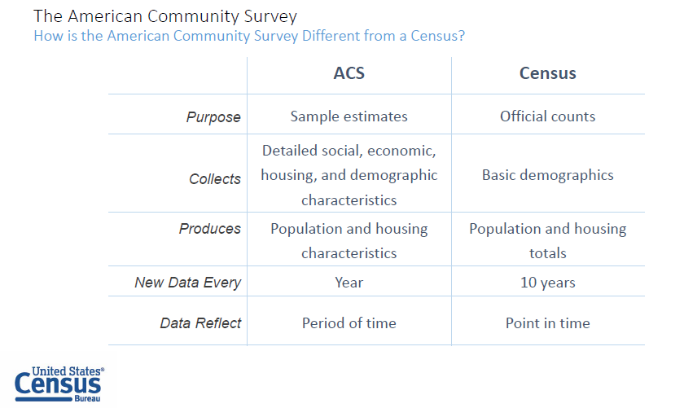

Slide 5
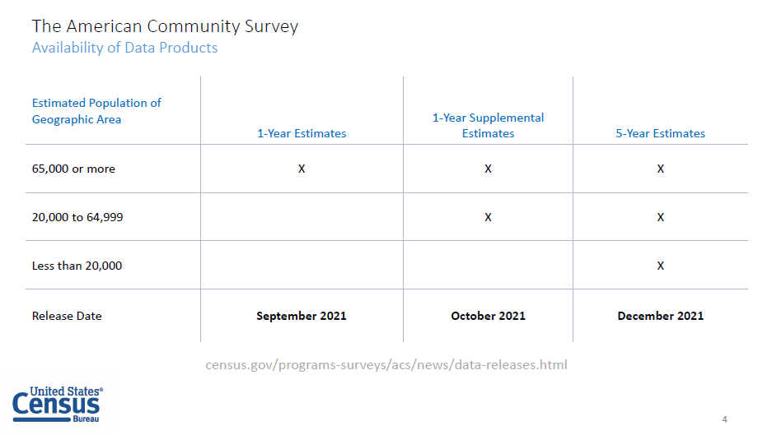

Slide 6
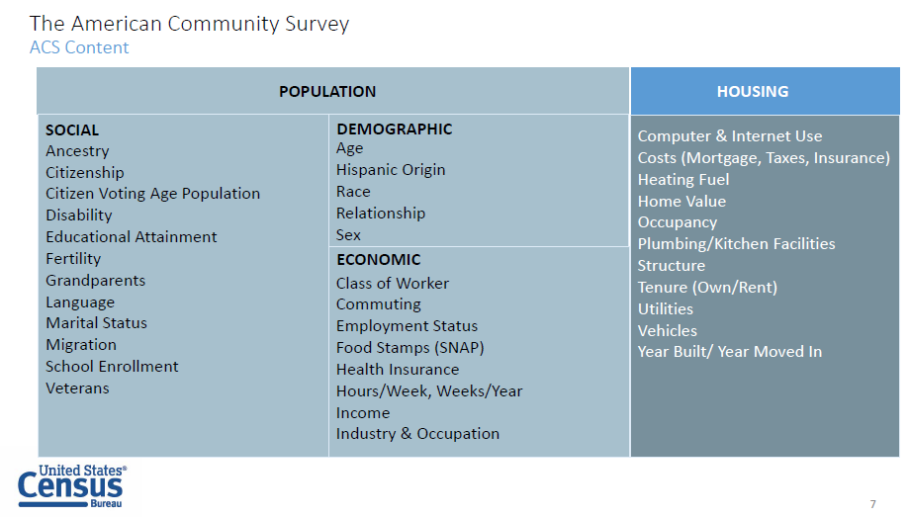

Slide 7
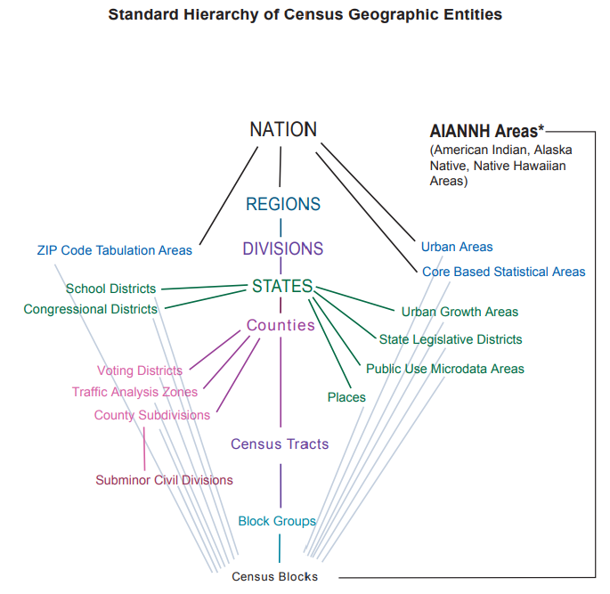

Standard Hierarchy of Census Geographic Entities
In order to map census data, we need both the GIS files at the geographic level of interest (State, tract, block group, etc.), as well as the information tables at the matching levels.
How does the Census organize geography?
Notes:
For areas that are not currently classified as “American Indian, Alaska Native, Native Hawaiian Areas,” you can read the Standard Hierarchy from top to bottom, cutting the nation into regions, each region into divisions, each division into states, etc. Alternatively, you can read the Standard Hierarchy from bottom to top: Census Blocks are grouped into Block Groups, which are grouped into Census Tracts, which are grouped into Counties, etc.

Slide 8
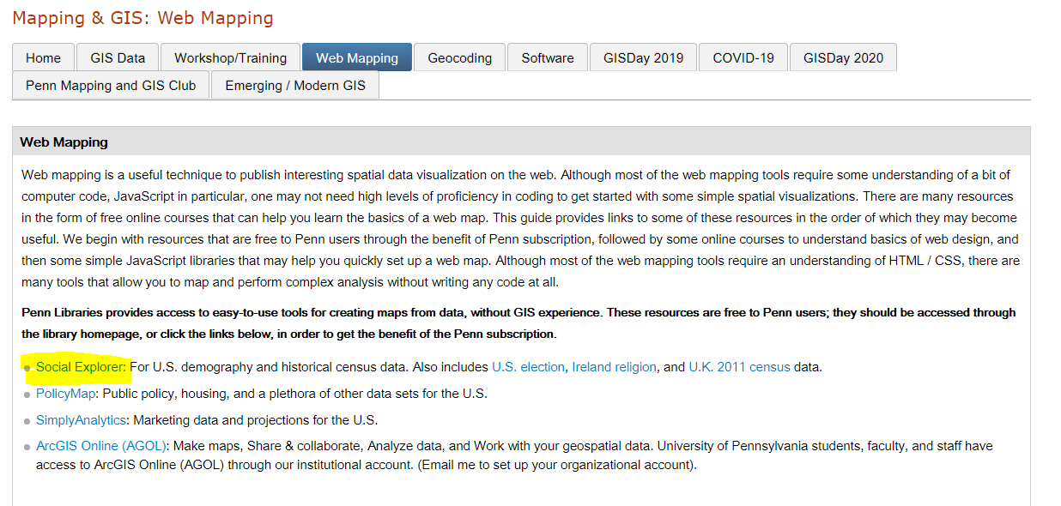
1. Accessing and downloading through Social Explorer
https://guides.library.upenn.edu/mapping/webmaps

Slide 9
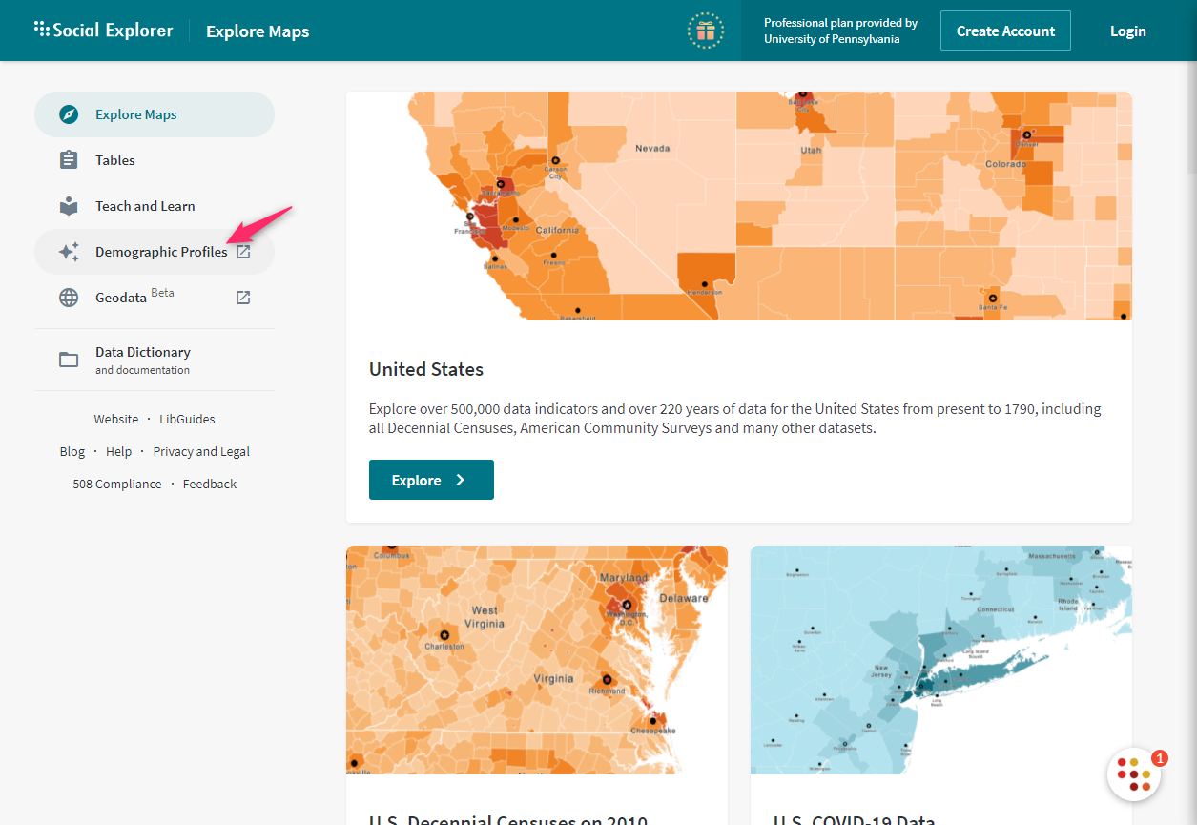
Demographic Profile
Explore quick facts about an area of interest by:
States, Counties, Places, MSA, ZIP Codes

Slide 10
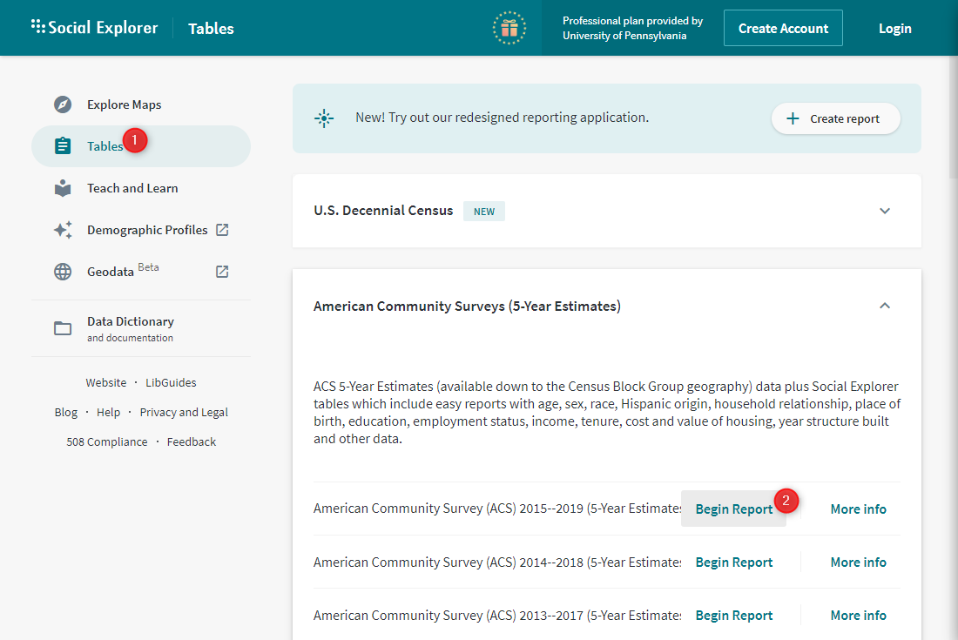
Generate Tables Report

Slide 11
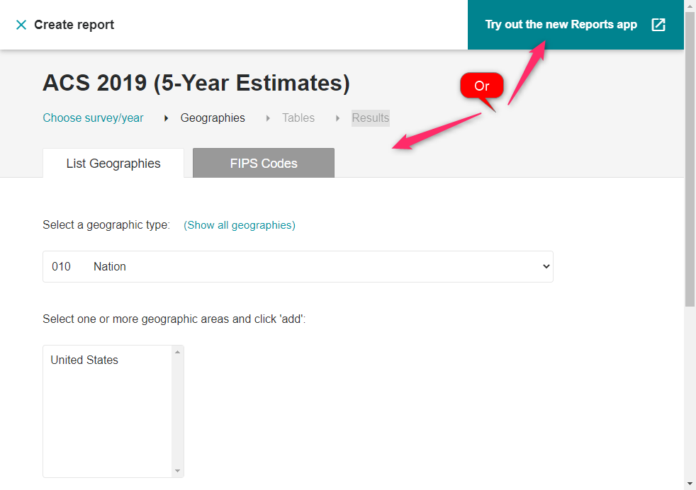
Proceed either to the classical interface or the “new Reports app” interface.
Survey year
Census Geography (Nation, county, census tract, block group, etc.)
Tables
Results

Slide 12
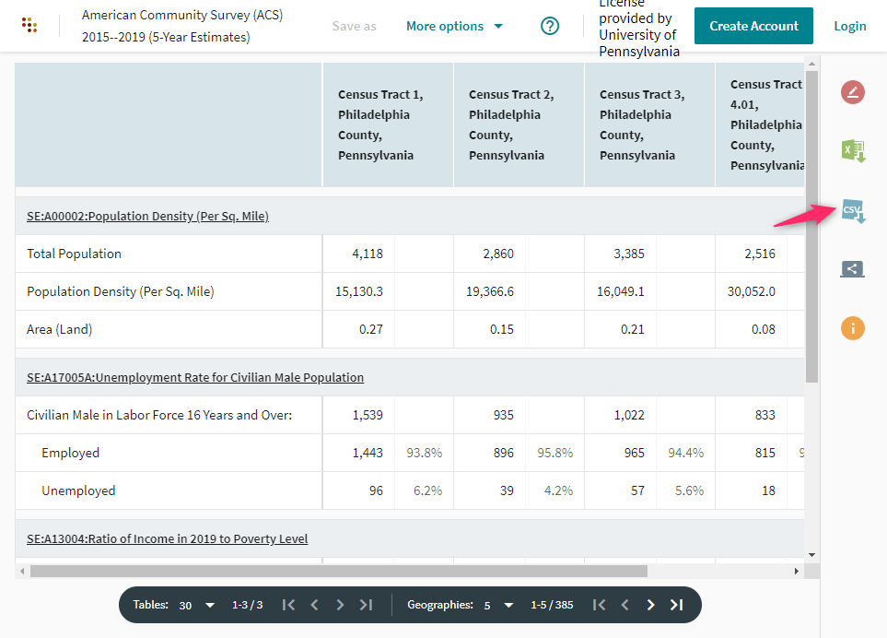
For GIS, download CSV option

Slide 13
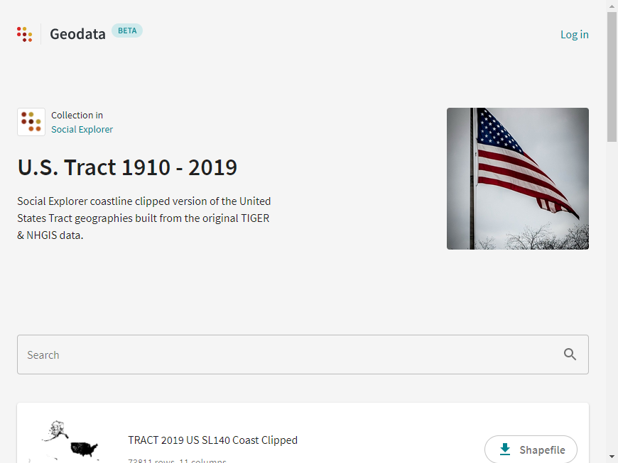
Download Geographic data for Census geography level of and year of interest.
Will Join later with the data table using the Geoid and Geo_FIPS columns as common link between the two.

Slide 14
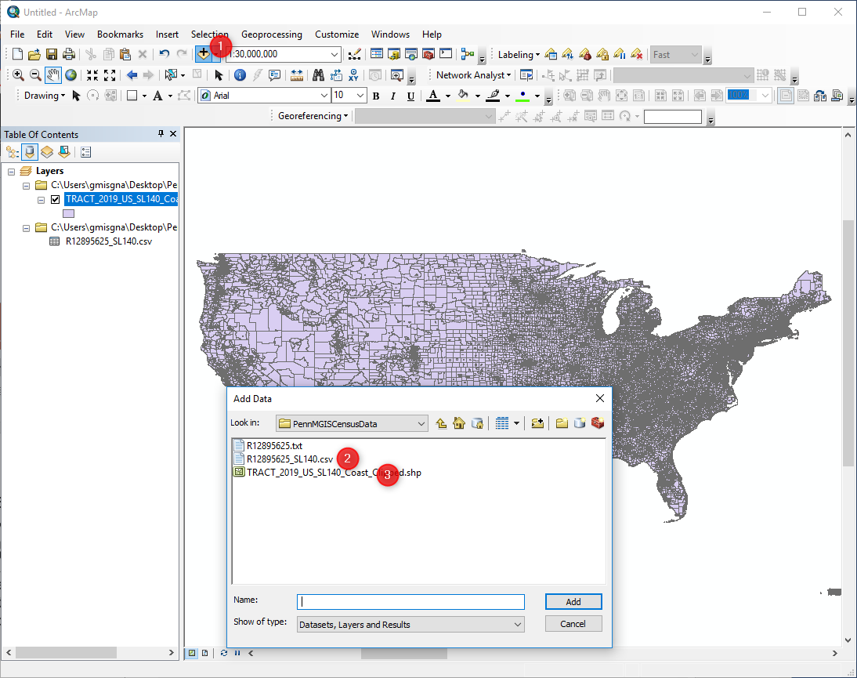
Open ArcMap
Add both the Geography map and the Table

Slide 15
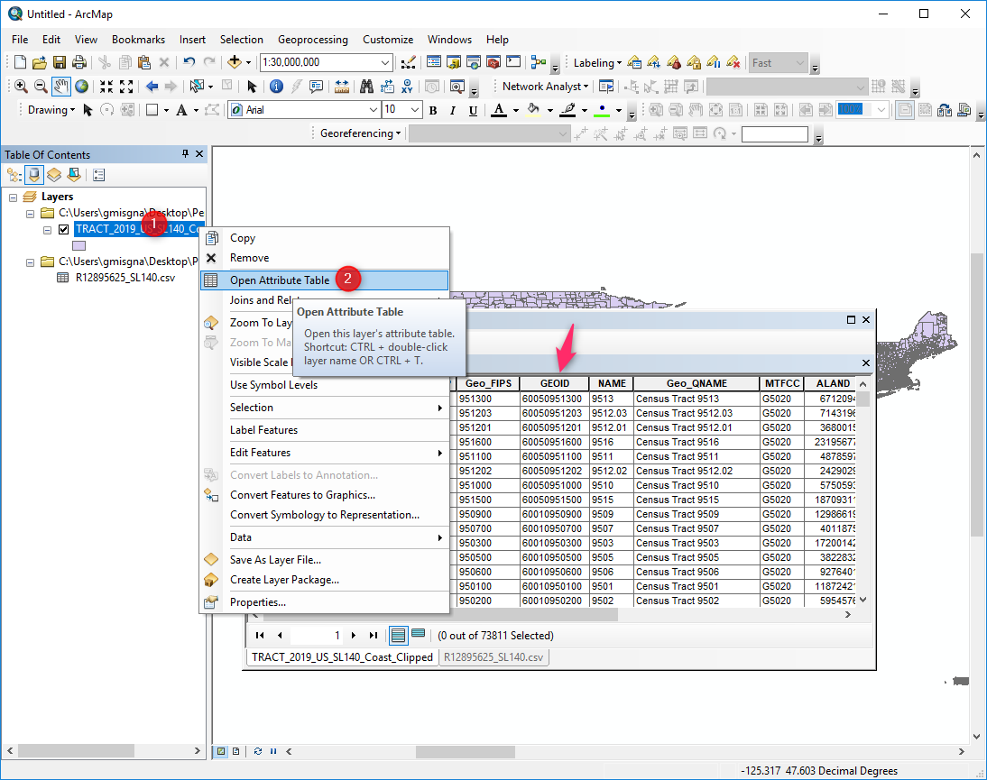
Open Attribute table
GEOID or Geo_FIPS are the columns used to join the Map and the table.

Slide 16
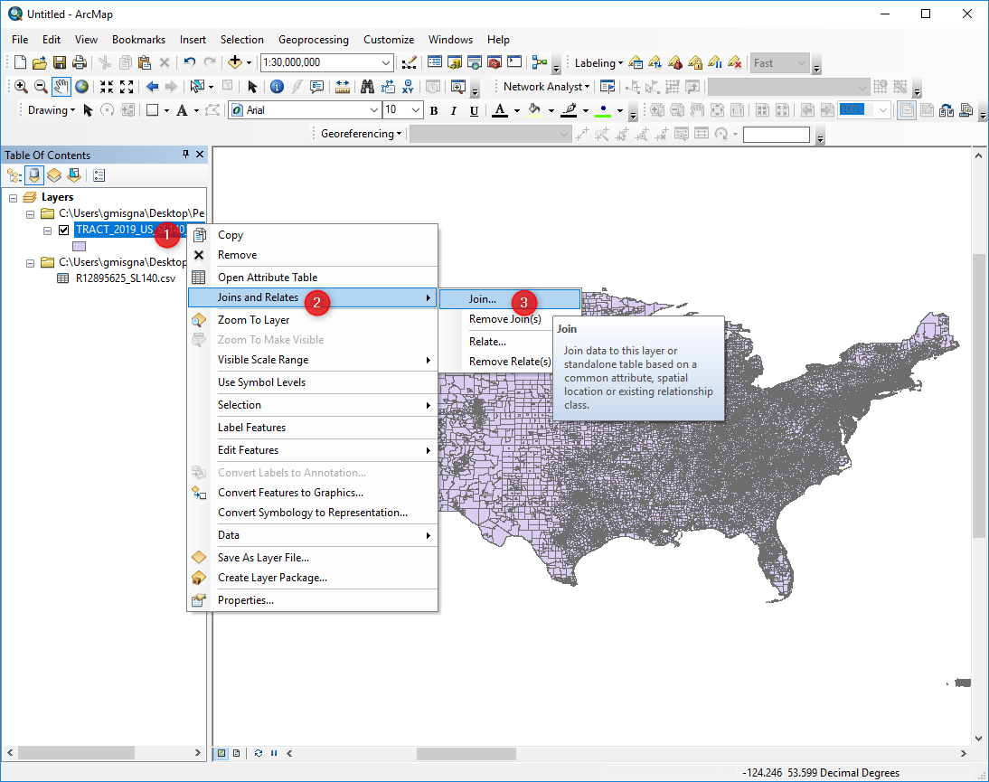
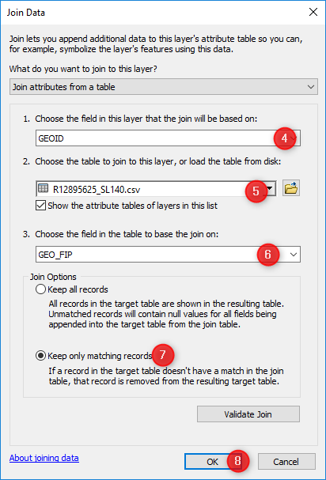
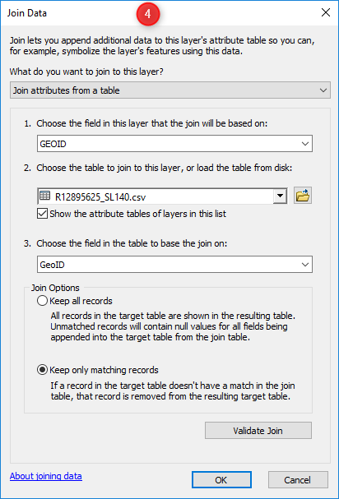
Joining data table to census geography map

Slide 17
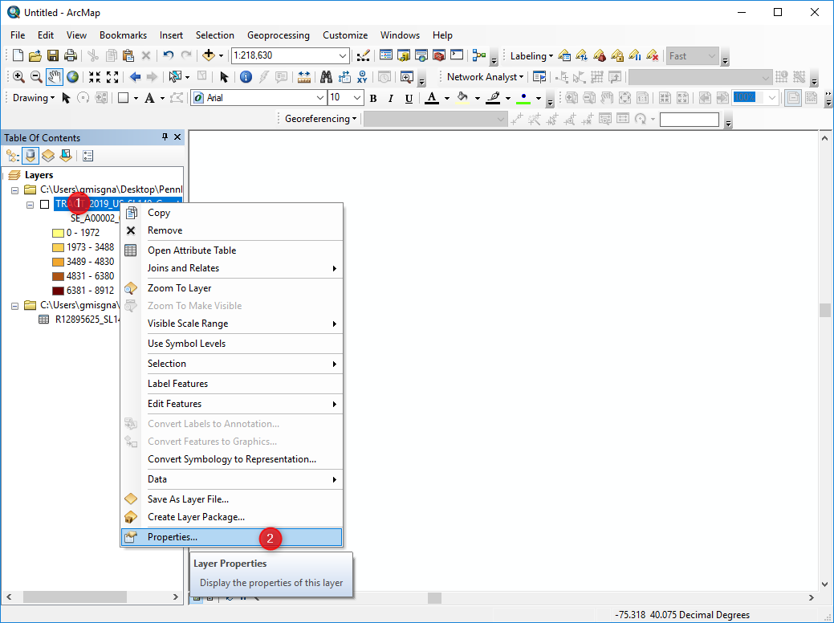
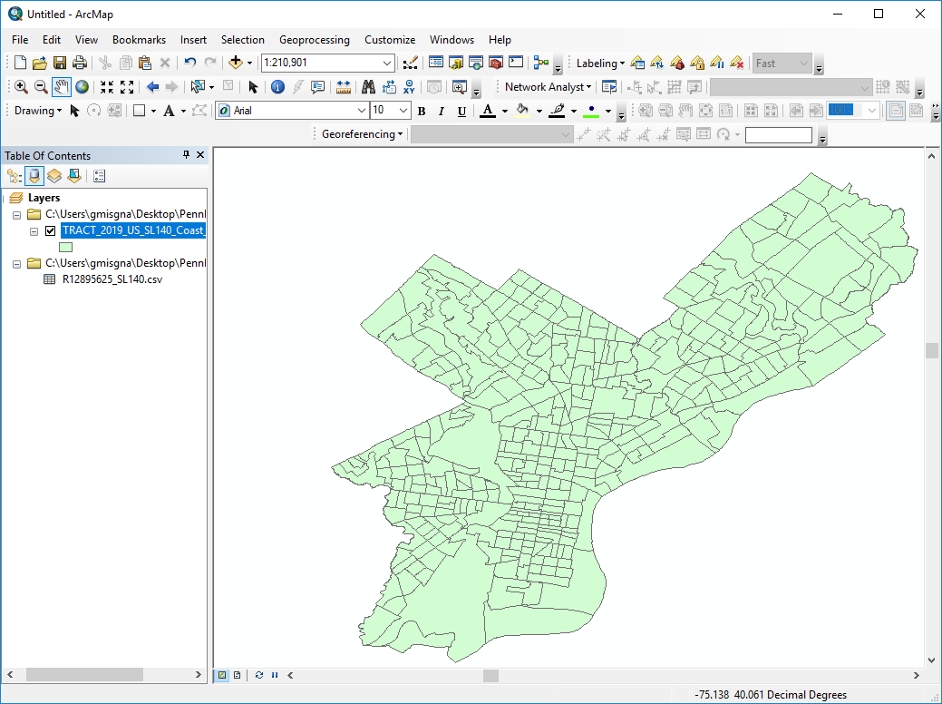
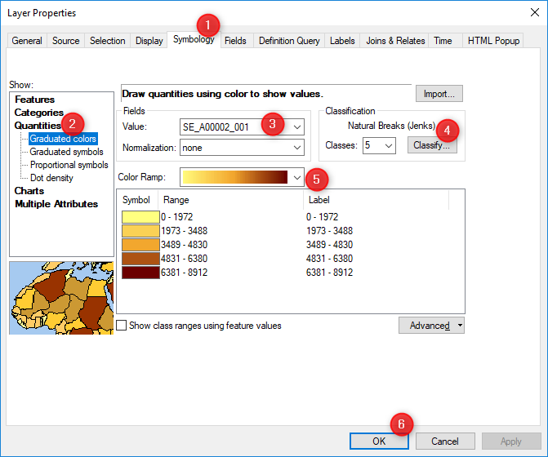
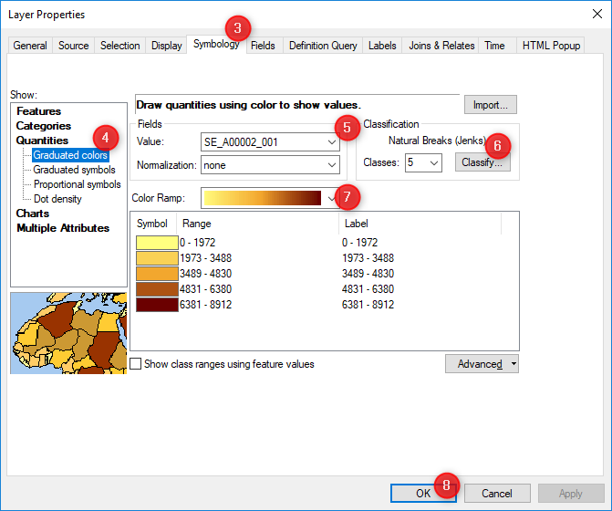
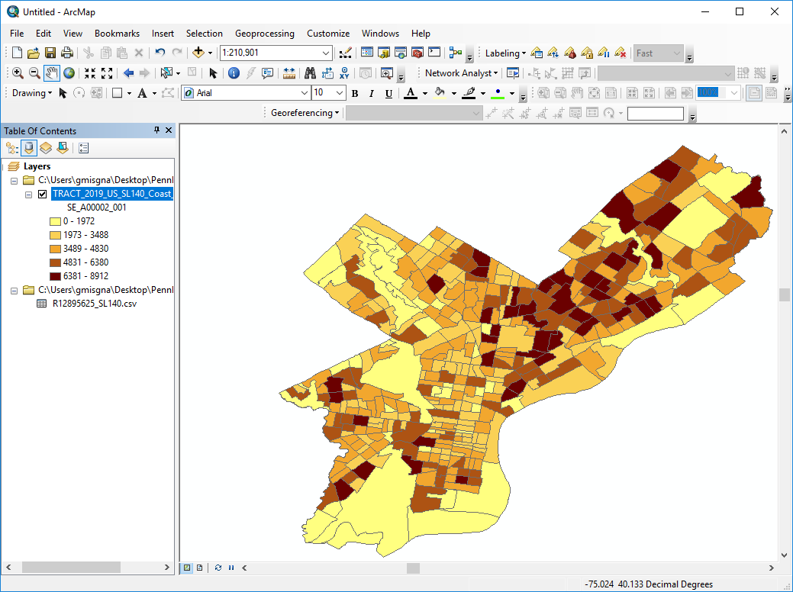
Symbolize

Slide 18
2. Accessing and downloading “Selected Demographic and Economic Data” geodatabase from census bureau
Go to census.gov
Browse by topics - > Geography
Choose Geographies
Click Geography Mapping files
Pick a year (for 2019 and prior years) ->
Click TIGER/Line with Selected Demographic and Economic Data
Select census geography level of interest from the boxes and dropdowns.
Open the downloaded geodatabase in ArcMap or QGIS
Add geography layer, data tables, meta data table
Open Geography table, data table, and metadata table. Take a note of the columns to use for joining the geography and the data tables (Geoid_Data and Geoid)
Join geography layer and data tables and visualize
Symbolize

Slide 19
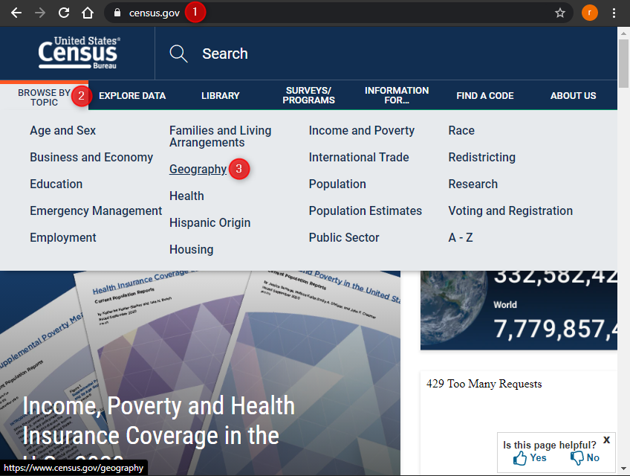
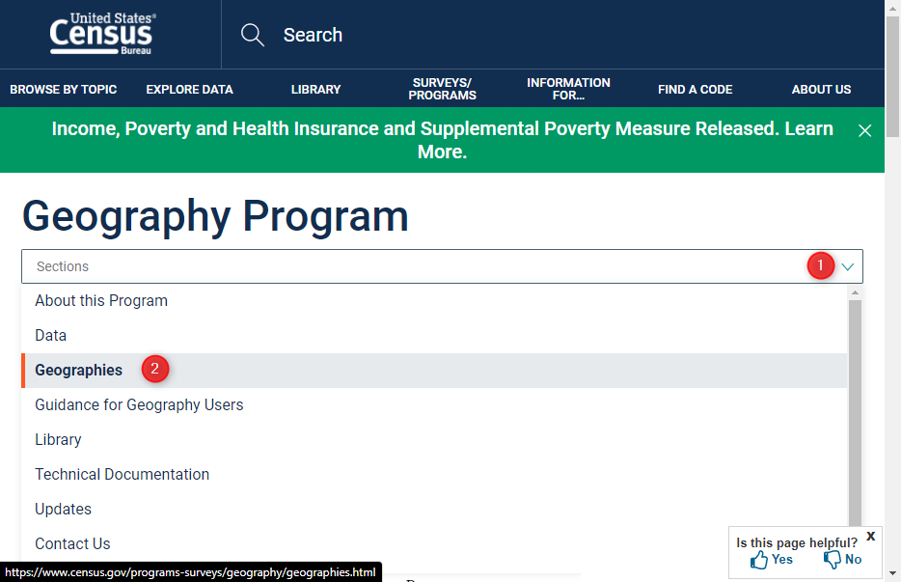
Go to census.gov
Browse by topics - > Geography
Choose Geographies

Slide 20
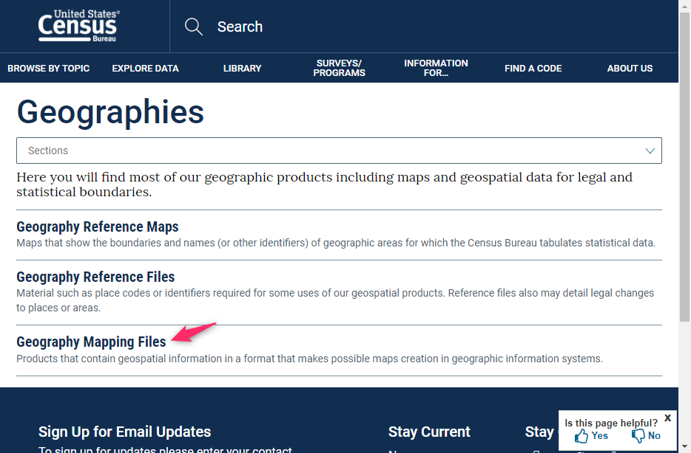
iv. Click Geography Mapping files.

Slide 21
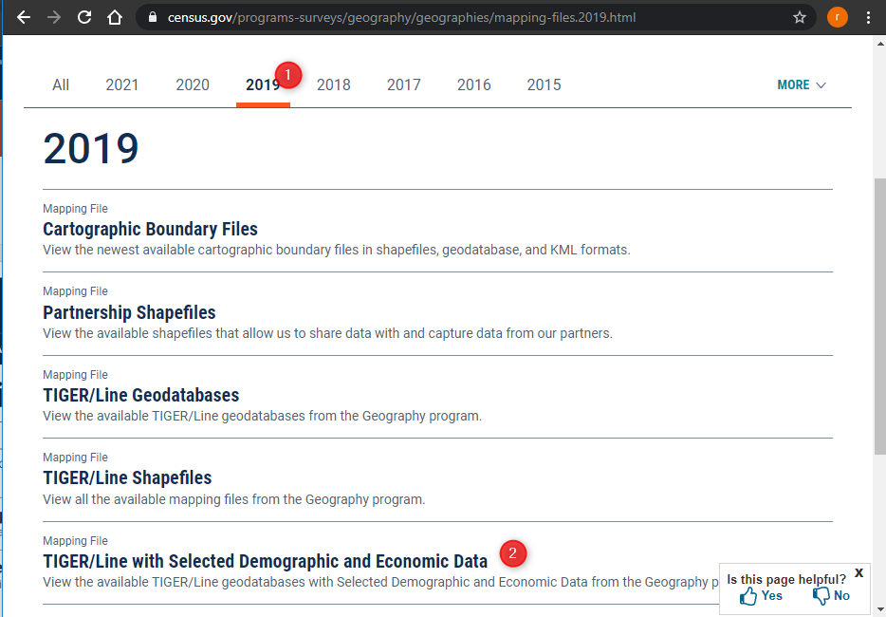
V. Pick a year (for 2019 and prior years) ->
Vi. Click TIGER/Line with Selected Demographic and Economic Data

Slide 22
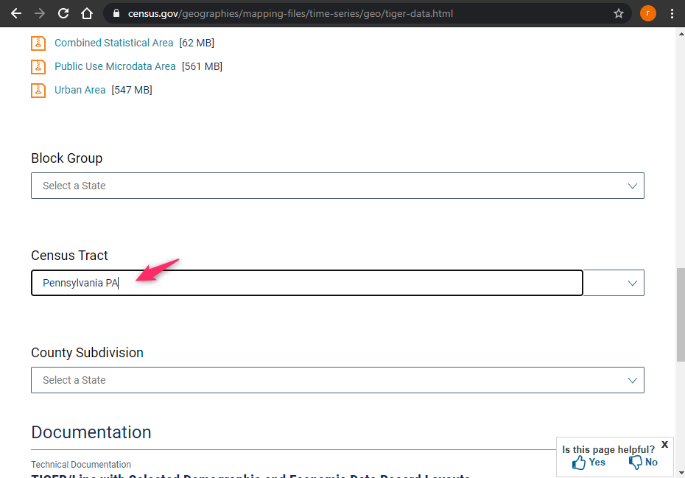
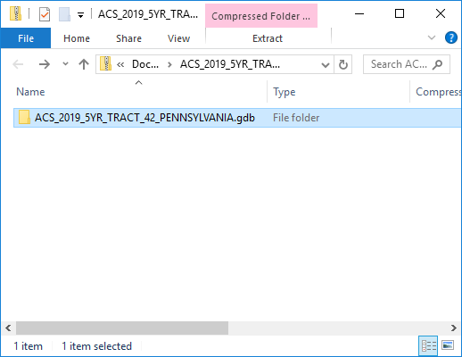
vii. Select census geography level of interest from the boxes and dropdowns.

Slide 23
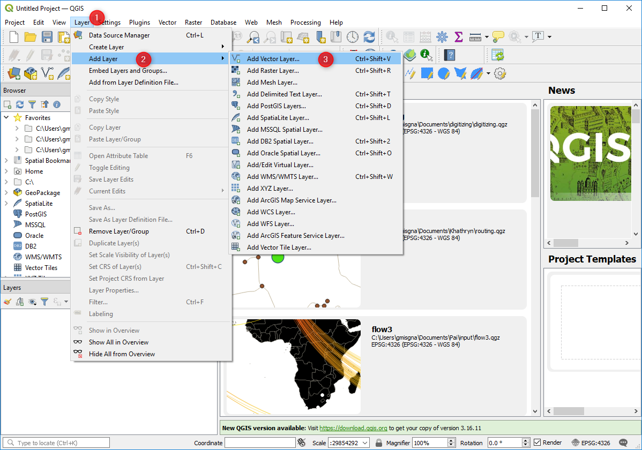
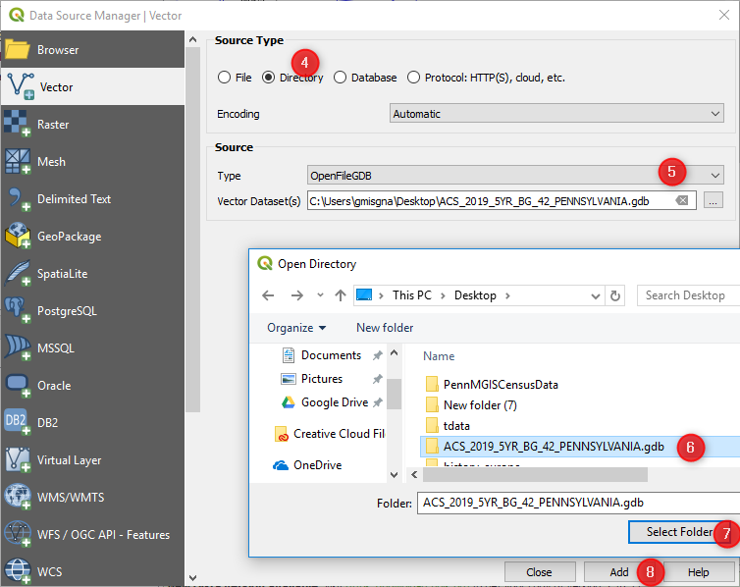
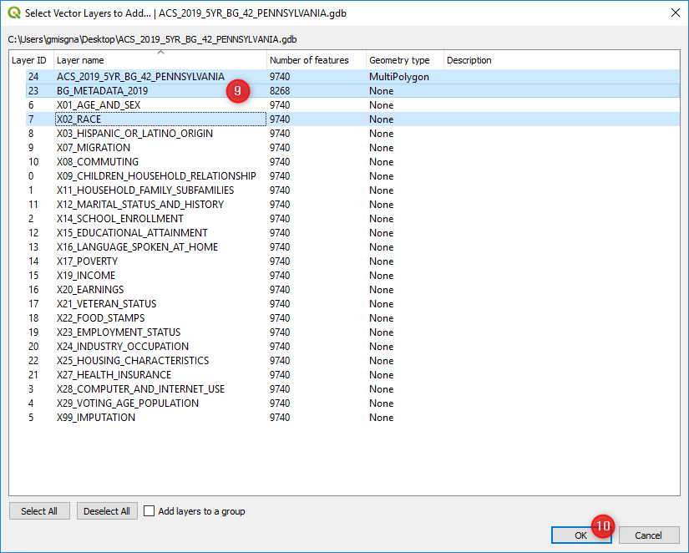
viii. Open the downloaded geodatabase in ArcMap or QGIS
ix. Add geography layer, data tables, meta data table
QGIS 3

Slide 24
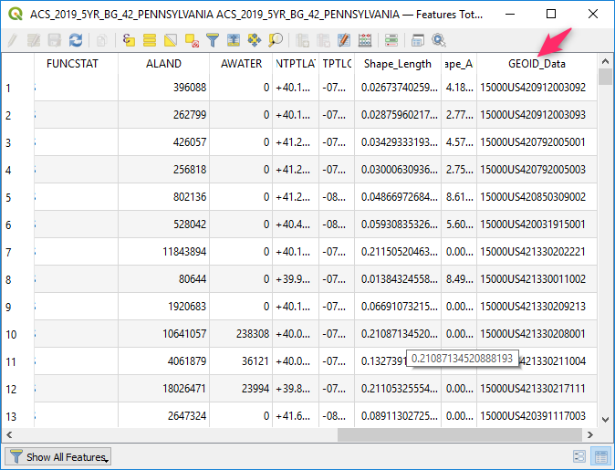
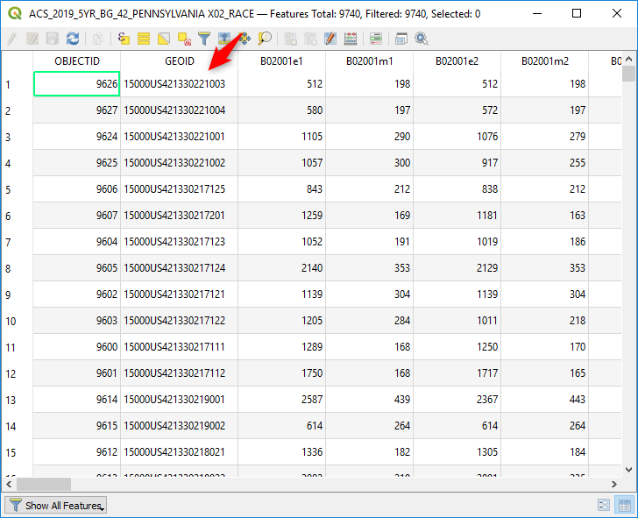
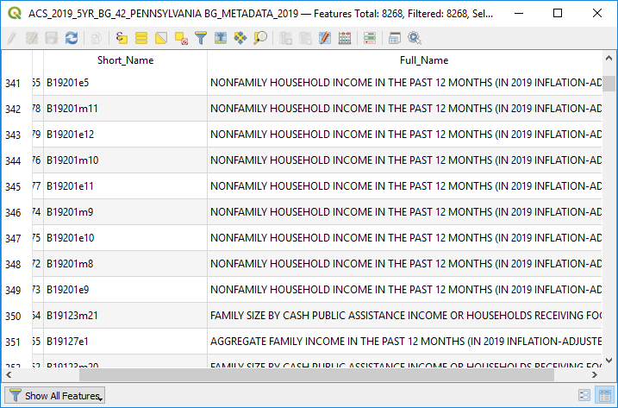
x. Open Geography table, data table, and metadata table. Take a note of the columns to use for joining the geography and the data tables (Geoid_Data and Geoid). Columns need to be the same type.
.

Slide 25
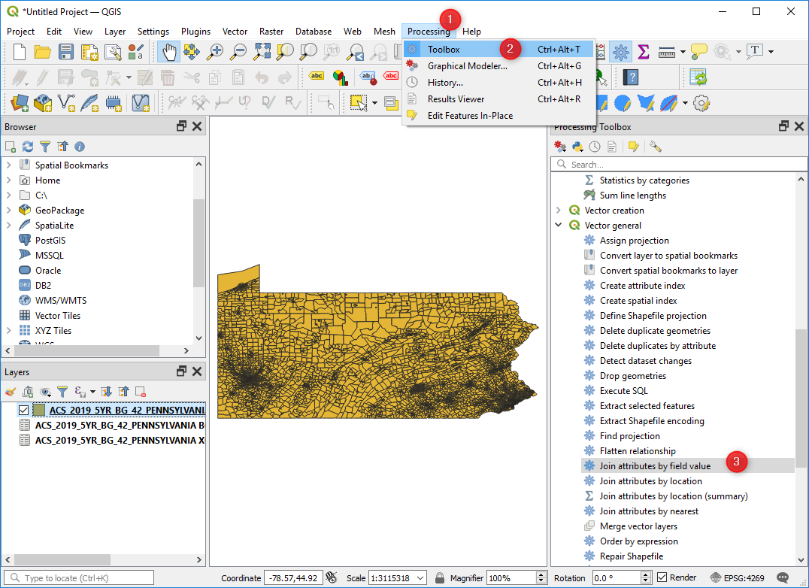
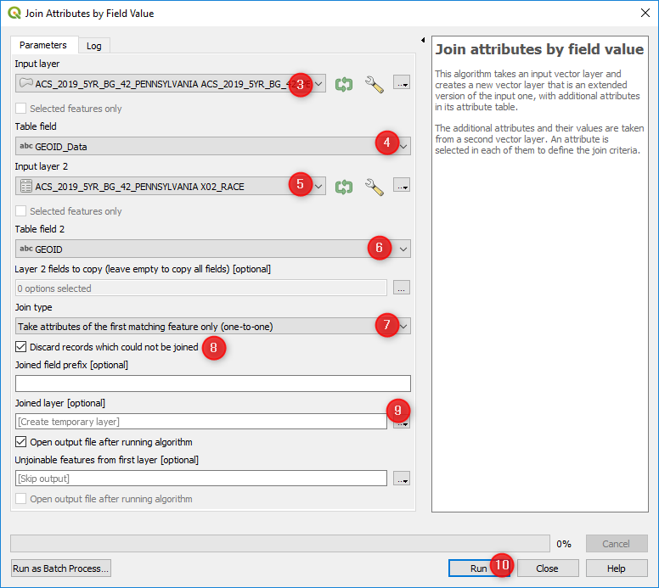

xi. Join geography map and data tables and visualize.

Slide 26
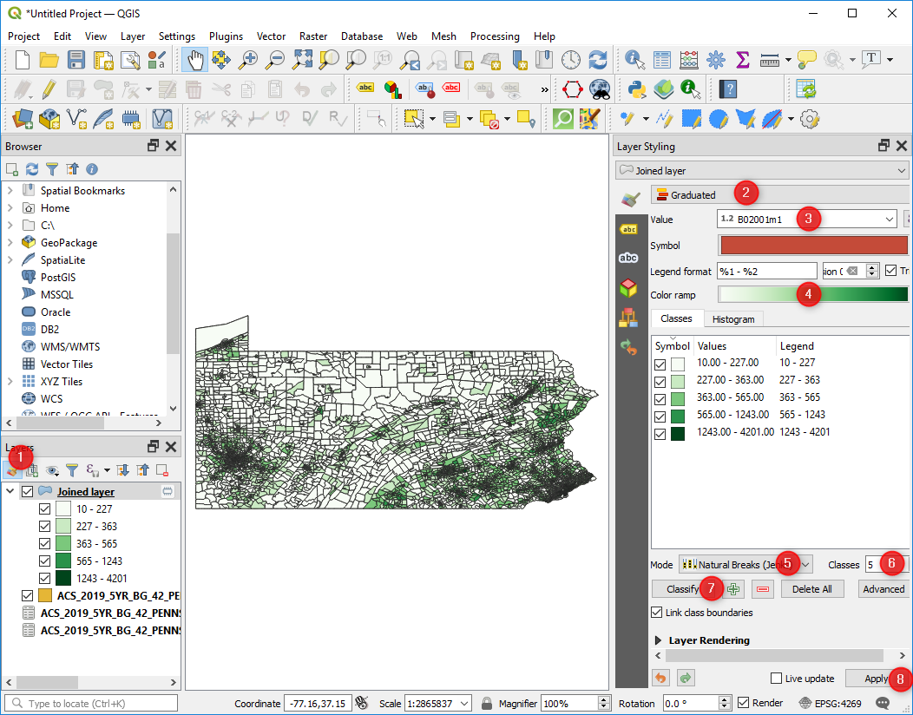
xii. Symbolize

Slide 27
3. Accessing and downloading through python based census API wrapper (Cenpy) Use Jupyter Notebook
“The Jupyter Notebook is an open-source web application that allows you to create and share documents that contain live code, equations, visualizations and narrative text.”
Uses include: data cleaning and transformation, numerical simulation, statistical modeling, data visualization, machine learning, and much more.
Cenpy is a python package “to explore and query the US Census API and return Pandas Dataframes [another python package]. This package is intended for exploratory data analysis.” https://github.com/cenpy-devs/cenpy
Notes:
https://github.com/PennMGIS/tutorials

Slide 28
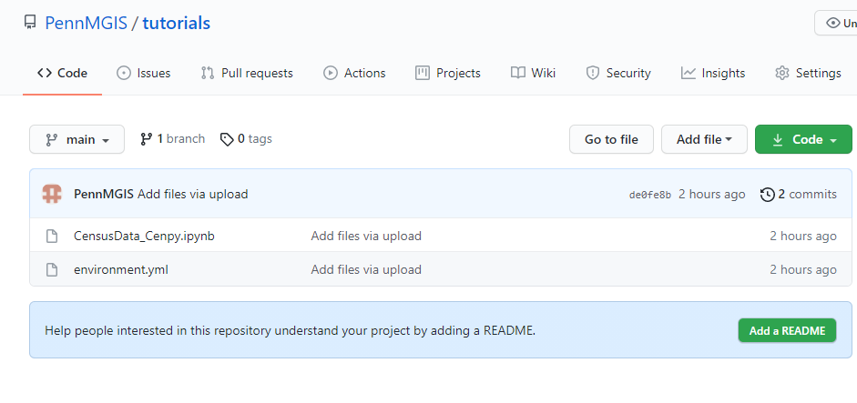
Open tutorial code
Open Jupyter note book file (CensusData_Cenpy.ipynb) on PennMGIS github to see the code
https://github.com/PennMGIS/tutorials

Slide 29
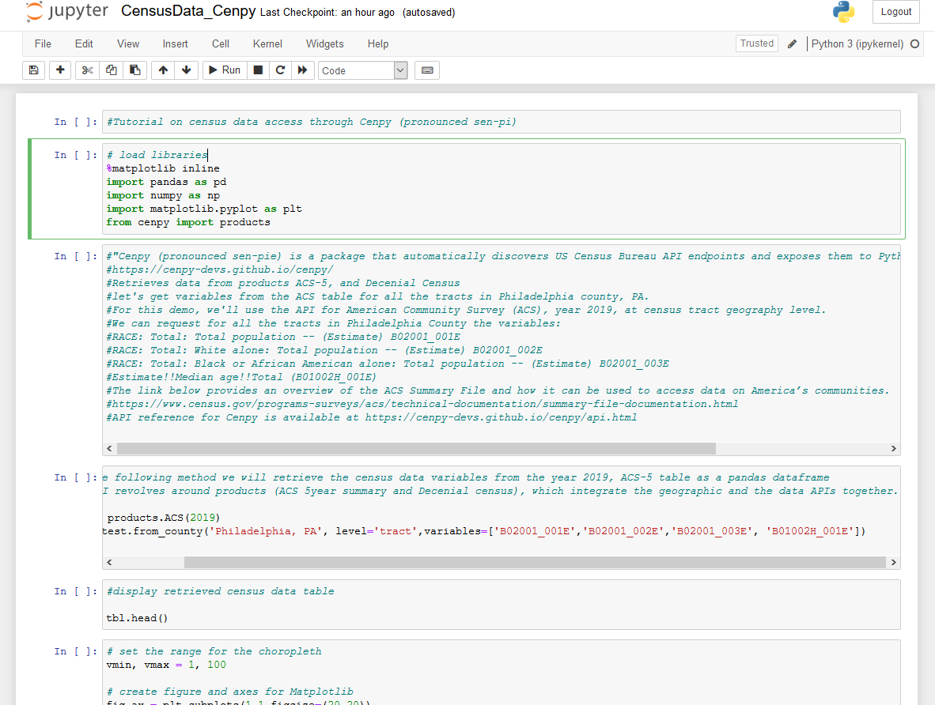
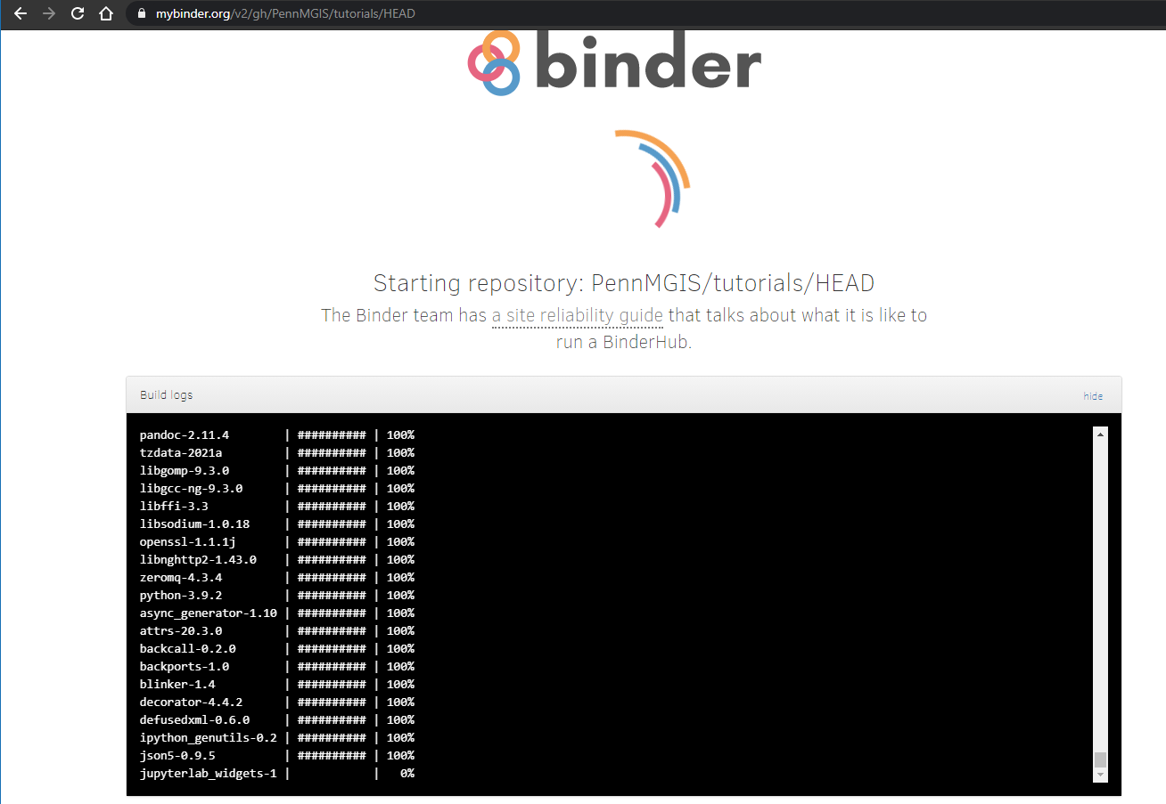
You can also open the jupyter notebook file in Binder for interactive coding
https://github.com/PennMGIS/tutorials/blob/main/CensusData_Cenpy.ipynb
Notes:
The Jupyter Notebook is an open-source web application that allows you to create and share documents that contain live code, equations, visualizations and narrative text.
https://github.com/PennMGIS/tutorials/blob/main/CensusData_Cenpy.ipynb

Slide 30
References
data.census.gov: Navigating a New Site for Census Bureau Data
https://www.youtube.com/watch?v=R6-IYatGVEI&t=767s
https://www2.census.gov/about/training-workshops/2019/2019-09-05-ced-presentation.pdf
TIGER/Line with Selected Demographic and Economic Data
https://www.census.gov/geographies/mapping-files/time-series/geo/tiger-data.html
“To download data, we need to identify the relevant tables containing the variables of interest to us. One way to do this would be to refer to the ACS documentation, in particular the Table Shells.”
https://www.census.gov/programs-surveys/acs/technical-documentation/summary-file-documentation.html.
“Cenpy (pronounced sen-pie) is a package that automatically discovers US Census Bureau API endpoints and exposes them to Python in a consistent fashion.”
https://cenpy-devs.github.io/cenpy/

