Slide 1

JUnit 5 – Part 2
Features, Architecture, and Extensibility
Steve Moyer
Steve Seltzer
Niraja Ramesh
The Pennsylvania State University

Slide 2
About Us
Steve Moyer
  Enterprise Architect
Steve Seltzer
  Programmer/Analyst
Niraja Ramesh
  Programmer/Analyst

Slide 3
About Us
Enterprise Information Technology
Core IT support organization for Penn State
Software Engineering Unit

Slide 4
About You
Notes:
First time at JavaOne
Experimenting with JUnit 5
Using JUnit 5 in production
Using coverage as a project metric

Slide 5
Agenda
Rationale
Architecture
Principles
Features
Code examples
Future directions
Junit Pioneer
References

Slide 6
Rationale
Decouple test execution and reporting from test definition and provisioning
Rethinking the JUnit’s extensibility story
Support for Java 8 features (Lambdas, Streams, Interface default methods) for better assertions, generating test cases, formulating test hierachies, testing asynchronous code.

Slide 7
Architecture

Slide 8
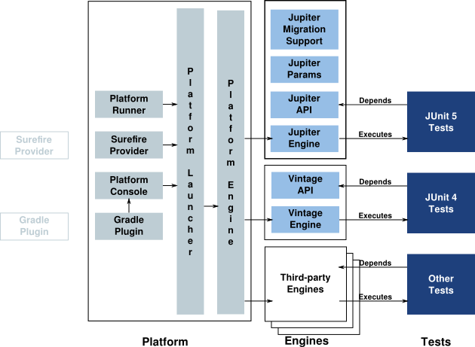
Architecture
Notes:
What about junit-jupiter-params?
Also consider the next 3 slides to update with jupiter-params

Slide 9
What do I need?
junit-jupiter-api
  to compile test classes and/or extensions
junit-jupiter-params
  to define parameterized tests
junit-jupiter-migration-support
  support for select JUnit 4 rules
junit-jupiter-engine (and dependencies)
  to run JUnit 5 tests
junit-vintage-engine (and dependencies)
  to run JUnit 4 tests (using JUnit 5)

Slide 10
What do I need?
junit-platform-console (and dependencies)
  to execute JUnit 5 tests from the command line
junit-platform-runner (and dependencies)
  to execute JUnit 5 tests using JUnit 4 in tools that don’t yet natively support JUnit 5.

Slide 11
What do I need?
junit-platform-maven-provider
  to execute tests using JUnit 5 during a Maven build.
  See the Maven example at: https://github.com/junit-team/junit5-samples/tree/master/junit5-maven-consumer
junit-platform-gradle-plugin
  to execute tests using JUnit 5 during a Gradle build.
  See the Gradle example at: https://github.com/junit-team/junit5-samples/tree/master/junit5-gradle-consumer
https://github.com/junit-team/junit5-samples
Notes:
See junit5-samples project for maven and gradle setup examples

Slide 12
Principles

Slide 13
Principles
Prefer extension points over features
An extension point should be good at one thing
It should be hard to write tests that behave differently based on how they are run
Tests should be easy to understand
Minimize dependencies (especially third-party)
https://github.com/junit-team/junit5/wiki/Core-Principles

Slide 14
Features

Slide 15
Features
Meta-Annotations
Tags and filters
Dependency injection through parameters on constructors and methods
Interface default methods
Extensions
Notes:
Categories in Junit4 is now Tags
Parameterized tests
Test Template
Repeated Test?
Compatibility with assertion libraries
AssertJ
Hamcrest

Slide 16
Features
API Isolation
  Jupiter API for writing tests and extensions
  Engine API for writing new engines
API Evolution
  API annotations
    Internal
    Deprecated
    Experimental
    Maintained
    Stable
https://github.com/apiguardian-team/apiguardian

Slide 17
Code Examples

Slide 18
Code Examples
Assertion tests
Exception tests
Assumption tests
Meta-Annotation
Dynamic tests
Extension tests
Parameterized Tests
Repeated Tests
Test Template
Grouped tests
Nested tests
Notes:
Add more examples
Parameterized Tests
Repeated Tests
Test Template

Slide 19
Assertions

Slide 20
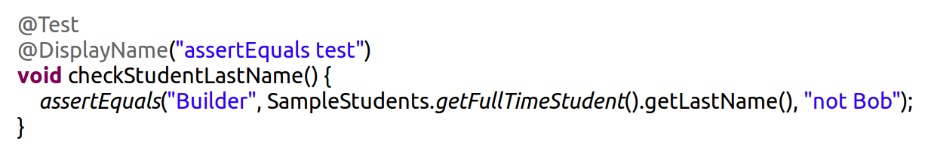
Assertion Tests
Simple Assertions
Junit 4 Junit 5
assert...(expected, actual) assert...(expected, actual)
assert...(message, expected, actual) assert...(expected, actual, message)

Slide 21
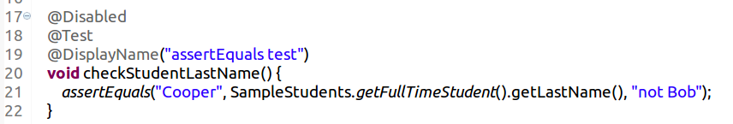

Assertion Tests
Simple Assertions

Slide 22
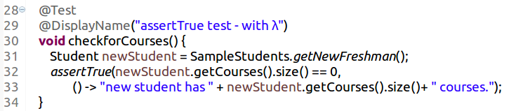
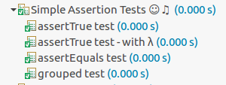
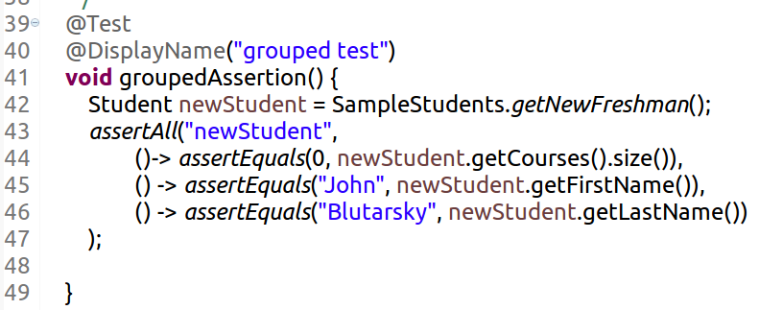
Assertion Tests
Notes:
can us lambda expressions in assertions.
assertAll is a grouped assertion

Slide 23
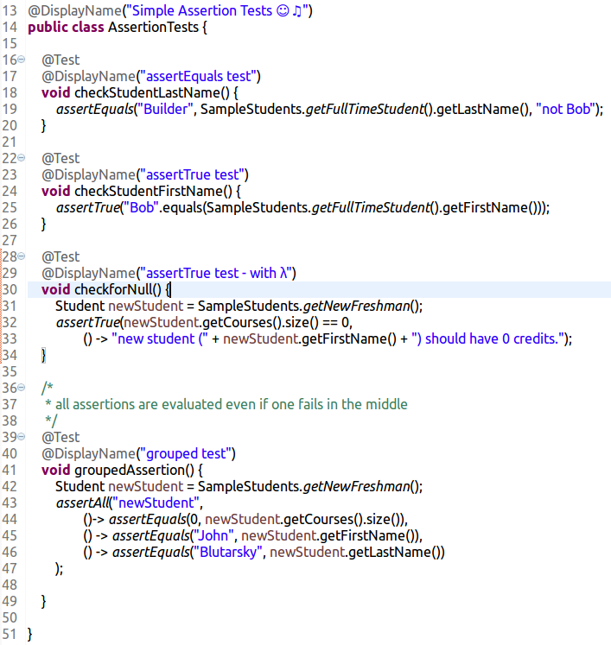
Assertion Tests
AssertionTests.java

Slide 24
Maven Output
maven console output
output - txt file
output - xml file
Notes:
counts of success, failure, skipped
Surefire xml report has method names

Slide 25
Available Assertions
http://junit.org/junit5/docs/current/api/org/junit/jupiter/api/Assertions.html
assertTrue
assertFalse
assertEquals
assertNotEquals
assertArrayEquals
asserIterableEquals
assertLinesMatch
fail
assertNull
assertNotNull
assertSame
assertNotSame
assertAll
assertThrows
assertTimeout
assertTimeoutPreemptively
Notes:
ExpectThrows – not there anymore
Check all
AssertTimeout
assertTimeout Preemptively
AsserIterableEquals
AssertLinesMatch

Slide 26
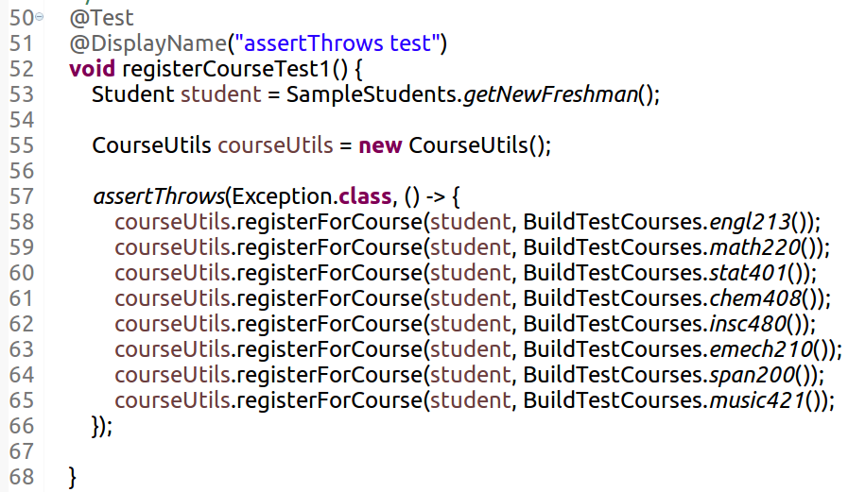
Exception Tests
ExceptionTests.java
Notes:
AssertThrows returns the expected exception (assertions can be executed against that reference)

Slide 27
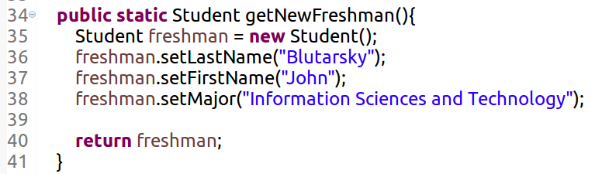
Exception Tests
The class builds data models for freshman, part-time, full-time and so forth.
SampleStudents.java

Slide 28
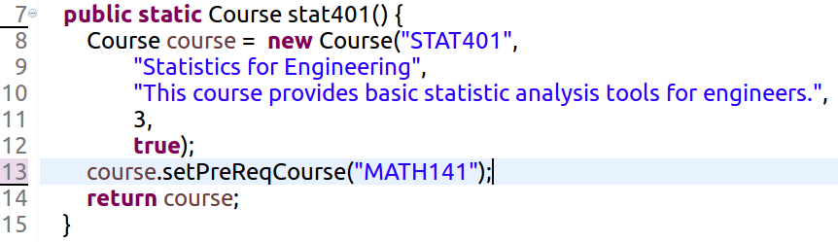
Exception Tests
This class creates different courses that we will register the students throughout our tests.
BuildTestCourses.java

Slide 29
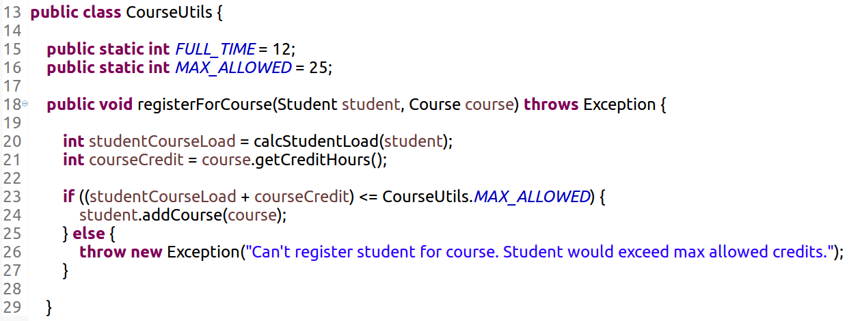
Exception Tests
This class registers courses for the students.
Throws exception if their total credits exceed MAX_ALLOWED.
CourseUtils.java

Slide 30

Exception Tests
Total credits for all courses exceed 25
‘registerForCourse’ method throws an exception assertThrows compares the thrown exception class to the expected one
ExceptionTests.java

Slide 31
Assumptions

Slide 32
Assumptions Tests
assumeTrue
assumeFalse
assumingThat
Notes:
failed assumptions do not result in a test failure; rather, a failed assumption results in a test being disabled.

Slide 33
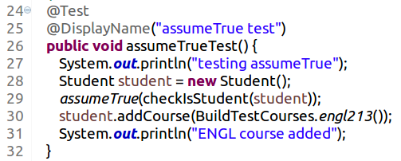
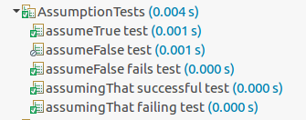
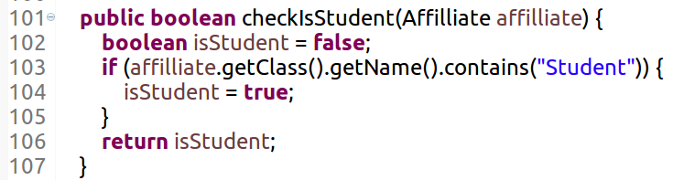
Assumption Tests
assumeTrue
AssumptionTests.java

Slide 34
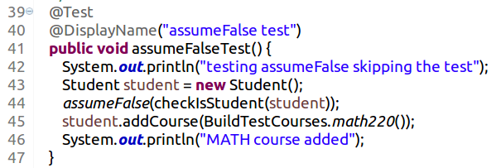
Assumptions Test
assumeFalse
AssumptionTests.java
Notes:
Talk about assumingThat – pass and fail cases available in code repo

Slide 35
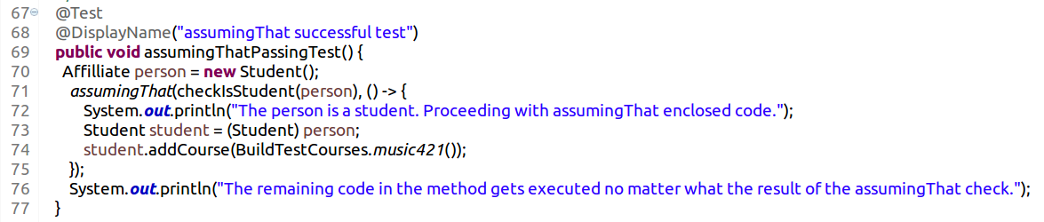
Assumptions Test
assumingThat
AssumptionTests.java
Notes:
Talk about assumingThat – pass and fail cases available in code repo

Slide 36
Meta-Annotations

Slide 37
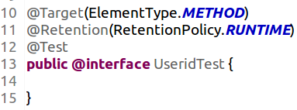
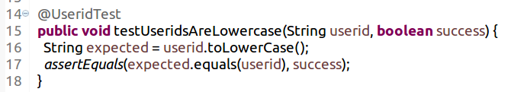
Meta-Annotation
UseridCaseTests.java

Slide 38
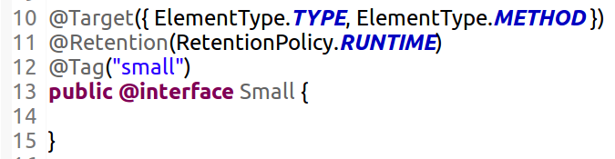
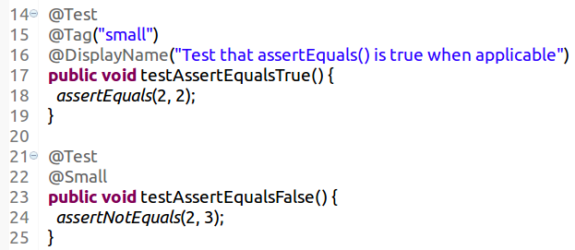
Tagging & Filtering
TaggingTest.java
Notes:
@Tag annotation
Can combine more than one in the custom annotation

Slide 39
Repeated Tests

Slide 40
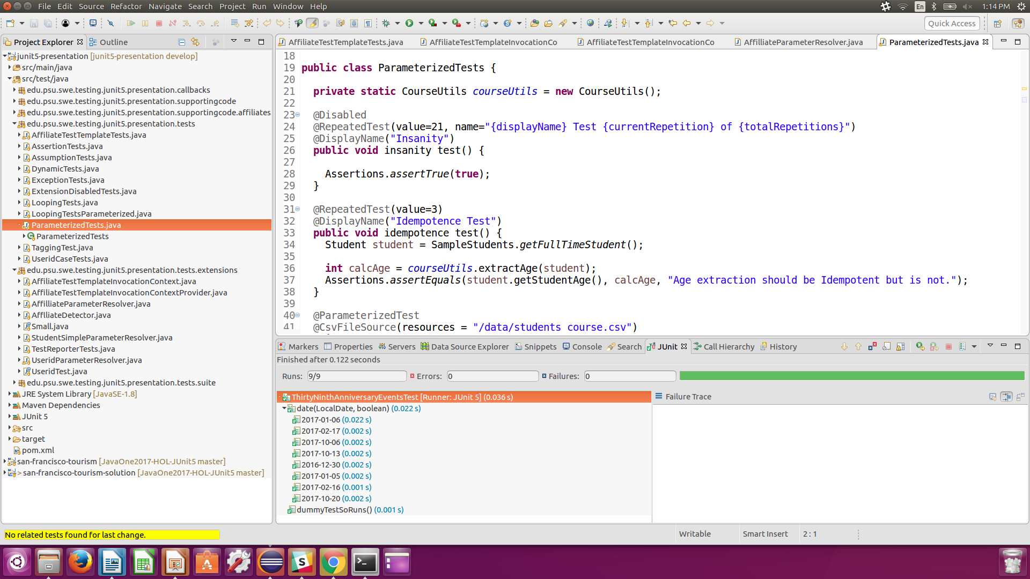
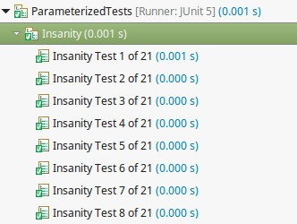
Repeated Test
Notes:
Not intended for performance testing
Other frameworks and libraries for that

Slide 41
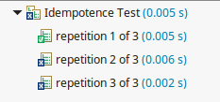
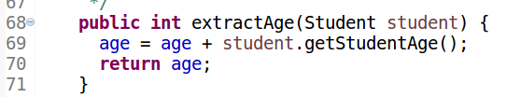
Repeated Test

Slide 42
Parameterized Tests

Slide 43
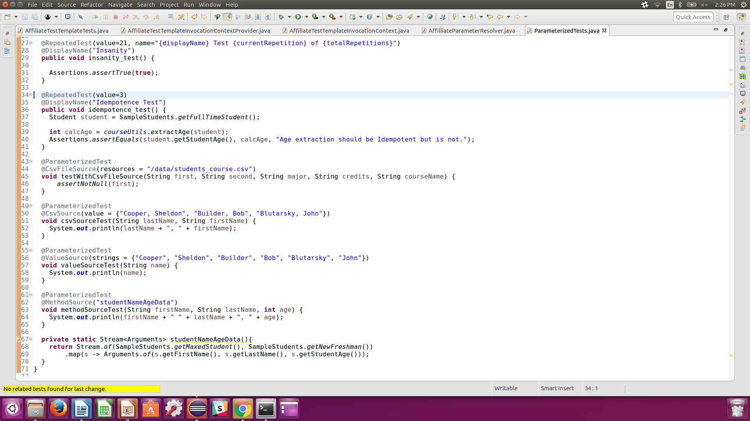
Parameterized CSV Sources
@CsvFileSource
@CsvSource
Notes:
Will parse input and pass it to the input parameters
Both offer Implicit and Explicit parameter conversion.
See the users guide for list of implicit conversion and how to implement an explicit converter.

Slide 44
Parameterized Test Sources
Notes:
Implicit and Explicit parameter conversion

Slide 45
Test Template
Notes:
Parameterized test actually specialized implementation of TestTemplate
- Designed to be invoked multiple times
- Each invocation behaves like an independent @Test method (the callback methods are executed @BeforeAll)

Slide 46
Test Template
Parameterized test actually specialized implementation of TestTemplate
Designed to be invoked multiple times
Each invocation behaves like an independent @Test method
Notes:
These DynamicTest instances will then be executed lazily, enabling dynamic and even non-deterministic generation of test cases.

Slide 47
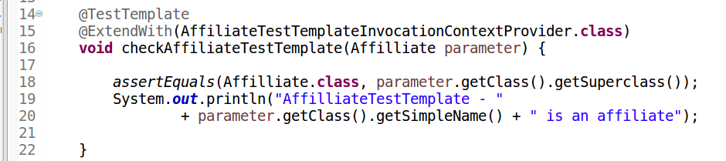
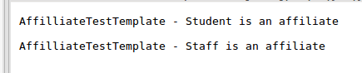
Test Template
Notes:
For the test template extend with an implementation TestTemplateInvocationContextProvider

Slide 48
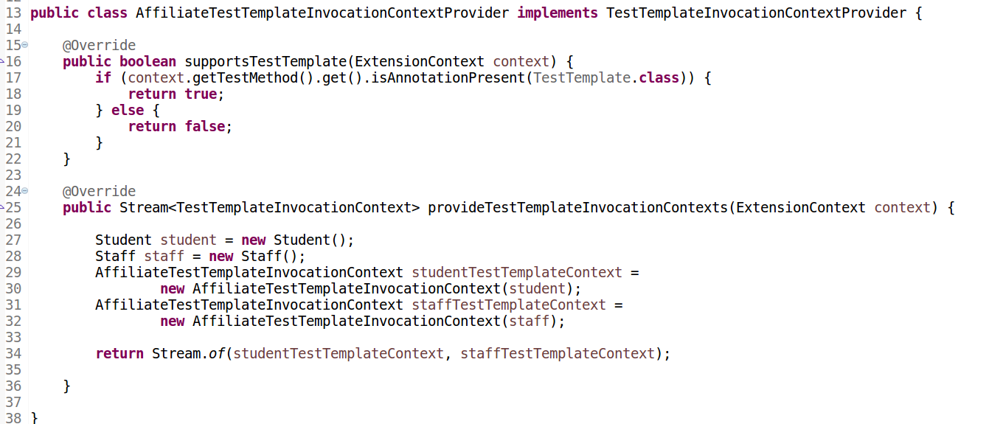
Test Template
InvocationContextProvider
Notes:
The will return a stream of TestTemplateInvocationContext(s)

Slide 49
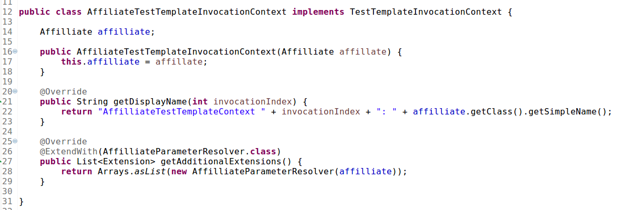
Test Template
InvocationContext
Notes:
Which are themselves an implementation of the interface.

Slide 50
Extensibility

Slide 51
Extension Points
http://junit.org/junit5/docs/current/api/org/junit/jupiter/api/extension/Extension.html
ParameterResolver
ExecutionCondition
TestExecutionExceptionHandler
TestInstancePostProcessor
BeforeAllCallback
AfterAllCallback
BeforeEachCallback
AfterEachCallback
BeforeTestExecutionCallback
AfterTestExecutionCallback
Notes:
TestInstancePostProcessor analogous to @PostConstruct annotation.

Slide 52
ExecutionCondition
Extension Point
Notes:
- Can be used to determine programatically whether a test will be executed.

Slide 53
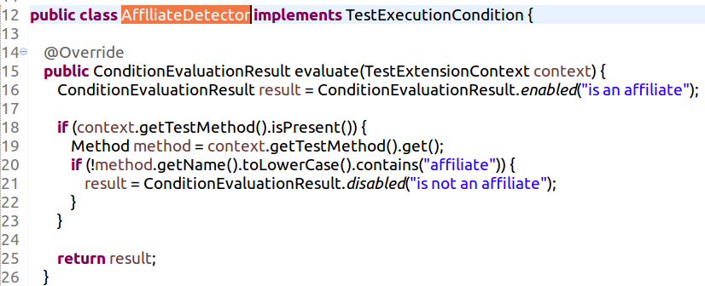
Extension Test
implements TestExecutionCondition
This class disables a test if the method name does not contain the word ‘affiliate’
AfflliateDetector.java
Notes:
**Update Screenshot**
- Class that will perform check and will conditionally disable test.
- Line 20 checks method name to see that it contains “Affiliate”. If not, the test is disabled.
- Can be used to check for annotations. Example might be @RequiresDBConnection.

Slide 54

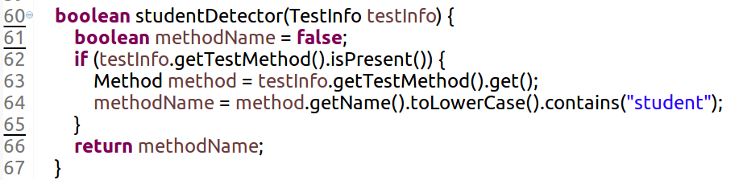
Extension Test
implements TestExecutionCondition
Register AffiliateDetector extension via @ExtendWith
Class ExtensionDisabledTests contains a method that will return a boolean indicating whether method name contains the word ‘student’
ExtensionDisabledTests.java
Notes:
‘TestInfo’ is derived from the JUnit5 API and has is a built in parameter resolver.
TestInfo carries Method name, DisplayName, Tags, and a reference to the Class associated with the current test or container, if available.
Line 60 is a method within the class that will check to see if the test method name contains the word “Student”.

Slide 55
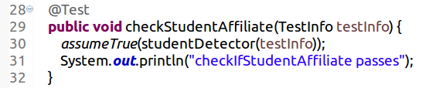
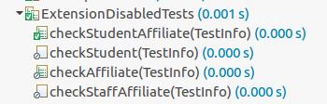
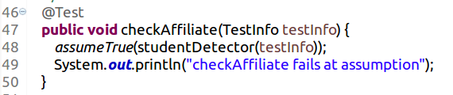
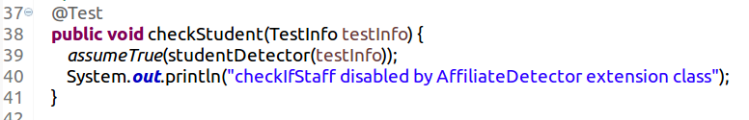
Extension Test
implements TestExecutionCondition
Contains “Affiliate” (passes TestExecutionCondition)
Contains “Student” (passes studentDetector method )
Contains “Affiliate” (passes TestExecutionCondition)
No “Student” (fails studentDetector method )
No “Affiliate” (fails TestExecutionCondition)
ExtensionDisabledTests.java
Notes:
Mention how ‘TestInfo’ is derived from the api and is a built in parameter to the tests

Slide 56
ParameterResolver
Extension Point

Slide 57
Built-in ParameterResolvers
TestInfo
  If a method parameter of type TestInfo is resolved, JUnit will supply an instance that allows a test to retrieve the display name, tags, test class and test method.
TestReporter
  If a method parameter of type TestReporter is resolved, JUnit will supply an instance that allows a test to publish entries to the output report.

Slide 58
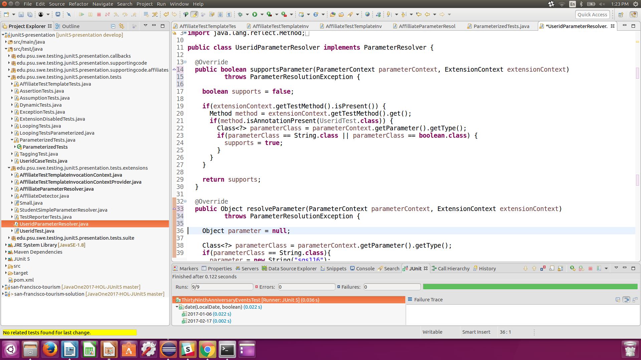
Extension Test
implements ParameterResolver
looks for @UseridTest annotation to return true/false
returns value for given parameters
(in the example, a String and a boolean)
UseridParameterResolver.java
Notes:
**UPDATE CODE – supports is now supportsParameter**
Two parts to Parameter Resolver class:
Supports – Determines whether the parameter replacement is applicable for the method depending on criteria
Resolve – Returns the parameter value

Slide 59
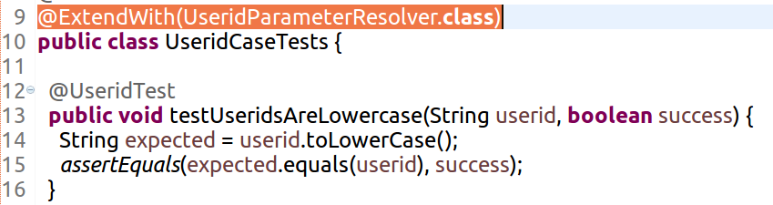
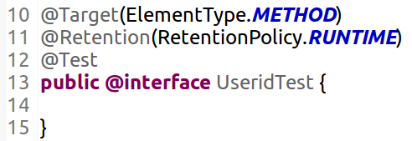
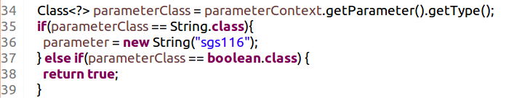

Extension Test
implements ParameterResolver
UseridCaseTests.java
Notes:
@Test is a meta-annotation on @UseridTest and so the method does not need a seperate @Test annotations.
From the parameterContext we can find the parameter Type. We could also get the parameter position if desired.
The method receives sgs116 and a boolean true to indicate that the parameter is expected to pass.

Slide 60
Callbacks
Extension Point

Slide 61
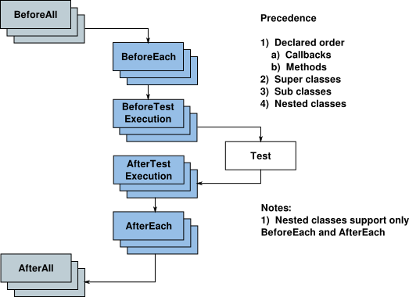
Extension Tests
Notes:
Precedent order applies to each level.
Check on non-static
@BeforeAll and @AfterAll

Slide 62


Extension Test
implements Callback
class implementing callbacks
ParentTests – registers extension with class implementing callbacks
ChildTests – extends ParentTests
Each class prints out the methods available within that class
Callback Example

Slide 63
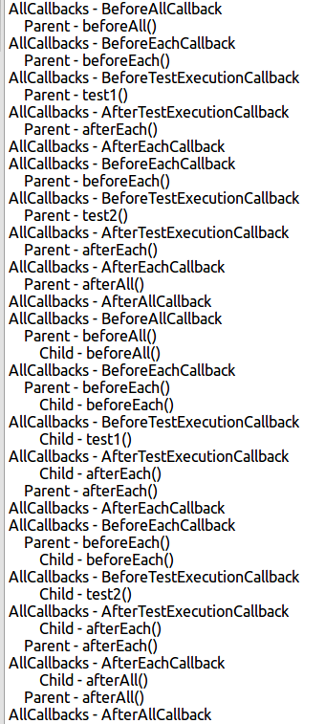
Extension Tests
implements Callback

Slide 64
Nested Tests

Slide 65
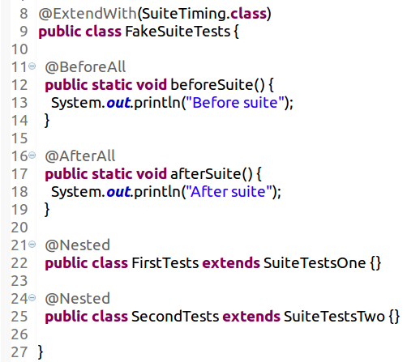
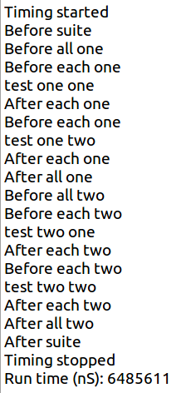
Nested Tests
FakeSuiteTests.java
Notes:
Make a note of using the nested annotation to mimic a test suite
good time to bring up the future plans for BeforeSuite/AfterSuite annotation for future release

Slide 66
Dynamic Tests

Slide 67
Dynamic Test
Test case generated at run-time by a factory method @TestFactory
Composed of a display name and an Executable
Executable is a functional interface – meaning tests can be provided as lambda expressions or method references
Because of dynamic nature, lifecycle callbacks are not applicable
Notes:
These DynamicTest instances will then be executed lazily, enabling dynamic and even non-deterministic generation of test cases.

Slide 68
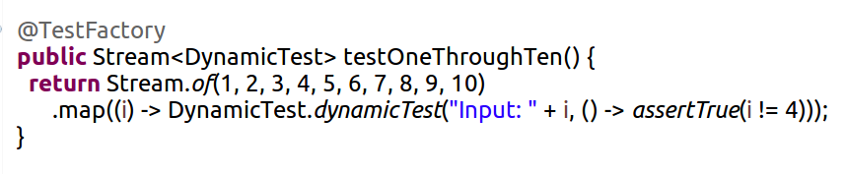
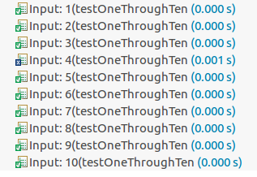
Dynamic Testing
DynamicTests.java
Notes:
Generates test case for each

Slide 69
Grouped Tests

Slide 70
Grouped Tests
Traditional For Loop
assertAll()
Factory Tests (@TestFactory)

Slide 71
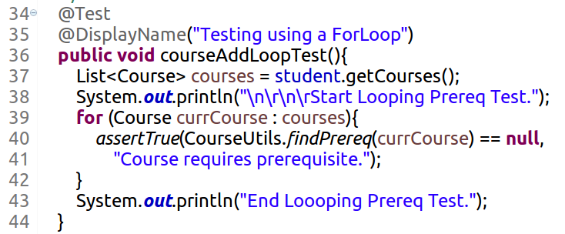

Collection Testing
Halts test execution when course prerequisite is found
LoopingTests.java

Slide 72
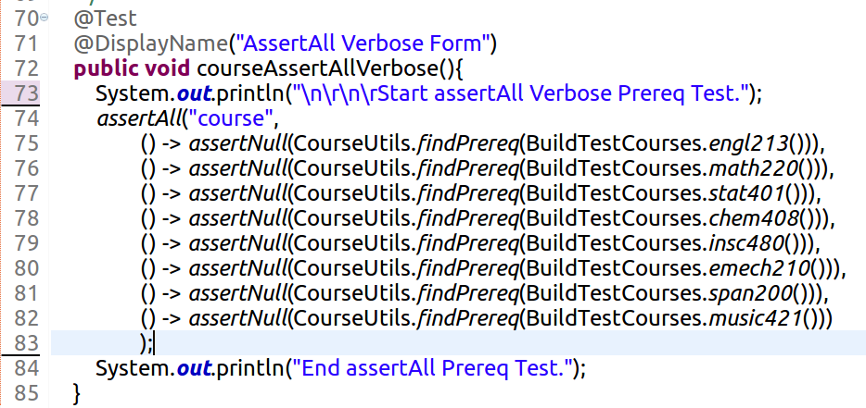
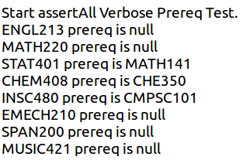
AssertAll
Executes all test cases inside the assertAll block
LoopingTests.java
Notes:
Mention that line 84 does not print

Slide 73
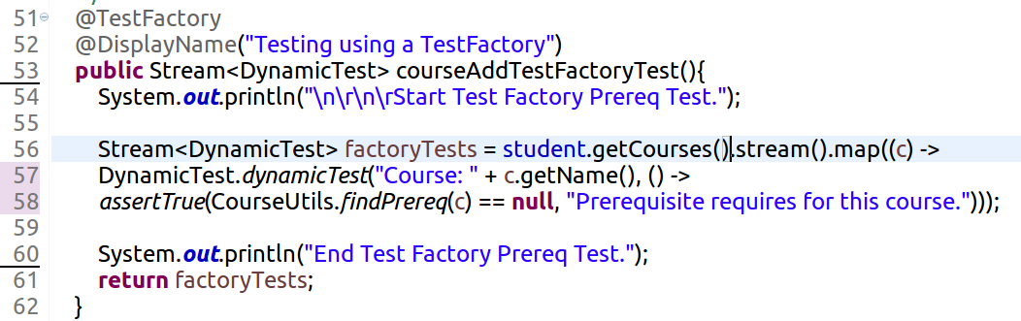
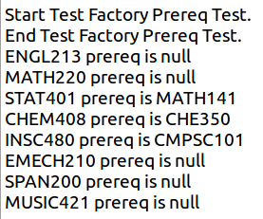
Factory Test
Executes all tests regardless of failures
LoopingTests.java
Notes:
Completes the method.
The Stream of dynamic tests is returned then the tests are executed.

Slide 74
Future Directions

Slide 75
Future
5.0.1 (October 3,2017)
5.1 (Release not announced)
  Declarative Suites
5.x
  Ordered/Scenario tests
Notes:
Ordered tests
RCs and GAs

Slide 76
Support
IntelliJ
Eclipse
Maven
Gradle
Console
Mockito (prototype)
PiTest (prototype)

Slide 77

JUnit Pioneer

Slide 78
JUnit Pioneer
JUnit 5 extensions
Community maintained and curated
http://www.junit-pioneer.org

Slide 79
Core Features
No additional dependencies
Mockito extension (until officially adopted by Mockito)
Conditional execution extensions
JUnit 4 rule replacement extensions
Console testing extensions (System.in, System.out and System.err)
Migration help for TestNG users (extra assertions)
Notes:
https://github.com/junit-pioneer/junit-pioneer

Slide 80
You can help!
Please contribute your extensions!
https://github.com/junit-pioneer/junit-pioneer
Notes:
https://github.com/junit-pioneer/junit-pioneer

Slide 81

upREST
Declarative testing of RESTful APIs
Notes:
https://github.com/junit-pioneer/junit-pioneer

Slide 82

Suite
Allows the definition of declarative suites
Notes:
https://github.com/junit-pioneer/junit-pioneer

Slide 83
Shameless Plug
Intro to Mutation Testing in Java [CON1694]
Thursday, Oct 05, 1:00 p.m. - 1:45 p.m. | Marriott Marquis (Yerba Buena Level) - Nob Hill C/D
Sure, we all know that it’s important to write tests. But how do we know if the tests are thorough? Code coverage isn’t enough. This introduction to mutation testing presents an overview, discusses how it works, and provides a live example of using mutation testing to improve tests.
Jeanne Boyarsky, Developer, CodeRanch
Notes:
https://github.com/junit-pioneer/junit-pioneer

Slide 84
Questions / Comments?

Slide 85
References

Slide 86
References
This presentation
  See the presentation at: http://bit.ly/2fOEArC
  See the code samples at: http://bit.ly/2xQVMnp
JUnit 5
  Users guide Current Milestone, SNAPSHOT
  Javadocs Current Milestone, SNAPSHOT
  Code and issues Github

