Slide 1

JUnit5
Features, Architecture, and Extensibility
Steve Moyer
Steve Seltzer
Niraja Ramesh
The Pennsylvania State University

Slide 2
About Us
Our unit works with Java for enterprise applications building student systems
Steve Moyer
  Enterprise Architect
Steve Seltzer
  Programmer/Analyst
Niraja Ramesh
  Programmer/Analyst

Slide 3
Agenda
JUnit5 evolution
Architecture
Features
Code examples
Running tests
Future directions
References

Slide 4
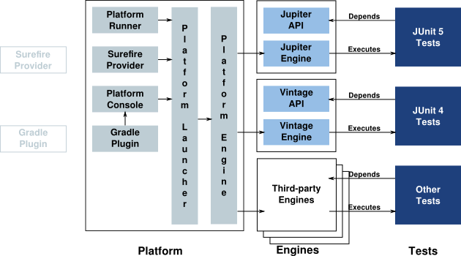
Architecture

Slide 5
Principles
Prefer extension points over features
an extension point should be good at one thing
It should be hard to write tests that behave differently based on how they are run
Tests should be easy to understand
Minimize dependencies (especially third-party)
https://github.com/junit-team/junit5/wiki/Core-Principles

Slide 6
Features
API Isolation
  Jupiter API for writing tests/extensions
  Engine API for writing new engines
API Evolution
  API annotations
    Internal, Deprecated, Experimental, Maintained, Stable
Meta Annotation (tags and filters)
Dependency injection through parameters
Dynamic tests (runtime)
  Java 8 features (functional interface)
Extensions
  Storing the state??

Slide 7
Set up
Maven build
Surefire plugin
Add as dependencies
  Jupiter-engine
    junit-platform-engine
    junit-jupiter-api
  Platform-runner (to run in eclipse IDE)
    junit-platform-launcher
    junit-4.12 (hamcrest-core)

Slide 8
Set up
Release 3.--
Maven build
Plugin
  Maven-compiler-plugin
  Maven-surefire-plugin with dependencies
    Junit-platform-surefire-provider
    Junit-jupiter-engine
    junit-vintage-engine
Add as dependencies
  Junit-jupiter-api
  Junit (to run Junit tests)
  Platform-runner (to run in eclipse IDE)

Slide 9
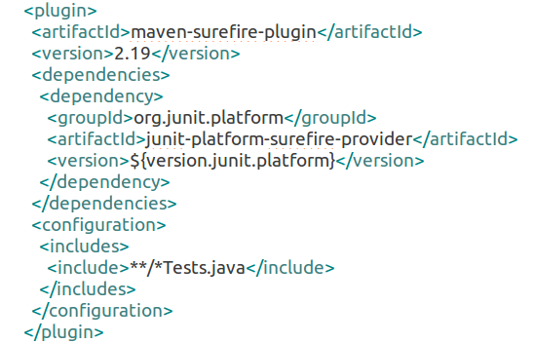
Set up
plugin
https://github.com/PennState/junit5-presentation/blob/develop/pom.xml

Slide 10
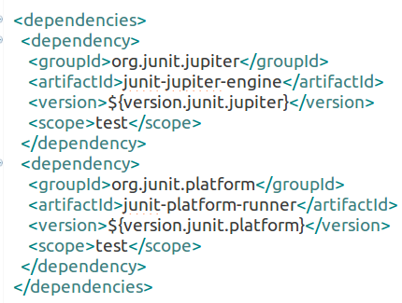
Set up
dependencies
https://github.com/PennState/junit5-presentation/blob/develop/pom.xml

Slide 11
Tests
Assertion tests
  Exception tests
Assumption tests
Meta annotation
Extension tests
Dynamic tests
Nested tests
Group tests

Slide 12
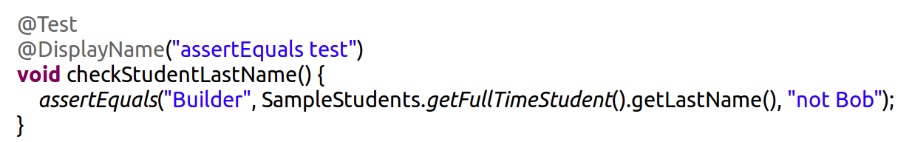
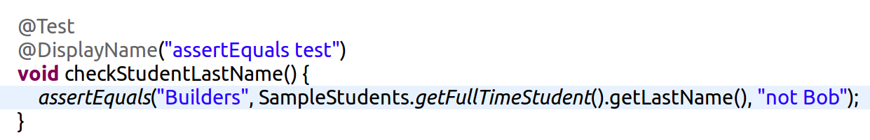
Assertion Test
Simple Assertions

Slide 13
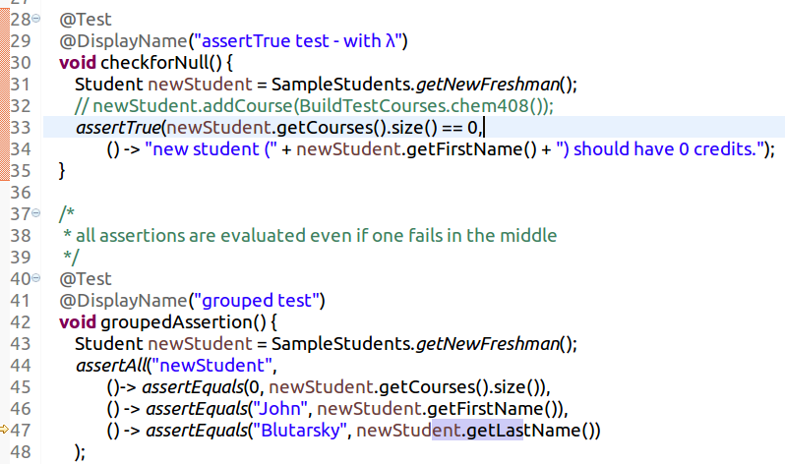
Assertion Tests

Slide 14
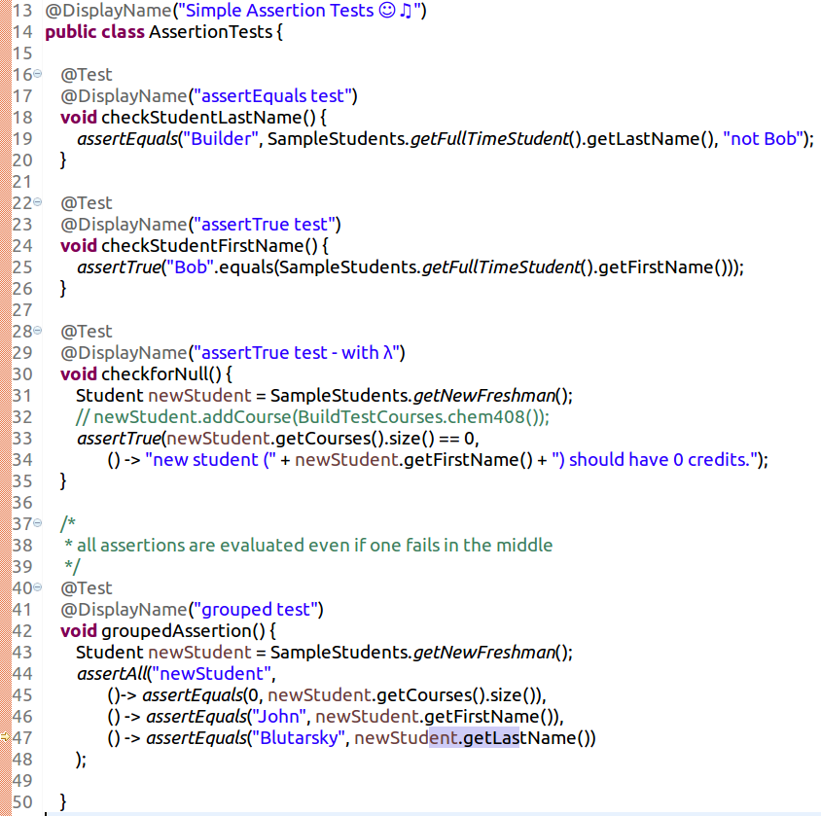
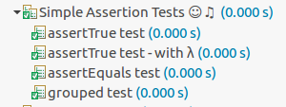
Assertion Tests
Code Example
Results
https://github.com/PennState/junit5-presentation/blob/develop/src/test/java/edu/psu/swe/testing/junit5/presentation/tests/AssertionTests.java
Notes:
Make note of @DisplayName annotation

Slide 15
Assertion Tests
Exception Tests
http://junit.org/junit5/docs/current/api/
AssertTrue
AssertFalse
AssertEquals
AssertNotEquals
AssertNull
AssertNotNull
AssertSame
AssertNotSame
AssertAll
AssertThrows ExpectThrows
Notes:
Make note of @DisplayName annotation

Slide 16
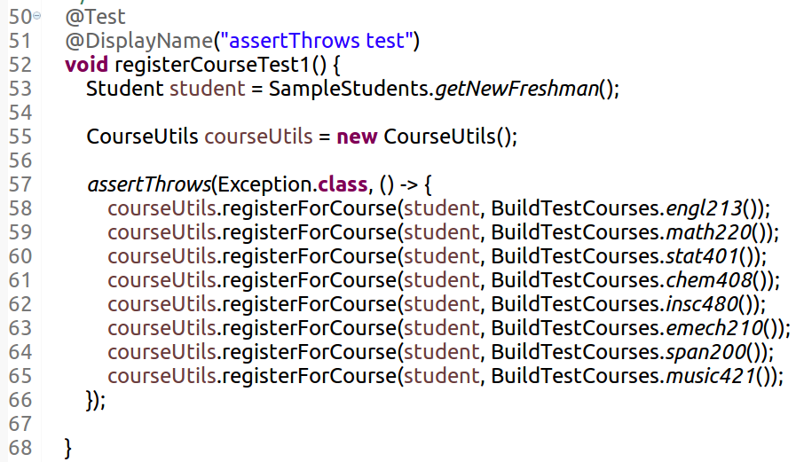
Exception Test
https://github.com/PennState/junit5-presentation/blob/develop/src/test/java/edu/psu/swe/testing/junit5/presentation/tests/ExceptionTests.java

Slide 17
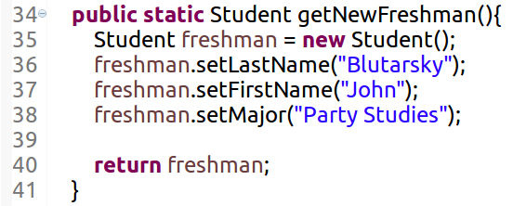
Exception Test
The class builds data models for freshman , part-time, full-time and so forth
https://github.com/PennState/junit5-presentation/blob/develop/src/test/java/edu/psu/swe/testing/junit5/presentation/supportingcode/SampleStudents.java

Slide 18
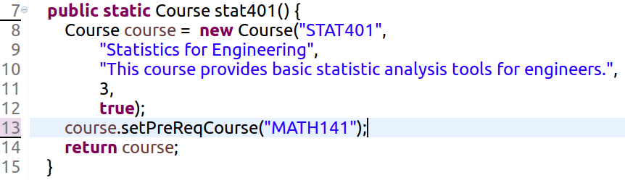
Exception Test
This class creates different courses that we will add to the students throughout our tests.
https://github.com/PennState/junit5-presentation/blob/develop/src/test/java/edu/psu/swe/testing/junit5/presentation/supportingcode/BuildTestCourses.java

Slide 19
Exception Test
https://github.com/PennState/junit5-presentation/blob/develop/src/test/java/edu/psu/swe/testing/junit5/presentation/tests/ExceptionTests.java

Slide 20
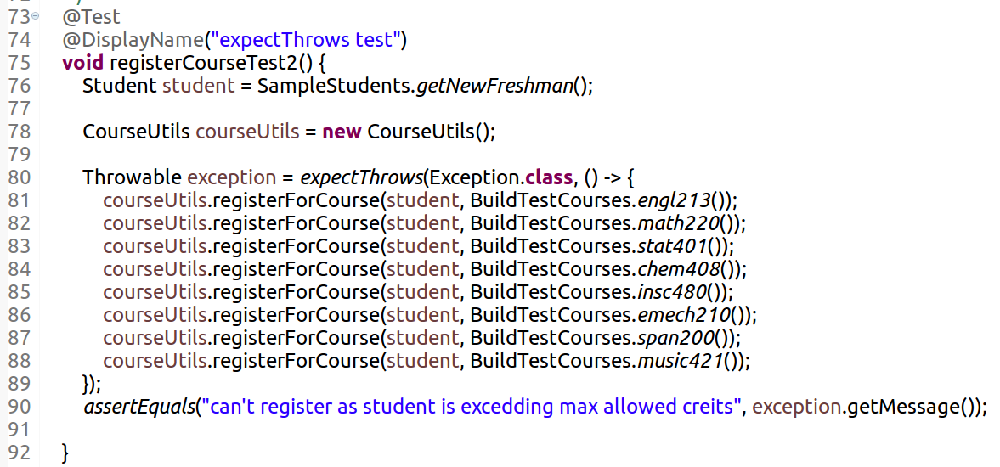
Exception Test
https://github.com/PennState/junit5-presentation/blob/develop/src/test/java/edu/psu/swe/testing/junit5/presentation/tests/ExceptionTests.java

Slide 21

Exception Tests
Code Example
Results
assertThrows expectThrows
https://github.com/PennState/junit5-presentation/blob/develop/src/test/java/edu/psu/swe/testing/junit5/presentation/tests/ExceptionTests.java

Slide 22
Assumptions Test
Assumptions are typically used whenever it does not make sense to continue execution of a given test method
AssumeTrue
AssumeFalse
AssumingThat
Notes:
failed assumptions do not result in a test failure; rather, a failed assumption results in a test being aborted.
What is the difference between assumeTrue and assumingThat

Slide 23
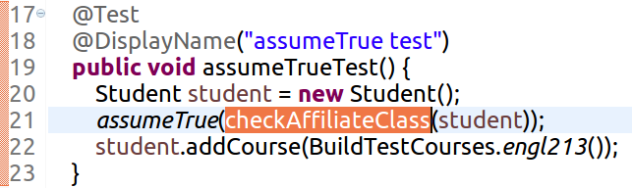
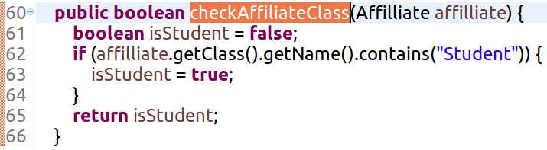
Assumptions Test
https://github.com/PennState/junit5-presentation/blob/develop/src/test/java/edu/psu/swe/testing/junit5/presentation/tests/AssumptionTests.java
UPDATE SCREENSHOT TO checkIsStudent

Slide 24
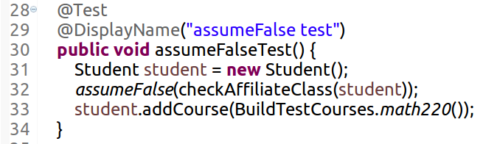
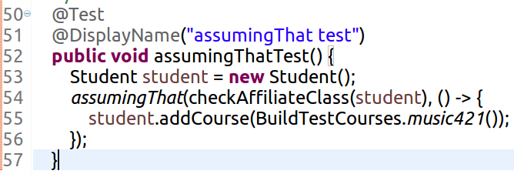
Assumptions Test
https://github.com/PennState/junit5-presentation/blob/develop/src/test/java/edu/psu/swe/testing/junit5/presentation/tests/AssumptionTests.java

Slide 25

Assumption Test
https://github.com/PennState/junit5-presentation/blob/develop/src/test/java/edu/psu/swe/testing/junit5/presentation/tests/AssumptionTests.java

Slide 26
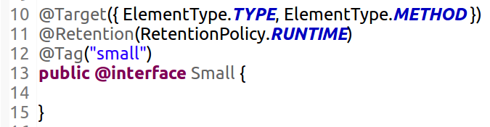
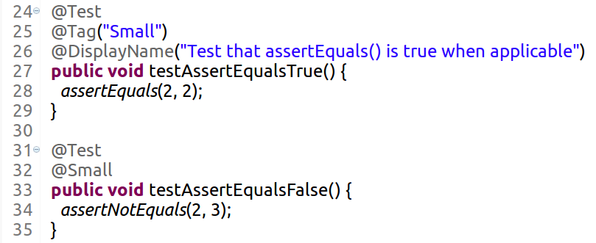
Meta Annotation
https://github.com/PennState/junit5-presentation/blob/develop/src/test/java/edu/psu/swe/testing/junit5/presentation/Small.java

Slide 27
Extensibility
extend a class
- that implements a TestExecutionCondition
- that implements a ParameterResolver
- that implements callbacks
Extensions can be registered declaratively via @ExtendWith.
Notes:
In contrast to the competing Runner, @Rule, and @ClassRule extension points in JUnit 4, the JUnit Jupiter extension model consists of a single, coherent concept: the Extension API. Note, however, that Extension itself is just a marker interface.
5.2.2. Extension Inheritance
Registered extensions are inherited within test class hierarchies with top-down semantics. Similarly, extensions registered at the class-level are inherited at the method-level. Furthermore, a specific extension implementation can only be registered once for a given extension context and its parent contexts. Consequently, any attempt to register a duplicate extension implementation will be ignored.

Slide 28
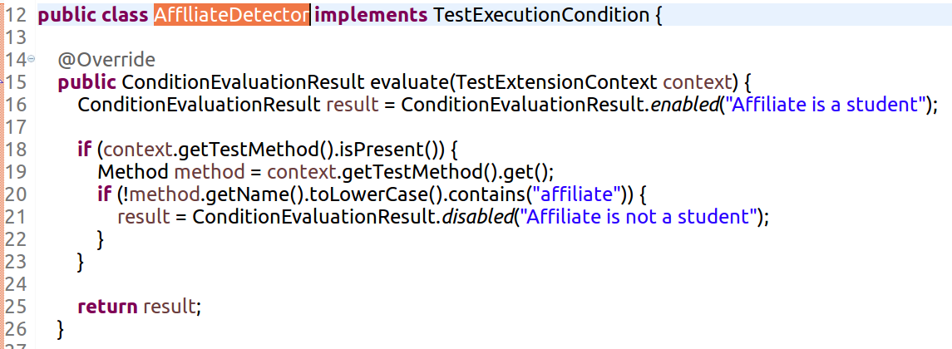
Extension Test
This class disables a test if the method name does not contain the word ‘affiliate’
https://github.com/PennState/junit5-presentation/blob/develop/src/test/java/edu/psu/swe/testing/junit5/presentation/tests/AfflliateDetector.java
implements TestExecutionCondition

Slide 29

Extension Test
This class registers an extension via @ExtendWith
Class contains a method that disables a test if the method name does not contain the word ‘student’ tests for method names containing ‘affiliate’ and/or ‘student’ through assumeTrue()
https://github.com/PennState/junit5-presentation/blob/develop/src/test/java/edu/psu/swe/testing/junit5/presentation/tests/ExtensionDisabledTests.java
implements TestExecutionCondition
Notes:
Mention how ‘TestInfo’ is derived from the api and is a built in parameter to the tests

Slide 30
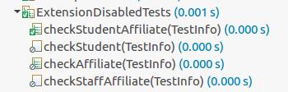
Extension Test
CheckStudentAffiliate – Extension class enables the test and Assumption passes to run the test checkStudent - Extension class disables the test checkAffiliate - Extension class enables the test Assumption fails to disable the test checkStaffAffiliate - shows another method to disable the test - with annotation @Disabled
implements TestExecutionCondition
https://github.com/PennState/junit5-presentation/blob/develop/src/test/java/edu/psu/swe/testing/junit5/presentation/tests/ExtensionDisabledTests.java

Slide 31
Extension Test
Looks for @UseridTest annotation
Returns default values for (user id) parameters
https://github.com/PennState/junit5-presentation/blob/develop/src/test/java/edu/psu/swe/testing/junit5/presentation/UseridParameterResolver.java
implements ParameterResolver

Slide 32
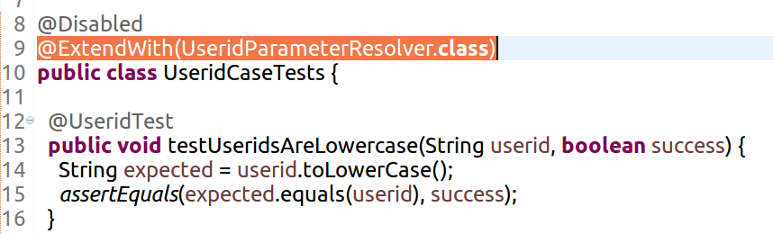
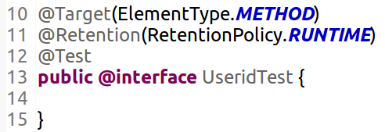

Extension Test
https://github.com/PennState/junit5-presentation/blob/develop/src/test/java/edu/psu/swe/testing/junit5/presentation/UseridCaseTests.java
implements ParameterResolver

Slide 33
Extension Tests
implements ParameterResolver
Replace this set of example with the new class that is being written
Results
Junit view showing failed tests
Any console print stmts

Slide 34


Extension Test
class implementing callbacks
ParentTests – registers extension with class implementing callbacks
ChildTests – extends ParentTests
Each class prints out the methods available within that class
https://github.com/PennState/junit5-presentation/tree/develop/src/test/java/edu/psu/swe/testing/junit5/presentation/callbacks
implements Callback

Slide 35
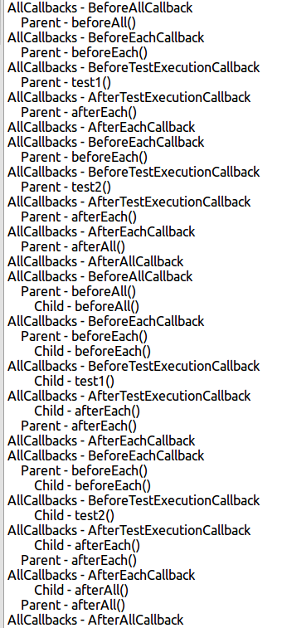
Extension Tests
Methods in Parent Class – flanged on either side by matching callback hierarchy
implements Callback

Slide 36
Extension Tests
Methods in Child Class – flanged on either side by matching callback hierarchy
implements Callback

Slide 37
Dynamic Test
http://junit.org/junit5/docs/current/user-guide/#writing-tests-dynamic-tests
Test case generated at run-time by a factory method @TestFactory
Composed of a display name and an Executable
Executable is a functional interface – meaning tests can be provided as lambda expressions or method referencecs
Becuase of dynamic nature, lifecycle callbacks are not applicable
Notes:
These DynamicTest instances will then be executed lazily, enabling dynamic and even non-deterministic generation of test cases.

Slide 38
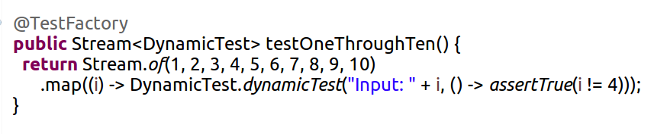
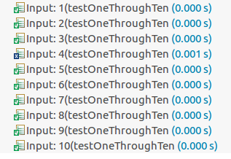
Dynamic Testing

Slide 39
Grouped Tests
Performing tests based on a collection can be done in a variety of ways.
Traditional For Loop Assertions
Factory Tests (@TestFactory)
assertAll()

Slide 40
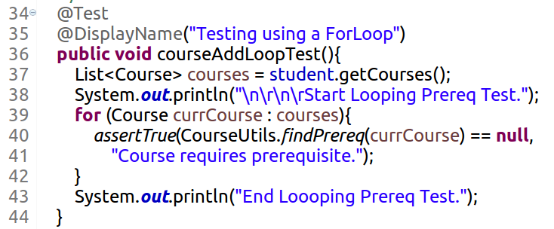
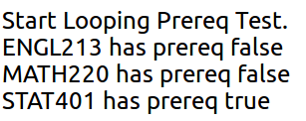
Collection Looping
Code Example
Escapes the loop the condition is true
Console Print Out
https://github.com/PennState/junit5-presentation/blob/develop/src/test/java/edu/psu/swe/testing/junit5/presentation/tests/LoopingTests.java

Slide 41
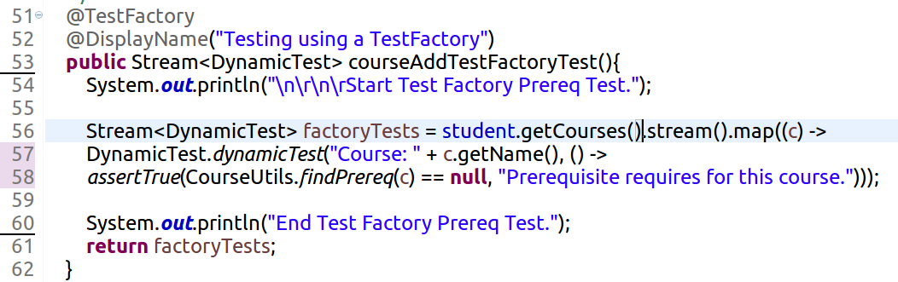
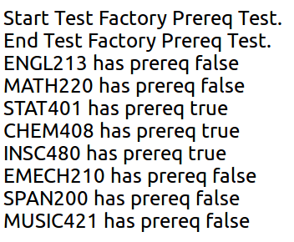
Factory Test
Code Example
Executes all tests irrespective of failures
Console Print Out
https://github.com/PennState/junit5-presentation/blob/develop/src/test/java/edu/psu/swe/testing/junit5/presentation/tests/LoopingTests.java

Slide 42
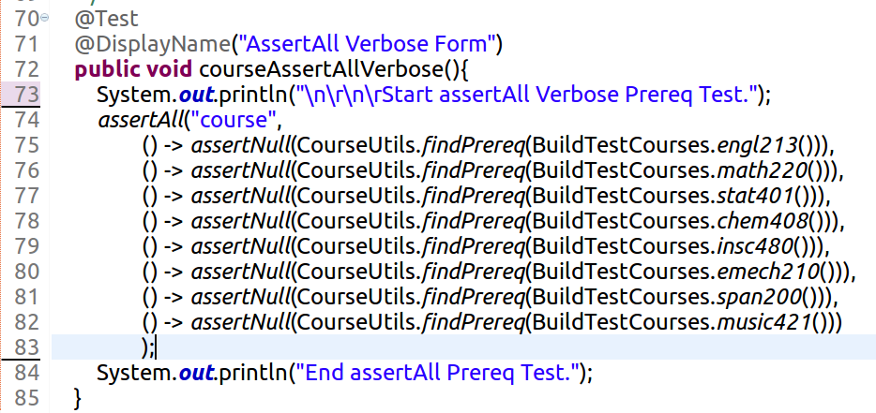
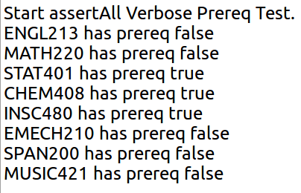
AssertAll
Code Example
Console Print Out
Executes all tests
https://github.com/PennState/junit5-presentation/blob/develop/src/test/java/edu/psu/swe/testing/junit5/presentation/tests/LoopingTests.java

Slide 43
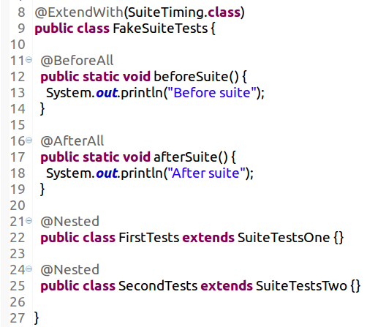
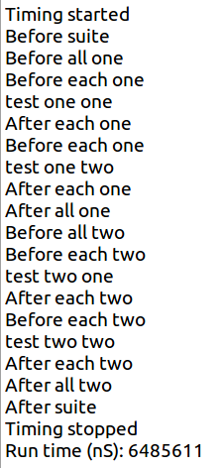
Nested Tests
https://github.com/PennState/junit5-presentation/blob/develop/src/test/java/edu/psu/swe/testing/junit5/presentation/FakeSuiteTests.java
Notes:
Make a note of using the nested annotation to mimic a test suite
good time to bring up the future plans for BeforeSuite/AfterSuite annotation for future release

Slide 44
Interface???

Slide 45
Running Tests
Within eclipse IDE
  @RunWith(JUnitPlatform.class)
  @SelectPackages()
Maven command line
  mvn clean test
  Surefire reports
Running tags with filters???

Slide 46
Future Directions
@BeforeSuite/@AfterSuite
Parameterized tests
Scenarios and ordered tests
Repeated tests
As of JUnit Jupiter 5.0.0-M2, dynamic tests must always be created by factory methods; however, this might be complemented by a registration facility in a later release.

Slide 47
References
Junit 5 Use Guide
  http://junit.org/junit5/docs/current/user-guide/
Junit 5 API
  http://junit.org/junit5/docs/current/api/
Junit 5 on GitHub
  https://github.com/junit-team/junit5
Penn State Junit 5 project on GitHub
  https://github.com/PennState/junit5-presentation

