Slide 1
Step 0: Starting Relational Dataset
Step 1: Concise RDF
Step 2: Semantically Rich RDF
Database: A
Table: person
type
input:HomoSapiens
type
NCBIT:HomoSapiens
person_id
1
input:identifier
IAO:CentrallyRegisteredIdentifier
IAO:denotes
type
1
type
xsd:integer
BFO:partOf
type
IAO:Symbol
TURBO:hasRepresentation
1
type
xsd:integer

Slide 2
:homoSapiensIdentifierDenotesHomoSapiens a :InstanceToInstanceRecipe ;
:subject obo:IAO_0000578 ; # centrally-registered identifier
:predicate obo:IAO_0000219 ; # denotes
:object obo:NCBITaxon_9606 ; # homo sapiens
:cardinality :1-1 ;
:mustExecuteIf :objectExists ;
.

Slide 3




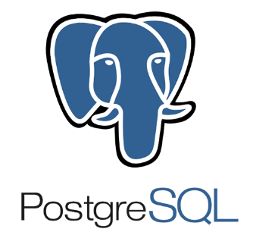

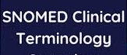
Step 1: Run Synthea
https://github.com/synthetichealth/synthea
OHDSI ETL-Synthea
generates
loads
Step 2: Run ETL-Synthea
https://github.com/OHDSI/ETL-Synthea
into
RDF Triplestore
exports RDF to
Carnival
reads
transforms
RDF in
imported to
Step 3: Run Carnival
https://github.com/pmbb-ibi/carnival
Semantic Engine
ChEBI
DrOn
RxNorm
Step 4: Run The Semantic Engine
https://github.com/PennTURBO/Drivetrain
Step 5: Import Ontologies

Slide 4

Transformation Instruction Set A
External Ontologies
Database A
understands
builds
Programmer
complies with
Application Ontology
references
understands
Transformation Instruction Set B
Database B
builds
understands
builds
references
Programmer
references
Graph Specification (specifies target model)
Transformation Instruction Set C
references
Database C
builds
understands
builds
Ontologist
Programmer

Slide 5
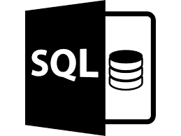
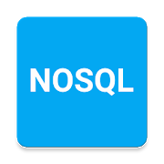

Data Sources
Data Aggregator Service
RDF dataset formatted using source-specific schema
RDF dataset formatted using target model
read by
builds
1
2
3
stores
6
imported by
9
Semantic Engine
validates
Validation Services
Semantic Engine Language Ontology
read by
RDF Triplestore
Semantic
Engine
Language
4
read by
5
applied to
8
Application Ontology
generates
Set of SPARQL Update Statements
Transformation Instruction Set
Graph Specification (specifies target model)
7

Slide 6

read by
Carnival
1
exports RDF to
RDF Triplestore
Penn Data Store
3
read by
2
Semantic Engine
5
Biobank
Transformation Instruction Set
Loss of Gene Function Mutation File
uses
transforms RDF data in
4

Slide 7
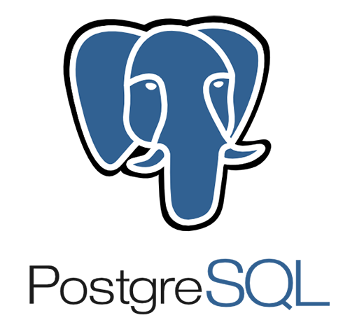
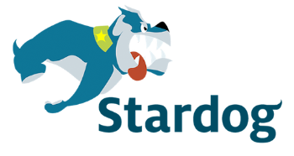
imported to
read by
1
3
Synthea Dataset
exports RDF to
OHDSI ETL-Synthea
4
RDF Triplestore
2
transforms Synthea data in
Semantic Engine
6
Synthea
Transformation Instruction Set
uses
transforms RDF data in
5

Slide 8
Penn Data Store
Semantic Engine Language
Semantic Engine
1
Loss of Gene Function Mutation CSV File
Data Aggregator (Carnival)
RDF Triplestore (Ontotext
GraphDB)
1
2
3

Slide 9
Synthea Dataset (CSV file)
OHDSI ETL-Synthea
Semantic Engine Language
Semantic Engine
1
PostgreSQL (Synthea schema)
PostgreSQL (OMOP schema)
Stardog Virtual Graph
RDF Triplestore (Ontotext
GraphDB)
2
3
4
5

Slide 10
Raw SPARQL Queries
PDS Patient Demographics Transformation
PDS Diagnoses Transformation
PDS Medications Transformation
Regeneron Genomic Loss of Function Transformation
Patient To Healthcare Encounter Linking
Patient To Biobank Encounter Linking
Input data from multiple sources
Carnival (data aggregator)
RDF Triplestore (Ontotext GraphDB)

Slide 11
Transformation Interpreter
Graph Specification
(data source independent)
PDS/Carnival Transformation Instruction Set
PDS Patient Demographics Process Specification
Regeneron Genomic Loss of Function Process Specification
Carnival (data aggregator)
RDF Triplestore (Ontotext GraphDB)
PDS Diagnoses Process Specification
Patient To Healthcare Encounter Linking
PDS Medications Specification
Patient To Biobank Encounter Linking
Input data from multiple sources

Slide 12
Transformation Instruction Set
Graph Specification
semExpander:hasRequiredInput
OR
semExpander:hasOptionalInput
OR
semExpander:hasOutput
semExpander:hasRequiredInput
OR
semExpander:hasOptionalInput
OR
semExpander:hasOutput
Connection Recipe
Process Specification
Connection Recipe
semExpander:inputNamedGraph
semExpander:outputNamedGraph
Named Graph
Named Graph

Slide 13
Class A
cardinality:1-1
cardinality:1-1
Class B
Class C
cardinality:many-1

