Slide 1
Waldo September
1. Correlation: individual RT & individual Mean Distance

Slide 2
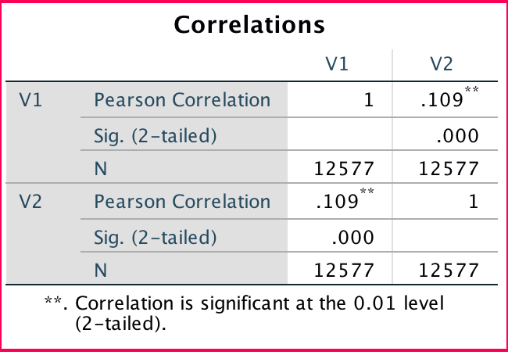
r = 0.109
V1: individual RT
V2: individual MD

Slide 3
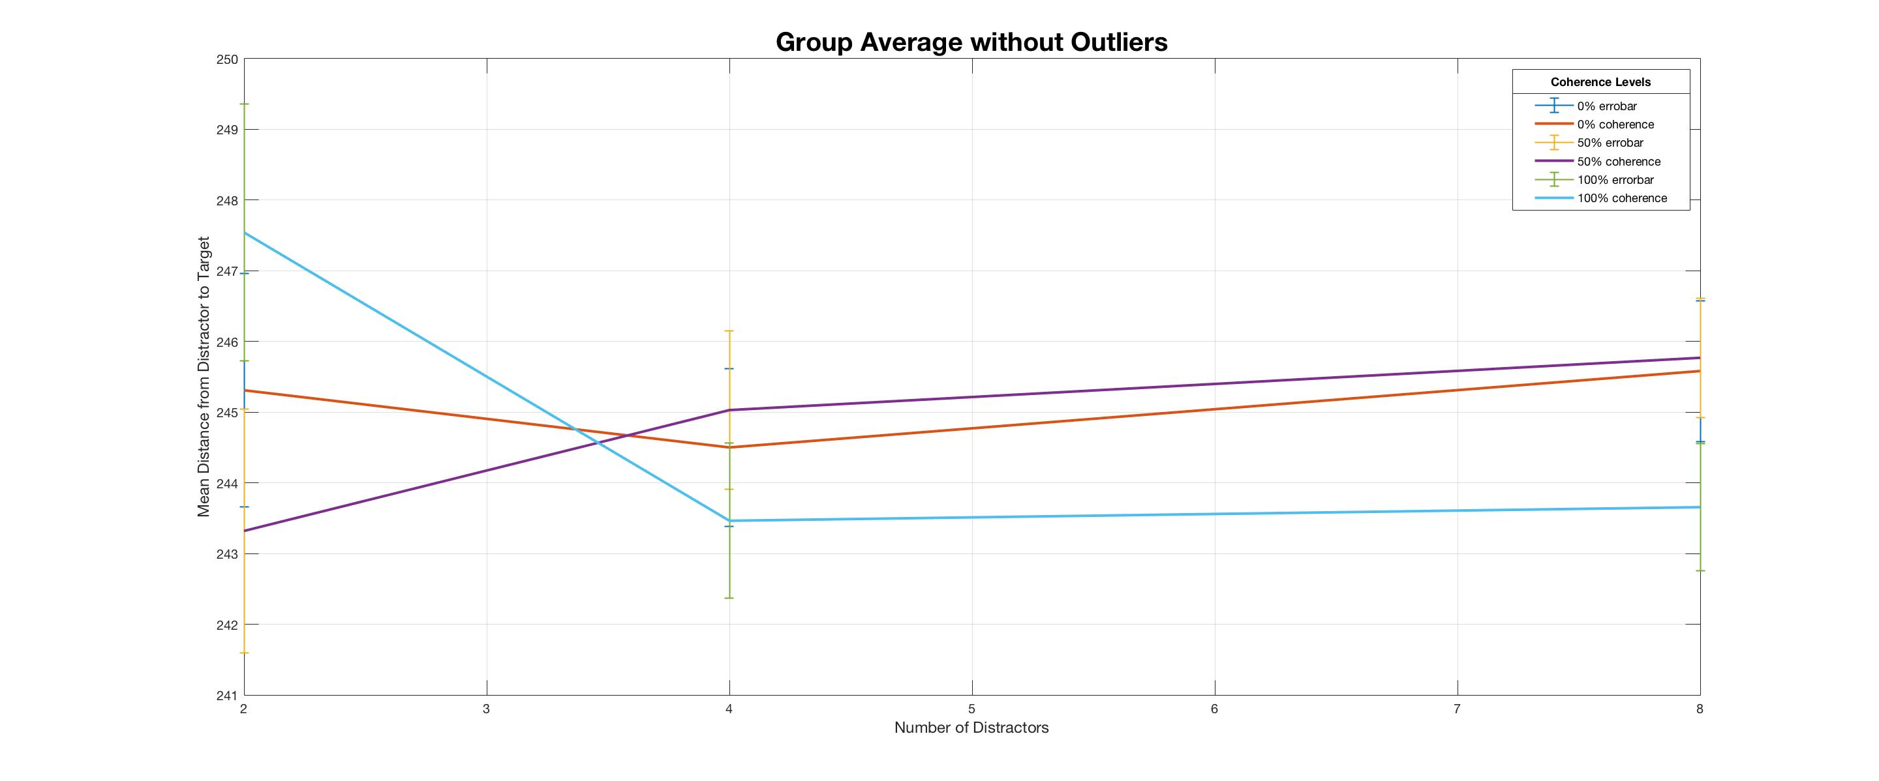
Ranging from 243-248, the means are similar as well

Slide 4
Center bin distance

Slide 5
RT | centerBinDis
1.96351834 | 184.750393
2.49251715 | 230.415667
2.33456164 | 260.637679
2.35678445 | 304.384794

