Slide 1

dazzle me;
i
DARE
you.
11digitaltechnology 1.43 AS91073 {web design}
Marius Roosendaal

Slide 2


bringing the design elements to life…one still @ a time…

Slide 3
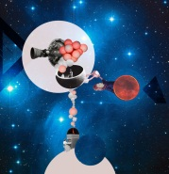


dazzle me; I dare you
design brief
To design and construct 3D scene which visually communicates the elements and principles of design. It must be entertaining, engaging and leave the viewer with an understanding of the design elements. You must also provide evidence of how the project progresses from conception through to post-production. This must be presented in the form of a website, as a ‘making of’ in documentary style. This project allows you to work in a group of maximum 3 students if desired, and combine your assets in the final website, which must be personalized and submitted independently.
specifications:
A 3D object/scene must be created
Of near professional quality
Media must be original (you cannot use pre-existing objects etc.)
Final 3D object and website must be available to present to an audience in a formal setting such as: on the SKC website, presented at a public exhibition (Term 3)
requirements:
Completion of all class/home learning
Adherence to specifications
DUE: Friday, August 24th

Slide 4
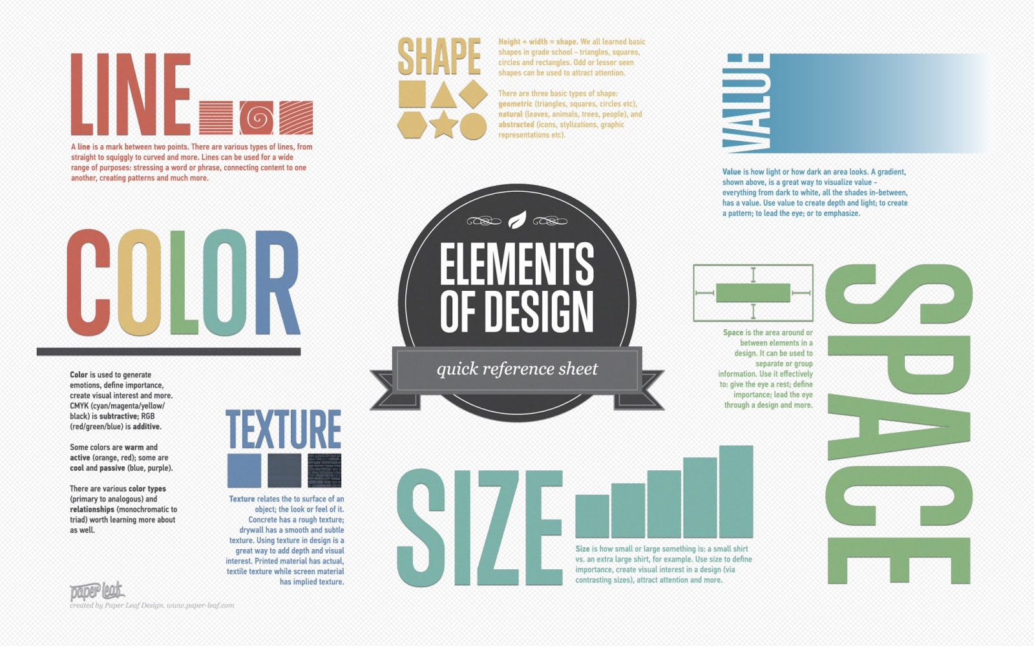

Slide 5
Things to consider:
Evidence the development of your 3D object or scene is presented as a website
{3D object: design elements}
Be creative
Engage in decent critique with your group and the class
Record your ideas as they develop…within the creation of a 3D object, but also the design of your website...
{website: the making of....}

Slide 6
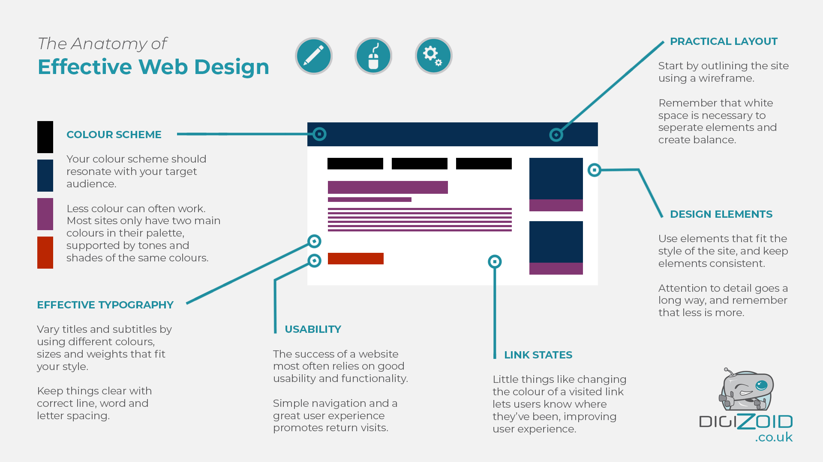

Slide 7
2. Planning
Software/ construction/ comparisons against existing work
Collecting evidence: WHAT and HOW??
…and display within a website…
{evidence of techniques}
Collecting resources: establish WHAT you need, HOW to get it and WHEN you need it by…do you have a backup plan???
Time management: For an E you need proof you have managed your time and resources well… testing your 3D model with HTC VIVE requires careful planning...
{evidence of adjusted planning}

Slide 8
3. Guidelines
Create original media (3D object or scene)
Research, install and test your software...What will you use?
(SketchFab + 3DBuilder, or + Blender, or + Unity, or ...)
Research existing outcomes...plethora of evidence online...find examples that inspire you...
record these on one of your web pages
Make it and test it (keep evidence of progress as snapshots);
a 3D Object / Scene to visually communicate the design elements
Test objects/scenes with the HTC Vive if possible; record evidence
Design and plan your website (minimum of 3 pages)
Plan an initial wireframes / design layouts for your web pages – evidence these in one of your web pages
Plan initial content and navigation
Choose your colour theme from coolors.co
Plan your folder and asset management
Embed your assets into your website
Data integrity and Testing of your final outcome
validation of HTML and CSS code
upload to GitHub repository
compression of your images (to reduce page load time) – use tinypng.com
evaluation of your outcome – is it fit for purpose
Think about the Legal, Ethical and Moral responsibilities of a web designer
https://www.rjmwebdesign.com/web-design-ethics.php
https://www.smashingmagazine.com/2018/03/using-ethics-in-web-design/

Slide 9
Data integrity and testing procedures
..applying data integrity and testing procedures to ensure the outcome meets the specifications
The final outcome must be tested to ensure it meets the specifications. Data integrity testing and testing procedures may include the following:
Pre-publishing testing for data integrity: links, images, fonts, embedded objects
Testing of layout, proofing (spelling) of static content
Testing of style rules (all style applied)
All fonts are consistent with specification
Hyperlinks are working
Images and 3D objects render as expected
The HTML files have loaded correctly with all elements in the correct location
Conduct the tests on your completed website
Document the outcomes from testing and any modifications and/or refinement as a result of testing

Slide 10
Legal and Ethical Issues
..following legal, ethical and/or moral requirements appropriate to the outcome
Legal, ethical and moral responsibilities refers to the social implications of the outcome within the wider community. This covers the following areas
Copyright
Copyright is a set of exclusive property rights to copy, publish, edit, perform, rent, record or distribute their original creations. In New Zealand the Copyright Act 1994 automatically protects original material. Users, managers and IT personnel need to understand that unauthorised copying and transmission of someone else's films or other works is copyright theft, which the organisation does not condone.

Slide 11
Privacy
Privacy and security of personal information are primary concerns. Security issues can occur if a hacker gains access to protected code or scripts. Privacy issues are those which involve unjustifiable access to personal information; not necessarily involving a breach of security.
Internet Ethics
Internet ethics means acceptable behaviour for using internet. We should be honest, respect the rights and property of others on the internet.
Duplicating copyrighted content without the author’s approval, accessing personal information of others, pretending to be someone else, avoiding bad language and hiding personal information are some of the examples that violate ethical principles.

Slide 12
Moral Considerations
Since the internet has become popular it has become an essential tool for making money. In the mid-1990s making money on the internet was mostly about buying and selling domains, selling hosting, doing web design, and selling products. Now things have changed and there are many more ways to make money on the internet. People can make money off of eBay, affiliate marketing, and content based websites to name a few.
Innovations such as Ad Sense are making it easy to make money online and people are taking advantage by putting up websites with the sole purpose of making money. Sometimes people use duplicate content or build sites that ad no value to the internet. To some people this practice is immoral.
Another moral consideration might involve ensuring that visual imagery on a website is appropriately inclusive and does not prejudice any particular group. Children who don’t see representations of themselves may feel excluded. Other topics that impact on moral consideration would include body shape, socio economic status, sexuality, gender, disabilities.

Slide 13
The evidence for this standard is very simple.
Make sure you read these carefully.
Evidence must be submitted to OLE and on the class USB stick; make sure you submit your 3D object separately, a zipped folder containing your website
Set up a GitHub account and submit the link to your depository to your teacher
If you have anything paper based hand in your folder

Slide 14
General assessment info:
4 credits internal due August 24th
Use class time and lunch studios (Thur and Fri) to check the quality of your work and/or ask for help
3omins HW EVERY night
Hand in for FF (final feedback) so you know where you are at
Use the rubric to monitor progress and quality of your work
Miss the deadline: N
Incorrect evidence handed in: N
If in doubt….ASK for help!

