Slide 1


COS 301
Demonstration Four

Slide 2

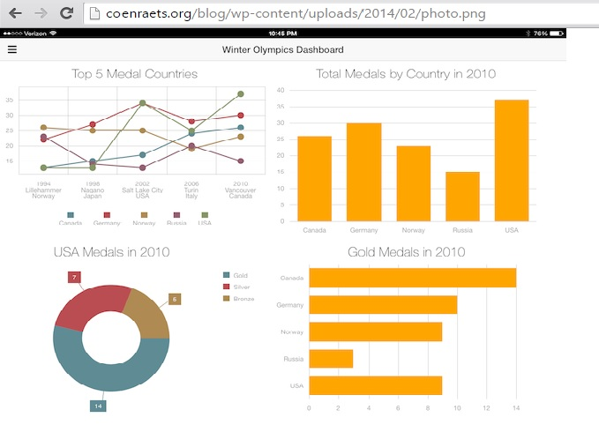
Stats Restructuring
Stats restructuring
Stats will be restructured to create a more usable and efficient user interface

Slide 3
Statistics Equations
Let m = Type of procedure(Elective/Emergency) or hospitalization period
Let d= date
Let n = Start Date
Let o = End Date
Aggregate(m, n, o) = { Aggregate (m, n, o) if m = Emergency & d <= end date & d>= start date
{Aggregate(m, n, o) if m = Elective & d<= end date & d >= start date

Slide 4

Demonstration

