Slide 1
Statistics Equations
Let m = Type of procedure(Elective/Emergency) or hospitalization period
Let d= date
Let n = Start Date
Let o = End Date
Aggregate(m, n, o) = { Aggregate (m, n, o) if m = Emergency & d <= end date & d>= start date
{Aggregate(m, n, o) if m = Elective & d<= end date & d >= start date

Slide 2
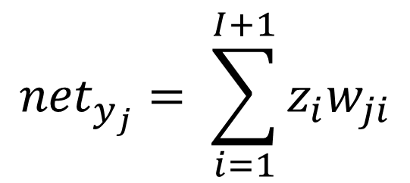
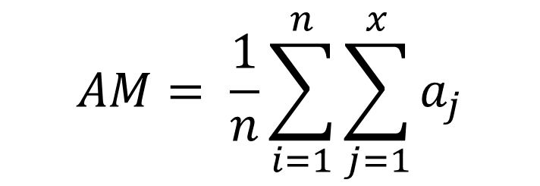
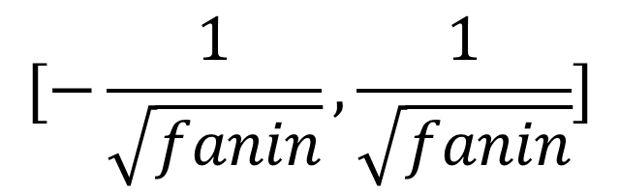
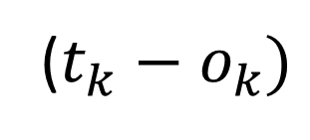
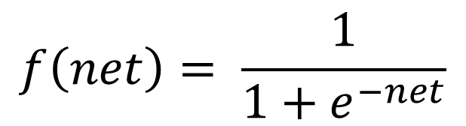
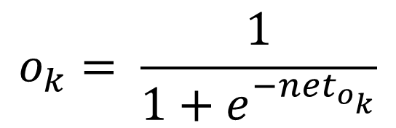
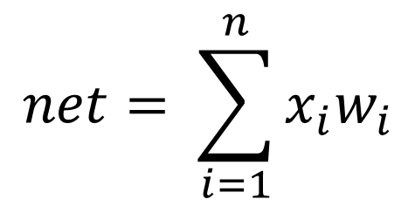
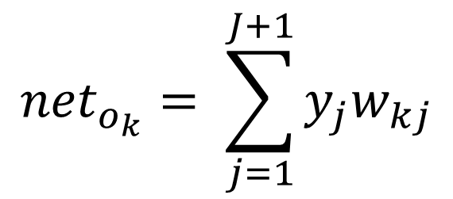
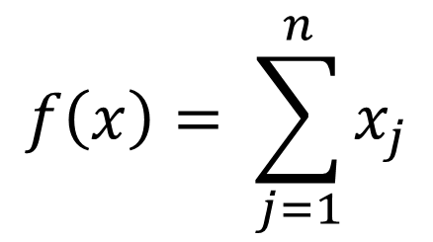
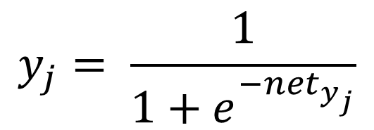
Statistics Equations
Statistics Average Equation
Graph Equation
$$AM= \frac{1}{n}\sum_{i=1}^{n}{\sum_{j=1}^{x}{a_{j}}}$$
$$f\left(x\right)= \sum_{j=1}^{n}{x_{j}}$$
Neural Network Equations
Input Function
Weight Initialization
Input Functions
$$net= \sum_{i=1}^{n}{x_{i}w_{i}}$$
$$[−\frac{1}{\sqrt{fanin}},\frac{1}{\sqrt{fanin}}]$$
$${net}_{y_{j}}= \sum_{i=1}^{I+1}{z_{i}w_{ji}}$$
$$y_{j}= \frac{1}{1+e^{{−net}_{y_{j}}}}$$
Activation Function
Training Error
$$f\left(net\right)= \frac{1}{1+e^{−net}}$$
$${net}_{o_{k}}= \sum_{j=1}^{J+1}{y_{j}w_{kj}}$$
($t_{k}−o_{k})$
$$o_{k}= \frac{1}{1+e^{{−net}_{o_{k}}}}$$

Slide 3
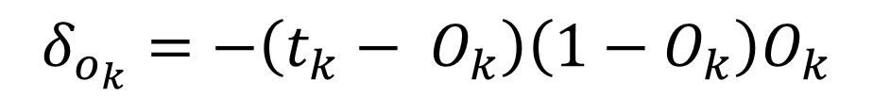
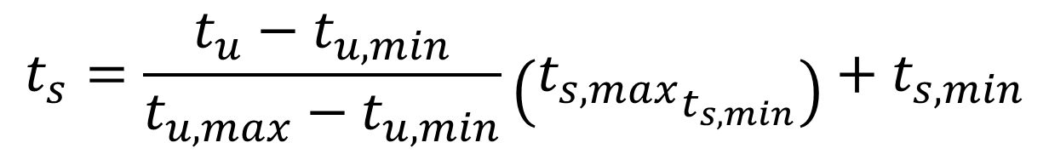
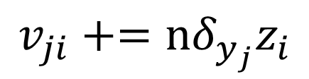
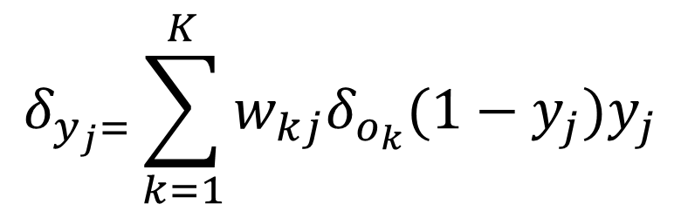
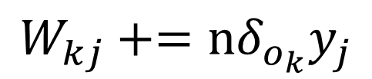
Statistics Equations Continued
Neural Network Equations Continued
Error Propagation Phase
Data Scaling
$$δ_{o_{k}}=−\left(t_{k}− O_{k}\right)\left(1−O_{k}\right)O_{k}$$
$$t_{s}=\frac{t_{u}−t_{u,min}}{t_{u,max}−t_{u,min}}\left({t_{s,max}}_{t_{s,min}}\right)+t_{s,min}$$
$$W_{kj}+=nδ_{o_{k}}y_{j}$$
$$δ_{y_{j}=}\sum_{k=1}^{K}{w_{kj}δ_{o_{k}}(1−y_{j})y_{j}}$$
$$v_{ji}+=nδ_{y_{j}}z_{i}$$

Slide 4


‘Let us not be content to wait and see what will happen, but give us the determination to make the right things happen’
- Horace Mann

Slide 5





Architecture Standards
Node.js
Express.js
Angular.js
MongoDB

Slide 6

Hosted Server
Heroku
Hosting Service
Heroku lets you deploy, run and manage applications written in Ruby, Node.js, Java, Python, Clojure, Scala, Go and PHP.

Slide 7
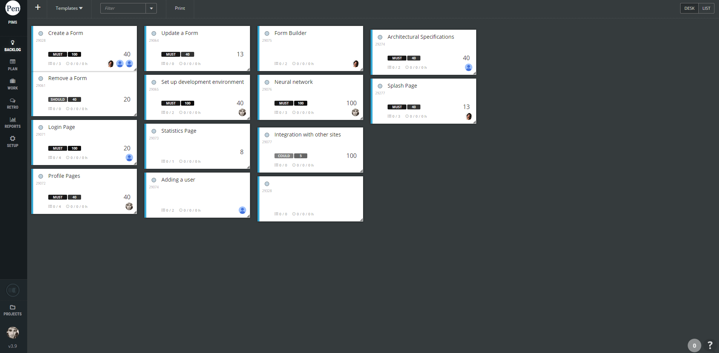
Scrum Software
ScrumDesk
Agile Tool
Agile project managment solution that helps manage Scrum projects easy and correctly on an intuitive virtual board.

Slide 8
Burn down charts

Slide 9
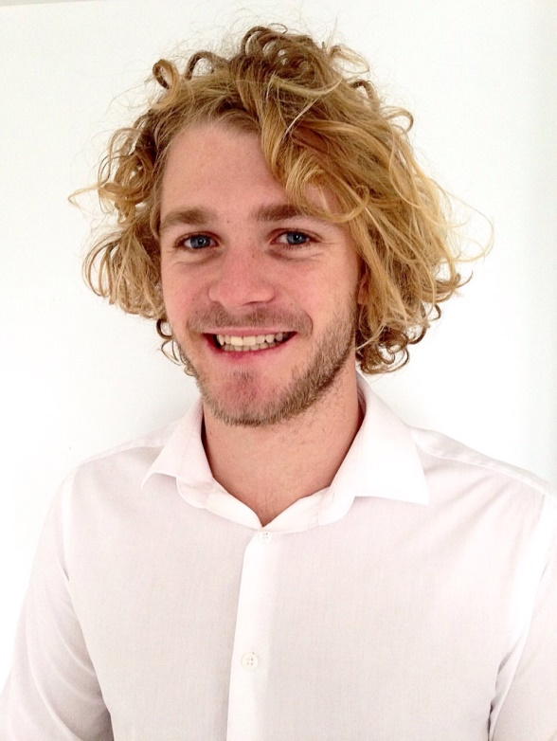
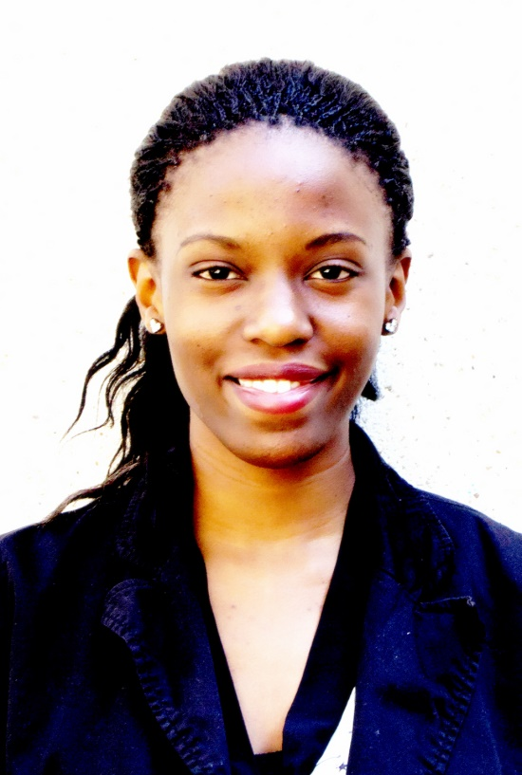
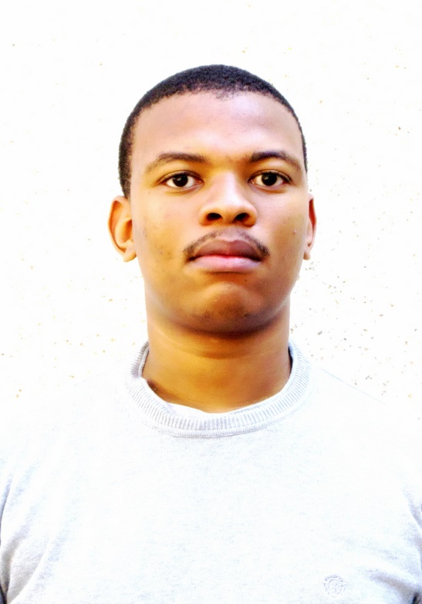
The Team
Trevor Austin
Liz Joseph
Lindelo Mapumulo
Software Engineer
Software Engineer
Software Engineer
Team lead that provides the team with motivation and direction
Team coordinator that keeps the team organised and professional
Team resource investigator that provides the team with modern and valuable information
Notes:
Trevor –Team Lead
Liz –Team Cood
Lindelo – Team Software

Slide 10
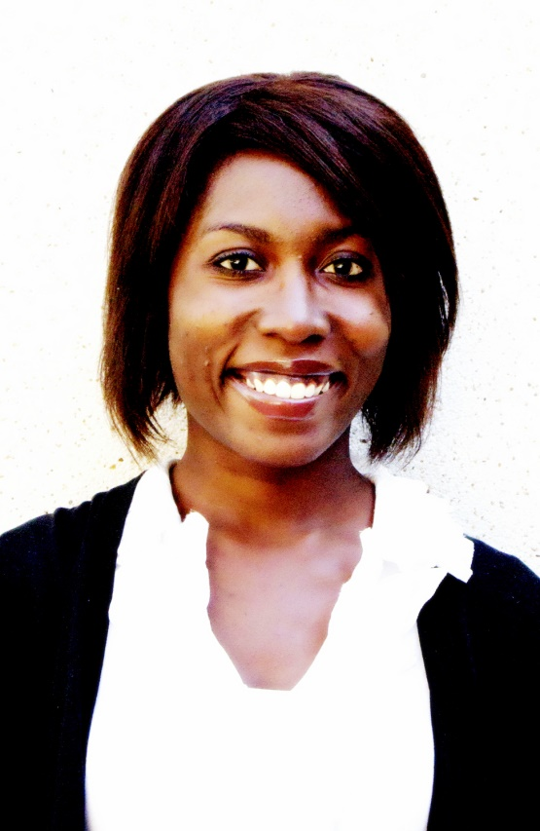
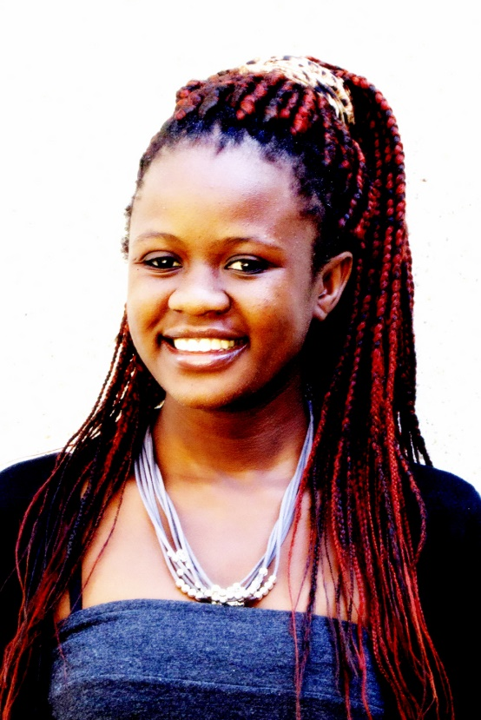
The Team
Ruth Ojo
Maria Qumayo
Developer
Developer
Team planner that keeps the team on the objective track
Team shaper that provides the team with structure and direction
Notes:
Ruth – Team Planner
Maria – Team shaper

Slide 11



Platforms
mobıle
desktop
portable

Slide 12





Group Communication Standards
Whatsapp
Google Calendar
Google Hangouts
Gmail
Group Meetings

Slide 13
‘Simplicity is the ultimate sophistication.’
-Leonardo da Vinci
Notes:
Questions????

