Slide 1


COS 301
Demonstration Two

Slide 2





Architecture Standards
Node.js
Express.js
Angular.js
MongoDB

Slide 3

Hosted Server
Heroku
Hosting Service
Heroku lets you deploy, run and manage applications written in Ruby, Node.js, Java, Python, Clojure, Scala, Go and PHP.

Slide 4
Functionality Decided Upon
Form-builder
Artificial Intelligence
Web application that allows for login and form input
Web application with modern interface & intelligent animations
Notifications

Slide 5

Demonstration

Slide 6
Artificial Intelligence

Slide 7
Units Tests

Slide 8
Meeting Times
Group Meetings
Monday, Wednesday, Friday 12:30
On request
Client Meetings
Completion of programming module
Problems with System
Recent Project Demonstrations

Slide 9
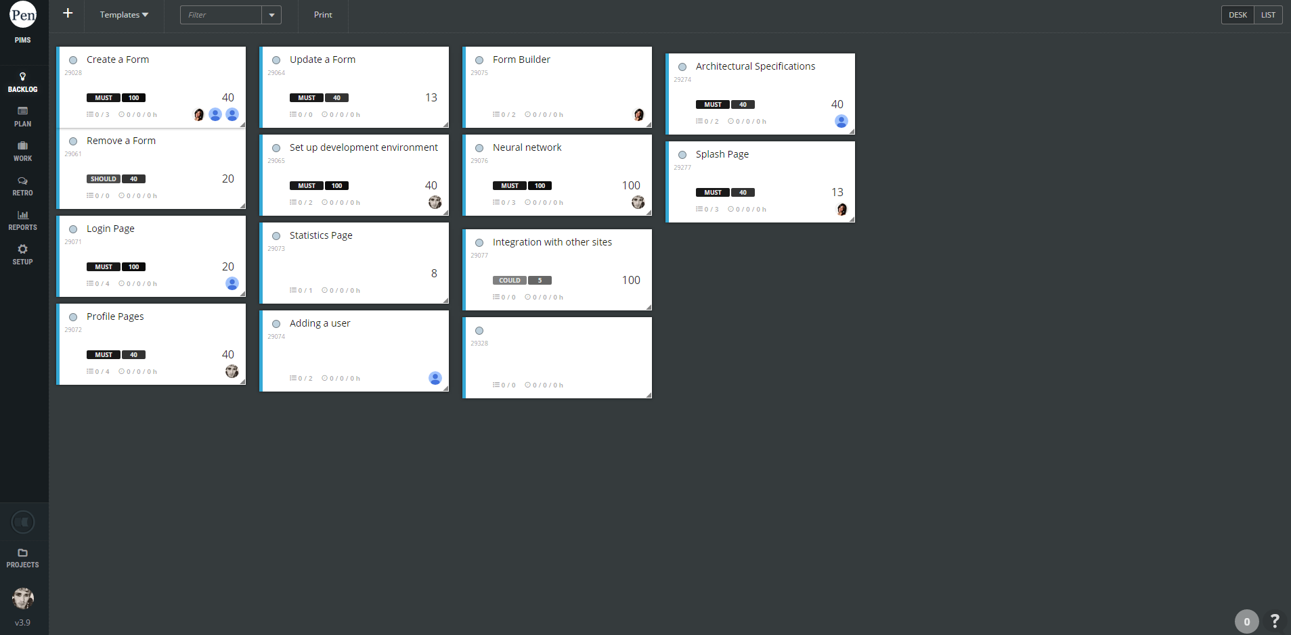
Scrum Software
ScrumDesk
Agile Tool
Agile project managment solution that helps manage Scrum projects easy and correctly on an intuitive virtual board.

Slide 10
Burn down charts

Slide 11


‘Even the best planning is not so omniscient as to get it right the first time’
- Fred Brooks

