Slide 1


COS 301
Demonstration Three

Slide 2

Redefining the Core Goal
Statistics
Core Goal
After many discussions and meetings we have determined that our core goal was not clear.

Slide 3
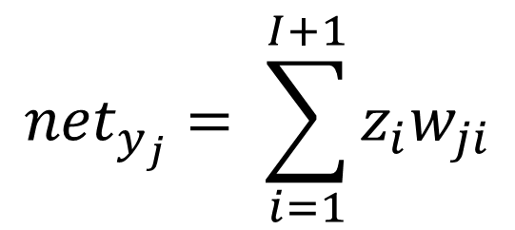
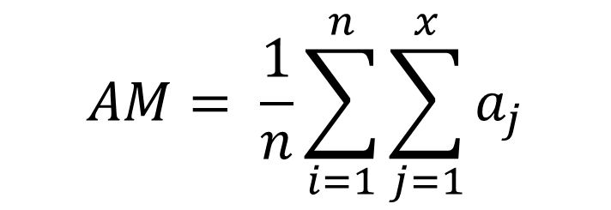
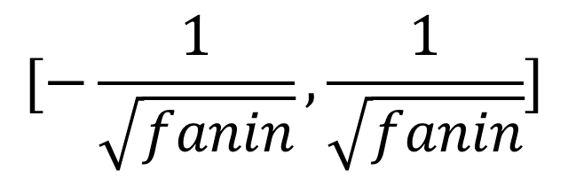
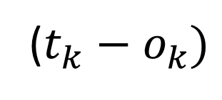
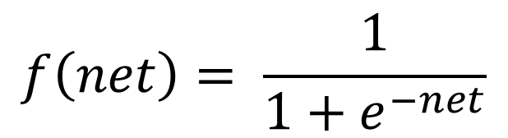
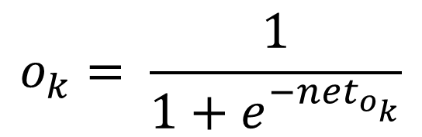
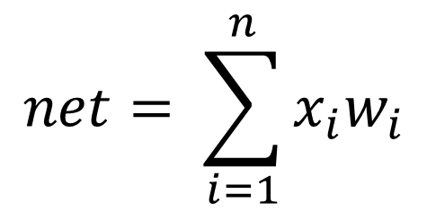
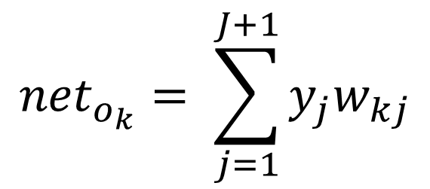
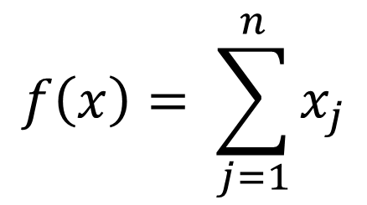
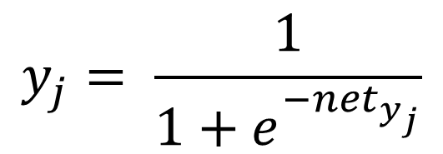
Statistics Equations
Statistics Average Equation
Graph Equation
$$AM= \frac{1}{n}\sum_{i=1}^{n}{\sum_{j=1}^{x}{a_{j}}}$$
$$f\left(x\right)= \sum_{j=1}^{n}{x_{j}}$$
Neural Network Equations
Input Function
Weight Initialization
Input Functions
$$net= \sum_{i=1}^{n}{x_{i}w_{i}}$$
$$[−\frac{1}{\sqrt{fanin}},\frac{1}{\sqrt{fanin}}]$$
$${net}_{y_{j}}= \sum_{i=1}^{I+1}{z_{i}w_{ji}}$$
$$y_{j}= \frac{1}{1+e^{{−net}_{y_{j}}}}$$
Activation Function
Training Error
$$f\left(net\right)= \frac{1}{1+e^{−net}}$$
$${net}_{o_{k}}= \sum_{j=1}^{J+1}{y_{j}w_{kj}}$$
($t_{k}−o_{k})$
$$o_{k}= \frac{1}{1+e^{{−net}_{o_{k}}}}$$

Slide 4
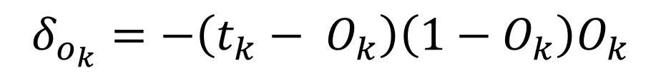
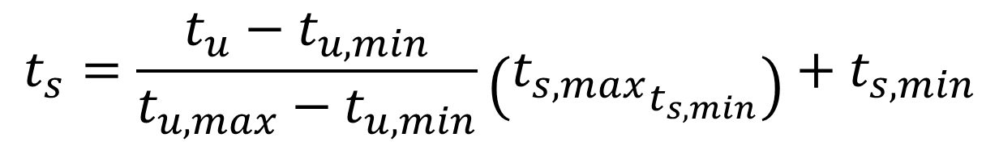
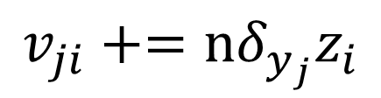
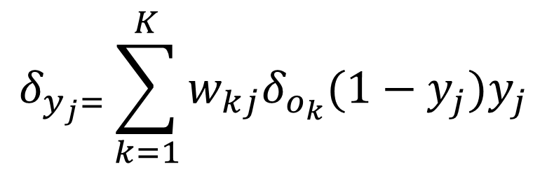
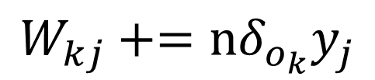
Statistics Equations Continued
Neural Network Equations Continued
Error Propagation Phase
Data Scaling
$$δ_{o_{k}}=−\left(t_{k}− O_{k}\right)\left(1−O_{k}\right)O_{k}$$
$$t_{s}=\frac{t_{u}−t_{u,min}}{t_{u,max}−t_{u,min}}\left({t_{s,max}}_{t_{s,min}}\right)+t_{s,min}$$
$$W_{kj}+=nδ_{o_{k}}y_{j}$$
$$δ_{y_{j}=}\sum_{k=1}^{K}{w_{kj}δ_{o_{k}}(1−y_{j})y_{j}}$$
$$v_{ji}+=nδ_{y_{j}}z_{i}$$

Slide 5

Demonstration

Slide 6


‘Let us not be content to wait and see what will happen, but give us the determination to make the right things happen’
- Horace Mann

