Slide 1
Software For Data Science
Seth Russell – seth.Russell@cuanschutz.edu
AccordS Data Science Program, D2V Analytics Core
https://github.com/magic-lantern/bios6642
Notes:
Introductions:
Names
programming experience

Slide 2
Version Control
“Did you think the lion was sleeping because he didn't roar?” ― Friedrich Schiller, Die Verschwörung des Fiesco zu Genua
Notes:
Just because you haven’t been bit by losing a version of something you are working on doesn’t mean it won’t happen

Slide 3


Why Git Rules the world (of software)
https://www.atlassian.com/git/tutorials/why-git
Notes:
Git has branching
Decentralized workflow
Support for multiple people working on the same thing at the same time – though only really works with text files.

Slide 4
Common Terms
git checkout
git status
git add
git commit
git push
git pull
git branch
git log
Notes:
Explain briefly what each of these do.
Demonstration?

Slide 5
Why Git Rules the world
Save Time
Git is lightning fast. And although we're talking about only a few seconds per command, it quickly adds up in your work day. Use your time for something more useful than waiting for your version control system to get back to you.
Work Offline
What if you want to work while you're on the move? With a centralized VCS like Subversion or CVS, you're stranded if you're not connected to the central repository. With Git, almost everything is possible simply on your local machine: make a commit, browse your project's complete history, merge or create branches... Git let's you decide where and when you want to work.
https://www.git-tower.com/learn/git/ebook/en/command-line/appendix/why-git

Slide 6
Why Git Rules the world
Undo Mistakes
People make mistakes. A good thing about Git is that there's a little "undo" command for almost every situation. Correct your last commit because you forgot to include that small change. Revert a whole commit because that feature isn't necessary, anymore. And when the going gets tough you can even restore disappeared commits with the Reflog - because, behind the scenes, Git rarely really deletes something. This is peace of mind.
Don't Worry
Git gives you the confidence that you can't screw things up - and this is a great feeling. In Git, every clone of a project that one of your teammates might have on his local computer is a fully usable backup. Additionally, almost every action in Git only adds data (deleting is very rare). That means that losing data or breaking a repository beyond repair is really hard to do.
https://www.git-tower.com/learn/git/ebook/en/command-line/appendix/why-git

Slide 7
Why Git Rules the world
Don’t Mix Things Up
Separation of concerns is paramount to keeping track of things. While you’re working on feature A, nothing (and no-one) else should be affected by your unfinished code. What if it turns out the feature isn’t necessary anymore? Or if, after 10 commits, you notice that you took a completely wrong approach? Branching is the answer for these problems. And while other version control systems also know branches, Git is the first one to make it work as it should: fast & easy.
https://www.git-tower.com/learn/git/ebook/en/command-line/appendix/why-git

Slide 8

Notes:
Can users install software on the lab computers? If yes, show this. If no, perhaps just show web version of github?

Slide 9
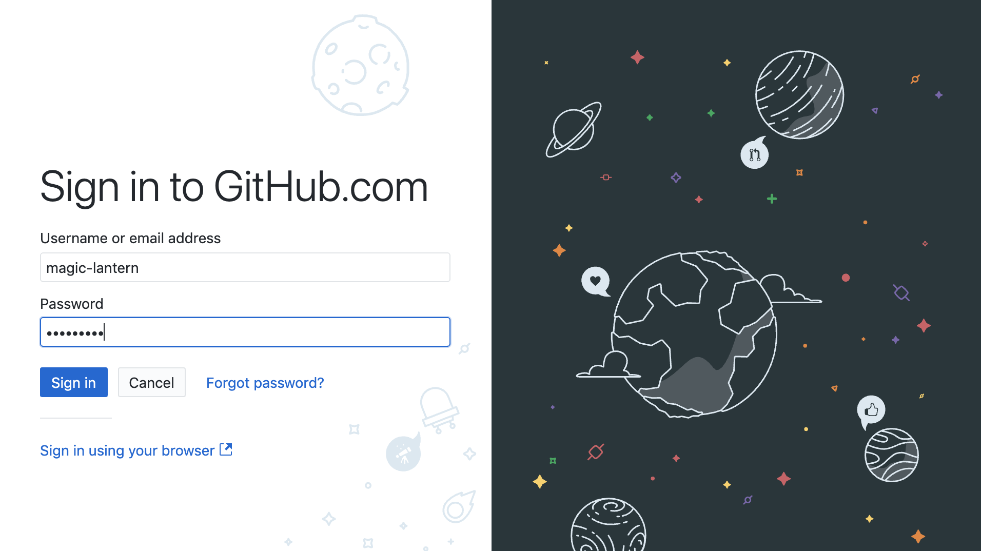

Slide 10
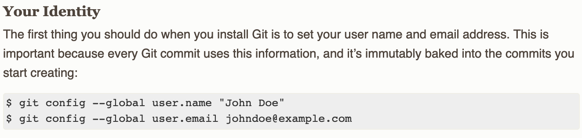
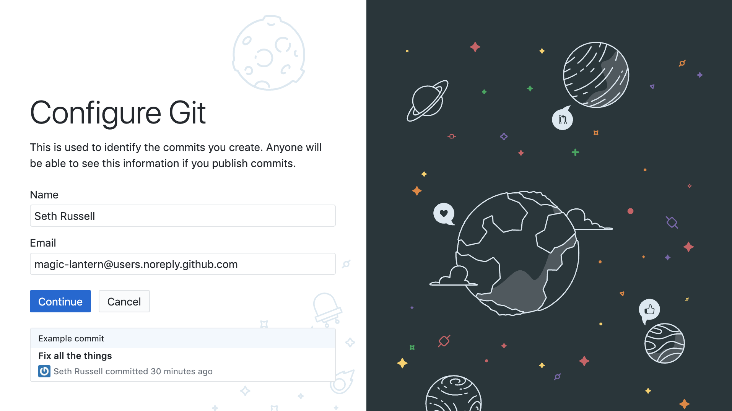

Slide 11
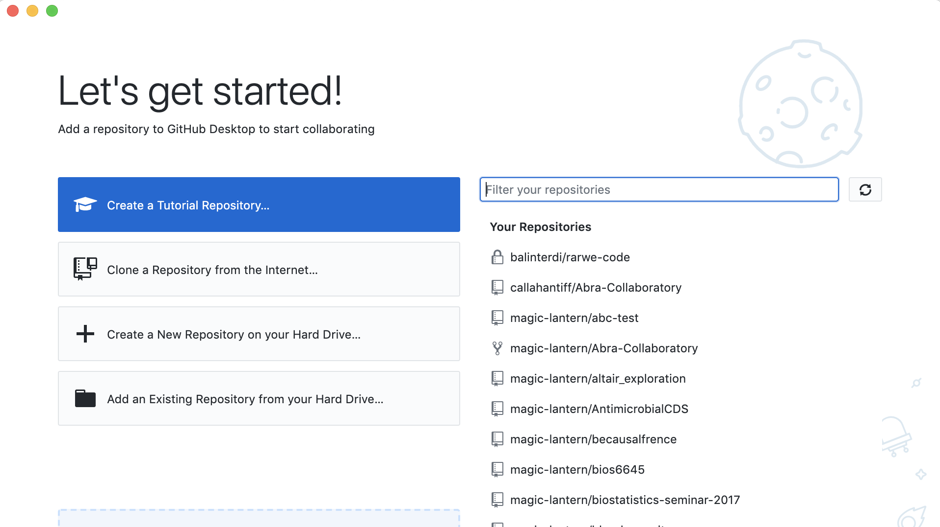

Slide 12
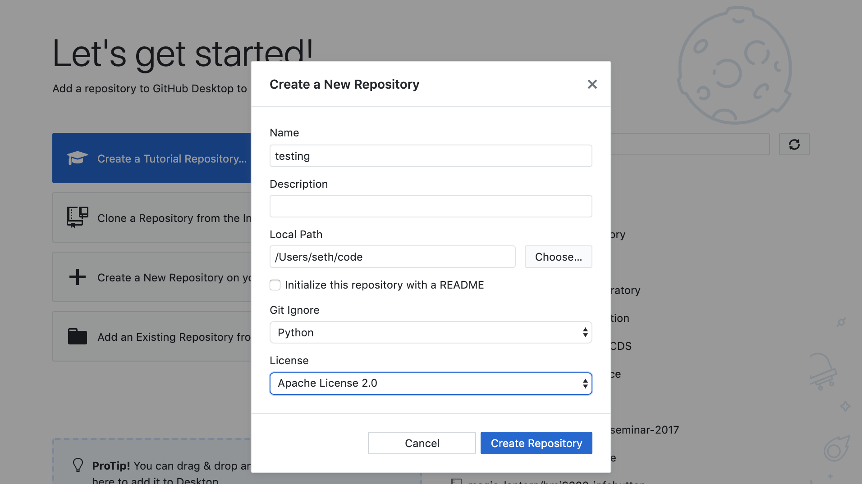

Slide 13
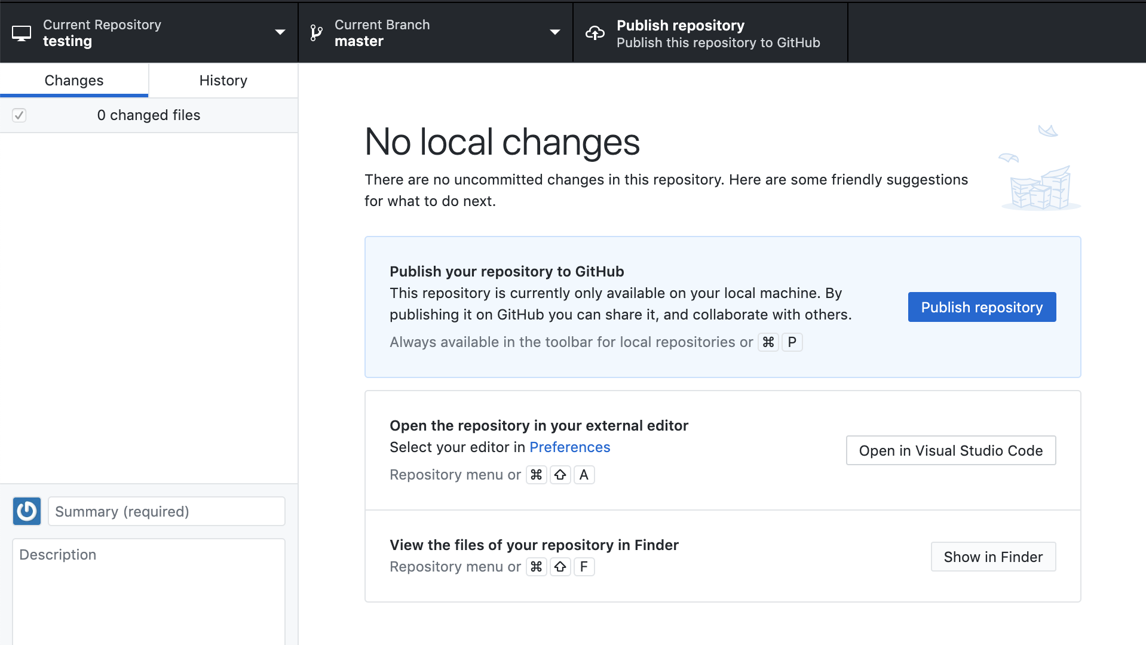

Slide 14
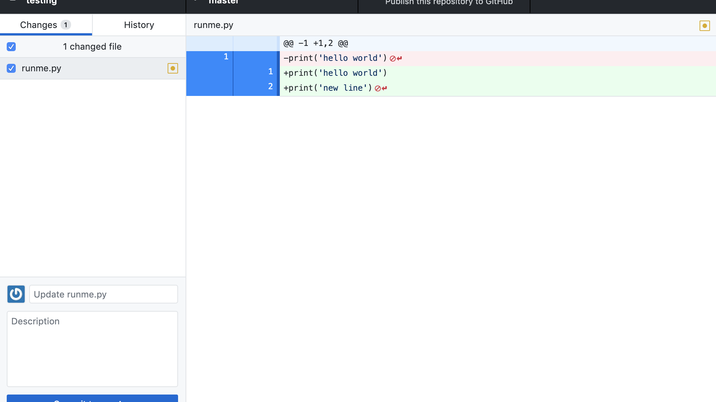

Slide 15
Version Control
What deep wounds ever closed without a scar?
Lord Byron
Notes:
Best way to learn git is by using it – or not using it and losing work and thus realizing you need to make an improvement in this area.

Slide 16
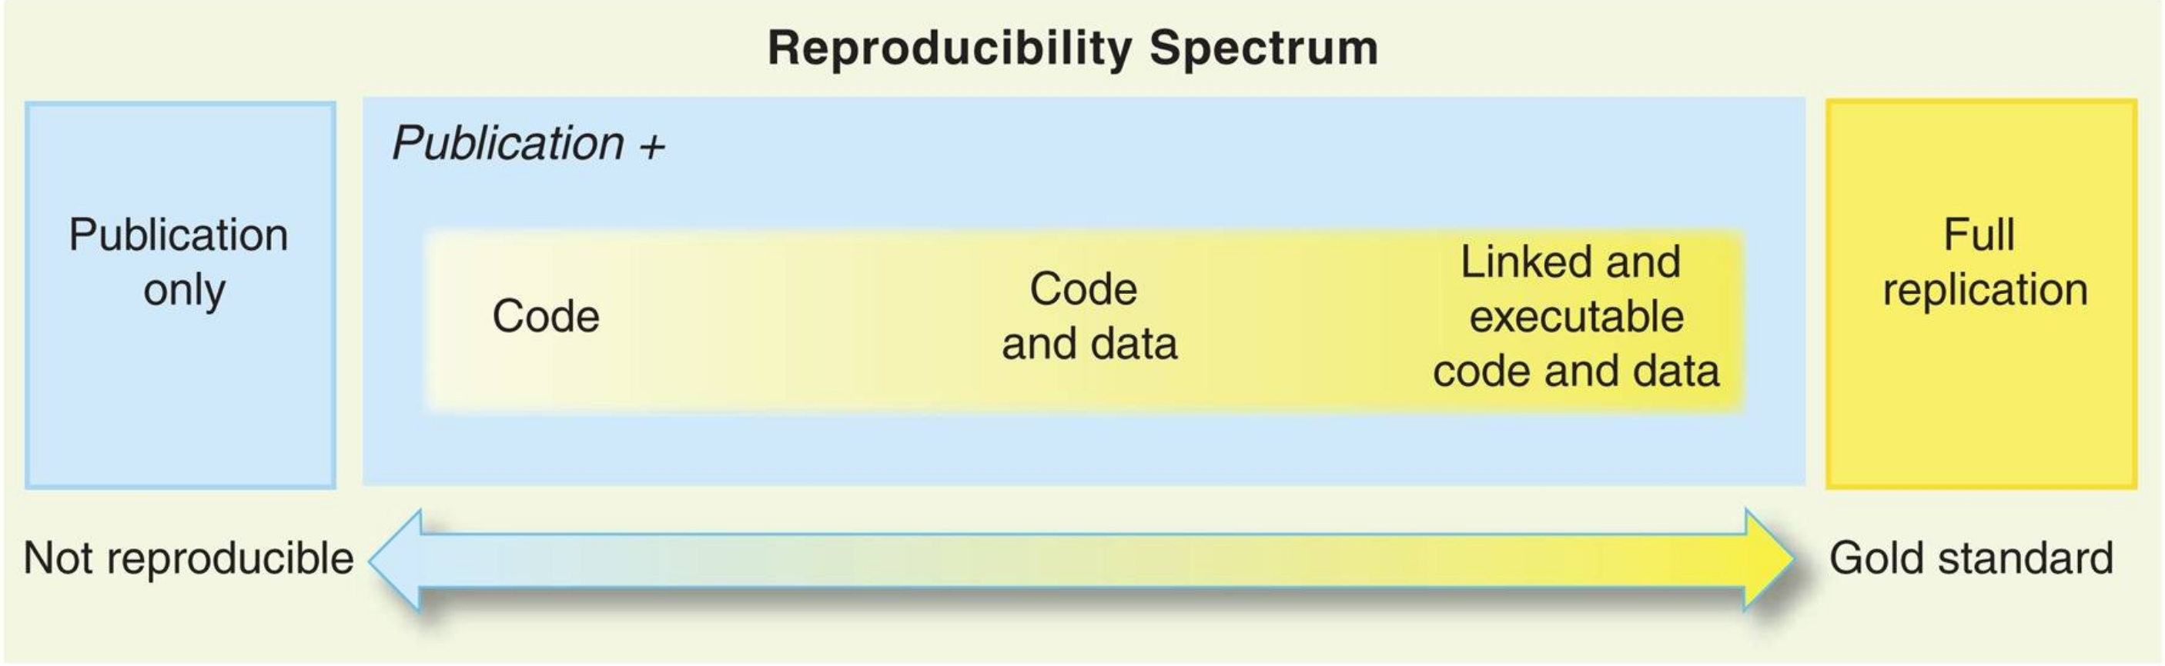
Git and Reproducible Science
Peng RD. Reproducible research in computational science. Science. 2011 Dec 2;334(6060):1226-7. doi: 10.1126/science.1213847. PMID: 22144613; PMCID: PMC3383002.
Notes:
Key Points
Open scientific work is more useful and more highly cited than closed.
Making Code Citable
Anything that is hosted in a version control repository (data, code, papers, etc.) can be turned into a citable object. You’ll learn how to do this in lesson 12: Citation.
How Reproducible Is My Work?
Ask one of your labmates to reproduce a result you recently obtained using only what they can find in your papers or on the web. Try to do the same for one of their results, then try to do it for a result from a lab you work with.
How to Find an Appropriate Data Repository?
Surf the internet for a couple of minutes and check out the data repositories mentioned above: Figshare, Zenodo, Dryad. Depending on your field of research, you might find community-recognized repositories that are well-known in your field. See also “Recommended Data Repositories“ from Nature.
How to Track Large Data or Image Files using Git?
Large data or image files such as .md5 or .psd file types can be tracked within a github repository using the Git Large File Storage open source extension tool. This tool automatically uploads large file contents to a remote server and replaces the file with a text pointer within the github repository.

