Slide 1
Software For Data Science
Seth Russell – seth.Russell@cuanschutz.edu
AccordS Data Science Program, D2V Analytics Core
https://github.com/magic-lantern/bios6642

Slide 2
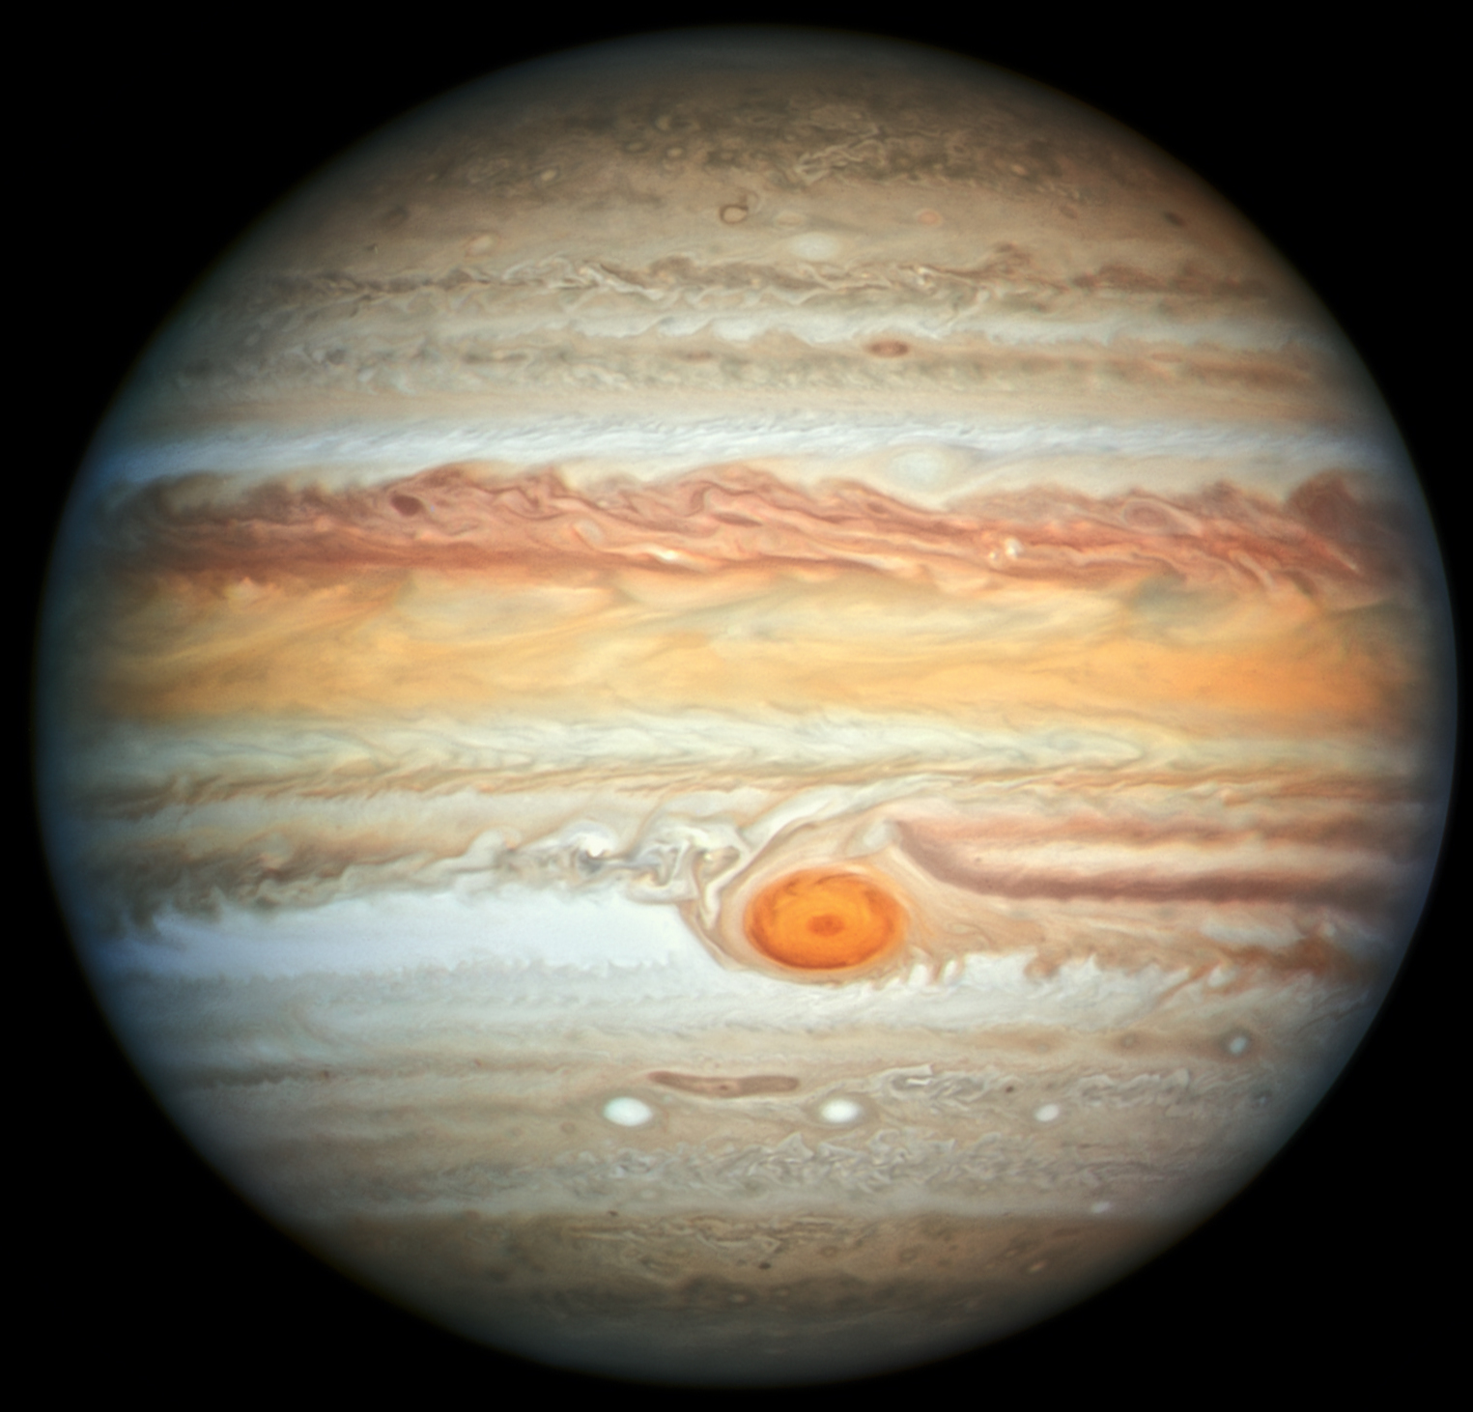
Jupyter Notebooks
Greatest Invention of the Modern Age:
spell check
By NASA, ESA, and A. Simon (NASA Goddard), edited by PlanetUser - https://www.nasa.gov/feature/goddard/2019/hubble-new-portrait-of-jupiter, Public Domain, https://commons.wikimedia.org/w/index.php?curid=81259729

Slide 3
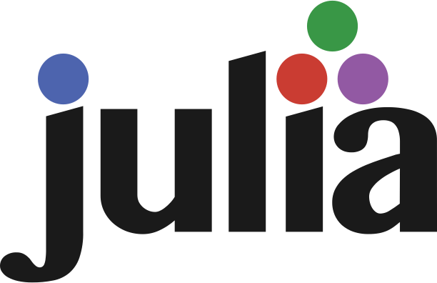


Jupyter Notebooks

Slide 4
Jupyter features
Jupyter: Help > Keyboard Shortcuts
Jupyterlab: Settings > Advanced Settings Editor > Keyboard Shortcuts
Command Mode:
<Enter>: Switch to Edit mode
<Shift> <Enter>: run cell, select below
Y : change cell to code
M : change cell to markdown
A : insert cell above
B : insert cell below
X : cut selected cells
C : copy selected cells
V : paste cells below
Z : undo cell deletion
S: Save and Checkpoint
<Shift> L: Toggle Line Numbers

Slide 5
Jupyter features
Jupyter: Help > Keyboard Shortcuts
Jupyterlab: Settings > Advanced Settings Editor > Keyboard Shortcuts
Edit Mode:
<ESC>: Switch to Command mode
<TAB> : code completion or indent
<Shift> <TAB> : tooltip
<Ctrl> Z: undo
<Shift> <Enter>: run cell, select below
<Ctrl> S: Save

Slide 6
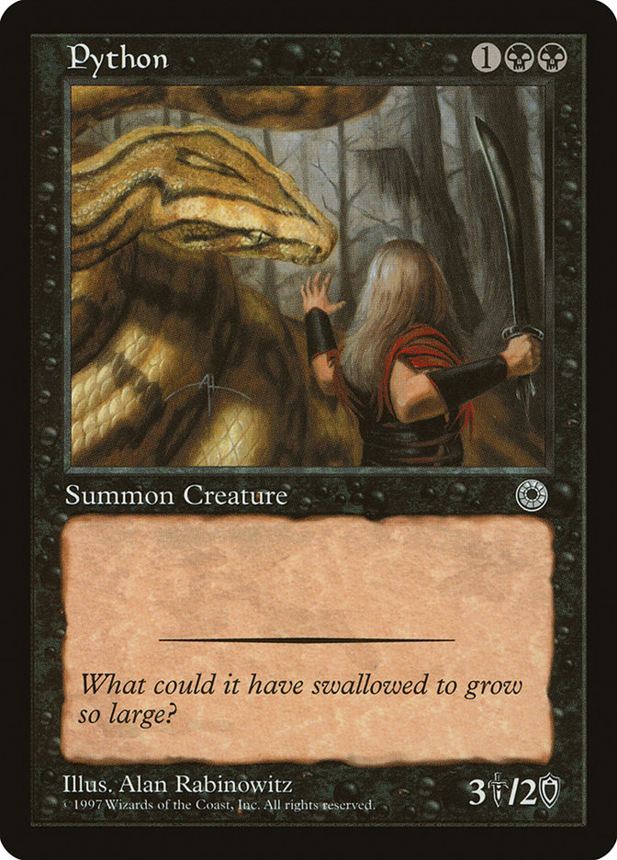
Jupyter Magic
MAGICS are enhancements that IPython adds on top of the normal Python syntax.
These are known in IPython as magic commands, and are prefixed by the % character. These magic commands are designed to succinctly solve various common problems in standard data analysis.
Magic commands come in two flavors:
line magics: Denoted by a single % prefix and operate on a single line of input
cell magics: Denoted by a double %% prefix and operate on multiple lines of input.
https://jakevdp.github.io/PythonDataScienceHandbook/01.03-magic-commands.html

Slide 7
Jupyter Magic Magic
Like normal Python functions, IPython magic functions have docstrings, and this useful documentation can be accessed in the standard manner. So, for example, to read the documentation of the %timeit magic simply type this:
%timeit?
Documentation for other functions can be accessed similarly. To access a general description of available magic functions, including some examples, you can type this:
%magic
For a quick and simple list of all available magic functions, type this:
%lsmagic
Notes:
Quiz – is %timeit line magic or cell magic?

Slide 8
Jupyter Demo
See https://github.com/magic-lantern/bios6642/tree/master/code
Notes:
Quiz – is %timeit line magic or cell magic?

Slide 9
Jupyter Extensions
Must have:
Jupytext: https://github.com/mwouts/jupytext
Matplotlib: https://github.com/matplotlib/jupyter-matplotlib
Offline: https://github.com/manics/jupyter-offlinenotebook
DEMO
Windows: Open Anaconda Prompt (run as administrator)
macOS/Linux: Open terminal
Notes:
conda install -c conda-forge ipympl
# If using the Notebook
conda install -c conda-forge widgetsnbextension
# If using JupyterLab
conda install nodejs
jupyter labextension install @jupyter-widgets/jupyterlab-manager
jupyter labextension install jupyter-matplotlib
%matplotlib widget

Slide 10
Jupyter Extensions
Many many more:
https://github.com/ipython-contrib/jupyter_contrib_nbextensions
https://github.com/mauhai/awesome-jupyterlab

Slide 11
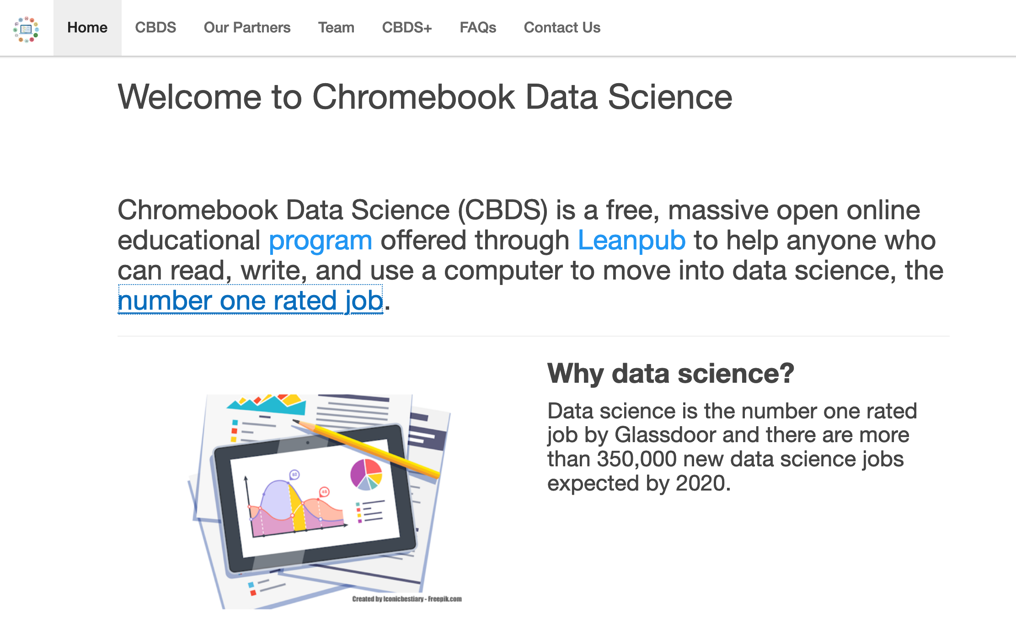
Jupyter in the cloud
https://www.kaggle.com/notebooks
https://colab.research.google.com/notebooks/intro.ipynb
https://notebooks.azure.com/
https://jupyter.org/try (Supports R, Python, Julia, Ruby, and more on mybinder.org)

Slide 12
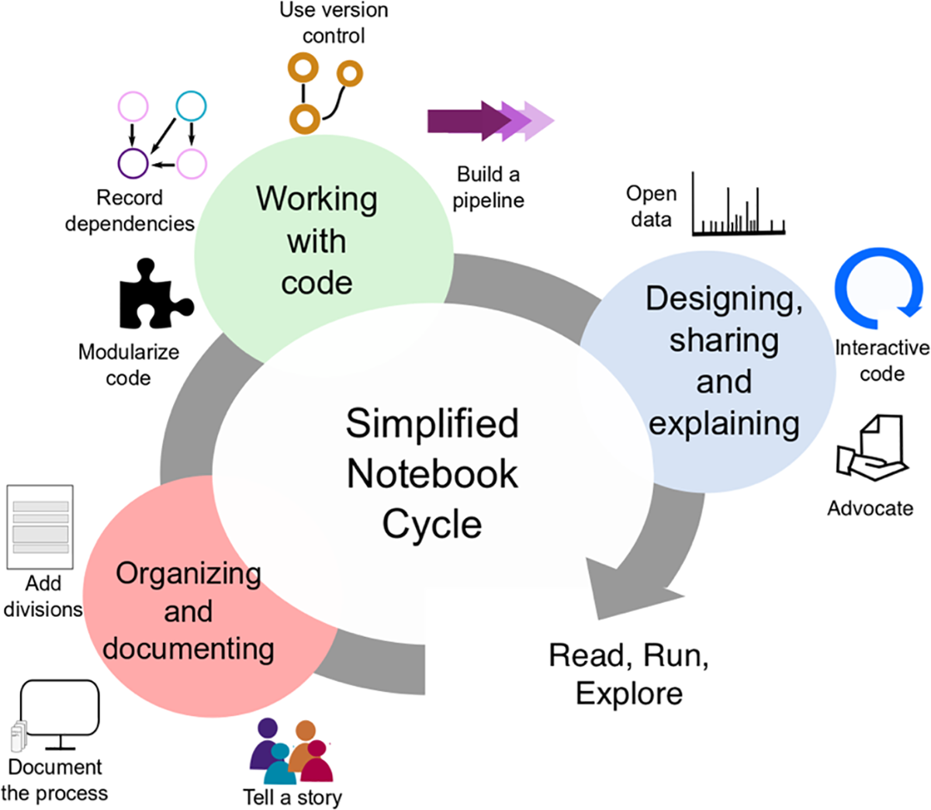
Reproducible Science with Jupyter
Ten simple rules for writing and sharing computational analyses in Jupyter Notebooks:
Rule 1: Tell a story for an audience
Rule 2: Document the process, not just the results
Rule 3: Use cell divisions to make steps clear
Rule 4: Modularize code
Rule 5: Record dependencies
Rule 6: Use version control
…
Ten simple rules for writing and sharing computational analyses in Jupyter Notebooks
https://doi.org/10.1371/journal.pcbi.1007007

Slide 13
Not Jupyter Notebooks!
Joel Grus: “I Don’t Like Notebooks”
Out of order execution
Notebooks are difficult for beginners
Unit testing
https://youtu.be/7jiPeIFXb6U
https://docs.google.com/presentation/d/1n2RlMdmv1p25Xy5thJUhkKGvjtV-dkAIsUXP-AL4ffI/edit#slide=id.g362da58057_0_1
SOLUTION: Use iPython or an IDE

Slide 14
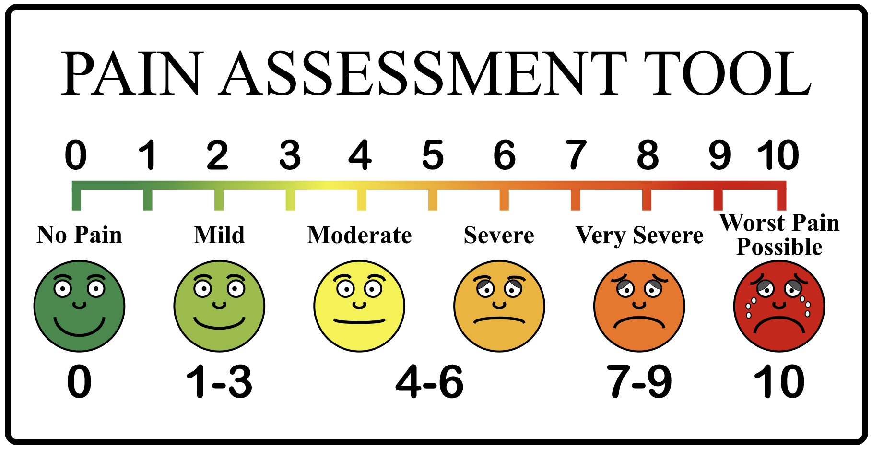
Not Jupyter Notebooks!!
Austin Z. Henley - What's wrong with computational notebooks?
Hard to manage code – not true IDE
Versioning difficult
Sharing difficult
Can’t easily be converted to a product
SOLUTION: Fix Notebooks, add tools to solve pain points
http://web.eecs.utk.edu/~azh/blog/notebookpainpoints.html

Slide 15
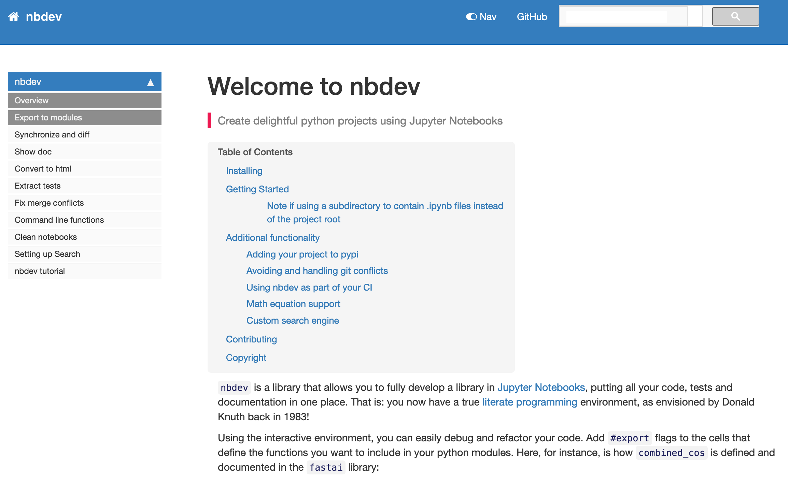
Not Jupyter Notebooks!!!
Jeremy Howard - So what’s missing in Jupyter Notebook?
Create modular reusable code, which can be run outside of Jupyter
Creating hyperlinked searchable documentation
Test code (including automatically through continuous integration)
Navigate code
Handle version control
https://www.fast.ai/page2/#so-whats-missing-in-jupyter-notebook

Slide 16

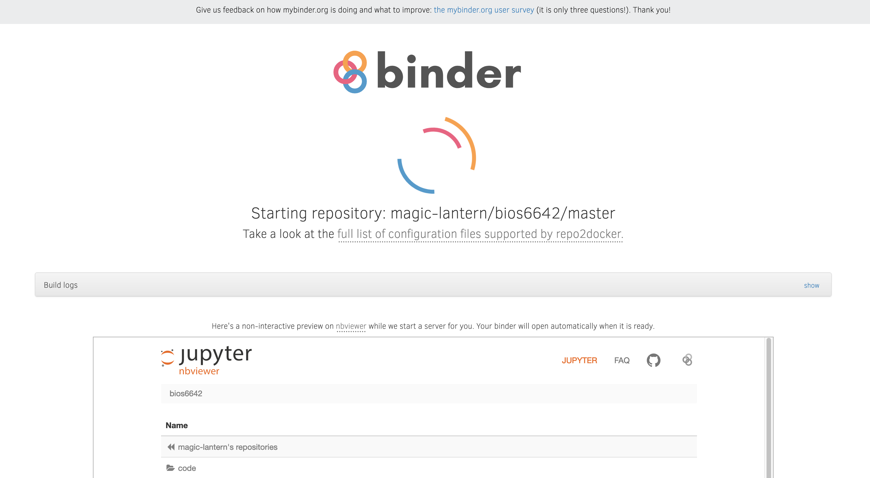
Jupyter Data Science Demo

