Slide 1
TECHSAKSHAM CAPSTRONE PROJECT
REGISTRATION FORM
PRESENTED BY:
Penumechu Pavithra -RUCE
Kamatham Divya -RUCE
Valagonda Komala - RUCE
G.Pavani - RUCE
Jampanapalli Shailaja -RUCE
Under the Esteemed Guidance of
UMAMAHESHWARI

Slide 2
OUTLINE
Abstract
Objective
Problem Statement
Technology Used
Conclusion
Reference

Slide 3
ABSTRACT
A Registration form is a set of fields that a user will input into and submit to a company or individual.
Many of the organizations & companies use registration forms to signup customers for subscriptions, product, service or other programs or plan.

Slide 4
OBJECTIVE
The aim of this project is to build a registration form that will completely automate the process of new registration in any organization.
The system will handle new registration of users.
The system will be based and will have two implementations i.e client side and server side.

Slide 5
PROBLEM STATEMENT
An Online Registration System needs to be developed in addition students on-campus, off-campus, in-state, out-state,out-of-country can easily and inexpensively take advantage of many of services provided by the office.
It is difficult to Register with telephone because busy signals and long distance charges are inherent problem of telephone registration system.

Slide 6
It helps to computerize everything and reducing the errors as compared to manual Registration form.
Some extra Features can also be added like SMS support, MAIL support which leads to increase in response time.
Different parties may also interact with each other.

Slide 7
TECHNOLOGY USED
HTML
CSS

Slide 8
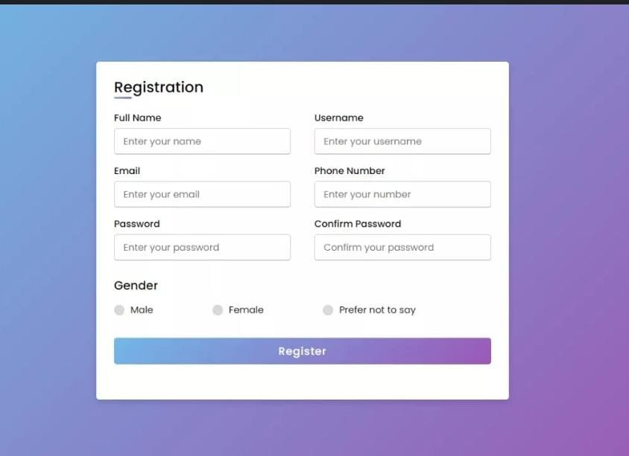

Slide 9
CONCLUSION
This registration form is efficient in maintaining student’s details and can easily perform operations on records.
This project is made in order to replace the manual work.
This also helps the people using this to save time and money.
Overall improve Efficiency.

Slide 10


