Slide 1

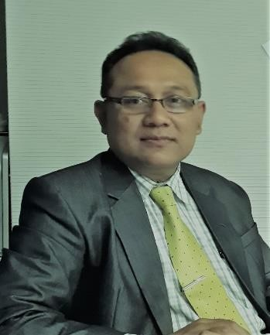

Sustainability Report: Opportunities dan Challenges for Industrialists, Practitioners dan Academicians Through Imaginary Tralogue
PROF . Eko Ganis Sukoharsono, SE, MCom (Accy), MCom-Hons, CSRS, CSRA, PH.D
Professor of Sustainability Accounting, FEB University of Brawijaya, and
Chairman, Institute of Certified Sustainability Practitioners
The Paper is prepared and presented at the National Seminar of The Indonesian Institute of Accountants – South Sumatera Pangkal Pinang, 16 November2019
1

Slide 2
Long Journey of the Word of “Sustainability”?
As early as 18th Century
Up to 1950s, No Concept
1953, Howard Bowen - Social Responsibility of Businessmen
  “it refers to the obligation of a businessman to pursue those policies, to make those decisions, or to follow those lines of action which are desirable in terms of the objectives and values of our society”

Slide 3
Long Journey of the Word of “Sustainability”?
1960, Davis: “Can Business Afford to Ignore its Social Responsibilities?”
– “businesses' decisions and actions taken for reasons at least partially beyond the
firm‘s direct economic or technical interest”
» a. Providing job employment
» b. Contribute to the government by paying taxes.
» c. Produce goods at affordable prices
– For historical thought in order, please read Sukoharson (2010): Metamorphosis of Social and Environmental Accounting to Sustainability Accounting
1980, World Conservation Strategy
1981, Lester R.Brown - Building a Sustainable Society
1987, Brundtland Report – Our Common Future
  “sustainable development is development that meets the needs of the present without compromising the ability of future generations to meet their own needs.”
1997, GRI – Sustainability Report

Slide 4
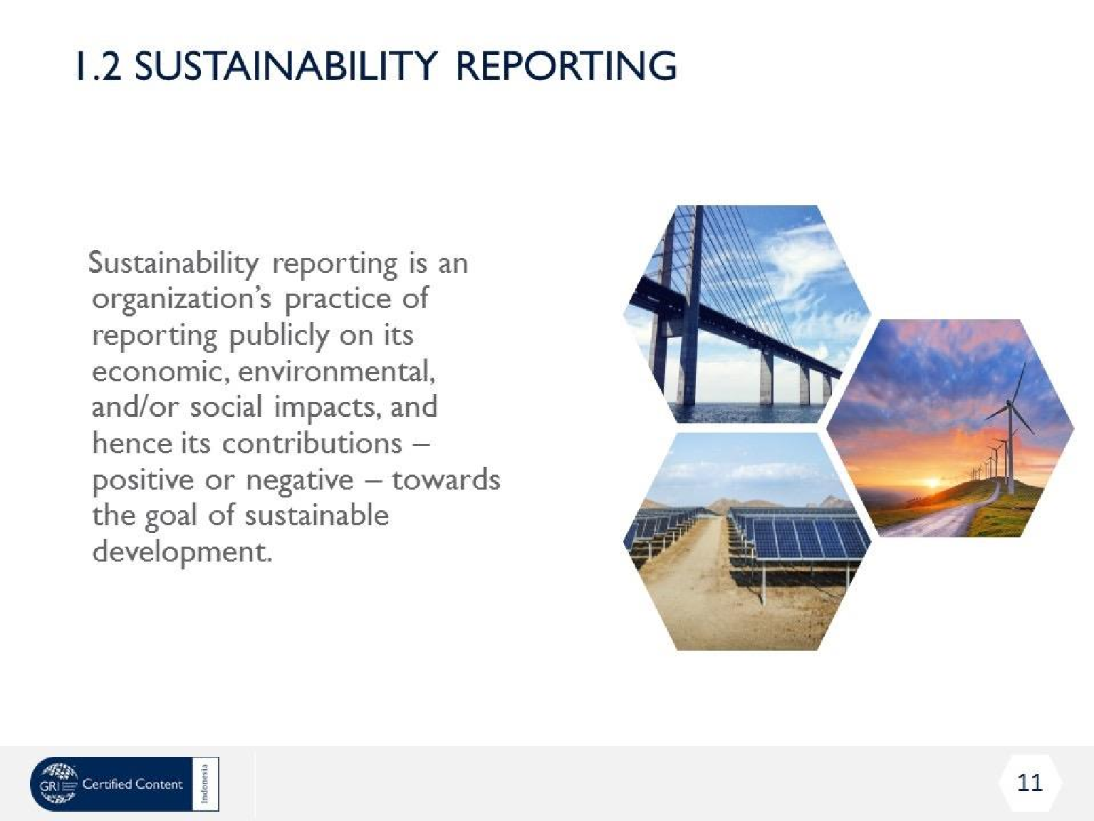
4

Slide 5
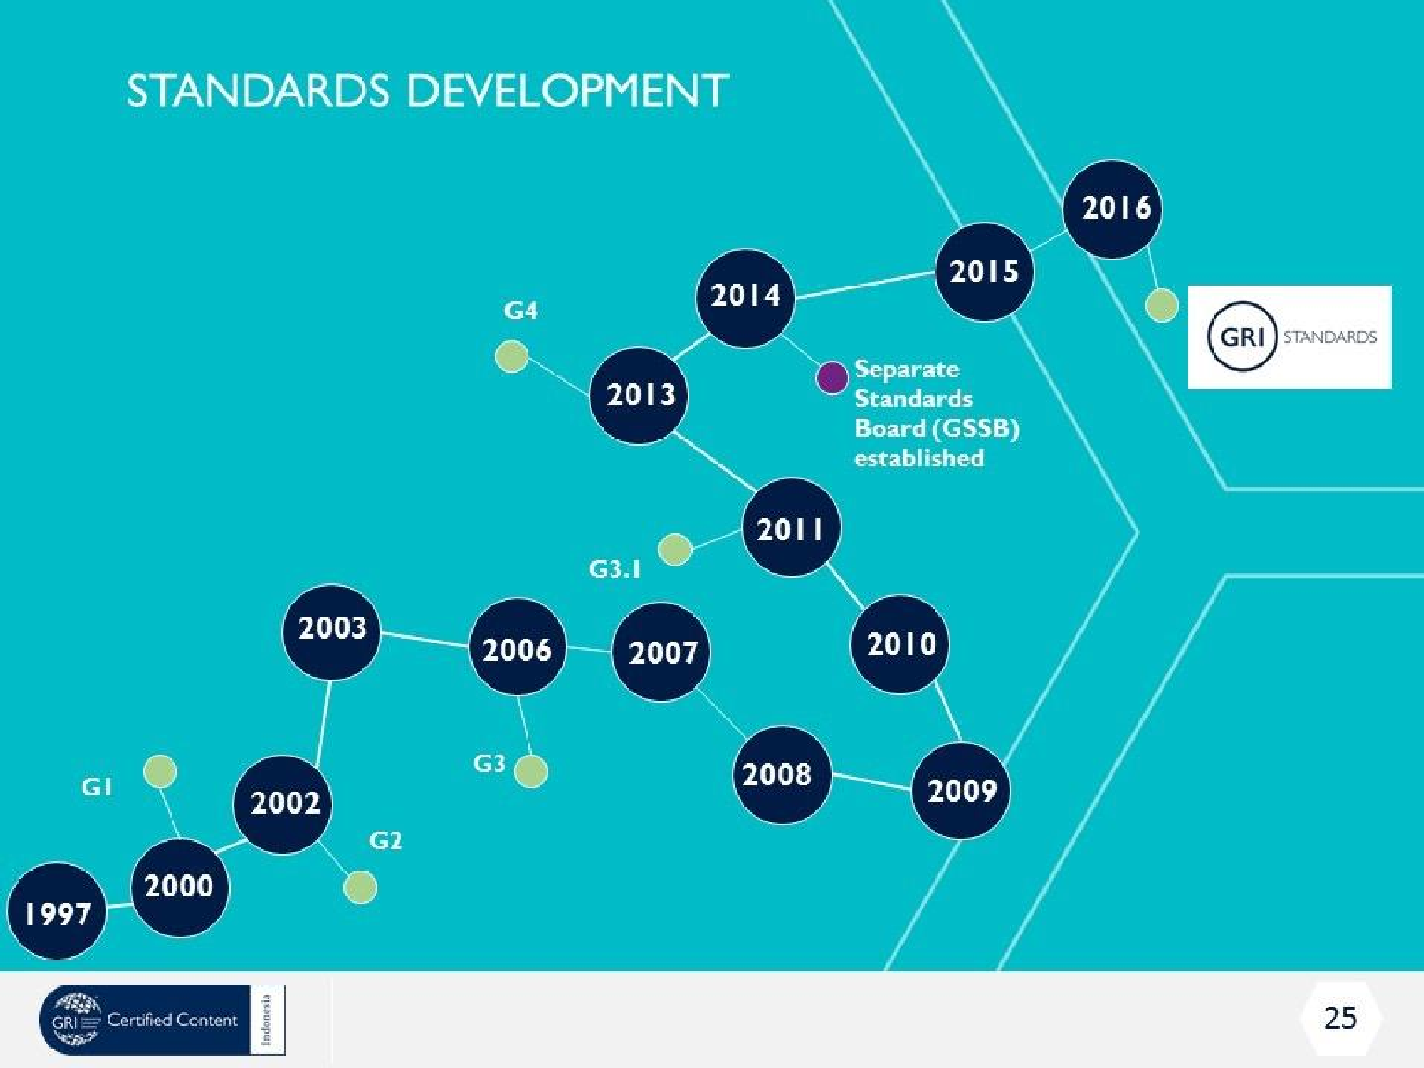
5

Slide 6
Sustainabiity Report and Its Opportunity
The Word “Opportunity” is not simple by meant of “kesempatan”
Certainty; Uncertainty; Risk
Opportunity :
  Logical Opportunity
  Empirical Opportunity
  Subjective Opportunity

Slide 7
Sustainability Report: Its Opportunities for Industrialists
Industrialist
: Additionally, the benefits of SR could also be split of internal and external benefits. For internal benefits to companies and organizations can include:
Increased understanding of risks and opportunities
Emphasizing the link between financial and non-financial performance
Influencing long term management strategy and policy, and business
plans
Streamlining processes, reducing costs and improving efficiency
Benchmarking and assessing sustainability performance with respect to laws, norms, codes, performance standards, and voluntary initiatives
Avoiding being implicated in publicized environmental, social and
governance failures
Comparing performance internally, and between organizations and sectors

Slide 8
Sustainability Report: Its Opportunities for Industrialists
Industrialist : Interestingly, SR could also have external benefits
External benefits of sustainability reporting can include:
Mitigating – or reversing – negative environmental, social and governance impacts
Improving reputation and brand loyalty
Enabling external stakeholders to understand the organization’s true value, and tangible and intangible assets
Demonstrating how the organization influences, and is influenced by, expectations about sustainable development

Slide 9
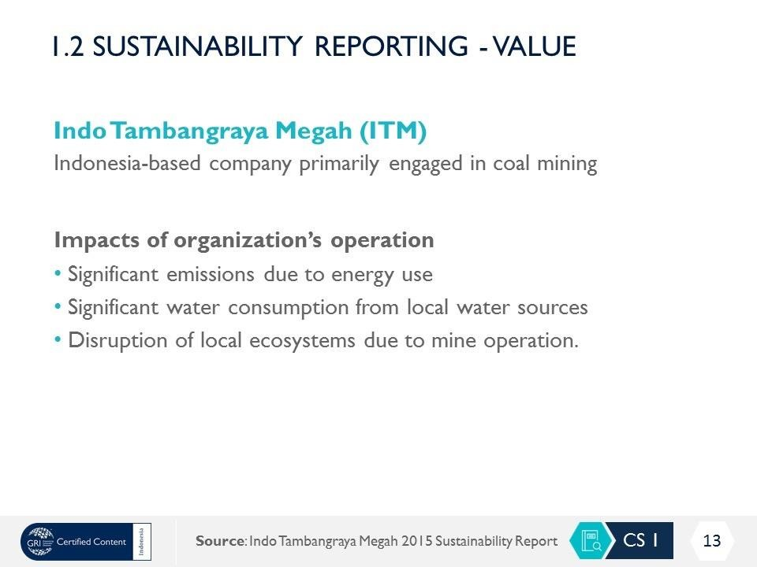

Slide 10
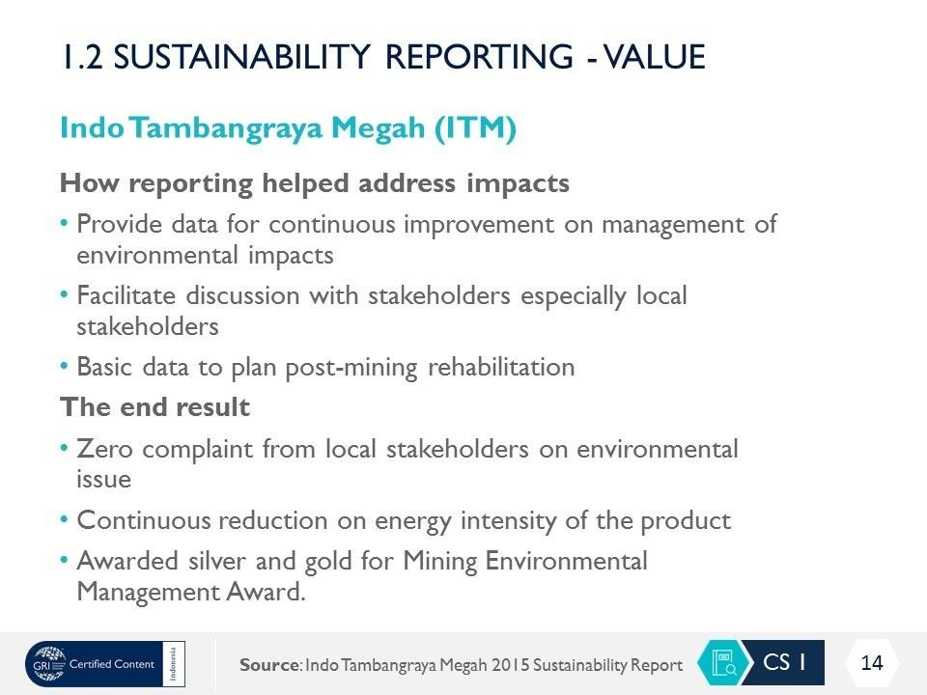

Slide 11
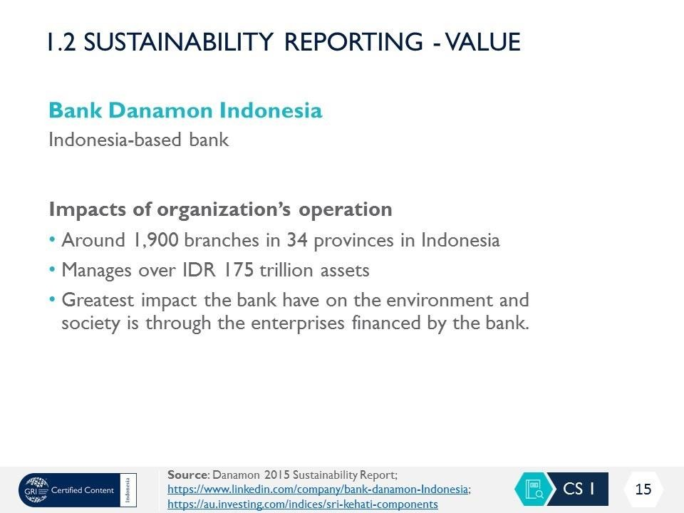

Slide 12
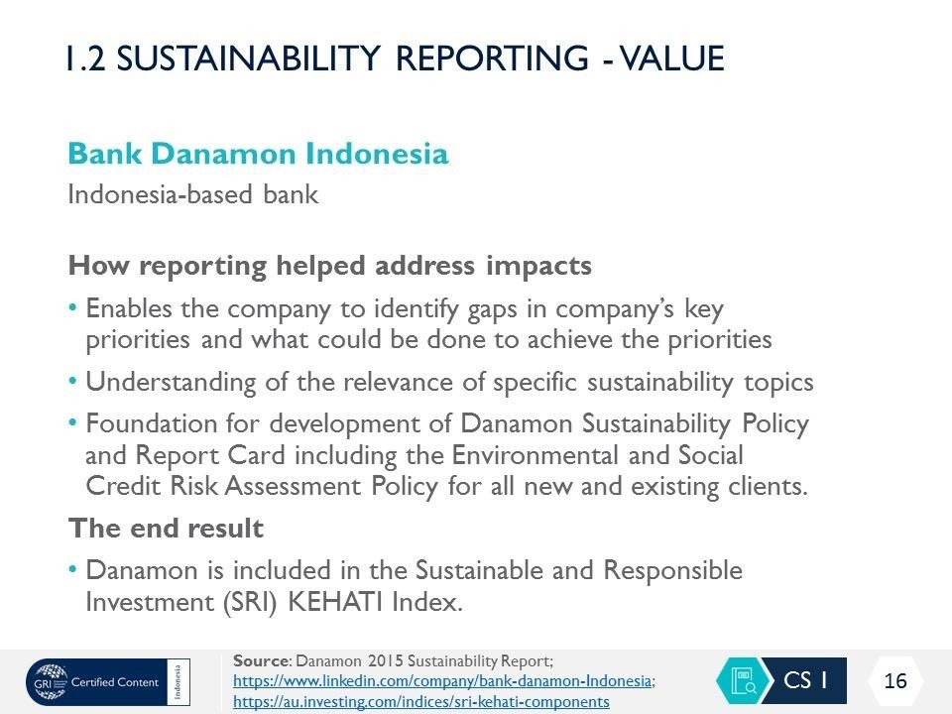

Slide 13
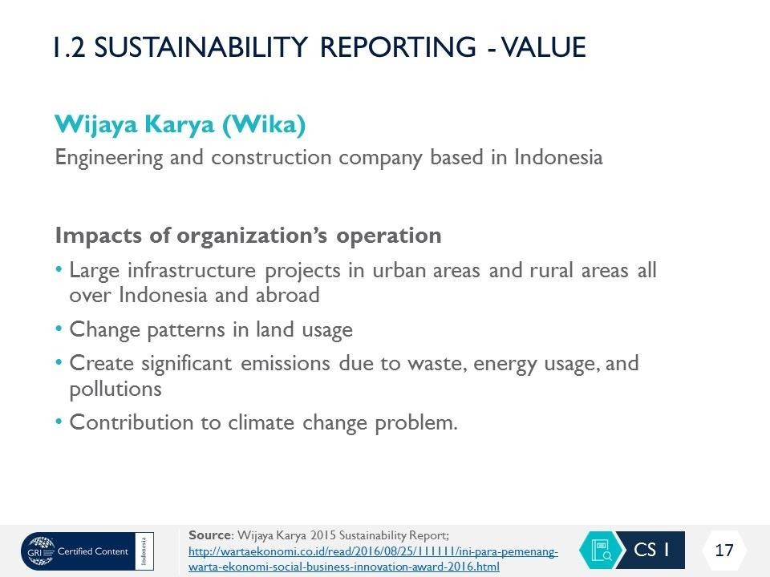

Slide 14
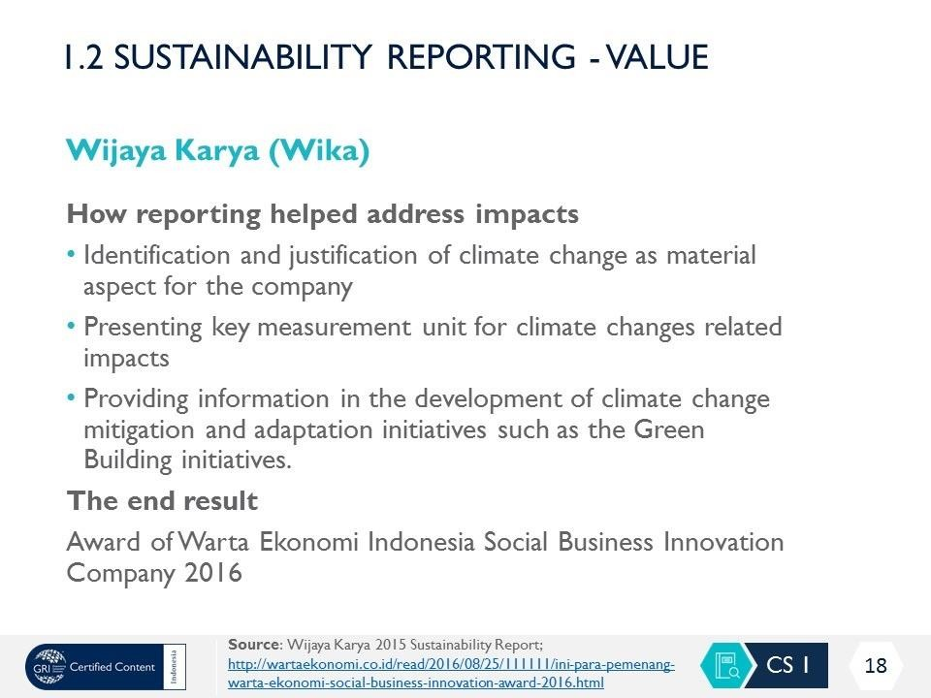

Slide 15
Sustainability Report: Its Opportunities for Practitioners
Practitioner
: As a practitioner in providing services to prepare the SR, this has
opportunities as follows:
SR Could create a new profession: CSRS and CSRA
New tasks and responsibility
Getting new knowledge
Contributing to the development of standards
Creating new Jobs to prepare SR and its assurance

Slide 16
Sustainability Report: Its Opportunities for Academicians
Academician
: Let me think now about the opportunities of SR for me are
New studies programs offered
New knowledge and skills
New research topics
New community services
New tasks and responsibilities

Slide 17
Sustainabiity Report and Its Challenges
The Word “Challenge” is not simple by meant of “Tantangan”
  The meaning of the word challenge is the thing or object that inspires determination to improve the ability to overcome problems.
  Challenge also means stimulation (to work harder and so on).
  Challenge is a part of everyday life. It makes us stronger
and without it life becomes somewhat meaningless

Slide 18
Sustainability Report: Its Challenges for Industrialists
Industrialist
: For me, the SR has challenges me and the company with the following:
Being More Transparent
Being More Accountable
Being More Responsible
Being More Fairness
New Competency of Employees

Slide 19
Sustainability Report: Its Challenges for Practitioners
Practitioner
: Different to the Industrialist, I am really appreciated it with its development, where it creates some positive effects as follows:
New Knowledge
New Standards to be learned
New Competency
More Time Spent to prepare
More Team with diverse knowledge
New Educational Requirements

Slide 20
Sustainability Report: Its Challenges for Academicians
Academician
: For me, it really helps to enrich knowledge in the academic atmosphere. The SR could bring challenges such as:
Create new Knowledge
Create new Competency
Create new Curriculum Design
Build new references
Enrich New standards to be learned

Slide 21
Sustainability Report: Its Challenges for Academicians
Academician
: It is believed that for academic atmosphere, the existence of SR has a wide range of teaching/ lecturing techniques in use. Why? The set of lecturing techniques to educate its contents of SR strongly depends on the instructional form of lectures (face to face lecture, education by correspondence or distance education). Apart from the ubiquitous lecture, the consultation revealed the following list (which is far from exhaustive)
Seminar (small group teaching)
Tutorials
Research seminar
Exercise classes or courses
Workshops (classroom based practical classes)
Problem-solving sessions
Laboratory teaching
Demonstration classes
Placement (internship/traineeship)
Work based practice
Fieldwork
Online / Distance or e-learning: which may be paper based or ICT based

Slide 22
THANK YOU
Sustainability Report: Opportunities dan Challenges for Industrialists, Practitioners dan Academicians Through Imaginary Tralogue
PROF . Eko Ganis Sukoharsono, SE, MCom (Accy), MCom-Hons, CSRS, CSRA, PH.D
Professor of Sustainability Accounting, FEB University of Brawijaya, and
Chairman, Institute of Certified Sustainability Practitioners

