Slide 1
C# Bonanza
Or something…

Slide 2
What will we look at
Functional programing
Lazy<T>
AoP (P#,MVC)
Dynamic(Expando)
Generic Extension methods
Expression
Readable Linq?!
ILWeaving
Task
IoC chain building (Autofac)
yield
Covariance (<in T, out Tout>
Immutable
Win32
Operators
Roslyn

Slide 3
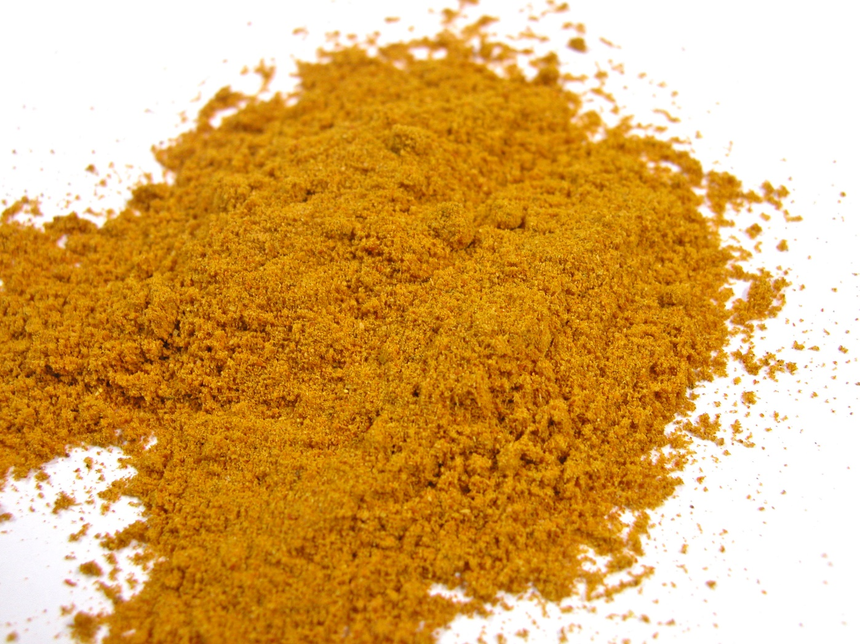
Curry vs Partial Implementation

Slide 4
Functional Programing, C# basics
Partial Implementation vs Curry (demo)

Slide 5
AoP use cases
Exceptions
Logging
Magic

Slide 6
Dynamic stuff
ExpandoObject
DynamicObject
Dynamic for TDD
(LeetSpeak)

Slide 7
Readable LINQ?!
Are you losing readability? Break out to a named method
Grouping?
ToList() or not?

Slide 8
Generic Extension methods
Tap<T> (Logging, Debugging, Chaining unchainable stuff)

Slide 9
Expression
TODO: Ta exemplet ifrån PropertyChanged
TODO: Ta exemplet ifrån To<T>() + Tap<T>

Slide 10
IL Weaving
Implement interfaces on build
NotifyPropertyChanged (demo)

Slide 11
Task, what can we do with this?
Task.Run -> Create async code from synchronous code
Task.ConfigureAwait -> Should we run the code after await on the UI?
Task.WhenAll -> Wait for all the tasks to finish
Task.WhenAny -> Wait for one task to finish
CancelationToken -> How do we cancel a task?

Slide 12
IoC chain building, when, where, why?
You want to separate implementations
Example
Alternative, TODO: top handler

Slide 13
Covariance <in Tin, out Tout>
Makes it possible to cast to other generic types

Slide 14
Immutable
Prevents a few bugs from existing
Chaining calls is built in

Slide 15
Operator overloading
Can be used to create a DSL
Left hand controls everything
Overriding true/false
Demo!

Slide 16
Roslyn, good stuff
Scripting language in C# for C#?

Slide 17
Win32, a few things to whet your appetite
Getting the title of the window that is currently in focus
Capturing mouse position
Capturing elements that the user clicked on
Pinvoke.net is your friend
Lets see some code…

Slide 18
Yield
Having a prepended list

