Slide 1
ORAL Assessment NLP1 Project1
Pepijn Baggen, Klaas Bloem, Eline Lunsingh Scheurleer

Slide 2
Question 1: data and metrics
Train/test split: 80/20
Column 'content': the text (a short account of an emotional experience)
Column 'emotion': the label as a string (one of 7 emotions)
7 emotion classes: joy, fear, anger, sadness, disgust, shame, guilt
Dataset size (train 6012, test: 1504, total: 7516)
Ratio largest to smallest class: 1.04
Always predict the largest class: 0.146
Random guessing (1/7): 0.143
Words per text: mean 22.2 | median 19 | min 1 | max 178
Metric: accuracy (classes are balanced, all emotions matter equally)

Slide 3
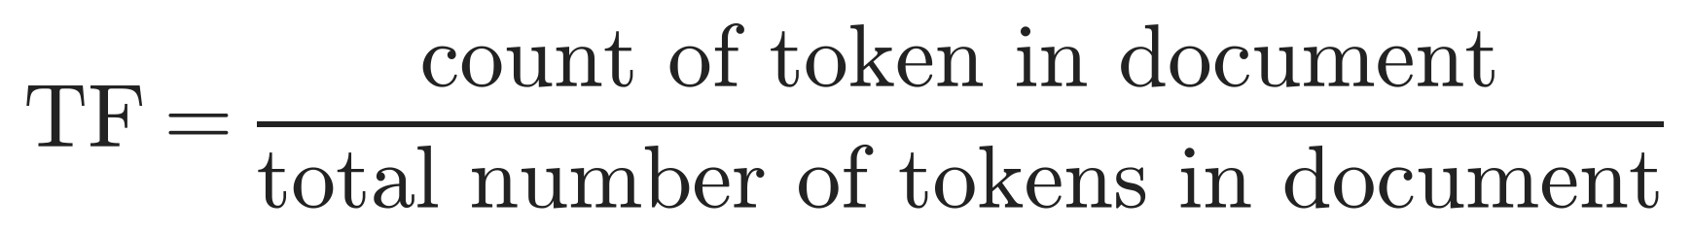
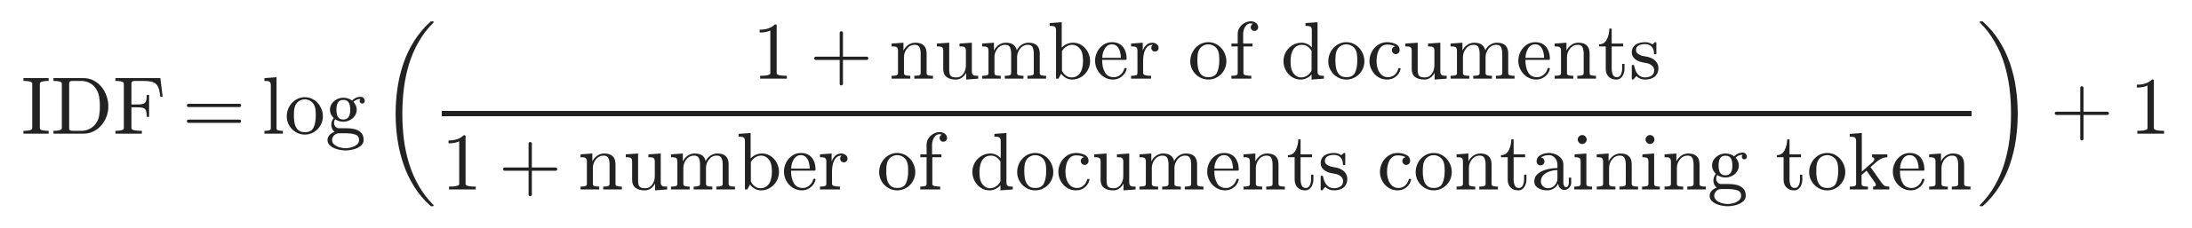
Question 2: features
Tokeniser
BPE (tutorial), retrained on the ISEAR train texts
Final run: vocab 5000, min_frequency 2
Tuning: MLP + BoW, 5-fold CV, 1 seed
Representation (5000 dims)
Token indicator (tutorial): 1 if the token occurs, else 0
Bag of words (tutorial): count of each token
TF-IDF (extra): TF × IDF, down-weights tokens that occur in many documents
Tokenizer | Mean val. accuracy | std
vocab 1000, mf 5 | 0.5319 | 0.0067
vocab 3000, mf 2 | 0.5474 | 0.0137
vocab 3000, mf 5 | 0.5466 | 0.0095
vocab 5000, mf 5 | 0.5572 | 0.0126

Slide 4
Question 3: architectures
Architectures
Logistic regression (tutorial)
MLP: 1 hidden layer, 128, ReLU (tutorial)
mlp2: 2 hidden layers, 128–64, ReLU, early stopping (own)
Tuning
Problem: overfitting (99% train, 55% val)
Regularisation: plateau, within noise
Extra capacity: no gain
Final run (both MLPs)
Dropout 0.5, weight decay 0.1, 20 epochs (mlp2: patience 3)
Test | Variant | Accuracy
No regularisation | dropout 0, wd 0 | 0.5426
Dropout | 0.1 / 0.3 / 0.5 | 0.5511 / 0.5426 / 0.5517
Dropout | 0.8 / 0.95 | 0.5556 / 0.5364
Weight decay (dropout 0.1) | 1e-3 / 1e-2 | 0.5409 / 0.5413
Weight decay (dropout 0.5) | 0.1 / 1 | 0.5494 / 0.5469
Weight decay (dropout 0.5) | 10 / 100 | 0.5063 / 0.2092
Lower learning rate | 1e-4, 40 epochs | 0.5509
Hidden size | 8 / 16 / 32 / 64 | 0.5286 / 0.5364 / 0.5429 / 0.5474
Architecture | MLP / mlp2 128-64 / mlp2 256-128 | 0.5559 / 0.5449 / 0.5434
Vocabulary | 1000 / 3000 / 5000 | 0.5319 / ~0.547 / 0.5572
min_frequency (vocab 3000) | 2 / 5 | 0.5474 / 0.5466
Tuning baseline, set before the tokeniser was chosen: MLP + BoW, BPE vocab 3000, mf 5, 5-fold CV, 1 seed

Slide 5
Question 4: results
5-fold CV × 3 seeds
Bayesian comparison (ROPE 0.005)
  Convention
  Variation between runs
Accuracy
  Balanced classes
  Classes matter equally
Other aspects:
  Per-class scores
  Confusion matrix
Limitation: MLP uses best epoch on validation, logistic not
Limitation: tokeniser and IDF on validation folds
  Mean validation accuracy (5-fold CV × 3 seeds)
Accuracy | Indicator | BoW | TF-IDF
Logistic | 0.5217 | 0.5235 | 0.5405
MLP | 0.5586 | 0.5519 | 0.5557
mlp2 | 0.5435 | 0.5445 | 0.5325
Test accuracy MLP + indicator: 0.550 ± 0.006
Held-out test set (1,504 texts), used once; 15 final-run models

Slide 6
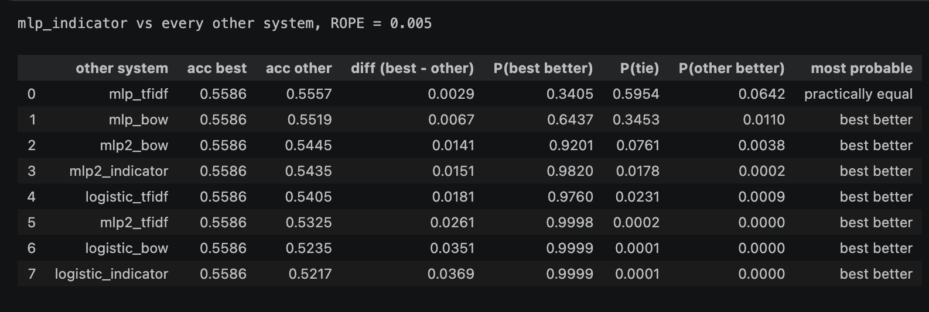
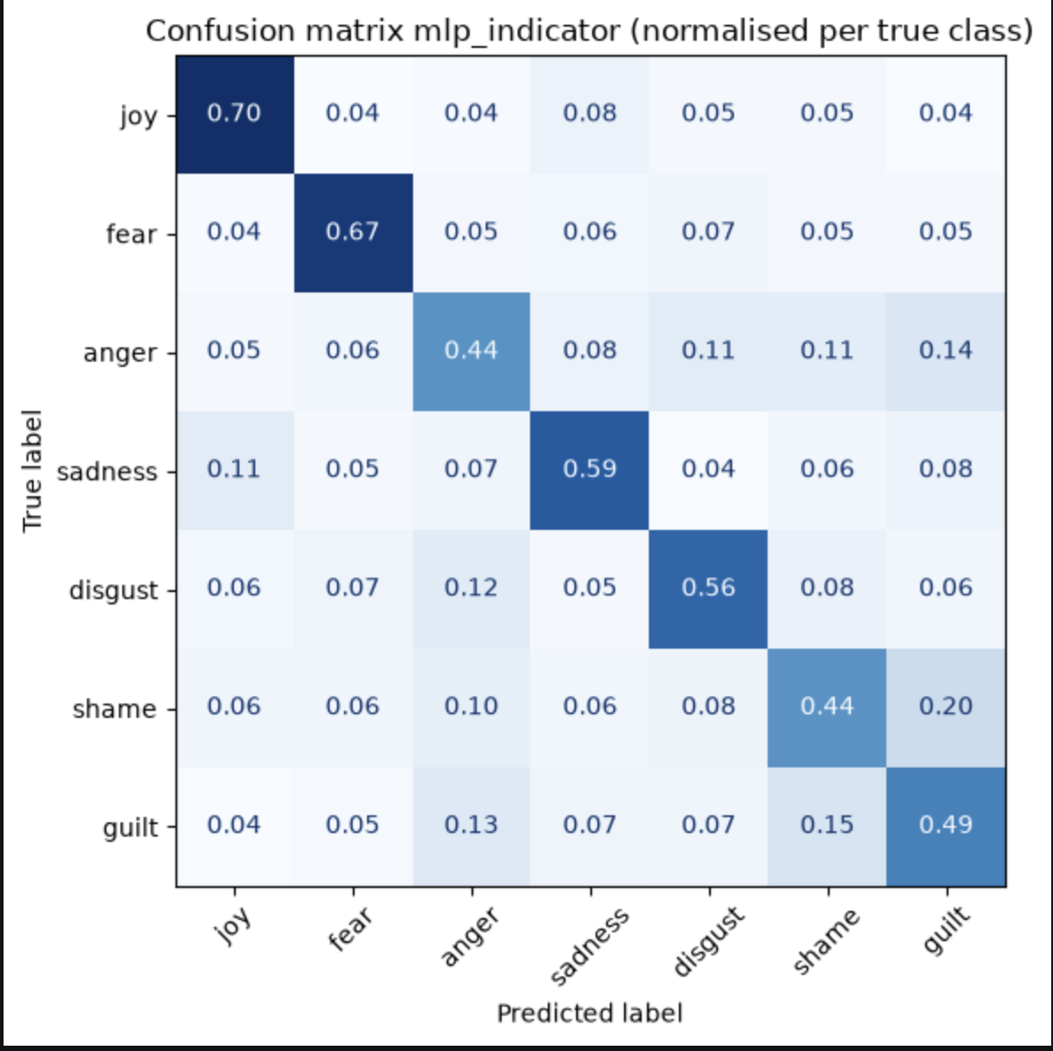
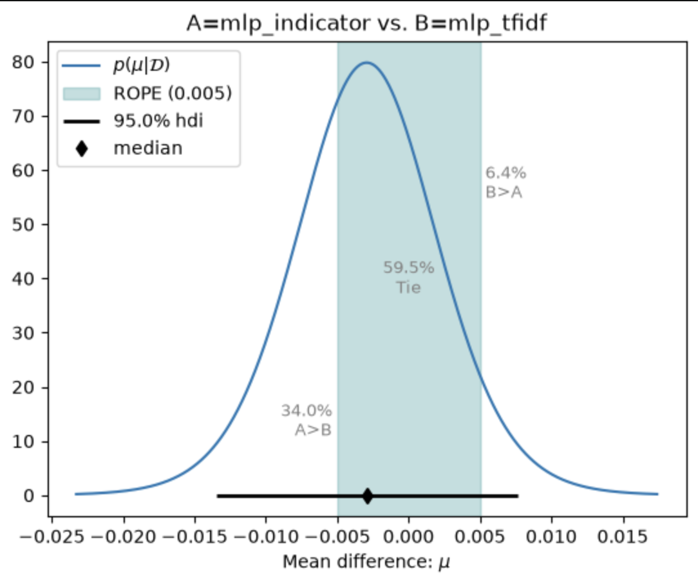
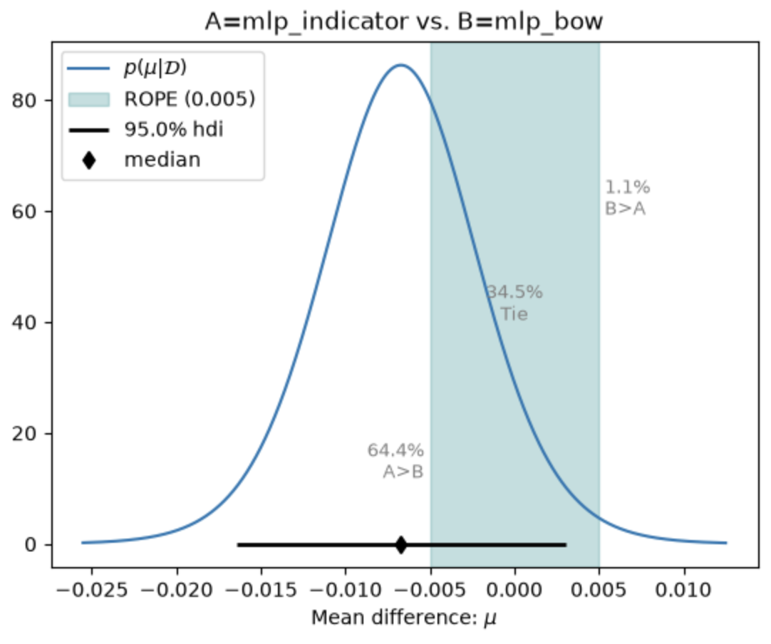
Question 5: extra (error analysis)
Example sentence (true: guilt, predicted: shame):
“I forgot to convey an important announcement”

