Slide 1

Course 01: Soar Essentials
The Engineer’s Guide to Soar
A Project-Based Tutorial Series
By Dr. Bryan Stearns, 2024

Slide 2
Course Design
This course has one main objective:
To equip you to be capable of programming and maintaining a Soar application
In this course, you will build a basic Supplier Sorting agent
See the ProblemOverview.pdf document for a description of the problem
Each lesson in this course builds on the previous lesson to gradually build up the agent from scratch into production-ready code.
After completing this course, you will be able to build and maintain Soar agents on your own!
This course only covers the basics.
It won’t teach advanced capabilities such as learning (Chunking, RL, SMem, EpMem, etc.)
But once you are comfortable with Soar basics, check the Soar Manual to learn more!

Slide 3
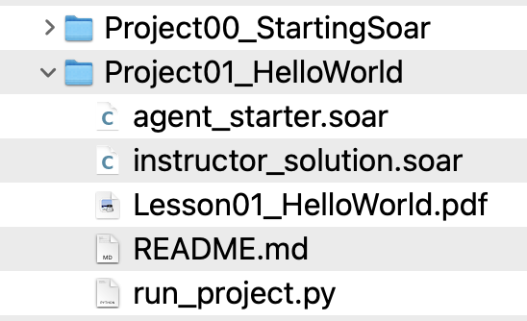
Lesson Design
Each lesson has two components:
Instruction: A pdf that describes the concepts and goals for the lesson
(You are here)
Application: A project assignment that applies the concepts to develop your agent
Each project folder comes with some starter Soar code that you must modify.
Walk through the pdf and edit the code as you go according to its instructions.
This is a self-guided learning and development experience.
By the end of the lesson pdf, you should have completed the assignment.
Each folder also comes with instructor solution code for the assignment.
(Don’t look at the solution unless you are stuck after watching the video.)
The provided “run_project.py” Python script lets you test your code at any time.

Slide 4
Lesson 00 – Outline
This first lesson answers two questions:
What is Soar?
How do I install and start Soar on my machine?

Slide 5
What is the Soar Cognitive Architecture?
A High-level Overview

Slide 6
What is Soar?
For the academic, Soar is an implemented theory of cognition
Used for experiments that help us test our understanding of human intelligence
For the engineer, Soar is a software engine
Used for making and running Artificial Intelligence (AI) agents.
Soar is both.
Soar is a Cognitive Architecture

Slide 7
What is an Architecture?
An architecture defines how different components connect to provide an emergent capability….
Something greater than the sum of its parts.
No one component is sufficient.
Removing any one component usually breaks the system.

Slide 8
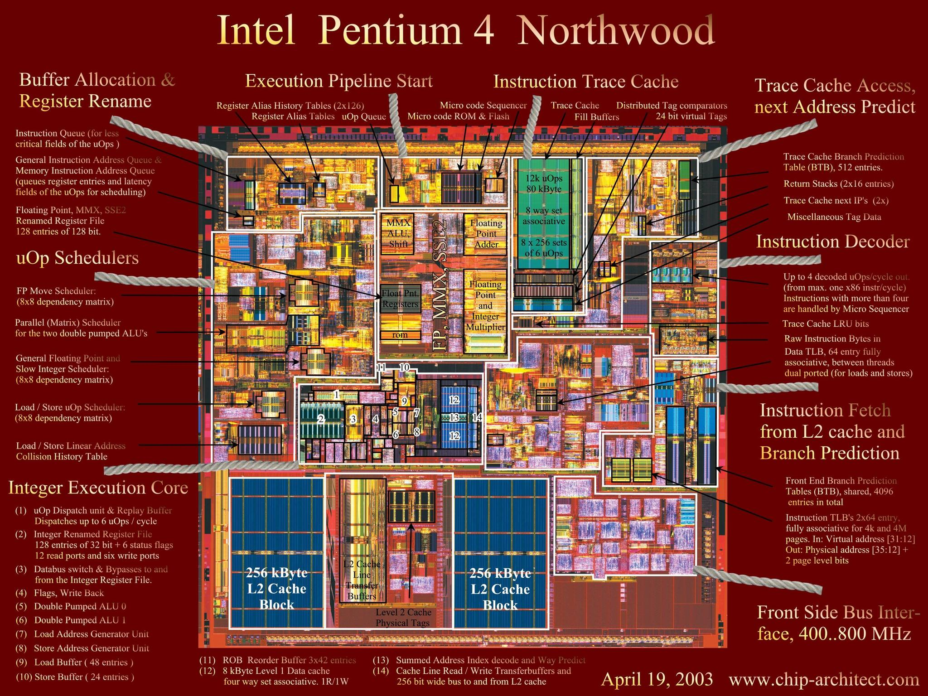
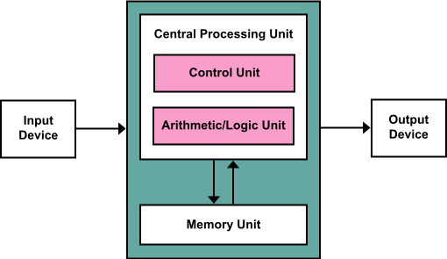
Computer Architecture
A computer uses a complex architecture to support general computation….

Slide 9
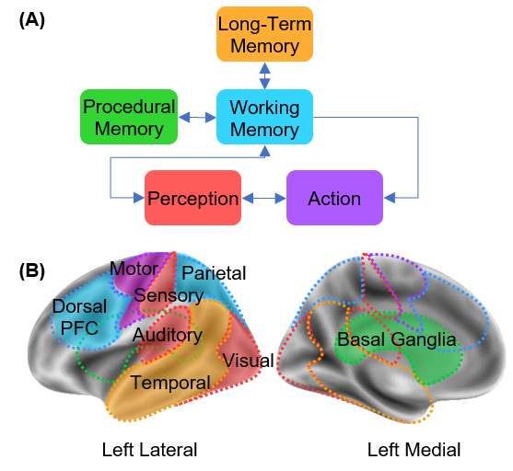
Human Cognitive Architecture
The human brain has an architecture
Human general processing emerges from the sum of all parts working together
Image source: Wapstra et al. (2022). Increased Basal Ganglia Modulatory Effective Connectivity Observed in Resting-State fMRI in Individuals With Parkinson’s Disease. Frontiers in Aging Neuroscience. 14. 719089. 10.3389/fnagi.2022.719089.

Slide 10
Artificial Cognitive Architecture
Behavior
Behavior
Cognitive Architectures are:
Computational theories about architectures that supply human-like cognition
Software engines that implement those theories
Theory implemented in:
Knowledge & Processes
Data & Software
Task Specific
General
Task Specific
Run-time System
Human Cognitive Architecture
Human Hardware
Computer Architecture
Computer Hardware

Slide 11

Cognitive Architecture History
Rooted in the birth of AI
Pursued by Allen Newell with Herbert Simon
Grew from work with the Logic Theorist presented at Dartmouth Conference
Field founded by Allen Newell
To improve theories of human cognition by implementing them in software
To improve software by learning from human cognition
Allen Newell

Slide 12

Many Cognitive Architectures Today
Each focuses on different aspects of human processing
Most are for academic experimentation in psychology or cognitive science
(Not built for AI or business)
Popular cognitive architectures today

Slide 13
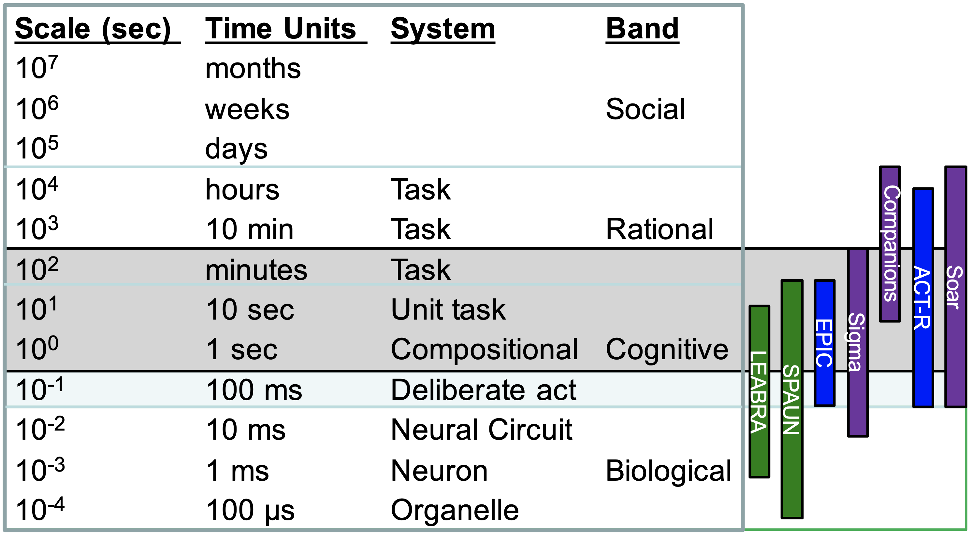
What is Soar’s Focus?
Newell’s Time Scale of Human Action
Built for practical AI that is inspired by humans
Design elements:
Hierarchical context-based decision making
End-to-end interactivity
Composing complex behaviors from common elements
Unified symbolic knowledge representations across architecture components
50 msec decision cycle

Slide 14
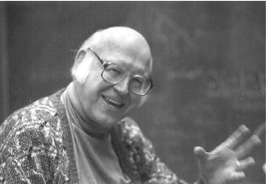

Soar’s Origins
Soar was Newell’s instantiation of Cognitive Architecture
Co-created with Newell’s students John Laird and Paul Rosenbloom in the 1980s
Intention for it to evolve over time with continued research
Soar continues to evolve
Led by John Laird and others
Now in version 9.6
Allen Newell
SOAR = State Operator And Result

Slide 15



The Modern Soar Cognitive Architecture
Soar is today the most popular cognitive architecture for use in AI applications.
It is 35+ years mature in the academic community and has spun off to a successful military contractor Enterprise ($25M+ AR) serving DARPA, Navy, and the Air Force.
It is free and open-source (BSD License)
Large enterprises (such as Optum) have begun to adopt it in recent years
Typically used for cases where rules engines are useful in concept but not adaptive enough in practice
Soar allows rule-like behavior that is more adaptive and generative while permitting full transparency and governance that one cannot get with black-box ML approaches

Slide 16
What Do People Use Soar For?
Autonomous, real-time, interactive agents
Ex: UAVs, personal assistants, game AI
Contextual conflict resolution in decision making
A>B, B>C, C>A… autonomously solve and continue
Ex: Policy1 says “recommend brain surgery”. Policy2 says “require continuous blood thinners”. Policy3 says “brain surgery requires stopping blood thinners”….
Use general problem solving to resolve conflicts
Can include asking humans for input if needed
Learning rules from experience (the results of past problem solving)
Ex: After finding the desired behavior to the blood thinner problem, autonomously learn it for the next time that scenario is encountered

Slide 17
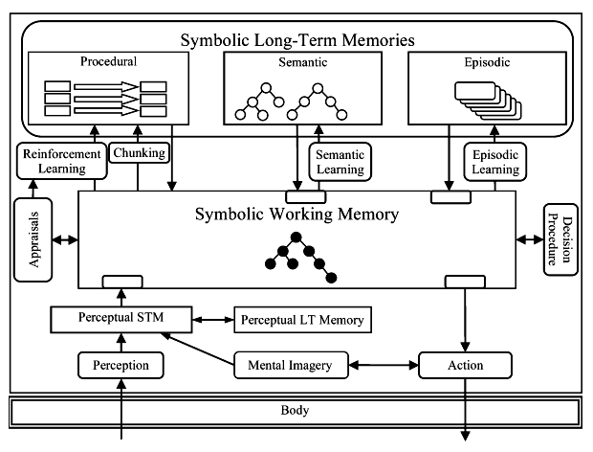
What is Soar’s Architecture?
Production Rules
Procedural Memory
Rules created by programmer, or learned
Symbolic Graph-based Memory
Working Memory
The central hub, a single memory graph
Rule conditions and actions happen here
Semantic Memory (optional)
Long-term graph storage
Episodic Memory (optional)
Snapshots of Working Memory over time
Other
Semantic Visual System (optional)
Converts 3D input into symbolic graph input
Allows agent to control focus of perception

Slide 18
What is Soar’s Architecture?
Production Rules
Procedural Memory
Rules created by programmer, or learned
Symbolic Graph-based Memory
Working Memory
The central hub, a single memory graph
Rule conditions and actions happen here
Semantic Memory (optional)
Long-term graph storage
Episodic Memory (optional)
Snapshots of Working Memory over time
Other
Semantic Visual System (optional)
Converts 3D input into symbolic graph input
Allows agent to control focus of perception
This course will focus on Procedural Memory and Working Memory

Slide 19
Modern Soar as an Application
Single C++ executable
Lightweight – can run on old smartphone, can run on large cluster
(more complex processing possible with greater resources)
Soft limit of 50 msec per I/O cycle (usually much less than that)
Single-threaded
Has API libraries for other common languages (built using SWIG)
Java
Python
C#
Tcl

Slide 20
How Does Soar Fit Into Software?
Call Soar run methods from interfacing application
Can use event listeners
(We’ll cover this in more detail later in the course.)
Using Direct Control
Using Event Listeners
Application
Soar Agent
Application
Soar Agent
loop:
process_stuff()
update_input()
run_agent(1)
collect_output()
Receive Input
update_input()
run_agent_forever()
output_event:
collect_output()
process_stuff()
if done:
stop_agent()
update_input()
Receive Input
Decision
Decision
Send Output
Send Output

Slide 21
Soar as an Engine
Does not provide task functionality out of the box
Provides the processing cycle with features like autonomous decision-making and learning
Like a game engine is for making computer games
Like a cloud platform is for running hosted applications
The Soar programmer must define (using production rules):
The choices used in decision making
The graph data structures used in I/O and internal processing / learning
The If/Then associations and sequences of logic

Slide 22
Soar’s Learning Capabilities
Soar provides several advanced learning capabilities:
Chunking: Autonomously learn new production rules
Reinforcement Learning: Autonomously tune decision making and rule selection
Episodic Memory: Autonomously record past experiences for rapid search and recall
Soar also provides a Semantic Memory store that allows long-term knowledge updates with more custom algorithms.
This course does not teach the learning features. It teaches core Soar processing and programming.
Once you understand the core, the rest is easy. Read the Soar Manual once you’re ready to learn how to learn with Soar!

Slide 23
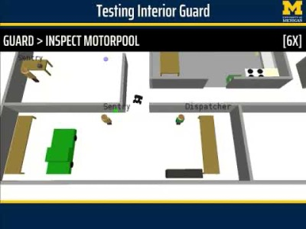
Soar Use Case: Rosie
A particular Soar agent
http://soargroup.github.io/rosie
Learns tasks by instruction
Language interaction
Asks for details when it doesn’t understand
Remembers definitions given in the past
Builds up a vocabulary of concepts and skills over time.
Video:
https://www.youtube.com/watch?v=_KsqaUavksk

Slide 24
Setting Up Soar
On Your Local Machine

Slide 25
The Soar Executable
The course materials include a copy of Soar 9.6.2 in the folder, “SoarSuite_9.6.2-Multiplatform”
You can also download Soar from https://soar.eecs.umich.edu
Files of interest inside the Soar folder:
File | Name | Description
bin/soar (.exe) | Soar Executable | The core Soar application
SoarJavaDebugger.sh (.bat) | Debugger Run Script | A useful tool for running/testing Soar agents
bin/Python_sml_ClientInterface.py | Python interface module | Python interface code imports this. (Other languages use similar files.)
bin/_Python_sml_ClientInterface.so (.pyd) | Python <-> C++ interpreter | The Python interface module uses this to interact with the Soar executable (Other languages use similar files.)
SoarManual.pdf | The Soar Manual | The definitive guide for all your unanswered Soar questions

Slide 26
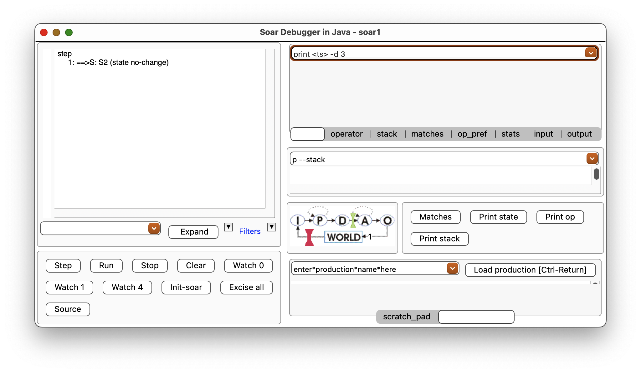
Running Soar Tutorial Projects
The course materials provide some Python scripts that automatically start Soar with the code you write, using a SoarJavaDebugger window.
Run the ”run_project.py” script located in the Project00_StartingSoar folder.
This window should open ➔
This is the SoarJavaDebugger
It is a Java-based tool for interacting with and debugging Soar
Click the “Step” button once
If Soar is running, you should see “1: ==>S: S2 (state no-change)” appear in the main text area.
Each project will provide a similar ”run_project.py” script you can use to quickly test your code.

Slide 27
Opening the Java Debugger Directly
The direct way to open the Soar Java Debugger is to run the SoarJavaDebugger.sh/.bat file.
(If using the .sh file, search online for how to set your computer to run the script when you double-click the file so you don’t need to use your terminal.)
The first time you run this file it will check your operating system and copy the appropriate Soar build files into the bin directory.
If running the SoarJavaDebugger file fails, you may need to add permissions on your machine to allow the script to run.
The Python script mentioned in the previous slide calls this same SoarJavaDebugger file, so it will also automatically perform this file copy the first time you run that script.

Slide 28
Loading Soar Agents Manually
The run_project.py script automatically loads your agent code into Soar.
Running the SoarJavaDebugger directly does not!
After opening the debugger, click the “Source” button to load an agent code file you have written into this Soar instance.
(You will not need to do this for projects in this course if you use the run_project.py script.)

Slide 29
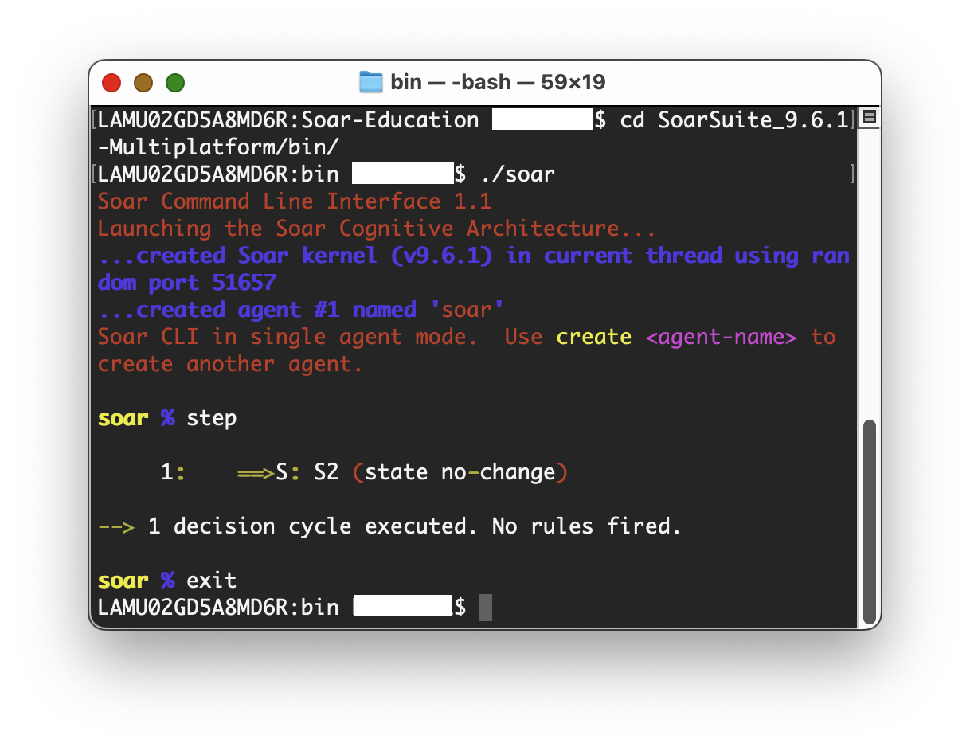
Starting the Soar Command Line Interface
Soar doesn’t need a debugger window.
There are three easy ways to run Soar direct from your terminal / command line:
From your terminal, run the soar (Mac/Linux) or soar.exe (Windows) executable
Initially this will be under the platform-specific directory within the bin folder.
Run the “SoarCLI.sh/.bat” script
This automatically runs the soar executable file appropriate for your OS.
Run the run_soar_cli() Python function in the run_soar.py file provided within this tutorial.
(The “exit” command ends the Soar process.)

Slide 30
Installing Soar for Other Applications
This step is not needed for projects in this course.
Your project files will call the Soar executable using relative paths in the tutorial directory.
If you want to install Soar such that you can use it in other applications without knowing the relative path, use environment variables so that those applications can find your Soar bin directory.
Set these environment variables on your machine to include the “bin” subfolder of your Soar installation:
SOAR_HOME (Soar libraries reference this; all systems)
DYLD_LIBRARY_PATH (library search path; Windows/Linux systems)
PATH (dll search path; Windows systems)
PYTHONPATH (if you intend to run Soar from Python code)
CLASSPATH (if you intend to run Soar from Java code)
(Search online for how to set up environment variables on your machine if you need help.
Read this article for more info about search paths in Soar:
https://soar.eecs.umich.edu/articles/articles/building-soar/86-how-library-search-paths-work

