Slide 1

Project 01: Hello World!
The Engineer’s Guide to Soar
Course 01: Soar Essentials
By Dr. Bryan Stearns, 2024

Slide 2
Lesson 01 – Outline
This lesson explains the following new concepts:
Basic Soar Computation
Soar Productions/Rules
Soar Working Memory (WM)
Writing Soar Rules
The Soar CLI
Conditions
The default "^type" Working Memory Element (WME)
Actions
The (write) and (crlf) RHS functions

Slide 3
Basic Soar Computation
What your code does

Slide 4
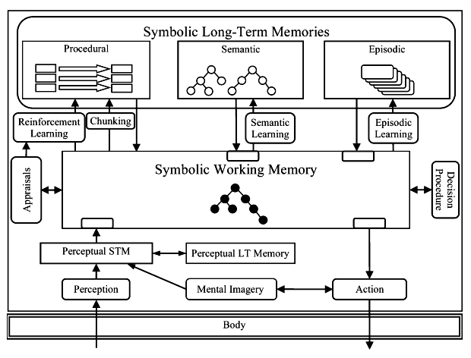
Programming Soar
Program a Soar agent by defining its initial Procedural Memory
Procedural Memory holds production rules (or just “rules”)
Soar rules:
Are IF -> THEN statements
Test the Working Memory (WM) graph
Modify WM when their conditions are satisfied.

Slide 5
Soar Working Memory
WM is a graph:
Directed
Cyclic
Has a single root node
bar
“one”
F1
B1
bar
foo
root
pi
3.14
food
F2
pie
P1
grandparent

Slide 6
Soar Working Memory: Graph Edges
Edges are always labeled
Labels do not have to be unique
Edges can point to:
Nodes
Strings
Integers
Floats
bar
“one”
F1
B1
bar
foo
root
pi
3.14
food
F2
pie
P1
grandparent

Slide 7
Soar Working Memory Elements
WM is represented as a set of edge tuples called “Working Memory Elements” (WMEs).
bar
“one”
F1
B1
ID | Attribute | Value
root | foo | F1
root | food | F2
F1 | bar | “one”
F1 | bar | B1
F2 | pi | 3.14
F2 | pie | P1
P1 | grandparent | root
bar
foo
root
pi
3.14
food
F2
pie
P1
grandparent
“WME” is pronounced “wim-ee”

Slide 8
How Do Soar Rules Work?
Rules
Working Memory
Graph Root
Rules condition on the WM graph and modify it in logical parallel
Some WM structures are controlled by the architecture
Rules interact with automatic architecture processes by reading/modifying these structures
Most WM structures will be created and controlled by programmed rules
Shared Control Structures
IF->THEN
Inputs
IF->THEN
Outputs
Architecture Processes
IF->THEN
Modules
Choices
IF->THEN
Decision
IF->THEN
Rule-Controlled Structures
IF->THEN
Other
State memory controlled by rules
Other

Slide 9
Soar Working Memory
Provided by Architecture
Root
input
I2
problem
”fever”
A directed, cyclic graph with a single root node
The root is a “state” node
(State nodes will be explained later.)
output
I3
status
“solved”
X1
response
solutions
item
X2
name
“rubber ducks”
next
item
X3
name
“more cowbell”
Created by Rules
parent

Slide 10
Writing Soar Rules
Coding your first Soar production

Slide 11
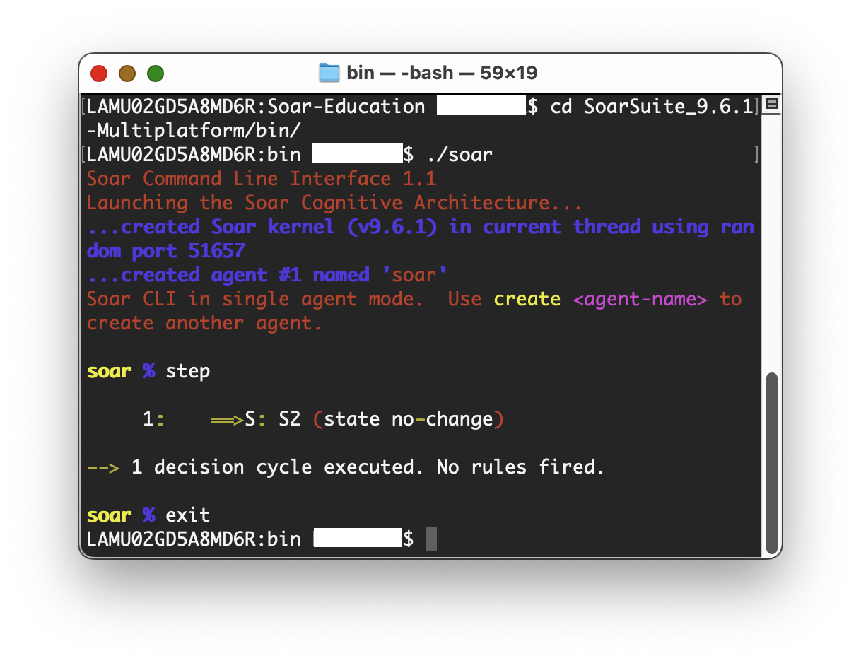
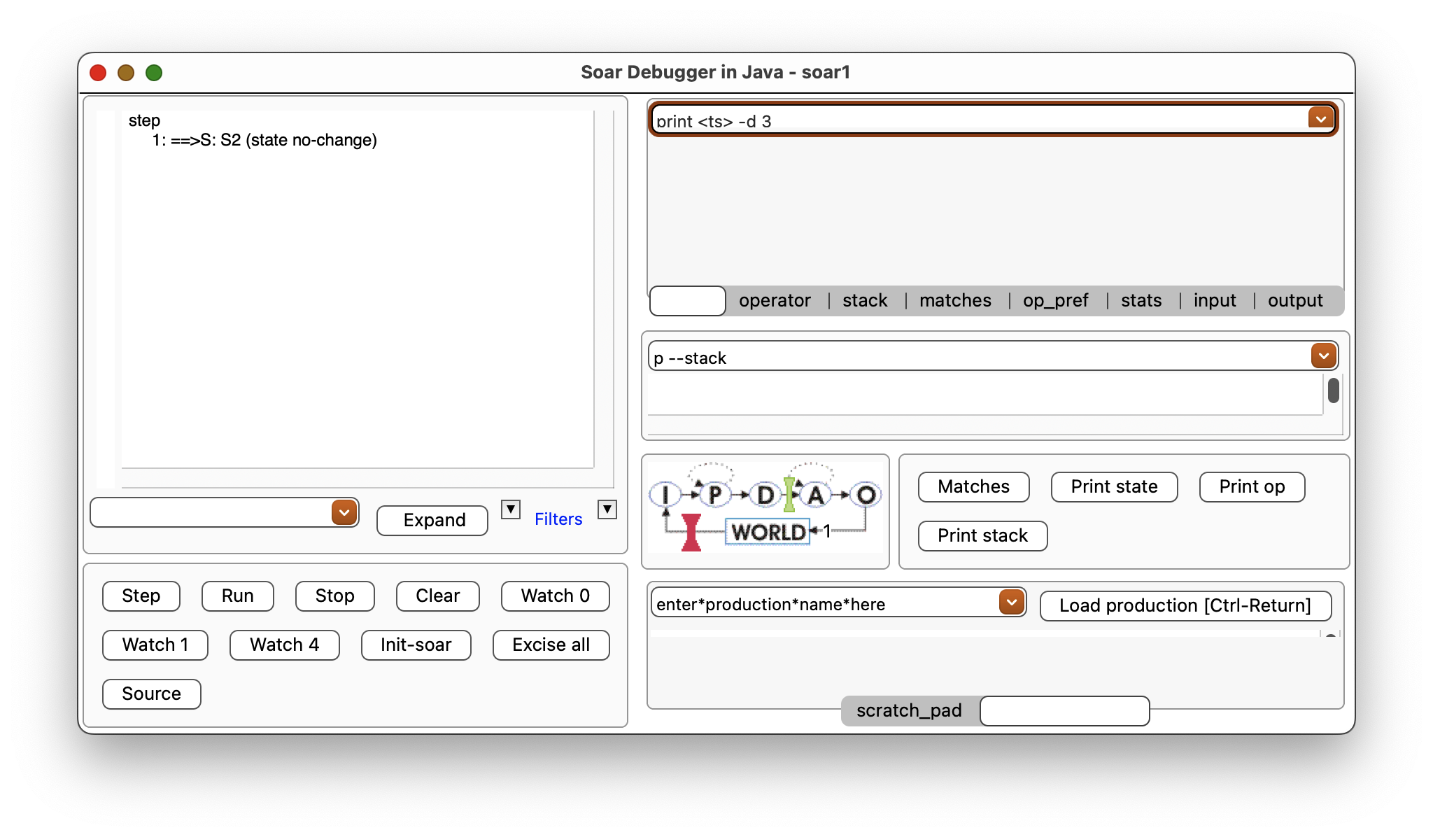
Soar Scripting
Almost all interactions with Soar invoke Soar’s Command Line Input (CLI) commands
Typed into a Soar kernel terminal
Or loaded from a text file (conventionally given the “.soar” extension).
We’ll be using files
CLI Input Areas

Slide 12
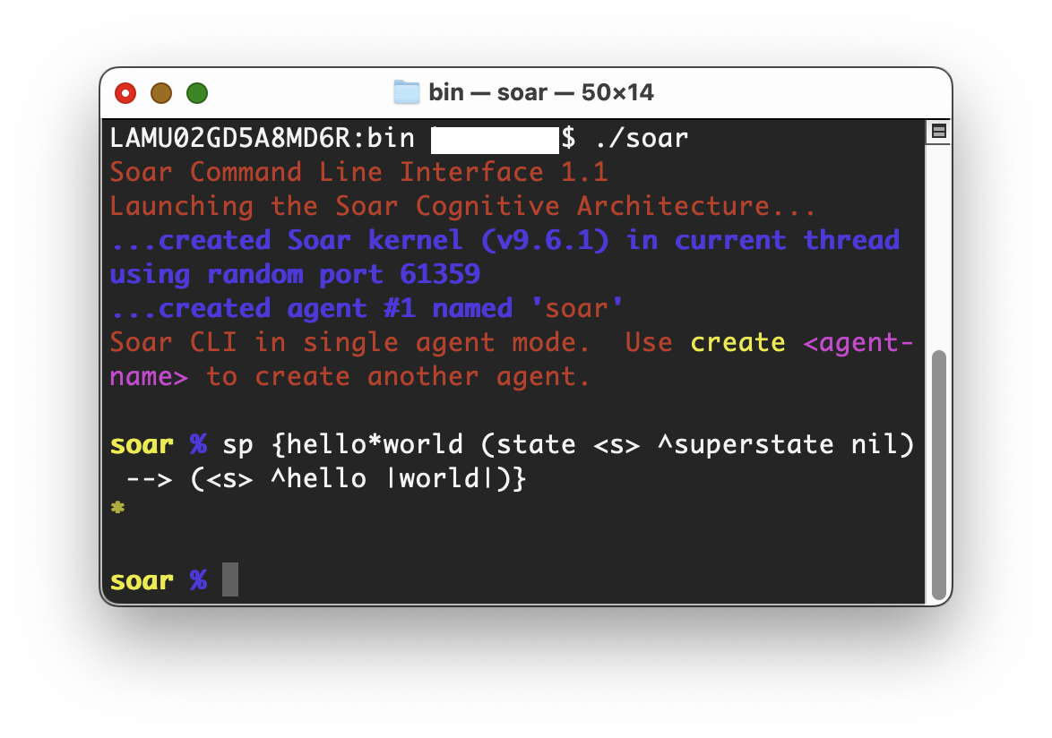
Define a Soar Rule
“sp” stands for “Soar Production”
sp { … }
The command that defines a Soar rule is “sp”
Followed by a space
Followed by curly braces that contain the rule definition

Slide 13
Soar Production Syntax
No spaces in the rule name
No quotes/apostrophes in the doc string
sp command syntax:
Rule name
An existing rule with the same name gets overwritten
Documentation string (optional)
But always a good idea!
Rule type (optional)
Ignore this for now
Conditions
One or more parentheses blocks
A “-->” separator
Actions
One or more parentheses blocks
sp {production-name
"Documentation string”
:type
(CONDITIONS)
-->
(ACTIONS) }
Indentation / line breaks don’t matter

Slide 14
LHS / RHS
“LHS”
The conditions are collectively referred to as the Left-Hand Side (LHS)
The actions are collectively referred to as the Right-Hand Side (RHS)
sp {production-name
(CONDITION1)
(CONDITION2)
-->
(ACTION1)
(ACTION2) }
“RHS”

Slide 15
Order of Conditions/Actions
The (blocks) of individual conditions or actions within each side can come in any order.
The conditions are evaluated as a whole.
The actions are executed in logical parallel.
sp {production-name
(CONDITION1)
(CONDITION2)
-->
(ACTION1)
(ACTION2) }
Order doesn’t matter
Order doesn’t matter

Slide 16
Let’s Write Some Code!
Open your agent_starter.soar file for Project01.
Write the start of your first rule to match what is shown below
We’ll replace the underscores with proper content later on
Proceed to the next slide when you’re done.
sp {hello*world
(____)
-->
(____)}

Slide 17
Example Rule
sp {example*rule
(state <s> ^foo <n>)
(<n> ^bar |one|)
-->
(<n> ^bar |one| - )
(<n> ^bar |two|) }
This is an example of a complete rule.
Let’s walk through the elements one at a time....

Slide 18
LHS Pattern Matching
ID
attribute
value
sp {example*rule
(state <s> ^foo <n>)
(<n> ^bar |one|)
-->
(...) }
Rule conditions describe a WM pattern
In terms of WMEs
All described WMEs must be present for the rule to be satisfied
The above rule tests for this pattern.
bar
“one”
root
foo

Slide 19
Rule Syntax: “state”
(There can be more than one “state” node in WM, but for now, assume it is the root.)
The pattern must begin at a state node
Use “state” in front of a WME ID to mark the ID as the start point
sp {example*rule
(state <s> ^foo <n>)
(<n> ^bar |one|)
-->
(...) }
bar
“one”
root
foo
The root of the WM graph is a “state” node

Slide 20
Rule Syntax: Variables
Binds to any node that matches (root ^foo …)
Binds to the root
Variables:
Can be used for ID, Attribute, and/or Value
Are any tokens inside <angle-brackets>
(No spaces in the name)
Bind to whatever value in the graph matches the pattern
Similar to variables in a query language
Are only in scope within the containing rule
sp {example*rule
(state <s> ^foo <n>)
(<n> ^bar |one|)
-->
(...) }
References the same node bound on the first line because it references the same variable name.

Slide 21
Rule Syntax: Attributes
sp {example*rule
(state <s> ^foo <n>)
(<n> ^bar |one|)
-->
(...) }
Attributes:
Must be preceded by the carat (“^”) character
Describe an edge label in the WM graph
root
foo
bar

Slide 22
Rule Syntax: Strings
Soar rules use the pipe (“|”) character to mark strings
The pipe characters are optional unless the string has spaces or special characters.
Soar will automatically infer the data type when it can
It will read numbers as int or float if they do not have pipes around them
sp {example*rule
(state <s> ^foo <n>)
(<n> ^bar |one|)
-->
(...) }
This line is equivalent to: (<n> ^bar one) Soar will infer a string type since there are no spaces or special characters.

Slide 23
Initial WMEs
The Soar architecture creates and maintains several WMEs.
The following are all initial attributes that branch off from the root node:
^io Points to the environment input and output graph structures
^smem Points to the Semantic Memory interface graph structures
^epmem Points to the Episodic Memory interface graph structures
^reward-link Points to the Reinforcement Learning interface graph structure
^superstate Points to the parent state root node, or |nil| if there is none
^type The type of the parent node (value will be |state|)
We’ll learn how to use most of these later.

Slide 24
Initial WMEs
The Soar architecture creates and maintains several WMEs.
The following are all initial attributes that branch off from the root node:
^io Points to the environment input and output graph structures
^smem Points to the Semantic Memory interface graph structures
^epmem Points to the Episodic Memory interface graph structures
^reward-link Points to the Reinforcement Learning interface graph structure
^superstate Points to the parent state root node, or |nil| if there is none
^type The type of the parent node (value will be |state|)
We’ll learn how to use most of these later.
For now, we’ll just focus on the type WME.

Slide 25
The type WME
The root will always have the type “state”.
You can use this to make a rule that always matches.
sp {example*rule*2
(state <s> ^type state)
-->
(...) }
This condition will always be true.
type
root
“state”

Slide 26
Let’s Write Some Code!
Open your agent_starter.soar file again.
Modify it using what you’ve learned to match the code below.
Proceed to the next slide when you’re done.
sp {hello*world
(state <s> ^type state)
-->
(____)}

Slide 27
Rule Actions
sp {example*rule (state <s> ^foo <n>) (<n> ^bar |one|) --> (<n> ^bar |one| - ) (<n> ^bar |two|) }
Conditions test for the existence of the described pattern.
Actions create or remove WMEs from part of that pattern.

Slide 28
Adding and Removing WMEs
If this graph pattern exists…
sp {example*rule (state <s> ^foo <n>) (<n> ^bar |one|) --> (<n> ^bar |one| - ) (<n> ^bar |two|) }
foo
bar
S
“one”
foo
bar
S
“one”
bar
“two”
Replace “one” with “two” (by removing the “one” WME and adding the “two” WME)

Slide 29
Adding and Removing WMEs
sp {example*rule (state <s> ^foo <n>) (<n> ^bar |one|) --> (<n> ^bar |one| - ) (<n> ^bar |two|) }
foo
bar
S
“one”
foo
bar
S
“one”
bar
“two”
Every ID variable on the RHS must have been bound on the LHS.
Notice the minus sign. This removes the described WME!

Slide 30
RHS Functions
Actions can also call functions!
These are called RHS Functions
RHS Functions use the following syntax:
(func-name [args …] )
Args must be separated by spaces
sp {example*rule*3
(state <s> ^foo <n>) (<n> ^bar |one|)
-->
(write |A message!|) }

Slide 31
The (write) Function
sp {example*rule*3
(state <s> ^foo <n>) (<n> ^bar |one|)
-->
(write |A message!|) }
The (write) function prints a message to std-out.
It takes any number of args
Converts those to string
Then concatenates them to form the printed message
A single arg

Slide 32
The (crlf) Function
It is useful to combine (write) with (crlf)
(crlf) returns a newline character
It takes no arguments
CRLF stands for “Carriage Return Line Feed”
You will usually want to end (write) messages with a (crlf).
So later messages start on a new line
sp {example*rule*3*with-crlf
(state <s> ^foo <n>) (<n> ^bar |one|)
-->
(write |A message!| (crlf)) }
1st arg
2nd arg

Slide 33
Provided RHS Functions
Function | Description
(interrupt) | Pauses Soar
(halt) | Terminate Soar
(+), (-), (*), (/) | Math operations
(int), (float) | Convert to the indicated data type
(min), (max) | The min and max operations
(ifeq) | Conditionally return a value
(size) | Get the count of edges from a node
Soar provides many useful RHS Functions
See the Soar Manual (pg. 71) for documentation
You can also write your own
See the Soar Manual (pg. 80)
A sampling of some useful RHS Functions

Slide 34
Let’s Write Some Code!
Open your agent_starter.soar file again.
Fill what remains so that the rule matches the code shown below
Run it in Soar using the run_project.py script.
Click the “Step” button once in the SoarJavaDebugger window.
You should see “Hello world!” appear in the main display area.
Congratulations! You have run your first Soar agent!
sp {hello*world
“Your first Soar rule”
(state <s> ^type state)
-->
(write |Hello world!| (crlf))}

